Slide 1
Dependency Injection and Choosing an IOC Container that Works for YOU!
BY JASON ROBERT
Notes:
This talk is primarily about dependency injection
Understand the foundation – what / why
Then discuss the details
PLEASE BE INTERACTIVE!!!

Slide 2
Introduction
Jason Robert
Twitter: @JasonTRobert
Github: jrob5756
Website: https://espressocoder.com/
Notes:
Various roles – Team Lead, Developer, Architecture
Work at Tyler Technologies
JR Technologies LLC
Architecture Consulting
Various development projects
Give me a follow!

Slide 3
Agenda
What is dependency injection
Why use dependency injection
How to choose an ioc container
Demo
Q & A

Slide 4
What is Dependency Injection?

Slide 5
SOLID Principles
S ingle Responsibility Principle
O pen / Closed Principle
L iskov Substitution Principle
I nterface Segregation Principle
D ependency Inversion Principle
Notes:
I bring these up because they are all closely related an work together in different ways.
---------------------------
Single Responsibility – Each class, function should have a single responsibility. One reason to change.
Open Closed Open for extension closed for modification – Don’t make breaking changes. Large framework at plex. Breaking changes were a nightmare. Obsolete then replace.
Liskov Substitution – Should not inherently change behavior of your base class. A square is a special type of rectangle but, can still be treated as a rectangle.
Interface Segregation Principle – A subclass should not depend on a method that it does not use. “throw new NotImplementedException”. Break interfaces into smaller purpose driven pieces.

Slide 6
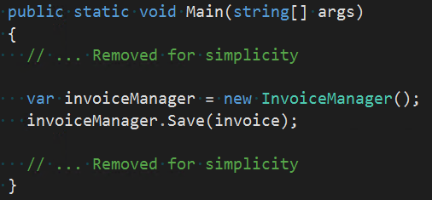
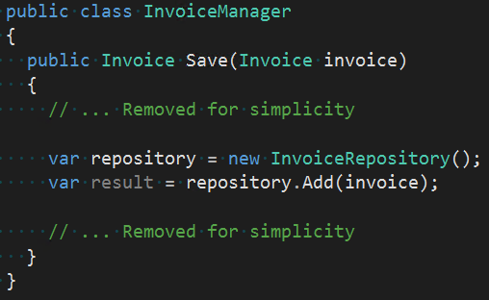
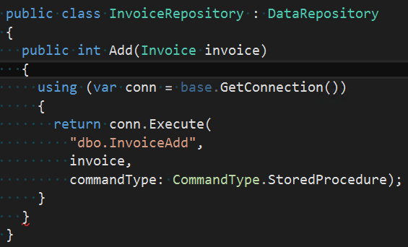
Traditional Layered Pattern
Notes:
High level components depend on low level components

Slide 7
Dependency Inversion
Presentation
Interface
Business
Interface
Data
Notes:
Remove dependency on lower level components
Means we are only reliant on the interface
Means we CANNOT initialize objects. NEW is bad.

Slide 8
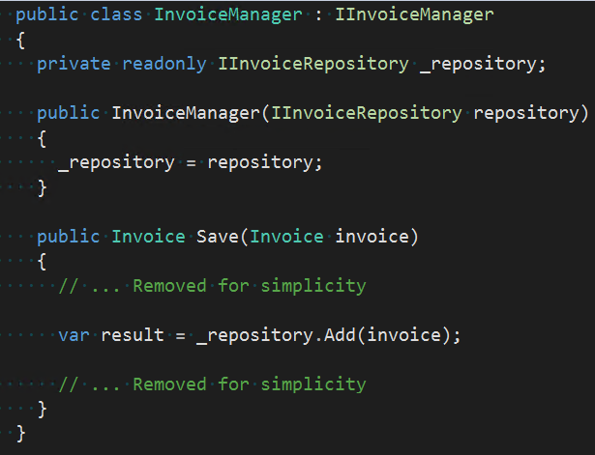
Dependency Inversion
Implementations are not referenced directly
Dependencies are provided externally
The ‘new’ keyword is baaaaad

Slide 9
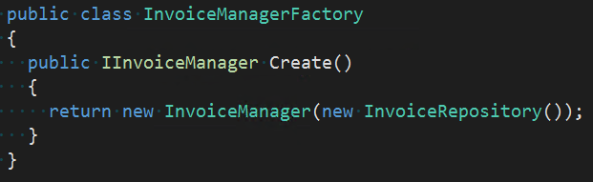
Factory Pattern
Dependencies are manually initialized
Factory still has to be created and managed
Can be tedious with large dependencies
Maintenance concerns
Notes:
Do not want logic inside of the constructors
What if we added a customer repository too?

Slide 10
Factory Pattern
There has to be a better way!!!

Slide 11
IOC Container
Performs the laborious task of injecting dependencies
Can be registered via config, code, or convention
Handles object lifecycles
Built for efficiency
Notes:
It is for convenience. As we saw, we could manually accomplish this.
Automagically instantiating our classes, lots of reflection, this should be done good.

Slide 12
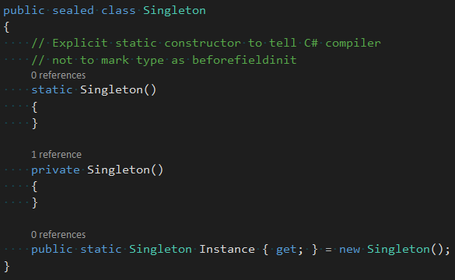

Singleton
http://csharpindepth.com/Articles/General/Singleton.aspx

Slide 13
Benefits of Dependency Injection
Notes:
Loose coupling
Testability
Supports Architectural Patterns

Slide 14
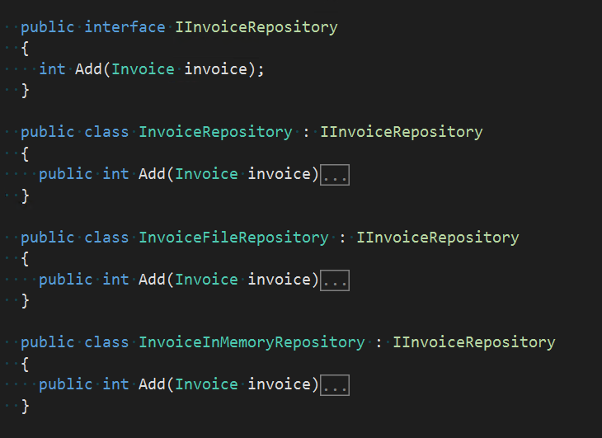
Loose Coupling
Implementations are not directly referenced
Implementations can changed without consumers knowledge
Easier to maintain
“Loosely Coupled”
Notes:
Interface Segregation Principle

Slide 15
Testability - Unit Testing
Isolate and test specific UNITS of code
Predictable behavior
Fast – No external dependencies
Different that integration tests

Slide 16
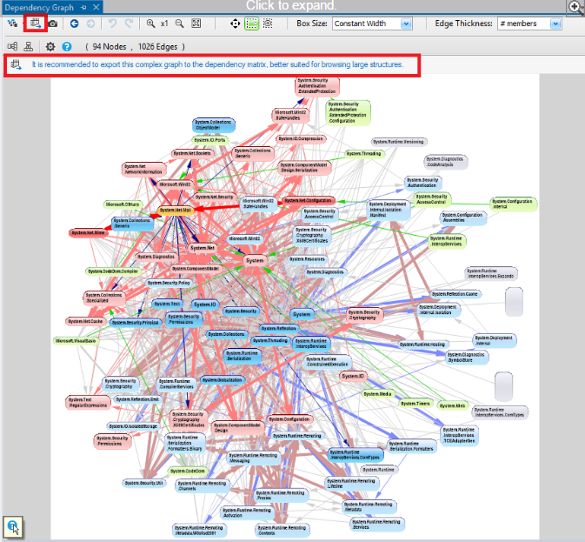
Testability - Dependencies
Presentation
Business 1
Business 2
Data 1
Data 2
http://www.ndepend.com/docs/visual-studio-dependency-graph

Slide 17

Testability - Mocking
Inject “Mocks” of dependencies
Control dependency behavior within tests
Beware of STATIC classes and functions!

Slide 18
Testability – CI / TDD
Continuous Integration (CI)
Test driven development
Would not be possible without Dependency Injection
Notes:
CI – Make sure source code builds at any given time
… Now we can make sure it WORKS too
Bamboo, TeamCity, Jenkins ….
Red, green, refactor

Slide 19
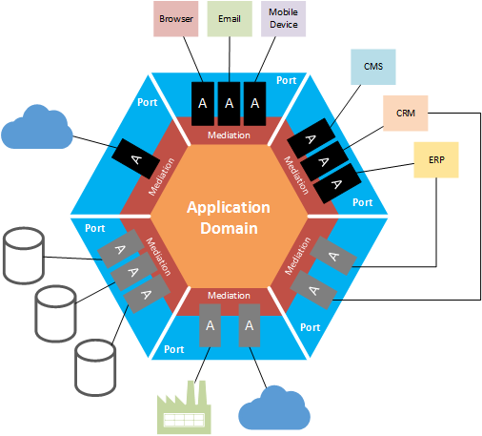
Architectural Patterns - Hexagonal
Ports and Adapters
Interaction via ports
Primary vs secondary ports
http://geekswithblogs.net/cyoung/archive/2014/12/20/hexagonal-architecturendashthe-great-reconciler.aspx
Notes:
Ports and adapters
Ports shared by one or more adapter
Interfaces
Adapter - the role of an adapter is to implement a concrete protocol by which some external system or device can communicate with the application.
Primary ports – inbound
Command pattern
Façade, api layer
Secondary ports – outbound
Dependency injection provides the mapping typically
http://alistair.cockburn.us/Hexagonal+architecture

Slide 20
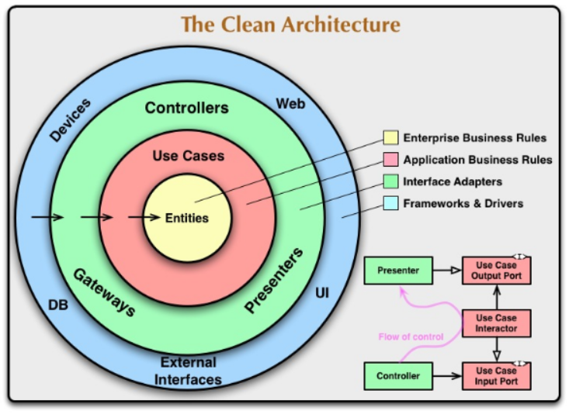
Architectural Patterns - Clean
Similar Hexagonal
Same premise of adapters
DI enables loose coupling
https://8thlight.com/blog/uncle-bob/2012/08/13/the-clean-architecture.html
Notes:
DI Enables loose coupling between layers

Slide 21
Choosing an IOC Container

Slide 22
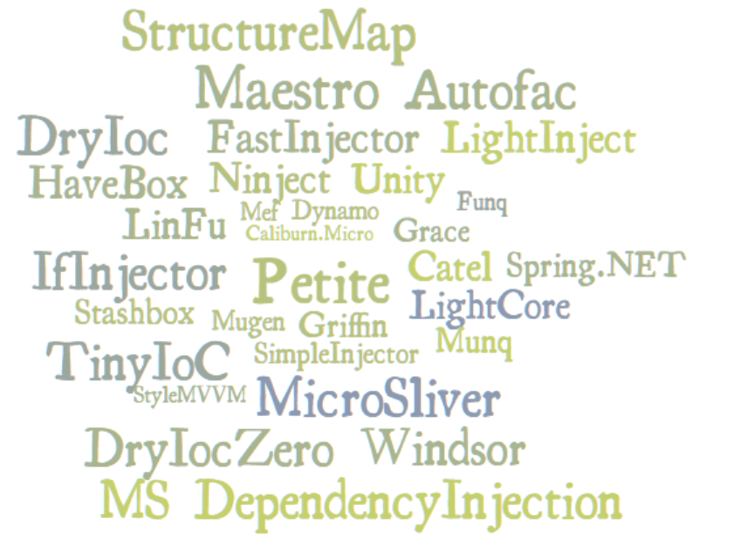
IOC Containers
?
?
?
?

Slide 23
IOC Containers
Critical piece of your application
Be wary of container specific features
Remember the purpose of an IOC Container

Slide 24

What are you looking for?
Performance
Prepare
Resolve
Ease of Use

Slide 25
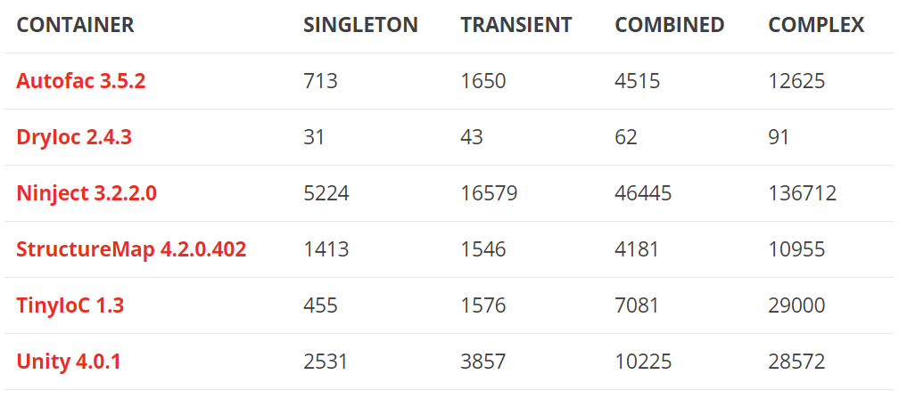
Performance
High Transaction Volume (Web Applications)?
Performance is critical to success
Perform / review benchmarks
How fast can types be initialized
https://github.com/danielpalme/IocPerformance

Slide 26
Features
Lifecycle Management
Singleton / Transient / Per Thread / Per Request / Scoped
Injection
Property / Constructor
Configuration
Code / XML / Convention / Attributes
Advanced
Generics / Enumerables / Nested Containers

Slide 27
My Go To Features
Convention based registration
Lifecycle Management
SPEEEEEEEEEEEEEEEEED!!!

Slide 28
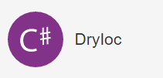


My Go To Containers

Slide 29
DEMO!

Slide 30
Putting it together
Containers seem to focus on fine tuning one or the other
Performance
Ease of Use
Choose a container that best suites the needs of your application
High transaction web app / service
One off console application
IOC Containers sole purpose is to make things easier for you
Use one that is widely adopted
Github – active contributions
Frequent release cycles

Slide 31
Questions?

Slide 32
THANK YOU!!!
Presentation and slides can be found here
https://github.com/jrob5756/IocTalk

Slide 33
Dependency Injection and Choosing an IOC Container that Works for YOU!
BY JASON ROBERT

