Slide 1
Object Tracking Using the
Extended Kalman Particle Filter

Slide 2
Introduction
The Kalman filter is used in a variety of domains that require the prediction of events in a linear dynamic system.
It is often used in control theory and control feedback systems because it recursively estimates the state of a system based on the system’s previous state.
Some applications include determining the orientation of a gyroscope in motion and tracking the position of moving objects using a radar.
Such systems receive information about events on a periodic basis. They apply the Kalman filter to predict what happens between these information updates.
The extended Kalman filter can approximate non-linear motion by approximating linear motion at each time step.
The Condensation filter is a form of the extended Kalman filter. It is used in computer vision for object tracking by predicting the position of particles in space.

Slide 3
Method
Select a target point (i.e. pixel) on the object that encapsulates the representative features you wish to track, usually color.
Form a circle with a user-defined radius around the target point and select points within the area of that circle to form the representative particle set.
Points are assigned a probability of belonging to the object based on their Euclidean distance to the target point and how closely their color profile matches that of the target
The color similarity between the target point and particle is calculated using the Bhattacharyya distance.
Particles are selected to form the representative particle set based on their individual probabilities and random chance.
It is a Monte Carlo method because it relies on repeated random sampling to compute a result.
In a recursive process, previous particle locations and color histograms are used to generate estimates of the next particle locations until these estimates have an error rate below some threshold.

Slide 4

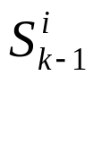
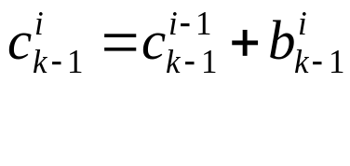
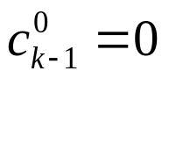
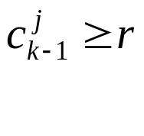
Particle Probability Estimation
Given an initial set of points defined by the user, , where k = the time-step and i = the particle id number
Select M states starting from and generate a random number r from 0-1.
Estimate the cumulative probability of each particle using:
Find the smallest j for which
The goal is to generate j particles for use in calculating new particles at time-step k using only particles from k-1 and Brownian motion

Slide 5
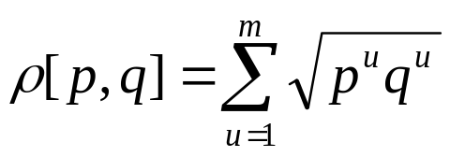

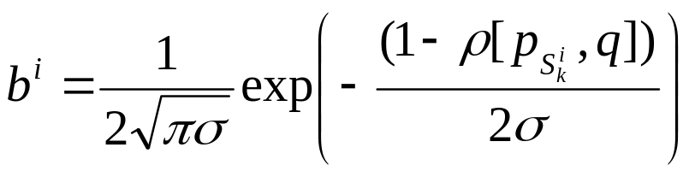
Bhattacharyya distance
The Bhattacharyya coefficient for particle i at time-step k, is a measure between two distributions: the target histogram q and the candidate histogram p
It can be calculated as:
And the Bhattacharyya distance can be calculated as:
This coefficient is used in the calculation of cumulative probability, with a smaller distance leading to larger weights through:

Slide 6
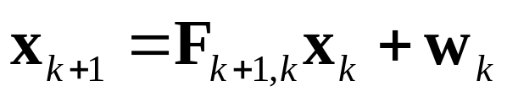
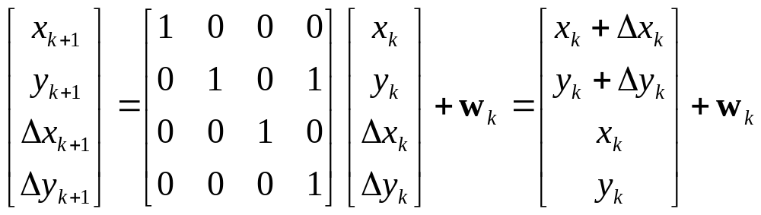
Particle Motion
After the points in the particle set have been chosen at time k, predict the position and velocity of each particle at time k+1 by applying an update rule.
weight matrix at time k
(multivariate Gaussian variable)
state matrix (x,y) at time k+1
state matrix (x,y) at time k
state transition matrix from time k to k+1
The update rule is chosen based on the situation. If the objects being tracked have uniform linear movement, the following equation may be suitable:

Slide 7
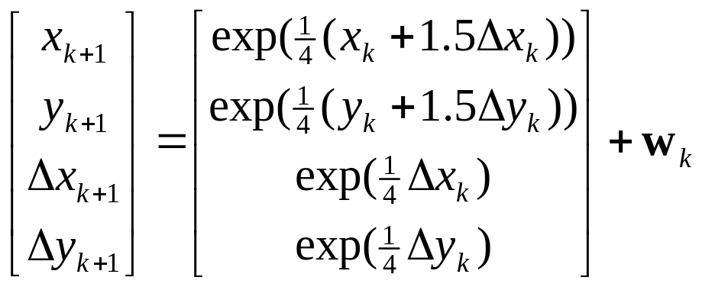
Particle Motion
If the objects being tracked have unpredictable movement (that’s not too fast) Brownian particle motion may be suitable:
This form of motion is based on the work of Scottish botanist Robert Brown in 1827.
It simulates the seemingly random movement of visible particles suspended in a liquid or gas caused by collisions with invisible atoms. It is also referred to as a random walk, and is commonly used in Monte Carlo methods.
Brownian particle motion Java applet:
http://galileo.phys.virginia.edu/classes/109N/more_stuff/Applets/brownian/brownian.html

Slide 8
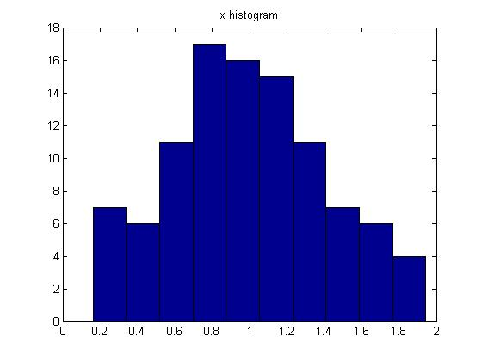
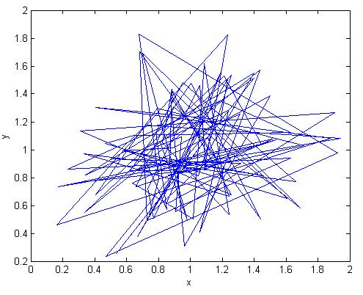
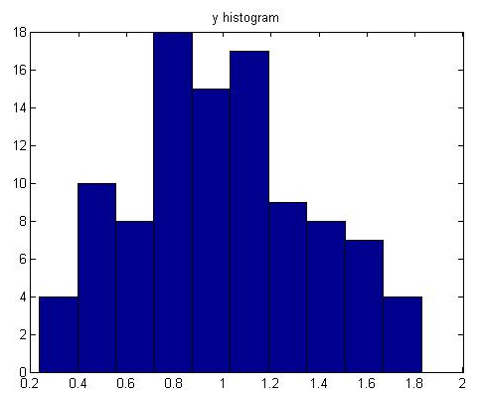
Particle Motion
Brownian particle motion
center = (1,1); xscale = yscale = 1
random Gaussian values in range [0,1]

Slide 9
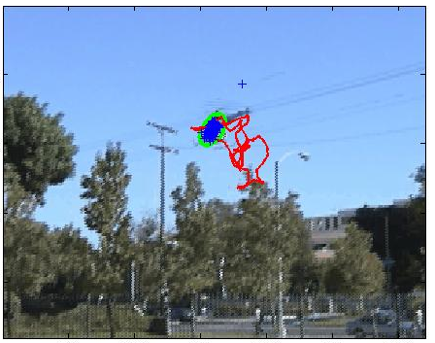
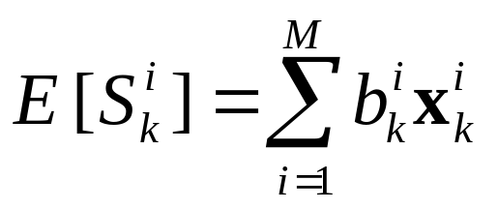
Tracking
After the M points in the particle set have been chosen and their movements have been updated, the instantaneous movement (moment) of the object between time steps can be calculated as follows:
estimated target point position
set of particles at time k
state matrix for particle i at time k
weight contribution of particle i at time k
towards the overall estimate of the target point position
USC helicopter trajectory in red.

Slide 10
Demo
Kalman Particle filter toolbox Matlab implementation by Kevin Murphy:
http://www.cs.ubc.ca/~murphyk/Software/Kalman/kalman.html
University of Southern California Robotics Research Labs video of a vision-based autonomous landing helicopter.
Randomized particle motion causes different results every time the filter is applied to the video. In general the results are good.
The majority of Murphy’s implementation is in C code to increase performance (speed).

Slide 11
References
[1] Cuevas E., Zaldivar D. and Rojas R. Kalman Filter for Vision Tracking,
Technical Report B 05-12, Freie Universität Berlin, Fachbereich Mathematik
und Informatik, 2005.
[2] Cuevas E., Zaldivar D. and Rojas R. Particle Filter in Vision Tracking, Technical
Report B-05-13. Institut für Informatik, Freie Universität Berlin, 2005.

