Slide 1
Machine Learning Fundamentals: Capstone Project
Joe Robie

Slide 2
Exploration of Dataset Part 1
The dataset contains information pertaining to “OKCupid,” an online dating site that aims to match people who would be compatible into relationships.
The profiles of which there were nearly 60,000, contains several datapoints, which include such info as age, body type, diet, drinks, education, several essay prompt, height, job, ethnicity, sex, sign, and status.
Two graphs I created show the distribution of age in the dataset as well as the number of people that fall into each of the income buckets.

Slide 3
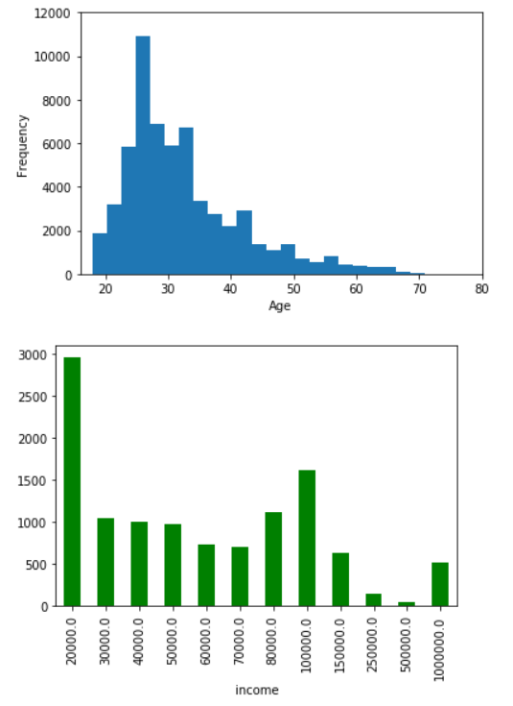
Exploration of Dataset Part 2
The blue histogram in the top right shows that most ages group around the late 20s to mid-30s range, which is understandable given that such an age group is likely single and looking for something serious in their lives.
The blue bar graph shows that while most people make ~$20K annually out of any other group, there is fairly even distribution between $30K and $100K.

Slide 4
Key Questions
Key Question #1: How do several independent variables predict a person’s sign? Variables analyzed were:
Whether a person drinks, smokes, does drugs
The length of the person’s essays
The number of essays answered
The person’s age
Key Question #2: How do essays predict a person’s income level? The words in all the essays were analyzed in this instance. A classifier and linear regression approach was taken to try and answer this question.
Key Question #3: Is essay length and number of essays answered a good predictor of a person’s age?

Slide 5
Deep Dive into Questions and Approaches Taken
Key Question #1: Predicting a persons sign.
For this question, the k-nearest-neighbors (KNN) approach was used. This approach was leveraged given that the signs can be considered more “categorical” in nature, therefore making a classifier approach the more natural choice.
First, a column was added to the dataframe to get the count of total words used in all the essay questions answered. Columns were also added for number of essays answered, average essay length, as well as for the number of times “me” and “i” were used in the essay.
Furthermore, questions related to smoking, taking drugs, and drinking were changed into numbers, thereby making them “categorical” in nature.

Slide 6
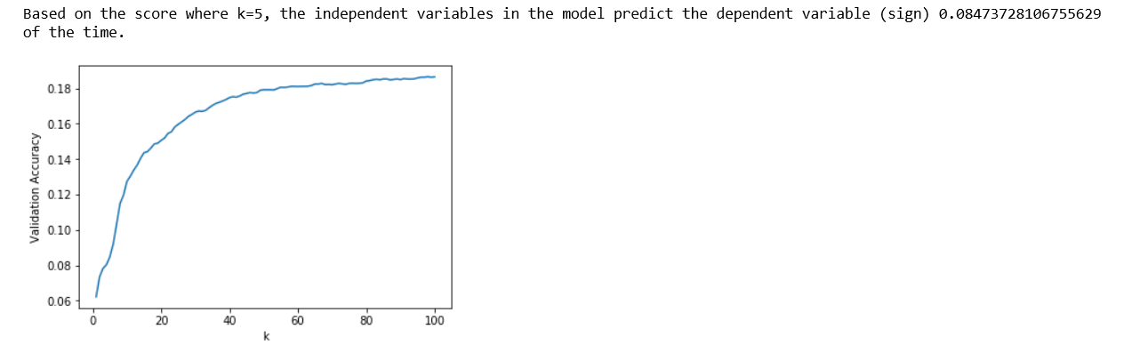
Deep Dive into Questions and Approaches Taken
Key Question #1: Predicting a persons sign.
The result was a KNN model that unimpressively predicted a person’s sign with ~8.5% accuracy, essentially the same as randomly guessing. The graph below reveals that a higher for “k” would increase the validation accuracy by more than 18% if k = 100, but regardless, the result is unimpressive for prediction purposes.

Slide 7
Deep Dive into Questions and Approaches Taken
Key Question #2: Predicting income level by analyzing essays.
The Naïve Bayes approach was taken to this question to better assess how individual words in all the essays predicted income.
Again, income was changed into a categorical variable since the options for income were not continuous, but specific figures that ranged in $10K intervals.
The result of this test was rather impressive given that ~80% of essays were correctly classified into income categories.
The thought that essays can help predict income level in some capacity is a bit strange, so additional analysis was conducted on this topic to better assess how multiple variables might predict income level.

Slide 8
Deep Dive into Questions and Approaches Taken
Key Question #2: Continued
The alternative approach was to leverage Multiple Linear Regression (MLR) on essay length, number of essays answered, and age to predict income level. While this approach is inherently flowed given that the income levels are more categorical in nature, a follow-up to this project would be to use a logistical regression to help predict income and see which various combinations of variables produce the highest accuracy.
The result of the MLR test was that in a mere 0.5% of instances, income levels were accurately predicted through the analysis of the essays. This test should thereby be disregarded.

Slide 9
Deep Dive into Questions and Approaches Taken
Key Question #3: Predicting age based on a person’s essay length and number of essays answered.
A Multiple Linear Regression (MLR) model was used again to now test age, a variable that more continuous in nature.
My predication was that essay length and number of essays answered would be a good predictor of age given that older people, who are ideally more mature, would take time to write more lengthy profiles.
The prediction was quite wrong since the variables only predicted age correctly 0.8% of the time. Additional items in the dataset should be tested against age at a later point.
As a bonus, a final regression was taken on several data points and education, but the results were again unimpressive, yielding a an R² of merely 0.5%. Perhaps a logistical regression should be run next time.

Slide 10
Conclusion
The results from this dataset proved to be unhelpful in making predictions about various aspects of people given that information on their profiles. The dataset should be further analyzed with different independent variables against different dependent variables to hopefully arrive at more predictive results that could be helpful in better matching profiles.

