Slide 1
Creating Mobile apps
Creating mobile apps using MIT App inventor

Slide 2
Today’s Objectives:
To become familiar with the “MIT app inventor” software and create your first mobile app.
To gives examples of events and corresponding actions when using a smartphone.
To create our first app from a template.

Slide 3
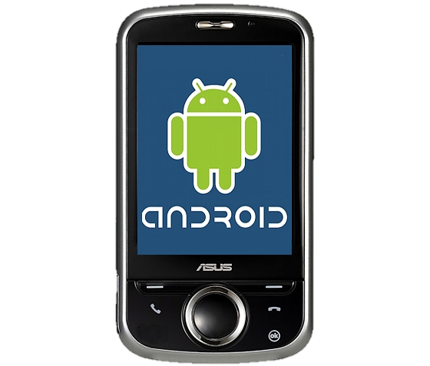
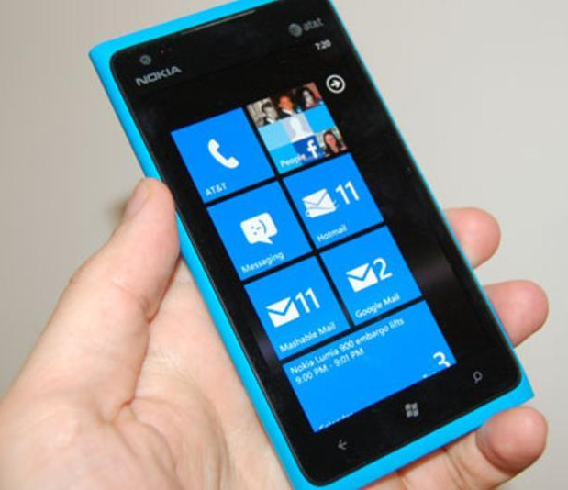
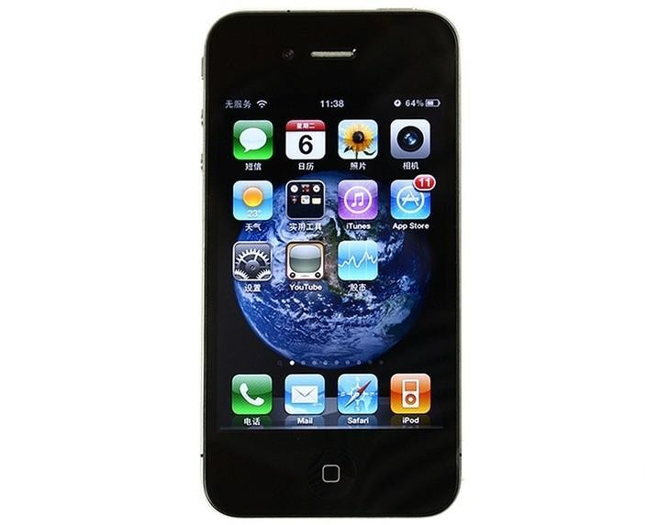
Apps, Operating Systems and hardware
Hardware
Built by other companies, Samsung, Sony, Motorola, HTC etc
Hardware
Built by other companies, LG, Nokia, HTC etc
Hardware
Built only by apple, therefore easier to design consistent apps
Software
Currently running Jellybean, apps written by anyone.
Software
Currently running windows phone 8.1, apps written by subscribing developers.
Software
Currently running iOS 7, apps written by subscribing developers.
Making Apps
Can be written in java or using app inventor for free
Making Apps
Can be made using touchdevelop for free
Making Apps
Need to purchase SDK from apple

Slide 4
Events / actions
Events are the things that the device can respond to such as:
Pressing screen
Shaking the device
Receiving a call
Actions are the things the phone can do in response to events:
Increase the volume
Show a picture
Move a sprite (image) on the screen

Slide 5
Home Learning

