Slide 1
Data and Model Updates
Structural and policy determinants of NDC
implementation

Slide 2
OECD Policy Stringency Index
Database with info for ~40 countries.
Policy stringency is measured from 0-6.
No relevant signal to predict total emissions.
Base Error: 1.637
With Policy Error: 1.635

Slide 3
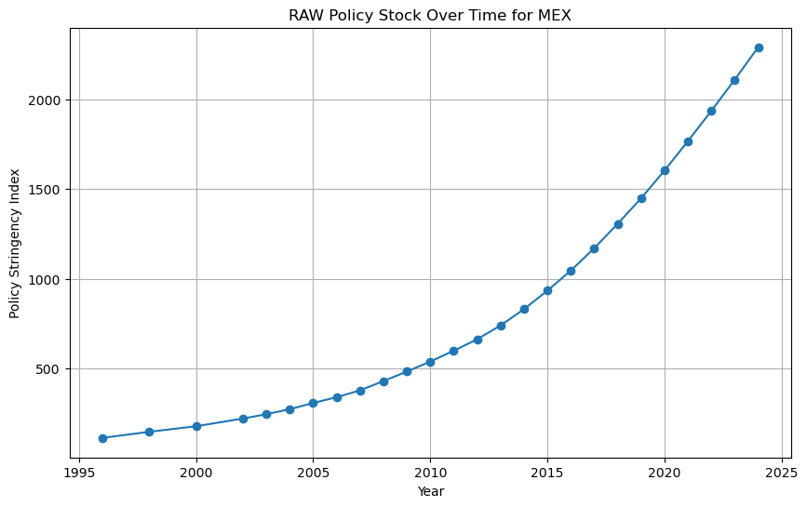
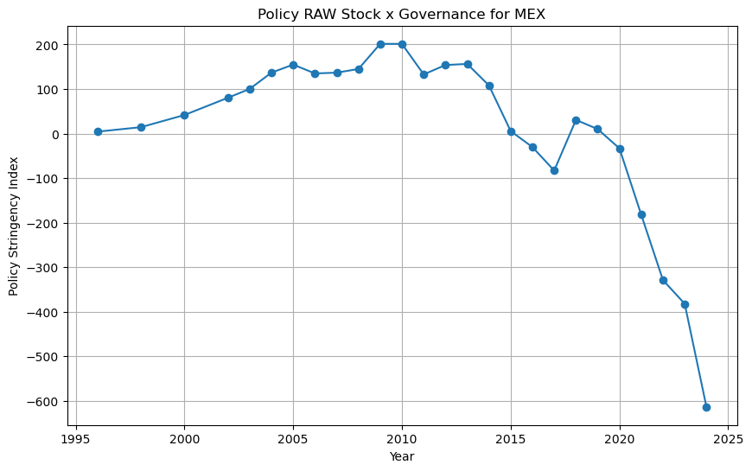
IEA Policy Stock x Governance Estimate
Also, a very poor signal and does not have predictive power

Slide 4
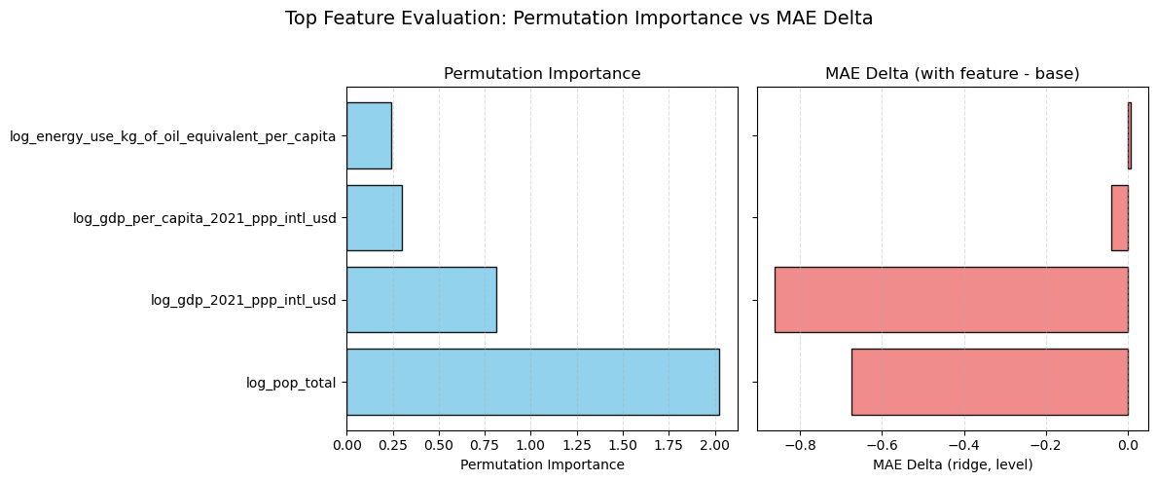
Most Relevant Predictors

Slide 5
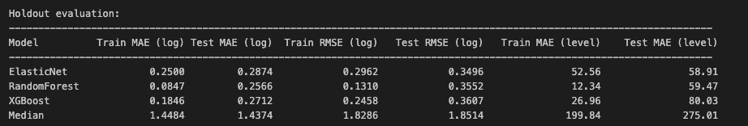
Model Evaluation

Slide 6
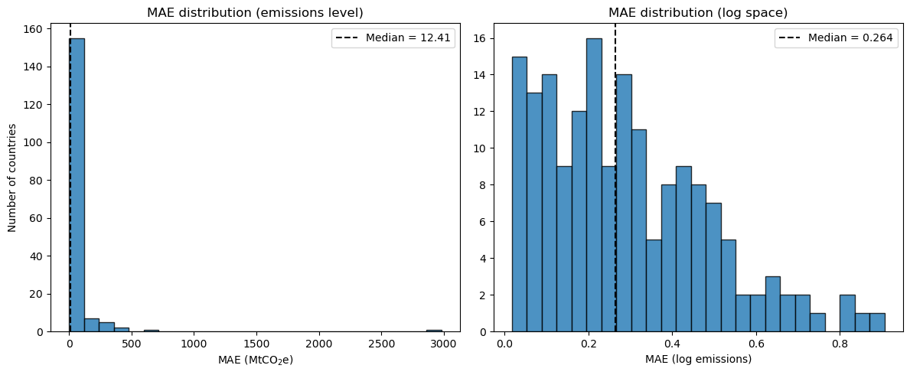
Errors Distribution

Slide 7
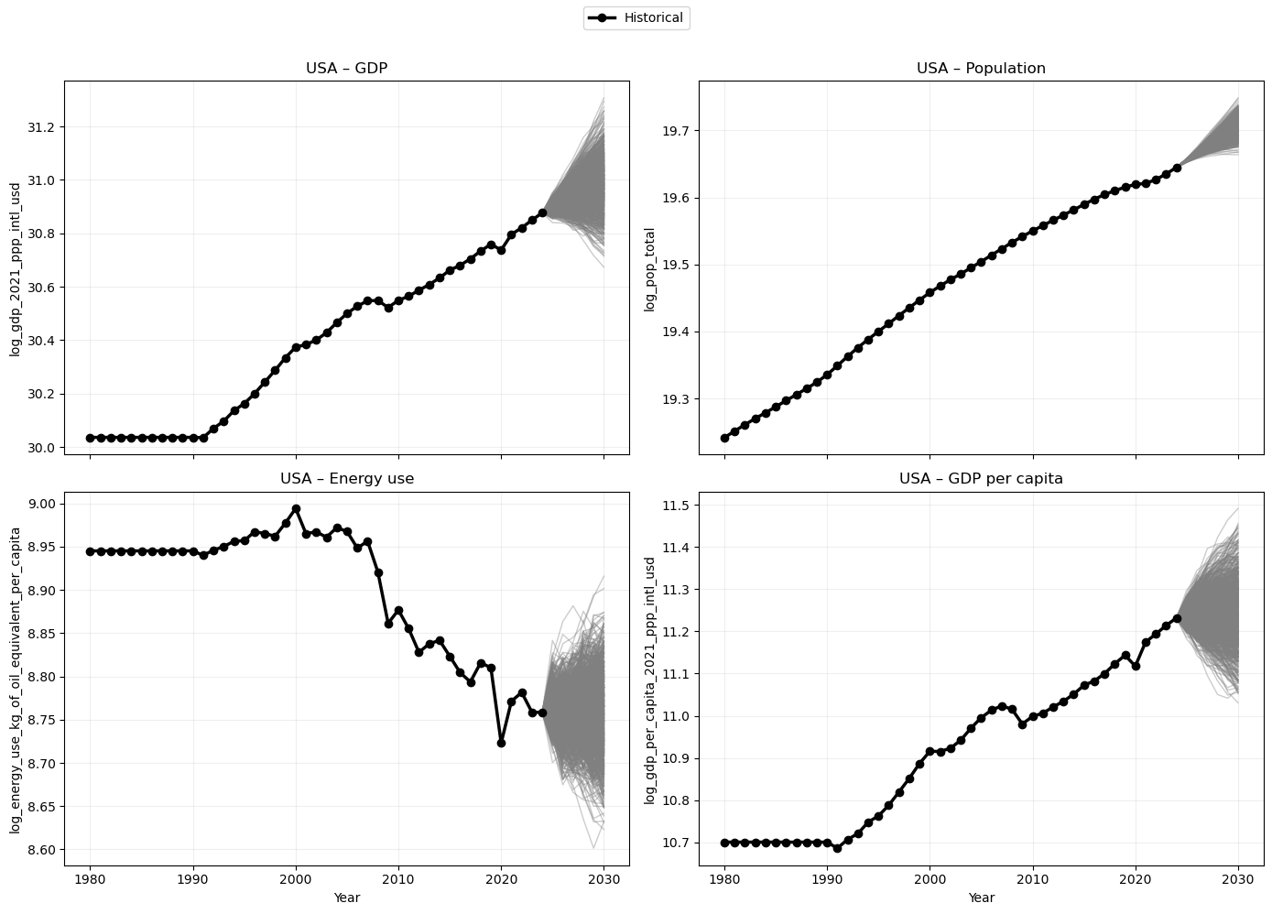
ARIMA Projections USA

Slide 8
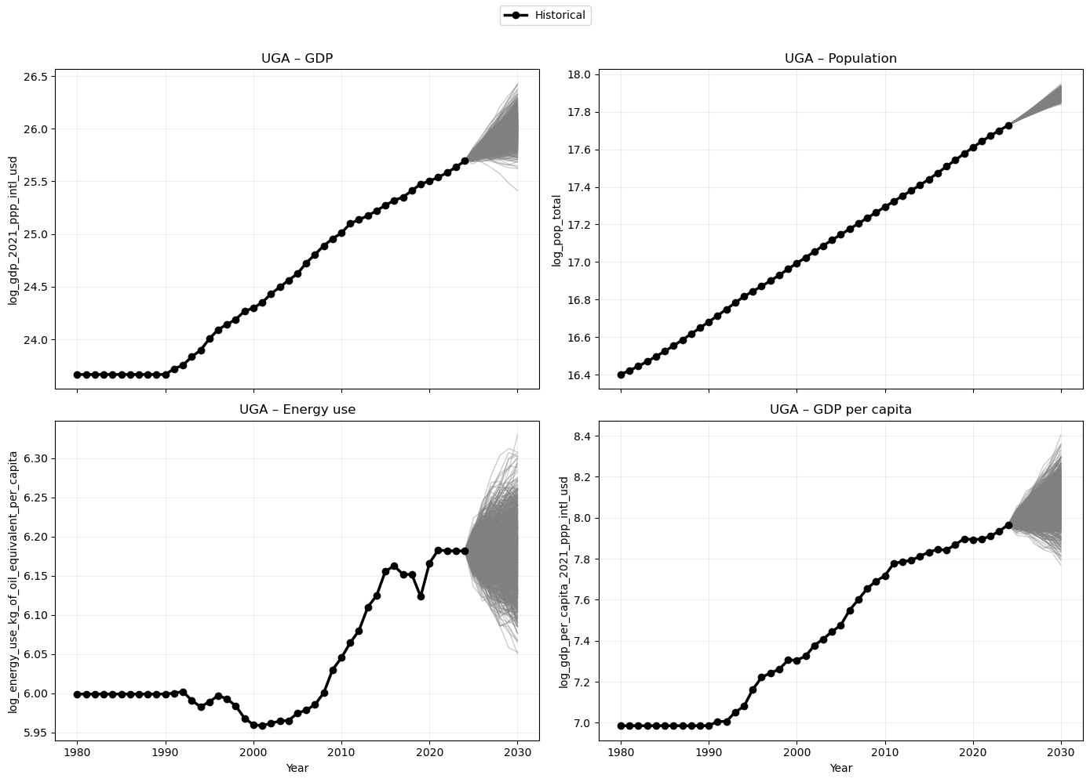
ARIMA Projections UGA

Slide 9
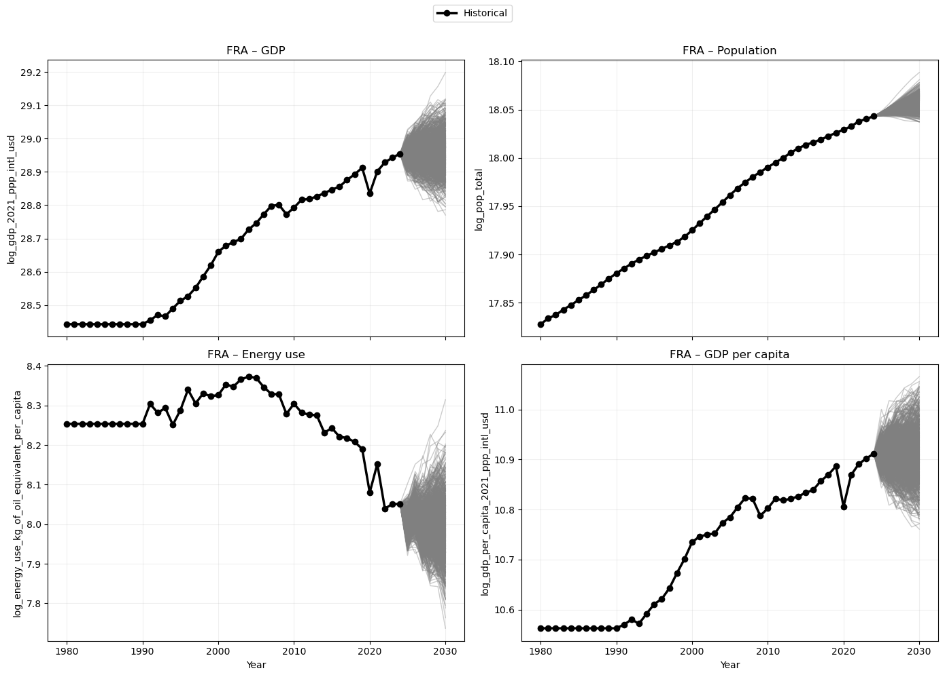
ARIMA Projections FRA

Slide 10
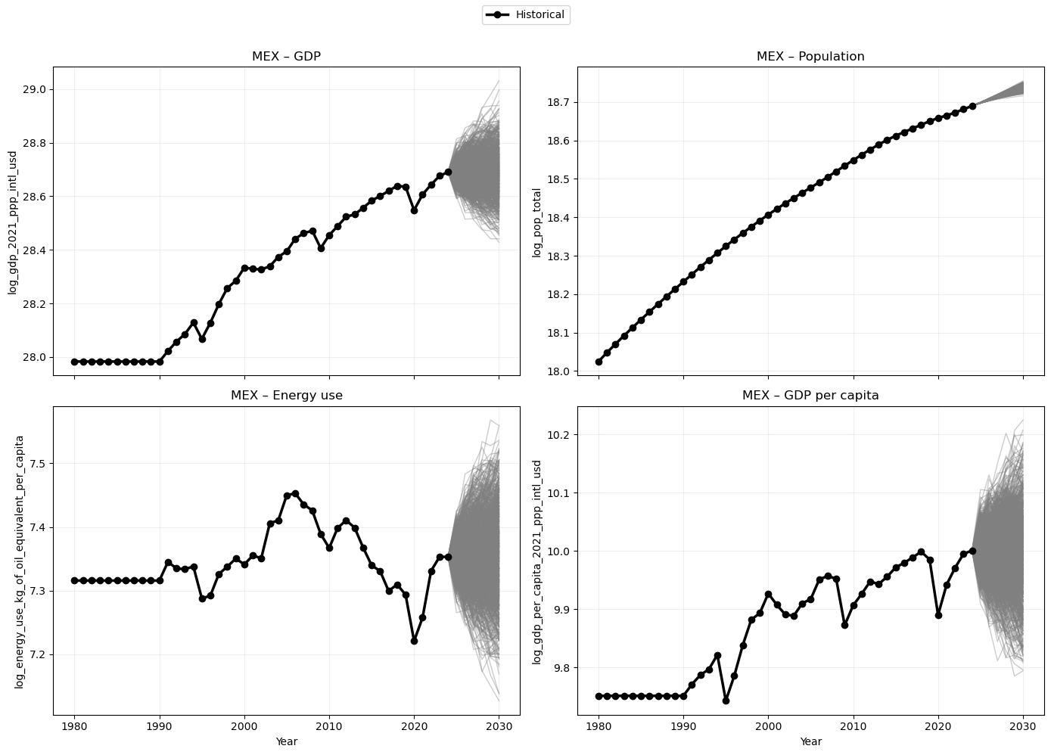
ARIMA Projections MEX

Slide 11
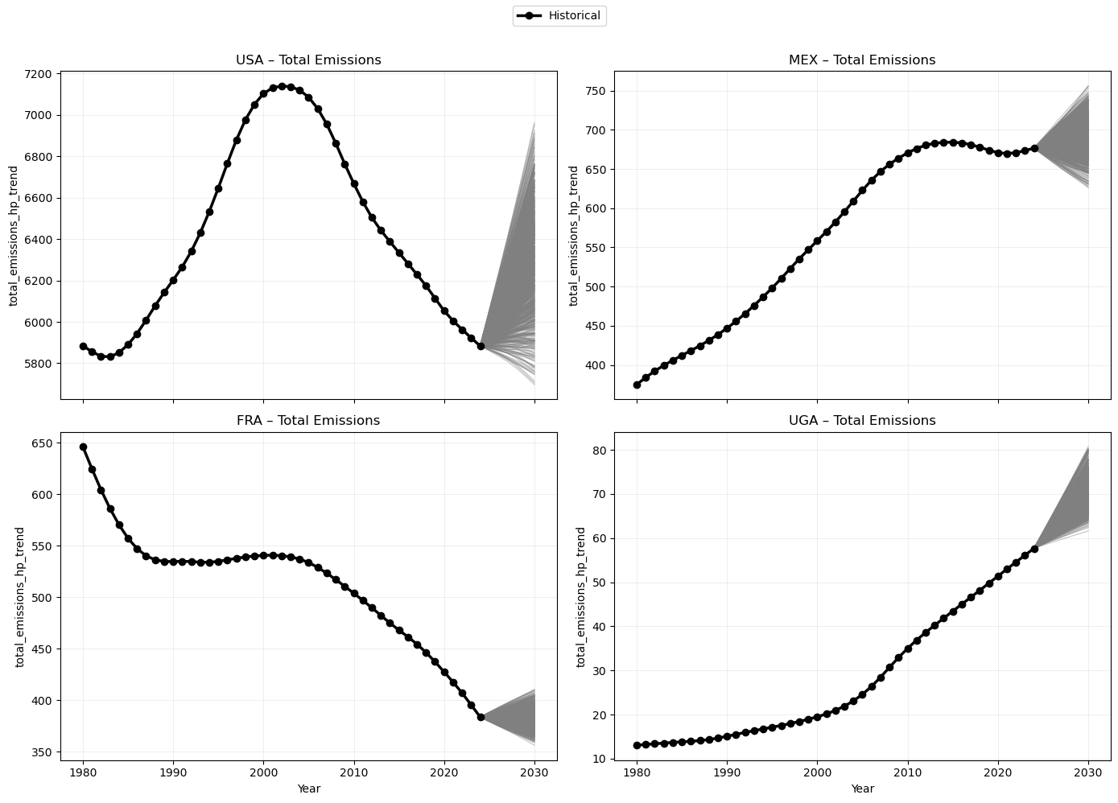
Emission Predictions

Slide 12
Update Feb 9th

Slide 13
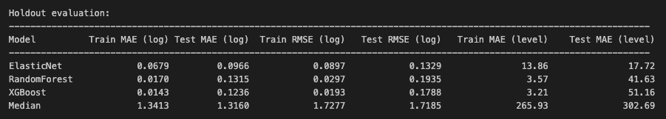
Model Evaluation

Slide 14
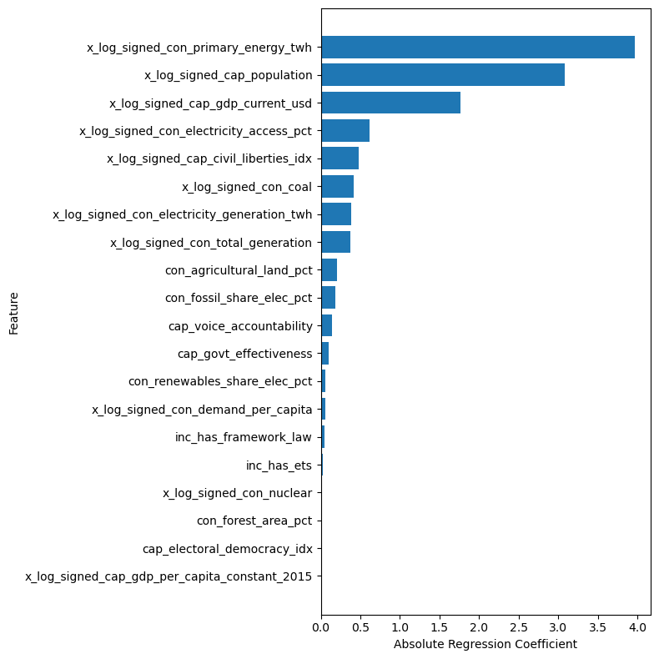
Most Important Features

Slide 15
Update Feb 16th

Slide 16
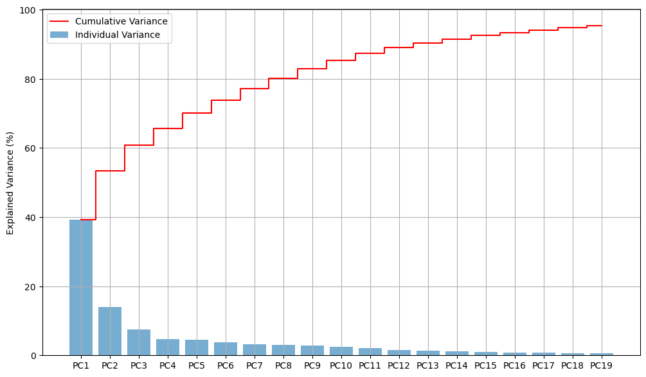
PCA
Notes:
We had 41 predictors

Slide 17
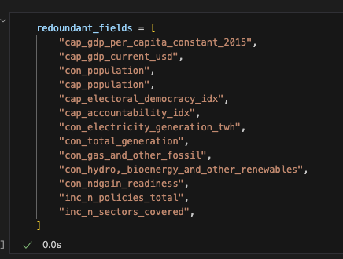
Correlation Analysis
Computed pairwise feature correlation
Tested removal of highly correlated features individually
Dropped features with no performance loss (or improvement)

Slide 18
Top Loadings in Top PCs
PC1 — Vulnerability and institutional capacity to act
ND-GAIN score
Government effectiveness
PC2 — Fossil-fuel electricity generation
Gas generation share
Coal generation share
PC3 — Renewable vs. fossil electricity mix
Renewable generation share
Fossil-fuel generation share
PC4 — Climate policy adoption
Cumulative number of climate laws
Presence of climate framework law
PC5 — Land use
Agricultural land share of total area
Forest area share of total area
PC6 — Carbon pricing policy
Carbon pricing coverage
Presence of ETS

Slide 19
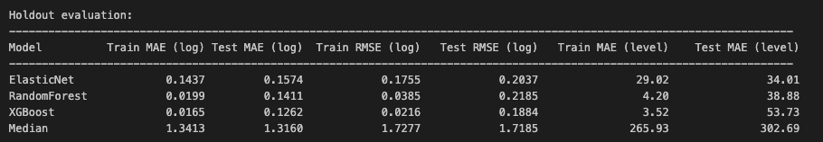
Train-test Metrics with Cleaner Feature Set

Slide 20
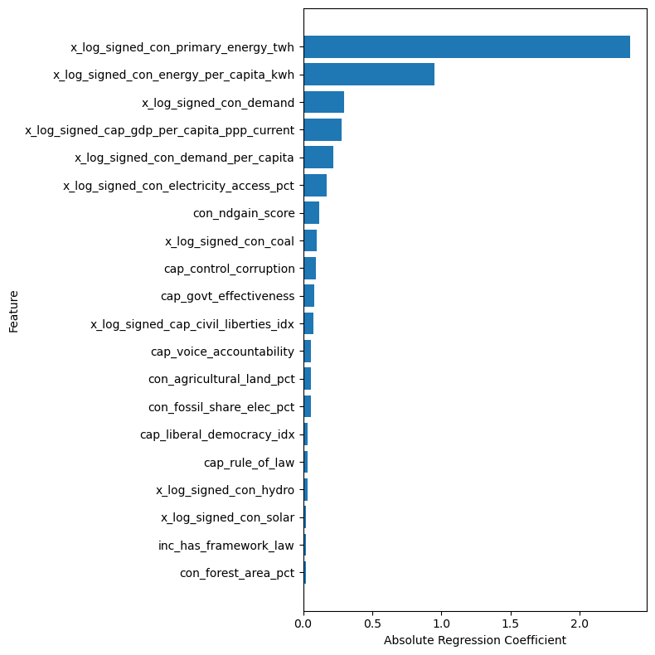
Most Important Features
Top regression features may differ from the highest PC loadings, but they support the same narrative
This narrative centers on institutional capacity, vulnerability, and electricity generation

Slide 21
Update Feb 23rd

Slide 22
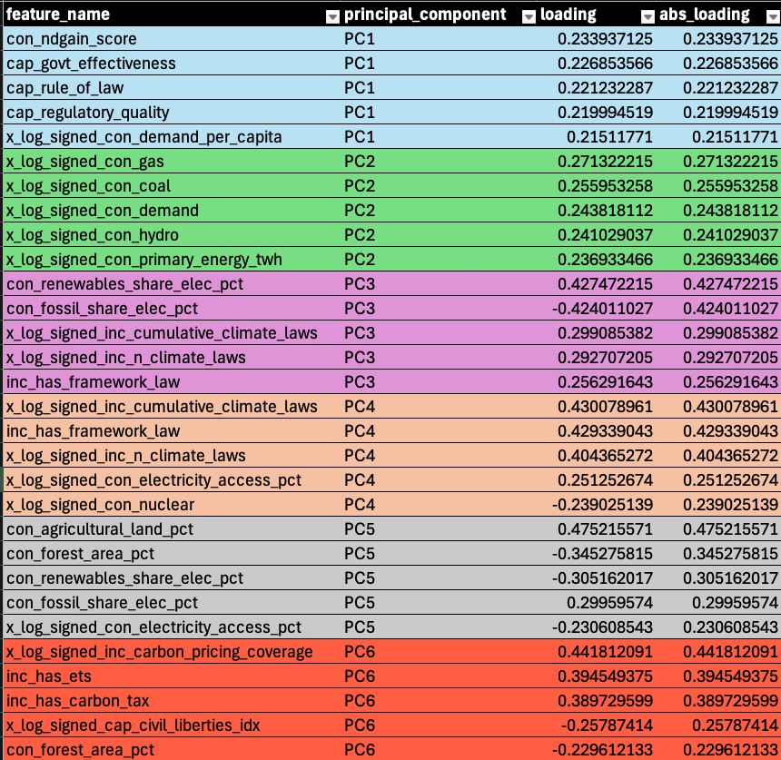
Reminder of the Top Loading Features per PC
Features are tied to institutional capacity, policy, vulnerabilities, and how electricity is generated
Agricultural land and forest areas are also included.

Slide 23
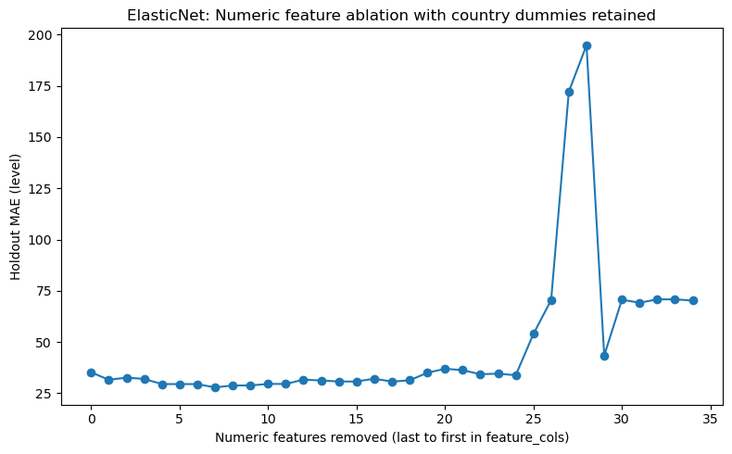
Ablation Experiment
We obtained the unique feature names that appeared in the top 5 loadings for each principal component.
The experiment consisted of training and evaluating the model iteratively by removing one feature at a time
The features with the lowest loading and from the last principal components are removed first

Slide 24
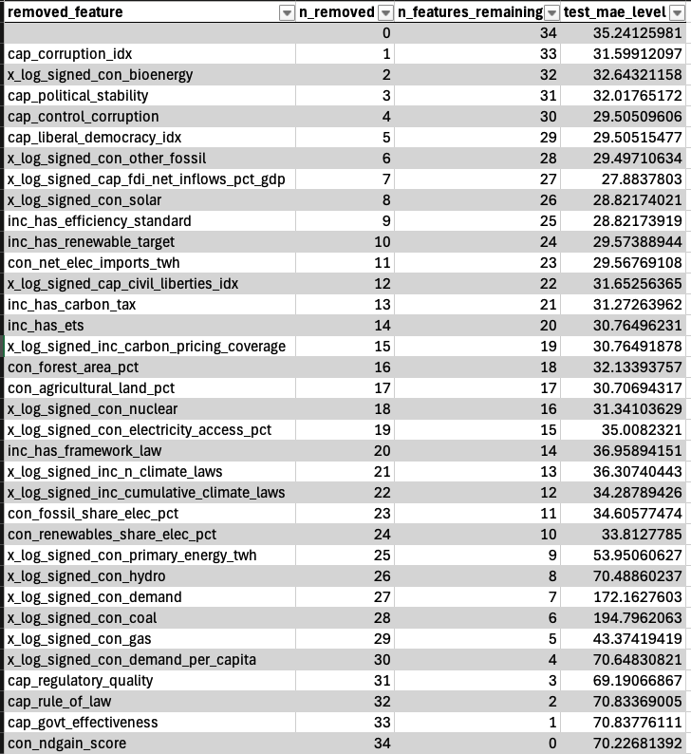
Ablation Experiment Results

Slide 25
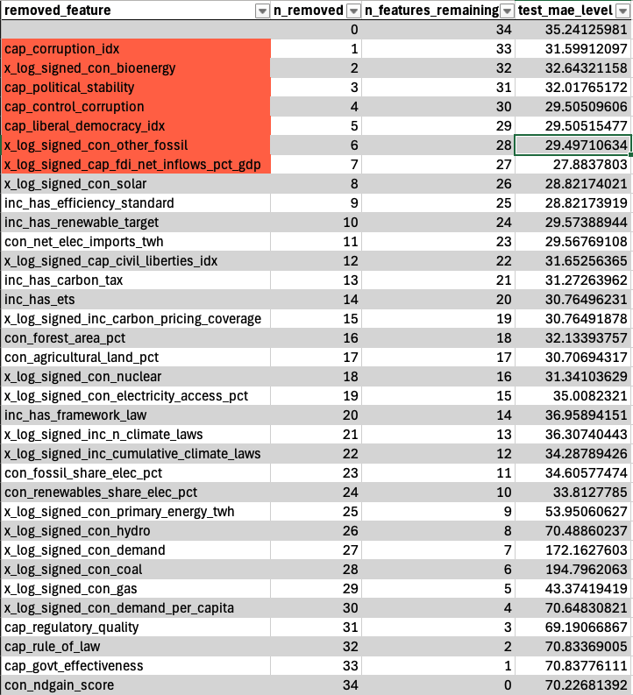
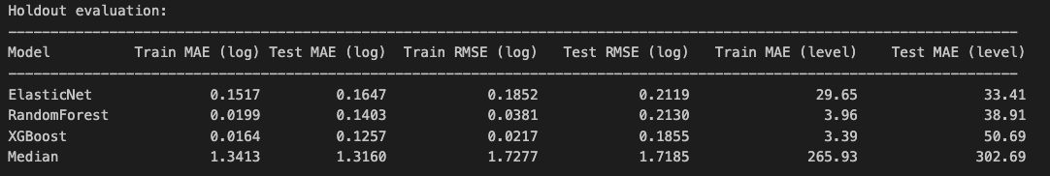
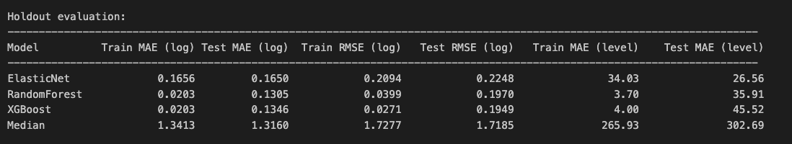
Model Training and Evaluation
We trained the model by removing 7 features from the top loadings set
When evaluating it we get a similar if not better performance than the original model with correlation filtering

Slide 26
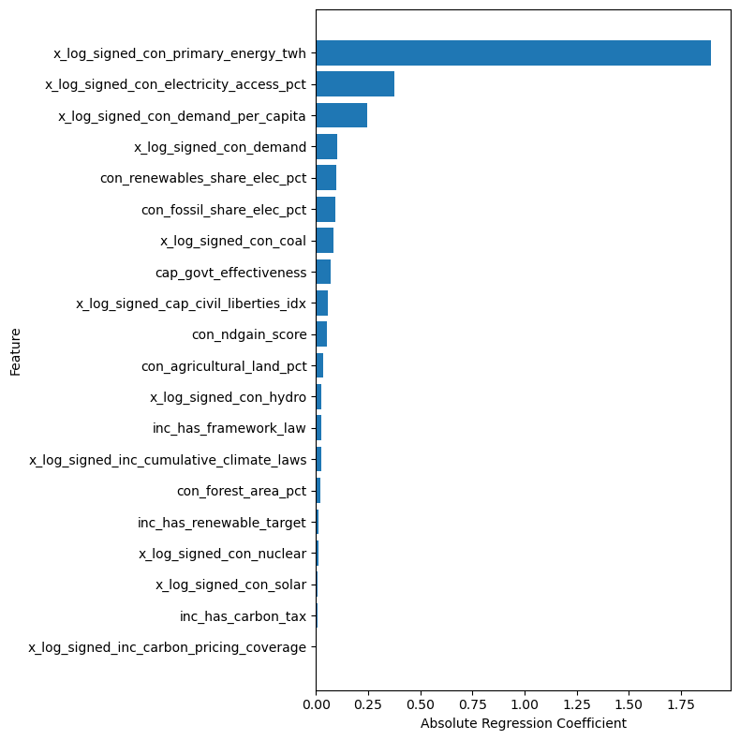
Top Regressors
One key insights it that GDP per capita was filtered out during this process; however it didn’t hurt model performance

Slide 27
Update March 2nd

Slide 28
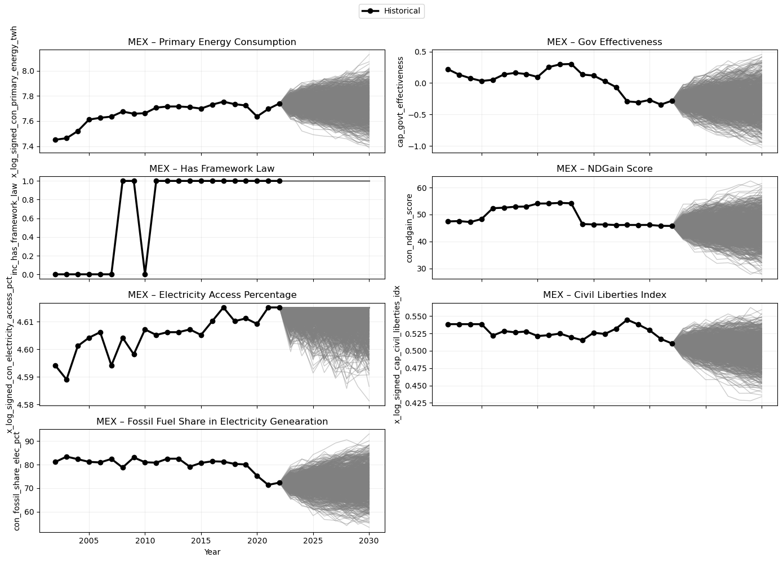
Projected Predictors
We created the projections using ARIMA
The different type of variables are treated properly to create realistic projections

Slide 29
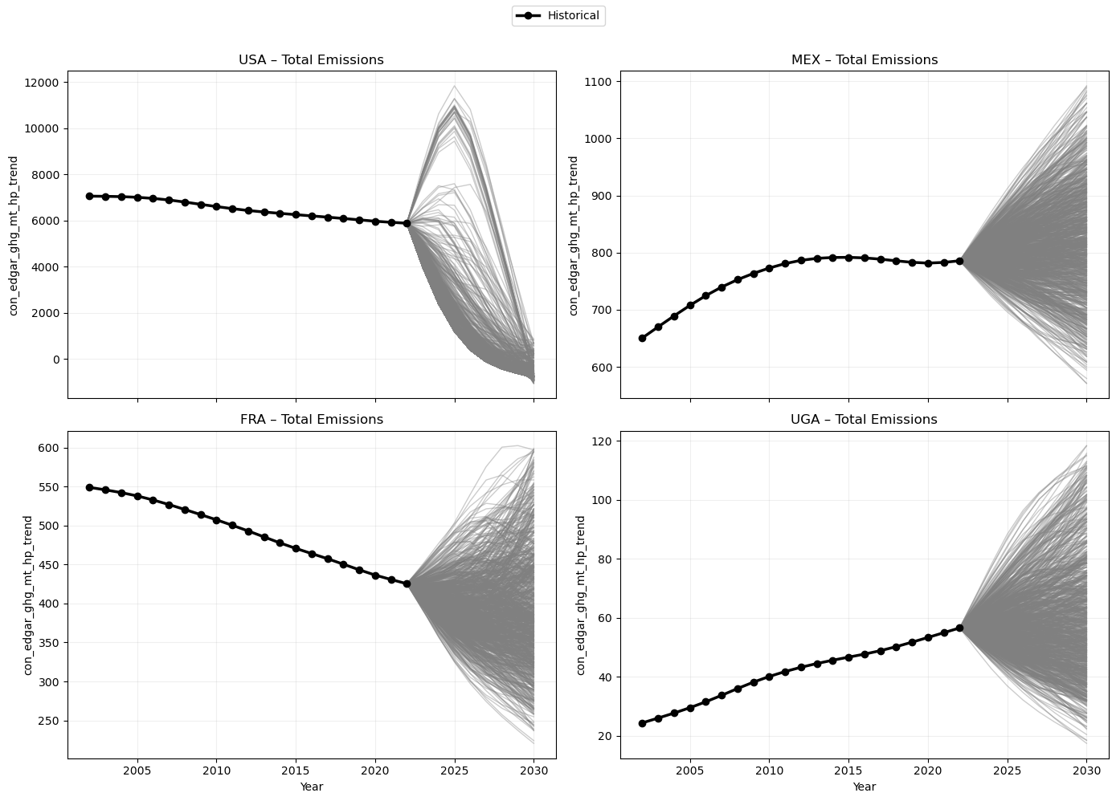
Projected Emissions
With the trained model we predicted future emissions using the projected features
We use the hp filter to clean the trajectories

Slide 30
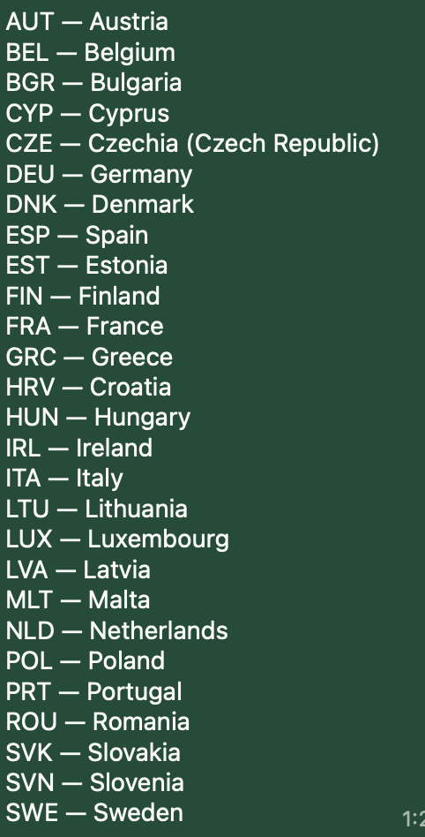
The following are preliminary results since we’re missing data for key countries

Slide 31
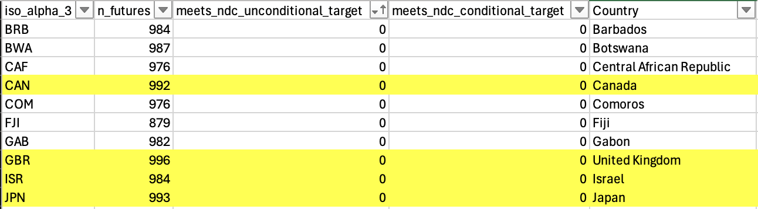
Also… Some important countries have 0 chance of meeting their targets which means that we might need to adjust the ARIMA projections

Slide 32
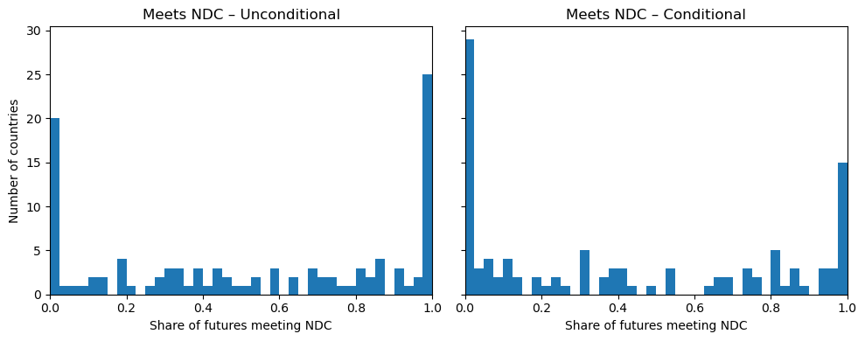
Distribution of the probability of meeting the NDC target

Slide 33
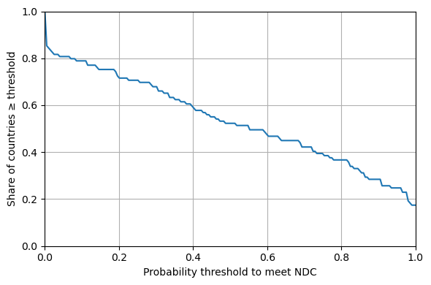
What’s the share of countries that meet certain probability?

Slide 34
Update March 9th

Slide 35
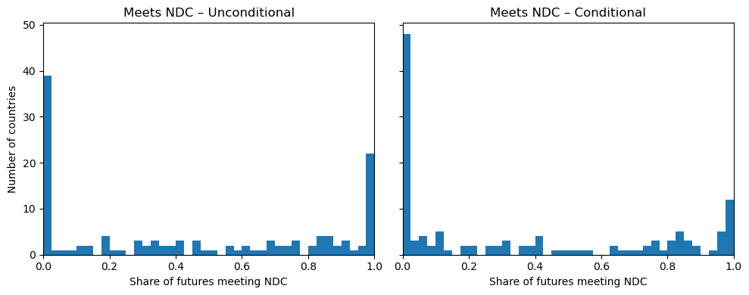

Slide 36
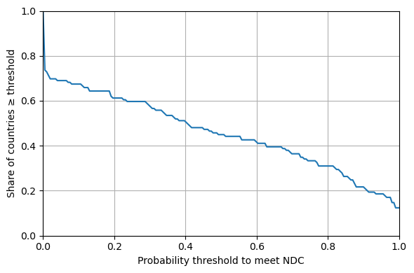

Slide 37
Let’s Check the Projections

Slide 38
Update March 30th
Scenario Discovery

Slide 39
Compute vulnerability indicator
Simple threshold: if value 2030 > 2022 then vulnerable.
Class balance threshold: find a value that balances the the amount 0s and 1s in the indicators class
Select various thresholds: select various quantiles of the 2030 value distribution and set various thresholds and therefore get various vulnerability indicator fields

Slide 40
Compute vulnerability indicator
Simple threshold: if value 2030 > 2022 then vulnerable.

Slide 41
Aggregate ARIMA features
The ARIMA data is in time series format however the vulnerability indicator isn’t, so we need to aggregate the time series data to be able to build our training data for the Random Forest

Slide 42
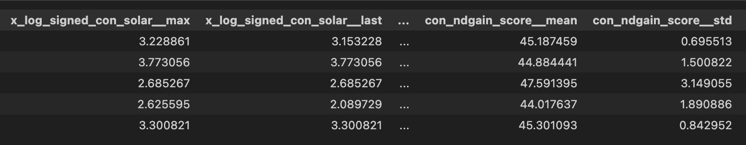
Example of ARIMA aggregated features

Slide 43
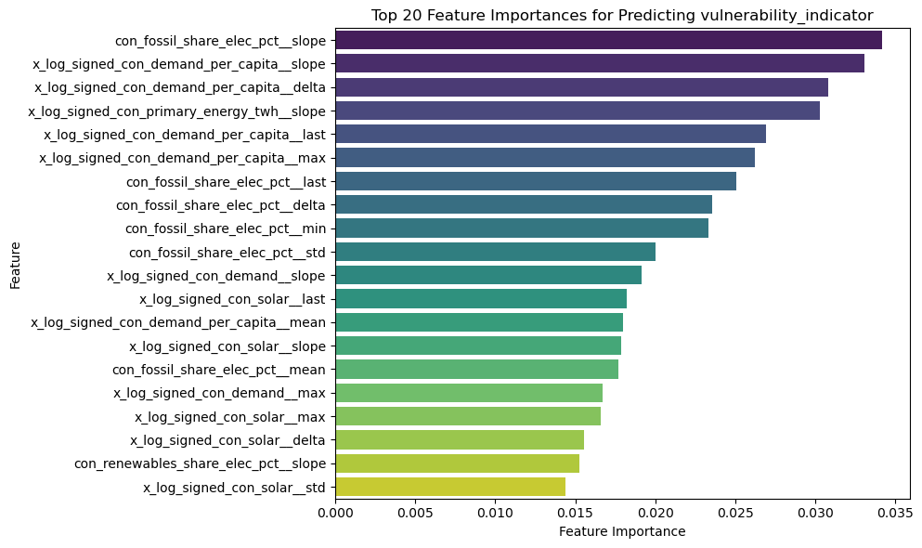
Obtaining feature importance with RF
Predicts vulnerability indicator and we obtain feature importance

Slide 44
What drivers should we pick?
Since we’ve decomposed the drivers into their aggregates, we pick the top ”k” independent drivers
For example:
'con_fossil_share_elec_pct’,
'x_log_signed_con_demand_per_capita'

Slide 45
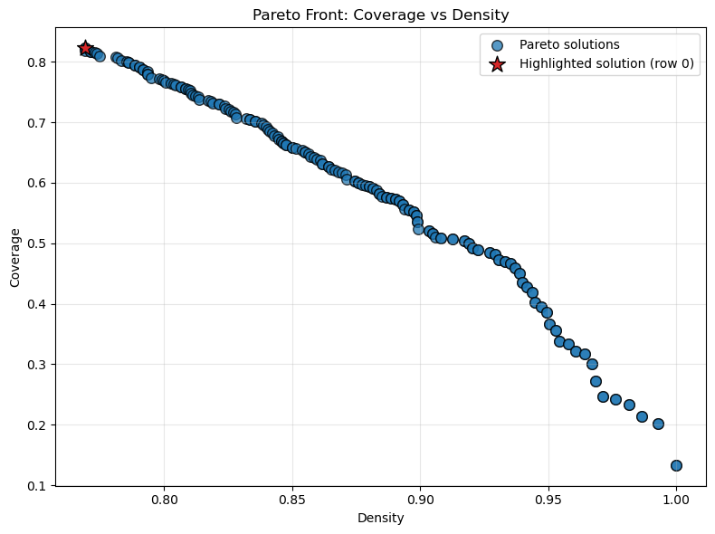
Finally we run the multi-objective optimization

Slide 46
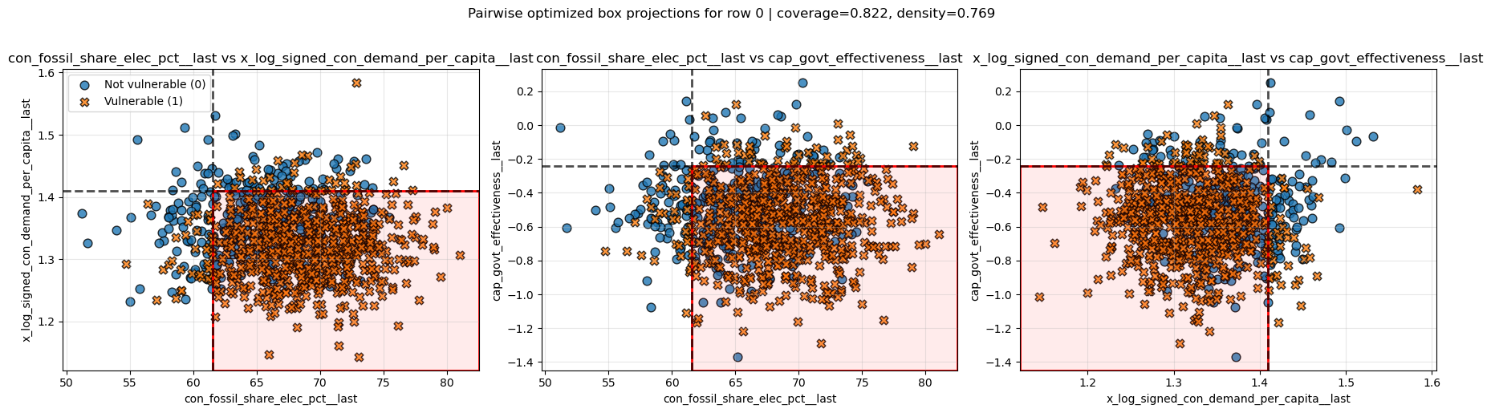
Results for Mexico

Slide 47
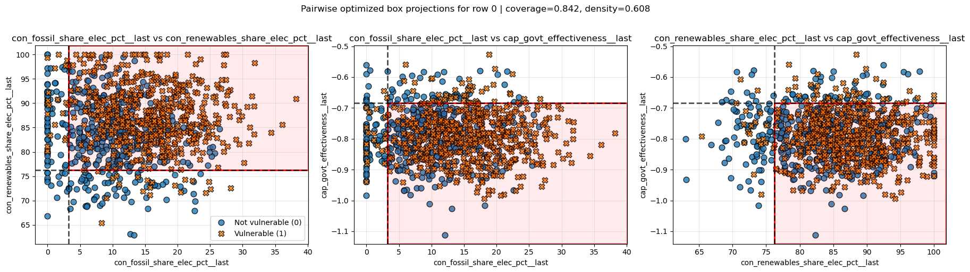
Results for Brasil

Slide 48
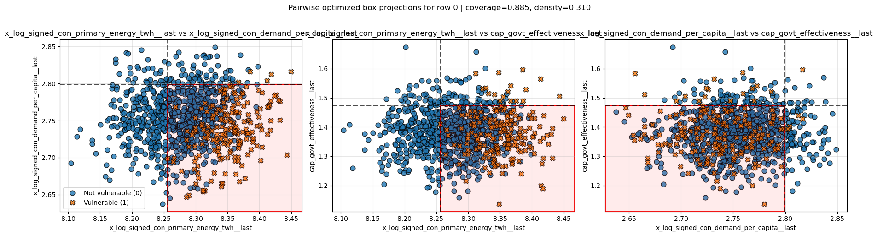
Results for Canada

Slide 49
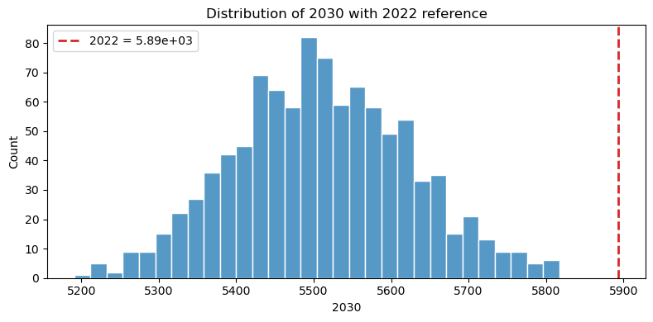
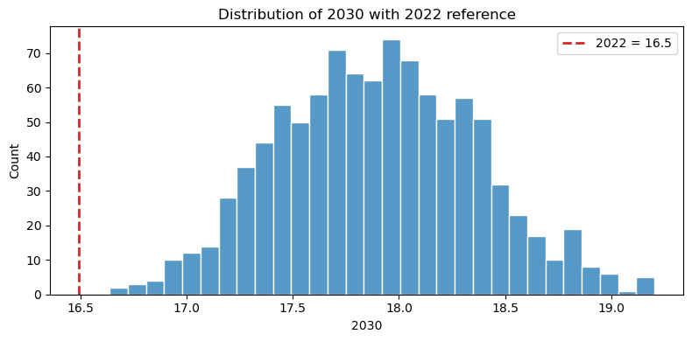
The issues with this approach
There are countries like the USA or Costa Rica that have no futures with 2030 values below or above the 2022 value so that rule doesn’t work for them.

Slide 50
Possible solutions
Class balance threshold: find a value that balances the the amount 0s and 1s in the indicators class
Select various thresholds: select various quantiles of the 2030 value distribution and set various thresholds and therefore get various vulnerability indicator fields

Slide 51
What I am currently doing
Class balance threshold: find a value that balances the the amount 0s and 1s in the indicators class

Slide 52
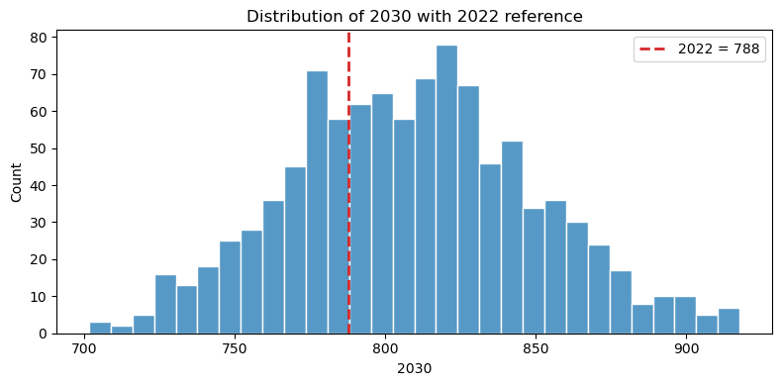
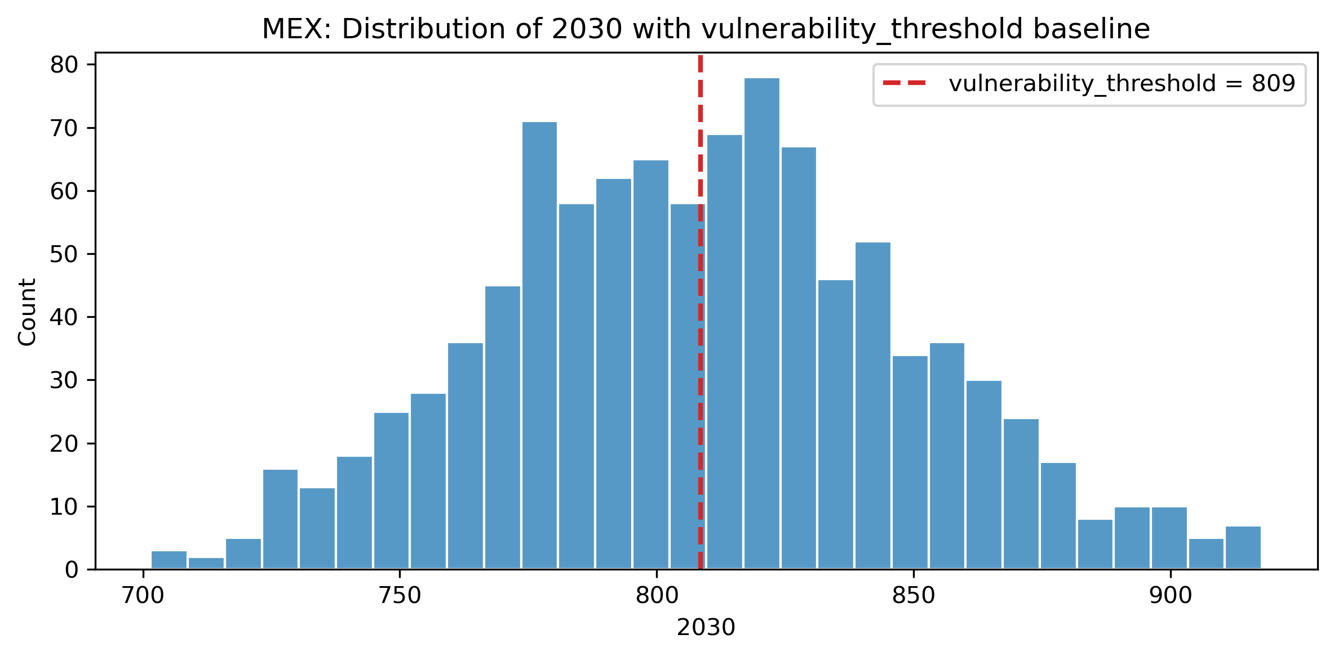
How it changed for Mexico

Slide 53
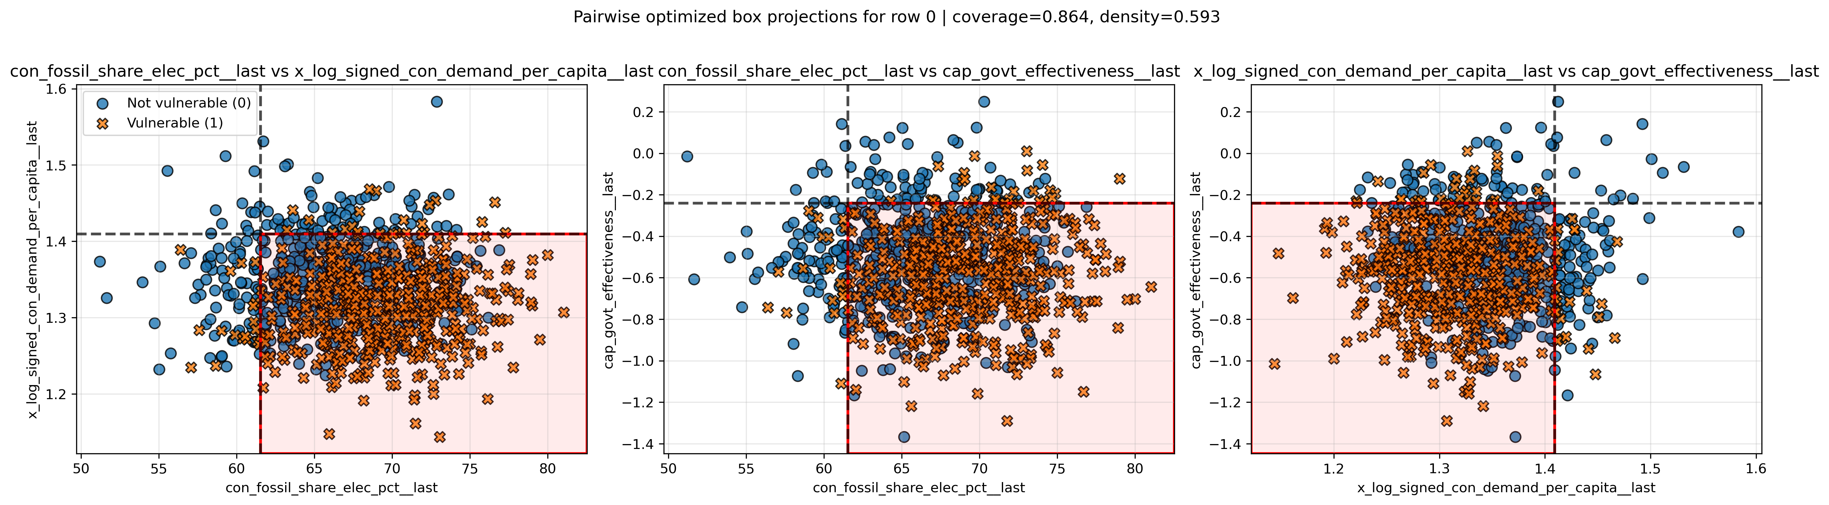
How results changed

Slide 54
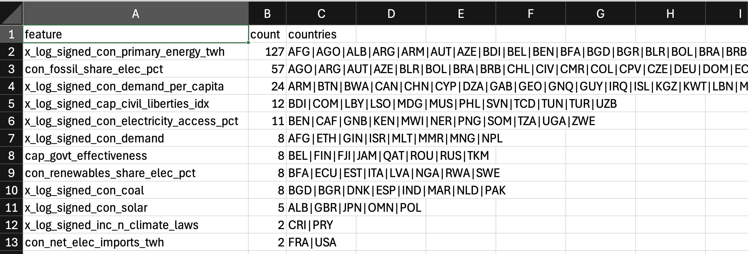
I did that for the 136 countries we have, and this are the top features

Slide 55
Update April 6th
Scenario Discovery

Slide 56
General Updates
Checked coverage and density calculation
We set the scenario discovery for the top 3 drivers
We use the auto threshold method using the quantile 50 value
Reduced the number of aggregations to train the random forest model
Updated the box cutoffs selection, prioritizing density
Updated the reports to add feature combination count and income level classification

Slide 57
General Updates
Checked coverage and density calculation
We set the scenario discovery for the top 3 drivers
We use the auto threshold method using the quantile 50 value
Reduced the number of aggregations to train the random forest model
Updated the box cutoffs selection, prioritizing density
Updated the reports to add feature combination count and income level classification

Slide 58
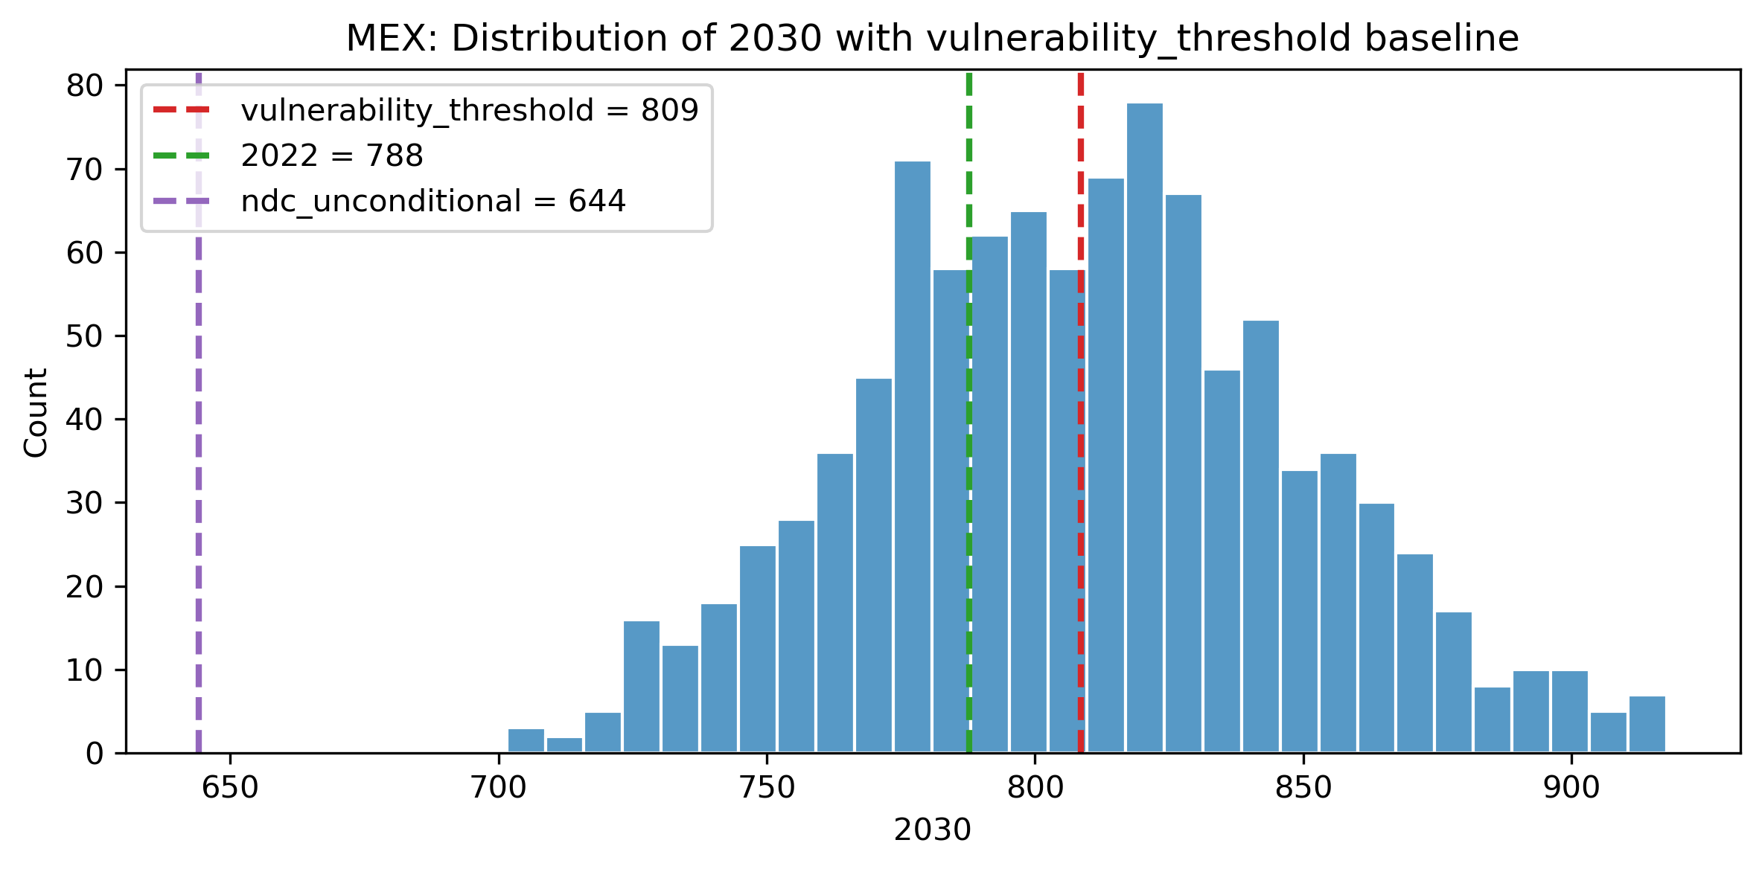
Example: MEX

Slide 59
Some stats about the thresholds
Value Type | % of countries where the value is above the vulnerability threshold
2022 Value | 37.5
NDC Unconditional Target | 44.85

Slide 60
General Updates
Checked coverage and density calculation
We set the scenario discovery for the top 3 drivers
We use the auto threshold method using the quantile 50 value
Reduced the number of aggregations to train the random forest model
Updated the box cutoffs selection, prioritizing density
Updated the reports to add feature combination count and income level classification

Slide 61
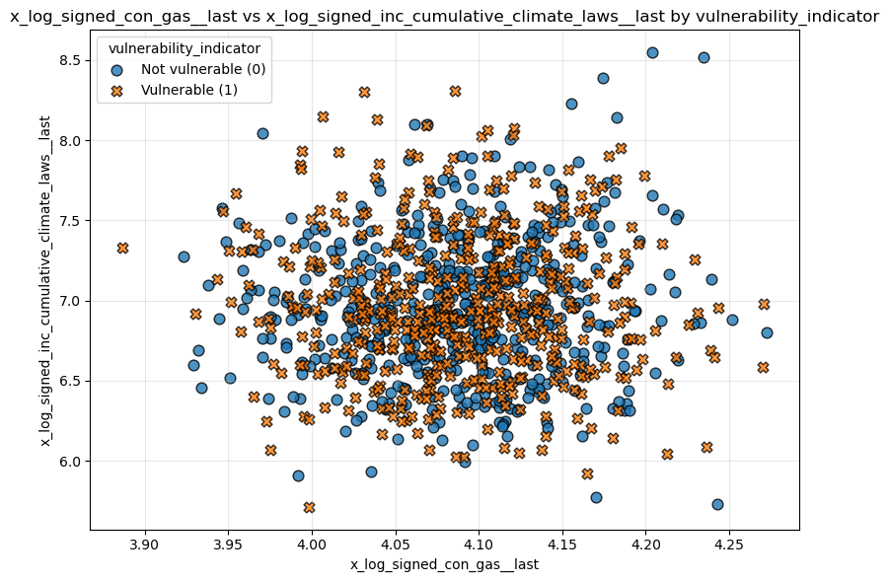
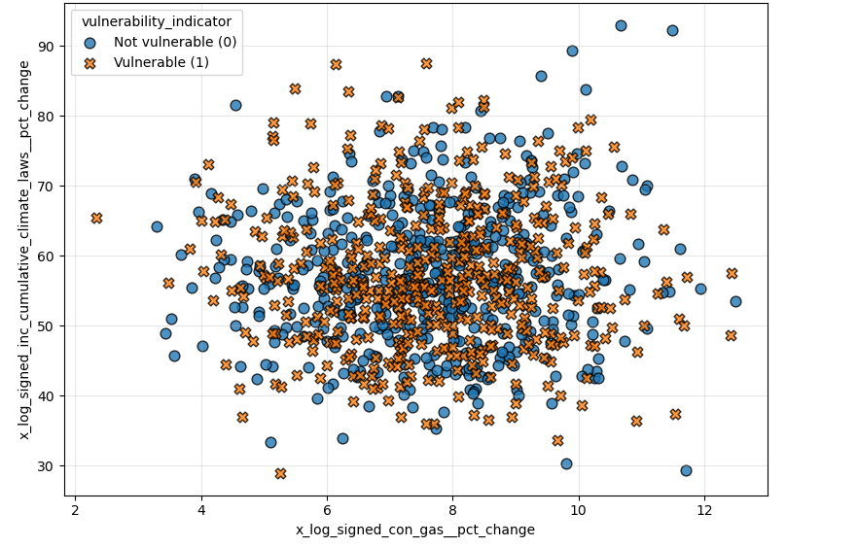
Using pct_change only is not great

Slide 62
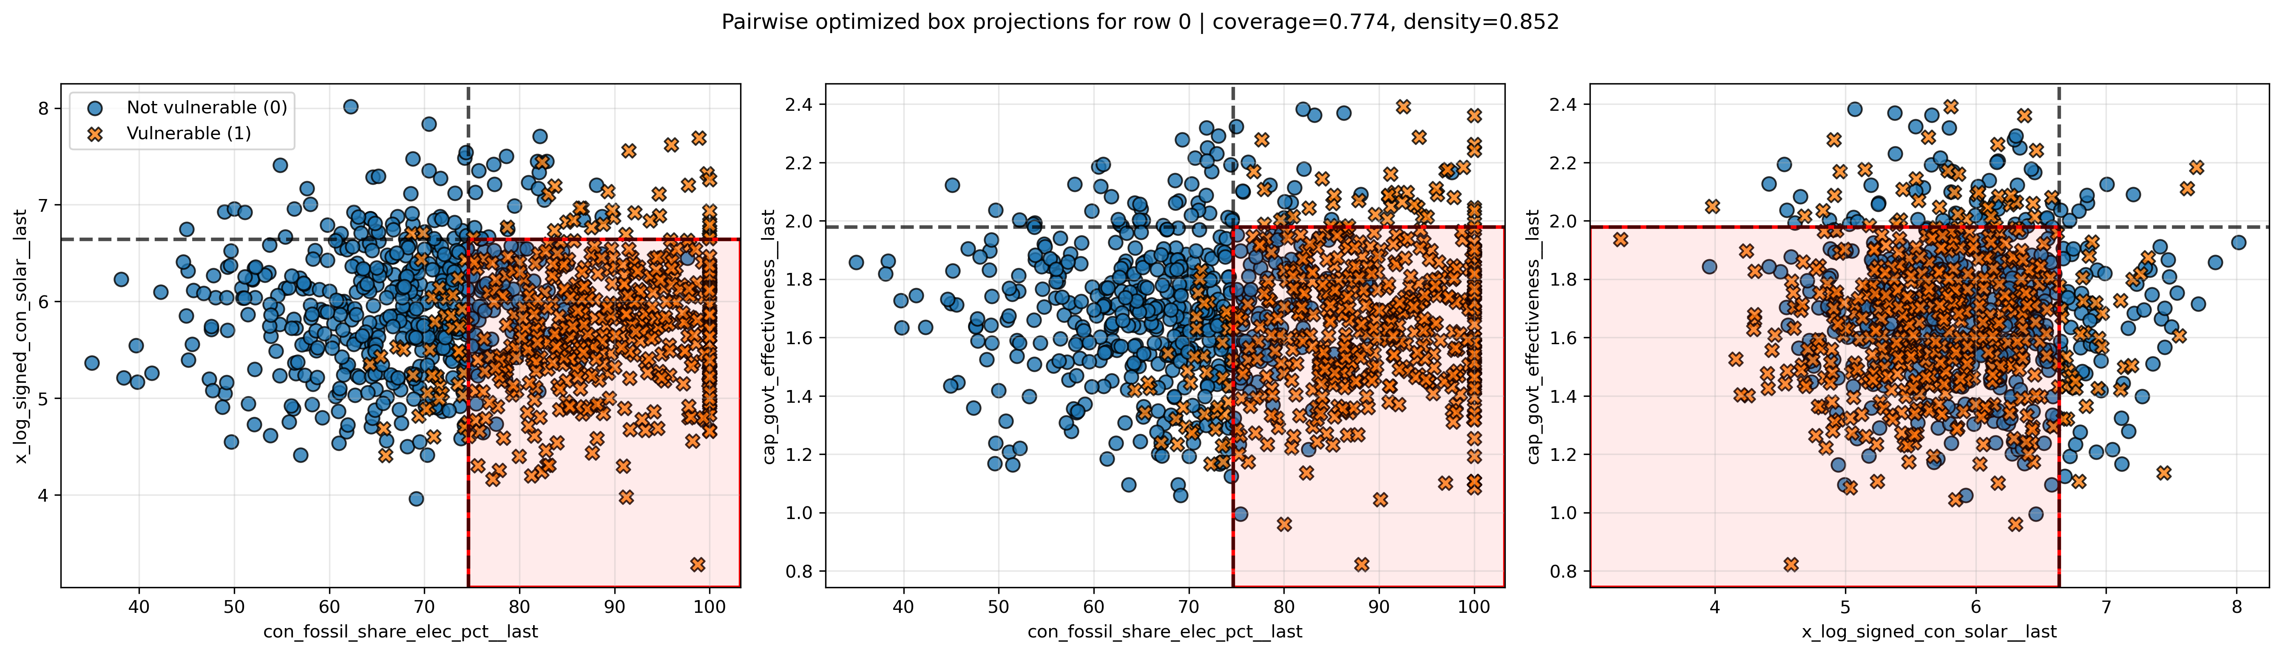
Example of Japan using start, last, delta and pct_change

Slide 63
General Updates
Checked coverage and density calculation
We set the scenario discovery for the top 3 drivers
We use the auto threshold method using the quantile 50 value
Reduced the number of aggregations to train the random forest model
Updated the box cutoffs selection, prioritizing density
Updated the reports to add feature combination count and income level classification

Slide 64
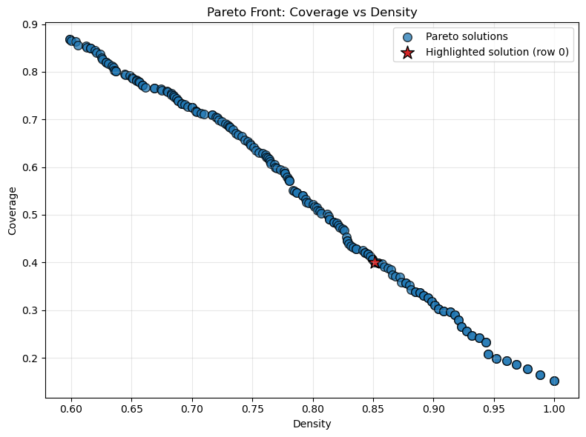
New selection method

Slide 65
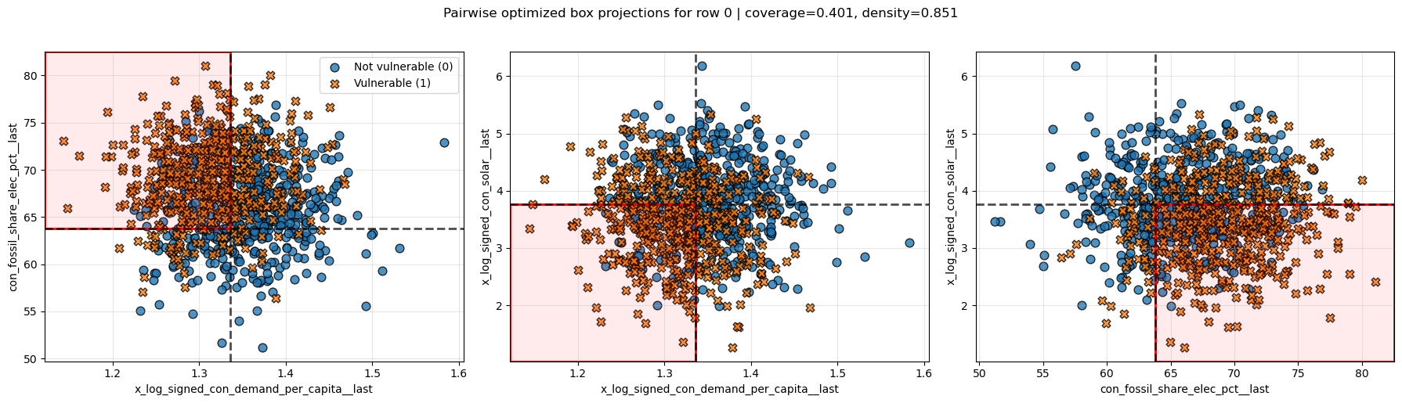
Example: MEX

Slide 66
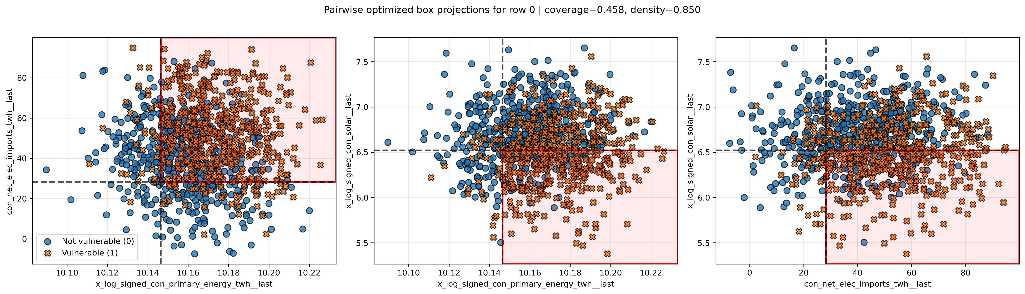
Example: USA

Slide 67
Example: JPN

Slide 68
Stats about the new cutoff selection method
% of countries where the density is above 60%
100%

Slide 69
General Updates
Checked coverage and density calculation
We set the scenario discovery for the top 3 drivers
We use the auto threshold method using the quantile 50 value
Reduced the number of aggregations to train the random forest model
Updated the box cutoffs selection, prioritizing density
Updated the reports to add feature combination count and income level classification

Slide 70

New Feature Combination Table

Slide 71

Added Income Level Classification

Slide 72
Let’s check the tables

Slide 73
Update April 27th
Robustness Checks

Slide 74
Robustness Check: Add Lags

Slide 75
What did we add?
We added 1, 2, and 3 years lag to some incentive variables:
Has an efficiency standard
Has a renewable target
Has a carbon tax
Has ETS
Carbon pricing coverage
Number of climate laws

Slide 76

Ablation Study Results

Slide 77

Comparison Against Baseline
Model Version | Train MAE | Test MAE
ENET Baseline | 11.99 | 16.99
ENET with Lags | 11.87 | 16.73
Very slight improvement in metrics. These lags might not help incentives to show up in the scenario discovery.

Slide 78
Robustness Check: Policy Stringency Index

Slide 79
What did we add?
We added the aggregated version of the OECD Policy Stringency Index, plus some interaction features:
Policy stringency index (0-10)
Policy stringency index – government efficiency
Policy stringency index – corruption control
Policy stringency index – regulatory quality

Slide 80

Ablation Study Results

Slide 81

Comparison Against Baseline
Model Version | Train MAE | Test MAE
ENET Baseline | 11.99 | 16.99
ENET Baseline with OECD subset | 17.39 | 26.17
ENET with Policy Index | 18.37 | 28.87
There is a considerable reduction in the number of records, from 2448 to 792, which causes the metrics to drop. The policy index is available only for 56 countries (the USA is not included in this subset).
The policy index with interaction terms provides predictive power; however, it might not show up in the top combinations in the scenario discovery

Slide 82
Robustness Check:Quick Mediation Test

Slide 83
What did we do?
Predict the Primary Energy (TWh) in 10 years, using the incentives variables:
Has a carbon tax
Has ETS
Has a framework law
Has a renewable target
Has an efficiency standard
Number of climate laws
Cumulative climate laws
Carbon pricing coverage

Slide 84

Ablation Study Results

Slide 85

Model Results
Model Version | Train MAE | Test MAE
ENET | 752.11 | 870.23
The incentive features aren’t very effective at predicting primary energy over the next 10 years. Even though the results are logical, the MAE is very high relative to the reductions achieved by each feature in the ablation study.

