Slide 1
SeedHealth Framework Integration within a Network System
We use the SeedHealth framework to model within node seed degeneration by cycle (time step)
Assumptions (of the toy example):
Static network seed trade volumes
Other SeedHealth parameters (W and Z) are constant among node types
For this methods diagram, we are not using a stochastic version of SeedHealth (parameters are set as fixed values)
In the final model, we will include different parameters for each node type/location. This does not change the network integration itself, only the SeedHealth input parameters

Slide 2
Methodology

Slide 3
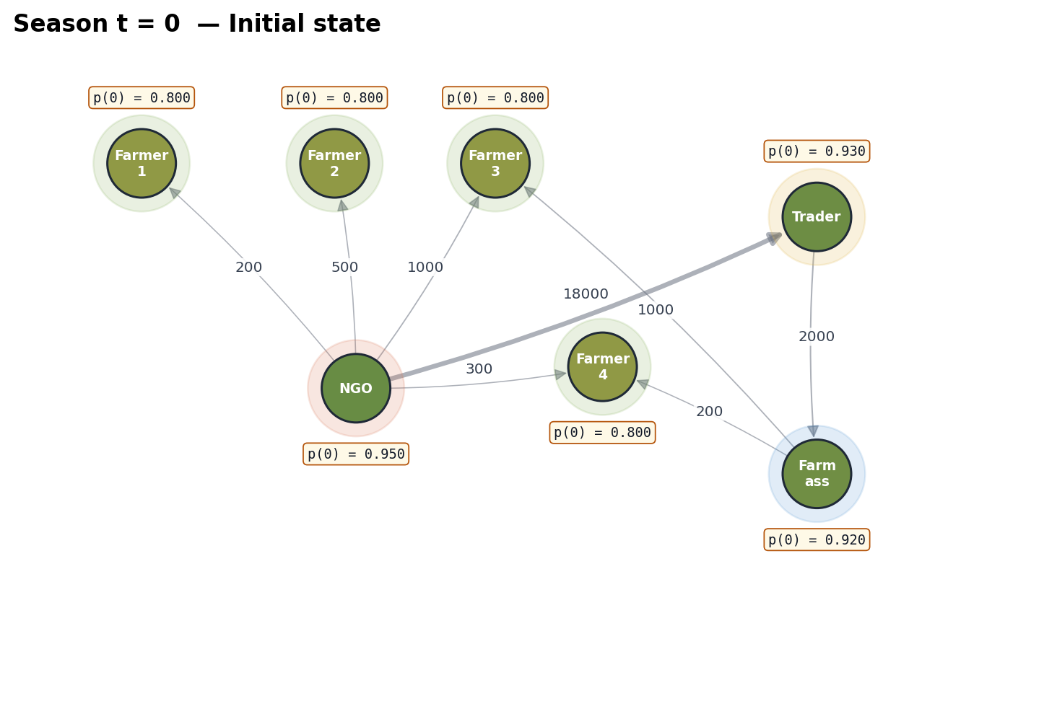
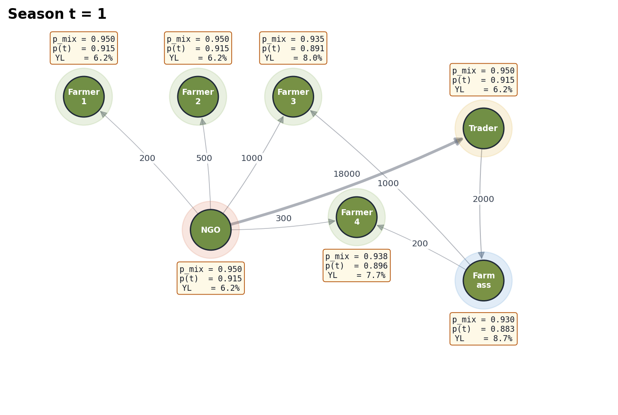
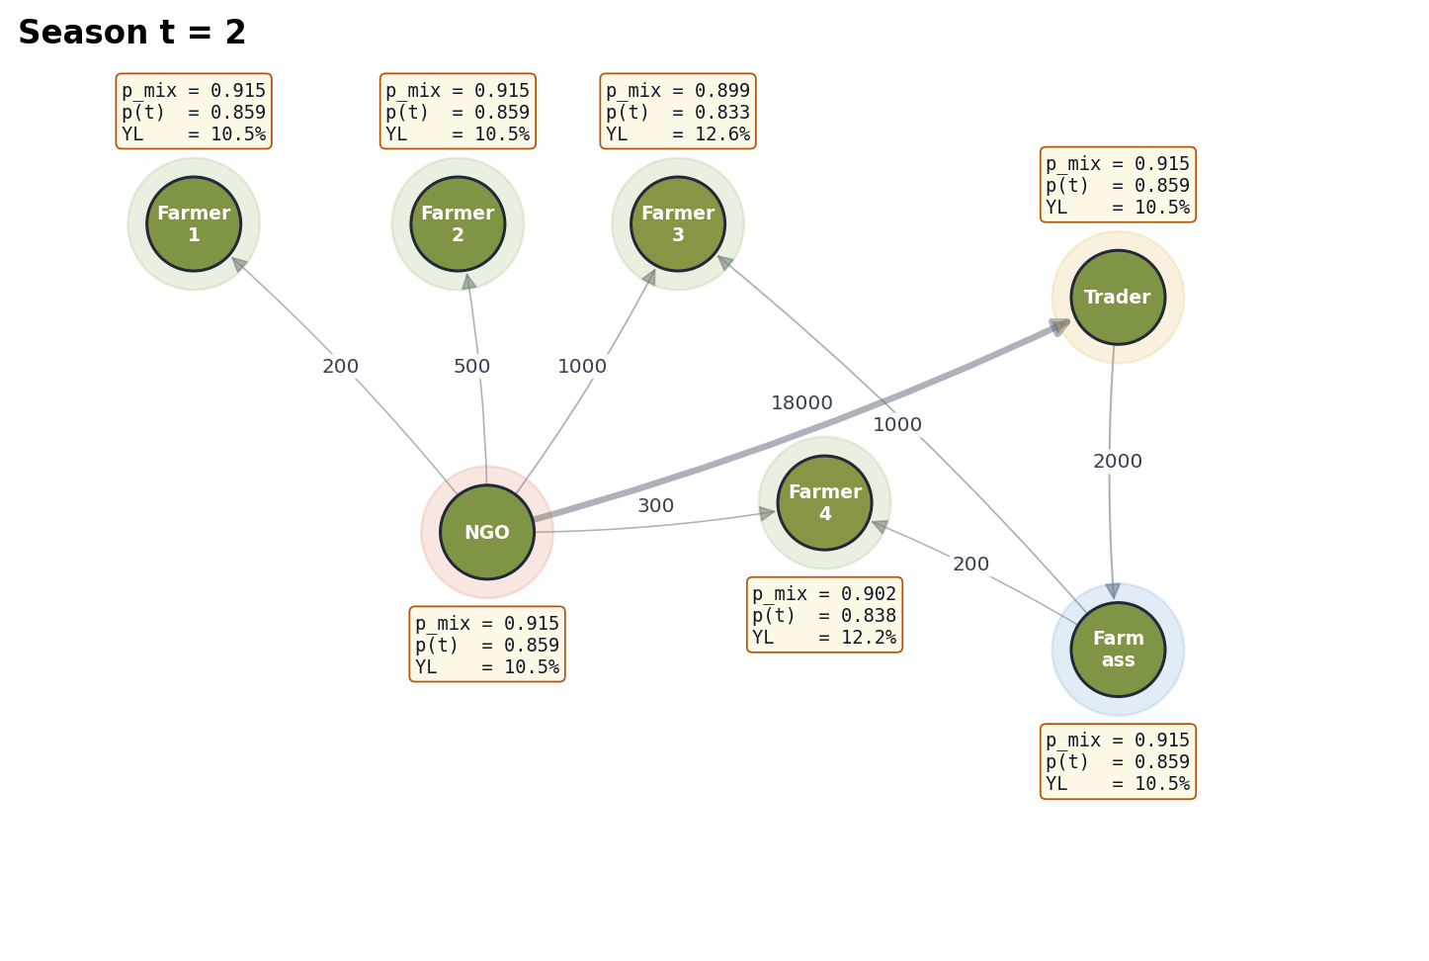
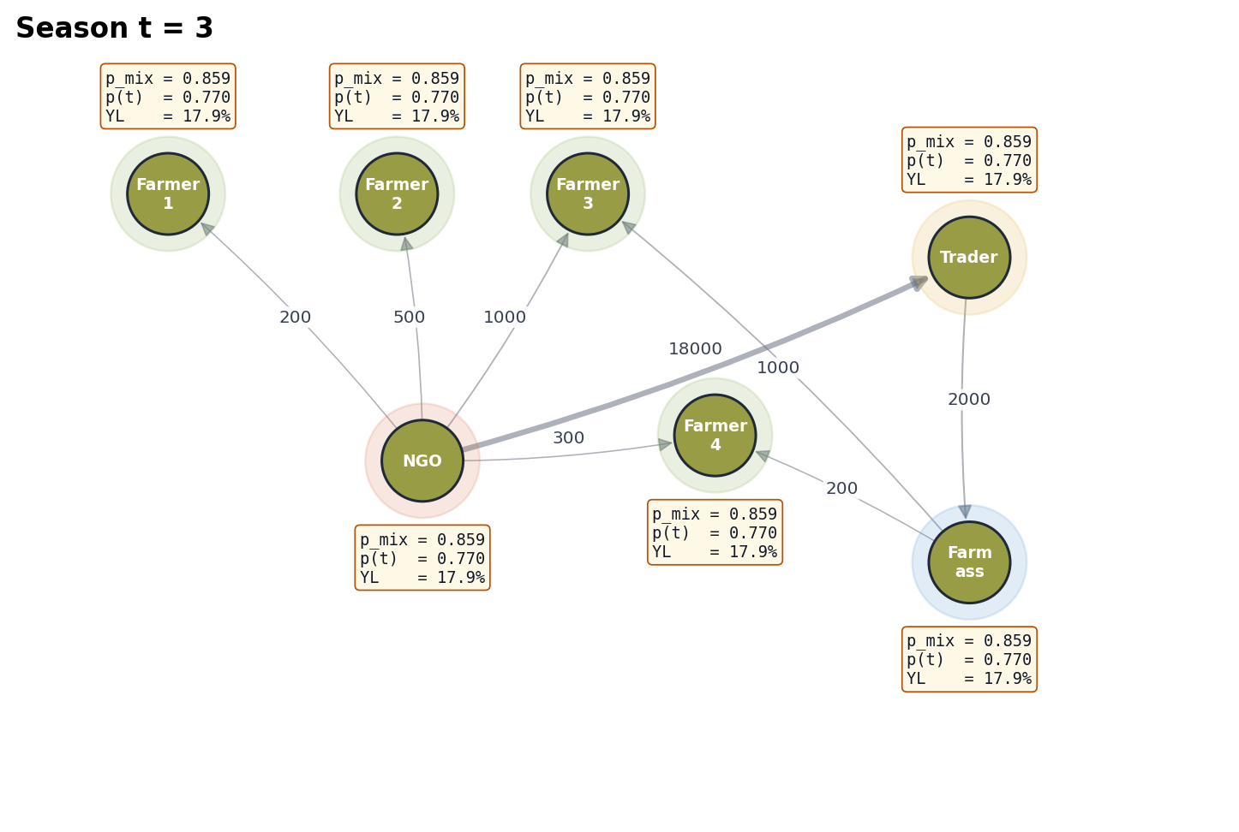
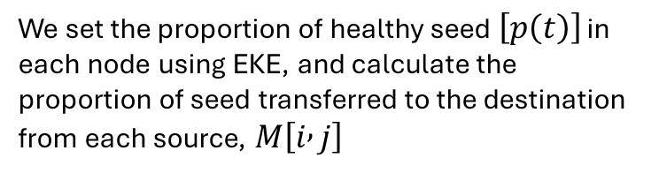
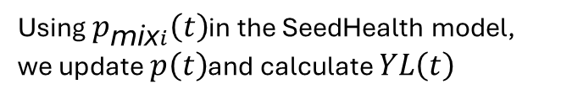
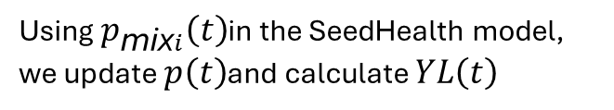
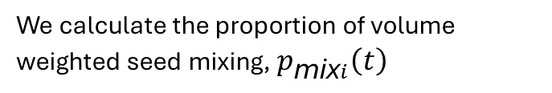
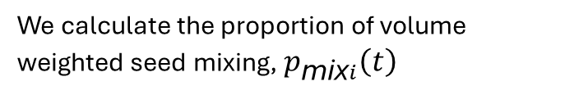
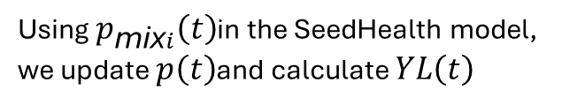
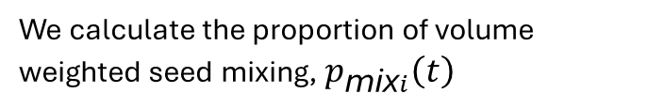
t= 0
We set the proportion of healthy seed $\left[p\left(t\right)\right]$ in each node using EKE, and calculate the proportion of seed transferred to the destination from each source, $M\left[i , j\right]$
From \ To | Farmer_1 | Farmer_2 | NGO | Farmer_3 | Farmer_4 | Trader | Farm_ass
Farmer_1 | · | · | · | · | · | · | ·
Farmer_2 | · | · | · | · | · | · | ·
NGO | 1.00 | 1.00 | 1.00 | 0.50 | 0.60 | 1.00 | ·
Farmer_3 | · | · | · | · | · | · | ·
Farmer_4 | · | · | · | · | · | · | ·
Trader | · | · | · | · | · | · | 1.00
Farm_ass | · | · | · | 0.50 | 0.40 | · | ·
Step 0
M[i, j] = w[i, j] / Σₖ w[k, j]
We calculate the proportion of volume weighted seed mixing, $p_{\text{mix}i}\left(t\right)$
t= 1
Node | p(t-1) at t=1 | Calculation | p_mix(t) | p(t) | YL (%)
Farmer_1 | 0.800 | (1.00·0.950)/1 | 0.9500 | 0.9154 | 6.16
Farmer_2 | 0.800 | (1.00·0.950)/1 | 0.9500 | 0.9154 | 6.16
NGO | 0.950 | self (0.950) | 0.9500 | 0.9154 | 6.16
Farmer_3 | 0.800 | (0.50·0.950 + 0.50·0.920)/1 | 0.9350 | 0.8908 | 8.04
Farmer_4 | 0.800 | (0.60·0.950 + 0.40·0.920)/1 | 0.9380 | 0.8957 | 7.66
Trader | 0.930 | (1.00·0.950)/1 | 0.9500 | 0.9154 | 6.16
Farm_ass | 0.920 | (1.00·0.930)/1 | 0.9300 | 0.8826 | 8.67
Step 1
p_mixᵢ(t) = Σⱼ wⱼᵢ · pⱼ(t − 1) / Σⱼ wⱼᵢ
Using $p_{\text{mix}i}\left(t\right)$in the SeedHealth model, we update $p\left(t\right)$and calculate $YL\left(t\right)$
We calculate the proportion of volume weighted seed mixing, $p_{\text{mix}i}\left(t\right)$
t= 2
Node | p(t-1) at t=2 | Calculation | p_mix(t) | p(t) | YL (%)
Farmer_1 | 0.915 | 1.00·0.915 | 0.9154 | 0.8590 | 10.52
Farmer_2 | 0.915 | 1.00·0.915 | 0.9154 | 0.8590 | 10.52
NGO | 0.915 | self (0.915) | 0.9154 | 0.8590 | 10.52
Farmer_3 | 0.891 | 0.50·0.915 + 0.50·0.883 | 0.8990 | 0.8326 | 12.63
Farmer_4 | 0.896 | 0.60·0.915 + 0.40·0.883 | 0.9023 | 0.8378 | 12.21
Trader | 0.915 | 1.00·0.915 | 0.9154 | 0.8590 | 10.52
Farm_ass | 0.883 | 1.00·0.915 | 0.9154 | 0.8590 | 10.52
Loop of 1
p_mixᵢ(t) = Σⱼ wⱼᵢ · pⱼ(t − 1) / Σⱼ wⱼᵢ
Using $p_{\text{mix}i}\left(t\right)$in the SeedHealth model, we update $p\left(t\right)$and calculate $YL\left(t\right)$
t= 3
We calculate the proportion of volume weighted seed mixing, $p_{\text{mix}i}\left(t\right)$
Node | p(t-1) at t=3 | Calculation | p_mix(t) | p(t) | YL (%)
Farmer_1 | 0.859 | 1.00·0.859 | 0.8590 | 0.7697 | 17.86
Farmer_2 | 0.859 | 1.00·0.859 | 0.8590 | 0.7697 | 17.86
NGO | 0.859 | self (0.859) | 0.8590 | 0.7697 | 17.86
Farmer_3 | 0.833 | 0.50·0.859 + 0.50·0.859 | 0.8590 | 0.7697 | 17.86
Farmer_4 | 0.838 | 0.60·0.859 + 0.40·0.859 | 0.8590 | 0.7697 | 17.86
Trader | 0.859 | 1.00·0.859 | 0.8590 | 0.7697 | 17.86
Farm_ass | 0.859 | 1.00·0.859 | 0.8590 | 0.7697 | 17.86
Loop of 1
p_mixᵢ(t) = Σⱼ wⱼᵢ · pⱼ(t − 1) / Σⱼ wⱼᵢ
… t
Using $p_{\text{mix}i}\left(t\right)$in the SeedHealth model, we update $p\left(t\right)$and calculate $YL\left(t\right)$

