Slide 1
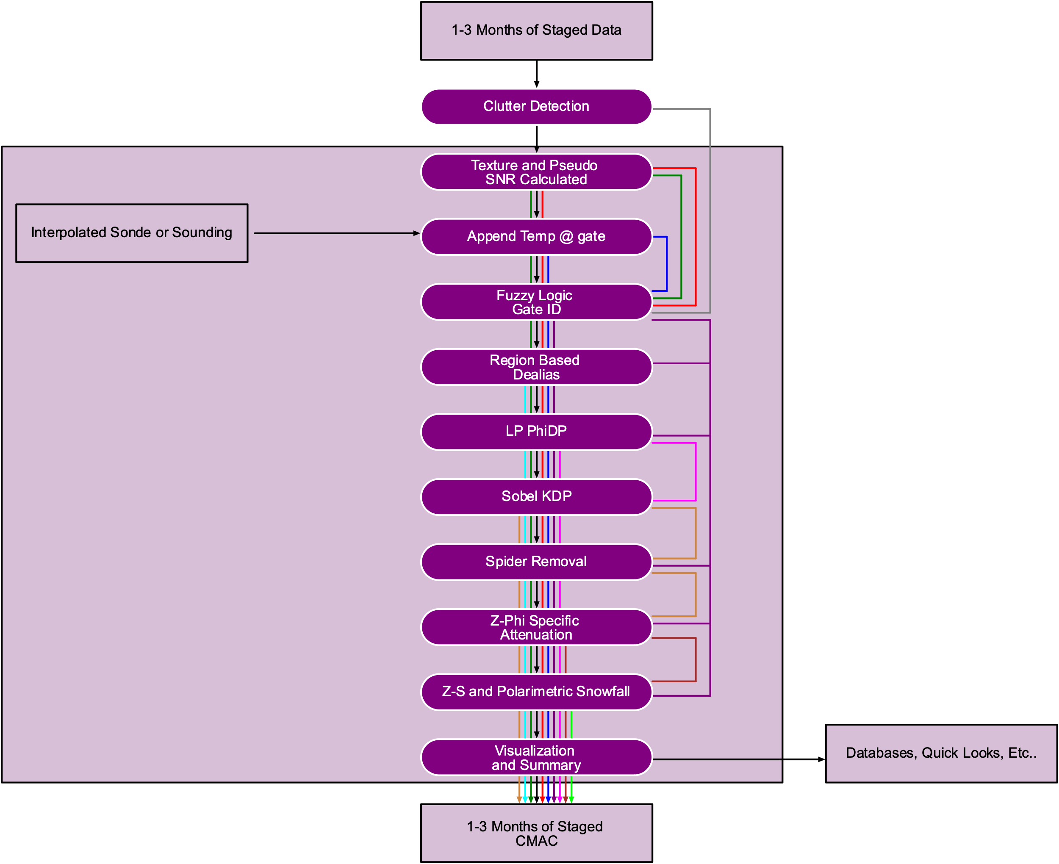
a1 / b1 data
Clutter
Vr Texture
Temp. At Gate
Pseudo SNR
Gate ID
Dealiased VR
Processed PhiDP
Processed KDP
Specific Attenuation
Precipitation Rate (A)

