Slide 1
BattleShip Project

Slide 2
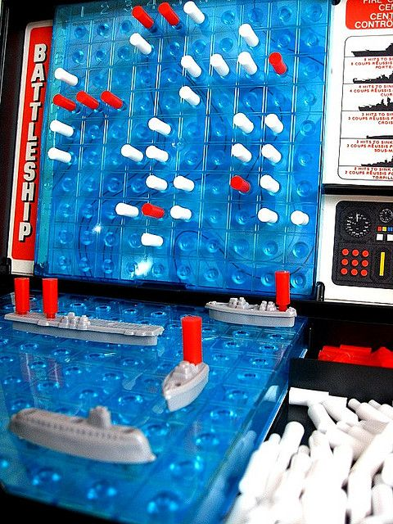
What is BattleShip?
Each player is each player’s board look similar the picture
On the bottom are your ships
Top is where you see all of your hits and misses
Notice it is a grid layout on. What does this remind you of?

Slide 3
How will our BattleShip differ?
An empty board will be filled with #.
Ships will be represented with S.
Hits will be represented with X.
Misses will be represented with O.
How can we achieve this criteria?

Slide 4
Our Grid System
By now we should know that a 2D char array is needed for this project!
Does anyone have any idea how we will prompt the user to choose a certain location?
If we were to use an x and y coordinate system would would represent rows and which would represent columns?

Slide 5
Let’s Play!!!

