Slide 1
Numpy
https://numpy.org/

Slide 2
Brief History
Notes:
NUMERIC & NUM_ARRAY

Slide 3
Let’s Get Motivated

Slide 4
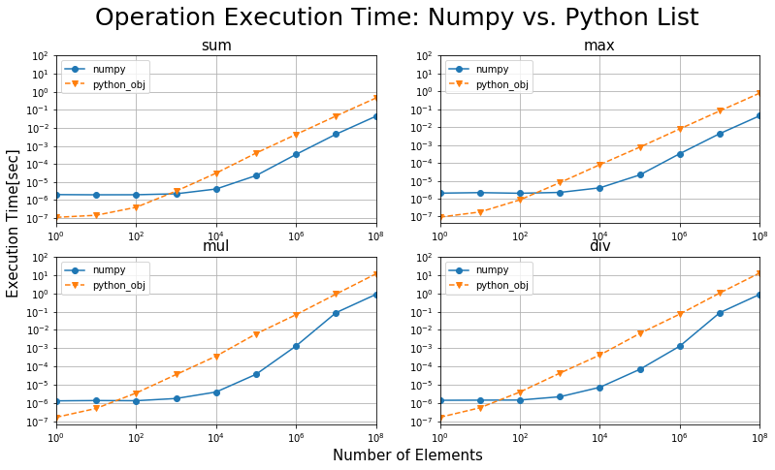
Using: AMD Ryzen 5 1600x with 16GB DDR4 MainMem

Slide 5
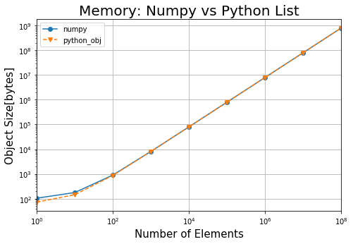
As reported by sys.getsizeof()

Slide 6
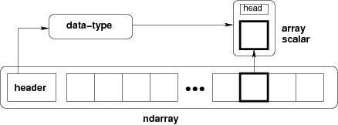
Ndarray Object
Source: https://www.tutorialspoint.com/numpy/numpy_ndarray_object.htm

Slide 7
Playing Around

Slide 8
Use Cases
MATHS
Storing/Manipulating Sparse/Dense Matrices
Linear Algebra
Sorting
Building new packages/protocols
PEP 3118 – Revising the buffer protocol

