Slide 1
EVE Online Forums: The Social Factor
Notes:
This presentation is a brief overview of my group’s final presentation for our Data Analytics class at Stevens Institute of Technology, which covers the basis of how we used our dependent variable to see how players interacted with each other on forums and made predictive models through regression to see how we could increase player retention.
My fellow group members who also contributed to this presentation are Andrew Achyuthuni (Stevens ‘20), Julia Dwight (Stevens ‘22), Philip Miller (Stevens ‘20), and Ryan Wall (Stevens ‘21)

Slide 2
Turning The Initial Sales Pitch Into Something We Can Predict With Regression
Notes:
The game is based on player interaction and group-based problem solving in which communication is an essential factor. A big contribution to the game’s success is attributed to the Eve Online community, which attracts new players and retain existing ones by giving players a reason to become further invested in the game.

Slide 3
Initial Plan
Family & School
How Players Interact
Measures of Game Sociability
Social
Notes:
Initial Plan
The dependent variable was social, which we interpreted as the personal connections and sense of belonging players obtain through playing Eve Online.
We wanted our inputs to be variables that show how players are involved in the Eve Community. They should be variables that represent players talking about their personal lives, social media, connections to other players, and/or giving advice
To mediate this process, we wanted a way to show how comfortable players are in the Eve Community when interacting with one another
Our moderators are things that would get in the way of players getting involved in the community. For instance, a younger player’s biggest commitment would be school, while an older player’s biggest commitment could be their family. We hoped to capture a full proportion of players’ ages

Slide 4
Variables Specified
Netspeak, Informal, Posemo, Affiliation
Family & School
Family, Work
Relig, Money, Leisure, Achieve, Sexual, Health, Body, Bio
Social
Notes:
We picked our variables based on the words listed under the dictionary poster (LIWC2015 Dictionary Poster in the ‘Data For Code’ folder) that explain each of those variables.
We understood the inputs to be variables that came from players talking about personal expericences, not just information that would normally be shared with complete strangers.
We chose Religion, Money, Leisure, Achieve, Sexual, Health, Body, and Bio. All of these have little to do with the game itself. Nonetheless, we think that religion is about personal beliefs, money is about financial details, leisure is about what people do in their free time, achieve is about personal successes, and then Sexual, Health, Body, and Bio are all about various bodily functions, feelings, and/or conditions.

Slide 5
Outcomes From Data Analysis

Slide 6
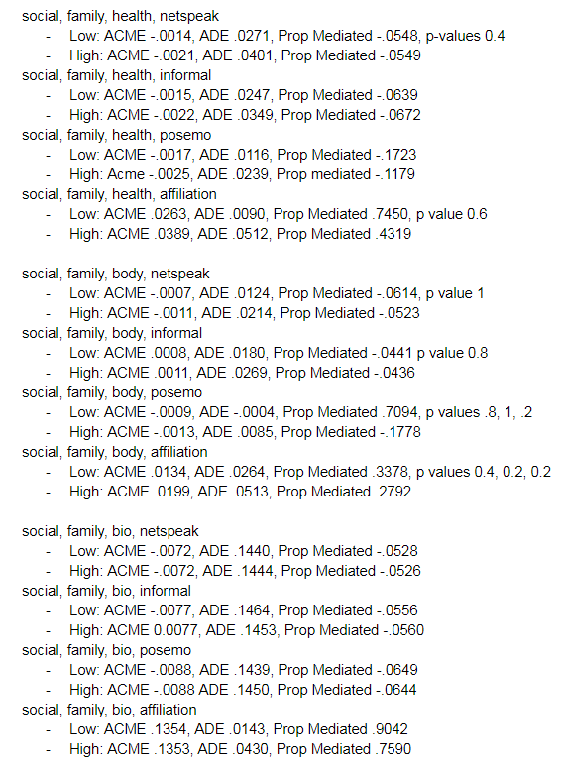
Typical Results
ACME < .01 Std Devs
ADE < .05 Std Devs
Prop Mediated < .1
Consistent Moderation
Notes:
Between high and low moderation, 2 moderators, 4 mediators, and 8 independent variables, we had a total of 128 possible regression models to analyze.
The typical analysis had a low Average Causal Mediation Effects (ACME), which in turn created a low Proportion Mediated. This meant that for most runs, there was little mediation occuring. In addition to that, most runs had little ‘total effect’, meaning that whatever relationship existing between the variables was not strong. One thing that was consistent between runs is that per each set of 4 runs from an input, the moderation would be fairly consistent.

Slide 7
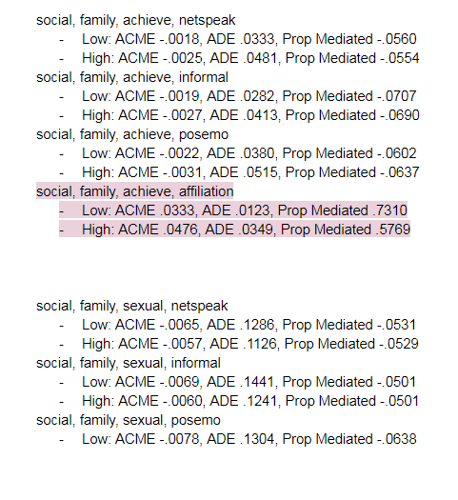
What Stood Out
ACME > .02 Std Devs
ADE < or close to ACME
Prop Mediated > .3
Notes:
Results that stood out to us were those that had higher ACME’s.
Anything above .02 or .03 stood out among the other estimates, but that does not make it a meaningful change. That is comparing 1% of a standard deviation difference to 2% of a standard deviation.
Some of our top ACME results were 10.5% and 42%, so the 42% was the one we wanted to focus on. These both had high mediation proportions of 0.90 and 0.78. We’re going to focus on the results of Leisure as the input, Affiliation as the mediator, and Family as the Moderator since it had the highest total effect and ACME

Slide 8
Conclusions From The Data

Slide 9
What Worked
What Didn’t
Inputs
Leisure, Sexual
Mediators
Affiliation
Moderators
Family
Inputs
Relig, Money, Achieve, Health, Body, Bio
Mediators
Netspeak, Informal, Posemo
Moderators
Work
Notes:
Our best inputs were leisure and sexual, but we needed context as to what they mean for crafting a recommendation.
Sexual on the dictionary poster contains exactly what you would expect it to contain. Leisure pointed to words that related to hobbies, clubs, and entertainment.
Our highest estimate was about 0.4 standard deviations between leisure and social, moderated by family, with about 85% mediation by affiliation. The moderating effect of family on leisure decreases as family increases, which makes sense, since having a family can mean someone has more responsibility and cannot spend as much time doing leisure activities.
Affiliation also contains terms about clubs and teams, coworkers, and how people are related or connected. This makes sense to go with leisure as many leisure activities in the dictionary poster involve sports teams, clubs, and ways players can be affiliated with other people.
What we can draw from this model is that Players talking about their leisure hobbies and clubs has a positive effect on the social interactions that take place in the game, but if the player has a family, that will limit the intensity of the effect as a family would take away from time spent in leisure activities and time spent in game.

Slide 10

The Model
Family
Affiliation
Leisure
Social
Notes:
These are the results from our model with the highest estimates and proportion mediated

Slide 11
Our Recommendation

Slide 12
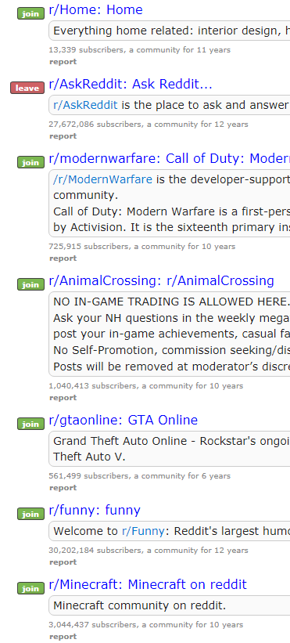

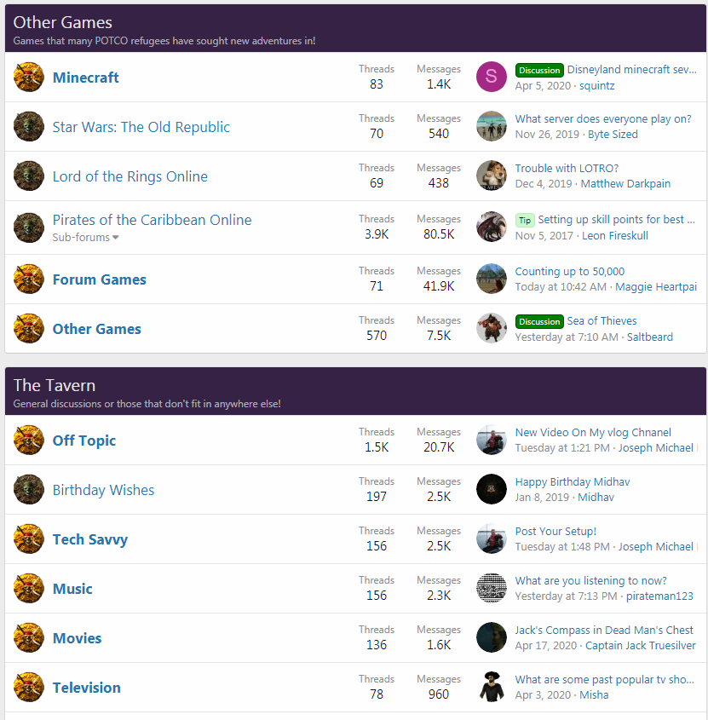
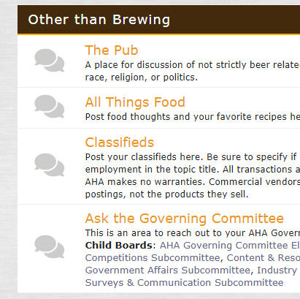
Addition Forum Section Unrelated to EVE
Notes:
Our recommendation for CCP Games would be to create a section on the forums for players to talk about topics that aren’t related to Eve Online.
As of right now, the Eve Online forums don’t currently have a section for topics unrelated to the game, and we have observed that conversations about leisure topics have a strong positive correlation with our outcome variable social when mediated with affiliation. So, when players talk about things that they enjoy outside of the video game on the Eve Forums, we interpret this as an increase or strengthening of the social connection between players.
This is an idea that has already been implemented by other forums that focus around a variety of topics. For instance, one example is a forum for a fan recreation of a Disney video game that has a section to talk about other video games and entertainment. Another example is a forum for brewing alcohol that has a section to talk about non-alcoholic topics. Even websites like Reddit are full of individual forums where users can talk about whatever interests them.
The point we would like to make is that people enjoy talking about their personal interests with others when they already have some sort of connection with them. This is shown with the results of our model and with research on other internet forums.
We hope that giving players this new forum section would create an additional reason for players to be interested in interacting with one another and increase their involvement with the Eve Community. This increase in involvement would then lead to a rise in player retention rates, which would then lead to more revenue for CCP Games.
The best part about this recommendation is that there is no real risk involved in its implementation, since it doesn’t require additional resources (or much effort) to implement.

