Slide 1


Modeling Credit Worthiness
For Individual Loans
Presented by:
Jacob Roelofsz and Jared Pavlik

Slide 2
Purpose
This project aims to predict whether an applicant is a good or bad client, a critical task for improving decision-making in areas like credit assessment and risk management. The absence of predefined labels reflects real-world ambiguity, highlighting the need for data-driven insights.

Slide 3
Questions
What makes an applicant bad vs good?
Did we identify/mitigate potential bias related to demographic information?
What are ethical considerations to take when analyzing this dataset?
Predict if a consumer is a good or bad client to give credit to.
Analyze with fewer features to see if eliminating background “noise”.
Optimize model using elbow curve.

Slide 4
Dataset Features
CODE_GENDER – Applicant Gender
FLAG_OWN_CAR – Own Car? (Y/N)
FLAG_OWN_REALTY – Own House? (Y/N)
CNT_CHILDREN - # of children
AMT_INCOME_TOTAL – Total Income
NAME_INCOME_TYPE – Employment Type
NAME_EDUCATION_TYPE – Education Level
NAME_FAMILY_STATUS – Single/Married
NAME_HOUSING_TYPE – House/Apartment
DAYS_BIRTH – Days since birth
DAYS_EMPLOYED – Length of Employment
FLAG_MOBILE – Own Mobile Phone? (Y/N)
FLAG_WORK_PHONE – Have Work Phone? (Y/N)
FLAG_PHONE – Is There a Phone? (Y/N)
FLAG_EMAIL – Is There an Email? (Y/N)
OCCUPATION_TYPE – Occupation Title
CNT_FAM_MEMBERS – Members in Family
MONTHS_BALANCE – # of Months Carrying Credit

Slide 5
Dataset Target
For our model, we used the STATUS column of our dataset. This column identifies if a user was past due on their debt.
The breakdown of the STATUS column is as follows:
0: 1-29 days past due
1: 30-59 days past due
2: 60-89 days overdue
3: 90-119 days overdue
4: 120-149 days overdue
5: Overdue or bad debts, write-offs for more than 150 days
C: paid off that month
X: No loan for the month
We then mapped out a target column using this column to determine if the applicant was “good” (did not carry debt) or if the applicant was ”bad” (did carry debt).

Slide 6

Model Accuracy
Overall, we were able to train 5 models during our time constraints. Each iteration attempted to optimized the model in some way to increase accuracy.
Our 4th model performed the best with 71% accuracy. The model also recorded a loss of 55%. We saved all of our models, with our best performing being our final model.

Slide 7
Attempted Optimizations
Time constraints led us to focus on manual layer manipulation for optimization.
Keras tuning was ruled out due to dataset size and time requirements.
Optimization methods used:
Kernel Regularization: Penalizes large weights to encourage simpler patterns.
Dropout: Randomly drops neurons during training to prevent overfitting and improve generalization.

Slide 8

Final Model Accuracy
Our final model’s overall accuracy is 71%, with a loss of 55%.
71% accuracy means the model correctly identifies whether a loan applicant is high-risk or low-risk 71% of the time.
A 55% loss suggests that there is still a considerable error in the model's predictions. For risk assessment, this means the model is making mistakes in assessing the risk level of applicants, which could lead to incorrect identification.

Slide 9
0: 1-29 days past due
1: 30-59 days past due
2: 60-89 days overdue
3: 90-119 days overdue
4: 120-149 days overdue
5: Overdue or bad debts, write-offs for more than 150 days
C: paid off that month
X: No loan for the month

Slide 10
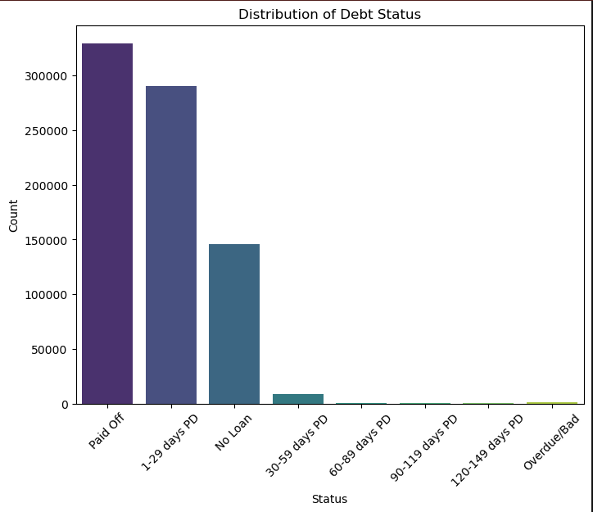

Slide 11
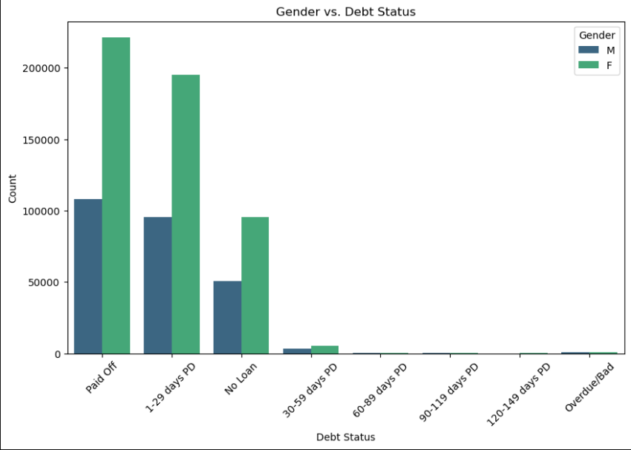

Slide 12
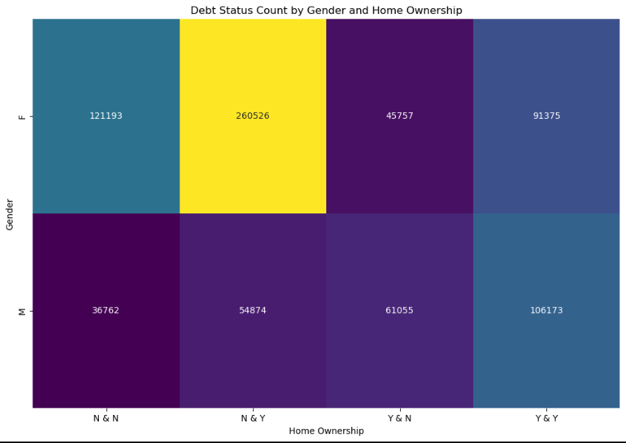

Slide 13
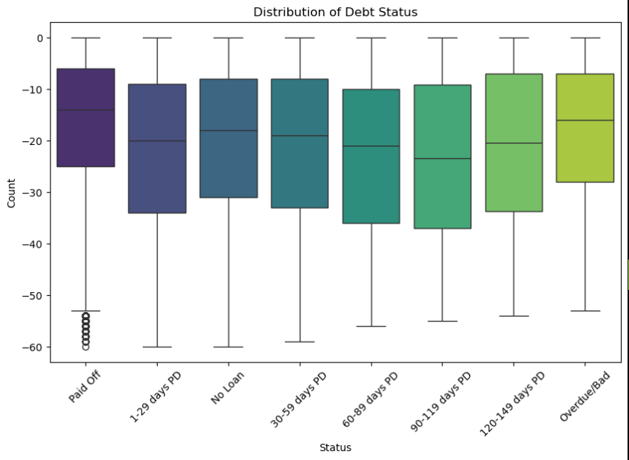

Slide 14
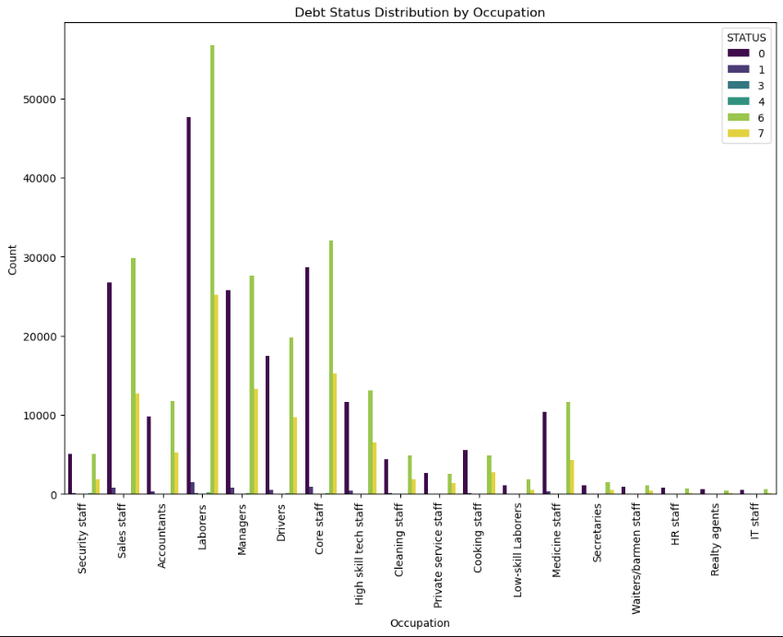

Slide 15
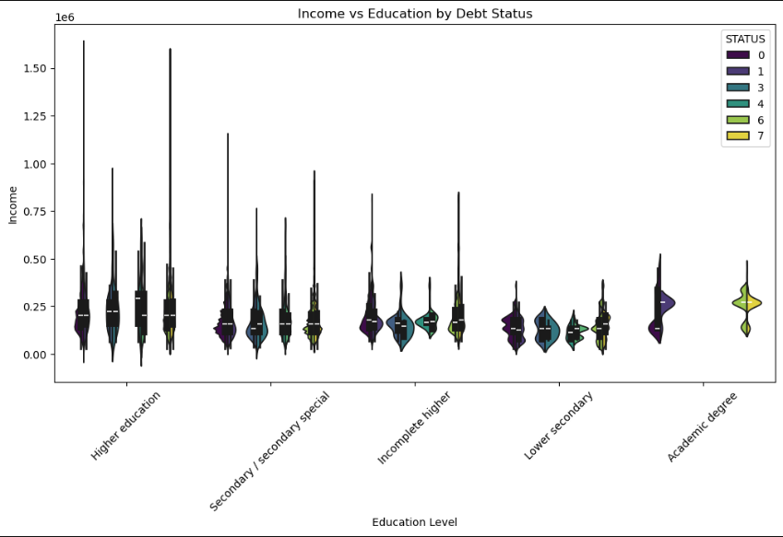

Slide 16
Problems to Overcome
Our first run we had a 100% test. This felt great, but worrisome. We found that we were declaring our “Status” incorrectly. Upon fixing this, we pulled the 61, 65, 70 percent respectfully.
We also worked with the columns to see if that changed out results, or how the weights changed. Ultimately the model was running through all data to get the most accurate percentage. For example, when removing gender there was only about a 3% change in predictability.

Slide 17
Thank you for your time!

