Slide 1
Model Evaluation
Data Science for Biomedical Informatics (BMIN503/EPID600)
Blanca E. Himes, Ph.D.
10/2/18

Slide 2

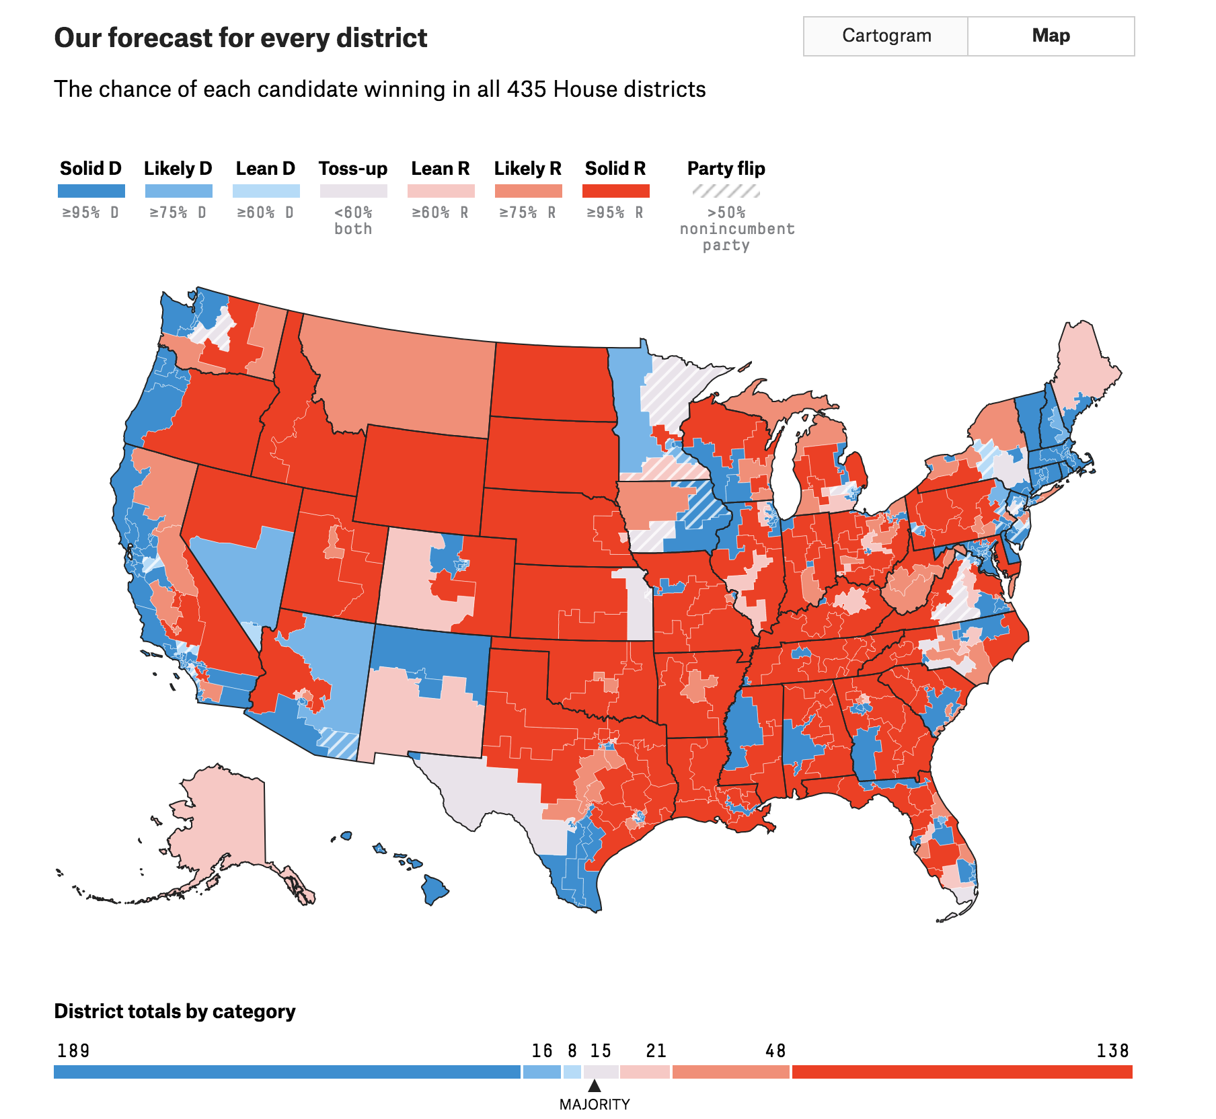
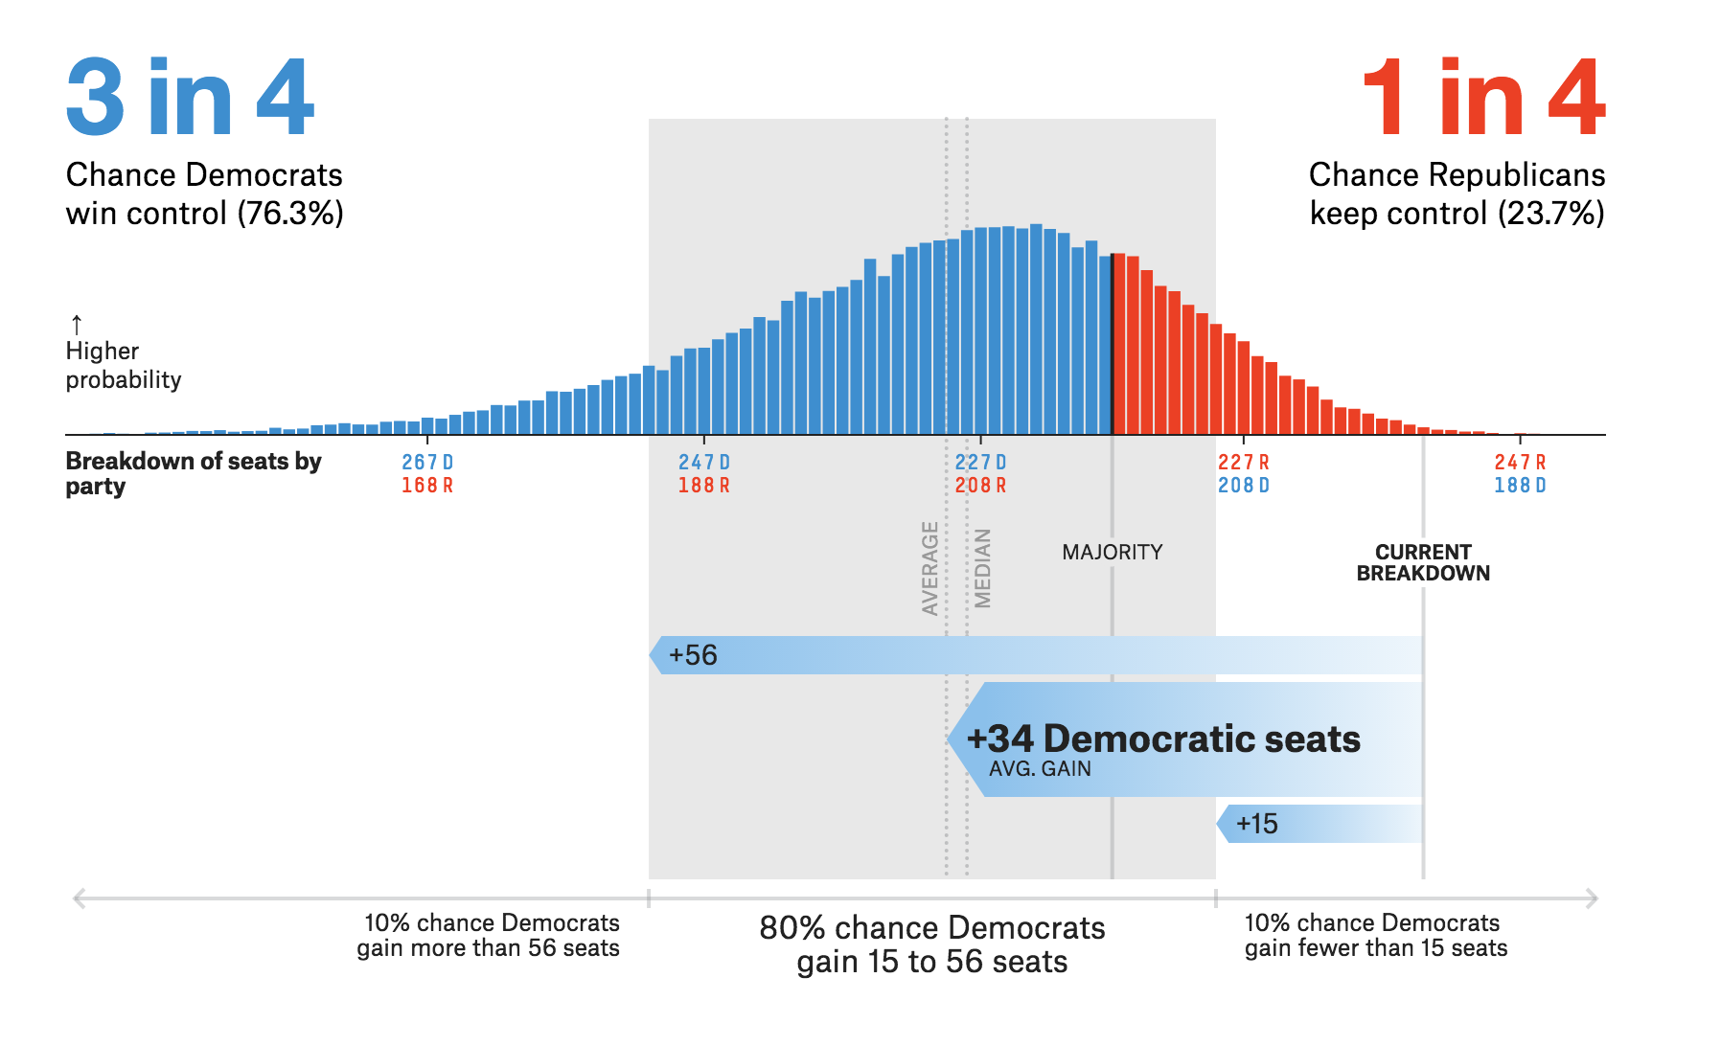
Predictive Analysis
http://fivethirtyeight.com
Notes:
Nate Silver’s book: Signal and The Noise

Slide 3

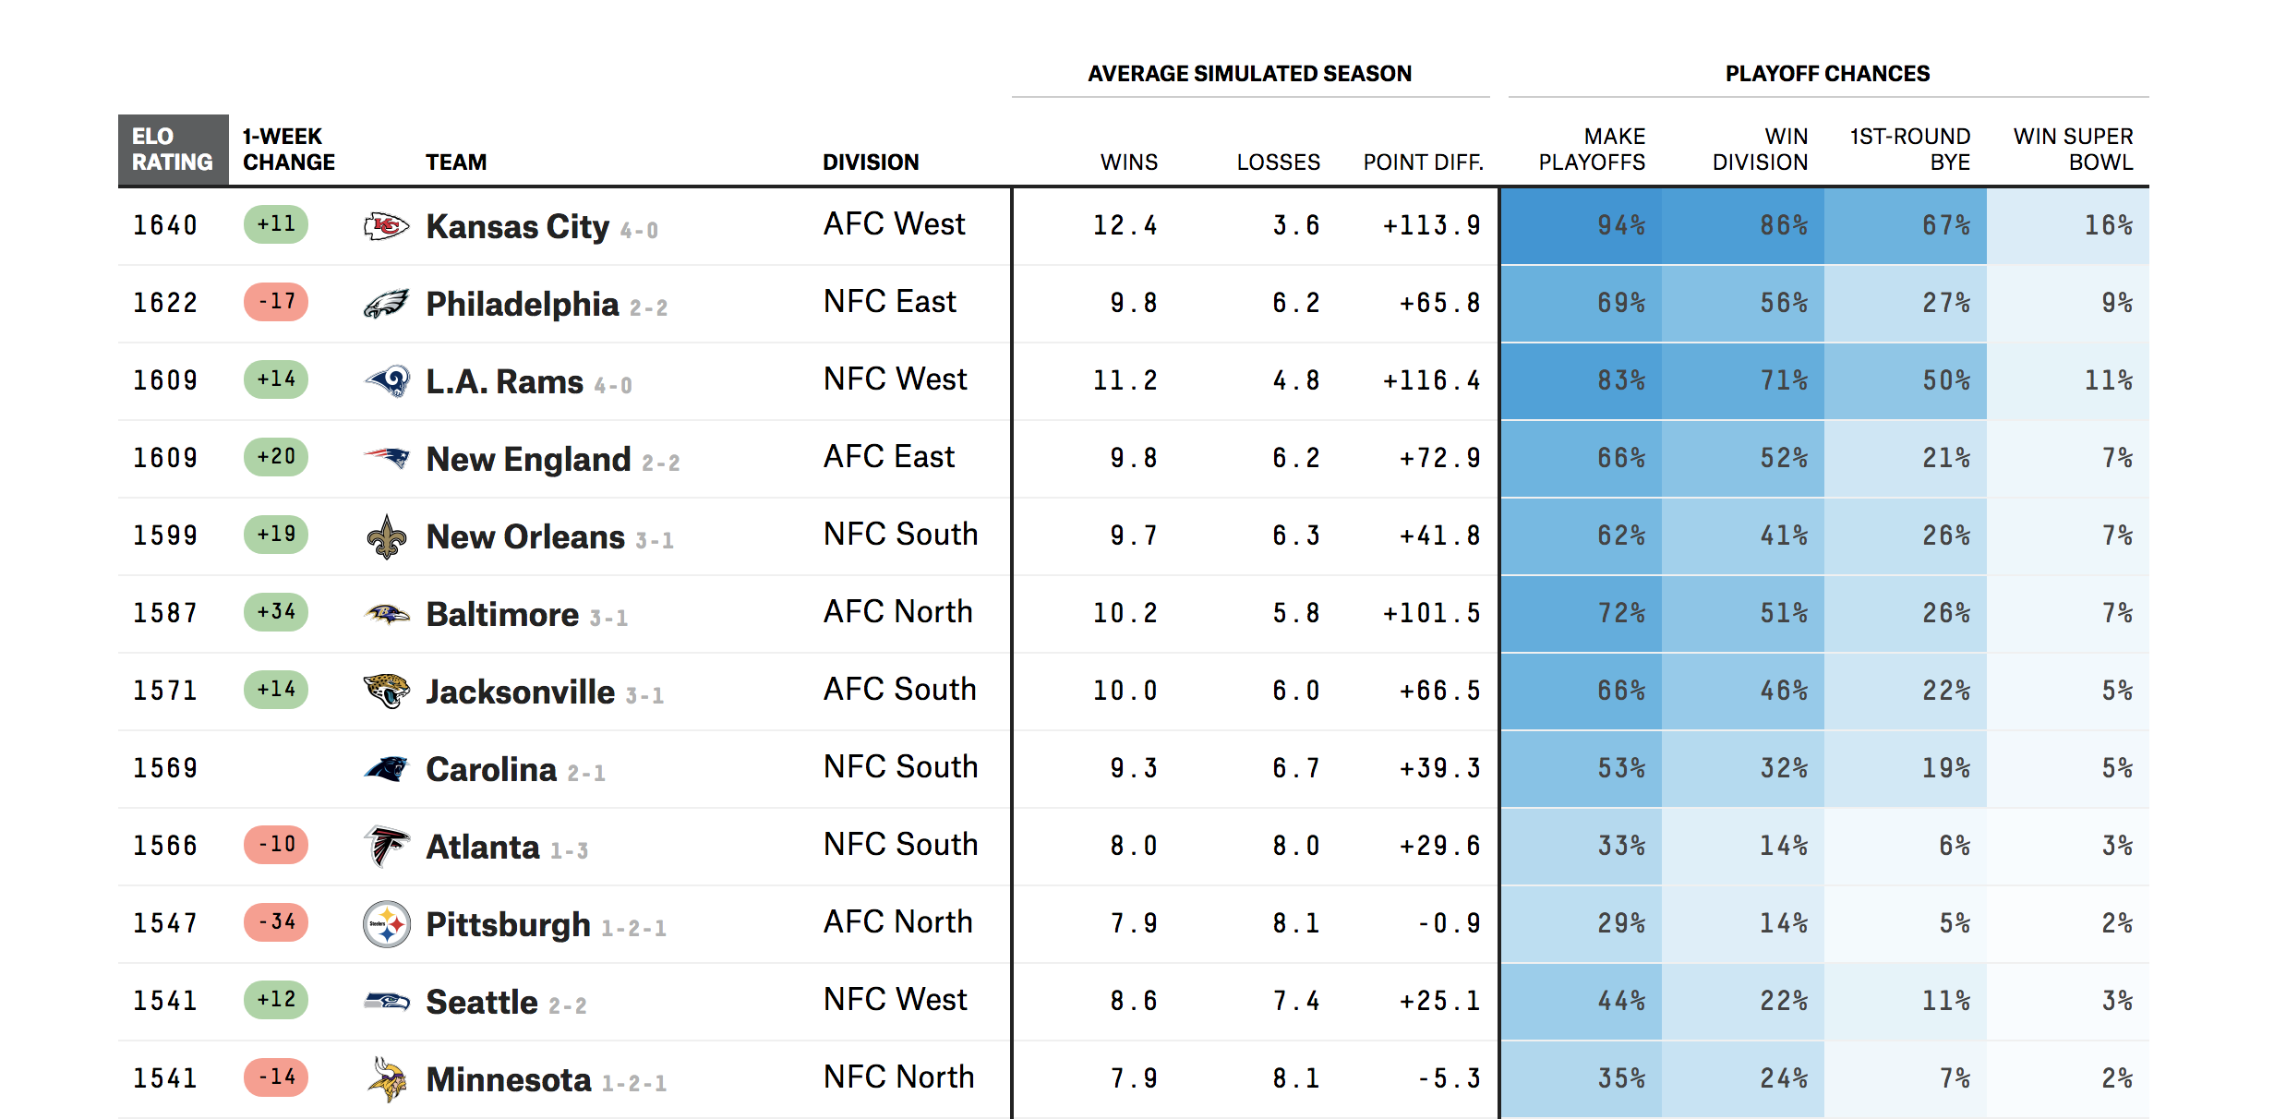
Predictive Analysis
http://fivethirtyeight.com

Slide 4
Predictive Analysis in Medicine
Who has a disease?
Who will get a disease?
Who will respond to a drug?
Who will have a poor outcome after a procedure?
Among those with a disease, who will survive?

Slide 5
Considerations for a Predictive Model
What do you want your predictive model to do?
Predict independent cases
Identify the variables that best predict the outcome
Assess quality of prediction

Slide 6
Feature Selection
Refers to filtering of variables before building a predictive model
Algorithms may be able to handle “a lot” of variables, but selecting important ones is advantageous:
Less likely to introduce “noise” by having irrelevant variables, and hence, better models made with less chance of overfitting
Model building proceeds more quickly
Models are easier to interpret

Slide 7
Potential Methods for Feature Selection
Filter variables to be “independent” or use a technique for dimensionality reduction
Filter variables based on a univariate statistic or score
Some techniques will select features as a model is built
Stepwise regression
Least absolute shrinkage and selection operator (LASSO)

Slide 8
Measures of Predictive Goodness
Perform a test on N individuals and classify as having a positive or negative result
Confusion matrix helps evaluate the test
Disease
+
-
True Positives (TP) | False Positives (FP)
False Negatives (FN) | True Negatives (TN)
+
Positive Predictive Value (PPV)=
TP/(All with Test +)
Test
-
False Discovery Rate (FDR)=
FP/(All with Test +)
Sensitivity = True Positive Rate (TPR) = TP/(All disease +)
Accuracy = (TP+TN)/N
Specificity = True Negative Rate (TNR) = TN/(All disease -)
False Positive Rate (FPR) = FP/(All disease -)

Slide 9
Model Predictive Accuracy
Training error
Test predictive accuracy using same data used to train model
Relatively easy to have overfit model
Test error
Ideally, test predictive accuracy on an independent sample
Sometimes this is not possible -> use cross-validation to avoid overfitting

Slide 10
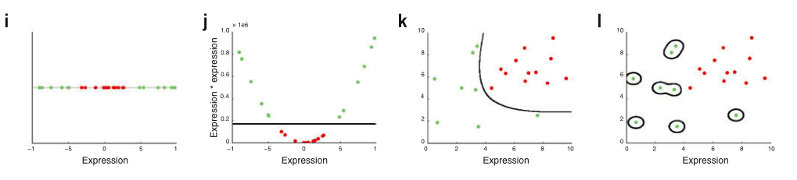
Overfitting
Problem when using large number of variables and few samples
Model seems correct because training set classified properly, but when used with independent data, model performs poorly
One reason simpler models are preferred
Example: kernel choice with SVMs.
Will always be able to separate data with a kernel function
Nobel WS, Nat Biotech (2006)

Slide 11
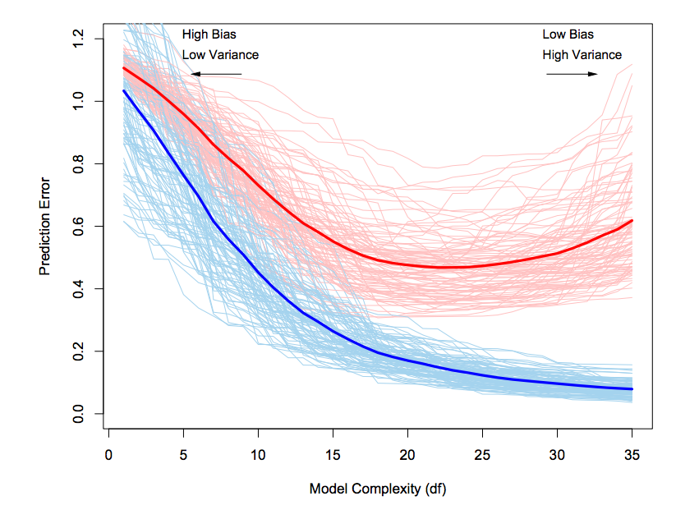
Training vs. Test Error
Test Sample
Training Sample
Hastie, Tibshirani, Friedman. The Elements of Statistical Learning (2009)

Slide 12
Cross-Validation
Widely used to select model parameters and test model error
General idea:
split data into groups
use a portion for creating model
use the rest for testing model
combine results obtained for each test
K-fold: Split data into K randomly selected sub-samples and use one portion for testing and K-1 for model training
Leave-one-out: Keep single observations out while using remaining data for training

Slide 13
K-Fold Cross-Validation
For K=10:
Data
Split into 10 groups
Train with 9, test with 1
Train with 9, test with 1
Train with 9, test with 1
.
.
.
.
.
.
Train with 9, test with 1

Slide 14
Prediction Error with Cross-Validation
Get weighted average of error in each fold
Be sure to implement cross-validation with a full dataset
CV error estimate would not reflect full dataset if performed using variables screened in advance
Σ
n_{k}
=
n
(ratio of misclassified in fold k)
_{k}

Slide 15
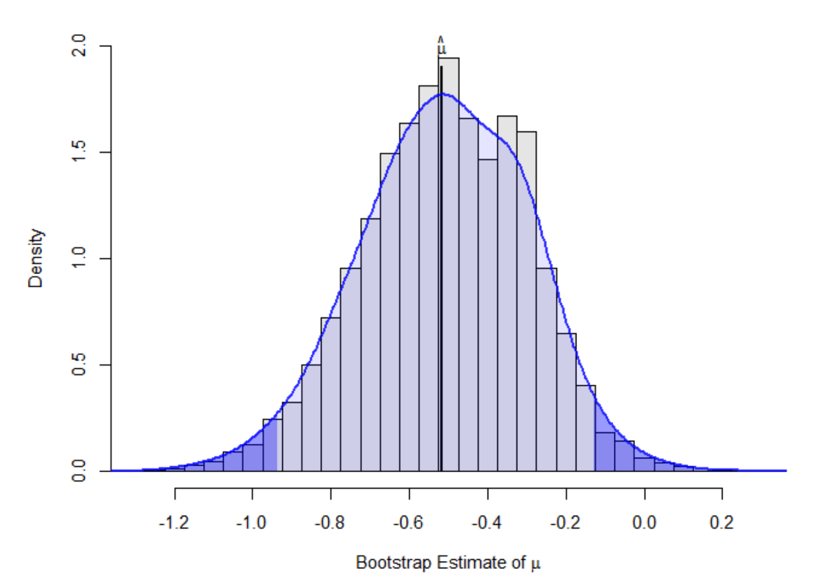
Bootstrap
Used to quantify uncertainty associated with model
Standard error
Confidence interval for coefficient
Obtain many datasets of the same size as original by sampling with replacement
Obtain statistics of interest and look at their distribution to estimate variability
Notes:
Figure from: http://www.metafor-project.org/doku.php/tips:bootstrapping_with_ma

Slide 16
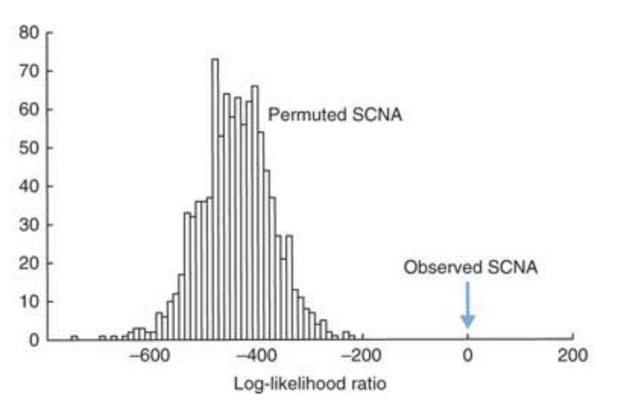
Permutation Testing
Used to get an empirical distribution of results expected which is then used to get false-discovery rate estimate of results observed with actual dataset
Randomly permute outcome variable of dataset many times
Obtain statistics of interest for each permuted dataset and look at their distribution to estimate likelihood of obtaining actual result
Notes:
Figure from http://www.nature.com/nbt/journal/v29/n12/fig_tab/nbt.2049_F4.html

Slide 17
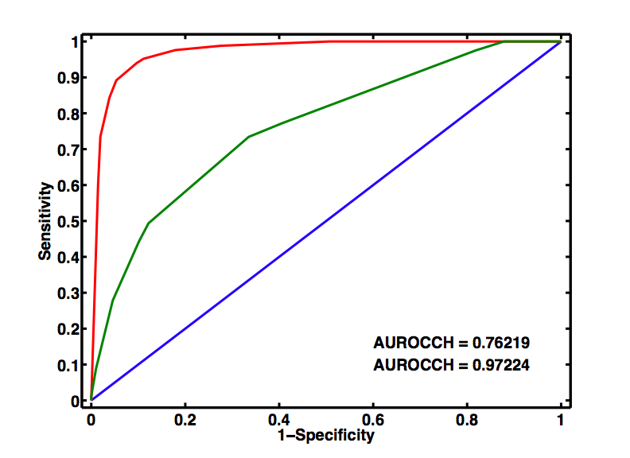
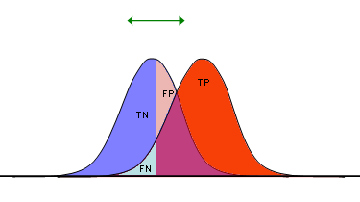
Receiver-Operating Characteristic (ROC)
Useful to evaluate predictive ability of a two-outcome test
Plots relationship between true positive and false positive rates over all thresholds that could distinguish the outcomes
ROC
Sensitivity (True Positive Rate)
1-Specificity (False Positive Rate)
Notes:
Figure on right from: https://en.wikipedia.org/wiki/Receiver_operating_characteristic#/media/File:Receiver_Operating_Characteristic.png

Slide 18
Area Under the ROC Curve (AUC)
An overall measure to evaluate an ROC
Interpretation: what is the probability that a classifier will rank a more positive instance than a more negative one?
=0.5 no predictive ability (as good as chance)
=1.0 perfect predictive ability (can distinguish two outcomes regardless of test threshold)

Slide 19
ROC Curves
Sensitivity (True Positive Rate)
AUC
0.97
0.74
Model 1
Model 2
1-Specificity (False Positive Rate)

Slide 20
Machine Learning Approaches
Supervised
Unsupervised
Outcome known
Performance: best model at predicting outcome
Model fit measures straightforward
Not sure what patterns may arise, looking for similar groups based on variable measures
Not clear how to measure performance
Can use to select predictors for a supervised approach

Slide 21
Machine Learning Approaches
Supervised
Unsupervised
Support Vector Machines
Decision Trees
Random Forests
Neural Networks
Bayesian Networks
Clustering
Hierarchical
K-means
Principal Component Analysis (PCA)
t-distributed stochastic neighbor embedding (tSNE)

Slide 22
PRACTICUM 10
Go to course CANVAS page (https://canvas.upenn.edu)
Under “Files” download “10_model_evaluation.html” and “10_model_evaluation.Rmd”

