Slide 1
R Programming Basics
Data Science for Biomedical Informatics (BMIN503/EPID600)
Blanca E. Himes, Ph.D.
9/4/18

Slide 2
Review of Previous Lectures
Installed programs, including R and RStudio
Can use R both interactively and for tool development
Reports that aid in reproducible research can be created easily
GitHub repositories can store sets of files that are associated with a project and help with:
Version control
Sharing of project
Large and active community of users and developers use R and GitHub

Slide 3
R Data Types (i.e. Classes)
Character
Numeric
Integer
Complex
Logical

Slide 4
R Data Structures
Vectors
1D, elements of one class
Lists
1D, elements can be of different classes
Factors
1D, elements represent categorical data with underlying numerical format in R
Matrices
2D, elements of one class
Data Frames
2D, elements can be of different classes

Slide 5
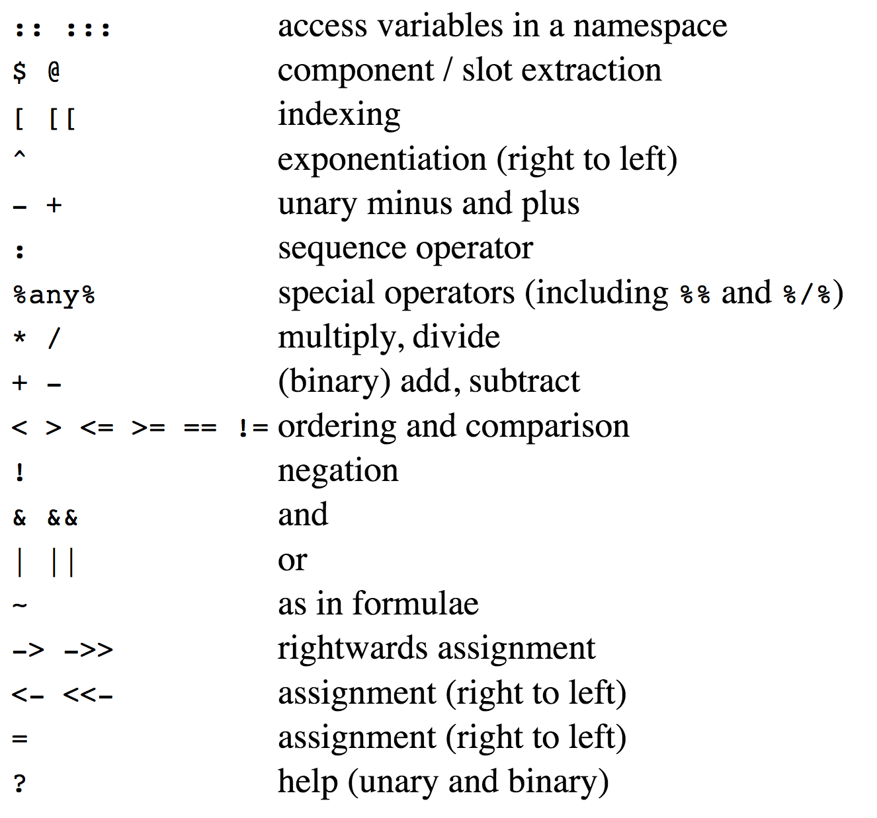
Basic Operators
https://stat.ethz.ch/R-manual/R-devel/library/base/html/Syntax.html

Slide 6
Missingness
Denoted as “NA”
Helpful function to test for missingness: is.na()

Slide 7
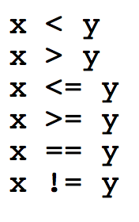
IF Statements
Conditional expressions where actions are taken dependent on conditions being TRUE or FALSE
Relational Operators:
https://stat.ethz.ch/R-manual/R-devel/library/base/html/Comparison.html

Slide 8
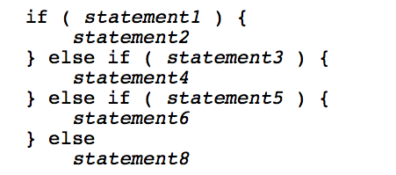
IF Statements
Conditional expressions where actions are taken dependent on conditions being TRUE or FALSE
Relational Operators:
Syntax:
https://cran.r-project.org/doc/manuals/R-lang.html#if

Slide 9

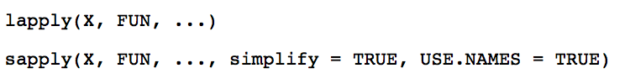

FOR Loops
Useful to repeat an operation several times
Syntax:
R has built-in functions that are useful to repeat operations over lists or columns/rows of a matrix
https://cran.r-project.org/doc/manuals/R-lang.html

Slide 10
Practicum 3
Go to course CANVAS page (https://canvas.upenn.edu)
Under “Files” download “3_R_basics.html” and 3_R_basics.Rmd”

