Slide 1
R Programming Basics II
Data Science for Biomedical Informatics (BMIN503/EPID600)
Blanca E. Himes, Ph.D.
9/6/18

Slide 2
Review: R Markdown
Structured file for reproducible research (.Rmd extension)
In addition to chunks of R code, can display text, tables, figures
R code can be tested within document as it is written in RStudio
When performing an analysis task, no matter how simple, save executed commands into an Rmd (or R) file
To get better at programming, practice on your own first, then seek help and compare your code to others’

Slide 3
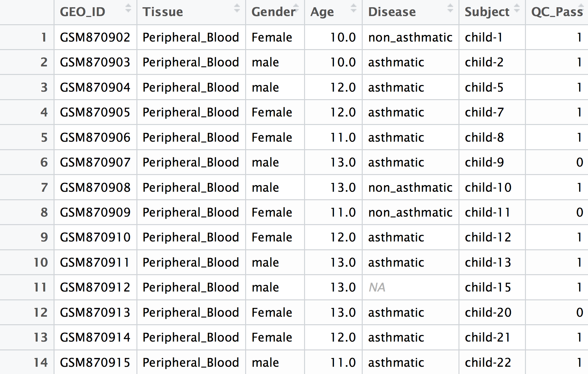
Review: Data Frame
2D data structure in R, commonly used for data analysis
Columns contain values of a variable (each is a vector)
Each row corresponds to an observation

Slide 4
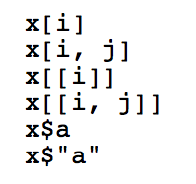
Subsetting
We often want to extract portions of data frames or other objects
Indexing operators are used for that purpose:
[] extract ranges
[[]] extract single entries
$ extracts entries by name
https://cran.r-project.org/doc/manuals/R-lang.html#Indexing
https://cran.r-project.org/doc/manuals/R-lang.html#Operators

Slide 5
Subsetting
We often want to extract portions of data frames or other objects
Indexing operators are used for that purpose:
Another helpful operator is:
https://cran.r-project.org/doc/manuals/R-lang.html#Indexing
https://cran.r-project.org/doc/manuals/R-lang.html#Operators

Slide 6

Functions
Major reason to use computer programs = repetitive tasks can be performed easily
Function: a unit of instructions that can be re-used to perform an operation or task
Syntax in R:

Slide 7
Functions
Can be used anonymously within code
or
Can define a variable to be a function
sapply(my.vector, function(x) { a*x + b })
f <- function(x) { a*x + b }
sapply(my.vector, f)

Slide 8
Scoping
When functions and variables are defined, their visibility is based on the place where they were defined and the rules of the language
Scope refers to the portions of a computer program where a variable binding is valid
Global environment
a <- 0
b <- 1

Slide 9
Scoping
When functions and variables are defined, their visibility is based on the place where they were defined and the rules of the language.
Scope refers to the portions of a computer program where a variable binding is valid
Global environment
a <- 0
f <- function(x) { a*x + b }
b <- 1

Slide 10
Scoping
When functions and variables are defined, their visibility is based on the place where they were defined and the rules of the language.
Scope refers to the portions of a computer program where a variable binding is valid
Global environment
Local environment of f
a <- 0
f <- function(x) { a*x + b }
b <- 1

Slide 11
Scoping
When functions and variables are defined, their visibility is based on the place where they were defined and the rules of the language.
Scope refers to the portions of a computer program where a variable binding is valid
Global environment
Local environment of f
a <- 0
f <- function(x) { a*x + b }
b <- 1
f(2) will have value 1

Slide 12
Scoping
When functions and variables are defined, their visibility is based on the place where they were defined and the rules of the language.
Scope refers to the portions of a computer program where a variable binding is valid
Global environment
Local environment of f
a <- 0
f <- function(x) { a*x + b }
b <- 1
Local environment of g
g <- function(x) {
a <- 1
b <- 2
f(x)
}

Slide 13
What is the Value of g(2)?
Global environment
Local environment of f
a <- 0
f <- function(x) { a*x + b }
b <- 1
Local environment of g
g <- function(x) {
a <- 1
b <- 2
f(x)
}
g(2) = 0*(2) + 1
OR
g(2) = 1*(2) + 2

Slide 14
Depends on Whether Static vs. Dynamic Scoping is Used
Static scoping: unbound variable values looked for in environment where object defined
Dynamic scoping: unbound variables are looked for in the environment used first then moving outward
Global environment
Local environment of f
a <- 0
f <- function(x) { a*x + b }
b <- 1
Local environment of g
g <- function(x) {
a <- 1
b <- 2
f(x)
}

Slide 15
R Uses Static Scoping
g(2) = 0*2+1 = 1
Global environment
Local environment of f
a <- 0
f <- function(x) { a*x + b }
b <- 1
Local environment of g
g <- function(x) {
a <- 1
b <- 2
f(x)
}

Slide 16
Practicum 4
Go to course CANVAS page (https://canvas.upenn.edu)
Under “Files” download “4_R_basics_2.html” and 4_R_basics_2.Rmd”

