Slide 1
Cleaning and Transforming Data
Data Science for Biomedical Informatics (BMIN503/EPID600)
Blanca E. Himes, Ph.D.
9/13/18

Slide 2
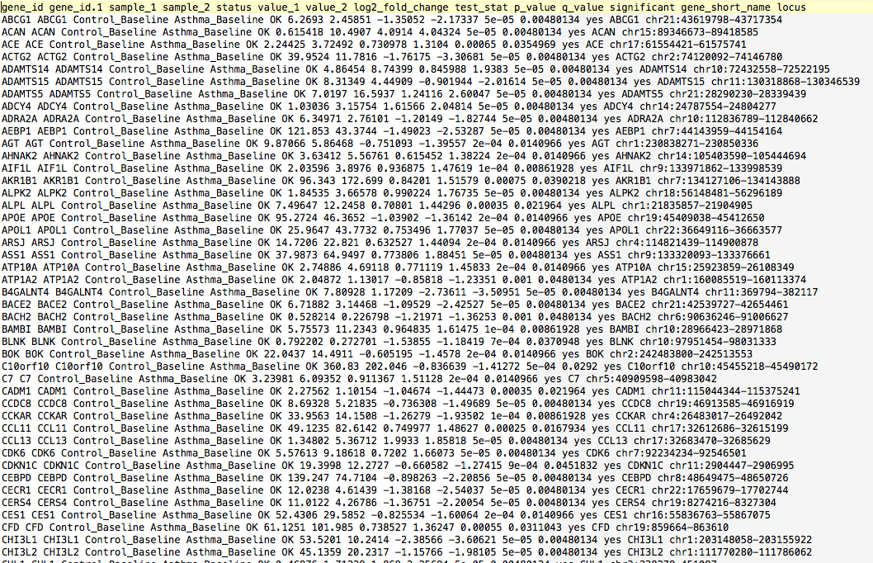
Cleaning Data
Raw data, as originally collected or received, is hardly ever the version that you will use for analysis
Getting to know raw data takes a substantial amount of time

Slide 3
Exploratory Data Analysis
The process of getting to know a dataset, including gathering some basic statistics
Important to do this thoroughly prior to addressing the question you had in mind
Look for patterns/strange values:
May lead to new hypotheses beyond those originally posed
May reflect errors, bias, artifacts
Decide what variables to use, which to recode, and new ones to create

Slide 4
Variable Name Choices
Be consistent with case
Use descriptive labels
No duplicates
No special characters (“.”, “_”,” “)
In R: cannot start with a number
an “X” will be inserted at the front if loading in from file

Slide 5
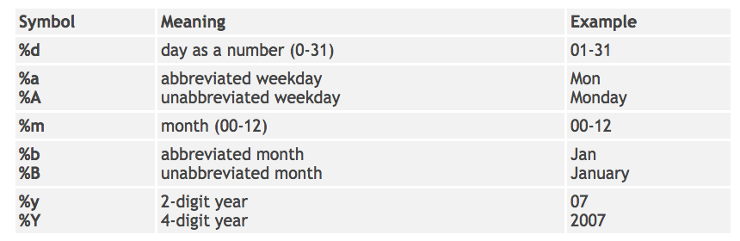
Dates in R
The Sys.Date() function returns an object of class Date
Characters can be converted to dates using as.Date() along with a format specification
A Date object can be formatted in various ways using the format() function
http://www.statmethods.net/input/dates.html

Slide 6
Analysis of Text Data
Sometimes we need to re-format and analyze text
Some useful R commands:
Regular expressions
Language “equations” useful to find matches in a body of text
paste() – joins strings together
gsub() – substitutes characters in an expression
grep() – regular expression matching

Slide 7
Regular Expressions
Used in many programming languages, including grep at the Unix command line
Combine literals with metacharacters to represent portions of text
. = any instance of a character
^ = start of line
$ = end of line
[ ] = to denote set of characters that are to be matched, including ranges:
[0-9] = numbers
[a-zA-Z] = letters
Use of ^ within [] indicates negation of characters [^a-z] means not a letter a-z
| = denotes “or” between alternatives
? = optional expression
\ = escaping of metacharacter

Slide 8
More Metacharacters
* = any number, including none, of the item (will find longest possible match)
+ = at least one of the item
{ } = contain range denoting min and max number of matches of an expression
{m,n} at least m but not more than n
{m} exactly m matches
{m,} at least m matches

Slide 9
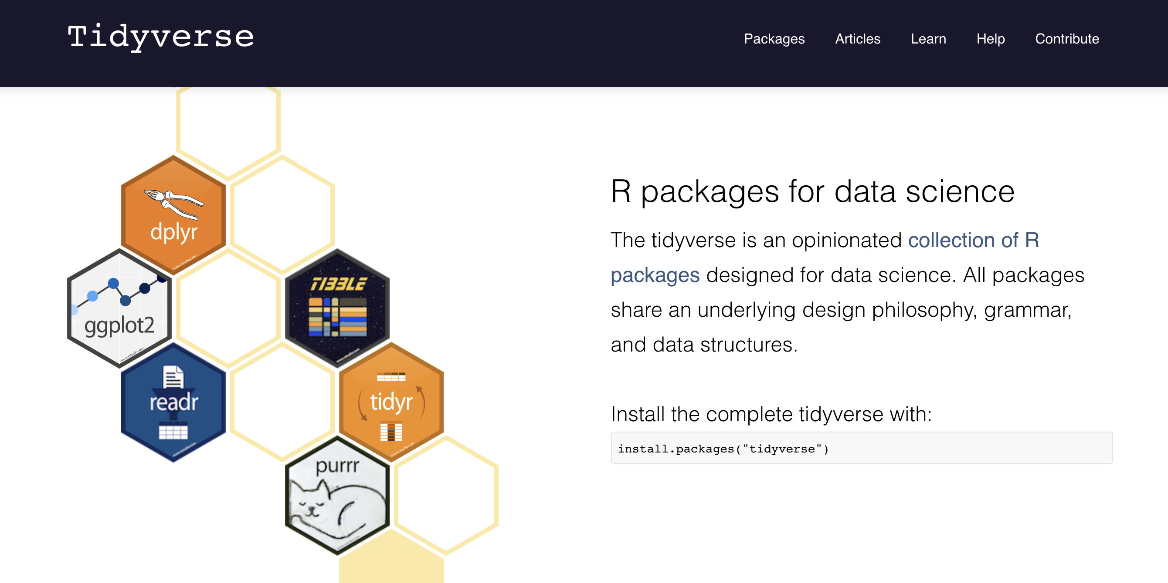
https://www.tidyverse.org

Slide 10
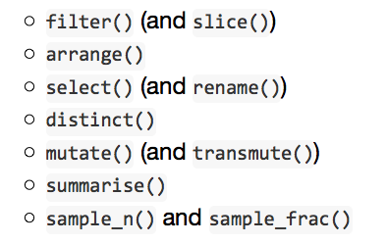
Data Frame Manipulation with dplyr
dplyr: R package designed to make data manipulation faster and more intuitive than using built-in R functions
Based on verbs:
new.data.frame <- command(data.frame, expression)

Slide 11
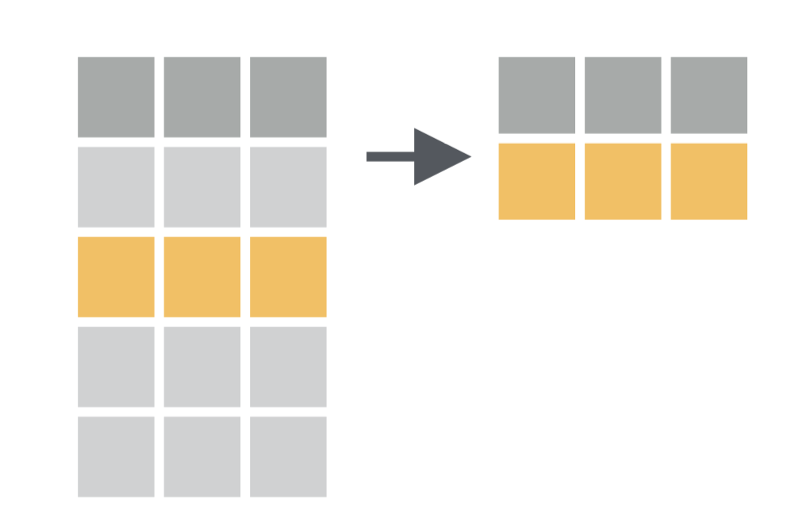
filter( )
Select a subset of rows in a data frame that meet given criteria using variables in the data frame.
filter(data, condition)
https://www.rstudio.com/wp-content/uploads/2015/02/data-wrangling-cheatsheet.pdf

Slide 12
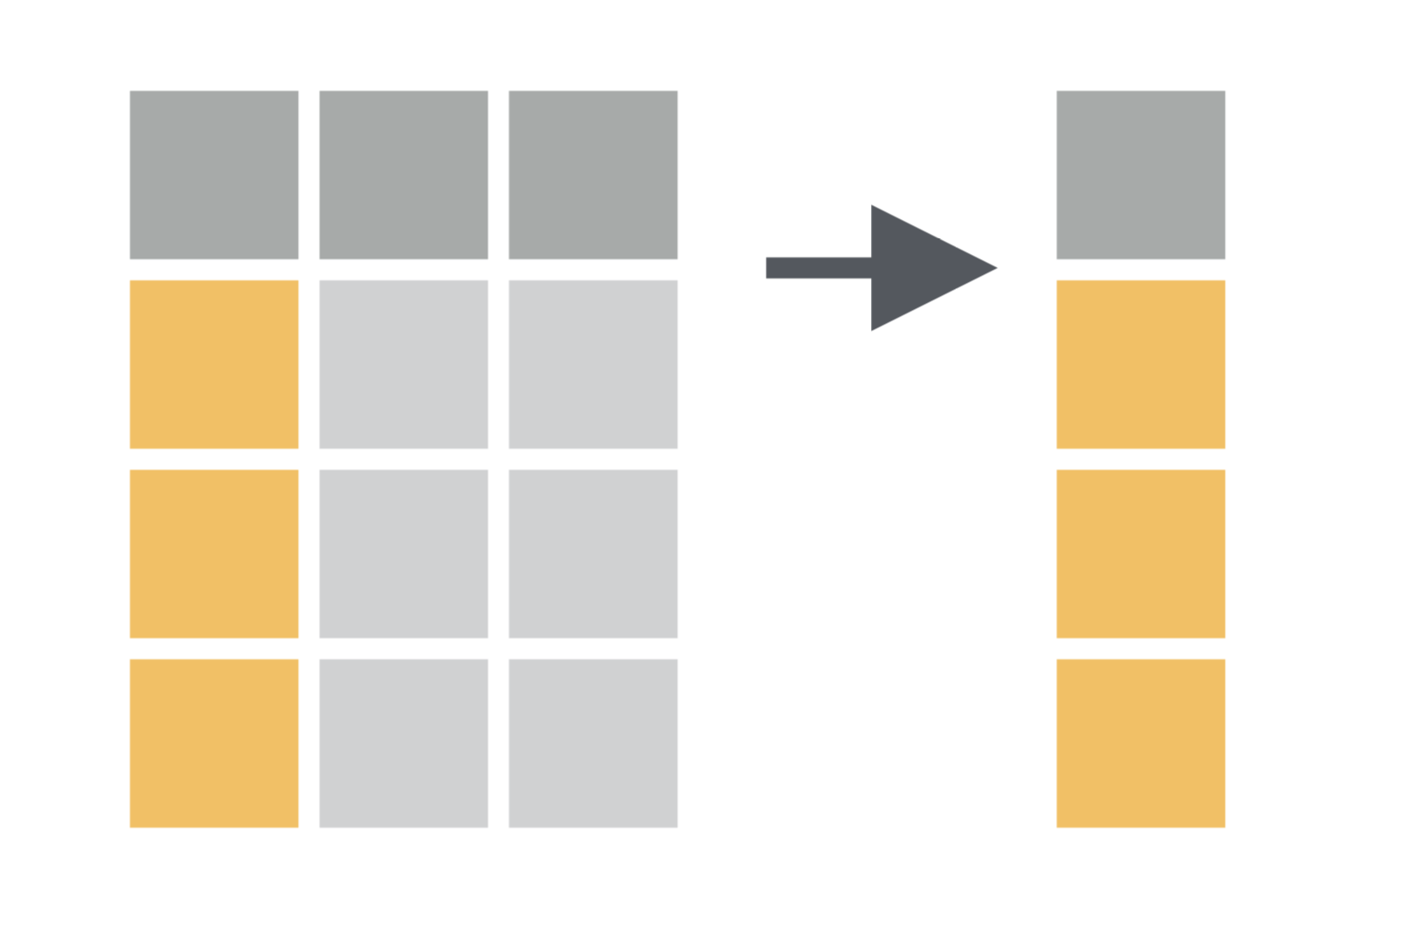
select( )
Select a subset of columns in a data frame according to column names (i.e., variables).
select(data, column names)
https://www.rstudio.com/wp-content/uploads/2015/02/data-wrangling-cheatsheet.pdf

Slide 13
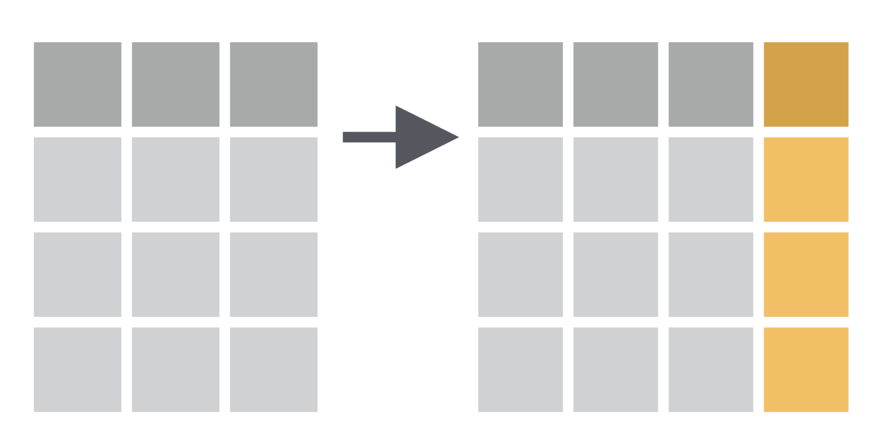
mutate( )
Creates new columns in a data frame, usually via a formula.
mutate(data, new.column=formula)
https://www.rstudio.com/wp-content/uploads/2015/02/data-wrangling-cheatsheet.pdf

Slide 14
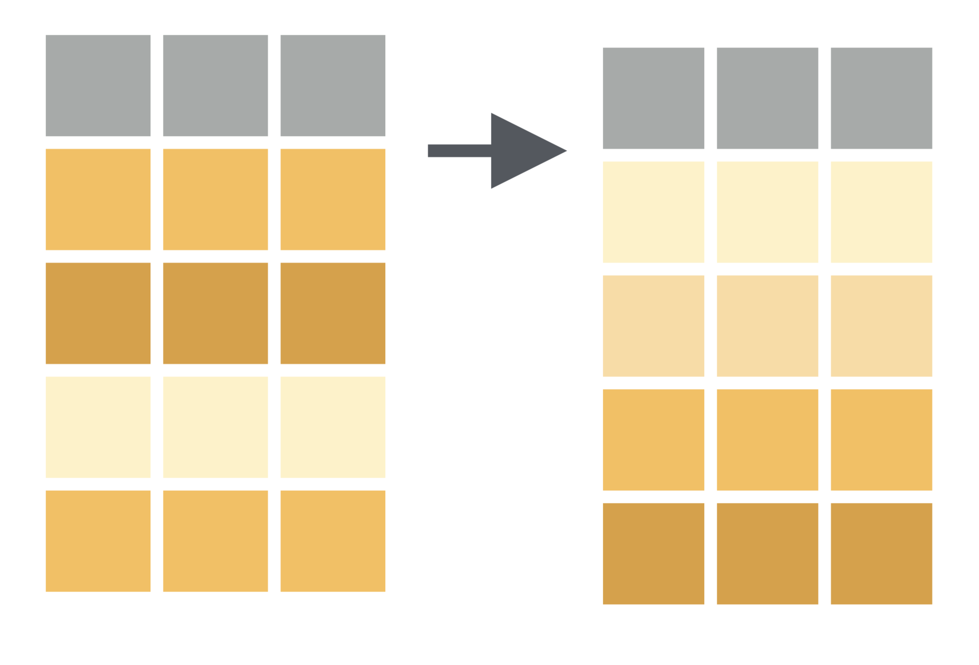
arrange( )
Orders rows in a data frame according to values a column.
Low-to-high is default. Use desc() for high-to-low
arrange(data, column)
https://www.rstudio.com/wp-content/uploads/2015/02/data-wrangling-cheatsheet.pdf

Slide 15
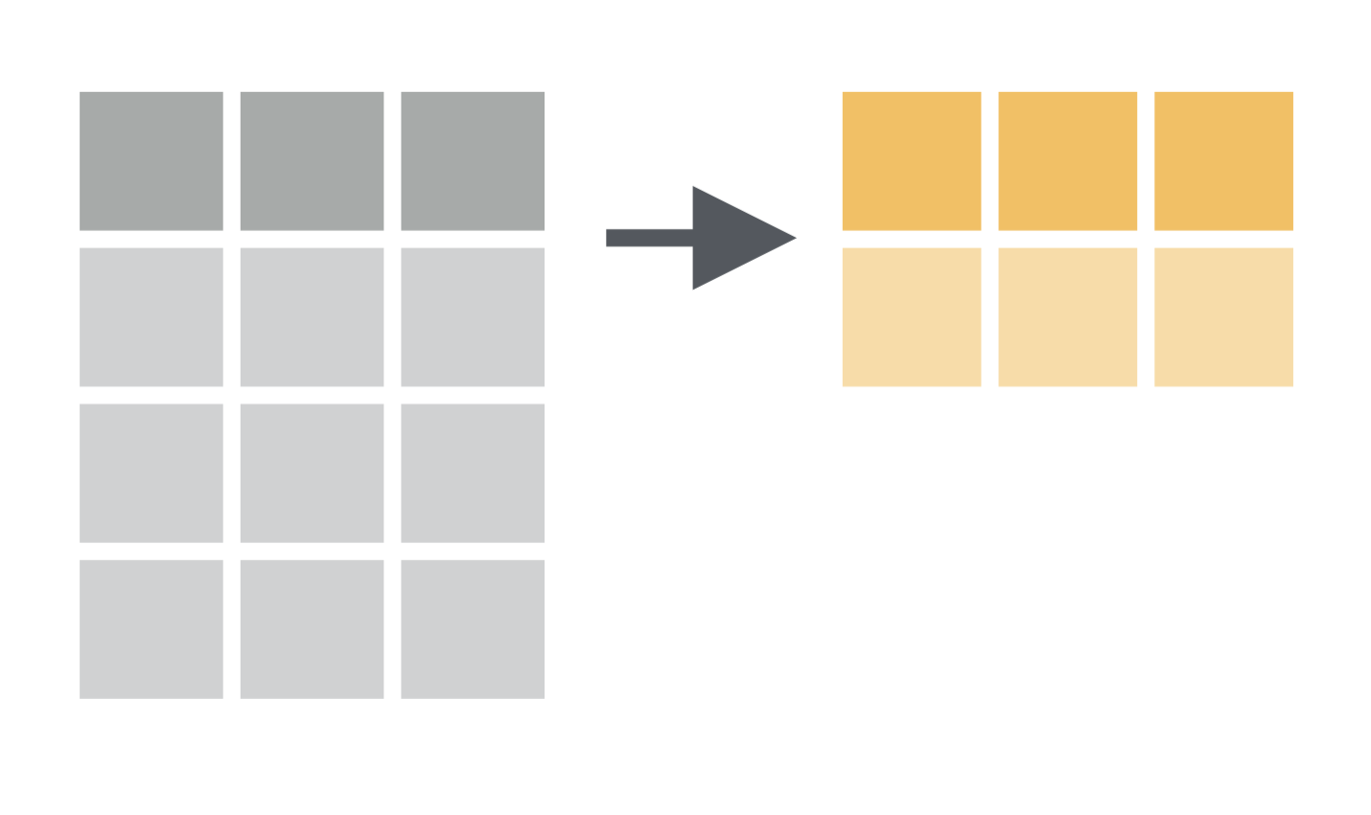
summarize( )
Creates a new table that summarizes a data frame according to formula provided.
summarize(data, new.column=formula)
https://www.rstudio.com/wp-content/uploads/2015/02/data-wrangling-cheatsheet.pdf

Slide 16
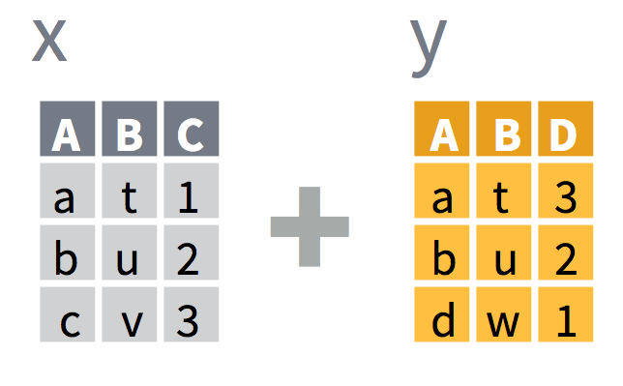
Joining Data Frames
*merge(): built-in R command to combine two data.frames
https://www.rstudio.com/wp-content/uploads/2015/02/data-wrangling-cheatsheet.pdf

Slide 17
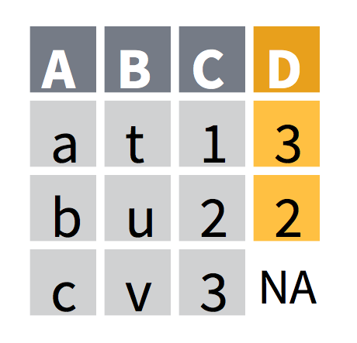

left_join( )
Joins matching values from y to x.
left_join(x, y, by=NULL, suffix=c(“.x”, “.y”))
https://www.rstudio.com/wp-content/uploads/2015/02/data-wrangling-cheatsheet.pdf

Slide 18
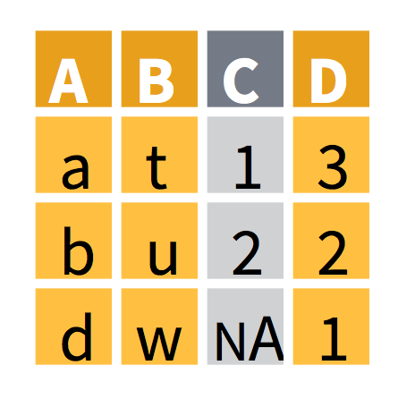
right_join( )
Joins matching values from x to y.
right_join(x, y, by=NULL, suffix=c(“.x”, “.y”))
https://www.rstudio.com/wp-content/uploads/2015/02/data-wrangling-cheatsheet.pdf

Slide 19
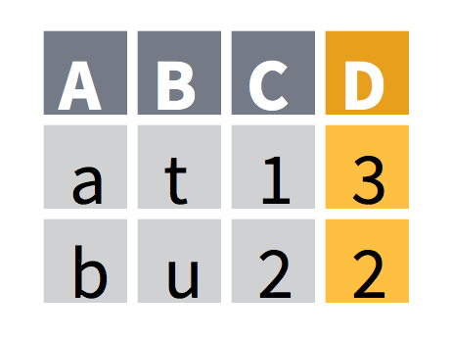
inner_join( )
Joins while retaining only rows in common to x and y.
inner_join(x, y, by=NULL, suffix=c(“.x”, “.y”))
https://www.rstudio.com/wp-content/uploads/2015/02/data-wrangling-cheatsheet.pdf

Slide 20
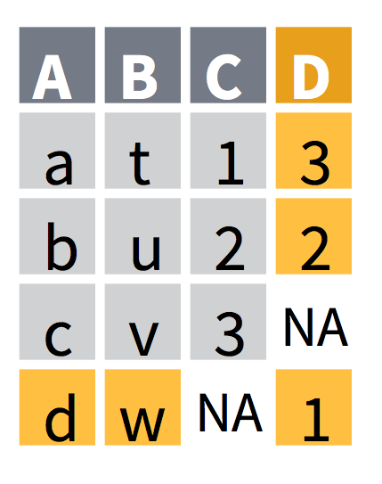
full_join( )
Joins while retaining all values, all rows.
full_join(x, y, by=NULL, suffix=c(“.x”, “.y”))
https://www.rstudio.com/wp-content/uploads/2015/02/data-wrangling-cheatsheet.pdf

Slide 21
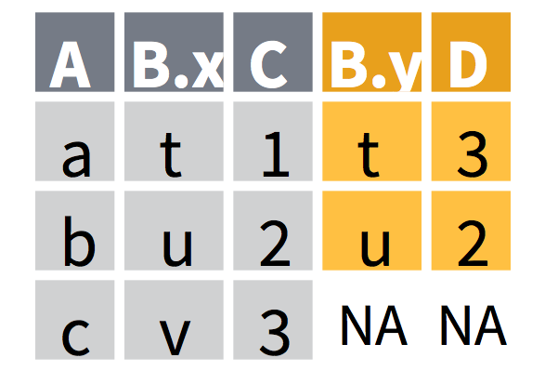
Specifying Join Options
The “by” option refers to what columns to use when matching rows
left_join(x, y, by=“A”, suffix=c(“.x”, “.y”))
https://www.rstudio.com/wp-content/uploads/2015/02/data-wrangling-cheatsheet.pdf

Slide 22
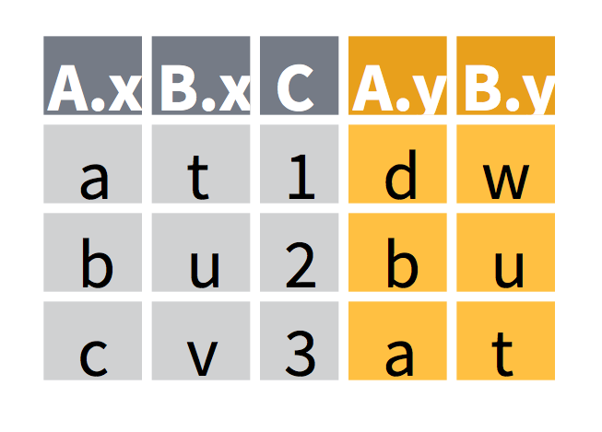
Specifying Join Options
The “by” option refers to what columns to use when matching rows
left_join(x, y, by=c(“C”=“D”)), suffix=c(“.x”, “.y”))
https://www.rstudio.com/wp-content/uploads/2015/02/data-wrangling-cheatsheet.pdf

Slide 23
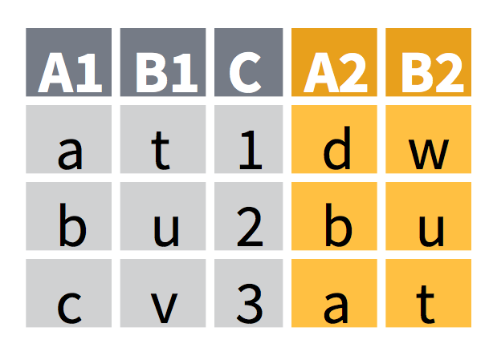
Specifying Join Options
The “suffix” option refers to what ending should be given to columns that have the same name in both x and y so that they are distinct in the final table
left_join(x, y, by=c(“C”=“D”)), suffix=c(“1”, “2”))
https://www.rstudio.com/wp-content/uploads/2015/02/data-wrangling-cheatsheet.pdf

Slide 24
Practicum 6
Go to course CANVAS page (https://canvas.upenn.edu)
Under “Files” download “6_transforming_data.html” and “6_transforming_data.Rmd”

