Slide 1
Data Science for Biomedical Informatics
Exploratory Data Analysis
Rebecca Hubbard
Associate Professor
Department of Biostatistics,
Epidemiology & Informatics
rhubb@upenn.edu
September 18, 2018

Slide 2
Outline
Explain the roles of exploratory data analysis (EDA)
Define variable types
Identify appropriate EDA for each variable type
Discuss EDA for measures of central tendency and dispersion
Construct and interpret graphical summaries

Slide 3
How does statistics fit into Data Science?
Statistics provides a rigorous, quantitative approach to thinking about and learning from data
Using mathematical properties of samples and probability theory, statistics allows us to generalize from a sample to the population
This is key to the “science” in data science because it means we aren’t just talking about the data that we happened to observe but can draw conclusions about relationships in general.

Slide 4
Step 1: Describe Sample
Sample a selected subset of units in the population
Study and summarize our sample
Describe sample characteristics
X
X
X
X
X
X
X
X
X
X
X
X
X
X
X
X
X
X
X
X
X
X
X
X
X
X
X
X
X
X
X
X
X
X
X
Sample
observed:
X₁, X₂, X₃, . . ., X_{m}.

Slide 5
Step 2: Learn About Population
Conduct analysis of sample
Use results to make conclusions about relationships that exist in the greater population
X
X
X
X
X
X
X
X
X
X
X
X
X
X
X
X
X
X
X
X
X
X
X
X
X
X
X
X
X
X
X
X
X
X
X
Inference
statistical analysis:
X₁, X₂, X₃, . . ., X_{m}.

Slide 6
Roles of descriptive statistics
Exploratory data analysis
Identify errors
Decide which, and evaluate validity of, methods we wish to apply
Describe sample
Table 1 (characterize sample)
Preliminary analysis
Address the question of interest descriptively
Convey complicated results in a more understandable way, e.g. graphically

Slide 7
Variable Types
Categorical (qualitative)
Nominal: no natural order (e.g. gender, race, study ID)
Ordinal: naturally ordered, but not numeric (e.g. severity scale, disease stage)
Numerical (quantitative)
Discrete: Finite number of values (e.g. IQ, counts)
Continuous: Infinite number of values (e.g. height, blood pressure)
Note: Convenient definitions, but not all variables are easily categorized (e.g. severity scale, age)

Slide 8
EDA: Categorical Variables
Qualitative variable
Ordinal or nominal
Common examples: gender, race, disease status, treatment
Typically described using counts and proportions
How many are in each group?
What proportion does each group represent in the sample?
Generally organized into a frequency table (part of “Table 1”)

Slide 9
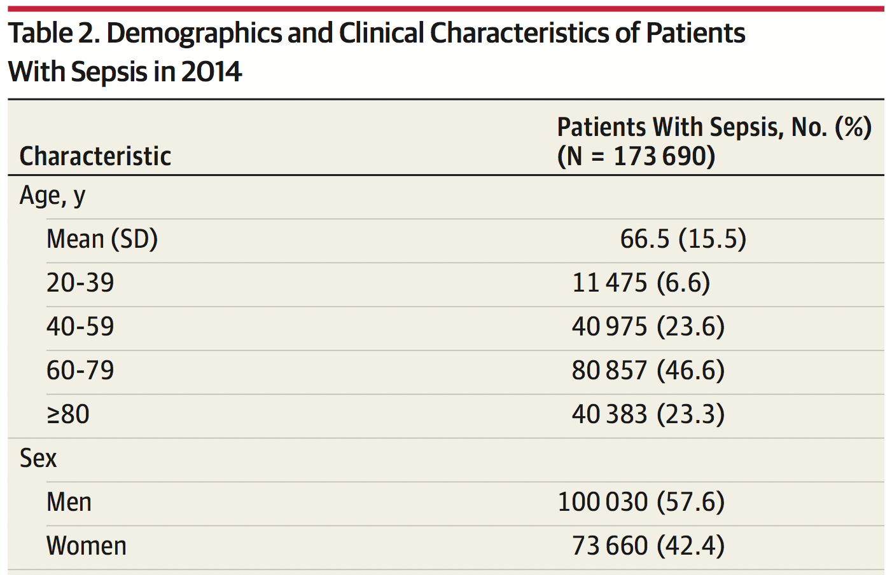
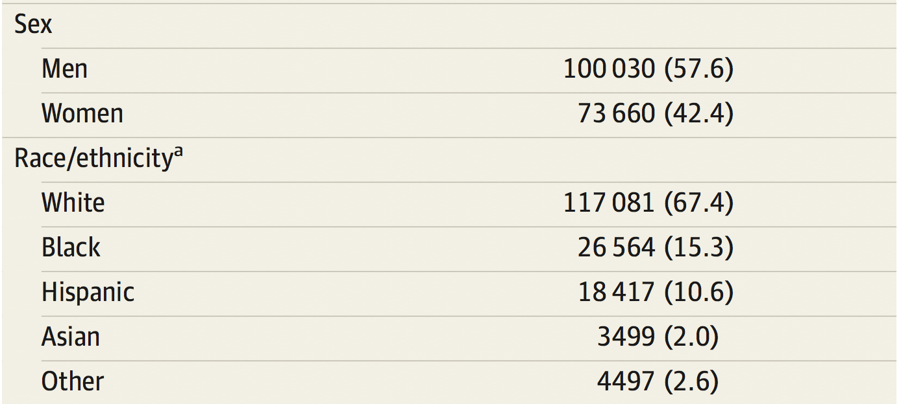
EDA: Categorical Variables
Notes:
Frequency Table: Cohort study of patients 65 and older

Slide 10
Descriptive Plots: Categorical Variables
Bar charts

Slide 11
Descriptive Plots: Categorical Variables
Presentation is important for figures
Must have well labeled axes and descriptive title
Including multiple colors and symbols can be useful, but also distracting if used excessively
Many bells and whistles are available for plots, but typically distract from message of the plot (e.g. 3D bar charts)

Slide 12
Pie Charts
Plots: increase comprehension of information
Pie Charts: obscure comprehension of information
Comparing heights or widths is easy
Comparing area is difficult

Slide 13
Pie Charts vs. Bar Charts

Slide 14
Two-Way Table
For multiple categorical variables, use a two-way or contingency table
Consider whether cell, row, or column percentages are most appropriate
Frequency N (%)
Sex | Race |  |  |  | Total
 | White | Black | Asian | Other
Female | 272 (40%) | 51 (7%) | 25 (4%) | 4 (1%) | 352 (51%)
Male | 262 (38%) | 46 (7%) | 19 (3%) | 8 (1%) | 335 (49%)
Total | 534 (78%) | 97 (14%) | 44 (6%) | 12 (2%) | 687 (100%)

Slide 15
Two-Way Table
E.g. row percentages highlight difference in racial distribution of males and females
Frequency N (%)
Sex | Race |  |  |  | Total
 | White | Black | Asian | Other
Female | 272 (77%) | 51 (15%) | 25 (7%) | 4 (1%) | 352 (100%)
Male | 262 (78%) | 46 (14%) | 19 (6%) | 8 (2%) | 335 (100%)
Total | 534 (78%) | 97 (14%) | 44 (6%) | 12 (2%) | 687 (100%)

Slide 16
EDA: Categorical Variables
Categorical variables are qualitative, often non-numeric variables
Describe using tables of counts and/or frequencies
Use bar charts for graphical presentation
Avoid pie charts

Slide 17
Bivariate association for categorical variables
Here is a contingency table for sex and CHD
Would like to summarize the strength of association between the two variables
> table(sex,chd)
chd
sex 0 1
0 154 48
1 104 66

Slide 18
Measures of association for binary outcomes
 |  | Outcome
 |  | No | Yes
Exposure | Yes | a | b
 | No | c | d
Risk difference (RD) = P(outcome|exposed) - P(outcome|not exposed)
= (b/(a+b)) - (d/(c+d))
RD(Female vs Male) = 66/(104+66) – 48/(48+154) = 0.15
> table(sex,chd)
0 1
0 154 48
1 104 66

Slide 19
Measures of association for binary outcomes
 |  | Outcome
 |  | No | Yes
Exposure | Yes | a | b
 | No | c | d
Risk difference interpretation
Additive difference in probability (risk) between exposed and unexposed
Also called excess risk
-1 < RD < 1
RD = 0 ⇒ no association; risk of outcome same for exposed and unexposed

Slide 20
Measures of association for binary outcomes
 |  | Outcome
 |  | No | Yes
Exposure | Yes | a | b
 | No | c | d
Relative risk (RR) = P(outcome|exposed)/P(outcome|not exposed)
= (b/(a+b))/(d/(c+d))
RR(Female vs Male) = (66/(104+66)) / (48/(48+154)) = 1.63
> table(sex,chd)
0 1
0 154 48
1 104 66

Slide 21
Measures of association for binary outcomes
 |  | Outcome
 |  | No | Yes
Exposure | Yes | a | b
 | No | c | d
Relative risk interpretation
Multiplicative difference in probability (risk) of outcome among exposed compared to unexposed
0 < RR < ∞
RR = 1 ⇒ no association; risk of outcome same for exposed and unexposed

Slide 22
Measures of association for binary outcomes
 |  | Outcome
 |  | No | Yes
Exposure | Yes | a | b
 | No | c | d
Odds = P/(1-P)
Odds ratio (OR) = Odds(outcome|exposed)/Odds(outcome|not exposed)
= ((b/(a+b))/(a/(a+b)))/((d/(c+d))/(c/(c+d)))
= (b/a)/(d/c) = (bc)/(ad)
OR(Female vs Male) = (66/104) / (48/154) = 2.04
> table(sex,chd)
0 1
0 154 48
1 104 66

Slide 23
Measures of association for binary outcomes
 |  | Outcome
 |  | No | Yes
Exposure | Yes | a | b
 | No | c | d
Odds ratio interpretation
Multiplicative difference in odds of outcome between exposed and unexposed
0 < OR < ∞
OR = 1 ⇒ no association; odds of outcome same for exposed and unexposed

Slide 24
Pros and cons of measures of association
RD is appealing because it directly communicates absolute increase in risk
Often more policy relevant than relative measures
RR more directly interpretable than OR (most people don’t have an intuitive understanding of odds)
OR estimable in case-control studies where RR and RD are not
For rare outcomes, OR ≈ RR
You can still use OR for a common outcome, but you must interpret it as an OR, not an RR

Slide 25
EDA: Numerical Variables
Numerical variables are quantitative
Discrete: take on a set of values (typically integers)
Continuous: take on a range of values limited only by precision
Common examples: age, height, income, number of hospitalizations
Many ways to describe numerical variables
Will cover the most typical descriptive statistics and plots
Measures of central tendency and dispersion

Slide 26
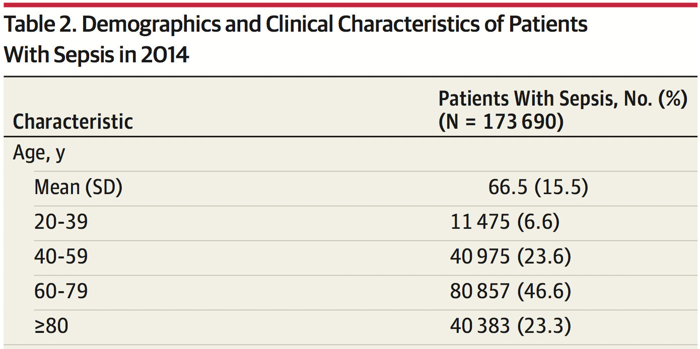
EDA: Numerical Variables
Can use frequency tables here too for discrete variables that take on few values or by creating intervals

Slide 27
Numerical Data
Bar plots and frequency tables don’t make sense when a numerical variable takes on many values (e.g. height)
We are more interested in the distribution
Where is the center of the height distribution
How much does height vary?
Are there some values far from the bulk of the data?
Generally interested in characteristics of the distribution (e.g. mean), not whether data follow a specific statistical distribution function (e.g. normal)
In “big data” contexts normality is generally irrelevant due to the central limit theorem

Slide 28
Histogram
Similar to a bar plot, but used for continuous data.
Divide data into intervals.
A rectangle is constructed with the base being the interval end-points and the height chosen so the area of the rectangle is proportional to the frequency (if the width of each interval is the same, then height ∝ frequency).
Shape can be sensitive to number and choice of intervals (rule of thumb: number of bins is smaller of or 10*log₁₀n)
Software will generally implement this for you, but you may need to refine
Histograms are very effective for moderate to large datasets.

Slide 29
Example: Histogram vs Bar Plot

Slide 30
Characteristics of Distributions
Shape
number of modes (peaks)
symmetry
Center
where is the center?
Dispersion or spread
how much variation?
outliers?
Other features
E.g., boundaries

Slide 31
Examples

Slide 32
Graphical vs. Numerical Summary
Journal space for figures is often limited
Numerical summaries offer a more concise way to summarize a distribution (Table 1)
Type of numerical summaries:
Measures of Central Tendency
Measures of Dispersion
You should take a look at graphical summaries even if they aren’t ultimately going into the paper
Not all distributional characteristics can easily be identified via numerical summary
E.g. outliers, bimodal distributions

Slide 33
Notation
Suppose we have N measurements of a variable.
We will denote these N measurements as:
X₁, X₂, X₃,…,X_{N}
where X₁ is the first measurement, X₂ is the second, …
Sometimes it is useful to order the measurements.
We denote the ordered measurements as:
X₍₁₎, X₍₂₎, X₍₃₎,…,X_{(N)}
where X₍₁₎ is the smallest value and X_{(N)} is the largest.

Slide 34
Measures of Central Tendency
The arithmetic mean is the most common measure of the central tendency of a sample. We use to refer to the mean and define it as:
Another measure is the median or “middle observation”. Half the values are below the median and half are above. Given the ordered sample, the median is:
N odd:
N even:

Slide 35
Strengths and weaknesses of median
Median is “resistant” to outliers
Median can be easier to understand
50% of sample is above the median, 50% of sample is below the median.

Slide 36
Strengths and weaknesses of mean
Mean is sensitive to skewness and highly influenced by very large (or small) values (outliers)
Mean is attractive mathematically
The mean is the “fulcrum” or center of mass of the distribution (think teeter totter)
Note that a proportion is simply a mean of 0/1 data (e.g. 0 = no disease; 1 = disease)
Mean has many nice statistical properties

Slide 37
Central Limit Theorem
The central limit theorem tells us about the distribution of the sample mean for large samples
No matter what distribution X follows, the mean of X based on a “sufficiently large sample” will be normally distributed with variance inversely proportional to the sample size
This is a very useful property because it means that using just one sample we can make inference about the central tendency of the population and also know how good (precise) our estimate is
The central limit theorem tells us about the sampling distribution of the mean even if the distribution of X is not normal or is unknown
Note: “sufficiently large” n ≥ 30 usually suffices but it depends on the distribution of the population (basically how skewed it is)
Notes:
37

Slide 38
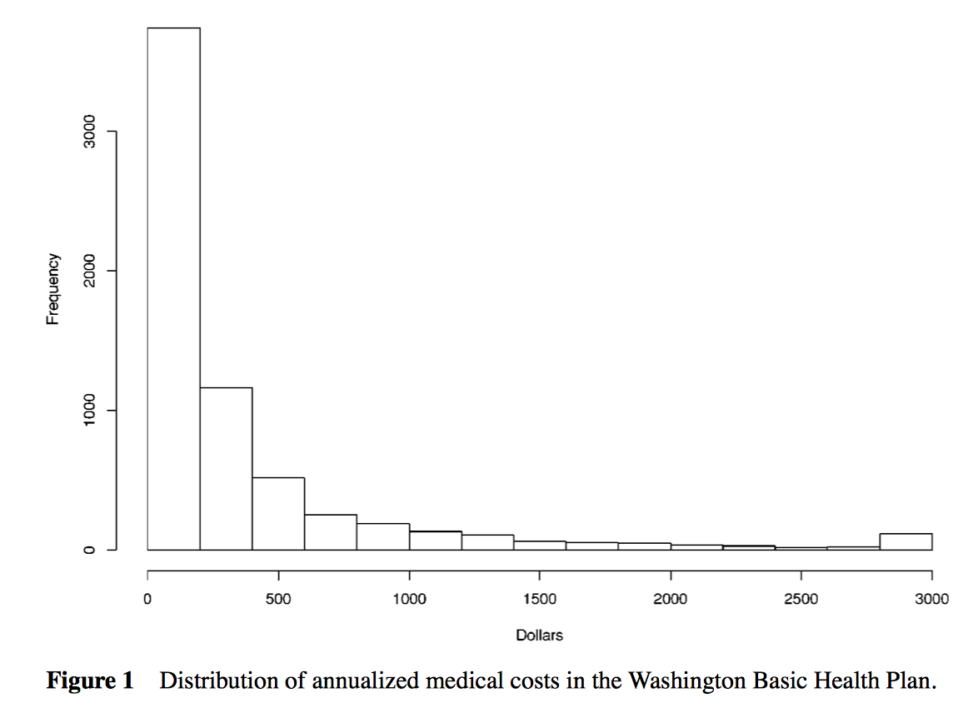
Central Limit Theorem
Lumley et al. looked at the sampling distribution of the mean for medical cost data
Medical cost data is notoriously difficult to work with because they are highly right skewed
Range = $0-22,450; Mean = $389, SD = $895
Notes:
38

Slide 39
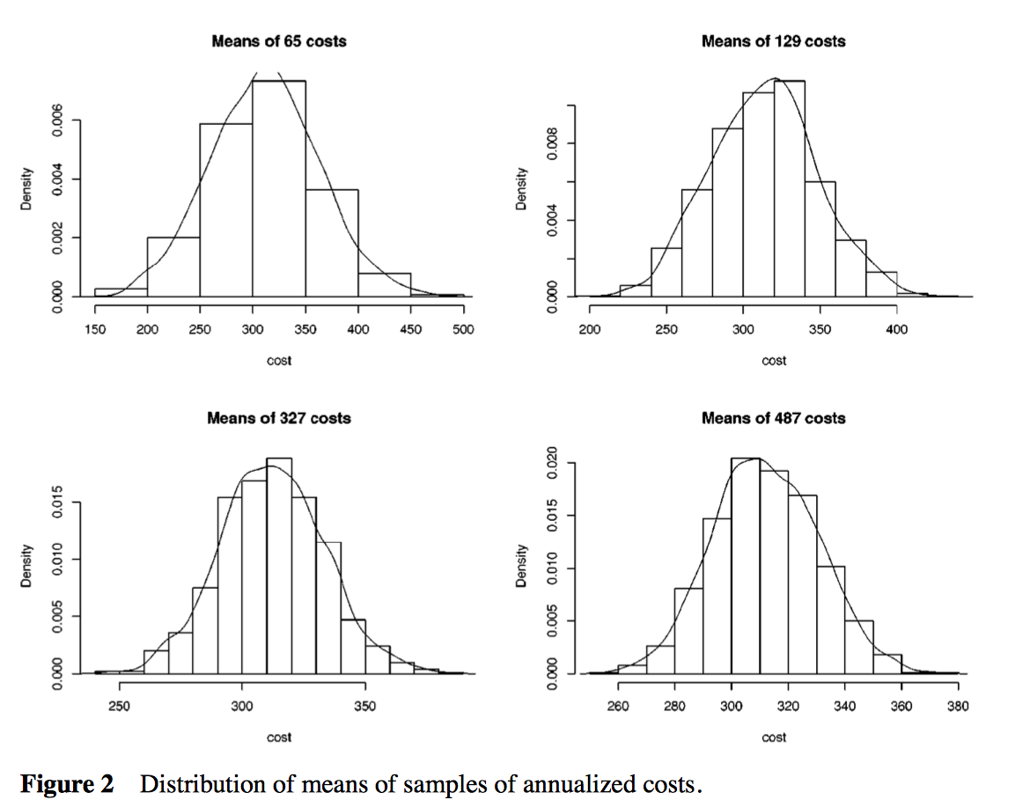
Sampling Distribution of Mean Cost
Notes:
39

Slide 40
Comparison of Mean and Median
Useful to look at both
Mean = Median: Symmetric Distribution (not necessarily normal)
Mean > Median: Right skewed distribution or high outliers
Mean < Median: Left skewed distribution or low outliers
Typically, only one is reported in Table 1
Which one?... Depends on what you are interested in
Mean is usually the default; useful if subsequent inferential analysis will focus on comparisons of means
Median may be more informative in the presence of outliers (e.g., Household income)

Slide 41
Measures of Dispersion: Range
The range is the difference between the largest and smallest observations:
Alternatively, the range may be denoted as the pair of observations (more useful for quality control):
Disadvantage: the range typically increases with increasing sample size – hard to compare ranges from samples of different size

Slide 42
Measures of Dispersion: Variance
The variance is defined as:
This is useful because it tells us the average variation around the mean
Squaring ensures all deviations have the same (positive) sign
The standard deviation is simply the square root of the variance:
This gives us a measure on the original scale of the data

Slide 43
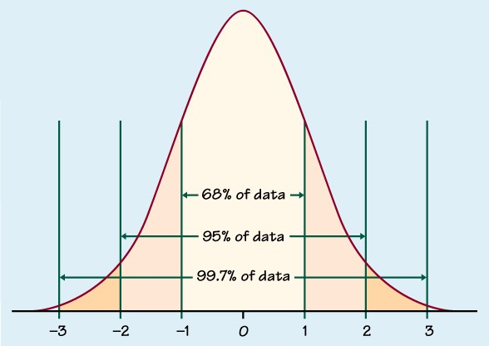
For normally distributed data
~68% of data within ±1σ of μ
~95% of data within ±2σ of μ
~99.7% of data within ±3σ of μ

Slide 44
Measures of Dispersion: Quartiles and Percentiles
Quartiles are the (25,50,75) percentiles.
The interquartile range (IQR) is Q_{.75} - Q_{.25} or (Q_{.25}, Q_{.75}) and is another useful measure of dispersion. The middle 50% of the data is found between Q_{.25} and Q_{.75}.
Q_{.25} – observation greater than 25% of data or median of the observations to the left (less than) the overall median.
Q_{.75} – observation greater than 75% of data or median of the observations to the right (greater than) the overall median.
More generally, the p^{th} percentile is the value which has p% of the sample values less than or equal to it.

Slide 45
Data Visualization: Boxplot
Effective way of examining the relationship between a numerical variable and a categorical variable. Examines differences in the distribution across groups.

Slide 46
Boxplot Interpretation/Construction
“outliers” – more than 1.5*IQR above the quartile
1.5*IQR
} ^{IQR}
75th percentile
median
25th percentile
smallest obs.
Define an outlier as any observation more than 1.5*IQR above or below the quartile
The “whiskers” extend to the smallest/largest non-outlying observations.

Slide 47
What if I find an outlier?
Check it for accuracy
Decide (based on scientific judgment) whether it is best to keep it or omit it
If you think it is representative, and likely would have appeared in a larger sample, keep it
If you think it is very unusual and unlikely to occur again in a larger sample, omit it
Report its existence [whether or not it is omitted]
Notes:
47

Slide 48
Data Visualization: Scatterplot
A scatterplot offers a convenient way of visualizing the relationship between pairs of quantitative variables.
Many interesting features can be seen in a scatterplot including the overall pattern (i.e. linear, nonlinear, periodic), strength and direction of the relationship, and outliers (values which are far from the bulk of the data).

Slide 49
Data Visualization: Scatterplot
Important information can be seen in two dimensions that isn’t obvious in one dimension

Slide 50
Data Visualization: Scatterplot
Use symbols or colors to add a third variable
No. of eggs

Slide 51
Correlation
How can we summarize the “strength of association” between two quantitative variables?

Slide 52
Pearson’s Correlation Coefficient
The correlation between two variables X and Y is:
Properties:
No distinction between x and y.
The correlation is constrained: -1 ≤ R ≤ +1
| R | = 1 means “perfect linear relationship”
The correlation is a scale free measure (correlation doesn’t change if there is a linear change in units).
Pearson’s correlation only measures strength of linear relationship.
Pearson’s correlation is sensitive to outliers. Spearman’s correlation avoids this problem by using ranks rather than values of X and Y

Slide 53
Pearson’s Correlation Coefficient
Perfect positive correlation (R = 1)
Perfect negative correlation (R = -1)
Uncorrelated (R = 0) but dependent
Notes:
Either R or r used to denote correlation coefficient

Slide 54
Summary
Roles of EDA
Check for errors
Describe your sample (Table 1)
Identify appropriate methods for inferential analysis
Make conclusions
Design a descriptive analysis that best fits your dataset and your scientific question of interest

