Slide 1
Good Y
Good X

Slide 2
Good Y
A
C
B
Good X

Slide 3
Good Y
A
B
C
D
E
Good X

Slide 4
Good Y
This Country would choose Bundle D as it is the max production bundle that satisfies their consumers
A
B
C
D
IC3
E
IC2
IC1
Good X

Slide 5
Tea
70
PPF for the Home Country
Coffee
90

Slide 6
Tea
120
Home
Foreign
70
Coffee
90
100

Slide 7
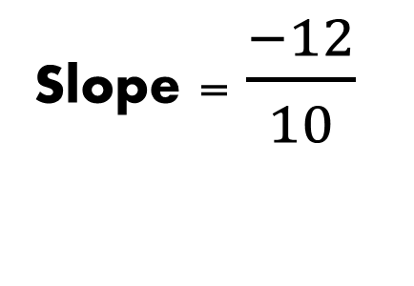
Tea
120
Slope = $\frac{−12}{10}$
Coffee
100

Slide 8
Tea
Potential Gains from Trade When Producing at Bundle B
70
B
Coffee
90

Slide 9
Tea
Potential Gains from Trade When Specializing on Coffee Production
70
E
Coffee
90

Slide 10
Tea
120
C
Potential Gains from Trade When Producing at Bundle C
Coffee
100

Slide 11
Tea
A
120
Potential Gains from Trade When Specializing in Tea Production
Coffee
100

Slide 12
Tea
70
(45,35)
Coffee
90

Slide 13
Tea
120
(30,80)
Coffee
100

Slide 14
Country | Coffee | Tea
Home | 45 | 35
Foreign | 30 | 80
Country | Coffee | Tea
Home | 45 | 35
Foreign | 30 | 80

Slide 15
Country | Coffee | Tea
Home | 9 | 7
Foreign | 10 | 12

Slide 16
Country | Coffee | Tea
Home | 90 | 0
Foreign | 0 | 120
Country | Coffee | Tea
Home | 45 | 40
Foreign | 45 | 80

