Slide 1
Good Y
Good X

Slide 2
Coffee
Slope = -4
Beef

Slide 3
Good Y
A
C
B
Good X

Slide 4
Good Y
A
B
C
D
E
Good X

Slide 5
Good Y
This Country would choose Bundle D as it is the max production bundle that satisfies their consumers
A
B
C
D
IC3
E
IC2
IC1
Good X

Slide 6
Tea
70
PPF for the Home Country
Coffee
90

Slide 7
Tea
120
Home
Foreign
70
Coffee
90
100

Slide 8
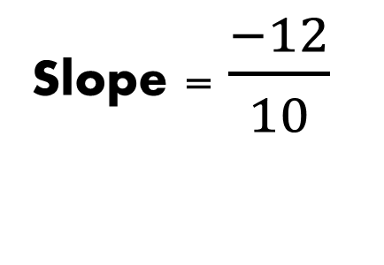
Tea
120
Slope = $\frac{−12}{10}$
Coffee
100

Slide 9
Tea
Potential Gains from Trade When Producing at Bundle B
70
B
Coffee
90

Slide 10
Tea
Potential Gains from Trade When Specializing on Coffee Production
70
E
Coffee
90

Slide 11
Tea
120
C
Potential Gains from Trade When Producing at Bundle C
Coffee
100

Slide 12
Tea
A
120
Potential Gains from Trade When Specializing in Tea Production
Coffee
100

Slide 13
Tea
70
(45,35)
Coffee
90

Slide 14
Tea
120
(30,80)
Coffee
100

Slide 15
Country | Coffee | Tea
Home | 45 | 35
Foreign | 30 | 80
Country | Coffee | Tea
Home | 45 | 35
Foreign | 30 | 80

Slide 16
Country | Coffee | Tea
Home | 9 | 7
Foreign | 10 | 12

Slide 17
Country | Coffee | Tea
Home | 90 | 0
Foreign | 0 | 120
Country | Coffee | Tea
Home | 45 | 40
Foreign | 45 | 80

Slide 18
 | Costa Rica | Japan
Capital | 90 Machines | 150 Machines
Labor | 300 Farmers | 400 Farmers

Slide 19
Textiles Output (Labor Good)
Manufacturing Output (Capital Good)

Slide 20
Textiles Output (Labor Good)
Manufacturing Output (Capital Good)

Slide 21
Textiles Output (Labor Good)
Manufacturing Output (Capital Good)

Slide 22
IC2
A
IC1
Textiles Output (Labor Good)
Slope = Opportunity Cost of Capital-Intensive Good Within Country
Manufacturing Output (Capital Good)

Slide 23
IC2
A
IC1
Textiles Output (Labor Good)
B
Slope = World Price of Capital-Intensive Good
Manufacturing Output (Capital Good)

Slide 24
With Trade, the country shifts their production bundle and consumes at a higher indifference curve
C
IC2
A
IC1
Textiles Output (Labor Good)
B
Manufacturing Output (Capital Good)

Slide 25
Goods Output
Labor Input

Slide 26
Country | Sparkling Selfies | Shirtless Selfies
Vampires | 12 | 4
Wolves | 6 | 18

Slide 27
Country | Sparkling Selfies | Shirtless Selfies
Vampires | 12 | 4

Slide 28
Shirtless
80
Sparkling
240

Slide 29
Factors | Cloth | Food
Specific | Capital | Land
Variable | Labor | Labor

Slide 30
 | Exports
Country A | Land-Intensive
Country B | Capital-Intensive

Slide 31
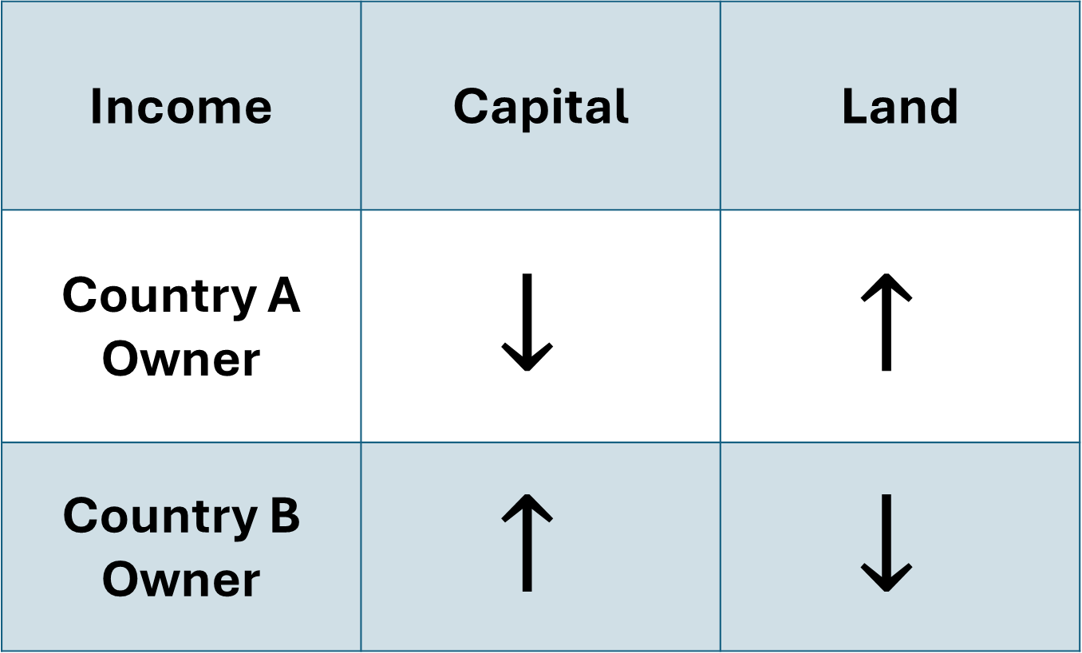
Income | Capital | Land
Country A Owner | $$↓$$ | $$↑$$
Country B Owner | $$↑$$ | $$↓$$

Slide 32


Wages (w)
$$P∗MPL_{X}$$
A
W
$$P∗MPL_{Y}$$
Labor Supply
L

Slide 33

Wages (w)
$$P∗MPL_{X}$$
$$P∗MP{L′}_{X}$$
A
W
B
W’
$$P∗MPL_{Y}$$
Labor Supply
L
L’

Slide 34


Price
$$P^{∗}$$
Quantity
$$Q^{∗}$$

Slide 35


Price
$$P^{∗}$$
Quantity
$$Q^{∗}$$
CONSUMER SURPLUS
PRODUCER SURPLUS

Slide 36




Price
$$P^{∗}$$
$$P^{W}$$
Quantity
$$Q_{1}^{ }$$
$$Q_{2}^{ }$$

Slide 37
Price
$$P^{∗}$$
$$P^{W}$$
Quantity
$$Q_{1}^{ }$$
$$Q_{2}^{ }$$

Slide 38







Price
$$P^{∗}$$
$$P^{t}$$
$$t_{ }^{ }$$
$$P^{W}$$
Quantity
$$Q_{1}^{ }$$
$$Q_{1}^{∗ }$$
$$Q_{2}^{∗ }$$
$$Q_{2}^{ }$$

Slide 39












Price
$$P^{∗}$$
$$e_{ }^{ }$$
$$f_{ }^{ }$$
$$a_{ }^{ }$$
$$c_{ }^{ }$$
$$b_{ }^{ }$$
$$d_{ }^{ }$$
$$P^{W}$$
$$g$$
Quantity
$$Q_{1}^{ }$$
$$Q_{1}^{∗ }$$
$$Q_{2}^{∗ }$$
$$Q_{2}^{ }$$

Slide 40

Price
$$P^{∗}$$
$$e_{ }^{ }$$
$$f_{ }^{ }$$
$$P^{t}$$
$$a_{ }^{ }$$
$$c_{ }^{ }$$
$$b_{ }^{ }$$
$$d_{ }^{ }$$
$$P^{W}$$
$$g$$
Quantity
$$Q_{1}^{ }$$
$$Q_{1}^{∗ }$$
$$Q_{2}^{∗ }$$
$$Q_{2}^{ }$$

Slide 41
Price
$$P^{∗}$$
$$e_{ }^{ }$$
$$f_{ }^{ }$$
$$P^{t}$$
$$a_{ }^{ }$$
$$c_{ }^{ }$$
$$b_{ }^{ }$$
$$d_{ }^{ }$$
$$P^{W}$$
$$g$$
Quantity
$$Q_{1}^{ }$$
$$Q_{1}^{∗ }$$
$$Q_{2}^{∗ }$$
$$Q_{2}^{ }$$

Slide 42
VARIABLE | NO TARIFF | 40% TARIFF ON FINAL GOOD | +10% TARIFF, INTERMEDIATE GOOD
DOMESTIC PRICE OF GOOD | 5,000
VALUE OF IMPORTED INPUT | 400
DOMESTIC VALUE-ADDED | 4,600
EFFECTIVE RP, % | 0

Slide 43
VARIABLE | NO TARIFF | 40% TARIFF ON FINAL GOOD | +10% TARIFF, INTERMEDIATE GOOD
DOMESTIC PRICE OF GOOD | 5,000 | 7,000
VALUE OF IMPORTED INPUT | 400 | 400
DOMESTIC VALUE-ADDED | 4,600 | 6,600
EFFECTIVE RP, % | 0 | 43.5

Slide 44
VARIABLE | NO TARIFF | 40% TARIFF ON FINAL GOOD | +10% TARIFF, INTERMEDIATE GOOD
DOMESTIC PRICE OF GOOD | 5,000 |  | 7,000
VALUE OF IMPORTED INPUT | 400 |  | 440
DOMESTIC VALUE-ADDED | 4,600 |  | 6,560
EFFECTIVE RP, % | 0 |  | 42.6

Slide 45
VARIABLE | NO TARIFF | 40% TARIFF ON FINAL GOOD | +10% TARIFF, INTERMEDIATE GOOD
DOMESTIC PRICE OF GOOD | 5,000 | 7,000 | 7,000
VALUE OF IMPORTED INPUT | 400 | 400 | 440
DOMESTIC VALUE-ADDED | 4,600 | 6,600 | 6,560
EFFECTIVE RP, % | 0 | 43.5 | 42.6

Slide 46

Price
$$P^{∗}$$
$$P_{w}^{ }$$
Quantity
$$Q_{1}^{ }$$
$$Q_{2}^{ }$$

Slide 47



Price
$$P^{∗}$$
$$P_{q}^{ }$$
$$P_{w}^{ }$$
Quantity
$$Q_{1}^{ }$$
$$Q_{1}^{∗ }$$
$$Q_{2}^{∗ }$$
$$Q_{2}^{ }$$

Slide 48
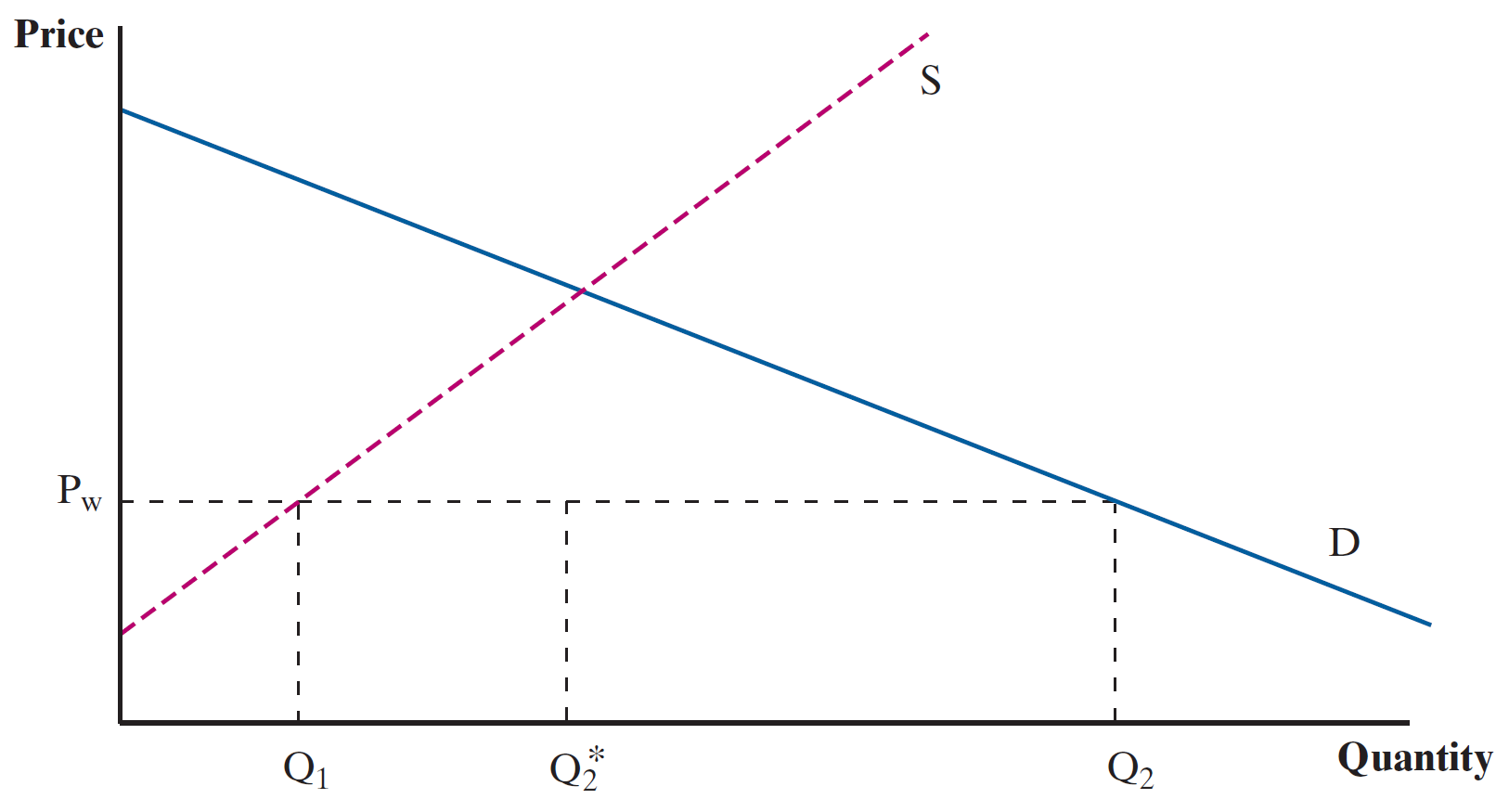
Quota
Quota

Slide 49
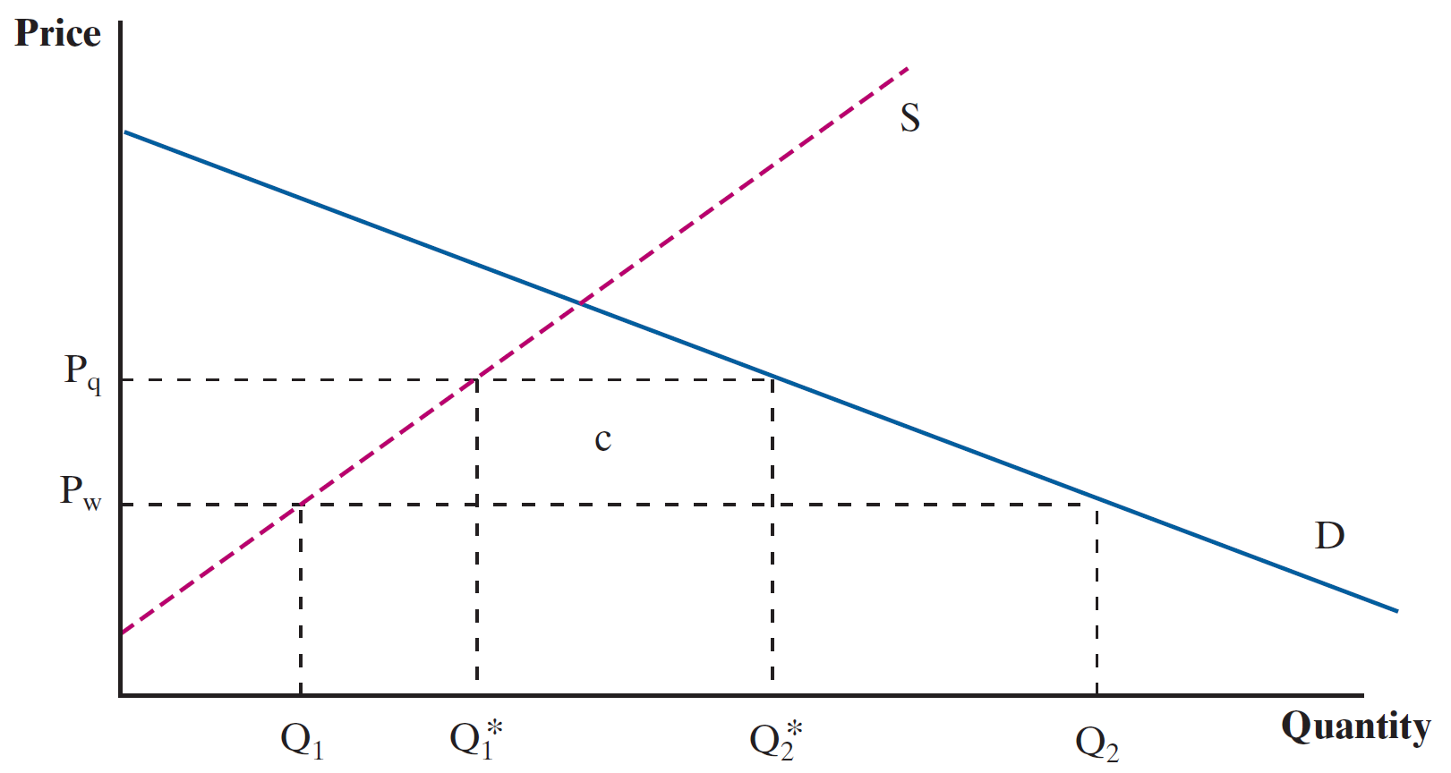

Slide 50
TYPE | INFLOWS (CREDIT) | OUTFLOWS (DEBIT)
GOODS AND SERVICES | EXPORTS | IMPORTS
PRIMARY INCOME | INVESTMENT INCOME (INTEREST, DIVIDENDS, PROFITS) COMPENSATION OF EMPLOYEES (WAGES EARNED BY DOMESTIC WORKERS WORKING ABROAD) | INVESTMENT INCOME (INTEREST, DIVIDENDS, PROFITS) COMPENSATION OF EMPLOYEES (WAGES PAID TO FOREIGN WORKERS IN DOMESTIC ECONOMY)
SECONDARY INCOME | INCOMING TRANSERS (E.G.,REMITTANCES, FOREIGN AID) | OUTGOING TRANSERS (E.G.,REMITTANCES, FOREIGN AID)

Slide 51
ID | DESCRIPTION | CREDIT | DEBIT
1 | GOODS AND SERVICES EXPORTS | 2498 | -
1a | GOODS EXPORTS | 1653 | -
1b | SERVICES EXPORTS | 845 | -
2 | PRIMARY INCOME RECEIPTS | 1123 | -
2a | INVESTMENT INCOME RECEIVED | 1116 | -
2b | COMPENSATION OF EMPLOYEES RECEIVED | 7 | -
3 | SECONDARY INCOME RECEIPTS | 143 | -
4 | GOODS AND SERVICES IMPORTS | - | 3114
4a | GOODS IMPORTS | - | 2519
4b | SERVICE IMPORTS | - | 595
5 | PRIMARY INCOME PAYMENTS | - | 866
5a | INVESTMENT INCOME PAID | - | 846
5b | COMPENSATION OF EMPLOYEES PAID | - | 20
6 | SECONDARY INCOME PAYMENTS | - | 282
7 | TOTAL DEBIT | - | 4262
8 | TOTAL CREDIT | 3764 | -
9 | CURRENT ACCOUNT BALANCE | - | 498

Slide 52
ID | DESCRIPTION | BILLIONS (USD)
1 | CURRENT ACCOUNT BALANCE | -498
2 | CAPITAL ACCOUNT BALANCE | 0
3 | FINANCIAL ACCOUNT | -
3a | NET US ACQUISITION OF FINANCIAL ASSETS, EXCLUDING FINANCIAL DERIVATIVES (INCREASE/OUTFLOW (+)) | 427
3b | NET US INCURRENCE OF LIABILITIES, EXCLUDING FINANCIAL DERIVATIVES (INCREASE/INFLOW (+)) | 784
3c | NET CHANGE IN FINANCIAL DERIVATIVES | -38
4 | SATISTICAL DISCREPANCY | 103
5 | MEMORANDA | -
5a | BALANCE OF CURRENT AND CAPITAL ACCOUNTS (LINES 1 + 2) | -498
5b | BALANCE ON FINANCIAL ACCOUNT (LINES 3a – 3b + 3c) | -395

Slide 53
ID | DESCRIPTION | CREDIT
3a | NET US ACQUISITION OF FINANCIAL ASSETS, EXCLUDING FINANCIAL DERIVATIVES (INCREASE/OUTFLOW (+)) | 427
3a.i | DIRECT INVESTMENT ASSETS | 198
3a.ii | PORTFOLIO INVESTMENT ASSETS | 39
3a.iii | OTHER INVESTMENT ASSETS | 189
3a.iv | RESERVE ASSETS | 5
3b | NET US INCURRENCE OF LIABILITIES, EXCLUDING FINANCIAL DERIVATIVES (INCREASE/INFLOW (+)) | 784
3b.i | DIRECT INVESTMENT LIABILITIES | 311
3b.ii | PORTFOLIO INVESTMENT LIABILITIES | 232
3b.iii | OTHER INVESTMENT LIABILITIES | 242
3c | NET CHANGE IN FINANCIAL DERIVATIVES | -38

Slide 54
ID | DESCRIPTION | CREDIT
3a | NET US ACQUISITION OF FINANCIAL ASSETS, EXCLUDING FINANCIAL DERIVATIVES (INCREASE/OUTFLOW (+)) | 427
3a.i | DIRECT INVESTMENT ASSETS | 198
3a.ii | PORTFOLIO INVESTMENT ASSETS | 39
3a.iii | OTHER INVESTMENT ASSETS | 189
3a.iv | RESERVE ASSETS | 5
3b | NET US INCURRENCE OF LIABILITIES, EXCLUDING FINANCIAL DERIVATIVES (INCREASE/INFLOW (+)) | 784
3b.i | DIRECT INVESTMENT LIABILITIES | 311
3b.ii | PORTFOLIO INVESTMENT LIABILITIES | 232
3b.iii | OTHER INVESTMENT LIABILITIES | 242
3c | NET CHANGE IN FINANCIAL DERIVATIVES | -38

Slide 55
ID | DESCRIPTION | CREDIT
3a | NET US ACQUISITION OF FINANCIAL ASSETS, EXCLUDING FINANCIAL DERIVATIVES (INCREASE/OUTFLOW (+)) | 427
3a.i | DIRECT INVESTMENT ASSETS | 198
3a.ii | PORTFOLIO INVESTMENT ASSETS | 39
3a.iii | OTHER INVESTMENT ASSETS | 189
3a.iv | RESERVE ASSETS | 5
3b | NET US INCURRENCE OF LIABILITIES, EXCLUDING FINANCIAL DERIVATIVES (INCREASE/INFLOW (+)) | 784
3b.i | DIRECT INVESTMENT LIABILITIES | 311
3b.ii | PORTFOLIO INVESTMENT LIABILITIES | 232
3b.iii | OTHER INVESTMENT LIABILITIES | 242
3c | NET CHANGE IN FINANCIAL DERIVATIVES | -38

