Slide 1
Software Craftsmanship North America
2012

Slide 2
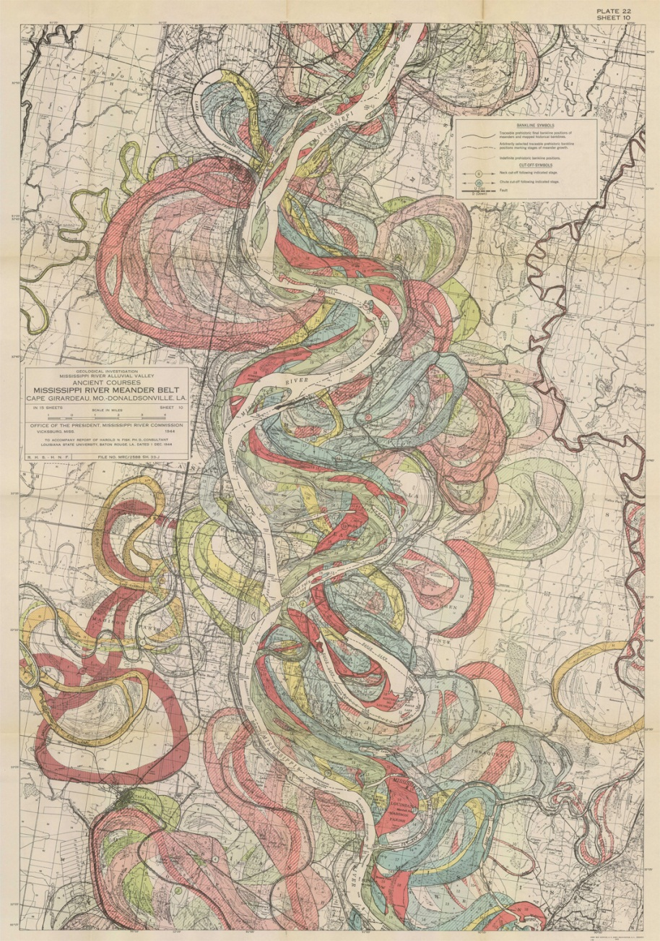
Code is Alive!

Slide 3
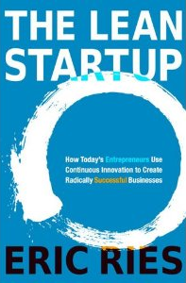
“Being a craftsman isn't only about code, but about understanding your customer ”

Slide 4
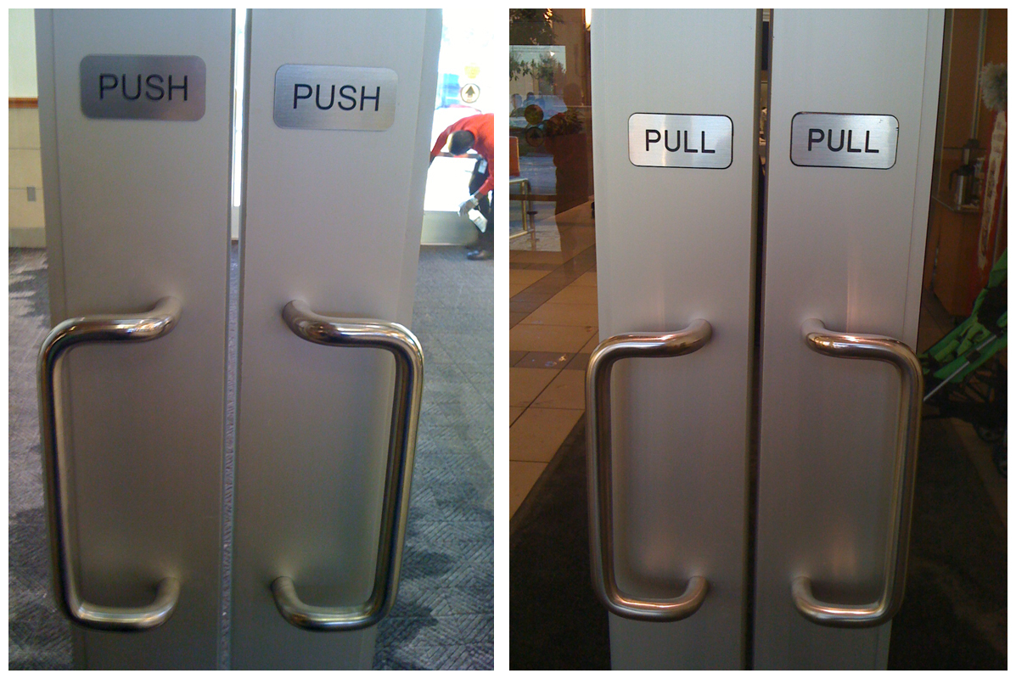
User experience is just as important when your user is a developer.
“People don't want to explore how to open the door, they just want to open the door."

Slide 5
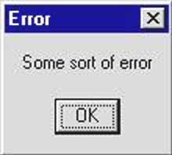
User experience is just as important when your user is a developer.
Error messages without an overload of data
Get the info you really need instead of taking extra steps
Idea: API reviews

Slide 6
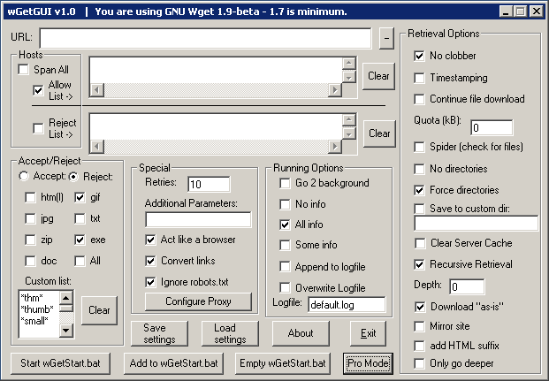
UI design is important too
Flow
Let’s track UI usage

Slide 7

Write Clean Code… or there will be consequences

Slide 8
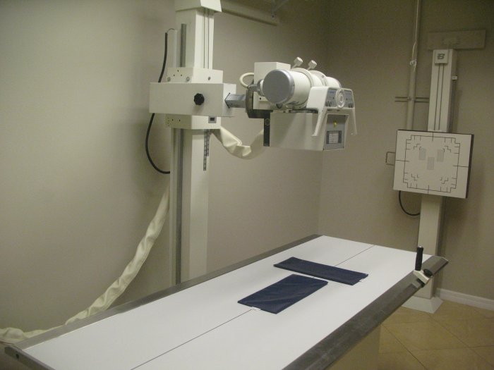
Uncle Bob says, “Don’t ship shit”
Software regulation is a scary thought
Shortcuts make things messy
Don’t be afraid of your code
http://en.wikipedia.org/wiki/Therac-25

Slide 9
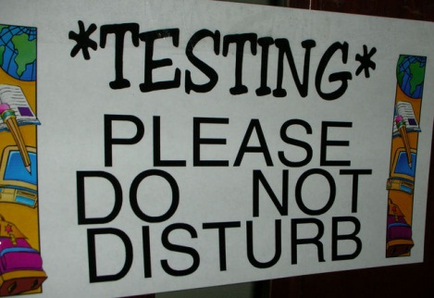
Test Empowerment

Slide 10
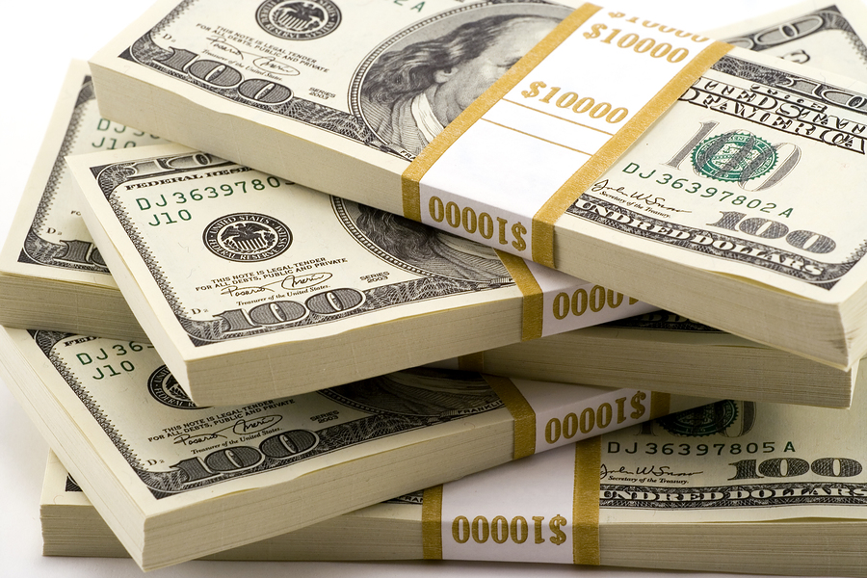
Tests can be expensive
Set a build budget. Which tests are most valuable.
Delete tests that take too long. Over time bad tests take longer to run and maintain

Slide 11

Focus tests
Confidence that if its green your app works
Has the test ever failed? Might be good candidate to be removed.

Slide 12
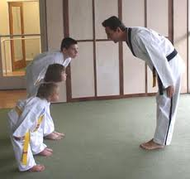
Refactor with respect

Slide 13
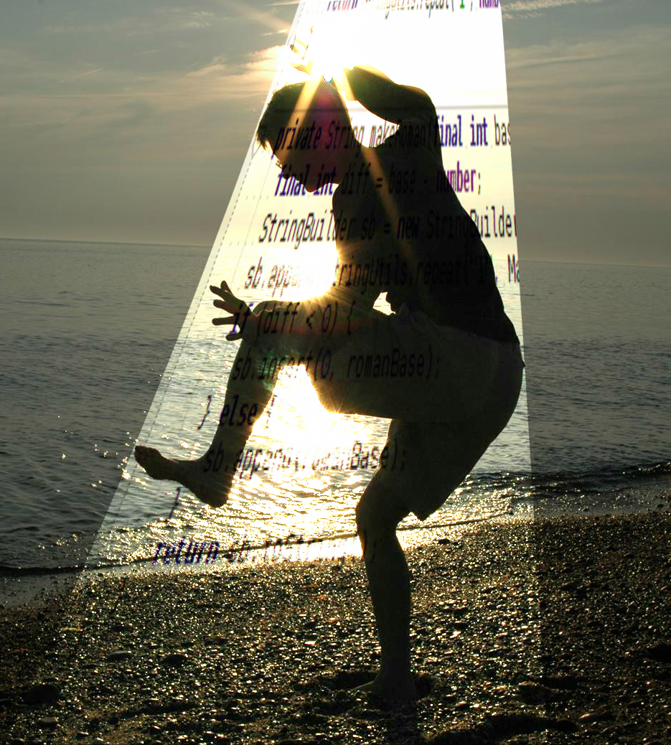
Kata exercises

Slide 14

Think about why you are doing something
Experiment
Do what you love and love what you do -> only you can do this
What is Reality?

Slide 15

Questions?

