Slide 1
Software Craftsmanship North America
2012

Slide 2
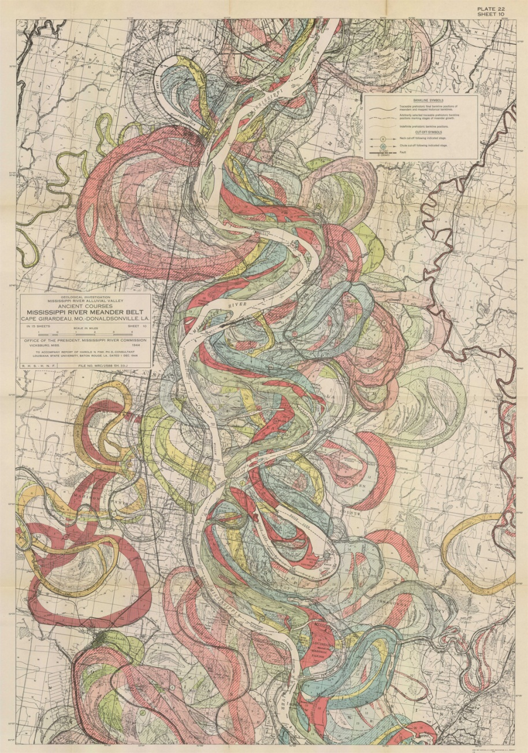
Code is Alive!

Slide 3
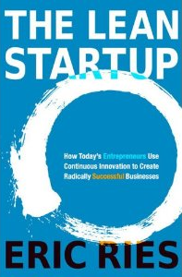
“Being a craftsman isn't only about code, but about understanding your customer ”

Slide 4
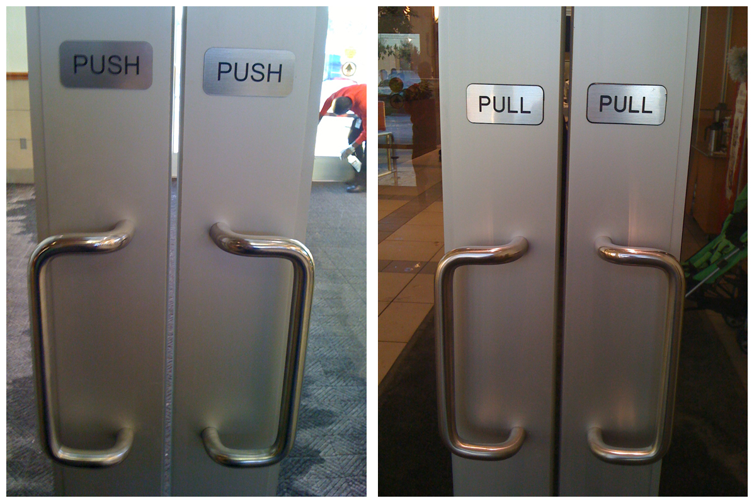
User experience is just as important when your user is a developer.
“People don't want to explore how to open the door, they just want to open the door."

Slide 5
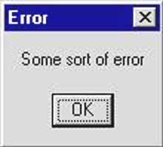
User experience is just as important when your user is a developer.
Error messages without an overload of data
Get the info you really need instead of taking extra steps
Idea: API reviews

Slide 6

Write Clean Code… or there will be consequences

Slide 7
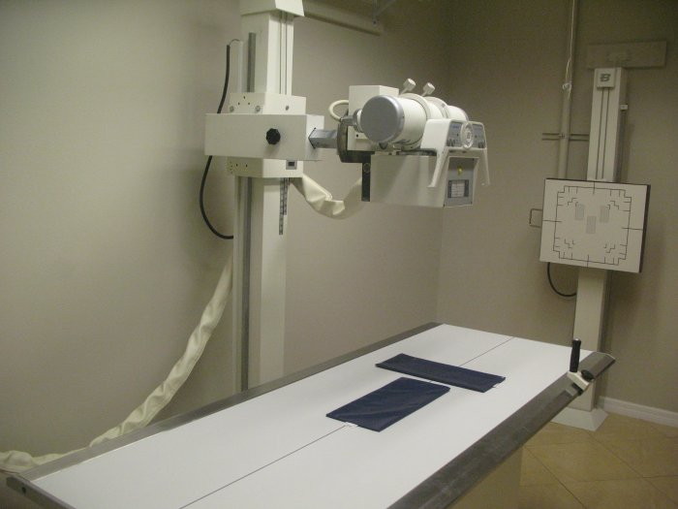
Uncle Bob says, “Don’t ship shit”
Software regulation is a scary thought
Shortcuts make things messy
Don’t be afraid of your code
http://en.wikipedia.org/wiki/Therac-25

Slide 8
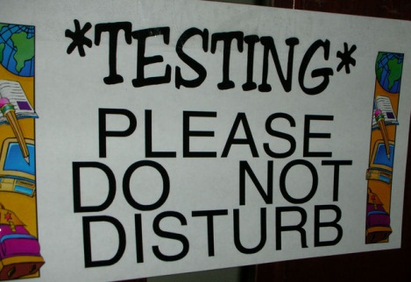
Test Empowerment

Slide 9
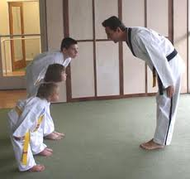
Refactor with respect

Slide 10

Kata exercises

Slide 11

Think about why you are doing something
Experiment
Do what you love and love what you do -> only you can do this
What is Reality?

Slide 12

Questions?

