Slide 1
Post-processing of results
Øystein A. Haaland

Slide 2
Post-processing of results
Genome-wide and candidate gene analyses often result in very much output
Not obvious how this should be handled
This session covers the following strategies
p-value adjusting
Per comparison error rate
Family-wise error rate
False discovery rate
Ploting
QQ-plot
Volcano plot
Manhattan plot
Regional plot

Slide 3
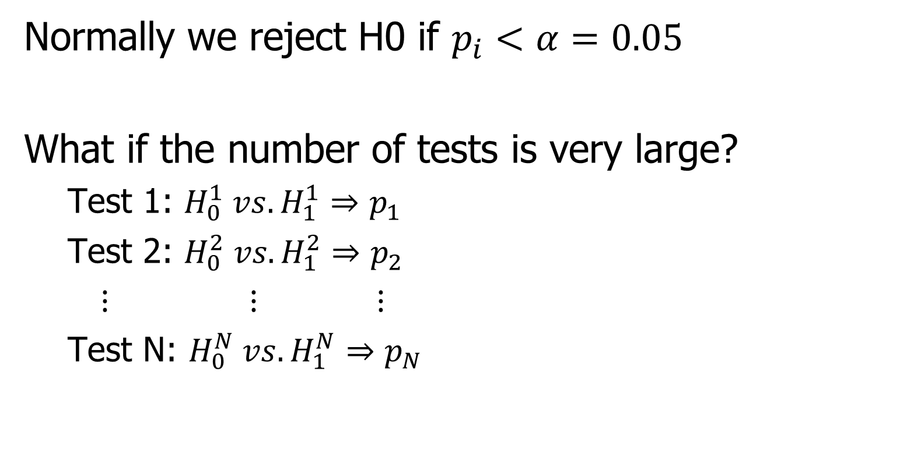
Multiple testing
Normally we reject H0 if $p_{i}<α=0.05$
What if the number of tests is very large?
Test 1: $H_{0}^{1} vs. H_{1}^{1}⇒p_{1}$
Test 2: $H_{0}^{2} vs. H_{1}^{2}⇒p_{2}$
$⋮$ $⋮$ $⋮$
Test N: $H_{0}^{N} vs. H_{1}^{N}⇒p_{N}$

Slide 4
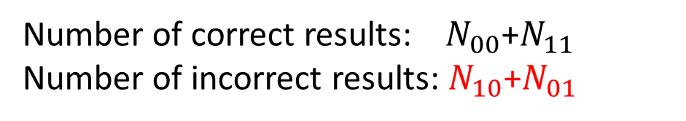
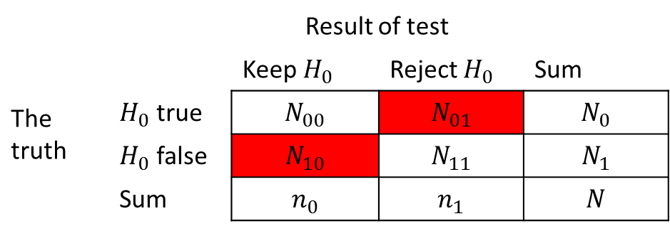
Multiple testing
 |  | Result of test
 |  | Keep $H_{0}$ | Reject $H_{0}$ | Sum
The truth | $H_{0}$ true | $$N_{00}$$ | $$N_{01}$$ | $$N_{0}$$
 | $H_{0}$ false | $$N_{10}$$ | $$N_{11}$$ | $$N_{1}$$
 | Sum | $$n_{0}$$ | $$n_{1}$$ | $$N$$
Number of correct results: $N_{00}$+$N_{11}$
Number of incorrect results: $N_{10}$+$N_{01}$

Slide 5
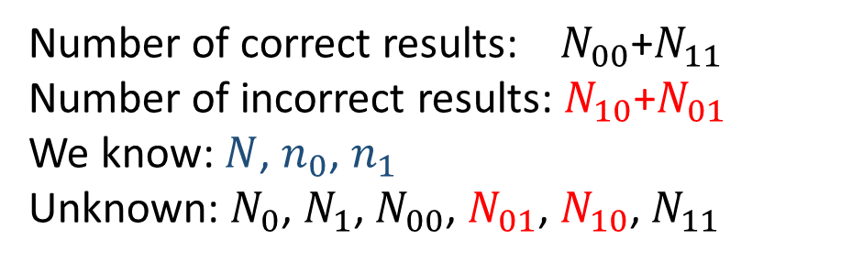
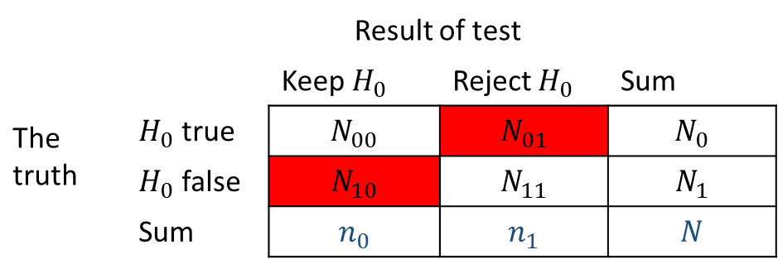
Multiple testing
 |  | Result of test
 |  | Keep $H_{0}$ | Reject $H_{0}$ | Sum
The truth | $H_{0}$ true | $$N_{00}$$ | $$N_{01}$$ | $$N_{0}$$
 | $H_{0}$ false | $$N_{10}$$ | $$N_{11}$$ | $$N_{1}$$
 | Sum | $$n_{0}$$ | $$n_{1}$$ | $$N$$
Number of correct results: $N_{00}$+$N_{11}$
Number of incorrect results: $N_{10}$+$N_{01}$
We know: $N$, $n_{0}$, $n_{1}$
Unknown: $N_{0}$, $N_{1}$, $N_{00}$, $N_{01}$, $N_{10}$, $N_{11}$

Slide 6
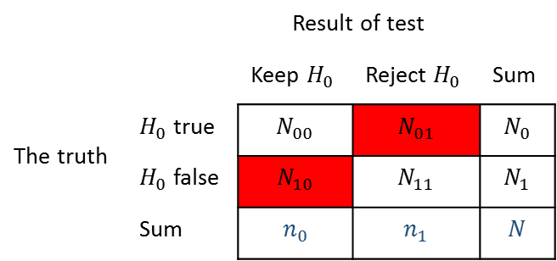
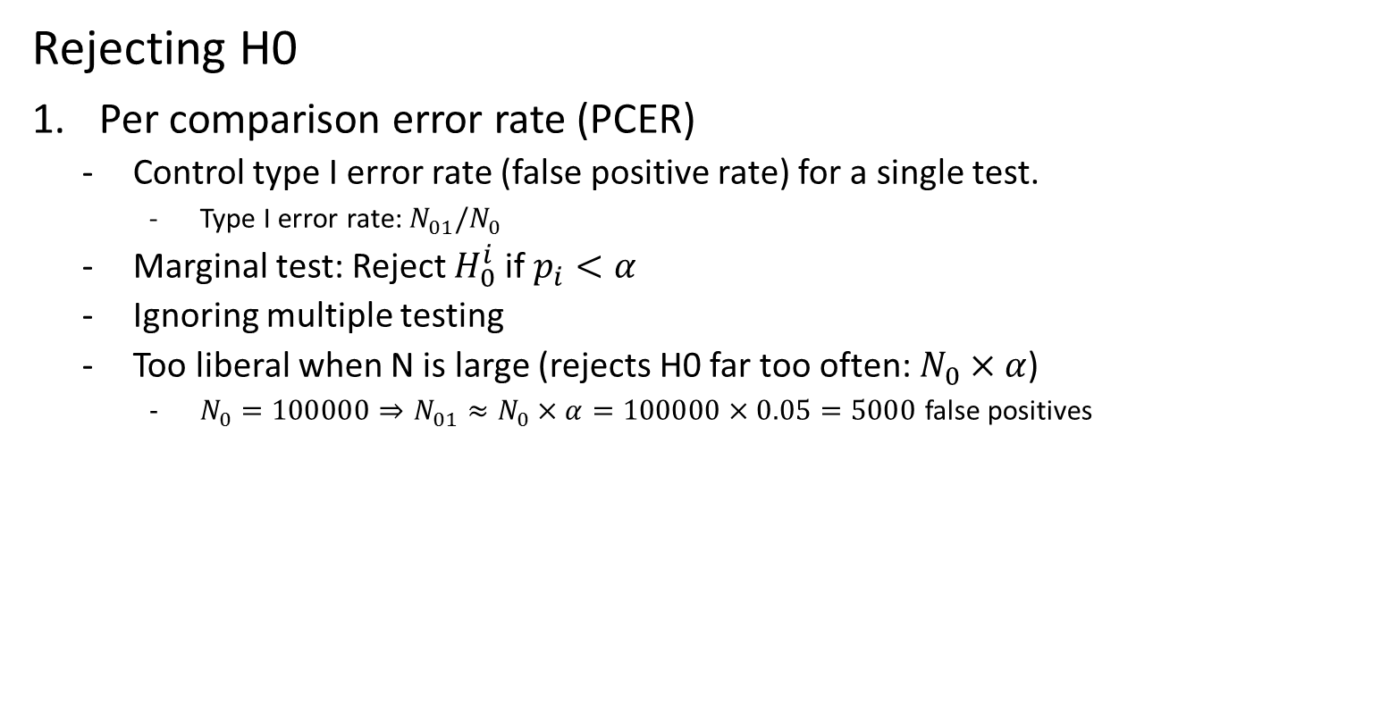
Multiple testing
 |  | Result of test
 |  | Keep $H_{0}$ | Reject $H_{0}$ | Sum
The truth | $H_{0}$ true | $$N_{00}$$ | $$N_{01}$$ | $$N_{0}$$
 | $H_{0}$ false | $$N_{10}$$ | $$N_{11}$$ | $$N_{1}$$
 | Sum | $$n_{0}$$ | $$n_{1}$$ | $$N$$
Rejecting H0
Per comparison error rate (PCER)
Control type I error rate (false positive rate) for a single test.
Type I error rate: $N_{01}/N_{0}$
Marginal test: Reject $H_{0}^{i}$ if $p_{i}<α$
Ignoring multiple testing
Too liberal when N is large (rejects H0 far too often: $N_{0}×α$)
$N_{0}=100000⇒N_{01}≈N_{0}×α=100000×0.05=5000$ false positives

Slide 7

Multiple testing
 |  | Result of test
 |  | Keep $H_{0}$ | Reject $H_{0}$ | Sum
The truth | $H_{0}$ true | $$N_{00}$$ | $$N_{01}$$ | $$N_{0}$$
 | $H_{0}$ false | $$N_{10}$$ | $$N_{11}$$ | $$N_{1}$$
 | Sum | $$n_{0}$$ | $$n_{1}$$ | $$N$$
Rejecting H0
Familywise error rate (FWER)
Control overall probability of type I errors (false positives)
Probability of «at least one type I error» < $α$
$P\left(N_{01}>0\right)<α$

Slide 8
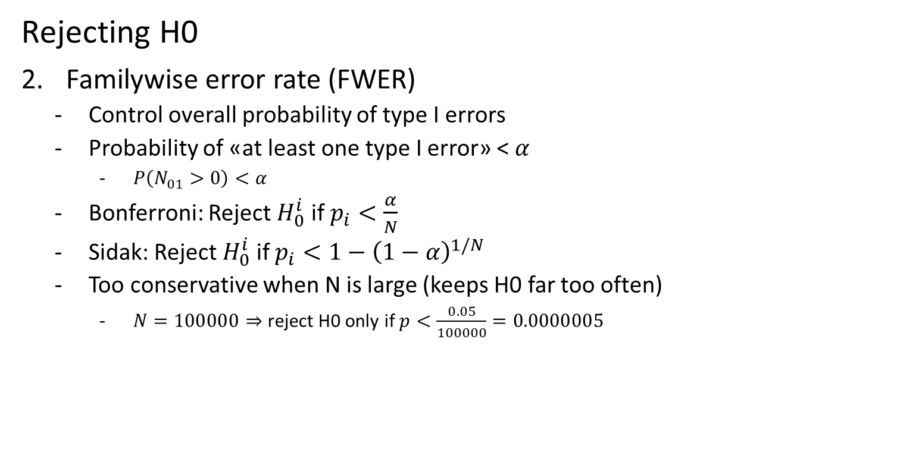
Multiple testing
 |  | Result of test
 |  | Keep $H_{0}$ | Reject $H_{0}$ | Sum
The truth | $H_{0}$ true | $$N_{00}$$ | $$N_{01}$$ | $$N_{0}$$
 | $H_{0}$ false | $$N_{10}$$ | $$N_{11}$$ | $$N_{1}$$
 | Sum | $$n_{0}$$ | $$n_{1}$$ | $$N$$
Rejecting H0
Familywise error rate (FWER)
Control overall probability of type I errors
Probability of «at least one type I error» < $α$
$P\left(N_{01}>0\right)<α$
Bonferroni: Reject $H_{0}^{i}$ if $p_{i}<\frac{α}{N}$
Sidak: Reject $H_{0}^{i}$ if $p_{i}<1−{\left(1−α\right)}^{1/N}$
Too conservative when N is large (keeps H0 far too often)
$N=100000⇒$ reject H0 only if $p<\frac{0.05}{100000}=0.0000005$

Slide 9
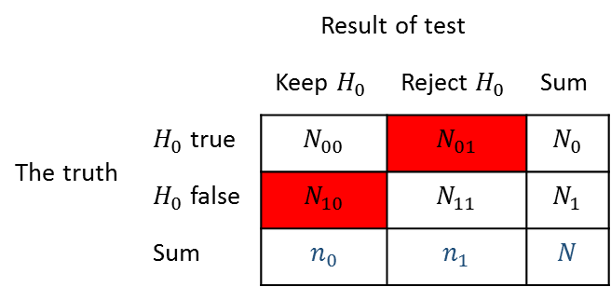

Multiple testing
 |  | Result of test
 |  | Keep $H_{0}$ | Reject $H_{0}$ | Sum
The truth | $H_{0}$ true | $$N_{00}$$ | $$N_{01}$$ | $$N_{0}$$
 | $H_{0}$ false | $$N_{10}$$ | $$N_{11}$$ | $$N_{1}$$
 | Sum | $$n_{0}$$ | $$n_{1}$$ | $$N$$
Rejecting H0
3. False discovery rate (FDR)
Focuses only on tests where H0 was rejected ($N_{01}$ and $N_{11}$)
Expected proportion of rejections that are false rejections
$E\left[\frac{N_{01}}{N_{01}+N_{11}}\right]<q$

Slide 10
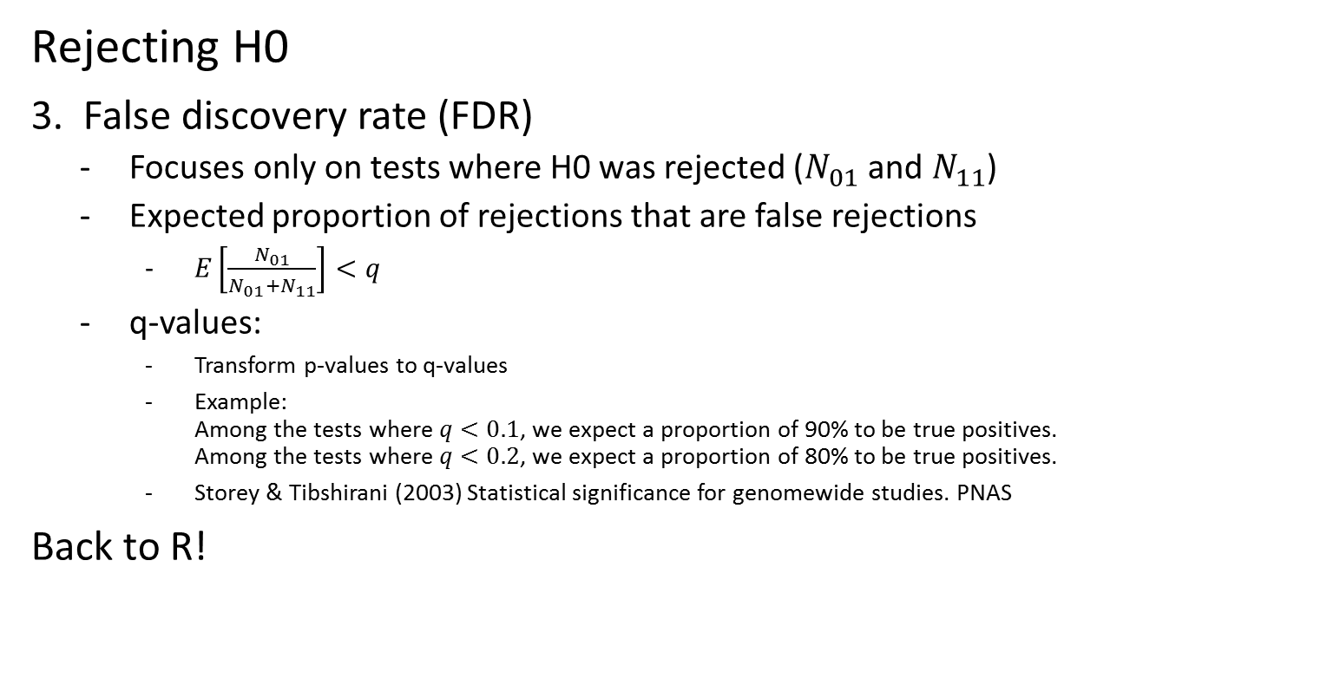
Multiple testing
 |  | Result of test
 |  | Keep $H_{0}$ | Reject $H_{0}$ | Sum
The truth | $H_{0}$ true | $$N_{00}$$ | $$N_{01}$$ | $$N_{0}$$
 | $H_{0}$ false | $$N_{10}$$ | $$N_{11}$$ | $$N_{1}$$
 | Sum | $$n_{0}$$ | $$n_{1}$$ | $$N$$
Rejecting H0
3. False discovery rate (FDR)
Focuses only on tests where H0 was rejected ($N_{01}$ and $N_{11}$)
Expected proportion of rejections that are false rejections
$E\left[\frac{N_{01}}{N_{01}+N_{11}}\right]<q$
q-values:
Transform p-values to q-values
Example: Among the tests where $q<0.1$, we expect a proportion of 90% to be true positives. Among the tests where $q<0.2$, we expect a proportion of 80% to be true positives.
Storey & Tibshirani (2003) Statistical significance for genomewide studies. PNAS
Back to R!

Slide 11
Manhattan plot
Zoom out to get an overview of where on the genome low p-values are prevalent
X-axis: Chromosome and position on chromosome
Y-axis: -log10(p-value)
Right: Example from analyses looking for gene-environment effects on the risk of facial clefts. SNPs with p-values less than 0.00001 are colored blue.

Slide 12
Manhattan plot
What is going on here?
Zoom out to get an overview of where on the genome low p-values are prevalent
X-axis: Chromosome and position on chromosome
Y-axis: -log10(p-value)
Right: Example from analyses looking for gene-environment effects on the risk of facial clefts. SNPs with p-values less than 0.00001 are colored blue.

Slide 13
Regional plot
Zoom back in to get more detail on the areas of interest
X-axis: Position on chromosome Genes Recombination rate at position
Y-axis: -log10(p-value) Recombination rate
Right: Regional plot for rs4243412 (blue). Linkage disequilibrium with rs4243412 is indicated by colors (red, orange, yellow, white). Light blue lines indicate recombination rate.

Slide 14

Thank you for your attention!

