Slide 1

Rethinking REST in a Microservices World
James Roper
@jroper

Slide 2
Agenda
What is asynchronous communication?
Asynchronous vs synchronous architectures
Asynchronous communication in practice

Slide 3
Asynchronous communication
Not asynchronous IO
  Asynchronous IO is good…
  … but that's not what this presentation is about

Slide 4
Asynchronous IO
Don't consume threads while waiting for things
  Responses are handled via callbacks
CompletionStage<Response> futureResponse = makeRequest();
CompletionStage<MyModel> futureModel =
futureResponse.thenApply(response -> {
MyModel model = decode(response.getBody());
return model;
});
  Callback only takes a thread when it's executed

Slide 5
Asynchronous communication
Not asynchronous IO
  Asynchronous IO is good…
  … but that's not what this presentation is about
  Asynchronous IO is about not blocking threads
Async communication is not blocking requests
  A service processing a request shouldn't block on another service

Slide 6
Synchronous communication
B
C
A
E
D

Slide 7
Synchronous communication
Failure bubbles back up
Slow response times bubble back up
Some services will be needed by everything
  Bottleneck to load
  Single point of failure
Often whole system needs to be up to serve any request

Slide 8
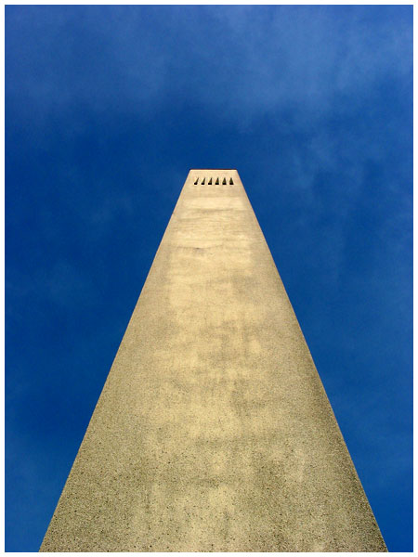
https://flic.kr/p/4h6k

Slide 9
Asynchronous communication
B
✔
C
✔
✔
A
E
✔
D

Slide 10
Asynchronous communication
Failure stops at the failed component
Slow response time stops at slow component
Removes bottlenecks/single points of failure
Consistency may lag
  But can be eventually consistent
Components are isolated

Slide 11
REST
REST is a synchronous messaging protocol
  Client sends a request, server sends a response
Can be used for asynchronous messaging
  204 No Content
It's not really the problem
  But...

Slide 12
Danger!
We have a monolith called Chirper
Monoliths are bad!
Let's convert to microservices

Slide 13
Chirper monolith
FriendService
REST!
ChirpService
REST!
REST!
LikeService

Slide 14
Monolith to microservices
Problem is that REST is our go to
  Let's just replace method calls with REST calls!
When moving to microservices
  Don't just do 1:1 service/interface replacement
  Design for asynchronous architecture

Slide 15
Asynchronous in practice
Let's look at two approaches
  Denormalize and push data
  Communicate through the client

Slide 16
Dernormalize and push
Services store all data they need
  This may mean duplicating, aka denormalizing data
Consistency needs to be addressed
  One approach is at least once messaging and idempotency

Slide 17
Chirper Likes
Chirps
GET /chirps
✔
GET /likes
Likes
like count

Slide 18
Demo
Chirper implemented using Lagom
  Reactive microservices framework for the JVM
  First class support for asynchronous messaging
  High productivity development environment
  Guides you all the way to production

Slide 19
Communicate through client
Client can cache data
  Mobile clients in particular
  Browsers with localStorage
Client can use own cache as fallback

Slide 20
Chirper Activity Stream
Activity
GET /friends
Friends
GET /feed
Get /chirps
Chirps
✔
Get /chirps

Slide 21
Demo

Slide 22
Client authorization
Communicate authorization through client
  Use authorization tokens, eg JWT
  Load token with entity – eg friends
  Send that token with actions
  Receiving service authorizes using token

Slide 23
Next steps
Try out Lagom
  https://lightbend.com/lagom
Read Jonas Bonér's Reactive Services Architecture
  https://lightbend.com/reactive-microservices-architecture
Check out this presentation
  https://github.com/jroper/rethinking-rest

