Slide 2
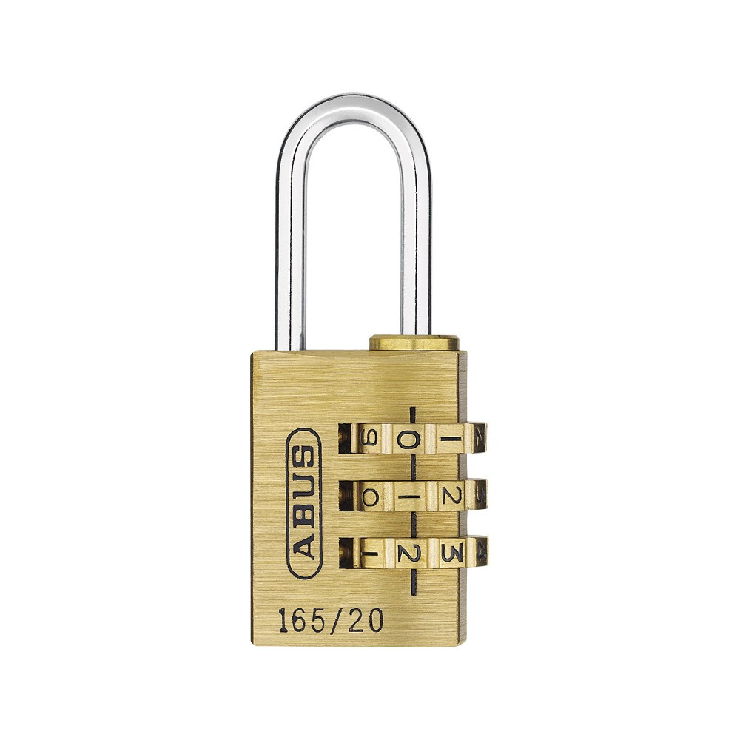
Closed
5
1
4

Slide 3
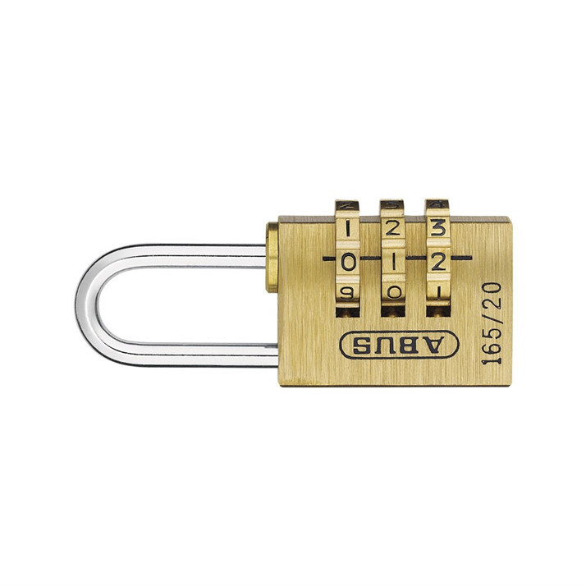
Open
7
7
7

Slide 4
Requirements
12 mögliche Kombinationen
1. Rad: 4,5,6,7
2. Rad: 5,6,7
3. Rad: 7
1 richtige Kombination
Microsoft Edge
Or possibly Firefox
Font (hand writing!)

