Slide 1

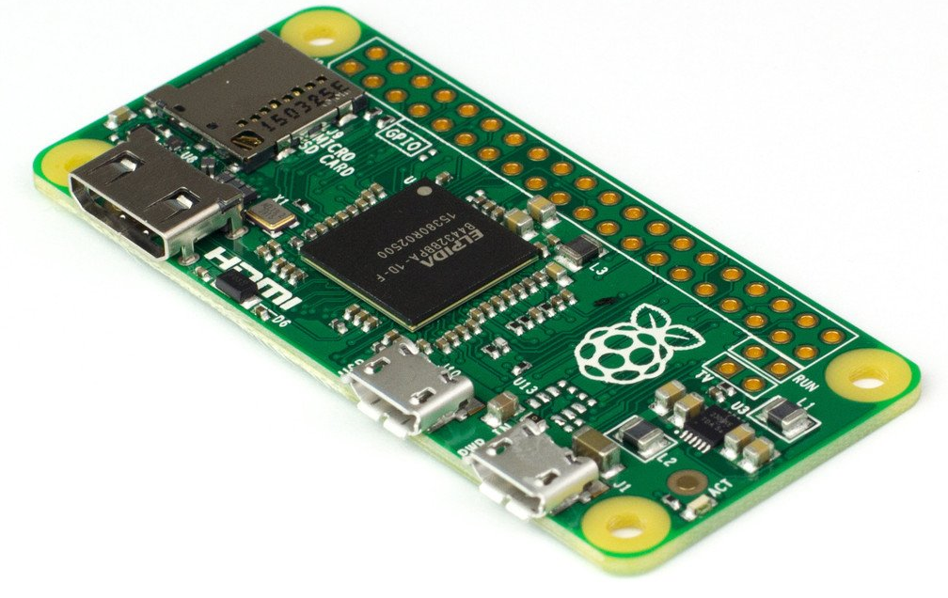
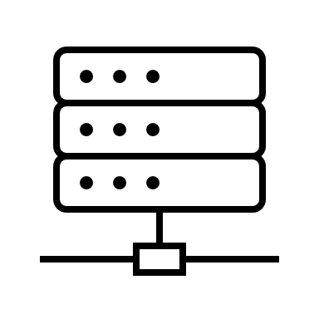

Check tank level
Control pump operation
System View
Web App
INSERT SCREENSHOT
OR Pond Control by js
Stream
Tank Level
Gauge
Water Pump
Water Tank (1m³)
Tube
(+VPN)
~ 230V
Relay
11x Wires (3.3V)
Raspberry Pi Zero W
GPIO
python pump relay
control
python
control logic
R/W
python
read tank level
nginx webserver
text files
GPIO
LAN
Wi-Fi
python
Django
app
schedule.csv
uwsgi R/W
mode.cfg
Thingspeak
IoT Platform
timer.cfg
python
REST / POST call
manual.cfg

