Slide 1
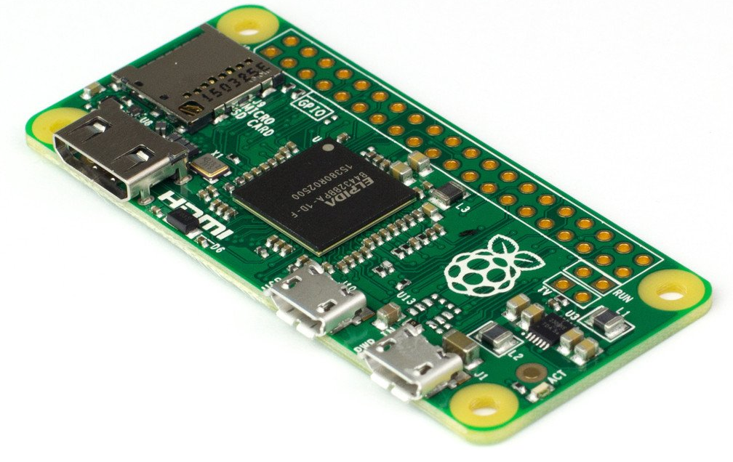
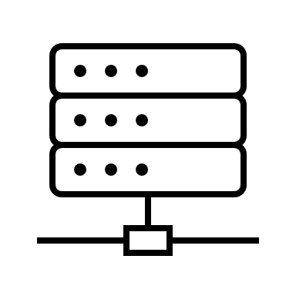

Web App
INSERT SCREENSHOT
Stream
Water Pump
Water Tank
Tank Level Gauge
~ 230V
Relay
11x 3.3V
(+VPN)
Raspberry Pi Zero W
pump relais
control / GPIO
control logic
R/W
read tank level / GPIO
nginx webserver
text files
LAN
WiFi
Django
app
R/W
schedule.csv
mode.cfg
timer.cfg
manual.cfg

