Slide 1
Thinking of and with Data: Supporting and Understanding Engaging Learning in STEM
Joshua M. Rosenberg, Doctoral Candidate
Michigan State University
January 23, 2018
University of Tennessee, Knoxville
Department of Theory and Practice of Teacher Education
Notes:
Thank you to the Mehmet Aydeniz and the search committee and the faculty and students in the TPTE department as well as Ms. Gina Guinn for making this trip possible.
This talk is on thinking of and with data in STEM.
In particular, this talk is focused on the affordances of new sources of data for teachers and students.
And, is on how new sources of data can help us understand teaching and learning in STEM.

Slide 2
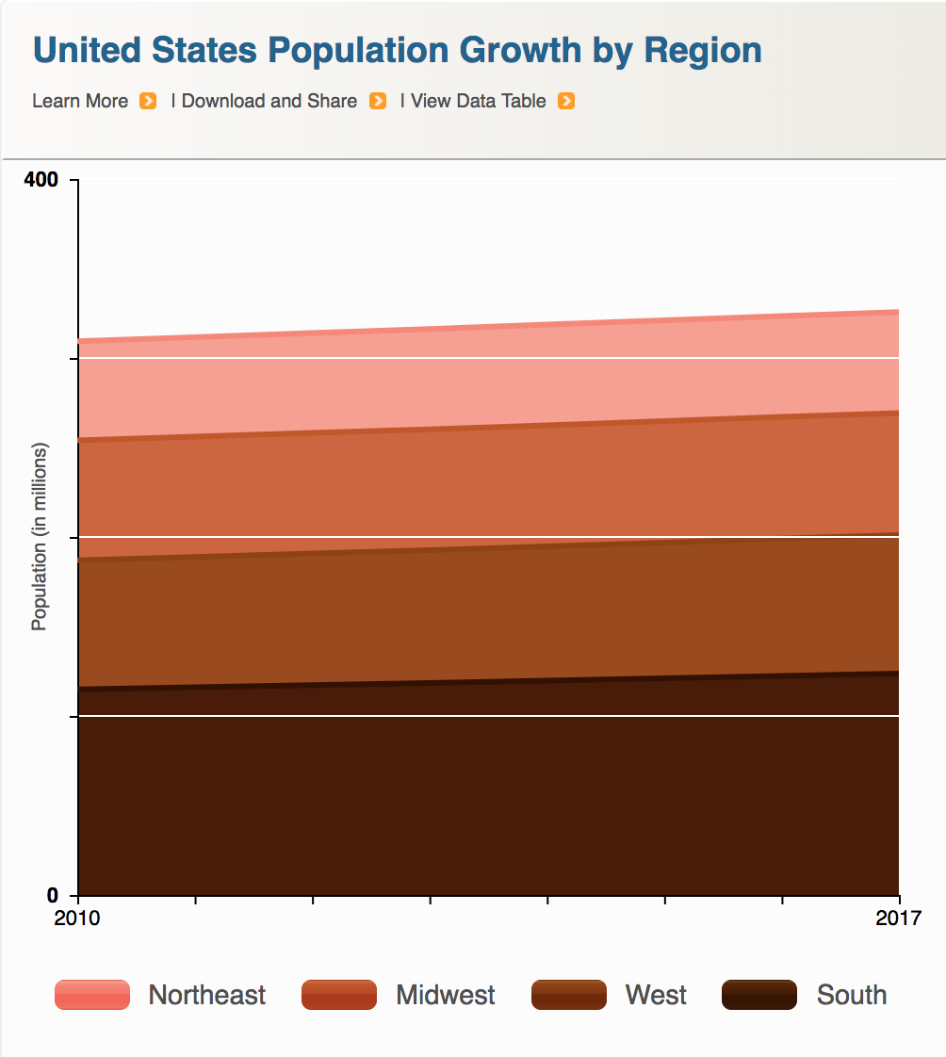


Data is power(ful)
Introduction | ESM | Networks | Future Work | Conclusion
Companies
Government
Citizens

Slide 3
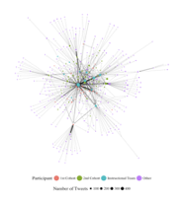
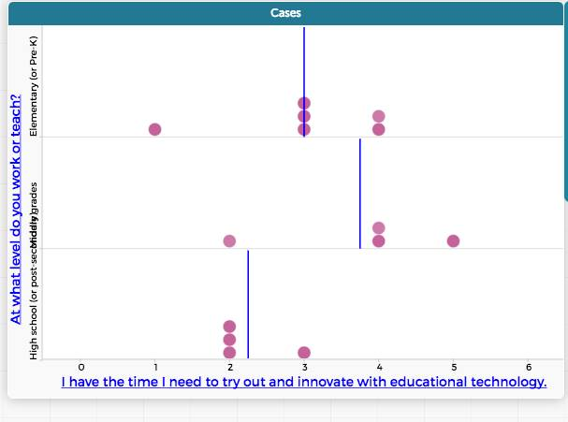
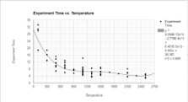
Data is power(ful)
Introduction | ESM | Networks | Future Work | Conclusion
Researchers
Teachers
Students

Slide 4
Guiding research questions
Students, teachers, and researchers’ thinking of and with data
What are the affordances of new types of data in STEM education?
How does this data help us understand teaching and learning in STEM?

Slide 5
Introduction | ESM | Networks | Future Work | Conclusion
Introduction
Experience Sampling
Network
Future Work
Conclusions

Slide 6
I think my model is
for other students
sf

Slide 7
Introduction | ESM | Networks | Future Work | Conclusion

Slide 9
Outline

