Slide 1
Thinking of and with Data: Supporting and Understanding Engaging Learning in STEM
Joshua M. Rosenberg, Doctoral Candidate
Michigan State University
January 23, 2018
University of Tennessee, Knoxville
Department of Theory and Practice of Teacher Education
Notes:
Thank you to the Mehmet Aydeniz and the search committee and the faculty and students in the TPTE department as well as Ms. Gina Guinn for making this trip possible.
This talk is on thinking of and with data in STEM.
In particular, this talk is focused on the affordances of new sources of data for teachers and students.
And, is on how new sources of data can help us understand teaching and learning in STEM.

Slide 2
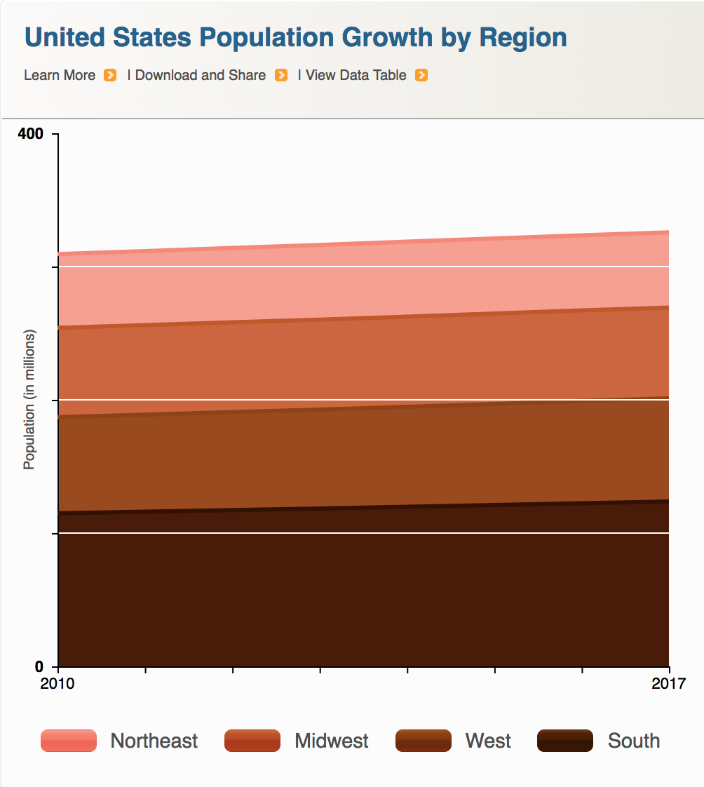


Data is power(ful)
Introduction | ESM | Text | Networks | Future Work | Conclusion
Companies
Government
Citizens

Slide 3
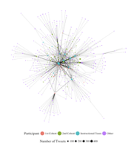
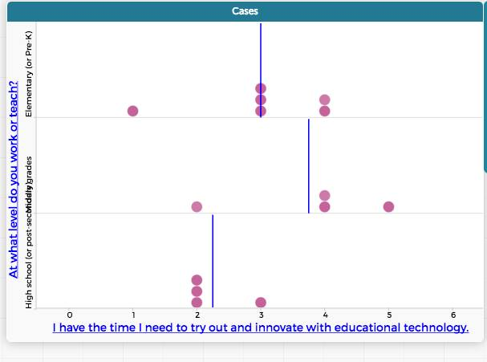
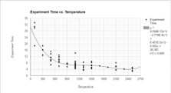
Data is power(ful)
Introduction | ESM | Text | Networks | Future Work | Conclusion
Researchers
Teachers
Students

Slide 4
Guiding questions and aims
Introduction | ESM | Text | Networks | Future Work | Conclusion
Demonstrate the affordances of thinking of and with new types of data for STEM education
To show how these new types of data help us to understand teaching and learning in STEM
Notes:
These are the guiding questions that setup the use and discussion of affordances of different data sources and then illustrations of what we can learn from them.
Goal is to show strengths of what kind of research we can do.

Slide 5
Introduction | ESM | Text | Networks | Future Work | Conclusions
Experience Sampling Method
Text Data
Digital Traces and Network Data
Future Work
Notes:
The organization of the talk is to discuss three data sources, their affordances, and what we can learn about teaching and learning in STEM from work with them.

Slide 6
To demonstrate the affordances of new types of data for STEM education
Introduction | ESM | Text | Networks | Future Work | Conclusion
Go beyond “doing school” and empower students to think of and with data (Berland, Schwarz, Krist, Lo, & Reiser, 2016; Horton & Hardin, 2015)
Support positive feedback loops with other school subjects
Use digital methods and data sources (Mishra, Koehler, & Greenhow, 2015; Baker & Siemens, 2015)
Notes:
I’m trying to lay out my findings ahead of time, but I’m having a bit of trouble with this and the next slide

Slide 7
To show how this data helps us understand teaching and learning in STEM
Introduction | ESM | Text | Networks | Future Work | Conclusion
Understand learning over time and from moment-to-moment (Cobb, Confrey, DiSessa, Lehrer, & Schauble, 2003)
Explore STEM teaching and learning in classroom contexts (Hatch, 2002)
Document complex teaching and learning process (Salganik, 2017)

Slide 8
Introduction | ESM | Text | Networks | Future Work | Conclusion
Experience Sampling Method
Text Data
Digital Traces and Network Data
Future Work
Notes:
The organization of the talk is to discuss three data sources, their affordances, and what we can learn about teaching and learning in STEM from work with them.

Slide 9
Experience sampling method (ESM)
Introduction | ESM | Text | Networks | Future Work | Conclusion
Involves asking people about their experiences using short surveys
Use of an app on phone
Every 15-30 minutes
“When you were signaled, how interested were you in what you were learning?”
Notes:
I know this past research is a stretch – I would like to keep this just for the moment :)

Slide 10
Experience sampling method (ESM)
Introduction | ESM | Text | Networks | Future Work | Conclusion
Affordances:
Understand learning experiences in a qualitatively distinct way (Hecktner, Schmidt, & Csikszentmihalyi, 2007)
Helps us to understand moment-to-moment changes in experiences and what impacts experiences
Allows us to understand experiences during activities rather than overall pre- and post-assessments of what did or did not work
Notes:
I know this past research is a stretch – I would like to keep this just for the moment :)
Importance (but under-emphasis on) context in research on teacher knowledge (Rosenberg & Koehler, 2015)
Role of context in explaining processes around teaching and learning with technology (Phillips, Koehler, & Rosenberg, 2016)

Slide 11
Purpose
Introduction | ESM | Text | Networks | Future Work | Conclusion
Explored “business-as-usual” and hands-on science, activities using a person-in-context approach (Schmidt, Rosenberg, & Beymer, 2018, JRST)
Use of ESM data and oerson-oriented analysis
To understand how learning activities (e.g., laboratory activities or lecture) and being able to choose impact students’ engagement
Notes:
Demonstrate how data can be used to empower teachers and students.

Slide 12
Context and Sample
Introduction | ESM | Text | Networks | Future Work | Conclusion
12 high school classrooms
Large, urban high school outside of a large metropolitan area
244 students, 4,136 responses
Notes:
Measures:
Experience Sampling Method for engagement and choice
Activities coded from video-recordings
Person-in-context approach:
Two step cluster analysis (Rosenberg, Schmidt, & Beymer, 2017)
Interpreted profile solutions on the basis of measures of fit, cross-validation, and concerns of parsimony

Slide 13
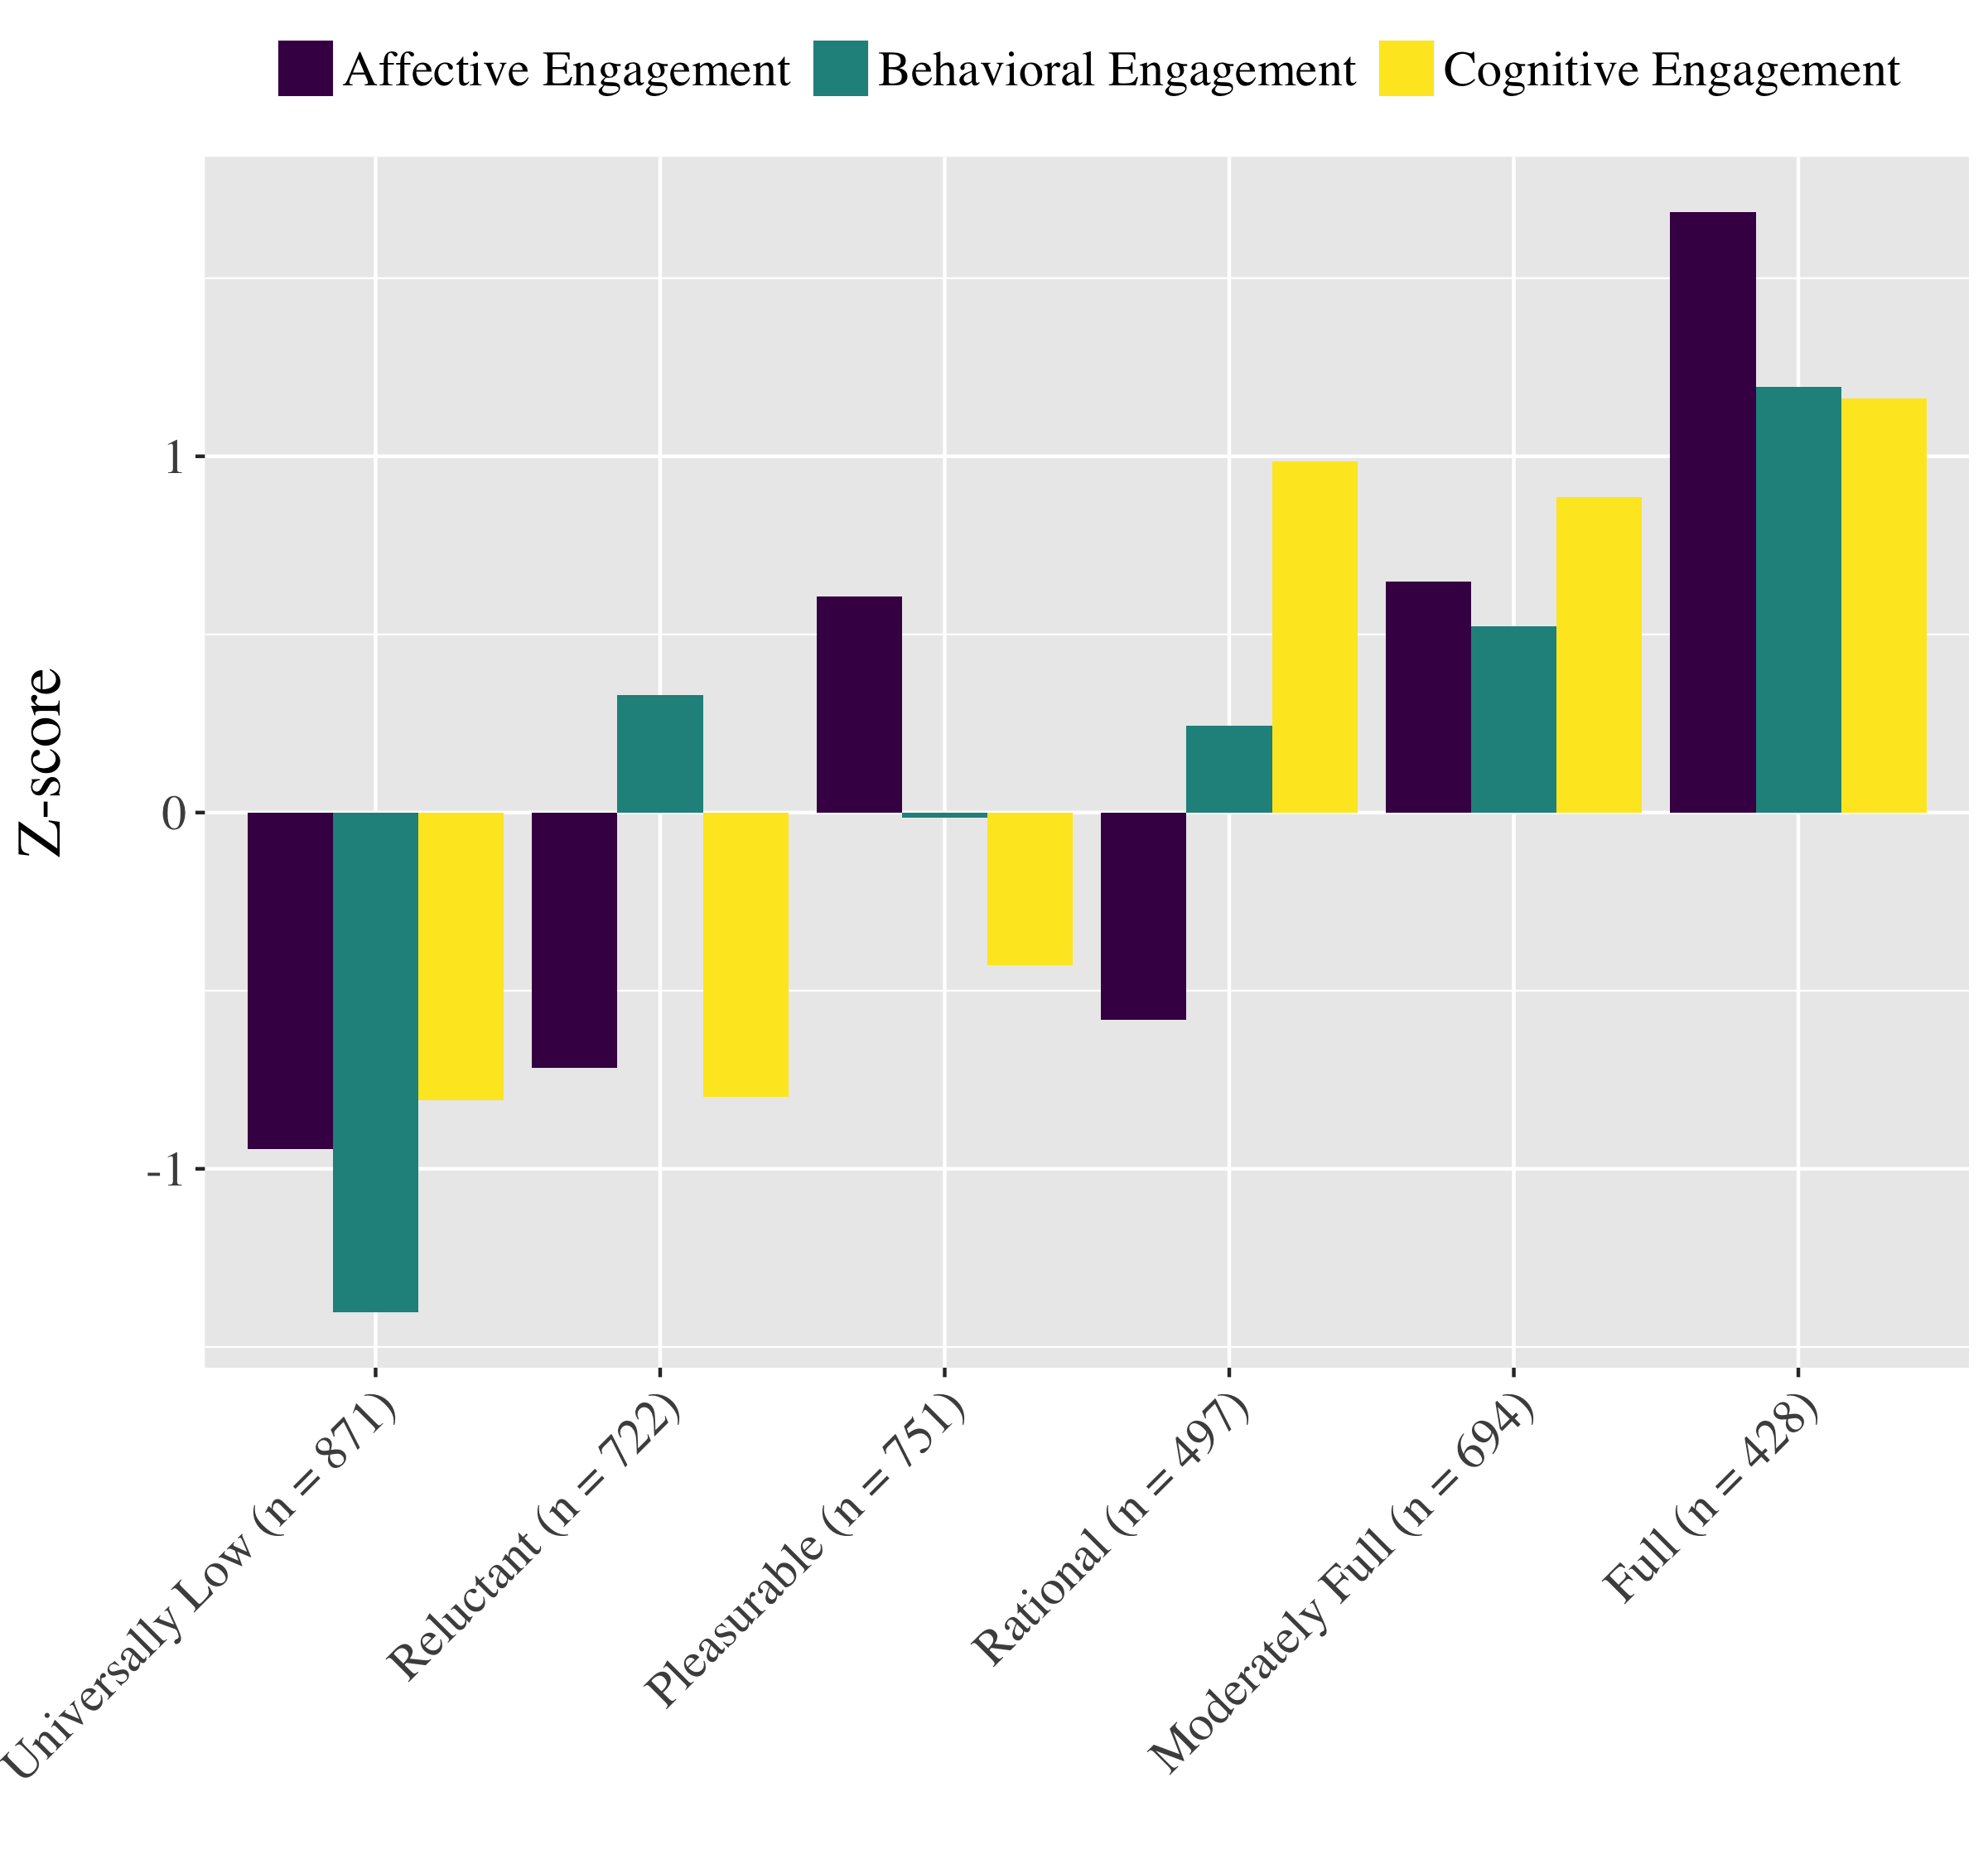
Profiles of Momentary Engagement
Introduction | ESM | Text | Networks | Future Work | Conclusion
Identified momentary profiles of engagement
Found six profiles from Universally Low to Full, with four complex patterns
Note students report multiple profiles

Slide 14
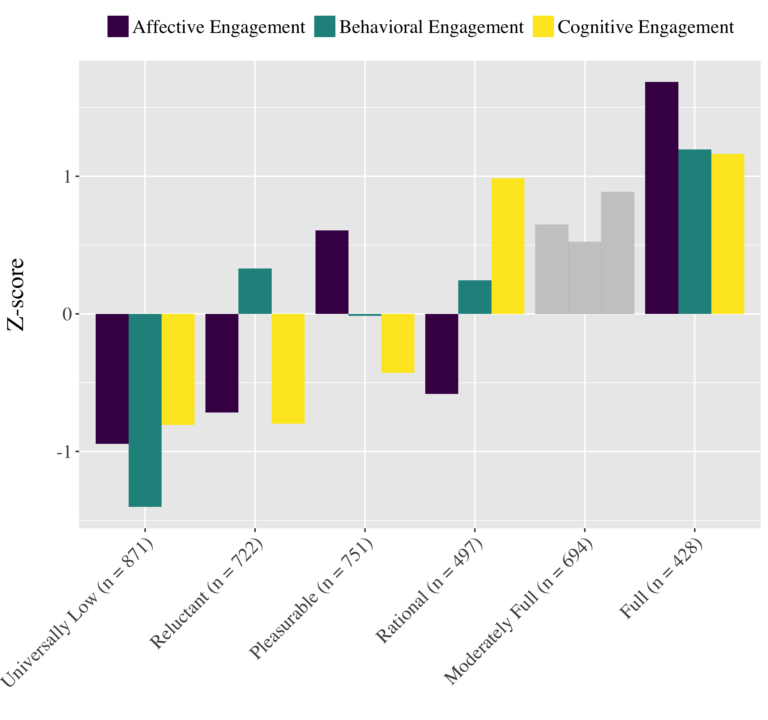
Laboratory
Activities
+
−
+
−
+
Notes:
Bear in mind that the bars on these figures are not displaying how often each of these profiles occur in activities – the plusses and minuses give you an indication of that.
The bars are simply representing how the profiles are defined – the plusses and minuses say if they are more or less likely to occur in Lab.

Slide 15
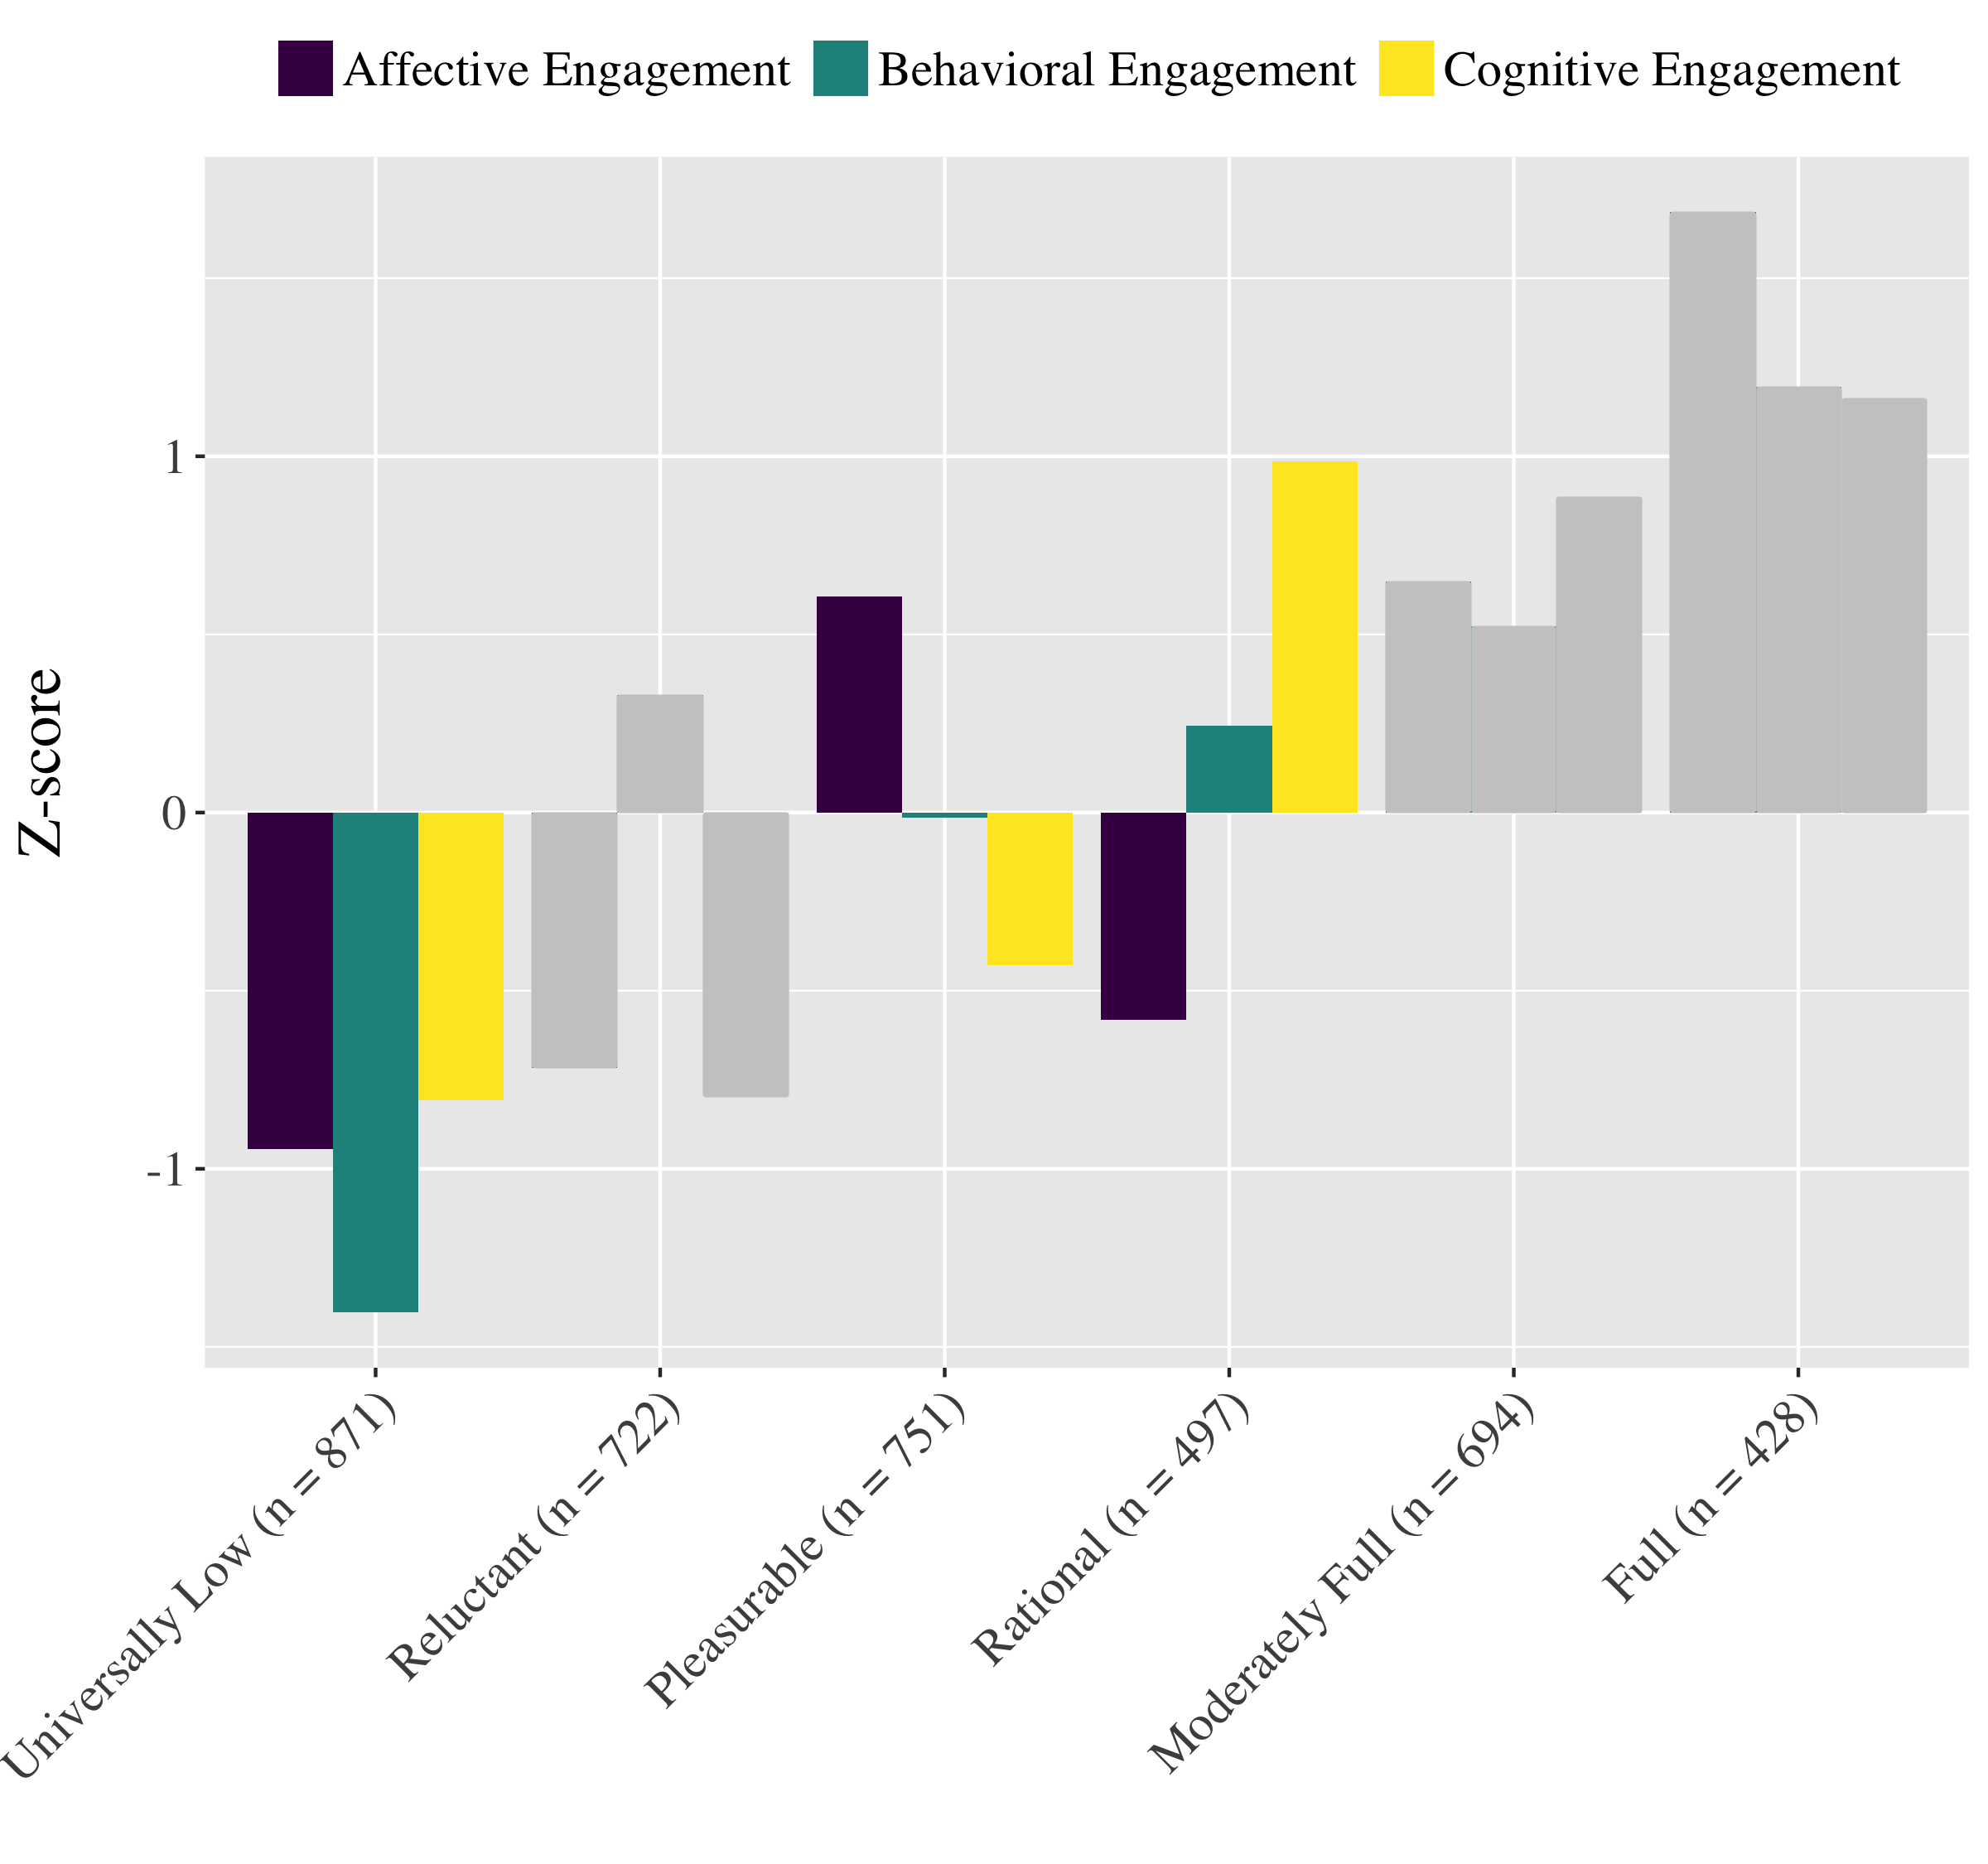
Test Activities
-
-
+

Slide 16
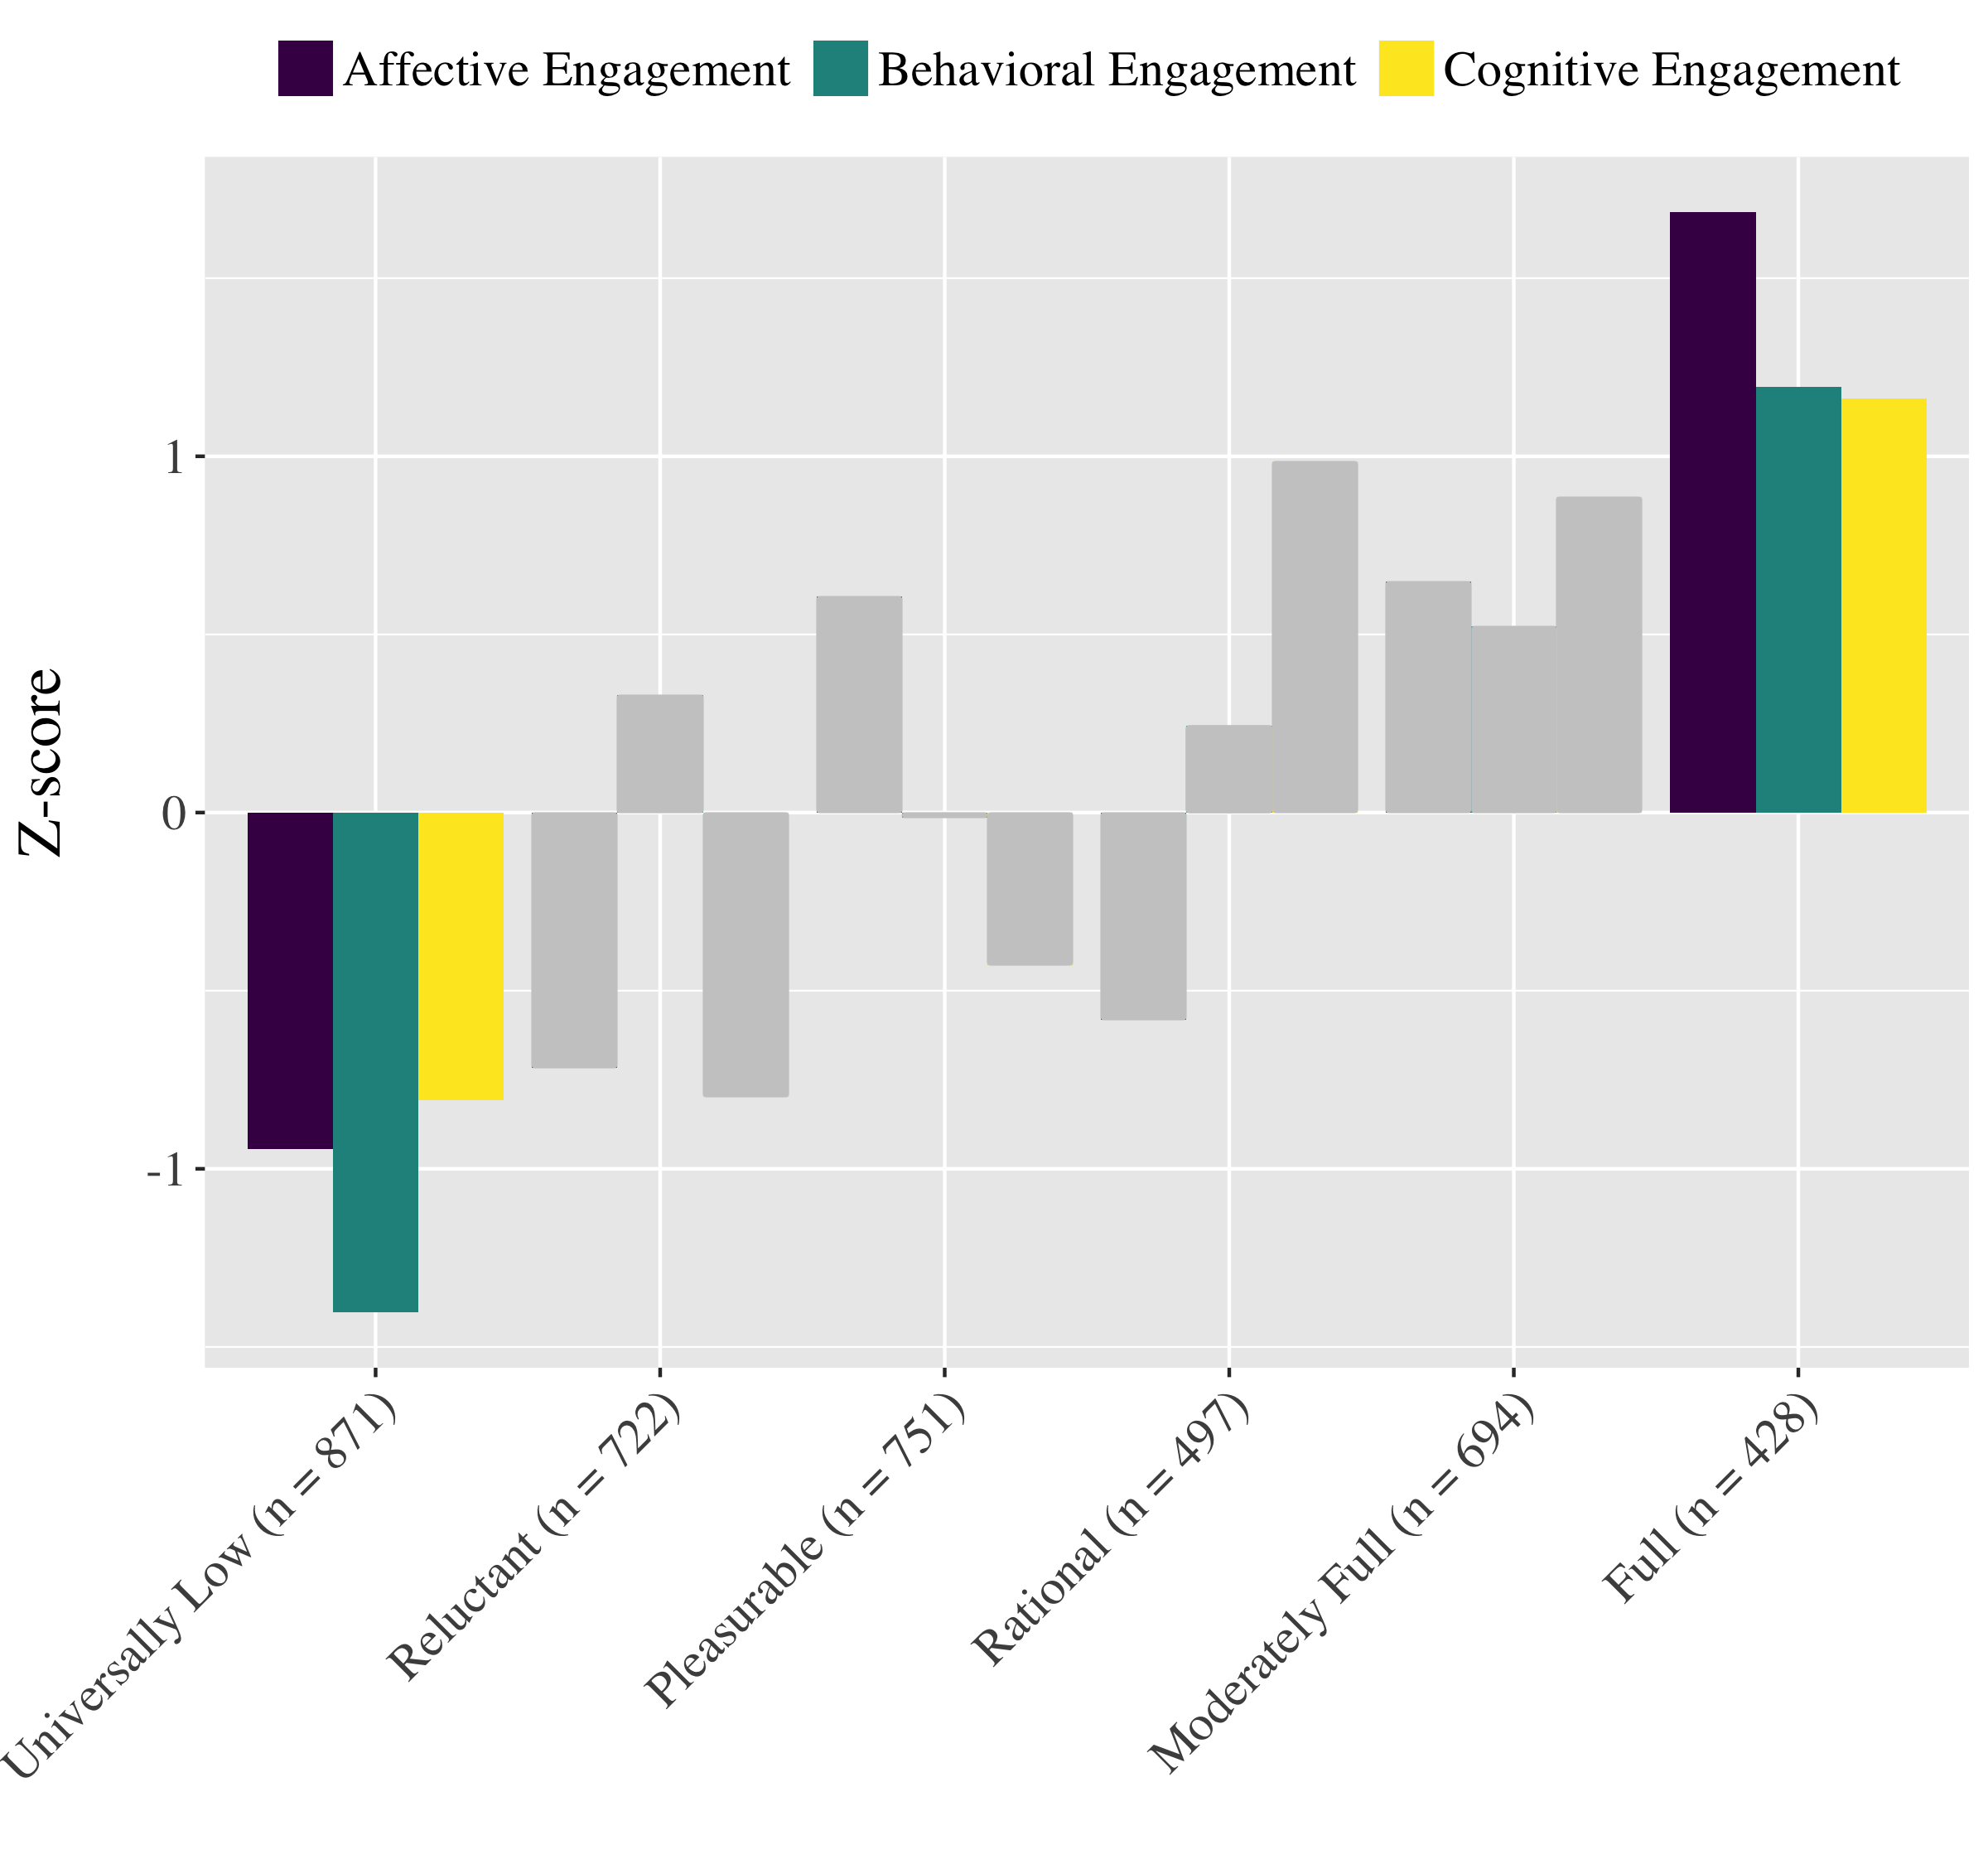
Choice:
Framing
-
+
Notes:
We next explored the various choices that students perceived having (framing, materials, who, etc.). Because these choice indicators were not mutually exclusive (e.g., students might report that they chose who they worked with AND what materials they chose… We ran a series of logistic regressions predicting the likelihood of being in each profile, given the choices afforded the student at that moment. So regression coefficients can be interpreted as independent effects of a particular choice, controlling on other choices that may have been relevant at the time. So here, for example, when students had choice in framing, they were half as likely to report universally low engagement and were 60% more likely to report full engagement.

Slide 17
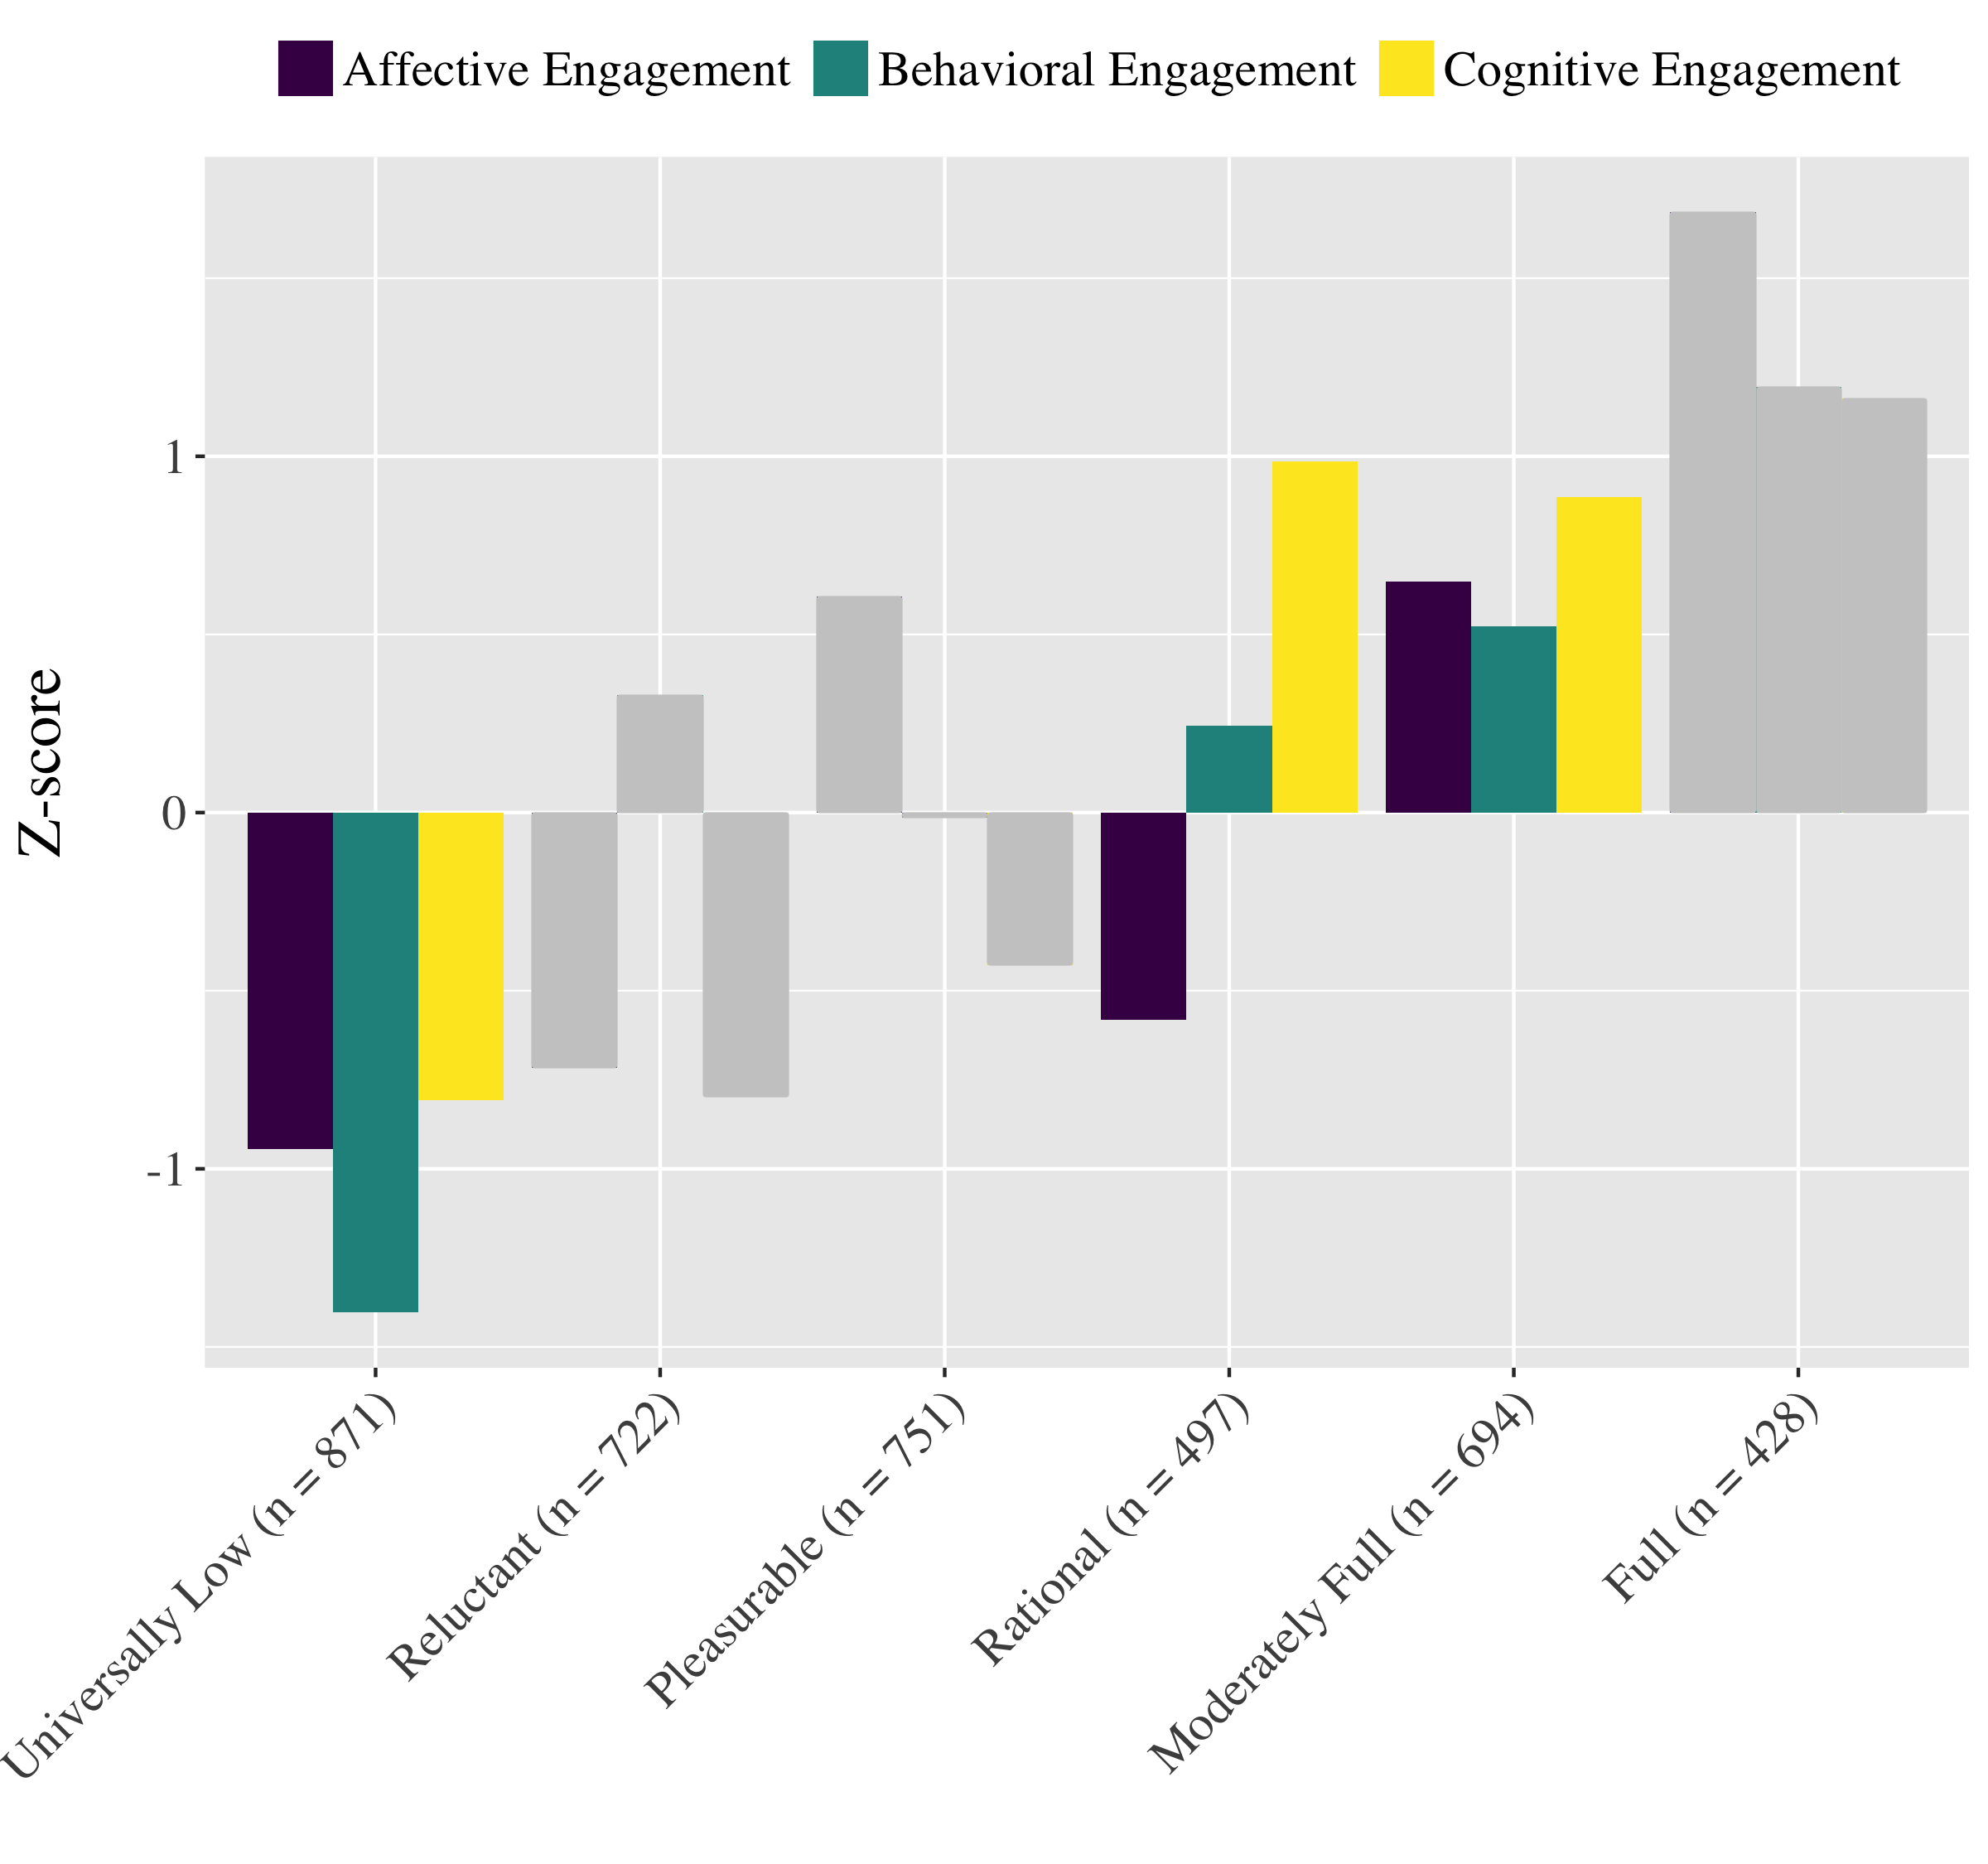
Choice:
With whom
+
−
-
Notes:
Universally low engagement is the most frequently observed profile, and is observed almost twice as often as full engagement, which is the least frequently observed profile.
The majority of observations represent one of these “intermediary” engagement profiles characterized by higher levels on one engagement dimension but lower levels on others.

Slide 18
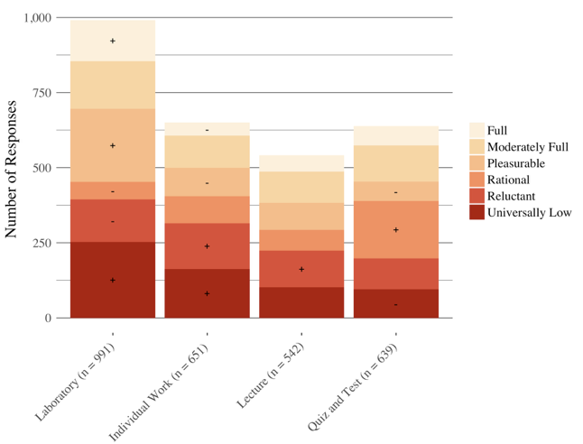
The impact of activities
Introduction | ESM | Text | Networks | Future Work | Conclusion

Slide 19
How engaged are students in-the-moment in science activities?
Introduction | ESM | Text | Networks | Future Work | Conclusion
 | Universally Low | Reluctant | Pleasurable | Rational | Moderately Full | Full
(Intercept) | 0.25 | 0.20 | 0.18 | 0.12 | 0.16 | 0.09
Who | 1.43 *** | 1.19 | 1.00 | .35 *** | .44 | 1.20
Materials | .38 *** | .38 *** | 1.36 * | 1.14 | 1.54 ** | 1.15
Time | .38 *** | 0.47 | 0.49 | 1.82 *** | 1.26 | 0.47
How to Do | .45 | 1.07 | 0.48 | 0.46 | 1.14 | 1.35 *
Framing | .44 * | 0.46 | 0.48 | 1.14 | 1.06 | 1.60 ***
Other | 0.49 | .40 *** | 1.24 * | 0.45 | .12 | 1.27
Results from logistic regressions; p < .05, ** p < .01, *** p < .001
Notes:
I know I need to present this different, I’m just not sure how yet—I think I may focus on specific profiles from the last slide and then highlight key relationships.

Slide 20
The impacts of choice during laboratory
Introduction | ESM | Text | Networks | Future Work | Conclusion
During laboratory, when students were able to make any choice (who, materials, time, how to do, framing, or other):
They are more likely to be fully engaged (z = 3.90, p < .05), which is not the case when they report no choice (z = -.23)

Slide 21
The impacts of choice
Introduction | ESM | Text | Networks | Future Work | Conclusion
For example, when students can choose with whom to work:
When students can choose the topic o

Slide 22
How engaged are students in-the-moment in science activities?
Introduction | ESM | Text | Networks | Future Work | Conclusion
 | Choice | Universally Low | Reluctant | Pleasurable | Rational | Moderately Full | Full
Individual Work
 | Any | 1.45 | 0.76 | -0.05 | -0.48 | -0.64 | -1.44
 | None | 1.05 | 3.33* | -2.77* | -0.1 | -0.14 | -3.36*
Laboratory
 | Any | 1.61 | -2.22* | 5.38* | -6.10* | 1.79 | 3.90*
 | None | 1.96 | -2.16* | 1.38 | -5.33* | -3.86* | -0.23
Lecture
 | Any | -3.70* | -0.08 | -1.84 | -1.86 | -0.77 | 0.5
 | None | 1.6 | 3.20* | 1.22 | 0.39 | 2.26* | -1.13
Quiz and Test
 | Any | -4.83* | -0.95 | -3.31* | 6.42* | 1.26 | 0.66
 | None | -0.7 | -0.99 | -3.49* | 6.26* | -0.15 | -1.34
p < .05, ** p < .01, *** p < .001
Notes:
This is related to the last slide – may put at the end.

Slide 23
Key findings
Introduction | ESM | Text | Networks | Future Work | Conclusion
Use of ESM allowed us to study the impacts of the learning activity and choice
Different activities in science are associated with different profiles of engagement
Providing chances for students to decide what to do or how to do it also impacts their engagement
As students move from activity to activity, their engagement can change
Notes:
Laboratory activities in science can be highly engaging
Choice—especially related to how students do laboratory activities and who determines how the activities is framed (choosing the purpose or topic)—is a key factor affecting how engaging laboratory activities are
Person-in-context approach helped us to characterize distinct profiles of engagement

Slide 24
How do students engage in work with data?
Introduction | ESM | Text | Networks | Future Work | Conclusion
Studied work with data in summer STEM programs using profiles of engagement and its conditions (PECs) (Rosenberg, in preparation)
Need to explore work with data in-the-moment in summer STEM programs to make recommendations regarding nature of work with data in such programs
Can support design of activities and interventions around work with data that are highly engaging to students and that support their capabilities to work with data

Slide 25
How do students engage in work with data?
Introduction | ESM | Text | Networks | Future Work | Conclusion
Context and Participants:
Nine summer STEM programs in urban areas in the Northeast
Racially and ethnically diverse (90% of youth from historically under-represented [in STEM] groups)
204 youth
2970 ESM responses
Measures:
ESM self-reports for cognitive, behavioral, and affective and perceptions of challenge and competence
Video-recordings of activities
Pre-program measures of interest

Slide 26
How do students engage in work with data?
Introduction | ESM | Text | Networks | Future Work | Conclusion
Developed open-source tool for Latent Profile Analysis (Rosenberg, 2018)
Interpreted profile solutions on the basis of measures of fit, cross-validation, and concerns of parsimony and interpretability
Used cross-classified mixed effects (or multi-level models) to account for youth, moment-to-moment, and program effects

Slide 27
How do students engage in work with data?
Introduction | ESM | Text | Networks | Future Work | Conclusion
Work With Data | Description
Asking questions or defining problems | Discussing and exploring topics to investigate and pose questions.
Making observations | Watching and noticing what is happening with respect to the phenomena or problem being investigated.
Generating data | Figuring out how or why to inscribe an observation as data and generating coding frames or measurement tools.
Data modeling | Understanding and explaining phenomena using models of the data that account for variability or uncertainty.
Interpreting and communicating findings | Discussing and sharing and presenting findings.

Slide 28
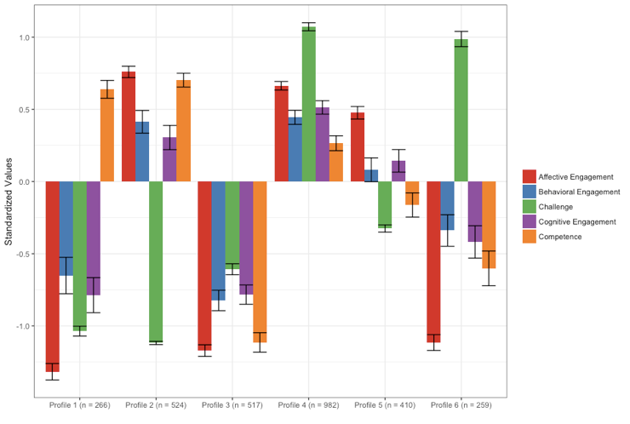
How do students engage in work with data?
Introduction | ESM | Text | Networks | Future Work | Conclusion
Notes:
6 profiles, model 2, estimated in Mplus via tidyLPA
Change the order of the clustered variables
Need to name the profiles

Slide 29
How do students engage in work with data?
Introduction | ESM | Text | Networks | Future Work | Conclusion
Key findings:
When learners are challenged, they also need to perceive themselves to be good at what they are to be highly engaged
When learners are highly engaged affectively, their behavioral and cognitive engagement and perceptions of being challenged or good at the activity are moderate
When students report high competence but low challenge, they are not as cognitively engaged as when challenged

Slide 30
How do students engage in work with data?
Introduction | ESM | Text | Networks | Future Work | Conclusion
Next steps:
Predict profiles of engagement and its conditions on the basis of the five codes for work with data:
Asking questions or defining problems
Making observations
Generating data
Data modeling
Interpreting and communicating findings
Analyze videos associated with moments that are especially engaging (or disengaging)

Slide 31
Introduction | ESM | Text | Networks | Future Work | Conclusion
Introduction
Experience Sampling Method
Text Data
Digital Traces and Network Data
Future Work
Conclusions

Slide 32
Text data
Introduction | ESM | Text | Networks | Future Work | Conclusion
Affordances:
Can understand teachers and students experiences richly because data is in “own words”
Can be used with other data sources to triangulate understanding of complex phenomena
Past research
Explored scientific modeling in the middle grades classroom (Schwarz, Ke, Lee, & Rosenberg, 2014, ICLS)

Slide 33
How do teachers develop reform-based pedagogical practices?
Introduction | ESM | Text | Networks | Future Work | Conclusion
Explored how two fifth-grade science teachers diverged in their use of scientific modeling in their teaching (Rosenberg, Schwarz, & Akcaoglu, revise and resubmit, JTE)
Interviewed teachers at the start and end of a long-term research project
Provided professional development and curricular support
Similar context (students and school and teaching experiences)
One teacher became modeling-centered whereas the other stopped using modeling after the project ended

Slide 34
How do teachers develop reform-based pedagogical practices?
Introduction | ESM | Text | Networks | Future Work | Conclusion
Mrs. M: “I might choose one specific concept and spend five days on it and say, "Here's how you will be learning science in my classroom," and teach them how to make a good model and teach them what it is. So I would . . . really give them the groundwork to say, "Here's why you're doing this, here's what I'm looking for and here's how you share it.”
Mr. H: “Because modeling took so much time and it was something that, if it was part of my curriculum, I would have had no problem with . . . I felt that pressure of taking two or three months to work on this research project and I still need to cover all this other stuff for my students. If there was a way to build it around a curriculum that was already there, that would be a way better seller.”

Slide 35
How do teachers develop reform-based pedagogical practices?
Introduction | ESM | Text | Networks | Future Work | Conclusion
Key findings:
For Mrs. M, improvising, a focus on learning community, and a willingness to adapt resources and goals aligned with modeling and provided a focal endeavor for the class
Modeling came to be seen as an effective for science learning and highly satisfying for teaching
For Mr. H, addressing the curriculum promoting accurate scientific ideas with evidence and logic, scientific modeling was too time intensive
Modeling became a frustrating endeavor that hindered other important goals

Slide 36
Can writing about the relevance of science enhance students’ value and interest?
Introduction | ESM | Text | Networks | Future Work | Conclusion
Examined changes in middle school science students’ value and interest in science through a relevance intervention (Akcaoglu, Rosenberg, Ranellucci, & Schwarz, 2018, IJER)
Interventions can support students’ value of or interest in what they are learning (Lawowski & Hulleman, 2015)
Carried out a relevance intervention in fifth- and sixth-grade classrooms using a field experiment
Used students’ written responses to better understand the impact of students’ writing about the usefulness of what they were learning about

Slide 37
Can writing about the relevance of science enhance students’ value and interest?
Introduction | ESM | Text | Networks | Future Work | Conclusion
Context and sample:
212 students in eight MS classrooms
Analysis of written responses
Connections
Psychological processes elicited
Field experiment
Use of mixed effects (or multi-level) models

Slide 38
Can writing about the relevance of science enhance students’ value and interest?
Introduction | ESM | Text | Networks | Future Work | Conclusion
“If I am ever blowing up balloons for a party and I want to keep the balloons big, I will keep them in a warm room so the molecules speed up and spread out, hitting the sides of the balloons and expanding it. In a cold room, the molecules will slow down and come together and the balloons sides will close and become smaller.”

Slide 39
Can writing about the relevance of science enhance students’ value and interest?
Introduction | ESM | Text | Networks | Future Work | Conclusion
 | Time 2 Utility Value | Time 2 Value | Time 2 Interest
Fixed Parts
Intercept | 5.52 | 5.51 | 5.49
Time 1 Self-efficacy | -0.19 (0.15) | -0.19 (0.13) | -0.15 (0.15)
Time 1 Interest | 0.24 (0.09)* | 0.19 (0.08)* | 0.42 (0.10)*
Time 1 Utility Value | 0.43 (.08)*** | 0.46 (0.10)* | 0.29 (0.12)*
Intervention | 0.44 (0.20)* | 0.32 (0.17) | 0.02 (0.20)
Self-efficacy X Treatment | 0.24 (.209) | 0.12 (0.17) | 0.30 (0.20)
Gender | -0.22 (0.20) | -0.02 (0.17) | -0.30 (0.20)
Random Parts
Classroom 𝞂² | 1.73 | 1.23 | 1.67
Classroom ICC | 0.03 | 0.07 | 0.15
p < .05, ** p < .01, *** p < .001

Slide 40
Can writing about the relevance of science enhance students’ value and interest?
Introduction | ESM | Text | Networks | Future Work | Conclusion
Cognitive Processing (12.08% of text instead compared to 9.27% of text [t = 2.81; p < .05, d = .50])

Slide 41
Introduction | ESM | Text | Networks | Future Work | Conclusion
Introduction
Experience Sampling Method
Text Data
Digital Traces and Network Data
Future Work
Conclusions

Slide 42
Digital traces and network data
Introduction | ESM | Text | Networks | Future Work | Conclusion
Affordances:
Study informal professional learning and interest-driven communities
Can capture involvement and interactions in naturalistic settings
Past research
Examined the role of State Educational Twitter Hashtags as educational affinity spaces (Rosenberg, Greenhalgh, Koehler, Hamilton, & Akcaoglu, 2016; Rosenberg, Akcaoglu, Staudt Willet, Greenhalgh, & Koehler, 2017)
Documented teachers’ technology knowledge evidenced through digital portfolios using the TPACK framework (Koehler, Greenhalgh, Rosenberg, & Keenan, 2017)

Slide 43
For what purposes do students in a degree program use a hashtag?
Introduction | ESM | Text | Networks | Future Work | Conclusion
Gathered tweets from over a year from students in a Master of Arts in Educational Technology degree program and coded them to understand what purposes they served (Greenhalgh, Rosenberg, & Wolf, 2016, EDM)
Collected tweets associated with twelve hashtags from over a year
Carried out in vivo (or inductive) coding to generate notes
Collapsed notes into initial categories and then into six major themes
Notes:
Put in portfolios

Slide 44
For what purposes do students in a degree program use a hashtag?
Introduction | ESM | Text | Networks | Future Work | Conclusion
Code | Purpose | Example
Build Community | to chat, express community identity, or strengthen personal connections | This just made my day! Thanks to [Twitter handle] for the awesome #CEP810 parting gift! [link to photo of gift]
Ask for and Provide Support | to offer or obtain help, including making announcements or asking for help from the community | Enhancing dance lesson after some exploration! #CEP811~suggestions for clips/connectors w/ longer wires?#makeymakey [link to photo of current technology setup]
Contribute to Disciplinary Conversation | to contribute one’s own work—whether completed in a class or independently—to the conversation about education and educational technology | I designed a MOOC! [link to blog post] #CEP811 #MAET #Edtech
Make Connections with Other Communities | to engage with or recommend groups and people outside of the program | In Michigan, following #ASCD15 for some more resources! Keep them coming #maet #macul15
Engage with Disciplinary Conversation | to participate in the conversation about education and educational technology by sharing or recommending already established ideas and resources | The Alphabet Soup Recipe for Success from Students in our EdTech Certificate Program. Yummy! #CEP810 #CEP811 #MAET [link to blog post]
Unclear or Irrelevant Purpose | the tweet’s purpose either could not be determined because of broken links or privacy settings or was clearly unrelated to the MAET program | Har lovet Sol at se film efter Disney. Tror jeg får problemer med at holde mig vågen. #mæt
Notes:
Need to describe 2-3 of these at the most

Slide 45
How does community form among in-service STEM teachers?
Introduction | ESM | Text | Networks | Future Work | Conclusion
Used social network analysis models and methods to understand the development of community among in-service STEM teachers in a graduate certificate program
Collected tweets associated with #MSUrbanSTEM hashtag and three cohorts of students
Supported community across different formal and informal educational and social media technologies
Used network plots to explore the structure of community

Slide 46
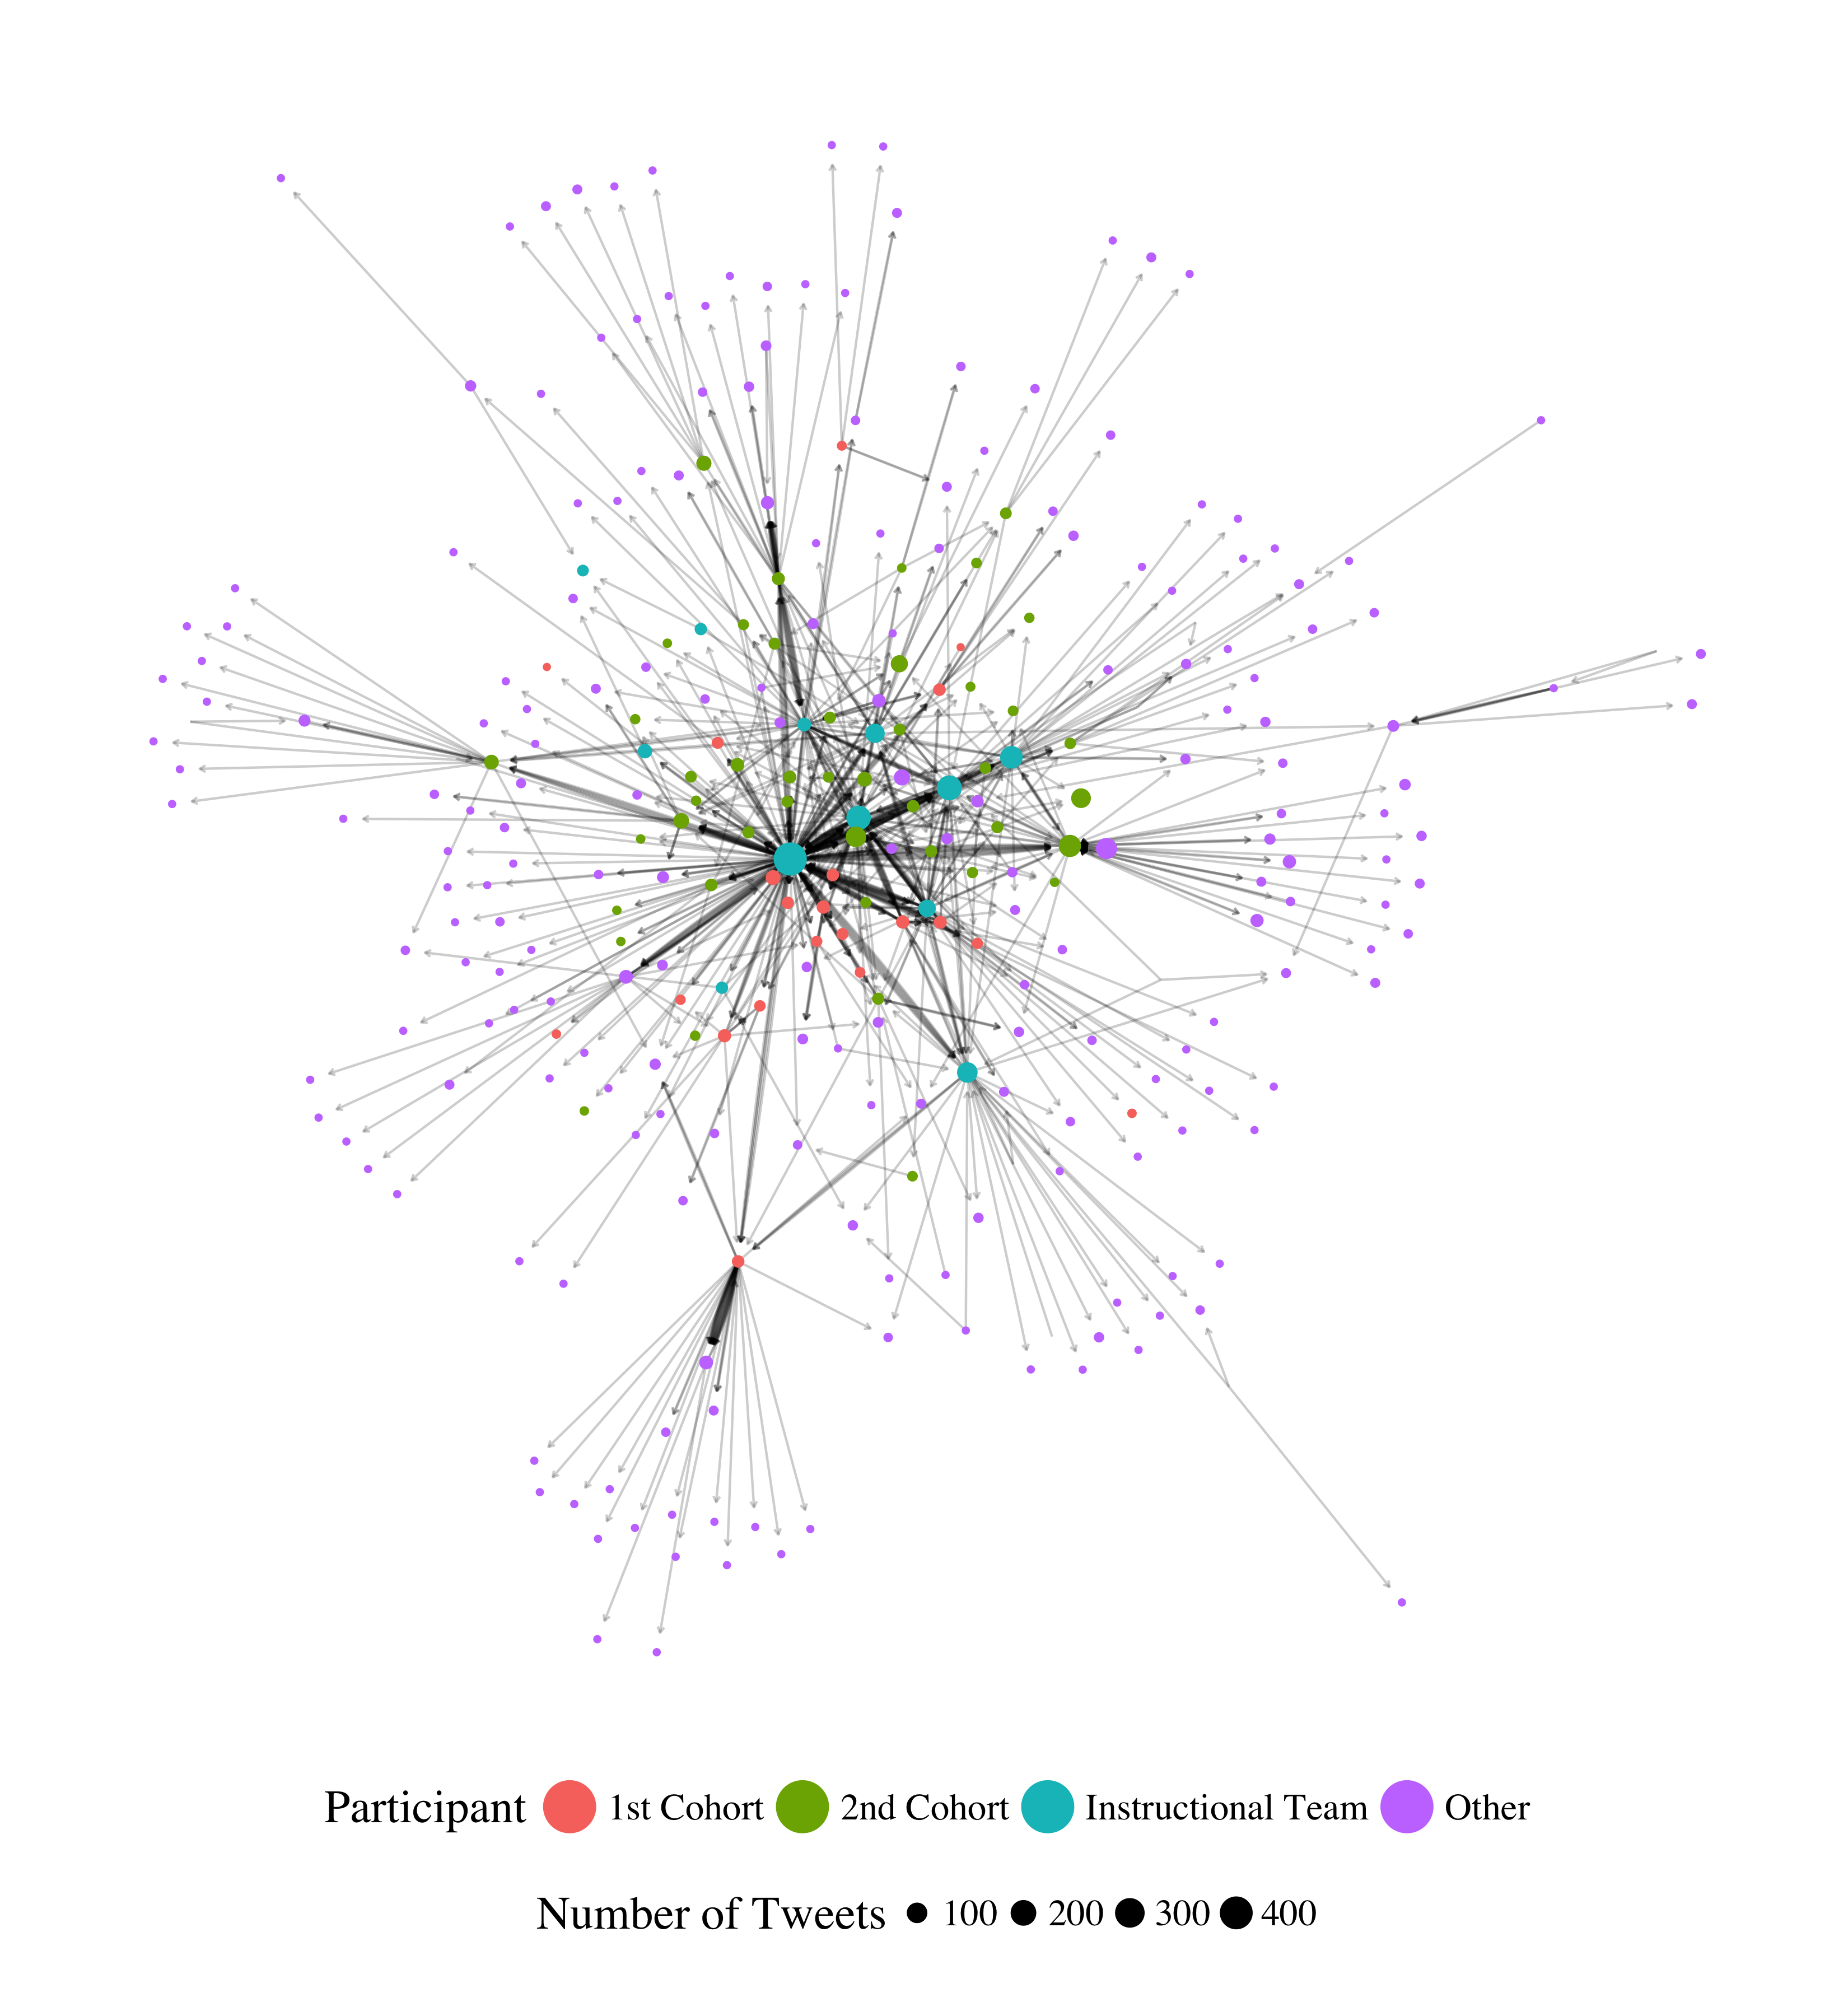
How does community form among in-service STEM teachers?
Introduction | ESM | Text | Networks | Future Work | Conclusion
Notes:
Conversing (replying and mentioning) network. Need to think through how to introduce this – maybe zoom in on part and label the parts.

Slide 47
How does community form among in-service STEM teachers?
Introduction | ESM | Text | Networks | Future Work | Conclusion
Key findings:
Prominent role of instructors and relative infrequency of cross-cohort conversing
Presented these findings to instructors and to students and to foster cross-cohort endorsing and conversing
Next steps:
Survey students about who they go to for help and who they consider they closest colleague
Use of social network influence models to see how digital and face-to-face relations impact changes in practice

Slide 48
Introduction | ESM | Text | Networks | Future Work | Conclusion
Introduction
Experience Sampling Method
Text Data
Digital Traces and Network Data
Future Work
Conclusions

Slide 49
Future Work
Introduction | ESM | Text | Networks | Future Work | Conclusion
Supporting students to do data science
Supporting teachers to work with data
Leveraging the network effect to scale innovations
Notes:
Need to think of how to introduce this.

Slide 50
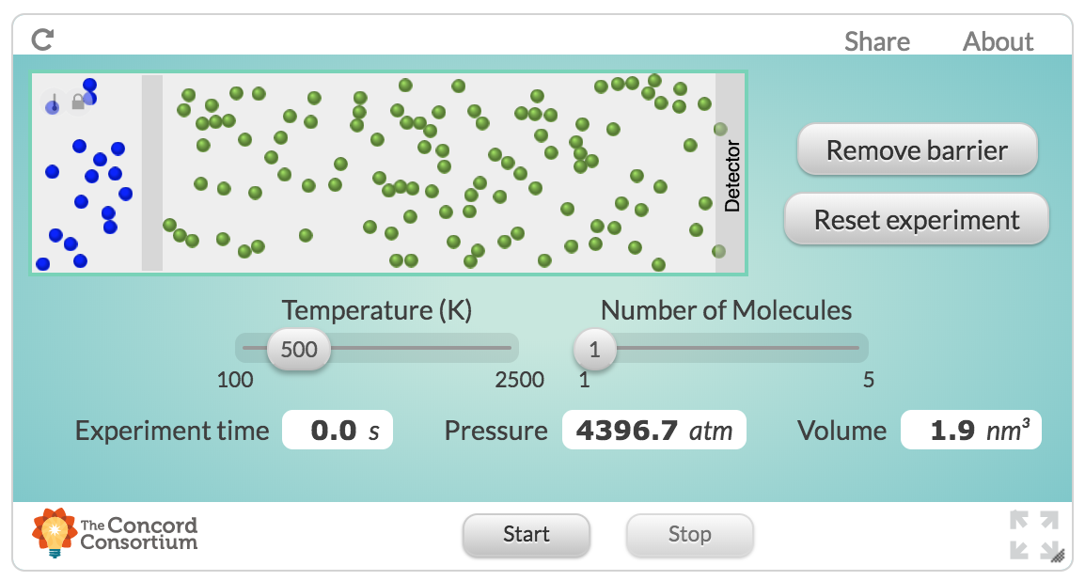
Supporting students to do data science
Introduction | ESM | Text | Networks | Future Work | Conclusion
Past studies were not in contexts not designed and developed to help teach students data science

Slide 51
Supporting students to do data science
Introduction | ESM | Text | Networks | Future Work | Conclusion
Build on collaboration with Michigan Virtual School (Rosenberg, 2017, MVLRI RPIN) to design activities and tools to make it easier for students to use data in online science classes
Focus on data wrangling (accessing, organizing, and transforming data) to expand opportunities to work with data
Partner with faculty across departments at University of Tennessee, Knoxville to support and document work with data at post-secondary level
Strong potential for funding (NSF ITEST)

Slide 52
Supporting teachers to work with data
Introduction | ESM | Text | Networks | Future Work | Conclusion
Teachers find the shift toward more open-ended work with data to be challenging and working with teachers to study and show how these activities are possible is important

Slide 53
Supporting teachers to work with data
Introduction | ESM | Text | Networks | Future Work | Conclusion
Engage pre-service and in-service teachers in coursework and opportunities to ”hands-on” work with data
Explore how work with in mathematics and engineering classes allows learners to more deeply engage in science as part of a positive “feedback loop”
Potential for collaborative work across the Theory and Practice of Teacher Education department and impact on teacher preparation coursework
Opportunities to involve teachers in design and development of technological tools (i.e., support TPACK)

Slide 54
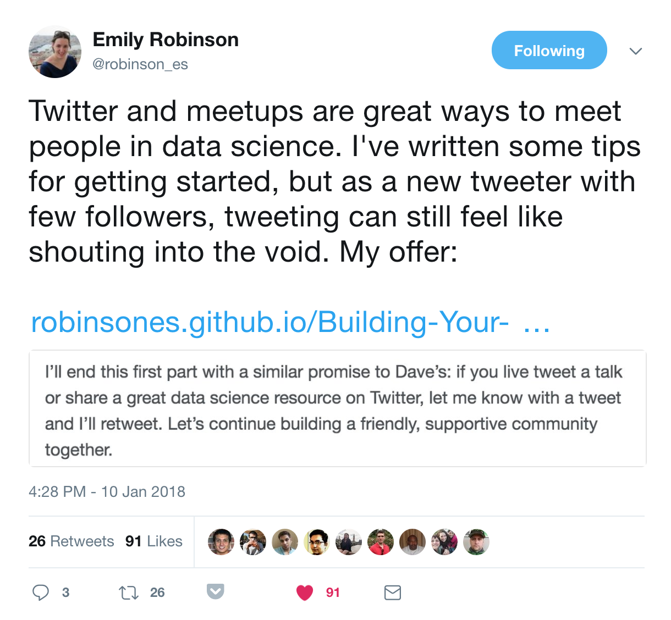
Leveraging the network effect to scale innovations
Introduction | ESM | Text | Networks | Future Work | Conclusion
Scale innovations in STEM teaching and learning through networks

Slide 55
Leveraging the network effect to scale innovations
Introduction | ESM | Text | Networks | Future Work | Conclusion
Understand how involvement in formal and informal digital communities supports changes in teachers’ practices and the diffusion of innovations
Understand how access to specific networks at specific times impacts involvement in a community
Opportunities for expanding impact and carrying out research through foundations (Gates Foundation and programs focused on addressing equity through networks of researchers, administrators, and practitioners)

Slide 56
Introduction
Experience Sampling Method
Text Data
Digital Traces and Network Data
Future Work
Conclusions

Slide 57
Guiding research questions
Introduction | ESM | Text | Networks | Future Work | Conclusion
What are the affordances of thinking of and with new types of data in STEM education?
Experience sampling method: Moment-to-moment changes, measures distinct constructs
Text data: In “own words”, can be used with other sources for rich understanding
Digital traces and network data: Reflect vibrancy of interest-driven communities, in-depth data over time and in naturalistic setting
Notes:
[not done]

Slide 58
Guiding research questions
Introduction | ESM | Text | Networks | Future Work | Conclusion
How do these new types of data help us to understand teaching and learning in STEM?
Experience sampling method: Impact of specific activities and choices in-the-moment; profiles of engagement and its conditions common to summer STEM programs
Text data: How teachers adapt reform-based science teaching practices; use of text as part of targeted interventions to support students’ value of and interest in science
Digital traces and network data: Development of formal and informal teacher professional learning networks; how teachers influence one another and change practice
Notes:
[not done]

Slide 59
Who gets to use data?
Introduction | ESM | Text | Networks | Future Work | Conclusion
Data can be used to empower learners and learning communities across STEM content areas
Potential for substantial impacts at the K-12 and post-secondary levels
Opportunity to improve STEM teaching and learning and to build capacity of researchers through deliberate use of new data sources
Notes:
Demonstrate how data can be used to empower teachers and students.

Slide 60
Acknowledgments
Introduction | ESM | Text | Networks | Future Work | Conclusion
Thank you to collaborators and participating teachers and students
Thank you to Mehmet Aydeniz and the search committee for inviting me on behalf of the TPTE department
Time for questions from the audience
Notes:
Demonstrate how data can be used to empower teachers and students.

Slide 61
References
Introduction | ESM | Text | Networks | Future Work | Conclusion
Cobb et al., 2003
Turner & Noley, 2015
Mishra, Koehler, & Greenhow, 2016
NGSS Lead States, 2015
National Research Council, 2012
Severance et al., 2012
Wilkerson-Jerde & Wilensky, 2015
Rosenberg & Koehler, 2015
Rosenberg et al., 2016
Koehler et al., 2016
Schmidt, Rosenberg, & Beymer, 2018
Beymer, Rosenberg, & Schmidt, in press
Akcaoglu, Rosenberg, Ranellucci, & Schwarz, 2018
Notes:
Demonstrate how data can be used to empower teachers and students.

