Slide 1
Thinking of and with data: How students and teachers (and researchers) use data in STEM education
Joshua M. Rosenberg, Doctoral Candidate
Michigan State University
January 24th, 2018
University of Tennessee, Knoxville
Department of Theory and Practice of Teacher Education
Notes:
Work with data
Also implications
Mention NGSS
Make a slide
Thank you to the Mehmet Aydeniz and the search committee and the faculty and students in the TPTE department as well as Ms. Gina Guinn for making this trip possible.
This talk is on thinking of and with data in STEM.
In particular, this talk is focused on the affordances of new sources of data for teachers and students.
And, is on how new sources of data can help us understand teaching and learning in STEM.
Work with data can help students (and teachers) across STEM classrooms to go beyond “doing school” to engage in disciplinary practices, such as analyzing and interpreting data and developing and using models. Using authentic sources of data in classroom contexts can be challenging because of the time and planning such work takes as well as how it differs from how students have traditionally worked with data at school. In this talk, I describe research on how students engage with authentic sources of data in science classrooms and summer STEM enrichment programs. Also, I show how researchers can use a variety of data sources and methods to understand student engagement with data and other science and STEM activities. I discuss implications for teachers, teacher educators and professional development providers, and for the design of educational technologies. Finally, I outline some future directions for uses of data across STEM disciplines.

Slide 2
Biography
Introduction | ESM | Text | Networks | Future Work | Conclusion
Undergraduate degree in Biology from University of North Carolina Asheville, Burroughs Wellcome Fund Scholar
Taught H.S. Biology, Chemistry, and Earth Science
Motivated by challenges and opportunities from helping students to do science, particularly with technological tools
Doctoral degree at Michigan State University
Taught or assisted courses in teacher education, educational technology, and research methods
Apply research to teaching about technology integration in science education, especially on teachers’ Technological Pedagogical Content Knowledge (TPACK)
Notes:
why you went to grad school

Slide 3
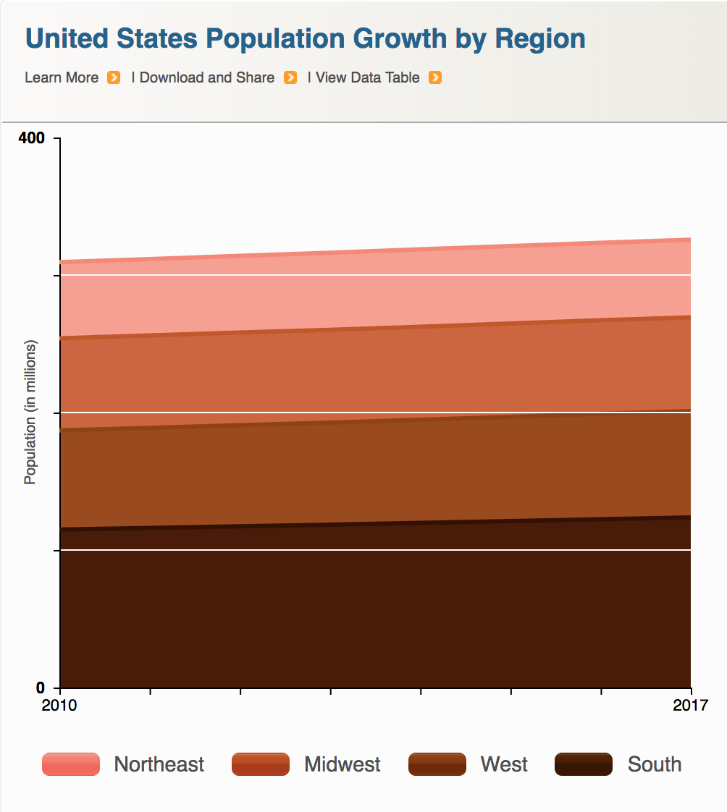
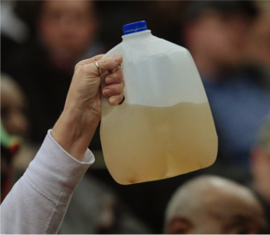

Data is power(ful)
Introduction | ESM | Text | Networks | Future Work | Conclusion
Companies
Government
Citizens

Slide 4
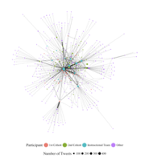
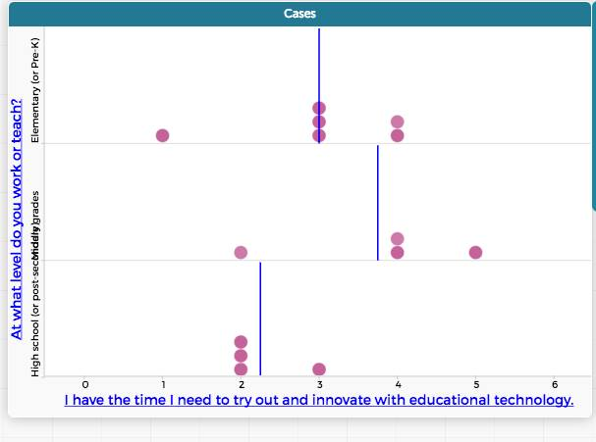
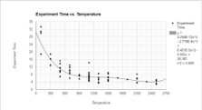
Data is power(ful)
Introduction | ESM | Text | Networks | Future Work | Conclusion
Researchers
Teachers
Students
Notes:
talking about agency

Slide 5

Work with data

Slide 6
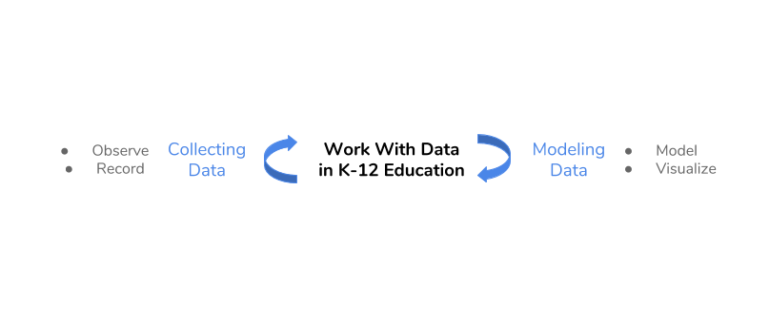
Work with data

Slide 7
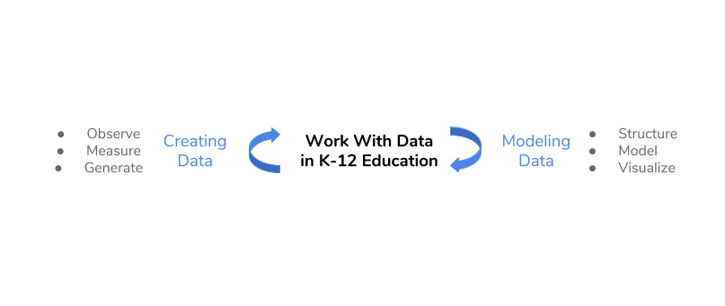
Work with data

Slide 8
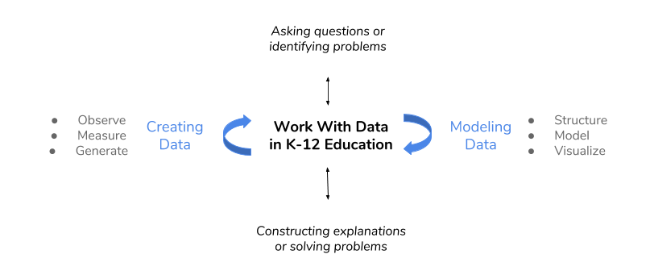
Work with data
Hancock, Kaput, & Goldsmith, 1992; Wild & Pfannkuck, 1999
NGSS Lead States, 2013; National Research Council, 2012

Slide 9
Work with data
Researchers’ design and development
Use of new data sources and methods for research
Hancock, Kaput, & Goldsmith, 1992; Wild & Pfannkuck, 1999
NGSS Lead States, 2013; National Research Council, 2012

Slide 10
Challenges
Introduction | ESM | Text | Networks | Future Work | Conclusion
Hard for teachers and students
Requires sustained focus on one topic / phenomena
Shift from work with data in schools focusing on small, organized data sets
Requires using skills from across disciplines
Notes:
we want students to get students to a specific answer
how do we help teachers and students interact with data in a more authentic way
that requires the way teachers and students interact with data
ngss - what does ngss say

Slide 11
Opportunities
Introduction | ESM | Text | Networks | Future Work | Conclusion
Helps teachers and students to go beyond “doing school”
Provide opportunities for positive feedback loops
Can empower students to engage in inquiry in their lives Can prepare students for data-intensive occupations

Slide 12
Aims
Introduction | ESM | Text | Networks | Future Work | Conclusion
Explore how students engage with authentic sources of data
Describe how researchers can use a variety of data sources to understand students’ engagement and learning
Discuss how teachers can support students’ engagement with data
Notes:
These are the guiding questions that setup the use and discussion of affordances of different data sources and then illustrations of what we can learn from them.
Goal is to show strengths of what kind of research we can do.
Big picture - need to convey this
need to show data source
How the studies are connected
How the studies fit in with the aim
What they help us understand about teaching and learning

Slide 13
Outline
Introduction | ESM | Text | Digital Traces | Future Work | Conclusion
For three data sources:
Experience sampling method (ESM)
Text data
Digital traces and network data
Describe their affordances for studying teaching and learning in STEM
Demonstrate how they can be used be used by researchers
Share findings related to how teachers and students use data
Notes:
These are the guiding questions that setup the use and discussion of affordances of different data sources and then illustrations of what we can learn from them.
Goal is to show strengths of what kind of research we can do.
Big picture - need to convey this
need to show data source
How the studies are connected
How the studies fit in with the aim
What they help us understand about teaching and learning

Slide 14
Student, teacher, and researcher use of data
Introduction | ESM | Text | Networks | Future Work | Conclusion
For students
For teachers
For researchers

Slide 15
Introduction | ESM | Text | Networks | Future Work | Conclusions
Experience Sampling Method
Text Data
Digital Traces and Network Data
Future Work
Notes:
The organization of the talk is to discuss three data sources, their affordances, and what we can learn about teaching and learning in STEM from work with them.
Understand learning over time and from moment-to-moment (Cobb, Confrey, DiSessa, Lehrer, & Schauble, 2003)
Explore STEM teaching and learning in classroom contexts (Hatch, 2002)
Document complex teaching and learning process (Salganik, 2017)
Go beyond “doing school” and empower students to think of and with data (Berland, Schwarz, Krist, Lo, & Reiser, 2016; Horton & Hardin, 2015)
Support positive feedback loops with other school subjects
Use digital methods and data sources (Mishra, Koehler, & Greenhow, 2015; Baker & Siemens, 2015)

Slide 16
Introduction | ESM | Text | Networks | Future Work | Conclusion
Experience Sampling Method
Text Data
Digital Traces and Network Data
Future Work
Notes:
The organization of the talk is to discuss three data sources, their affordances, and what we can learn about teaching and learning in STEM from work with them.

Slide 17
Experience sampling method (ESM)
Introduction | ESM | Text | Networks | Future Work | Conclusion
Involves asking people about their experiences using short surveys
Use of an app on phone
Every 15-30 minutes
“When you were signaled, how interested were you in what you were learning?”
Notes:
I know this past research is a stretch – I would like to keep this just for the moment :)

Slide 18
Affordances
Introduction | ESM | Text | Networks | Future Work | Conclusion
Understand learning experiences in a qualitatively distinct way (Hektner, Schmidt, & Csikszentmihalyi, 2007)
Helps us to understand moment-to-moment changes in experiences and what impacts experiences
Allows us to understand experiences during activities rather than overall pre- and post-assessments of what did or did not work
Notes:
I know this past research is a stretch – I would like to keep this just for the moment :)
Importance (but under-emphasis on) context in research on teacher knowledge (Rosenberg & Koehler, 2015)
Role of context in explaining processes around teaching and learning with technology (Phillips, Koehler, & Rosenberg, 2016)

Slide 19
Purpose
Introduction | ESM | Text | Networks | Future Work | Conclusion
Explored “business-as-usual” and hands-on science, activities using a person-in-context approach (Schmidt, Rosenberg, & Beymer, 2018, JRST)
Use of ESM data and person-oriented analysis
To understand how learning activities (e.g., laboratory activities or lecture) and being able to choose impact students’ engagement
Notes:
Demonstrate how data can be used to empower teachers and students.
What role this play

Slide 20
Context and Sample
Introduction | ESM | Text | Networks | Future Work | Conclusion
12 high school classrooms
Large high school outside of a large metropolitan area
244 students, 4,136 responses
Notes:
Measures:
Experience Sampling Method for engagement and choice
Activities coded from video-recordings
Person-in-context approach:
Two step cluster analysis (Rosenberg, Schmidt, & Beymer, 2017)
Interpreted profile solutions on the basis of measures of fit, cross-validation, and concerns of parsimony

Slide 21
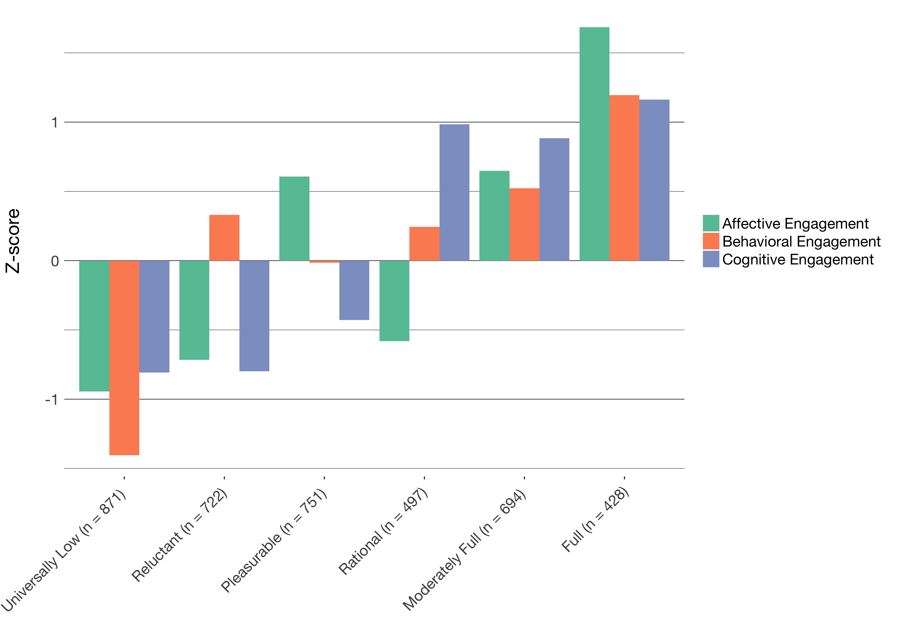
Profiles of Momentary Engagement
Introduction | ESM | Text | Networks | Future Work | Conclusion
Identified momentary profiles of engagement
Found six profiles from Universally Low to Full, with four complex patterns
Note that students report multiple profiles

Slide 22
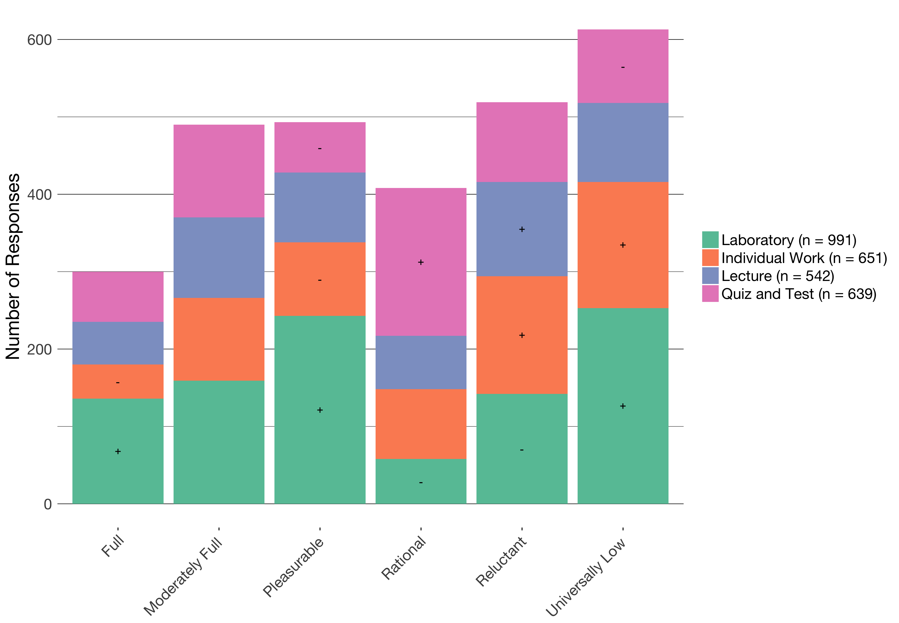
Profiles by activity
Introduction | ESM | Text | Networks | Future Work | Conclusion

Slide 23
The impacts of activity on engagement
Introduction | ESM | Text | Networks | Future Work | Conclusion
Different activities in science are associated with different profiles of engagement
Laboratory activities can be particularly engaging (and disengaging)
Quizzes and tests have some affordances in terms of students’ engagement
Individual work can be particularly disengaging

Slide 24
Profiles by choice
Introduction | ESM | Text | Networks | Future Work | Conclusion
 | Universally Low | Reluctant | Pleasurable | Rational | Moderately Full | Full
Who | 1.43 *** | 1.19 | 1.00 | .35 *** | .44 | 1.20
Time | .38 *** | 0.47 | 0.49 | 1.82 *** | 1.26 | 0.47
How to Do | .45 | 1.07 | 0.48 | 0.46 | 1.14 | 1.35 *
Framing | .44 * | 0.46 | 0.48 | 1.14 | 1.06 | 1.60 ***

Slide 25
The impacts of choice on engagement
Introduction | ESM | Text | Networks | Future Work | Conclusion
Choosing with whom to work is not associated with higher engagement
Choosing how much time to take is associated with rational engagement
Choosing how to do an activity or what the purpose or topic of the activity is associated with engaging profiles

Slide 26
The impacts of choice during laboratory
Introduction | ESM | Text | Networks | Future Work | Conclusion
During laboratory, when students were able to make any choice (who, materials, time, how to do, framing, or other):
They are more likely to be fully engaged (z = 3.90, p < .05), which is not the case when they report no choice (z = -.23)

Slide 27
Key findings
Introduction | ESM | Text | Networks | Future Work | Conclusion
Use of ESM allowed us to study the impacts of the learning activity and choice
Different activities in science are associated with different profiles of engagement
Providing chances for students to decide what to do or how to do it also impacts their engagement
As students move from activity to activity, their engagement can change
Notes:
Laboratory activities in science can be highly engaging
Choice—especially related to how students do laboratory activities and who determines how the activities is framed (choosing the purpose or topic)—is a key factor affecting how engaging laboratory activities are
Person-in-context approach helped us to characterize distinct profiles of engagement

Slide 28
How do students engage in work with data?
Introduction | ESM | Text | Networks | Future Work | Conclusion
Studied work with data in summer STEM programs using profiles of engagement and its conditions (PECs) (Rosenberg, in preparation)
Can help us make informed recommendations and design activities and interventions focused on work with data
ESM can allow us to understand the impact of specific aspects of work with data or data modeling (Lehrer & Schauble, 2015)

Slide 29
How do students engage in work with data?
Introduction | ESM | Text | Networks | Future Work | Conclusion
Context and Participants:
Nine summer STEM programs in urban areas in the Northeast
Highly diverse (90% of youth from historically under-represented [in STEM] groups)
204 youth, 2970 ESM responses
Measures:
ESM self-reports for cognitive, behavioral, and affective and perceptions of challenge and competence
Video-recordings of activities
Pre-program measures of interest

Slide 30
How do students engage in work with data?
Introduction | ESM | Text | Networks | Future Work | Conclusion
Work With Data | Description
Asking questions or defining problems | Discussing and exploring topics to investigate and pose questions.
Making observations | Watching and noticing what is happening with respect to the phenomena or problem being investigated.
Generating data | Figuring out how or why to record an observation as data and generating coding frames or measurement tools.
Data modeling | Understanding and explaining phenomena using models of the data that account for variability or uncertainty.
Interpreting and communicating findings | Discussing and sharing and presenting findings.
Notes:
shorten

Slide 31
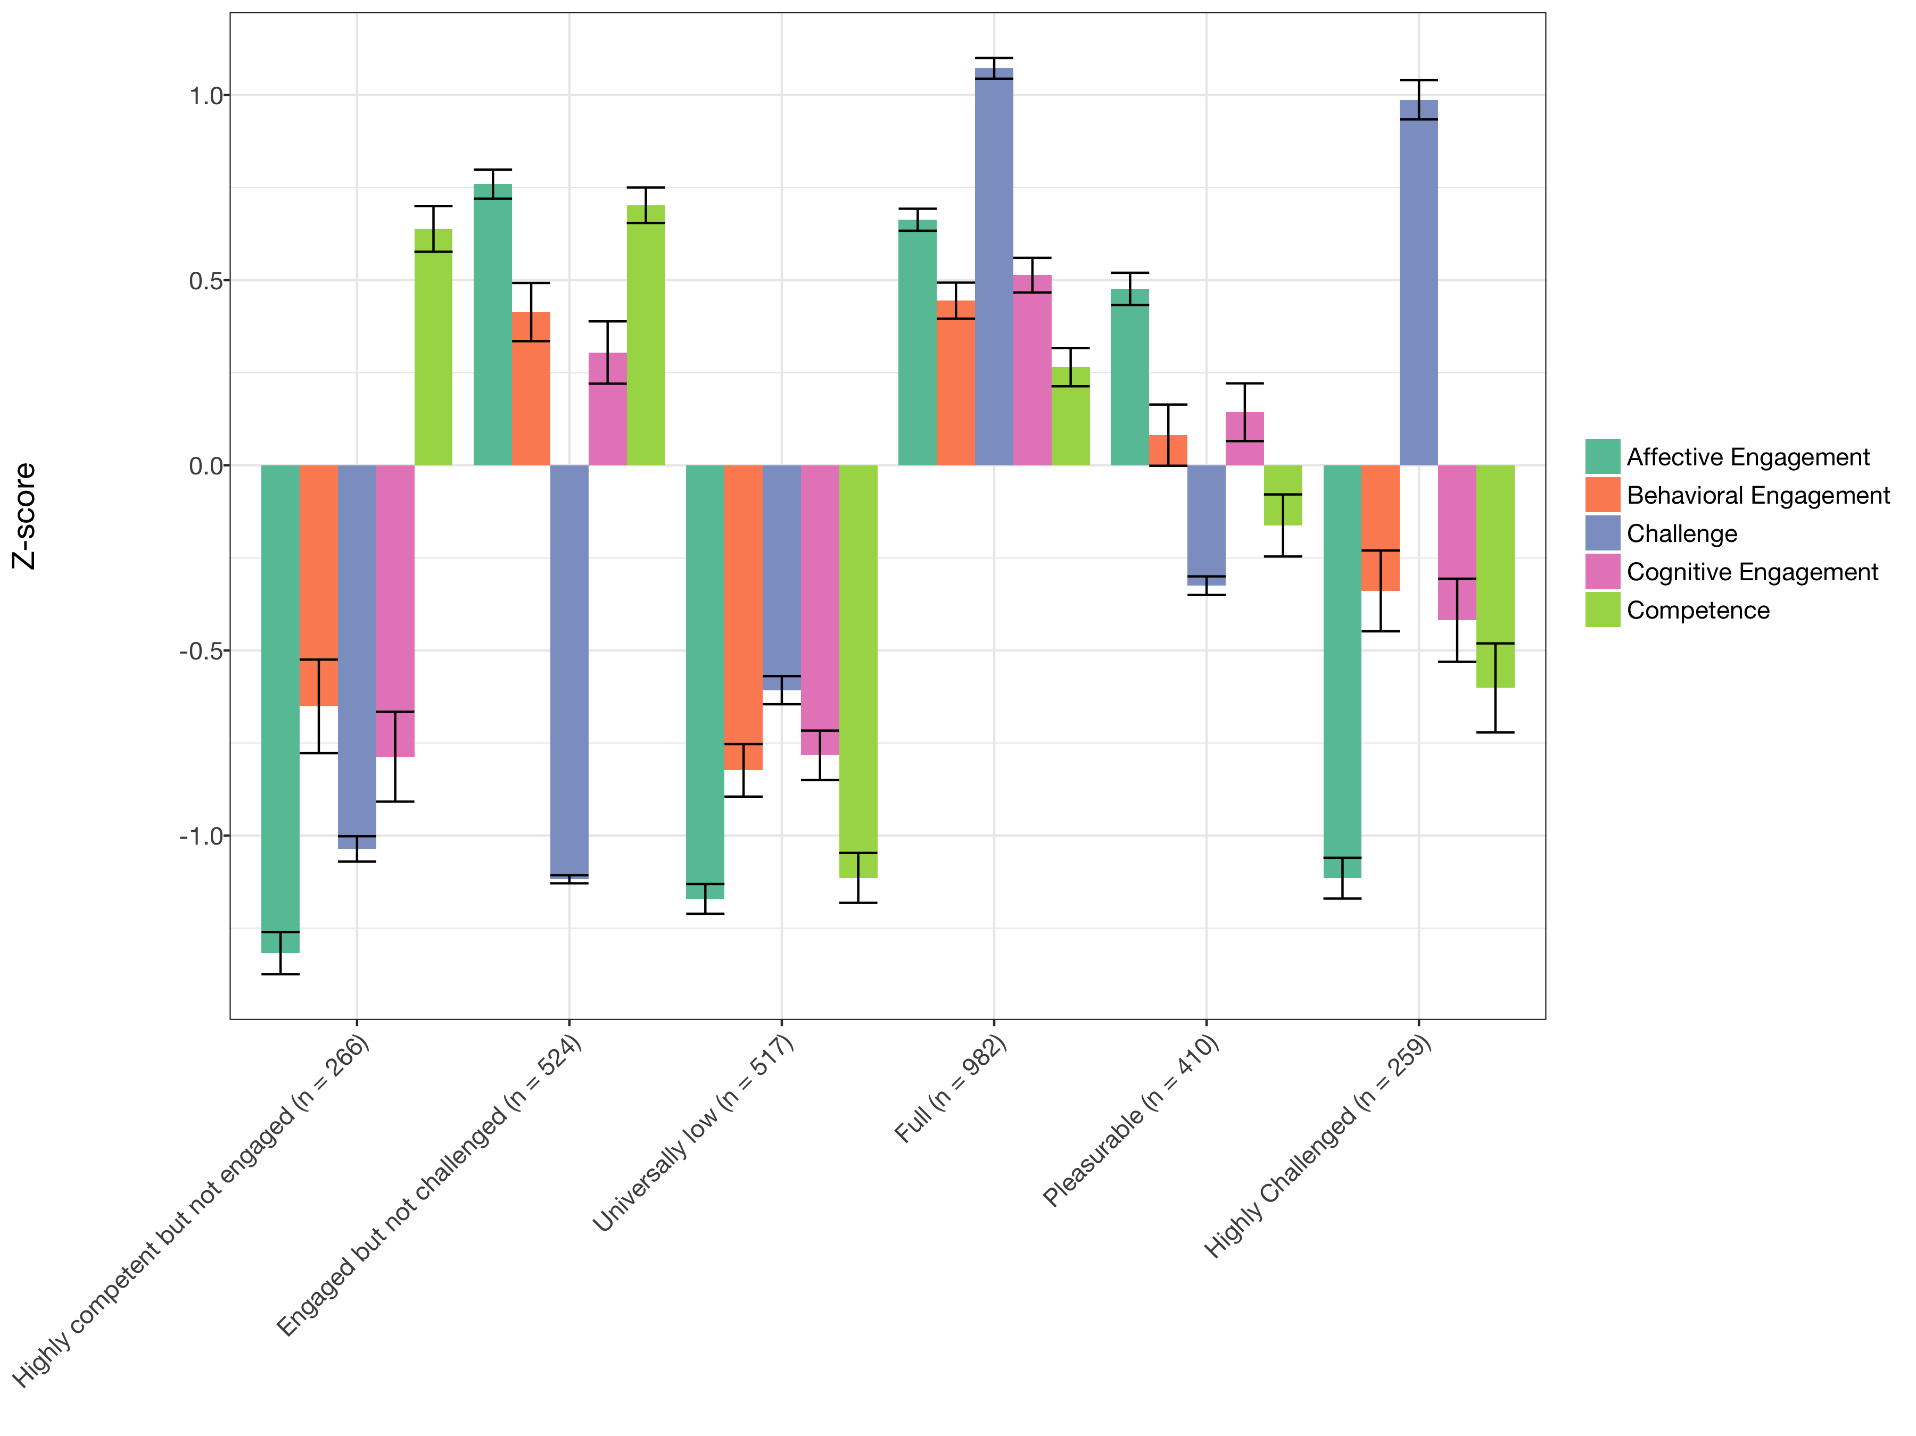
How do students engage in work with data?
Introduction | ESM | Text | Networks | Future Work | Conclusion
Developed tool for Latent Profile Analysis
Interpreted profiles using multiple criteria
Notes:
6 profiles, model 2, estimated in Mplus via tidyLPA
Change the order of the clustered variables
Need to name the profiles

Slide 32
Profiles of engagement and its conditions
Introduction | ESM | Text | Networks | Future Work | Conclusion
When learners are challenged, they also need to think themselves as good at what they are doing to be highly engaged
When learners report Pleasurable engagement, their behavioral and cognitive engagement and perceptions of being challenged or good at the activity are moderate
When students report being Engaged but not Challenged, they may not be engaged in learning-related processes
Notes:
Mention more general findings

Slide 33
Work with data and profiles of engagement and its conditions
Introduction | ESM | Text | Networks | Future Work | Conclusion
When students report being Fully engaged:
Students are more likely to be supported in generating data (B = 1.395, p = .029) and less likely to be observing phenomena (B = 0.410, p = .028)
Qualitative analysis of video suggests that modeling data is more often done by teachers (not students)
Notes:
6 profiles, model 2, estimated in Mplus via tidyLPA
Change the order of the clustered variables
Need to name the profiles

Slide 34
Work with data and profiles of engagement and its conditions
Introduction | ESM | Text | Networks | Future Work | Conclusion
Students’ generating data by recording or documenting phenomena is associated with potentially adaptive profiles of engagement and its conditions (Full)
Making observations was negatively associated with Full engagement
Notes:
Mention more general findings

Slide 35
Key findings
Introduction | ESM | Text | Networks | Future Work | Conclusion
Studying engagement at the moment-to-moment level helps us understand how specific activities related to work with data engage learners
Some aspects of work focused on generating or recording data are more engaging than others
Notes:
Mention more general findings

Slide 36
Introduction | ESM | Text | Networks | Future Work | Conclusion
Experience Sampling Method
Text Data
Digital Traces and Network Data
Future Work

Slide 37
Affordances
Introduction | ESM | Text | Networks | Future Work | Conclusion
Can understand teachers and students experiences richly because data is in “own words”
Can be used with other data sources to triangulate understanding of complex phenomena

Slide 38
How do teachers develop reform-based pedagogical practices?
Introduction | ESM | Text | Networks | Future Work | Conclusion
Explored how two fifth-grade science teachers diverged in their use of scientific modeling in their teaching (Rosenberg, Schwarz, & Akcaoglu, revise and resubmit, JTE)
Interviewed teachers at the start and end of a long-term research project
Project was focused on students’ creation, critique, and revision of models (Schwarz, Ke, Lee, & Rosenberg, 2014, ICLS)
One teacher became modeling-centered whereas the other stopped using modeling after the project ended
Notes:
define models'

Slide 39
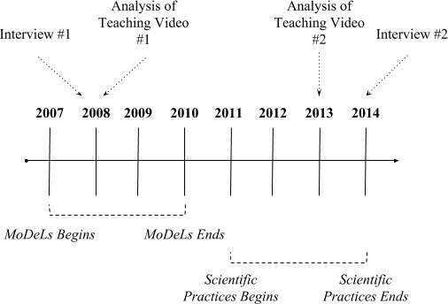
Timeline of project

Slide 40
Mrs. M
Introduction | ESM | Text | Networks | Future Work | Conclusion
“I used to think [models/modeling] was just the picture or something you wrote. But after this experience it's really a process. We all come in with these ideas, and at fifth grade they come in with sometimes some really strange things. ... Once you get them to share those ideas, the coolest part is seeing them - not to say that they're wrong - but seeing them adapt and evolve those into a better understanding of what's really going on ... So that evolution process of models is what's really been something that's kind of changed my own thinking. It's not just, "Here, this is the end of it." No, it's not the end. We constantly change the things that we think about through our own experiences or things that we learn. And students are doing the same thing.”
Notes:
shorten
say some out loud

Slide 41
Mr. H
Introduction | ESM | Text | Networks | Future Work | Conclusion
“I felt pressured with all the other things I was expected to do and not having enough time to do it. Because modeling took so much time and it was something that, if it was part of my curriculum, I would have had no problem with. But because it was a research thing and it was on top of what I had to teach, it was a lot of pressure … I felt that pressure of taking two or three months to work on this research project and I still need to cover all this other stuff for my students … And I guess it was nice because there weren't very many parents that questioned me on it. And maybe it's because we worked hard at showing them that this was good stuff, this was good teaching and learning. But if you're in a place where you don't have that support, that would be really tough. But I think you could totally take the experience with modeling and wrap around any existing curriculum. Take what a district has already and say, "How can we pop in modeling?" I think it's totally doable.”
Notes:
come back to tech
redundancy

Slide 42
Key findings
Introduction | ESM | Text | Networks | Future Work | Conclusion
For Mrs. M, improvising, a focus on learning community, and a willingness to adapt resources and goals aligned with modeling and provided a focal endeavor for the class
Modeling came to be seen as an effective for science learning and highly satisfying for teaching
For Mr. H, addressing the curriculum promoting accurate scientific ideas with evidence and logic, scientific modeling was too time intensive
Modeling became a frustrating endeavor that hindered other important goals

Slide 43
Written relevance interventions
Introduction | ESM | Text | Networks | Future Work | Conclusion
Examined changes in middle school science students’ value and interest in science through a relevance intervention (Akcaoglu, Rosenberg, Ranellucci, & Schwarz, 2018, IJER)
Carried out a relevance intervention in fifth- and sixth-grade classrooms using a field experiment
Context and sample:
212 students in eight MS classrooms in a suburban area
Used students’ written responses to better understand the impact of students’ writing about the usefulness of what they were learning about

Slide 44
Example of a student response
Introduction | ESM | Text | Networks | Future Work | Conclusion
“If I am ever blowing up balloons for a party and I want to keep the balloons big, I will keep them in a warm room so the molecules speed up and spread out, hitting the sides of the balloons and expanding it. In a cold room, the molecules will slow down and come together and the balloons sides will close and become smaller.”

Slide 45
Can writing about the relevance of science enhance students’ value and interest?
Introduction | ESM | Text | Networks | Future Work | Conclusion
 | Time 2 Utility Value
Fixed Parts
Intercept | 5.52
Time 1 Self-efficacy | -0.19 (0.15)
Time 1 Interest | 0.24 (0.09)*
Time 1 Utility Value | 0.43 (.08)***
Intervention | 0.44 (0.20)*
Self-efficacy X Treatment | 0.24 (.209)
Gender | -0.22 (0.20)
Random Parts
Classroom 𝞂² | 1.73
Classroom ICC | 0.03
p < .05, ** p < .01, *** p < .001
Notes:
shorten

Slide 46
Linguistic Inquiry and Word Count findings
Introduction | ESM | Text | Networks | Future Work | Conclusion
Cognitive Processing (12.08% of text instead compared to 9.27% of text [t = 2.81; p < .05, d = .50])

Slide 47
Introduction | ESM | Text | Networks | Future Work | Conclusion
Experience Sampling Method
Text Data
Digital Traces and Network Data
Future Work

Slide 48
Affordances
Introduction | ESM | Text | Networks | Future Work | Conclusion
Study informal professional learning and interest-driven communities
Can capture involvement and interactions in naturalistic settings
Notes:
Past research
Examined the role of State Educational Twitter Hashtags as educational affinity spaces (Rosenberg, Greenhalgh, Koehler, Hamilton, & Akcaoglu, 2016; Rosenberg, Akcaoglu, Staudt Willet, Greenhalgh, & Koehler, 2017)
Documented teachers’ technology knowledge evidenced through digital portfolios using the TPACK framework (Koehler, Greenhalgh, Rosenberg, & Keenan, 2017)

Slide 49
What can we learn about teachers’ technological understanding from digital portfolios?
Introduction | ESM | Text | Networks | Future Work | Conclusion
Assessed teachers’ knowledge through digital portfolios as performance assessments (Koehler, Greenhalgh, Rosenberg, & Keenan, 2016, JTATE)
Analyzed portfolios from 589 students in Master of Arts in Educational Technology and Master of Arts in Education programs
Determine what artifacts teachers included and what they evidenced about teachers’ Technological Pedagogical Content Knowledge, or TPACK (Mishra & Koehler, 2006)
Focus on the program context as a factor that may impact the development of teachers’ TPACK (Rosenberg & Koehler, 2015)
Notes:
Put in portfolios

Slide 50
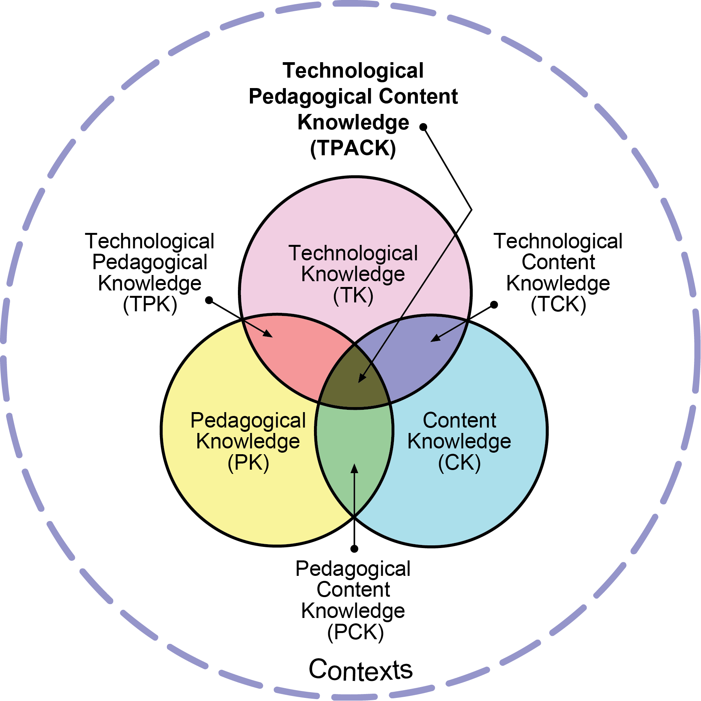
Technological Pedagogical Content Knowledge (TPACK)
Introduction | ESM | Text | Networks | Future Work | Conclusion
Notes:
Put in portfolios

Slide 51
Coding frame for specific artifacts for TPACK
Level | TCK | TPK | TPCK
1 | .23 | .02 | .11
2 | .36 | .50 | .47
3 | .32 | .42 | .36
4 | .09 | .06 | .06
Mean | 2.25 | 2.52 | 2.38
Std. Dev | .92 | .65 | .77
Criteria | 4 | 3 | 2 | 1
Technology Selection(s): Compatibility with curriculum goals & instructional strategies (TPACK) | Technology selection(s) are exemplary, given curriculum goal(s) and instructional strategies. | Technology selection(s) are appropriate, but not exemplary, given curriculum goal(s) and instructional strategies. | Technology selection(s) are marginally appropriate given curriculum goal(s) and instructional strategies. | Technology selection(s) are inappropriate given curriculum goal(s) and instructional strategies.
Harris et al.’s (2010) TIAI-Adapted Rubric Used to Analyze the DreamIT and LTI Artifacts.
Notes:
get rid

Slide 52
Content analysis of specific types of artifacts
Introduction | ESM | Text | Networks | Future Work | Conclusion
Artifact Technology | Overall N = 895 | MAED n = 453 | MAET n= 442 | Difference
Web | .23 | .11 | .35 | -.23 ***
Social media | .02 | .01 | .04 | -.03 *
Multimedia | .16 | .08 | .24 | -.16 ***
Word processing | .12 | .12 | .11 | -.01
Document presentation | .39 | .63 | .14 | .49 ***
Presentation | .06 | .03 | .10 | -.07 ***
Other | .02 | .01 | .02 | -.01
Notes:
Put in portfolios

Slide 53
Findings
Introduction | ESM | Text | Networks | Future Work | Conclusion
Digital portfolios can be used as performance assessments
The TPACK framework can guide an analysis of teachers’ technological understanding
Found differences in artifacts on the basis of students’ program
Notes:
Put in portfolios

Slide 54
How does community form among in-service STEM teachers?
Introduction | ESM | Text | Networks | Future Work | Conclusion
Used social network analysis models and methods to understand the development of community among in-service STEM teachers in a graduate certificate program (Rosenberg, Greenhalgh, Wolf, & Koehler, 2017, JCMST)
Collected tweets associated with #MSUrbanSTEM hashtag and three cohorts of students
Supported development of community across different communication technologies and social media tools
Used network plots to explore the structure of community

Slide 55
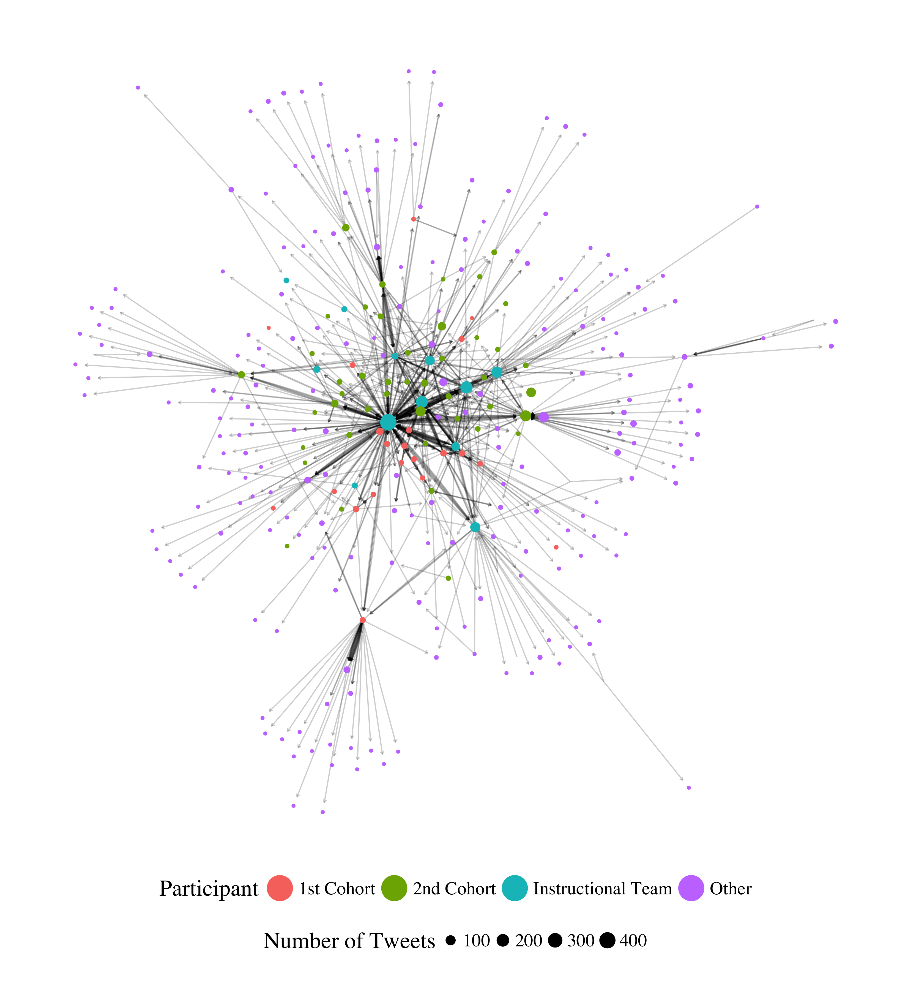
Introduction | ESM | Text | Networks | Future Work | Conclusion
Notes:
Conversing (replying and mentioning) network. Need to think through how to introduce this – maybe zoom in on part and label the parts.

Slide 56
Key findings
Introduction | ESM | Text | Networks | Future Work | Conclusion
Different roles that teachers played in the network
Prominent role of instructors and relative infrequency of cross-cohort conversing
Presented these findings to instructors and to students and to foster cross-cohort endorsing and conversing

Slide 57
Next steps
Introduction | ESM | Text | Networks | Future Work | Conclusion
Survey students about who they go to for help and who they consider they closest colleague
Use of social network influence models to see how digital and face-to-face relations impact changes in practice

Slide 58
Introduction | ESM | Text | Networks | Future Work | Conclusion
Experience Sampling Method
Text Data
Digital Traces and Network Data
Future Work

Slide 59
Future Work
Introduction | ESM | Text | Networks | Future Work | Conclusion
Supporting students to do data science
Supporting teachers to work with data
Leveraging the network effect to scale innovations
Notes:
Need to think of how to introduce this.

Slide 60
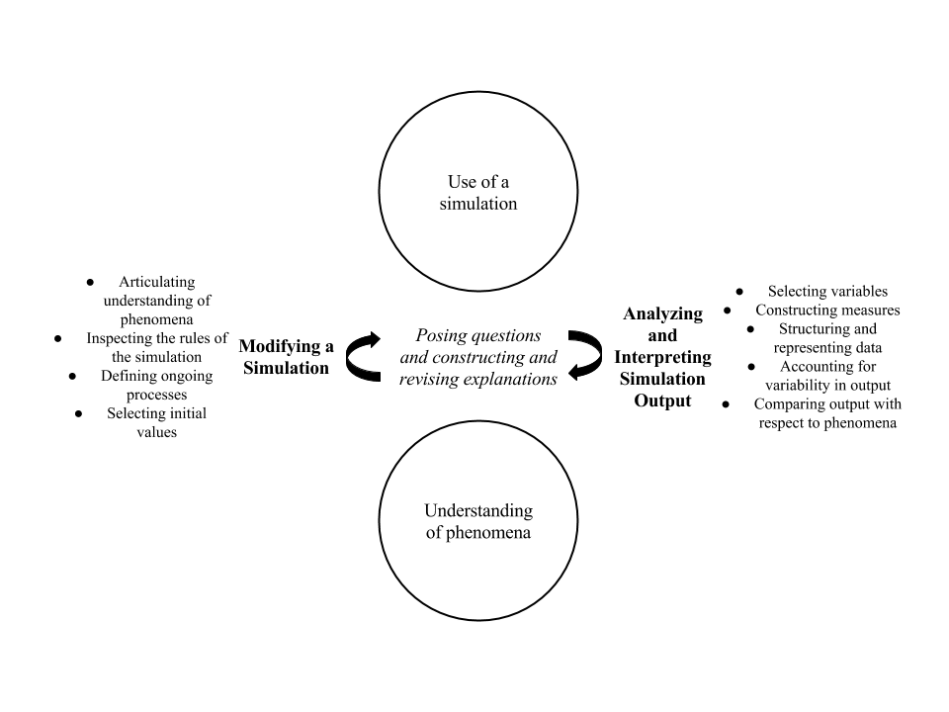
Supporting students to do data science
Introduction | ESM | Text | Networks | Future Work | Conclusion
Past studies were not in contexts not designed and developed to help teach students data science

Slide 61
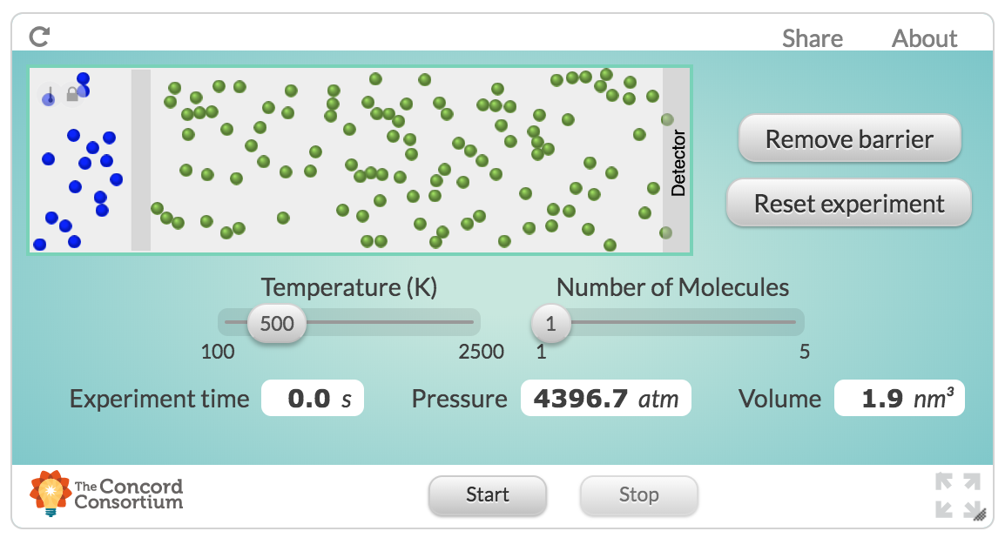
Use of computational science data
Introduction | ESM | Text | Networks | Future Work | Conclusion

Slide 62
Supporting students to do data science
Introduction | ESM | Text | Networks | Future Work | Conclusion
Build on collaboration with Michigan Virtual School (Rosenberg, 2017, MVLRI RPIN) to design activities and tools to make it easier for students to use data in online science classes
Focus on data wrangling (accessing, organizing, and transforming data) to expand opportunities to work with data
Partner with faculty across departments at University of Tennessee, Knoxville to support and document work with data at post-secondary level
Strong potential for funding (NSF ITEST)

Slide 63
Supporting teachers to work with data
Introduction | ESM | Text | Networks | Future Work | Conclusion
Teachers find the shift toward more open-ended work with data to be challenging and working with teachers to study and show how these activities are possible is important

Slide 64
Supporting teachers to work with data
Introduction | ESM | Text | Networks | Future Work | Conclusion
Engage pre-service and in-service teachers in coursework and opportunities to ”hands-on” work with data
Explore how work with in mathematics and engineering classes allows learners to more deeply engage in science as part of a positive “feedback loop”
Potential for collaborative work across the Theory and Practice of Teacher Education department and impact on teacher preparation coursework
Opportunities to involve teachers in design and development of technological tools (i.e., support TPACK)

Slide 65
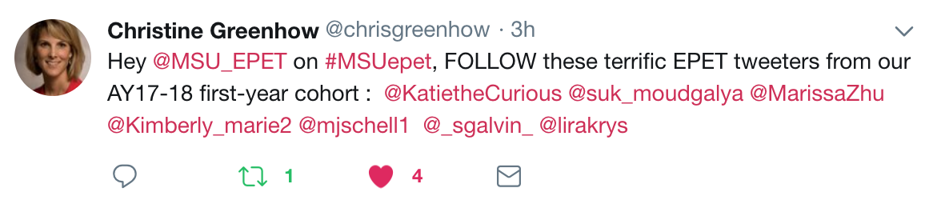
Leveraging the network effect to scale innovations
Introduction | ESM | Text | Networks | Future Work | Conclusion
Scale innovations in STEM teaching and learning through networks

Slide 66
Leveraging the network effect to scale innovations
Introduction | ESM | Text | Networks | Future Work | Conclusion
Understand how involvement in formal and informal digital communities supports changes in teachers’ practices and the diffusion of innovations
Understand how access to specific networks at specific times impacts involvement in a community
Opportunities for expanding impact and carrying out research through foundations (Gates Foundation and programs focused on addressing equity through networks of researchers, administrators, and practitioners)

Slide 67
What are the affordances of thinking of and with new types of data in STEM education?
Introduction | ESM | Text | Networks | Future Work | Conclusion
Experience sampling method: Moment-to-moment changes, measures distinct constructs
Text data: In “own words”, can be used with other sources for rich understanding
Digital traces and network data: Reflect vibrancy of interest-driven communities, in-depth data over time and in naturalistic setting
Notes:
[not done]

Slide 68
How do these new types of data help us to understand teaching and learning in STEM?
Introduction | ESM | Text | Networks | Future Work | Conclusion
Experience sampling method: Impact of specific activities and choices in-the-moment; profiles of engagement and its conditions common to summer STEM programs
Text data: How teachers adapt reform-based science teaching practices; use of text as part of targeted interventions to support students’ value of and interest in science
Digital traces and network data: Development of formal and informal teacher professional learning networks; how teachers influence one another and change practice
Notes:
[not done]

Slide 69
Summary
Introduction | ESM | Text | Networks | Future Work | Conclusion
Data can be used to empower learners and learning communities across STEM content areas
Potential for substantial impacts at the K-12 and post-secondary levels
Opportunity to improve STEM teaching and learning and to build capacity of researchers through deliberate use of new data sources
Notes:
Demonstrate how data can be used to empower teachers and students.

Slide 70
Future Work
Introduction | ESM | Text | Networks | Future Work | Conclusion
Supporting students to do data science
Supporting teachers to work with data
Leveraging the network effect to scale innovations
Notes:
Need to think of how to introduce this.

Slide 71
Thank You
Introduction | ESM | Text | Networks | Future Work | Conclusion
Thank you to collaborators and participating teachers and students
Questions?
Joshua Rosenberg (jrosen@msu.edu)
http://jmichaelrosenberg.com
@jrosenberg6432
Michigan State University
Notes:
Demonstrate how data can be used to empower teachers and students.

Slide 72
References
Introduction | ESM | Text | Networks | Future Work | Conclusion
Cobb et al., 2003
Turner & Noley, 2015
Mishra, Koehler, & Greenhow, 2016
NGSS Lead States, 2015
National Research Council, 2012
Severance et al., 2012
Wilkerson-Jerde & Wilensky, 2015
Rosenberg & Koehler, 2015
Rosenberg et al., 2016
Koehler et al., 2016
Schmidt, Rosenberg, & Beymer, 2018
Beymer, Rosenberg, & Schmidt, in press
Akcaoglu, Rosenberg, Ranellucci, & Schwarz, 2018
Notes:
Demonstrate how data can be used to empower teachers and students.

