Slide 1
Thinking of and with Data: Supporting and Understanding Engaging Learning in STEM
Joshua M. Rosenberg, Doctoral Candidate
Michigan State University
January 23, 2018
University of Tennessee, Knoxville
Department of Theory and Practice of Teacher Education
Notes:
Thank you to the Mehmet Aydeniz and the search committee and the faculty and students in the TPTE department as well as Ms. Gina Guinn for making this trip possible.
This talk is on thinking of and with data in STEM.
In particular, this talk is focused on the affordances of new sources of data for teachers and students.
And, is on how new sources of data can help us understand teaching and learning in STEM.

Slide 2
Introduction | ESM | Networks | Future Work | Conclusion
Introduction
Experience Sampling
Network
Future Work
Conclusions

Slide 3
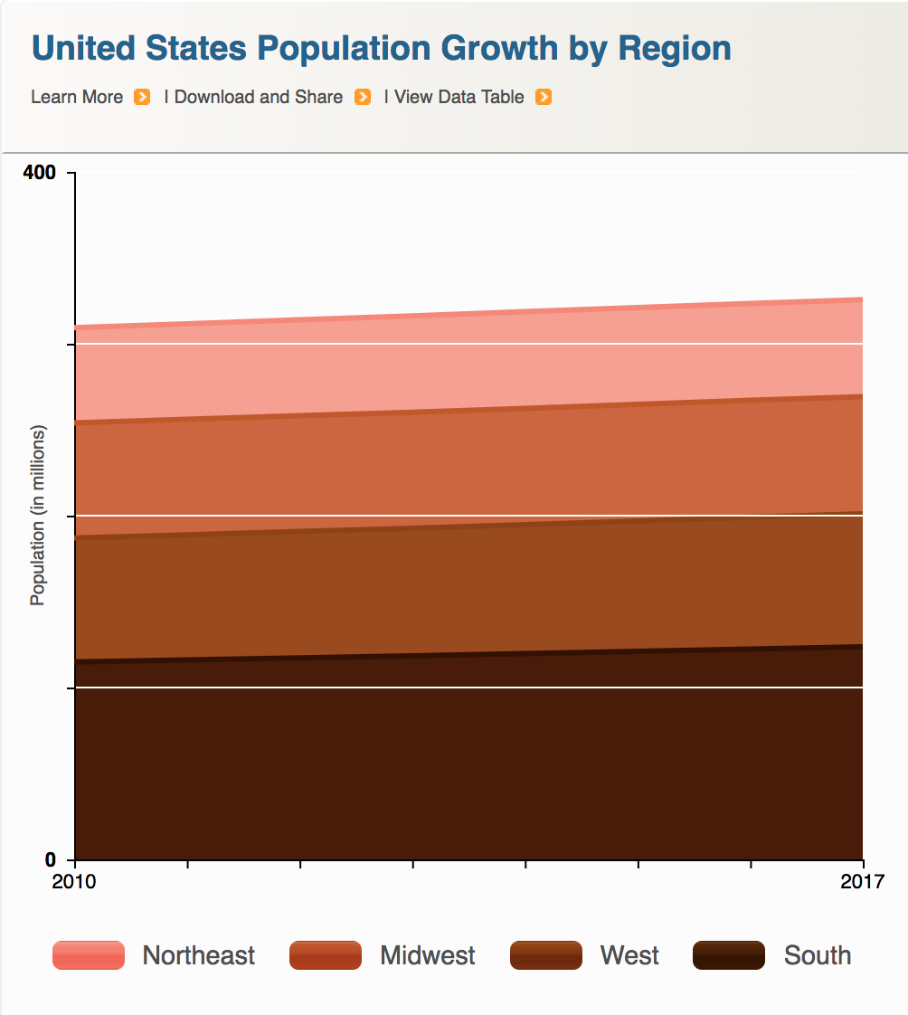


Data is power(ful)
Introduction | ESM | Networks | Future Work | Conclusion
Companies
Government
Citizens

Slide 4
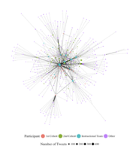
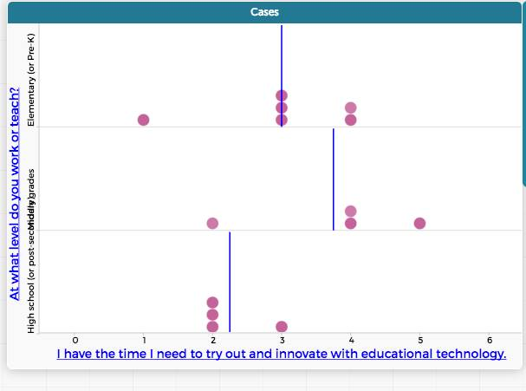
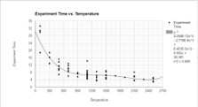
Data is power(ful)
Introduction | ESM | Networks | Future Work | Conclusion
Researchers
Teachers
Students

Slide 5
Guiding research questions
What are the affordances of thinking of and with new types of data in STEM education?
How do these new types of data help us to understand teaching and learning in STEM?

Slide 6
What are the affordances of new types of data in STEM education?
Study phenomena in-context and study teaching and learning processes (Cobb, Confrey, DiSessa, Lehrer, & Schauble, 2003; Tabak, 2004)
Develop a rich understanding of phenomena using multiple data sources (Hatch, 2002; Salganik, 2017)
Build the capacity of researchers to carry-out data-intensive research (Hodis & Hancock, 2015)
Notes:
Demonstrate how new types of data can help us to ask new questions and enrich or return to old questions in education

Slide 7
How does this data help us understand teaching and learning in STEM?
Go beyond doing school to asking questions based on interests (Berland, Schwarz, Krist, Lo, & Reiser, 2016)
Provide positive feedback loops with other school subjects (Lehrer & Schauble, 2015)
Empower students to think of and with data in their day-to-day lives (Horton & Hardin, 2015; Nolan & Temple Lang, 2015; Zeiffler, Garfield, delMas, & Gould, 2007)
Notes:
Demonstrate how data can be used to empower teachers and students.

Slide 8
Introduction | ESM | Networks | Future Work | Conclusion
Introduction
Experience Sampling
Network
Future Work
Conclusions

Slide 9
Experience sampling method
Affordances:
Past research
Importance (but under-emphasis on) context in research on teacher knowledge (Rosenberg & Koehler, 2015)
Role of context in explaining processes around teaching and learning with technology (Phillips, Koehler, & Rosenberg, 2016)
Notes:
Demonstrate how data can be used to empower teachers and students.

Slide 10
How engaged are students in-the-moment in science activities?
Explored “business-as-usual” and hands-on science, activities using a person-in-context approach (Schmidt, Rosenberg, & Beymer, 2018, JRST)
Notes:
Demonstrate how data can be used to empower teachers and students.

Slide 11
How engaged are students in-the-moment in science activities?
Notes:
Demonstrate how data can be used to empower teachers and students.

Slide 12
How engaged are students in-the-moment in science activities?
Notes:
Demonstrate how data can be used to empower teachers and students.

Slide 13
How engaged are students in-the-moment in science activities?
Notes:
Demonstrate how data can be used to empower teachers and students.

Slide 14
How do students engage in work with data?
Studied work with data in summer STEM programs using profiles of engagement and its conditions
Notes:
Demonstrate how data can be used to empower teachers and students.

Slide 15
How do students engage in work with data?
Notes:
Demonstrate how data can be used to empower teachers and students.

Slide 16
How do students engage in work with data?
Notes:
Demonstrate how data can be used to empower teachers and students.

Slide 17
How do students engage in work with data?
Notes:
Demonstrate how data can be used to empower teachers and students.

Slide 18
Introduction | ESM | Networks | Future Work | Conclusion
Introduction
Experience Sampling
Network
Future Work
Conclusions

Slide 19
Digital traces and network data
Affordances:
Past research
Explored the role of State Educational Twitter Hashtags as informal places for learning (Rosenberg, Greenhalgh, Koehler, Hamilton, & Akcaoglu, 2016)
Explored teachers’ technology knowledge evidenced through digital portfolios using the TPACK framework (Koehler, Greenhalgh, Rosenberg, & Keenan, 2017)
Notes:
Demonstrate how data can be used to empower teachers and students.

Slide 20
For what purposes do students in a degree program use a hashtag?
Gathered tweets from over a year from students in a Master of Arts in Educational Technology degree program and coded them to understand what purposes they served
Notes:
Demonstrate how data can be used to empower teachers and students.

Slide 21
For what purposes do students in a degree program use a hashtag?
Notes:
Demonstrate how data can be used to empower teachers and students.

Slide 22
For what purposes do students in a degree program use a hashtag?
Notes:
Demonstrate how data can be used to empower teachers and students.

Slide 23
How does community form among in-service STEM teachers?
Used social network analysis models and methods to understand the development of community among in-service STEM teachers in a graduate certificate program
Notes:
Demonstrate how data can be used to empower teachers and students.

Slide 24
How does community form among in-service STEM teachers?
Notes:
Demonstrate how data can be used to empower teachers and students.

Slide 25
How does community form among in-service STEM teachers?
Notes:
Demonstrate how data can be used to empower teachers and students.

Slide 26
Introduction | ESM | Networks | Future Work | Conclusion
Introduction
Experience Sampling
Networks
Future Work
Conclusions

Slide 27
Summary
Experience Sampling Method
Affordances
Key findings
Networks
Affordances
Key findings
Notes:
Demonstrate how data can be used to empower teachers and students.

Slide 28
Future Work
Supporting students to do data science
Combining methods and data sources to study complex phenomena
Leveraging the network effect to scale innovations
Notes:
Demonstrate how data can be used to empower teachers and students.

Slide 29
Supporting students to do data science
Notes:
Demonstrate how data can be used to empower teachers and students.

Slide 30
Supporting students to do data science
Notes:
Demonstrate how data can be used to empower teachers and students.

Slide 31
Combining methods and data sources to study complex phenomena
Notes:
Demonstrate how data can be used to empower teachers and students.

Slide 32
Combining methods and data sources to study complex phenomena
Notes:
Demonstrate how data can be used to empower teachers and students.

Slide 33
Leveraging the network effect to scale innovations
Notes:
Demonstrate how data can be used to empower teachers and students.

Slide 34
Leveraging the network effect to scale innovations
Notes:
Demonstrate how data can be used to empower teachers and students.

Slide 35
Introduction | ESM | Networks | Future Work | Conclusion
Introduction
Experience Sampling
Networks
Future Work
Conclusions

Slide 36
Future Work
Supporting students to do data science
Combining methods and data sources to study complex phenomena
Leveraging the network effect to scale innovations
Notes:
Demonstrate how data can be used to empower teachers and students.

Slide 37
Guiding research questions
What are the affordances of thinking of and with new types of data in STEM education?
Experience sampling method:
Digital traces and network data:
How do these new types of data help us to understand teaching and learning in STEM?
Experience sampling method:
Digital traces and network data:

Slide 38
Who gets to use data?
Notes:
Demonstrate how data can be used to empower teachers and students.

Slide 39
Acknowledgments
Thank you to collaborators and participating teachers and students
Thank you to Mehmet Aydeniz and the search committee for inviting me on behalf of the TPTE department
Time for questions from the audience
Notes:
Demonstrate how data can be used to empower teachers and students.

Slide 40
References
Cobb et al., 2003
Turner & Noley, 2015
Mishra, Koehler, & Greenhow, 2016
NGSS Lead States, 2015
National Research Council, 2012
Severance et al., 2012
Wilkerson-Jerde & Wilensky, 2015
Rosenberg & Koehler, 2015
Rosenberg et al., 2016
Koehler et al., 2016
Schmidt, Rosenberg, & Beymer, 2018
Beymer, Rosenberg, & Schmidt, in press
Akcaoglu, Rosenberg, Ranellucci, & Schwarz, 2018
Notes:
Demonstrate how data can be used to empower teachers and students.

Slide 41
I think my model is
for other students
sf

