Slide 1
Examining the development of fifth and sixth grade students’ epistemic considerations over time through an automated analysis of embedded assessments
Joshua M. Rosenberg and Christina V. Schwarz
Michigan State University
April 14, 2016
National Association for Research in Science Teaching 2016 Conference
Department of Marine Science

Slide 2
Background | Method | Findings | Discussion
Background
Recent science education reform efforts have focused on learning about scientific concepts through engaging in scientific and engineering practices
Not only is engaging children in scientific and engineering practices is challenging for teachers, understanding what students take away from engaging in scientific and engineering practices requires different approaches to assessment

Slide 3
Background | Method | Findings | Discussion
Background
Measuring epistemic considerations can be challenging
Contextualized (in practice)
May take awhile to develop
Coding can be labor-intensive

Slide 4
Background | Method | Findings | Discussion
Background
Automated approaches to analyzing text data have a long history and have increasingly been used in science education (Beggrow, Ha, Nehm, Pearl, & Boone, 2014; Sherin, 2013; Guo, Xing, & Lee, 2015)
It is possible to examine conceptual aspects of students’ transcribed responses
Embedded assessments are a contextualized, targeted item that may be amenable to text analysis
Understanding of development of epistemic considerations over time through engagement in scientific and engineering practices is still unfolding
Notes:
Add cite
Beggrow, E. P., Ha, M., Nehm, R. H., Pearl, D., & Boone, W. J. (2014). Assessing scientific practices using machine-learning methods: How closely do they match clinical interview performance? Journal of Science Education and Technology, 23(1), 160-182.
Chinn, C. A., Buckland, L. A., & Samarapungavan, A. L. A. (2011). Expanding the dimensions of epistemic cognition: Arguments from philosophy and psychology. Educational Psychologist, 46(3), 141-167
Guo, Y., Xing, W., & Lee, H. S. (2016). Identifying Students' Mechanistic Explanations in Textual Responses to Science Questions with Association Rule Mining. 2015 IEEE International Conference, Atlantic City, NJ. 10.1109/ICDMW.2015.225

Slide 5
Background | Method | Findings | Discussion
Background
Despite growing efforts to analyze text data in science education, no research has examined epistemic considerations nor examined their longitudinal development
Purpose of this analysis is to understand what themes can be identified in students’ epistemic considerations through analyzing embedded assessments
If meaningful, examine patterns of themes over time

Slide 6
Background | Method | Findings | Discussion
Method
Utilized responses from a subset (n = 43) of students who were in classes of one of two fifth-grade and two-sixth grade teachers
Collected 200 embedded assessments
Six units
Each embedded assessment included a prompt
Each embedded assessment included eight-10 items on epistemic considerations and “meta” items about scientific practices
Analyzed only the six items consistent across all six units in this study

Slide 7
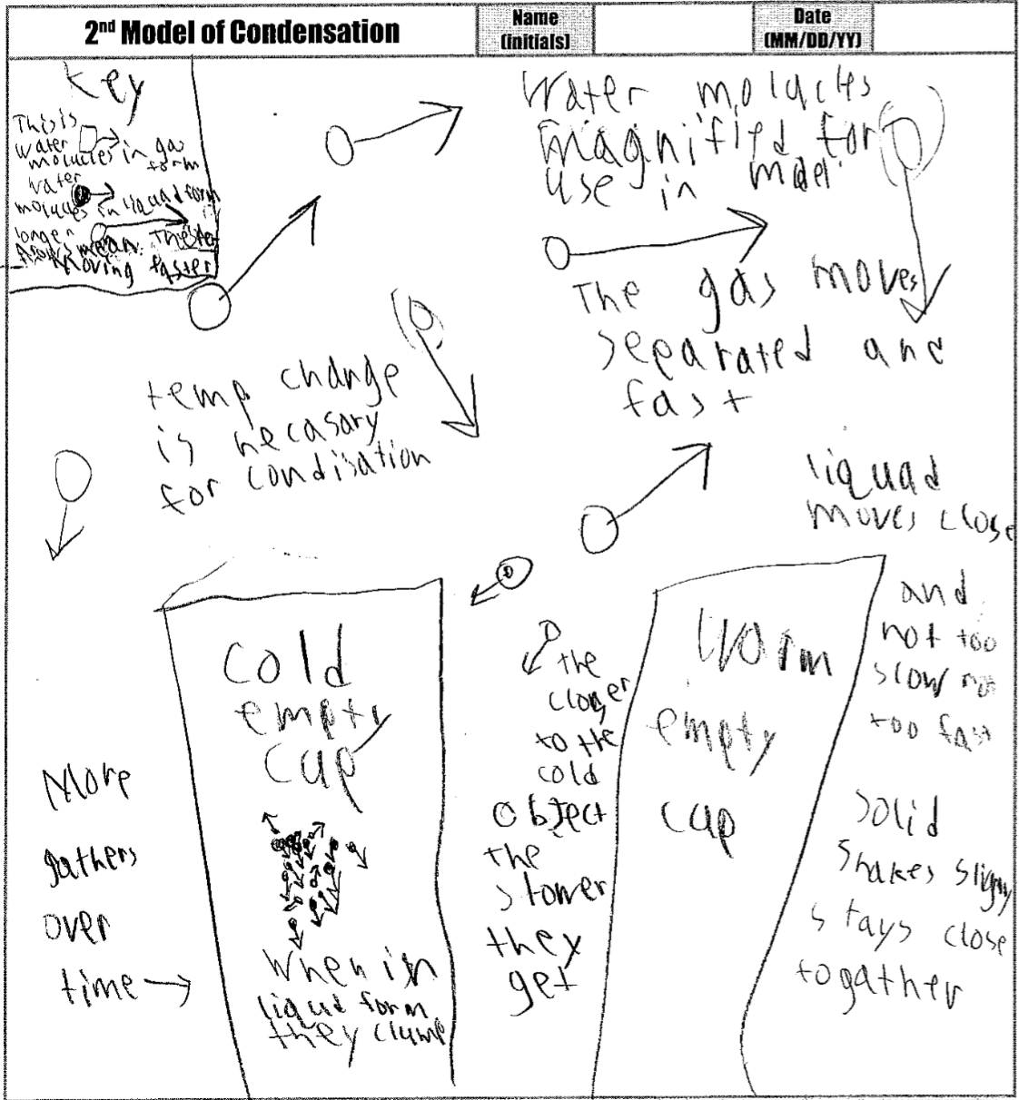

Slide 8
Background | Method | Findings | Discussion
Method
Utilized responses from a subset (n = 43) of students who were in classes of one of two fifth-grade and two-sixth grade teachers
Collected 200 embedded assessments
Six units
Each embedded assessment included a prompt
Each embedded assessment included eight-10 items on epistemic considerations and “meta” items about scientific practices
Analyzed only the six items consistent across all six units in this study

Slide 9
Background | Method | Findings | Discussion
Method
Epistemic considerations
Nature
Audience of model
Justification
Generality
(Meta / reflective)

Slide 10
Background | Method | Findings | Discussion
Method
Audience of model
Who do you think your model is for?
Generality
Do you think your model should explain all the different ways that [specific to unit] or should it mainly focus on a specific situation like [specific to unit]?

Slide 11
Background | Method | Findings | Discussion
Method
5th Grade Units
Evaporation (~1 month)
Condensation (~1 month)
Light (~3 months)
5th Grade Units
Chemistry I (~1.5 months)
Chemistry II (~1.5 months)
Earth Science (~2 months)

Slide 12
Background | Method | Findings | Discussion
Method
5th Grade Units
Evaporation (~1 month)
Condensation (~1 month)
Draw or attach a copy of your revised condensation model to answer the question: “How and why do liquids sometimes appear on cold surface over time?”
Light (~3 months)
6th Grade Units
Chemistry I (~1.5 months)
Chemistry II (~1.5 months)
Draw or attach a copy of your individual revised model that answers the question: “How and why do odors move across the room?”
Earth Science (~2 months)

Slide 13
Background | Method | Findings | Discussion
Method
Adapted Statistical Natural Language Processing technique described by Sherin (2013)
Focus on epistemic aspects instead of conceptual understanding
Length of responses compared to interviews
Analysis of a moderately-sized sample instead of individual students
Notes:
What changes?

Slide 14
Background | Method | Findings | Discussion
Method
Entered responses to six items for 200 embedded assessments from 43 students
Cleaned text and removed “stopwords” using the tm package in the statistical software and programming language R
Created term document matrices or vector-space representation
(Feinerer & Hornik, 2015; R Core Development Team, 2016)
Notes:
What changes?

Slide 15
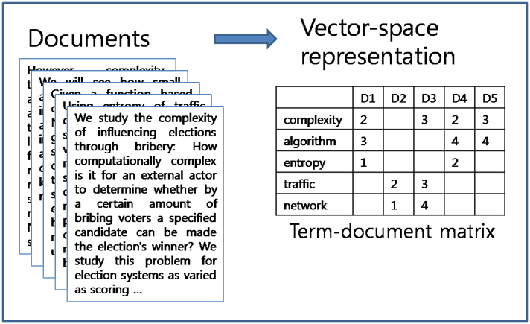
Choi (2016)

Slide 16
Background | Method | Findings | Discussion
Method
Selected the number of themes (or clusters)
Clustered documents using a two-step approach
Hierarchical
K-means
Inspected mean term frequencies and documents for each cluster
Examined frequencies of clusters over time
Notes:
What changes?

Slide 17
Background | Method | Findings | Discussion
Audience

Slide 18
Background | Method | Findings | Discussion
Findings
Selected the number of themes (or clusters)
Clustered documents using a two-step approach
Hierarchical
K-means
Inspected mean term frequencies and documents for each cluster
Examined frequencies of clusters over time
Notes:
What changes?

Slide 19
I think my model is
for other students
“I think my model is for my teacher and other students.”
“I think it is for other students. This is because it helps other students learn about how water shapes our world or we could compare what we think.”
“I think my model is for my class and my self.”

Slide 20
MSU
“To learn from and help me understand. Because it helps me understand better when we do more and more.”
“For the MSU research group and myself its for myself so I can understand condensation better.”
“Me and MSU. To teach me and for MSU to research.”
Notes:
Anyone and everybody! Scientists ,teachers, doctors, even newborn babies. Everybody!
To learn from and help me understand. Because it helps me understand better when we do more and more.
For MSU. Because this is there assessment that they want.

Slide 21
For people to understand how
“People who don't understand because then they can look at my model and see how it works.”
“For people who want to now how you see [some]thing. Because that’s what the model is for.”
“People who don't understand ideas about odors, molecules, and movement. Because then they will partly understand how odors move and what happens to odors.”

Slide 22
For anyone who wants to learn
“It is for anyone who wants to learn about this kind of stuff. Because people could look at my model and learn about air molecules.”
“Anyone who wants/needs to know about odor. Because it is an informative model to inform people.”
“Anyone who wants to learn about condensation.”

Slide 23
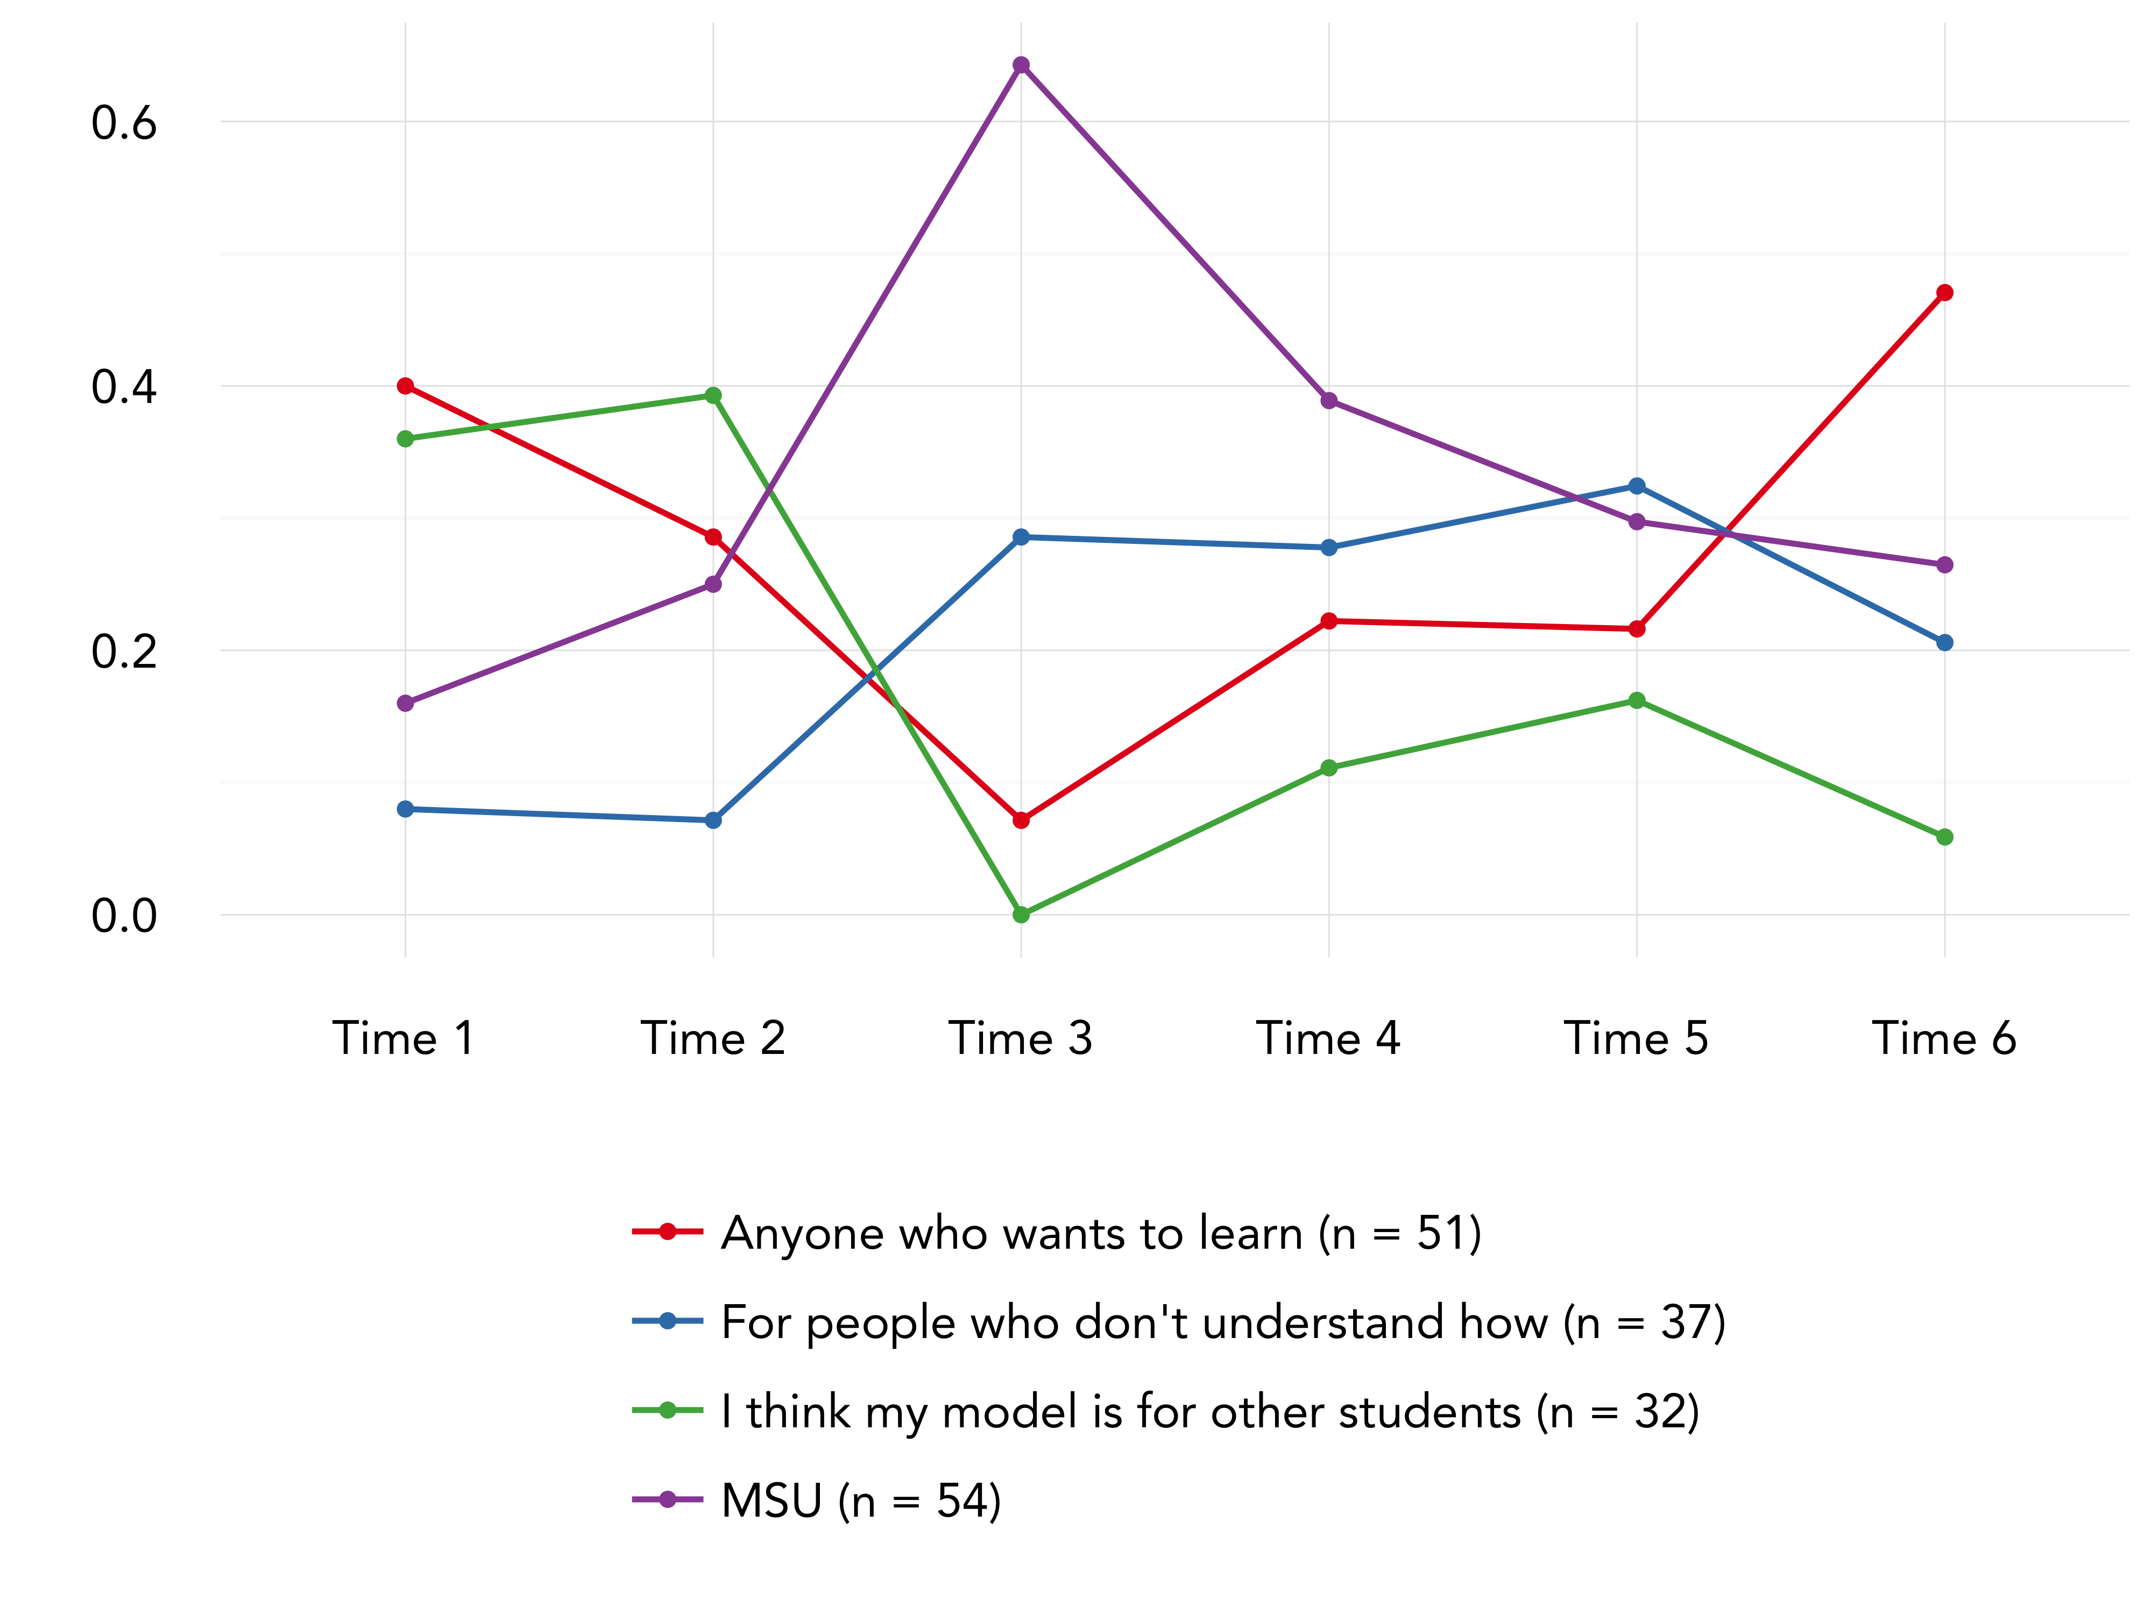

Slide 24
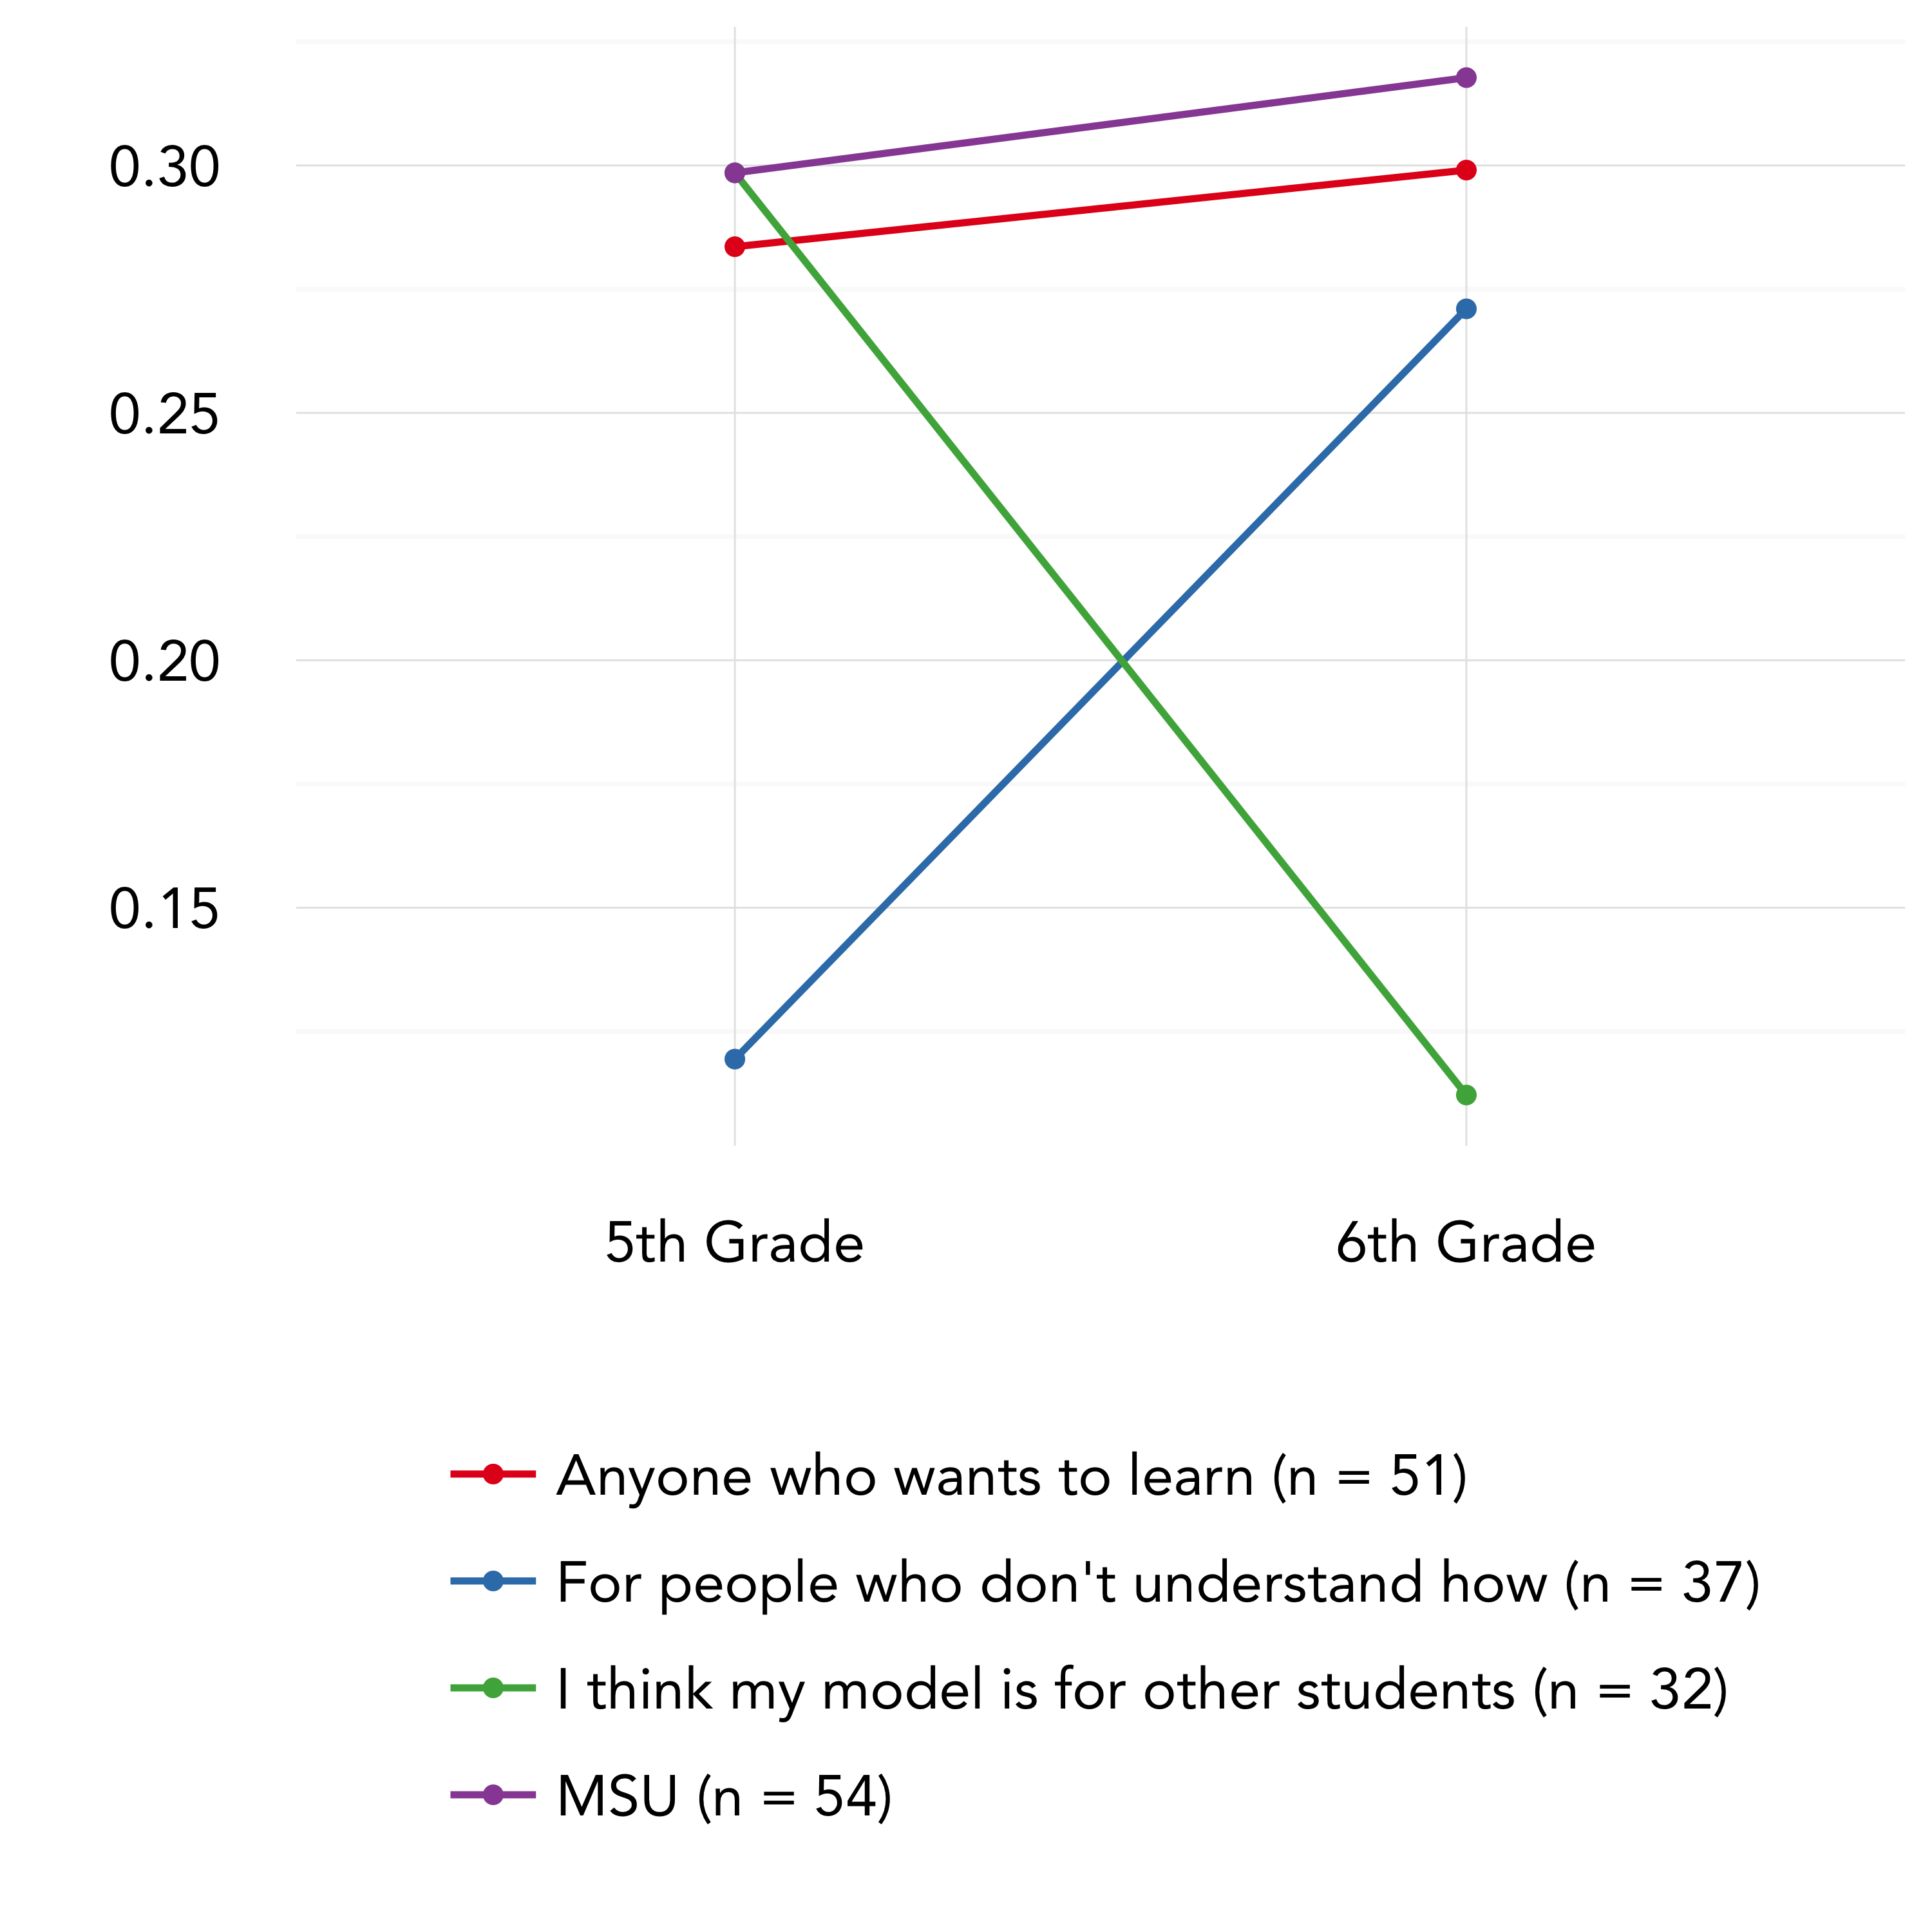

Slide 25
Background | Method | Findings | Discussion
Generality

Slide 26
Explain all different ways
“I think it should explain different ways that evaporation happens. Because it has to explain evaporation the big idea and has to show all the kinds of evaporation.”
“All different ways. Because that is not the only way evaporation happens. A little child might think it is if it focuses only on one phenomena.”
“All the different ways. A good model is general.”
Notes:
It shows all different ideas. So it fits with everything, like the G in GAME.

Slide 27
Ways water shapes things
“All things because the Grand Canyon isn't the only thing that water formed.”
“Because water form more than one thing. Because the water explains how some landforms are formed.”
“I think it should show all the way water shapes things.”
Notes:
Anyone and everybody! Scientists ,teachers, doctors, even newborn babies. Everybody!
To learn from and help me understand. Because it helps me understand better when we do more and more.
For MSU. Because this is there assessment that they want.

Slide 28
Show the way air moves
“My model works for all molecules in general. All air molecules and odor vapors move the same. The difference would be seen if you drew specific molecules.”
“Yes, because the air molecules could represent any smell. It could be perfume, air fresher, etc.”
“Yes because all odors move the same.”

Slide 29
Can explain one thing
“It should teach on one thing. It is easier to explain and that you can put one thing in more detail.”
“Only the cold pop can and ice pack because they shouldn't see every thing in one model.”
“It should explain all the types of evaporation. Because then it would be better instead of showing so many models you can just show one.”
Notes:
“Yes and no. It usually depends. If you say that the canyons were formed by elves, no. But you can explain to that person by weathering and erosion, that is the cause or nature.”
“Only the cold pop can and ice pack because they shouldn't see every thing in one model.”

Slide 30
Models should be general
“Not be so specific. Because all good models should fit all phenomena.”
“Not too specific. A good model is general.”
“My model should explain something in the middle. My model should explain something in the middle because a model should be general, but not so general that it becomes inaccurate for describing some phenomena.”

Slide 31
Should focus on a specific situation
“I think it should focus on a specific situation. If you focus on multiple things it will look messy and it will be hard to read.”
“I think my model should mainly focus on a specific situation. Because then it doesn’t go off in a bunch of different directions and get confusing.”
“I think the model should focus on the big idea (evaporation). Because if you describe to much of one thing you start going away from the big idea.”

Slide 32
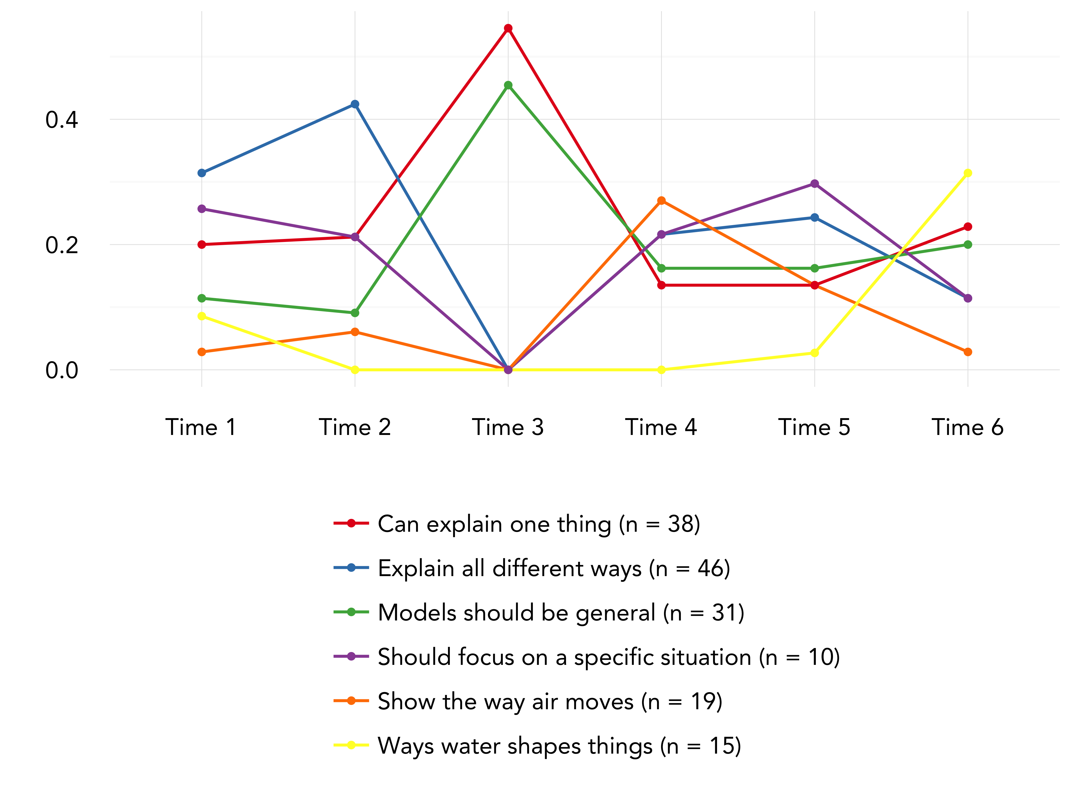

Slide 33
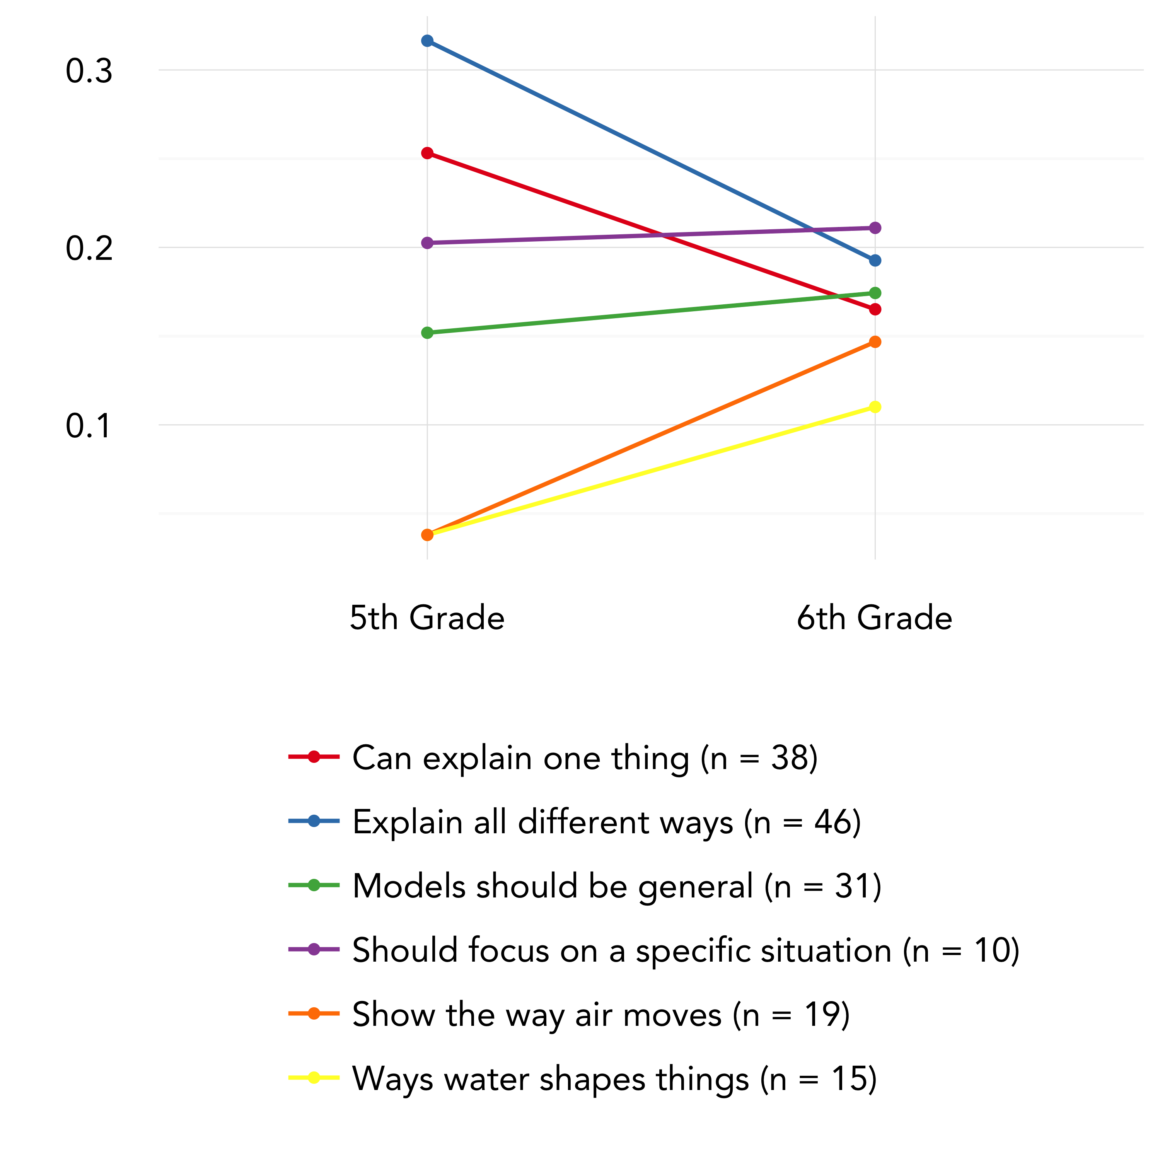

Slide 34
Background | Method | Findings | Discussion
Key Findings
Themes from an automated analysis of embedded assessment items focused on epistemic considerations of students’ engagement in scientific and engineering practices seem to pick up on different dimensions
Audience
Seems to be highly interpretable but explicit
Generality
Seems to be content-specific of focused on being either general or specific

Slide 35
Background | Method | Findings | Discussion
Key Findings
Longitudinal patterns demonstrate trends in themes that might be meaningful
Audience
Some growth over time
Generality
More challenging to interpret

Slide 36
Background | Method | Findings | Discussion
Significance and Limitations
Yes we can!
Significant variability within clusters
Notes:
Add others

Slide 37
Background | Method | Findings | Discussion
Discussion
Coding additional embedded assessment responses
Including other data sources to substantiate findings or to serve as factors in addition to time
Classification combined with clustering
Focusing on stopword removal to focus on epistemic (rather than explicit or content) aspects

Slide 38
Background | Method | Findings | Discussion
Thank you!
Joshua Rosenberg
jrosen@msu.edu
http://jmichaelrosenberg.com
Christina V. Schwarz
cschwarz@msu.edu
http://schwarz.wiki.educ.msu.edu/

Slide 39
References
Beggrow, E. P., Ha, M., Nehm, R. H., Pearl, D., & Boone, W. J. (2014). Assessing scientific practices using machine-learning methods: How closely do they match clinical interview performance? Journal of Science Education and Technology, 23(1), 160-182.
Chinn, C. A., Buckland, L. A., & Samarapungavan, A. L. A. (2011). Expanding the dimensions of epistemic cognition: Arguments from philosophy and psychology. Educational Psychologist, 46(3), 141-167
Ingo Feinerer and Kurt Hornik (2015). tm: Text Mining Package. R package version 0.6-2. http://CRAN.R-project.org/package=tm
Guo, Y., Xing, W., & Lee, H. S. (2016). Identifying Students' Mechanistic Explanations in Textual Responses to Science Questions with Association Rule Mining. 2015 IEEE International Conference, Atlantic City, NJ. 10.1109/ICDMW.2015.225
R Core Team (2015).
Sherin, B. (2013). A computational study of commonsense science: An exploration in the automated analysis of clinical interview data. Journal of the Learning Sciences, 22, 600-638.
R Development Core Team (2016). R: A language and environment for
statistical computing. R Foundation for Statistical Computing, Vienna, Austria. ISBN 3-900051-07-0, URL http://www.R-project.org.

