Slide 1

throwarm
Denver JS
6/5/2014
Thowarm allows you to parse data sets (like SQL results)
into re-usable, hierarchical objects.

Slide 2

Branding

Slide 3
Issues
Writing a lot of code trying to stuff record sets into usable forms
Inconsistent use of things like formatting and calculation functions

Slide 4
Throwarm Goals
Have reconfigurable object hierarchies
Keep functions with objects
Decouple objects from database
Do not abstract away SQL, especially for complex queries
Feel JavaScripty

Slide 5
An unexpected advantage
Throwarm objects are really easy to test

Slide 6
Throwarm
Objects
  Datagrams – single objects
  Datasets – groups of a single object
  Calc – allows for populated calculations
Builders – make and populate complex objects
Endpoints – simple DB interface (beta)

Slide 7
Making a Datagram
var Datagram = require('throwarm').Datagram;
function MyDatagram() {
MyDatagram.defineProperty(this,'base',{value:Datagram,writable:false,configurable:true,enumerable:false});
this.base(this);
this.fieldMap = {
};
}
MyDatagram..prototype = new Datagram();
MyDatagram.prototype.constructor = MyDatagram;
Use Film

Slide 8
Endpoints
Endpoints separate out the database interface to support simple DB operations
  Get
  Insert
  Update
You don't actually need to use Endpoints
Use Film

Slide 9
Calc
Supports Calculated Fields in Datagram
new Calc(['field','field2'], function(field, field2) {return( field + ' ' + field2 );}),
Use Film

Slide 10
Extending a Datagram
Easy – just add them to the prototype
Hide the extensions with Object.defineProperty
Note: Has can check for types
Use Rental

Slide 11
Making a Dataset
function MyDataset() {
var myDataset = new Dataset();
myDataset.typeName= 'MyDataset';
return myDataset;
}
Use Rentals

Slide 12
Extending a Dataset
Easy - just add to the dataset you created
Helper function
  has
  copyReturn
Use Rentals

Slide 13
Make a Builder
Create a data structure
Write an query
Call fill to fill the data structure

Slide 14
Questions?

Slide 15
Keep Operations with Data
Recordset
if(user.first || user.last) {
if(user.first) && user.last) {
user.first + ' ' + user.last
}
else {
user.first + user.last
}
}
else{
user.email()
}
//Better
Var lib = require('userLib');
lib.formatName(user.first, user.last, user.email);
Throwarm
user.formatedName();

Slide 16
Relations Go Both Ways

Slide 17
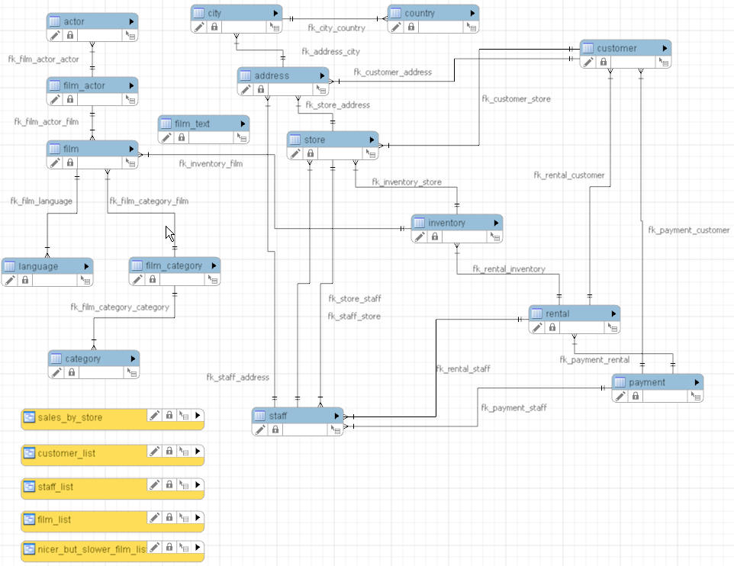
Sakila Database

