Slide 1

SlackCan
The app that combines two of the most essential student services to increase productivity and simplicity.
Created by:
Aaron Farntrog | Yehoshua Segal | Yossi Rotenstreich

Slide 2
/Commands
To interact with the app, simply enter a command.
There are five SlackCan commands:
/helloworld
/authenticate-canvas
/upcoming-assignments
/course-list
/course-assignments

Slide 3
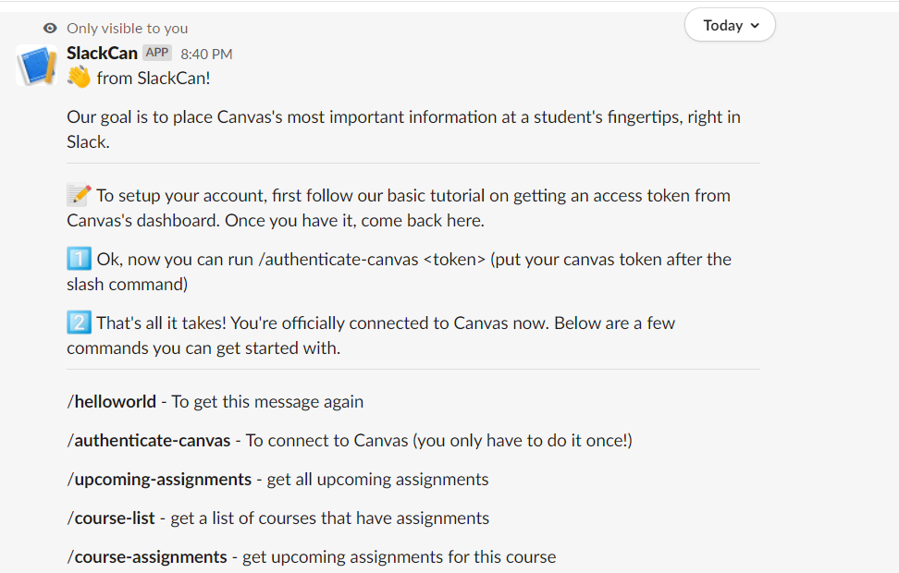
/helloworld
Here’s how it looks in action:
The /helloworld command displays a simple welcome message to the user and provides the user with basic setup instructions.

Slide 4
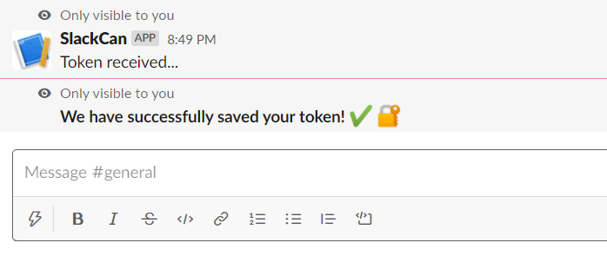

/authenticate-canvas
Here’s how it looks in action:
The /authenticate-canvas command is how you grant SlackCan access to your Canvas account. Simply type the command, followed by your Canvas authentication token*, so SlackCan can save the token to a database for future use.
* To generate a Canvas authentication token, login to Canvas, go to Account>Settings>Approved Integrations, and hit the button.

Slide 5
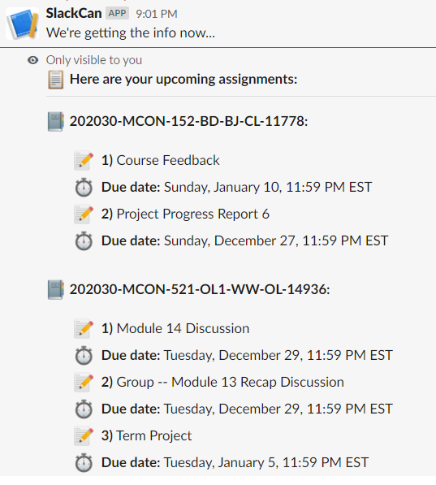
/upcoming-assignments
Here’s how it looks in action:
The /upcoming-assignments command, using your CAT, accesses your Canvas account and looks for all posted assignments that are not yet due. It then displays a list of all the upcoming assignments for each course.

Slide 6
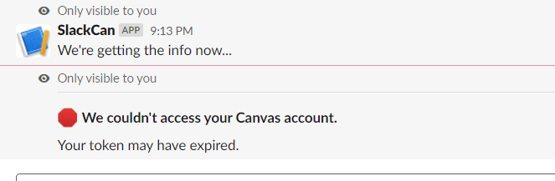
If SlackCan can’t access your Canvas account, you’ll see this message:

Slide 7
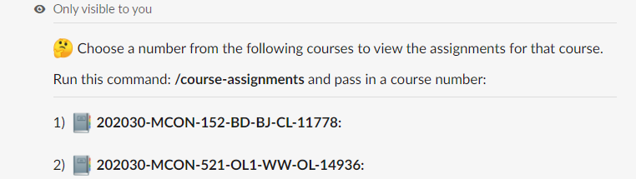
/course-list
The /course-list command displays a numbered list of courses in which you have upcoming assignments. The main purpose of this command is to give you the ability to retrieve a list of course specific assignments using the /course-assignments command.
Here’s how it looks in action:

Slide 8
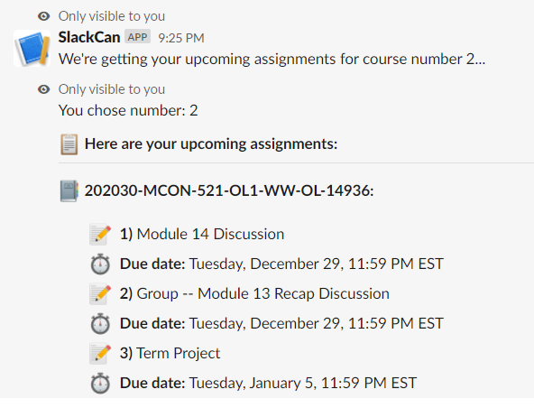
/course-assignments
The /course-assignments is used to retrieve a list of upcoming assignments for a specific course. Simply type the command, followed by the course number and you’ll see the list. If you don’t know the course number, just type the /course-list command.
Here’s how it looks in action:

Slide 9
Challenges
Technical challenges our team worked on to solve while building SlackCan

Slide 10
AUTHENTICATION
Problem:
The only way to access a students Canvas account is with a Canvas Token.
We created a command to give the user the ability to authenticate, however, we realized that it would be annoying to require the user to pass in a token each time they call a command that accesses Canvas
Solution:
We created a database to store the tokens.
So, a user only needs to enter their token once and we store it along with their Slack user ID.
Now, when a user calls a command, we retrieve their user ID so that we can identify their token in our database. We can then query canvas using the token we have saved for that user.

Slide 11
ASYNCHRONOUS
Problem:
Some of the slack commands need to query the Canvas API and do other work as well. This creates long running tasks which cannot be run synchronously since Slack will send the user a timeout error.
Solution:
After much research we figured out why the timeout errors were occurring, we then discovered the Slack way to handle asynchronous calls and implemented it.

