Slide 1
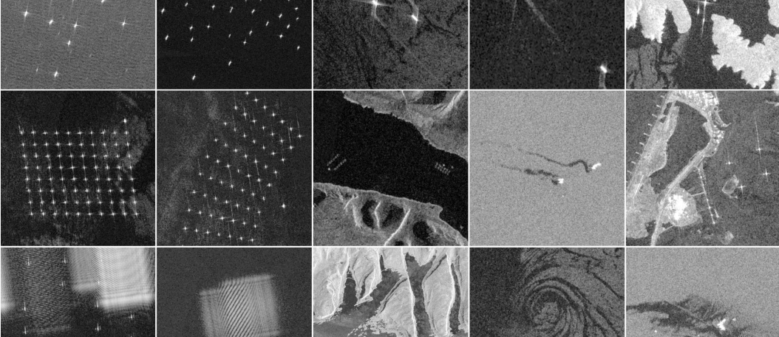
xView3: Label-Efficient Dark Vessel Detection
JHU EP 705.643 — Deep Learning Developments with PyTorch
John Roth & Kyle Wagner

Slide 2
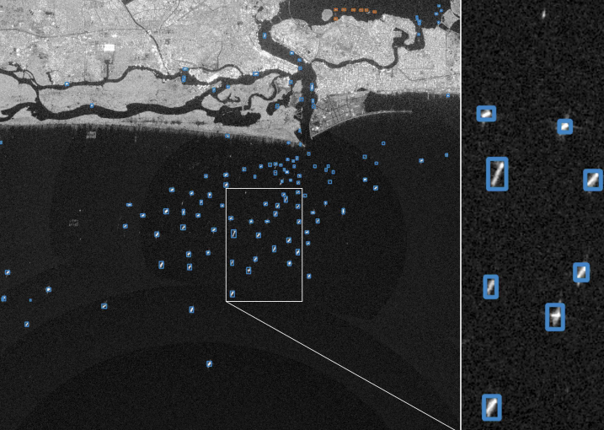
1. Problem & Motivation
xView3 targets vessel detection in Sentinel-1 SAR, including dark vessels not broadcasting AIS. With labels scarce, we compare how well pretrained foundation backbones transfer under a fixed harness.
Vessels are small, sparse, and domain-specific in SAR scenes
Dark vessels (no AIS) are operationally important; their labels are scarce
~1,000 scenes total, so supervised-only training risks overfitting
Core question: does a SAR foundation model beat an optical one for label-efficient dark-vessel detection?

Slide 3
2. Data — xView3
xView3 accessed via the SARFish mirror; label provenance still drives the split design.
Scale and inputs
991 Sentinel-1 scenes, ~29,400 x 24,400 px each
Dual-polarization VV + VH inputs
SARFish mirror on Hugging Face (Apache 2.0): selective GRD-only pulls
Label provenance
Train labels machine-generated (CFAR + AIS + GFW); HIGH/MED/LOW tiers
Native labels are points + lengths, not boxes
~50 human-verified validation scenes: reserved for final eval
Practical scoping
75-150 train scenes stratified by region and shoreline; 800 x 800 px chips
SARFish adds bboxes (where available) + precomputed distance-from-shore
Detection task only; chip-level fine-tuning on 800px tiles

Slide 4
3. Pretraining Datasets
Sensor and resolution match drive value; native Sentinel-1 sets are corpus-grade, finer-resolution SAR sets are still useful pixels.
Native Sentinel-1 (best fit)
xView3 / SARFish: the target; C-band, VV/VH, ~10 m
OpenSARShip 1.0/2.0: ~34k S-1 IW ship chips + AIS
LS-SSDD-v1.0: 15 large S-1 scenes, 9k 800px sub-images
Related SAR (resolution-shifted)
SAR-Ship-Dataset: ~39k S-1 + Gaofen-3 chips, 3-25 m
HRSID: ~5.6k chips, 0.5-3 m, boxes + instance masks
SSDD: 1,160 mixed-sensor images, 1-15 m, box/rbox/seg
FUSAR-Ship: Gaofen-3 C-band, ~1.1-1.7 m, type labels
How each is used
SARMAE is downloaded (pretrained on SAR-1M); we curate no SSL corpus ourselves
LS-SSDD alone is the supervised arm (Arm 4) source
HRSID + SAR-Ship + SSDD pool only for the challenge (Arm 5)
Licenses checked per source before download

Slide 5
4. The Six Arms
One fixed harness; the downloaded init is the only thing that changes. Arms 1-4 sit on the label-efficiency curve, 5 chases the leaderboard, 6 brackets the range.
1. Random init (floor)
From-scratch supervised on xView3; the no-pretraining baseline every other arm is measured against
2. SatDINO → xView3
Frozen frontier optical-satellite backbone + trained head; the RGB-domain transfer anchor
3. SARMAE → xView3
Downloaded SAR foundation model (SAR-1M), fine-tuned; the in-domain transfer arm
4. Supervised SAR-ship → xView3
Pretrain on labeled SAR ship detection, then fine-tune; labeled near-domain transfer
5. Best FM + Supervised → xView3
Stacked pretraining; the unconstrained run for the challenge leaderboard, reported separately
6. External references
YOLO26-COCO and LocateAnything-3B zero-shot; not on the curve, they bracket the achievable range

Slide 6
5. Detection Harness
Backbone — ViT-B/16. Patch embed takes a fixed 3-channel [VH, VV, VH-VV] SAR input (identical for every arm). Plain (non-hierarchical) ViT so the same network accepts every arm's downloaded weights.
Head — heatmap, not boxes. Deconv tower upsamples the stride-16 token grid to a stride-4 dense response map; one sigmoid channel per pixel. Matches xView3's point labels natively.
Training target — Gaussian blobs. Each vessel point is painted as a small 2D Gaussian; penalty-reduced focal loss. LOW-confidence labels become ignore regions, not positives or negatives.
Decode — peak + distance NMS. Local-maxima above threshold become detections; duplicates within a distance radius are suppressed (the box-free analog of IoU-NMS).
Scoring — distance matching. Predicted points greedily matched to ground-truth points within the xView3 tolerance; no IoU anywhere. Target, output, and metric all live in one point-and-distance space.
Why fixed. Frozen across all arms so the only variable is the ViT initialization; lineage is CenterNet (Objects as Points), validated for SAR by TRANSAR.

Slide 7
Arm 1 - Random Initialization (Floor)
Identity. ViT-B/16 with random weights, trained supervised on xView3 only. No pretraining of any kind.
What it tests. The no-pretraining floor. Every other arm's value is the gap above this line; without it, 'pretraining helps' has no baseline.
Source. None - weights are random init.
Expected role. Lowest curve, steepest climb with more labels. If a data-hungry ViT fails to converge at the scarce-label end, that itself is a finding.

Slide 8
Arm 2 - SatDINO → xView3
Identity. SatDINO ViT-B/16, an optical-satellite foundation model (DINO self-distillation on fMoW-RGB), downloaded and fine-tuned on xView3 through the same harness as every arm.
What it tests. Optical-domain transfer: does foundation-model pretraining on optical satellite imagery transfer to SAR detection?
Source. SatDINO (Straka & Gruber 2025), ViT-B/16 pretrained on fMoW-RGB; same size and fine-tuning regime as SARMAE. Downloadable (Apache-2.0); the optical ViT-B MAE was not, hence DINO.
Expected role. Same-size optical anchor (both ViT-B). Arms 2 and 3 differ in domain and in SSL method (DINO vs MAE); we compare the best released FM of each domain as-is, a documented caveat.

Slide 9
Arm 3 - SARMAE → xView3 (Core)
Identity. SARMAE ViT-B/16, a SAR foundation model (masked autoencoder pretrained on the 1M-image SAR-1M set), downloaded and fine-tuned on xView3.
What it tests. The headline contrast: does a SAR-domain foundation model beat an optical one (SatDINO) for dark-vessel detection?
Source. Downloaded (Liu et al., CVPR 2026; MiliLab/SARMAE). Same ViT-B as every arm, fine-tuned identically. We pretrain nothing - this removes the compute and novel-code risk.
Expected role. The SAR-FM arm. If it leads at low label fractions, in-domain pretraining wins; the gap to SatDINO is the optical-vs-SAR result.

Slide 10
Arm 4 - Supervised SAR-ship → xView3
Identity. ViT pretrained supervised on a labeled SAR ship-detection set, then fine-tuned on xView3.
What it tests. Labeled near-domain SAR transfer vs. the downloaded foundation models. Single matched source keeps the contrast clean (native Sentinel-1, scene-scale).
Source. LS-SSDD-v1.0 only: native Sentinel-1, scene-scale, already 800px chips. Boxes collapsed to centroids, fed to the same heatmap head.
Expected role. A labeled-transfer point of comparison against the SatDINO and SARMAE foundation-model arms on the label-efficiency curve.

Slide 11
Arm 5 - Best FM + Supervised (Challenge)
Identity. Stacked: best downloaded FM (SARMAE), then supervised SAR-ship, then fine-tune on xView3. Unconstrained.
What it tests. Maximum achievable score - not a controlled comparison. Reported separately from the five-arm study.
Source. Supervised stage pools all SAR detection sets (LS-SSDD + HRSID + SAR-Ship-Dataset + SSDD), centroids to heatmap; plus ensembling with YOLO26, TTA, pseudo-labeling, all-data training.
Expected role. The leaderboard entry / coda. Built last, only if the study lands and time remains; not on the label-efficiency curve.

Slide 12
Arm 6 - External References
Identity. Two off-the-shelf models run for context, neither fine-tuned through the harness.
YOLO26-COCO. Standard detector fine-tuned from COCO; boxes built from points+lengths, centers scored through our scorer. The recognizable absolute-number anchor.
LocateAnything-3B. Frozen grounding VLM, zero-shot on SAR chips with text prompts. A 'what does a 2026 generalist do out of the box on SAR?' probe.
Expected role. Brackets the achievable range top and bottom; contextualizes the study arms without being on the curve.

Slide 13
6. Evaluation Design
The label-efficiency curve is the headline; arm ordering doubles as an optical-to-SAR transferability result.
Splits and hygiene
Scene-level 75/15/10 split of train scenes (no chip-level leakage)
Pretraining sees only train + public chips, never validation
Final eval: human-verified scenes, untouched by any training
All four arms ViT-B, same head and fine-tuning; only the downloaded init differs
Experiment grid
4 study arms: random / SatDINO / SARMAE / supervised
x label fractions 10 / 25 / 50 / 100%
Seed reruns on the 25% + 100% cells for error bars
Corpus ablation: xView3 only vs + public + OpenSARShip
Headline readout
Label-efficiency curve: F1 vs labels, one line per arm
Gap over the floor at 10% labels = value of pretraining
Arm ordering = optical-to-SAR transfer: SatDINO < SARMAE
Challenge entry reported separately (see Arm 5)

Slide 14
7. Metrics
Every number flows through one frozen scorer; the metric mirrors the labels (points and distances), not bounding boxes.
Primary metric
xView3 aggregate detection F1 (precision + recall)
Distance-matched: predicted points to GT points within tolerance, no IoU
Threshold tuned on dev, frozen for test + final eval
Operational slices
Dark-vessel recall (non-AIS targets, the hard case)
Close-to-shore F1 (shoreline + infrastructure clutter)
Reported per arm and per label fraction
What we do NOT use
No IoU / box overlap anywhere - labels are points
Verified-scene F1 is the number that counts
Challenge entry scored on the leaderboard, reported apart

Slide 15
8. Feasibility & Schedule
Both foundation models are downloaded, so there is no pretraining long pole; total compute is ~130 GPU-hours, about a day on the node.
Compute plan
RTX 5070 Ti: fine-tune dev loop + YOLO26 / LocateAnything reference runs
One 8x V100 (32 GB) node: the fine-tune grid (one config per GPU) + supervised-transfer training; scene-scale inference
Challenge runtime budget was 15 min/scene on a V100, so our timings are directly comparable
Schedule and risk
Wk 1-2: SARFish GRD subset + chipping + heatmap harness; YOLO26 reference (harness frozen)
Wk 2-4: SatDINO + SARMAE (downloaded) + random arms fine-tuned; channel-format check first
Wk 3-5: supervised arm + full label-fraction grid + seed reruns, one config per card
Wk 5-7: final eval + error analysis (dark-vessel recall, shoreline)
Wk 7+: writeup; optional unconstrained challenge entry if time remains
Two-person split: data/scorer owner vs. harness/eval owner

Slide 16
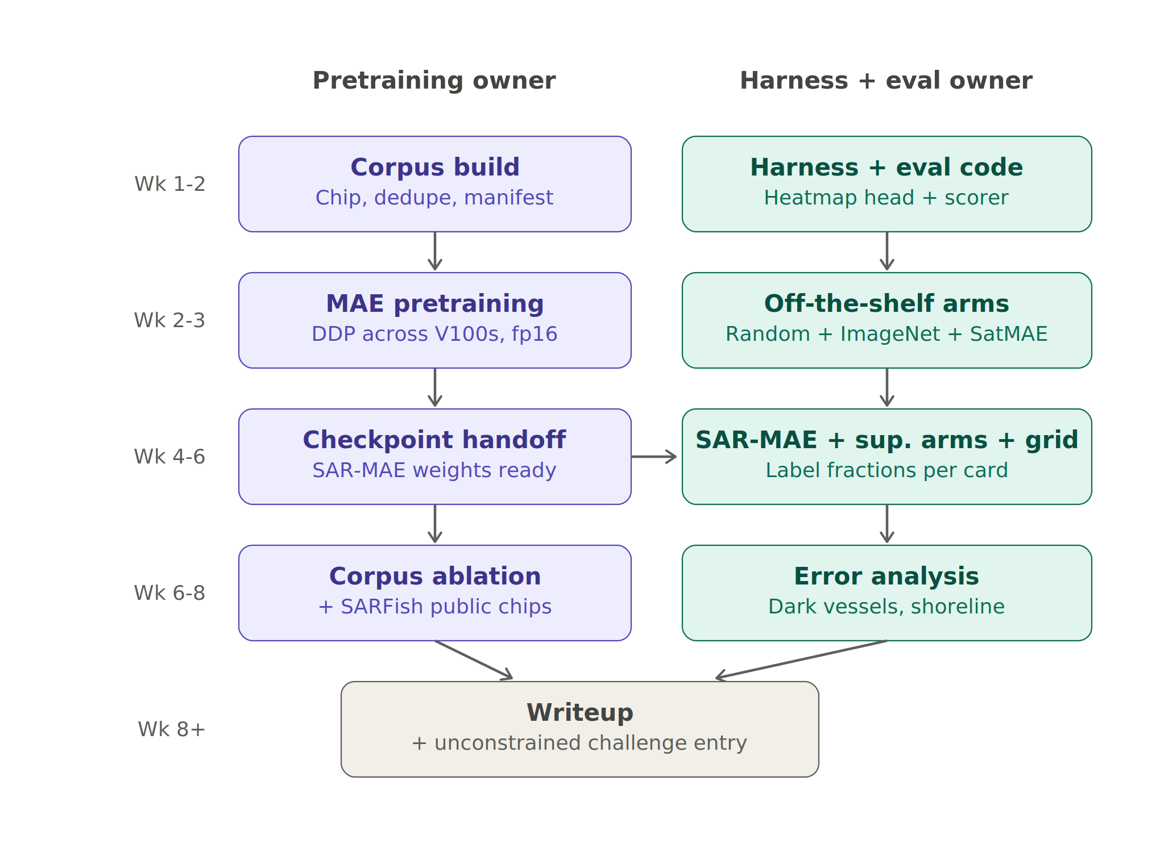
9. Schedule
Two independent lanes with no hard dependency: both foundation models are downloaded, so there is no pretraining handoff to block on.
Week | Data / scorer owner | Harness + eval owner
1-2 | Download + chip xView3; build splits | Heatmap harness + frozen scorer; YOLO26 ref
2-4 | Centroid conversion; data QA | SatDINO + SARMAE + random arms (FMs first)
3-5 | Support supervised-transfer training | Supervised arm; full label-fraction grid + seeds
5-7 | Assist error analysis | Final eval; error analysis: dark vessels, shoreline
7+ | Support writeup | Writeup + optional challenge entry

Slide 17
10. Alternatives & Fallbacks
Compositing bridge (answers the synthetic-data question). Paste real vessel chips onto real vessel-free backgrounds; ~1 week, no diffusion anywhere. Adds a synthetic-augmentation row so the final table reads SSL vs. augmentation vs. both.
Self-training / pseudo-labeling. Train on human-verified scenes, pseudo-label the noisy train scenes with high-confidence predictions (AI2 4th-place precedent; Zoph et al. 2020). Same harness; stands alone if pretraining underwhelms.
SAR-aware preprocessing study. dB scaling, speckle filtering, and polarimetric channel handling vs. RGB-style normalization; cheap, fast, and orthogonal to every other track.
Detection-head comparison. Heatmap head vs. ViTDet-style box head on the best initialization; timeboxed, one-slide result after the init grid lands.
Complex-valued SLC (stretch). SARFish SLC products (2.3 m azimuth spacing) enable Doppler/sublook features for moving vessels and complex-valued nets; storage and non-square pixels are the tax.
Ancillary-layer fusion. Add bathymetry, wind, or land/ice channels to disambiguate vessels from fixed infrastructure, especially close to shore.

Slide 18
11. References
Task & benchmark
xView3-SAR challenge (official site)
Paolo et al. 2022, xView3-SAR dataset paper (arXiv 2206.00897)
SARFish - xView3 GRD+SLC extension (Hugging Face)
AI2 sar_vessel_detect - xView3 4th-place pipeline (GitHub)
Models & methods
Ultralytics YOLO26 (baseline detector)
NVIDIA LocateAnything - grounding VLM (project page)
He et al. 2022, Masked Autoencoders (MAE) - arXiv 2111.06377
Straka & Gruber 2025, SatDINO - satellite DINO, ViT-B (arXiv 2508.21402)
Liu et al. 2026, SARMAE - SAR foundation model on SAR-1M, ViT-B (arXiv 2512.16635)
Li et al. 2024, SAR-JEPA gradient-feature SSL (ISPRS)
Zoph et al. 2020, Rethinking Pre-training & Self-training (arXiv 2006.06882)
SAR ship / vessel datasets
SAR-Ship-Dataset - Sentinel-1 + Gaofen-3 chips (GitHub)
HRSID - high-res SAR detection + segmentation (GitHub)
SSDD - SAR Ship Detection Dataset, official release (GitHub)
LS-SSDD-v1.0 - large-scene Sentinel-1 small-ship (GitHub)
OpenSARShip / OpenSARUrban - Sentinel-1 chips (SJTU)
SAR-JEPA datasets hub: MSAR, FUSAR-Ship, etc. (GitHub)

