Slide 1
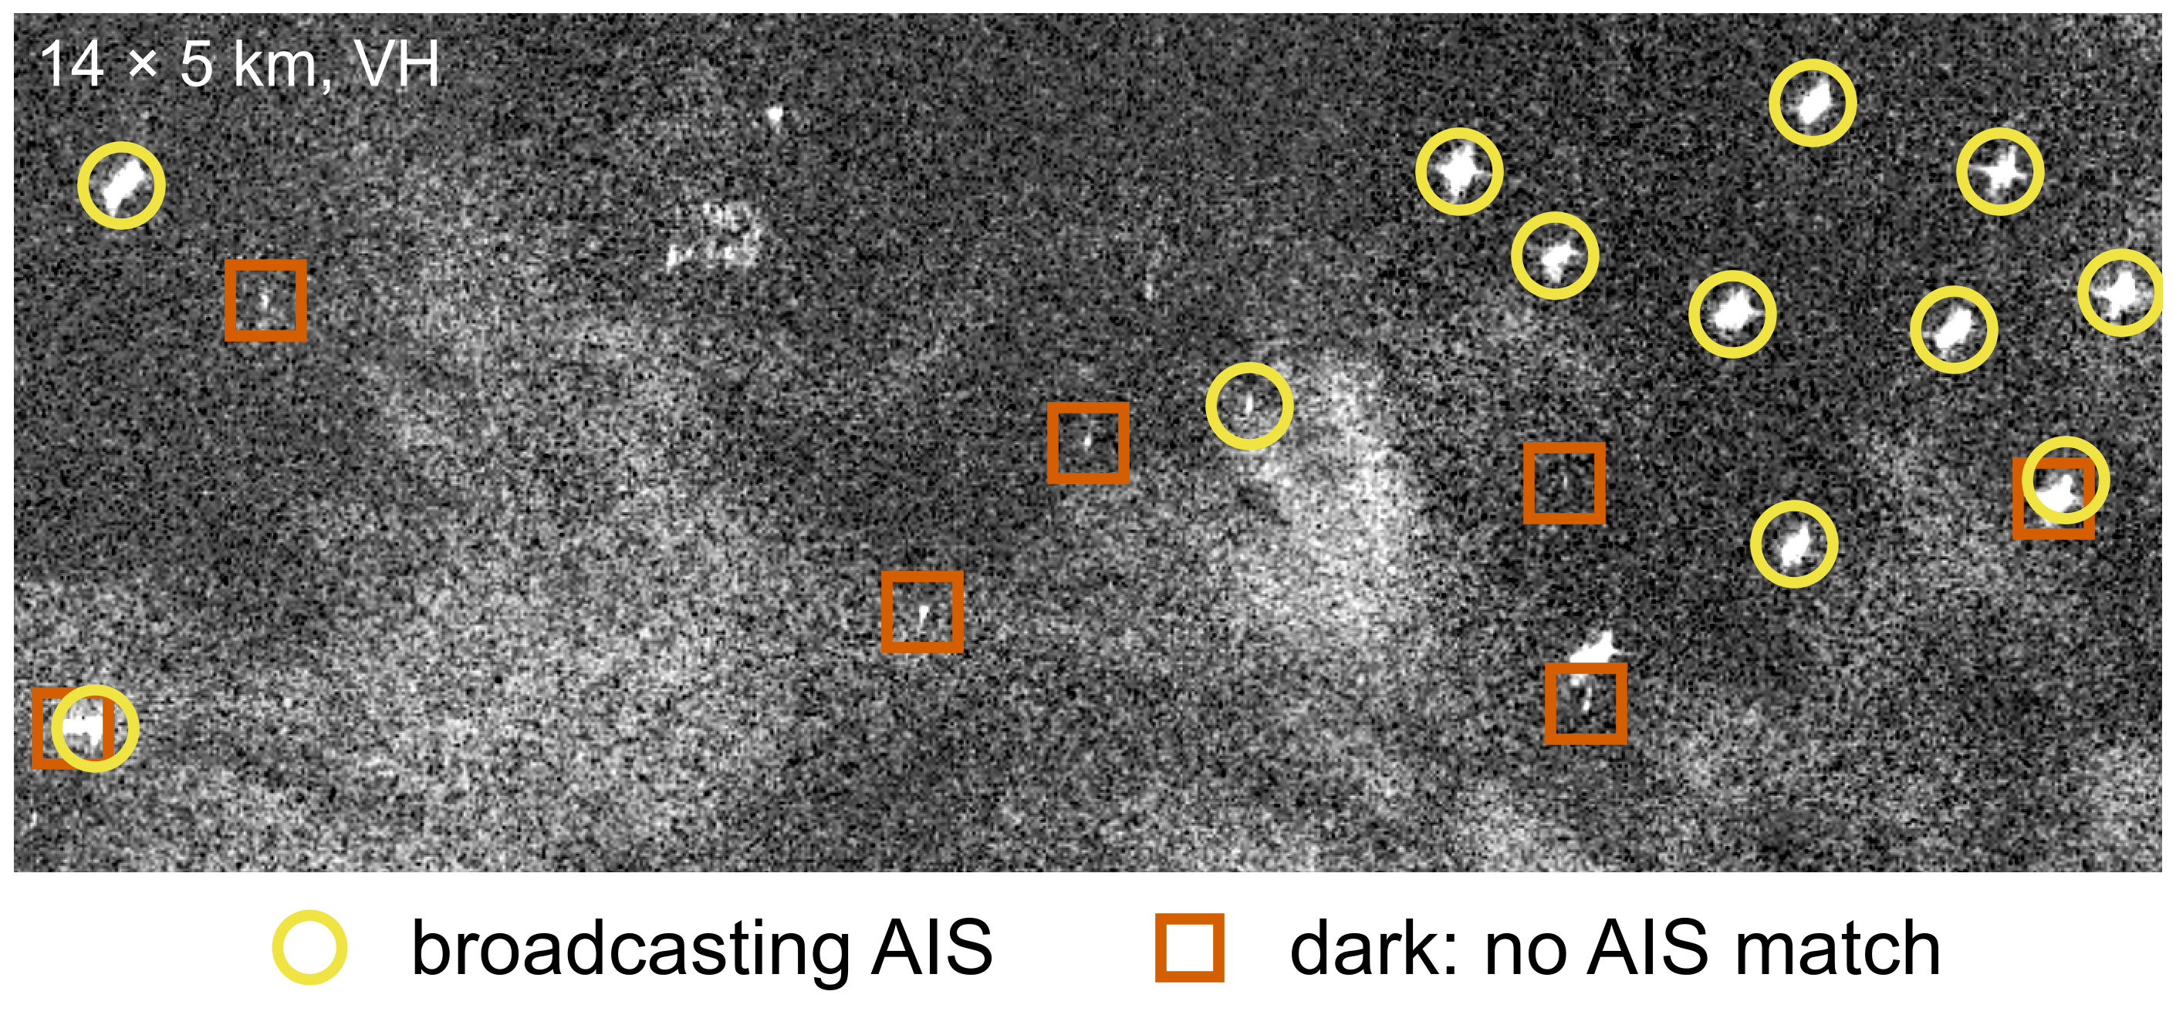
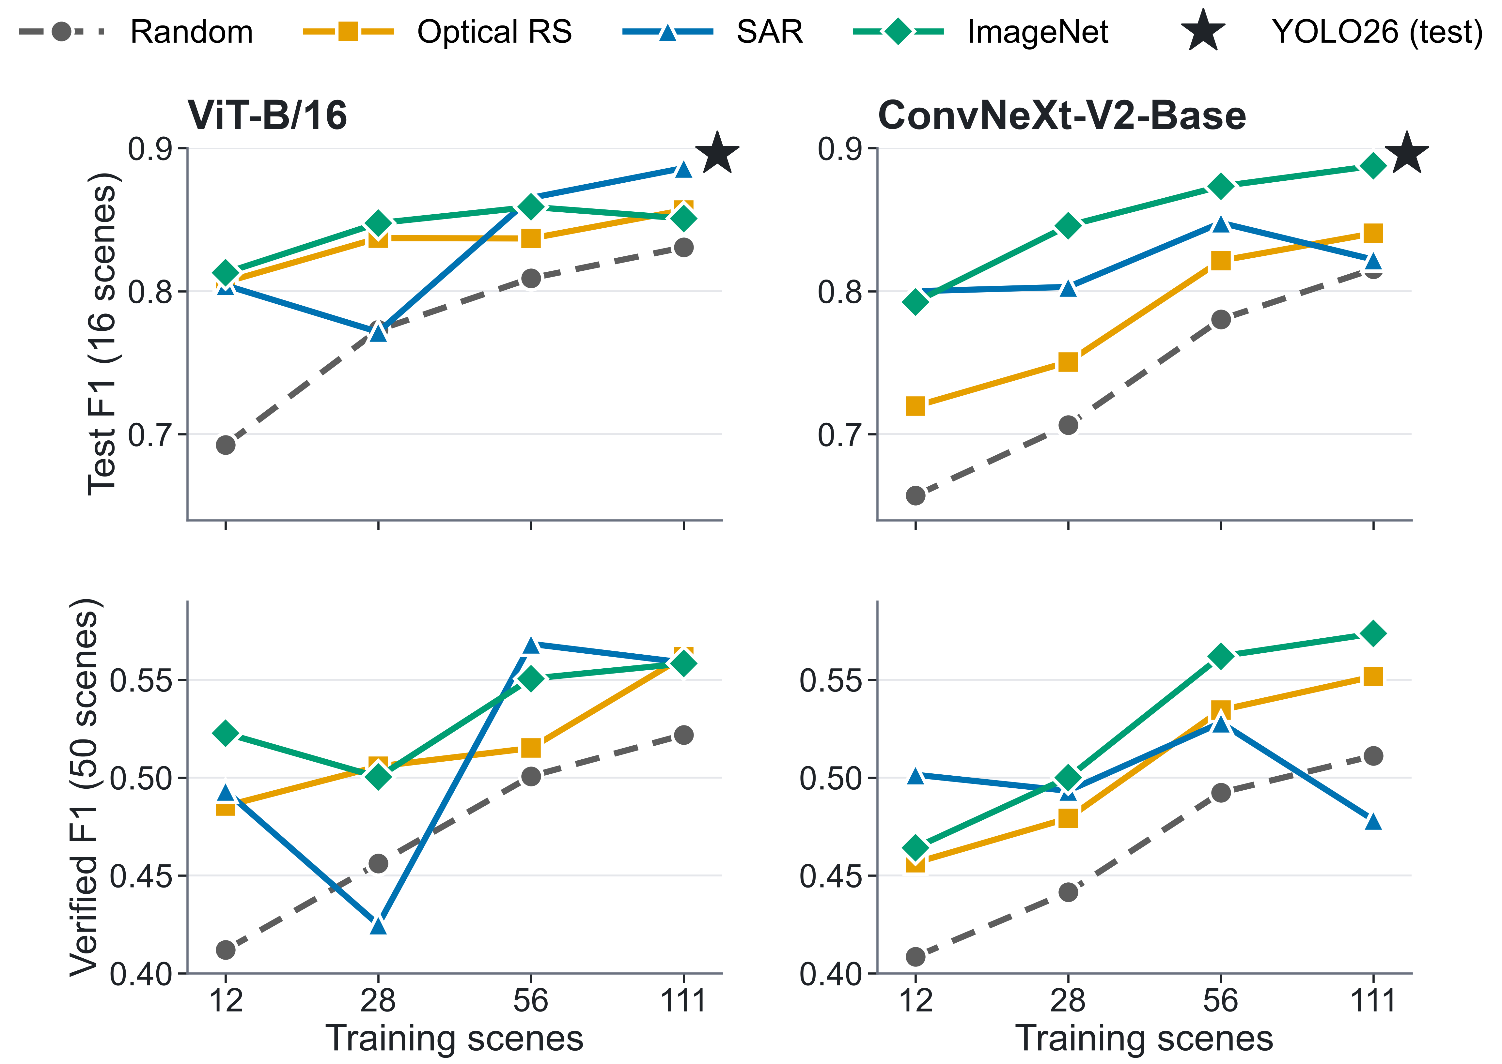
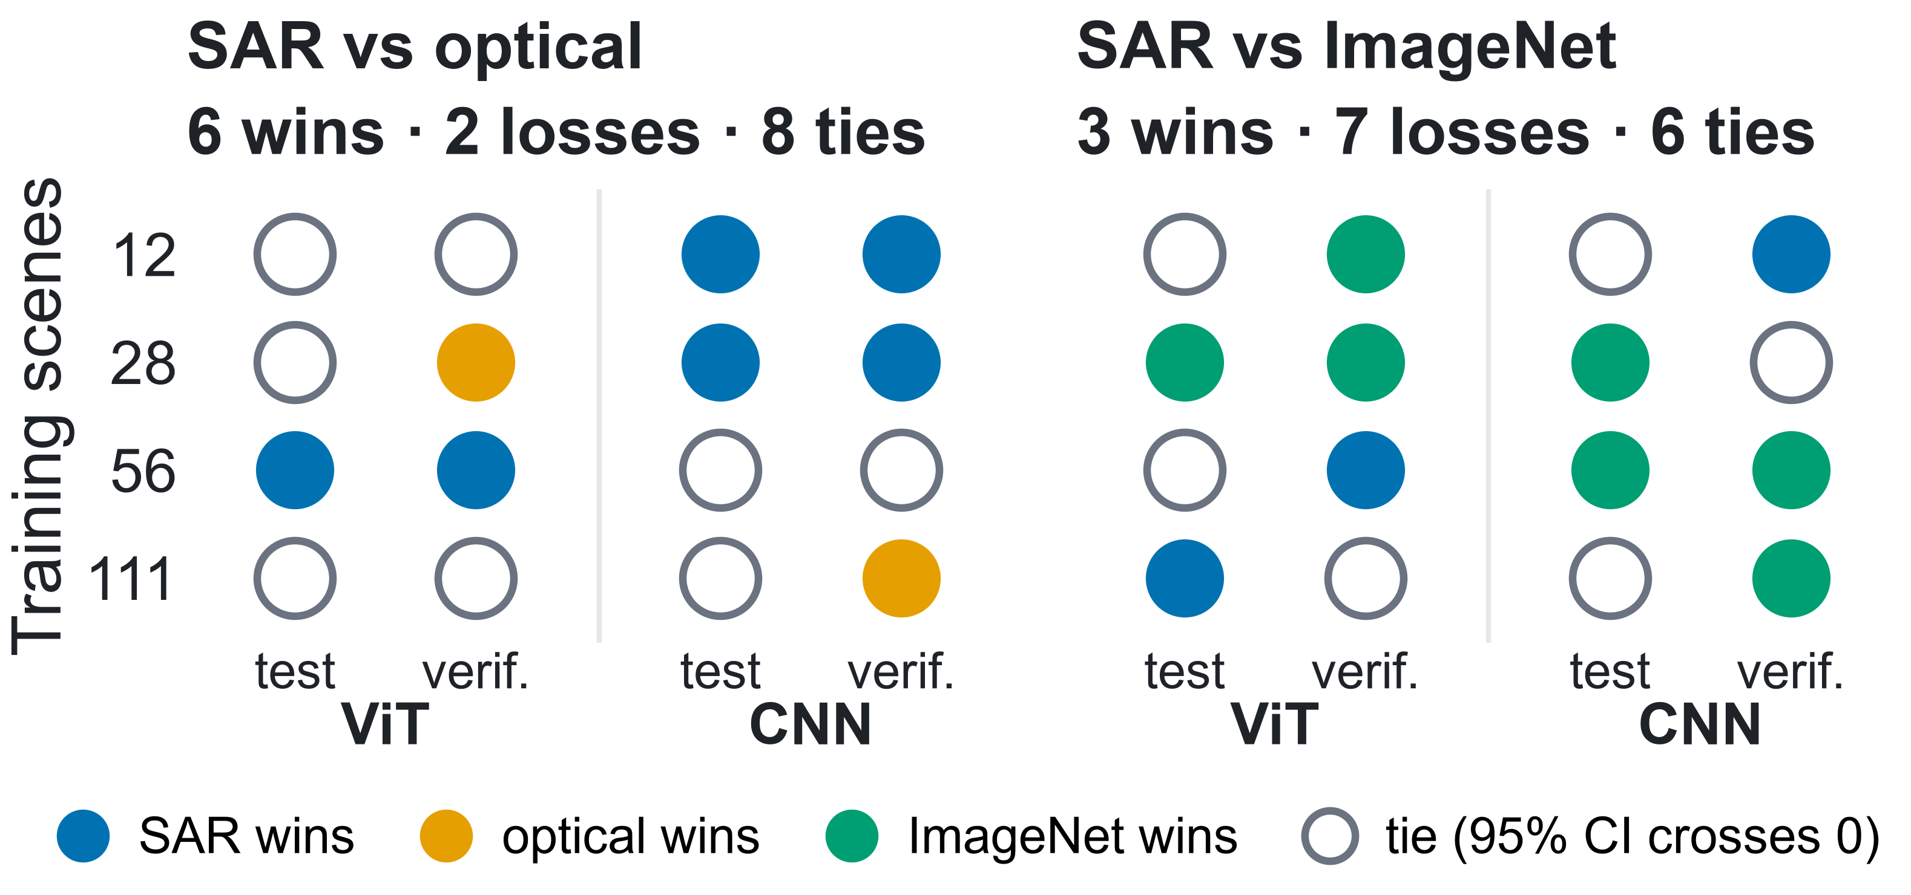
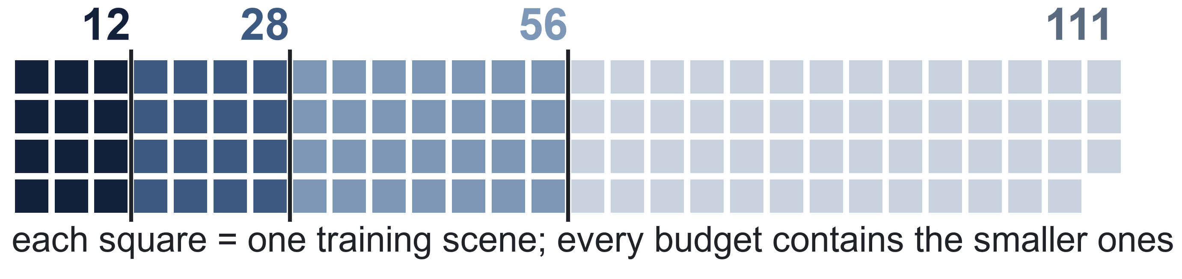
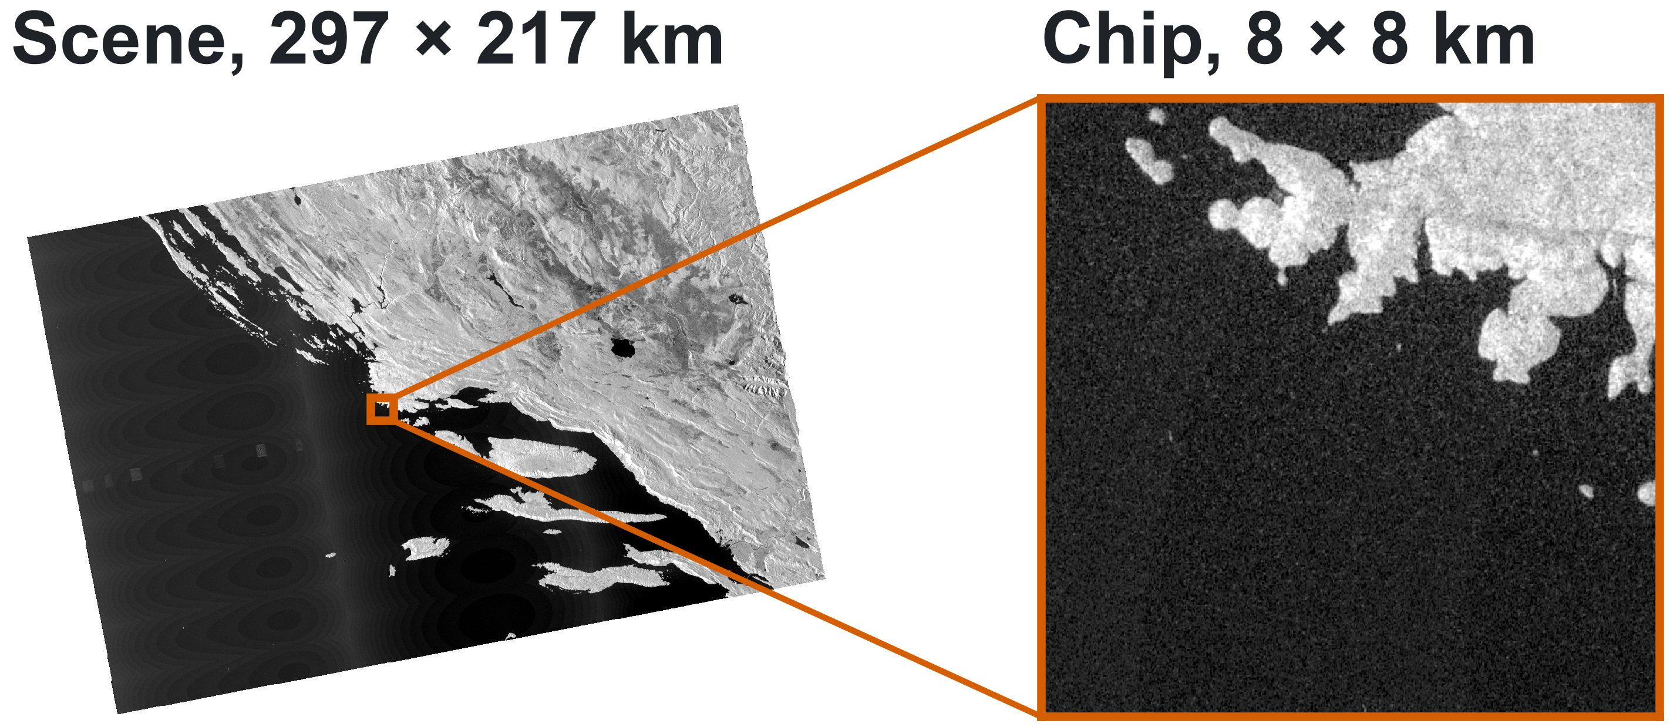
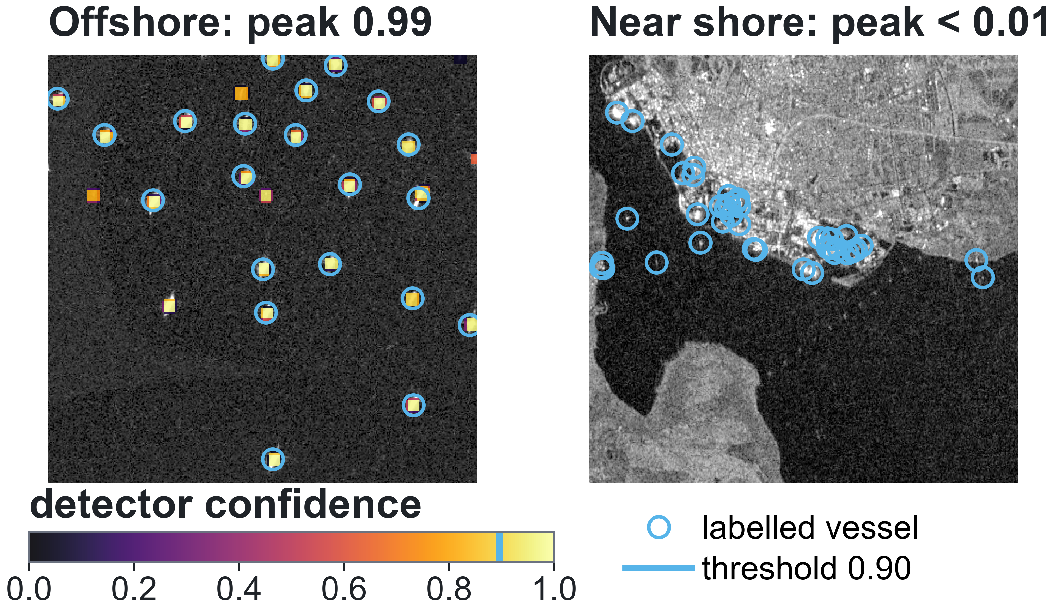
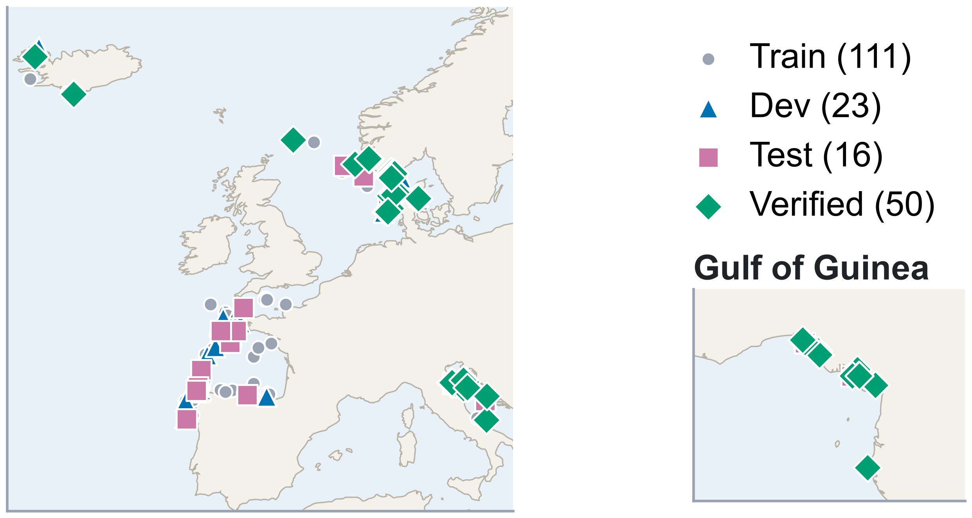
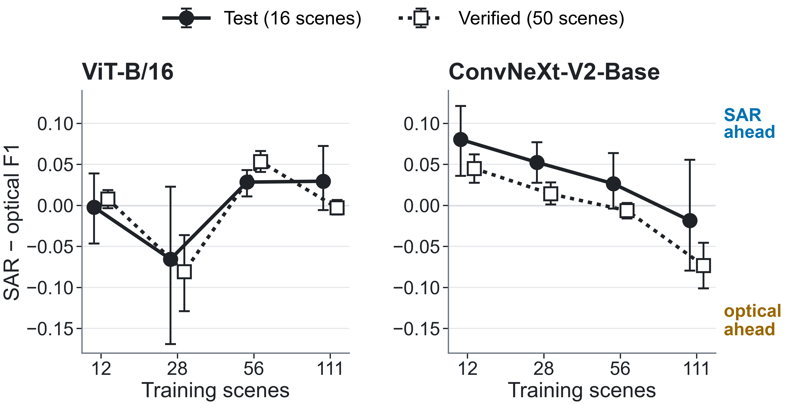
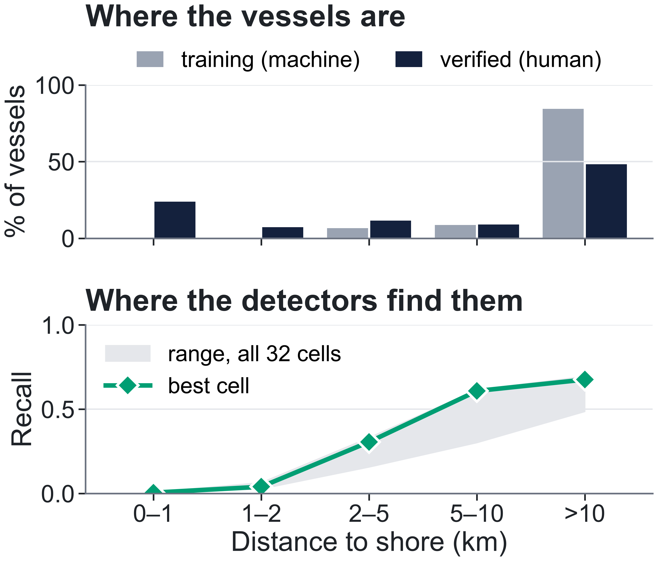
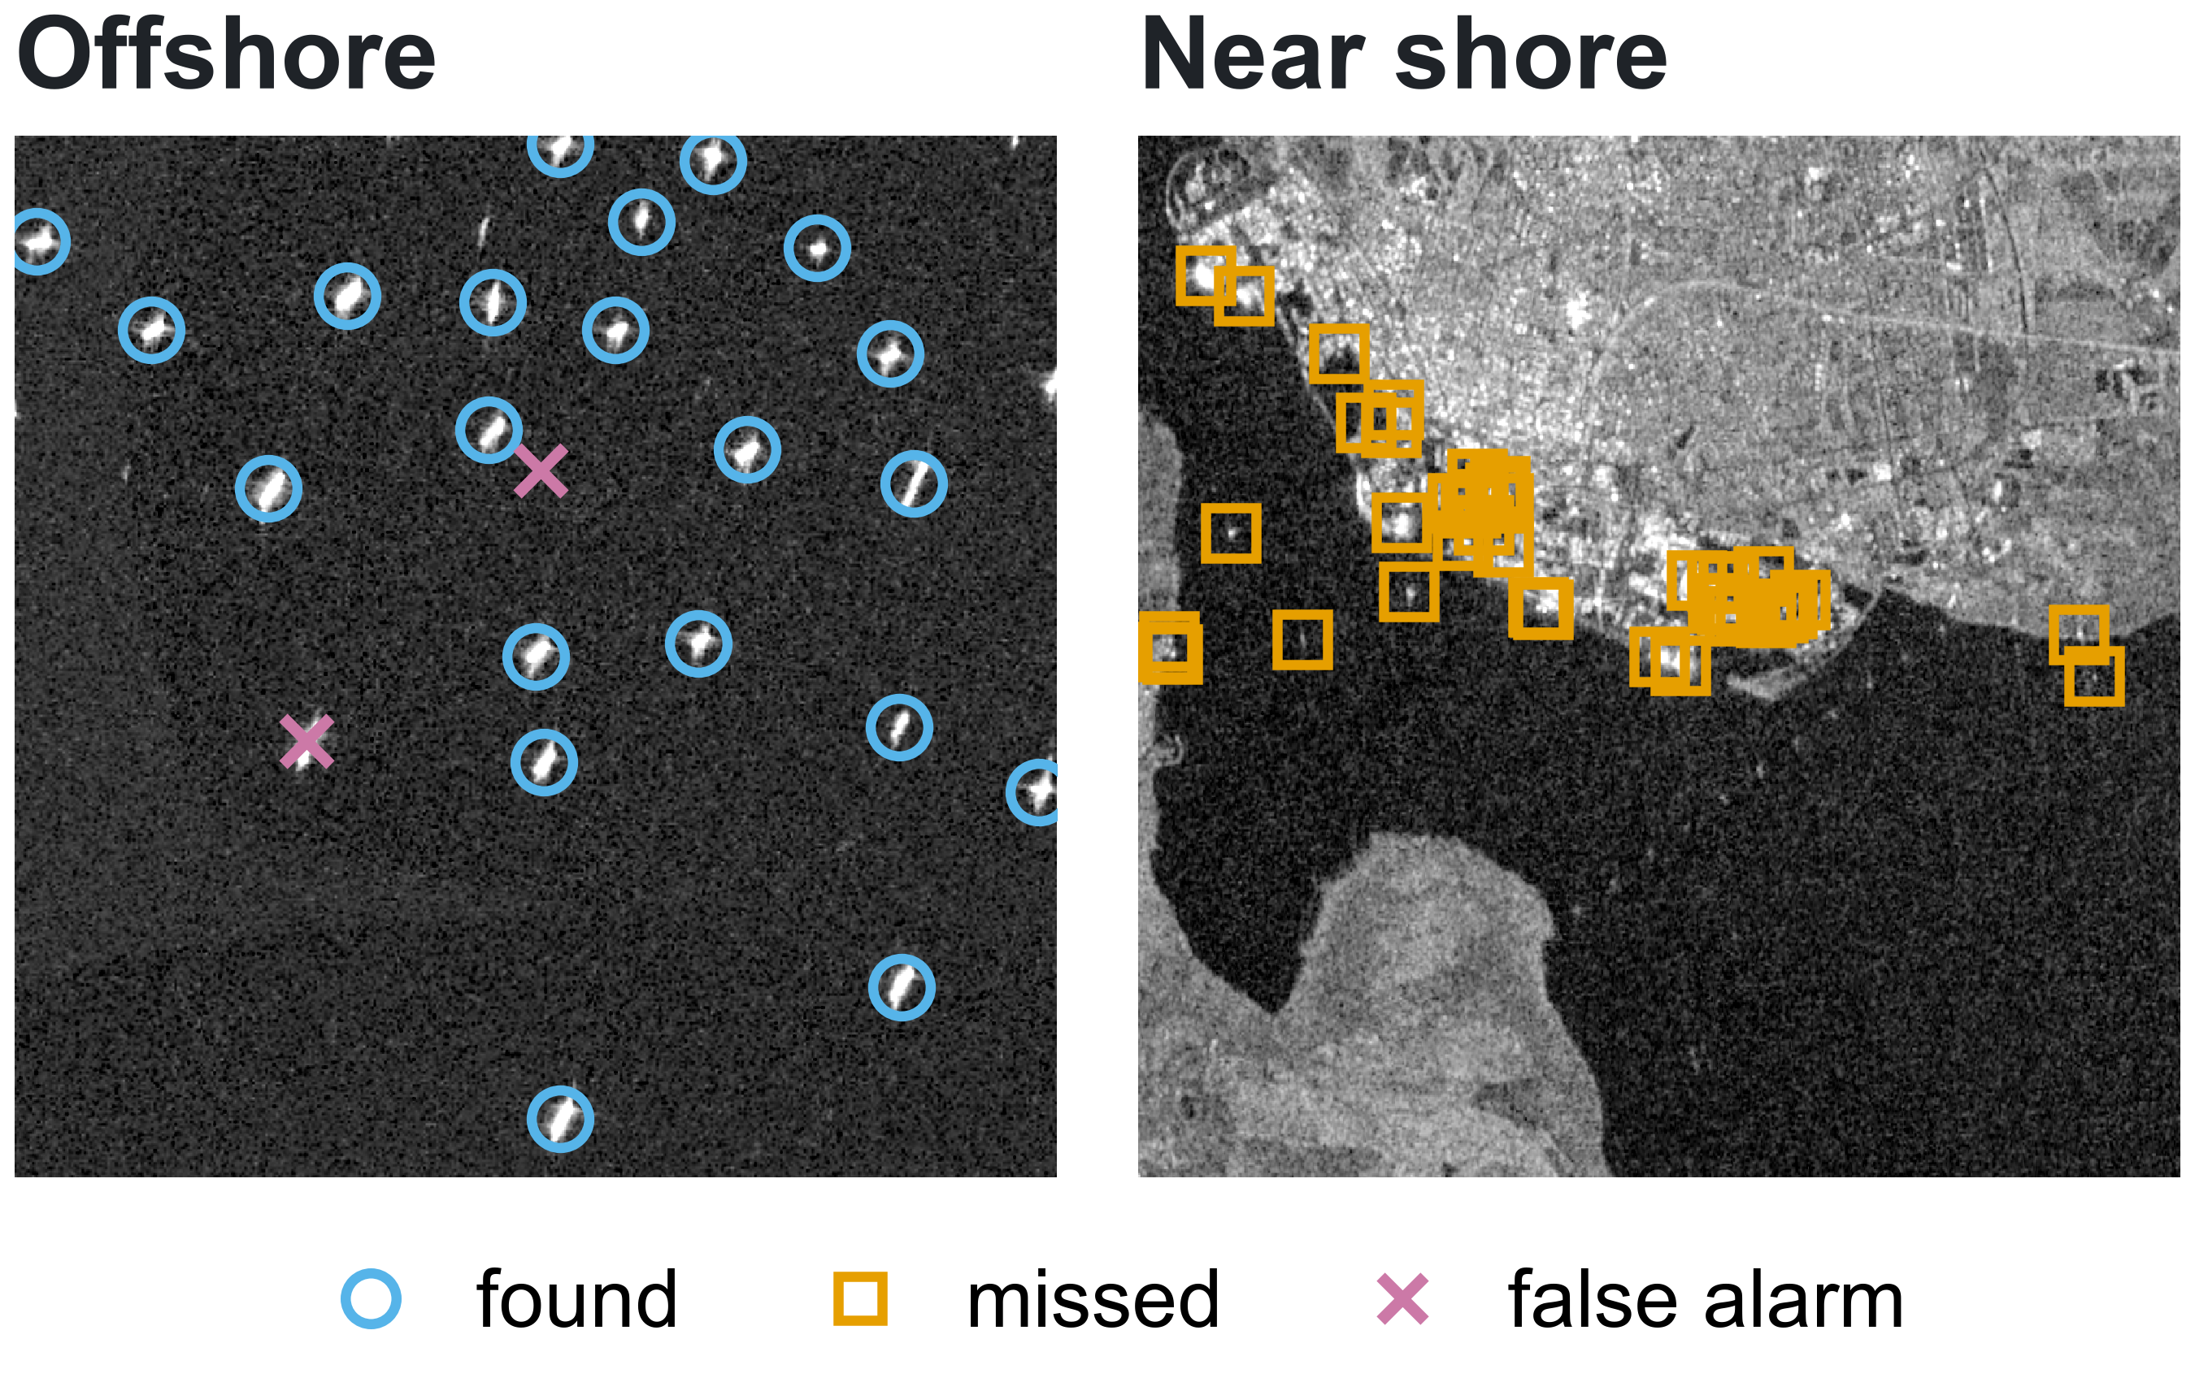
Label-Efficient Dark-Vessel Detection in SAR:
Does SAR-Domain Pretraining Outperform Optical and ImageNet Transfer Across ViT and CNN?
John Roth Kyle Wagner Liv d'Aliberti
Johns Hopkins University
Answer: no. SAR pretraining beats optical in 6 of 16 comparisons and ImageNet in 3 of 16 (ImageNet wins 7); its clearest edge is the CNN with 12–28 labeled scenes.
Motivation
8 arms × 4 budgets = 32 cells
Pretraining helps most when labels are scarce
Findings
Role | ViT-B/16 [3] | ConvNeXt V2 [4]
Random | random init | random init
Optical | SatDINO [6] (fMoW-RGB) | BigEarthNet-S2 [8]
SAR | SARMAE [7] (SAR-1M) | BigEarthNet-S1 [8]
ImageNet | AugReg [5] | FCMAE [4]
Pretraining pays off with few labels: +0.063 to +0.143 test F1 at 12 scenes.
SAR pretraining rarely wins:
Dark vessels send no AIS, yet radar [2] still sees them. Human-checked labels are scarce: which pretraining stretches them?
Data: xView3-SAR [1]
The input adapter matters: a seeded 3-channel stem lifts BigEarthNet-S2 above random at every budget.
No detector works near shore: recall ≤ 0.021 within 2 km in every cell.
One shared point detector
one encoder per track
F1 with 200 m matching, each cell scored once at the threshold it picked on 8 dev scenes. Top: 16 test scenes; bottom: 50 verified scenes. ★ YOLO26 at 111 scenes, test only (0.896). Zero-shot LocateAnything-3B: 0.122 F1 on dev chips.
Inside the detector
[VH, VV,
VH−VV]
512² crop
ViT-B/16, stride 16
shared
256-ch head
ConvNeXt-V2-B, s32 + up
SAR vs. optical: no stable winner
F1, 200 m geo match
threshold τ picked on dev
heatmap peaks ≥ 0.05, 120 m NMS
CenterNet-style heatmap [9], focal loss [10]; one recipe and seed for every cell.
8 dev scenes pick checkpoint and threshold; test and verified scenes are scored once.
Machine-made labels (AIS + automated detection) for train, dev and test; they miss vessels.
50 human-verified scenes: 8,642 vessels.
Recall falls toward the coast
Best cell, same two crops: peak 0.987 offshore, 0.001 in the harbor.
Limits
What the best detector finds
How to read: each point is SAR F1 minus optical F1; above 0, SAR wins, and a bar clear of 0 is a win. Solid: test; dotted: verified. Bars: 95% intervals over 10,000 scene resamples; retraining moved test F1 by up to 0.043.
One seed per cell; 8 dev scenes for selection.
Machine-made test labels; in-region test scenes.
Checkpoints also differ in objective and data.
In-region test: Sentinel-1 revisits put some test scenes near training scenes, so test F1 measures in-region generalization, not generalization to new regions.
References
[1] F. S. Paolo et al. xView3-SAR: Detecting dark fishing activity using SAR imagery. NeurIPS 2022.
[2] R. Torres et al. GMES Sentinel-1 mission. Remote Sens. Environ. 2012.
[3] A. Dosovitskiy et al. An image is worth 16×16 words. ICLR 2021.
[4] S. Woo et al. ConvNeXt V2: Co-designing and scaling ConvNets with masked autoencoders. CVPR 2023.
[5] A. Steiner et al. How to train your ViT? TMLR 2022.
[6] J. Straka and I. Gruber. SatDINO: A deep dive into self-supervised pretraining for remote sensing. arXiv:2508.21402, 2025.
[7] D. Liu et al. SARMAE: Masked autoencoder for SAR representation learning. CVPR 2026.
[8] K. N. Clasen et al. reBEN: Refined BigEarthNet dataset. IGARSS 2025.
[9] X. Zhou, D. Wang, and P. Krähenbühl. Objects as points. arXiv:1904.07850, 2019.
[10] T.-Y. Lin et al. Focal loss for dense object detection. ICCV 2017.
Open questions & next steps
Would joint SAR + optical foundation models win?
Does SAR trail ImageNet with matched pretraining?
Next: make detectors work near shore (recall ≤ 0.021 within 2 km): train on human-labeled near-shore vessels, add a distance-to-shore input, and set shore-aware thresholds.
Best cell (ImageNet CNN, 111 scenes), 8 × 8 km verified crops. Verified F1: 0.724 offshore, 0.026 within 2 km of shore.
50 verified scenes; the band spans all 32 cells. Best-cell recall: 0.676 beyond 10 km, 0.005 within 1 km.
Johns Hopkins University
Applied Imagery Pattern Recognition (AIPR) 2026
{jroth32, kwagne35, odalibe1}@jh.edu

