Slide 1
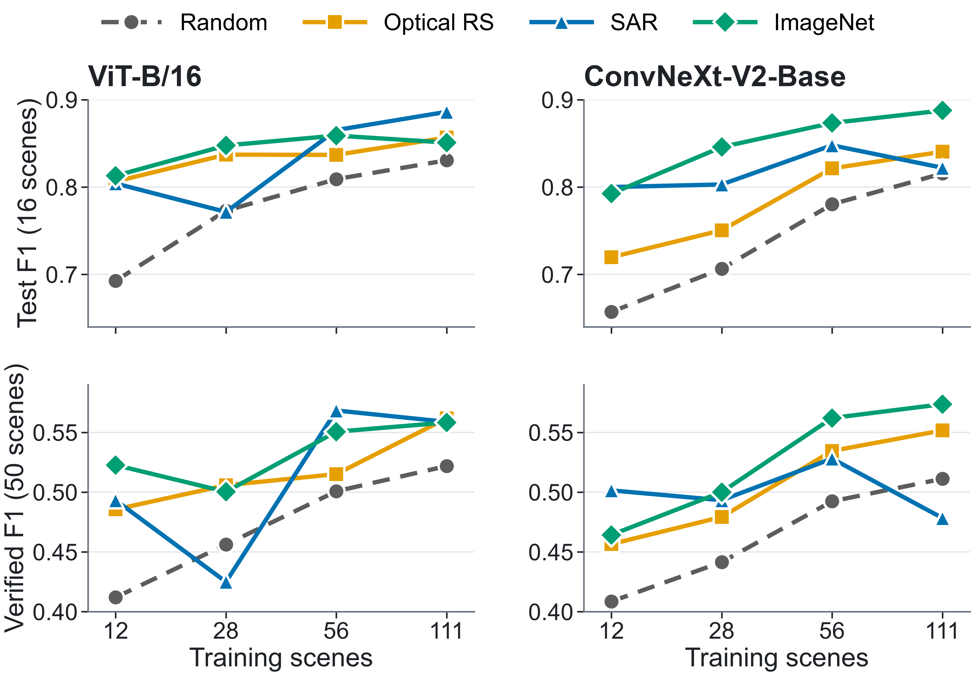
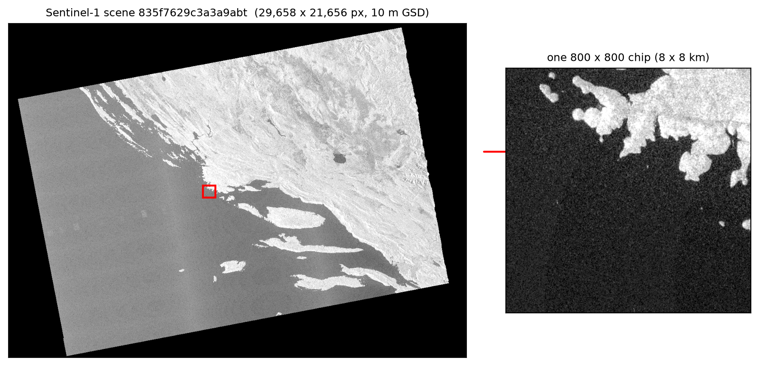
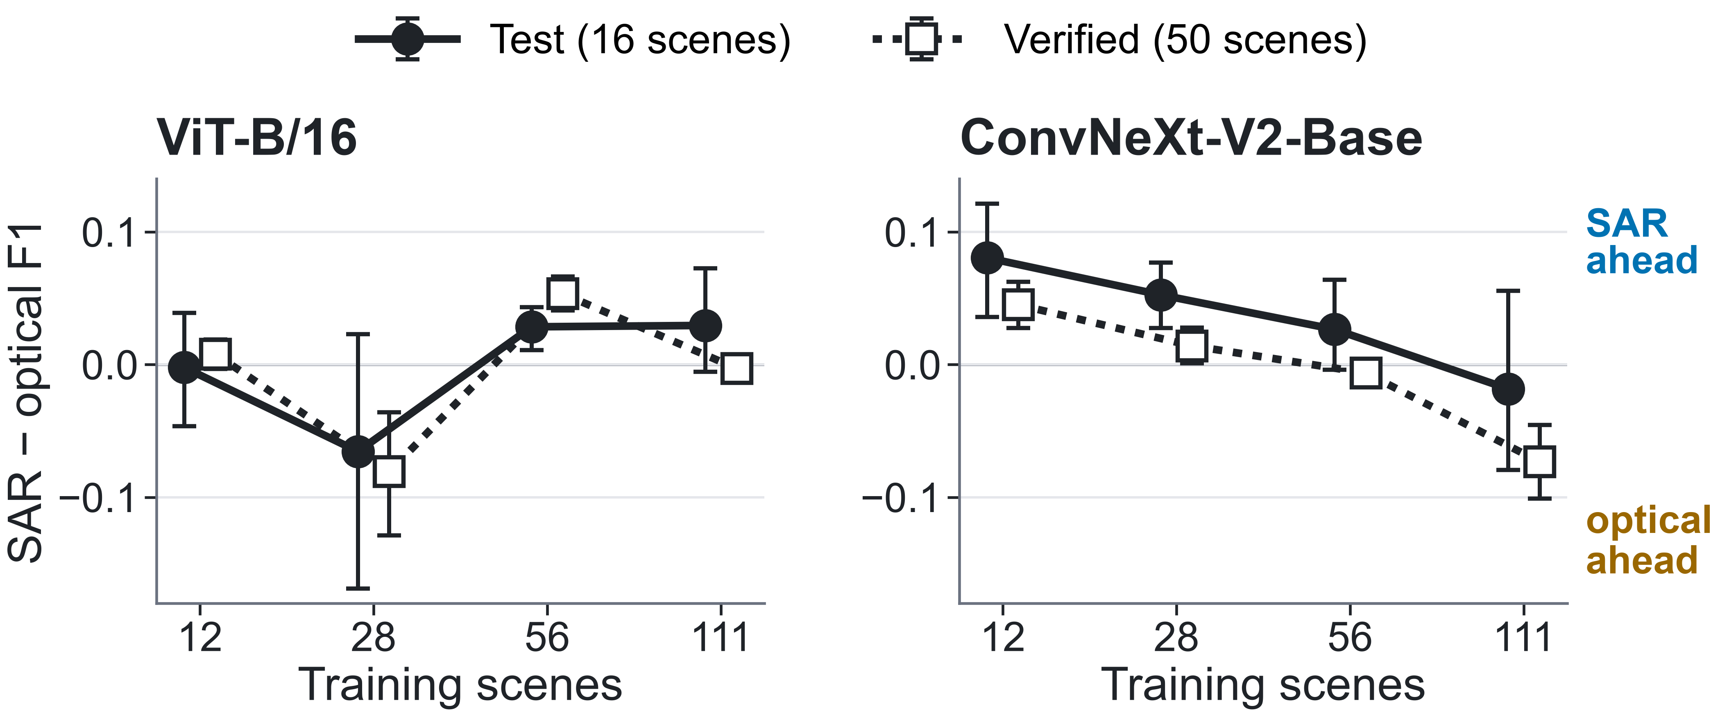
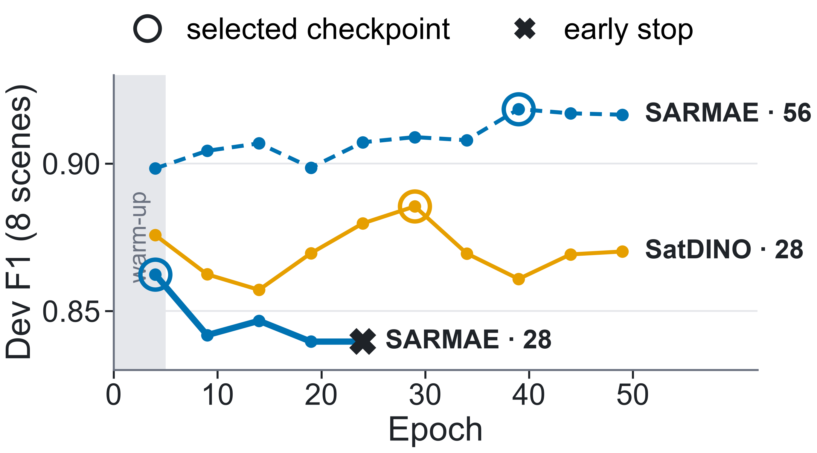
Label-Efficient Dark-Vessel Detection in SAR:
Does SAR-Domain Pretraining Outperform Optical and ImageNet Transfer Across ViT and CNN?
John Roth Kyle Wagner Liv d'Aliberti
Johns Hopkins University
Short answer: not consistently. With 12 labeled scenes every pretrained encoder beats random initialization, but SAR pretraining beats optical only for the CNN, and only while labels are scarce.
Motivation
8 arms × 4 budgets = 32 cells
Pretraining helps most when labels are scarce
Findings
Dark vessels have no matching AIS report. Sentinel-1 SAR [2] sees them at night and through cloud.
Vessels fill a few pixels in a 25,000-pixel scene. Sea clutter and coastlines give strong false returns.
Human-verified labels are scarce. Pretraining can lower the label cost, but which source domain helps most, and does the answer depend on the backbone?
Role | ViT-B/16 [3] | ConvNeXt V2 [4]
Random | fresh init | fresh init
Optical | SatDINO [6] (fMoW-RGB) | BigEarthNet-S2 [8]
SAR | SARMAE [7] (SAR-1M) | BigEarthNet-S1 [8]
ImageNet | AugReg [5] | FCMAE [4]
12 / 12
pretrained-vs-random comparisons at 12 training scenes have a 95% interval above zero.
Pretraining pays off with few labels. Gains at 12 scenes: +0.063 to +0.143 test F1, +0.048 to +0.111 verified F1.
SAR beats optical only for the CNN, and only with few labels: +0.080 [+0.036, +0.121] test F1 at 12 scenes, but −0.073 [−0.101, −0.046] verified F1 at 111. ViT: no stable order.
The input adapter matters. With a seeded 3-channel stem instead of band slicing, BigEarthNet-S2 beats random at every budget (+0.025 to +0.063 test F1).
The coastal gap is a label gap. Only 0.4% of training vessels lie within 2 km of shore, against 31% of verified ones.
Only the initialization changes inside a track; we compare domains within an architecture.
Data: xView3-SAR [1]
One shared point detector
one encoder per track
[VH, VV,
VH−VV]
512² crop
ViT-B/16, stride 16
shared
256-ch head
ConvNeXt-V2-B, s32 + up
F1, 200 m geo match
threshold τ picked on dev
heatmap peaks ≥ 0.05, 120 m NMS
F1 with 200 m matching. Each of the 32 cells is scored once with the threshold it picked on 8 dev scenes. Top: 16 held-out test scenes. Bottom: 50 near-shore, human-verified scenes. Seed 0.
One Sentinel-1 scene (about 300 × 220 km) and one 800-pixel chip (8 × 8 km).
150 frozen study scenes: 111 train, 23 dev, 16 test.
Nested budgets: 12 ⊂ 28 ⊂ 56 ⊂ 111 training scenes (10, 25, 50, 100%).
50 near-shore, human-verified scenes, opened once after test scoring: 8,642 vessels, 3,644 dark, 2,686 within 2 km of shore.
Input [VH, VV, VH−VV] in dB, 10 m pixels.
CenterNet-style heatmap [9] with focal loss [10]; F1 with 200 m geographic matching.
Same optimizer, schedule, crops, data order and seed (0) for every cell. Strict FP32: 567.6 H100 GPU-hours.
8 dev scenes pick each checkpoint and threshold; test and verified scenes are scored once, with no retuning.
SAR vs. optical depends on backbone and budget
Limits
One seed per cell; 8 dev scenes pick checkpoints and thresholds.
Monotonicity gate failed: two SAR test curves drop by more than 0.02 as labels grow.
Checkpoints differ in objective and corpus, not only domain.
References
Why SARMAE dips at 28 scenes
Open questions & next steps
[1] F. S. Paolo et al. xView3-SAR: Detecting dark fishing activity using SAR imagery. NeurIPS 2022.
[2] R. Torres et al. GMES Sentinel-1 mission. Remote Sens. Environ. 2012.
[3] A. Dosovitskiy et al. An image is worth 16×16 words. ICLR 2021.
[4] S. Woo et al. ConvNeXt V2: Co-designing and scaling ConvNets with masked autoencoders. CVPR 2023.
[5] A. Steiner et al. How to train your ViT? TMLR 2022.
[6] J. Straka and I. Gruber. SatDINO: Self-supervised pretraining for remote sensing. arXiv:2508.21402, 2025.
[7] D. Liu et al. SARMAE: Masked autoencoder for SAR representation learning. CVPR 2026.
[8] K. N. Clasen et al. reBEN: Refined BigEarthNet dataset. IGARSS 2025.
[9] X. Zhou, D. Wang, and P. Krähenbühl. Objects as points. arXiv:1904.07850, 2019.
[10] T.-Y. Lin et al. Focal loss for dense object detection. ICCV 2017.
Bars: 95% intervals from 10,000 paired scene resamples. They cover scene sampling only: retraining 28 unchanged cells moved test F1 by up to 0.043.
How do geospatial foundation models pretrained jointly on SAR and optical imagery fare against these single-source checkpoints?
Does SAR pretraining help where optical cannot: near shore and for small dark vessels?
Would per-arm learning rates or longer early-stopping patience remove the small-budget dips?
Next: near-shore training labels, a shoreline input channel, several seeds, and matched pretraining objectives across sensors.
The verified scenes expose a coastal label gap
0.4% → 31%
34 / 4,302
0.724
vessels within 2 km of shore:
training labels → verified scenes
best cell's predictions
within 2 km of shore
best cell's offshore verified F1
(0.574 overall)
At 28 scenes SARMAE peaks as warm-up ends, then overfits (training loss 0.482 → 0.034; dev precision 0.858 → 0.768). Early stopping keeps the epoch-4 checkpoint.
Every cell reaches at most 0.021 near-shore recall and 0.228 dark-vessel recall, while precision stays at 0.639–0.909: the detectors learned to stay silent near shore.
Johns Hopkins University
Applied Imagery Pattern Recognition (AIPR) 2026
{jroth32, kwagne35, odalibe1}@jh.edu

