Slide 1
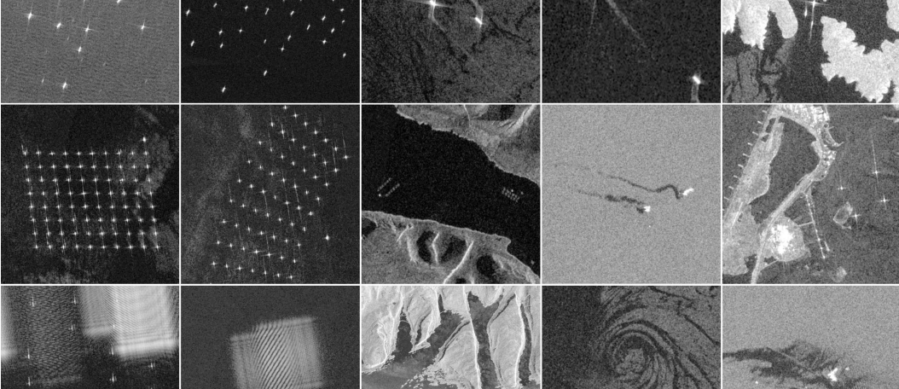
xView3: Label-Efficient Dark Vessel Detection
JHU EP 705.643 — Deep Learning Developments with PyTorch
John Roth & Kyle Wagner

Slide 2
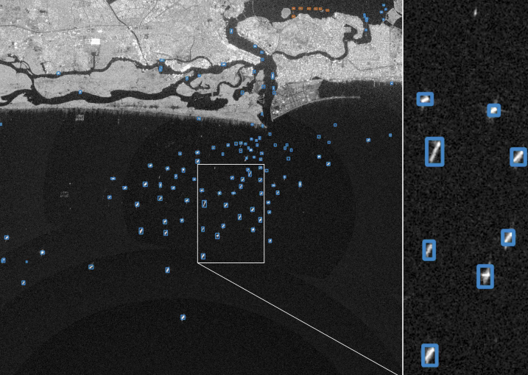
1. Problem & Motivation
xView3 targets vessel detection in Sentinel-1 SAR, including dark vessels not broadcasting AIS. With labels scarce, we compare how well pretrained foundation backbones transfer under a fixed detector.
Vessels are small, sparse, and domain-specific in SAR scenes
Dark vessels (no AIS) are operationally important; their labels are scarce
~1,000 scenes total, so supervised-only training risks overfitting
Core question: does a SAR foundation model beat an optical one for label-efficient dark-vessel detection?

Slide 3
2. Data — xView3
xView3 accessed via the SARFish mirror; label provenance still drives the split design.
Scale and inputs
991 Sentinel-1 scenes, ~29,400 x 24,400 px each
Dual-polarization VV + VH inputs
SARFish mirror on Hugging Face (Apache 2.0): selective GRD-only pulls
Label provenance
Train labels machine-generated (CFAR + AIS + GFW); HIGH/MED/LOW tiers
Native labels are points + lengths, not boxes
~50 human-verified validation scenes: reserved for final eval
Practical scoping
75-150 train scenes stratified by region and shoreline; 800 x 800 px chips
SARFish adds bboxes (where available) + precomputed distance-from-shore
Detection task only; chip-level fine-tuning on 800px tiles

Slide 4
3. Pretraining Datasets
Sensor and resolution match drive value; native Sentinel-1 sets are corpus-grade, finer-resolution SAR sets are still useful pixels.
Native Sentinel-1 (best fit)
xView3 / SARFish: the target; C-band, VV/VH, ~10 m
OpenSARShip 1.0/2.0: ~34k S-1 IW ship chips + AIS
LS-SSDD-v1.0: 15 large S-1 scenes, 9k 800px sub-images
Related SAR (resolution-shifted)
SAR-Ship-Dataset: ~39k S-1 + Gaofen-3 chips, 3-25 m
HRSID: ~5.6k chips, 0.5-3 m, boxes + instance masks
SSDD: 1,160 mixed-sensor images, 1-15 m, box/rbox/seg
FUSAR-Ship: Gaofen-3 C-band, ~1.1-1.7 m, type labels
How each is used
SARMAE (ViT) and BigEarthNet ConvNeXt (CNN) are downloaded; we curate no SSL corpus ourselves
LS-SSDD is the supervised-transfer source for BOTH tracks (Arms 4 and 8)
BigEarthNet ConvNeXt-V2-B (S1 SAR, S2 optical) downloaded for the CNN arms 6, 7
Licenses checked per source before download

Slide 5
4. The Eight Arms — Two Matched Tracks
Two size-matched backbones, one fixed head and schedule. ViT and CNN tracks run the same four pretraining roles, so we test optical-vs-SAR pretraining AND whether it holds across architectures.
ViT track (ViT-B/16, ~86M)
Arm 1 random floor; Arm 2 SatDINO (optical FM, DINO); Arm 3 SARMAE (SAR FM, MAE); Arm 4 supervised on LS-SSDD
CNN track (ConvNeXt-V2-B, ~89M)
Arm 5 random floor; Arm 6 BigEarthNet-S2 (optical RS); Arm 7 BigEarthNet-S1 (SAR RS); Arm 8 supervised on LS-SSDD
Matched by role
Arm k (ViT) pairs with arm k+4 (CNN): floor, optical, SAR, supervised. Within-track = pretraining effect; across matched roles = architecture effect.
Cleanest contrast
BigEarthNet S1 vs S2 (arms 6/7): same model, dataset, task — only SAR-vs-optical modality differs.
References (not on the curves)
R1 ImageNet-ConvNeXt (contingent, if time); R2 YOLO26-COCO; R3 LocateAnything zero-shot.
We pretrain nothing
All four FMs are downloaded; the only training is two cheap LS-SSDD supervised backbones (arms 4, 8). ~245 GPU-h total.

Slide 6
5. Detection Pipeline
Backbones — two, size-matched. ViT-B/16 (~86M) and ConvNeXt-V2-Base (~89M). Both take the fixed 3-channel [VH, VV, VH-VV] SAR input via the timm in_chans path. One head attaches to either backbone through a small per-family adapter.
Head — heatmap, not boxes. Deconv tower upsamples the stride-16 token grid to a stride-4 dense response map; one sigmoid channel per pixel. Matches xView3's point labels natively.
Training target — Gaussian blobs. Each vessel point is painted as a small 2D Gaussian; penalty-reduced focal loss. LOW-confidence labels become ignore regions, not positives or negatives.
Decode — peak + distance NMS. Local-maxima above threshold become detections; duplicates within a distance radius are suppressed (the box-free analog of IoU-NMS).
Scoring — distance matching. Predicted points greedily matched to ground-truth points within the xView3 tolerance; no IoU anywhere. Target, output, and metric all live in one point-and-distance space.
Why fixed, why two. Head/schedule frozen so within a track the only variable is initialization, and across matched roles the only variable is architecture. Lineage is CenterNet (Objects as Points), validated for SAR by TRANSAR.

Slide 7
Arm 1 - ViT Random Init (ViT Floor)
Identity. ViT-B/16 with random weights, trained supervised on xView3 only. No pretraining of any kind.
What it tests. The no-pretraining floor. Every other arm's value is the gap above this line; without it, 'pretraining helps' has no baseline.
Source. None - weights are random init.
Expected role. Lowest curve, steepest climb with more labels. If a data-hungry ViT fails to converge at the scarce-label end, that itself is a finding.

Slide 8
Arm 2 - SatDINO (ViT Optical FM)
Identity. SatDINO ViT-B/16, an optical-satellite foundation model (DINO self-distillation on fMoW-RGB), downloaded and fine-tuned on xView3 through the same detector as every arm.
What it tests. Optical-domain transfer: does foundation-model pretraining on optical satellite imagery transfer to SAR detection?
Source. SatDINO (Straka & Gruber 2025), ViT-B/16 pretrained on fMoW-RGB; same size and fine-tuning regime as SARMAE. Downloadable (Apache-2.0); the optical ViT-B MAE was not, hence DINO.
Expected role. Same-size optical anchor (both ViT-B). Arms 2 and 3 differ in domain and in SSL method (DINO vs MAE); we compare the best released FM of each domain as-is, a documented caveat.

Slide 9
Arm 3 - SARMAE (ViT SAR FM)
Identity. SARMAE ViT-B/16, a SAR foundation model (masked autoencoder pretrained on the 1M-image SAR-1M set), downloaded and fine-tuned on xView3.
What it tests. The headline contrast: does a SAR-domain foundation model beat an optical one (SatDINO) for dark-vessel detection?
Source. Downloaded (Liu et al., CVPR 2026; MiliLab/SARMAE). Same ViT-B as every arm, fine-tuned identically. We pretrain nothing - this removes the compute and novel-code risk.
Expected role. The SAR-FM arm. If it leads at low label fractions, in-domain pretraining wins; the gap to SatDINO is the optical-vs-SAR result.

Slide 10
Arm 4 - ViT Supervised (LS-SSDD)
Identity. ViT pretrained supervised on a labeled SAR ship-detection set, then fine-tuned on xView3.
What it tests. Labeled near-domain SAR transfer vs. the downloaded foundation models. Single matched source keeps the contrast clean (native Sentinel-1, scene-scale).
Source. LS-SSDD-v1.0 only: native Sentinel-1, scene-scale, already 800px chips. Boxes collapsed to centroids, fed to the same heatmap head.
Expected role. Labeled SAR-detection transfer for the ViT track; Arm 8 is its ConvNeXt twin. Point of comparison against the SatDINO and SARMAE

Slide 11
CNN Track - ConvNeXt-V2-B (Arms 5-8)
Backbone. ConvNeXt-V2-Base (~89M, size-matched to ViT-B), same head/schedule/seeds as the ViT track. The four CNN arms mirror the four ViT roles: floor, optical, SAR, supervised.
The two RS arms (6, 7). BigEarthNet ConvNeXt-V2-B, downloaded: S2 (Sentinel-2 optical) and S1 (Sentinel-1 SAR). Same model/dataset/task, only modality differs - the cleanest domain contrast in the study.
Floor + supervised (5, 8). Arm 5 random-init ConvNeXt floor; Arm 8 ConvNeXt supervised-pretrained on LS-SSDD (the CNN twin of Arm 4). Caveat: the BigEarthNet arms are supervised-classification pretrained, not SSL foundation models.
What it answers. Whether the SAR-vs-optical advantage seen on the ViT track is architecture-general. A finding that replicates across ViT and CNN is far stronger than one that might be ViT-specific.

Slide 12
References - ImageNet-ConvNeXt + External
Identity. Off-the-curve context arms. R1 (contingent): ImageNet ConvNeXt-V2-B, the RS-vs-generic-pretraining baseline for the CNN track, run only if the eight core arms finish early.
YOLO26-COCO. Standard detector fine-tuned from COCO; boxes built from points+lengths, centers scored through our scorer. The recognizable absolute-number anchor.
LocateAnything-3B. Frozen grounding VLM, zero-shot on SAR chips with text prompts. A 'what does a 2026 generalist do out of the box on SAR?' probe.
Expected role. Brackets the achievable range top and bottom; contextualizes the study arms without being on the curve.

Slide 13
6. Evaluation Design
The label-efficiency curve is the headline; arm ordering doubles as an optical-to-SAR transferability result.
Splits and hygiene
Scene-level 75/15/10 split of train scenes (no chip-level leakage)
Pretraining sees only train + public chips, never validation
Final eval: human-verified scenes, untouched by any training
All four arms ViT-B, same head and fine-tuning; only the downloaded init differs
Experiment grid
4 study arms: random / SatDINO / SARMAE / supervised
x label fractions 10 / 25 / 50 / 100%
Seed reruns on the 25% + 100% cells for error bars
Corpus ablation: xView3 only vs + public + OpenSARShip
Headline readout
Label-efficiency curve: F1 vs labels, one line per arm
Gap over the floor at 10% labels = value of pretraining
Arm ordering = optical-to-SAR transfer: SatDINO < SARMAE
Reference arms reported separately (not on the curves)

Slide 14
7. Metrics
Every number flows through one frozen scorer; the metric mirrors the labels (points and distances), not bounding boxes.
Primary metric
xView3 aggregate detection F1 (precision + recall)
Distance-matched: predicted points to GT points within tolerance, no IoU
Threshold tuned on dev, frozen for test + final eval
Operational slices
Dark-vessel recall (non-AIS targets, the hard case)
Close-to-shore F1 (shoreline + infrastructure clutter)
Reported per arm and per label fraction
What we do NOT use
No IoU / box overlap anywhere - labels are points
Verified-scene F1 is the number that counts
Reference arms scored for context, reported apart from the curves

Slide 15
8. Feasibility & Schedule
All four foundation models are downloaded, so there is no pretraining long pole; total compute is ~245 GPU-hours across two tracks, about two days on the node.
Compute plan
RTX 5070 Ti: fine-tune dev loop + YOLO26 / LocateAnything reference runs
One 8x V100 (32 GB) node: the eight-arm fine-tune grid (one config per GPU) + two LS-SSDD supervised backbones; scene-scale inference
xView3 runtime budget was 15 min/scene on a V100, so our timings are directly comparable
Schedule and risk
Jul 1-14: SARFish GRD subset + chipping + heatmap detector; YOLO26 reference (detector frozen)
Jul 15-28: both tracks' FM + floor arms (ViT: SatDINO, SARMAE; CNN: BigEarthNet S1/S2); channel-format check
Jul 29-Aug 11: two supervised arms (ViT+CNN on LS-SSDD) + full label-fraction grid + seed reruns
Aug 12-25: final eval + error analysis (dark-vessel recall, shoreline); begin writeup
Aug 26-Sep 1: finish writeup + submit; contingent ImageNet-ConvNeXt reference only if time remains
Two-person split: data/scorer owner vs. detector/eval owner

Slide 16
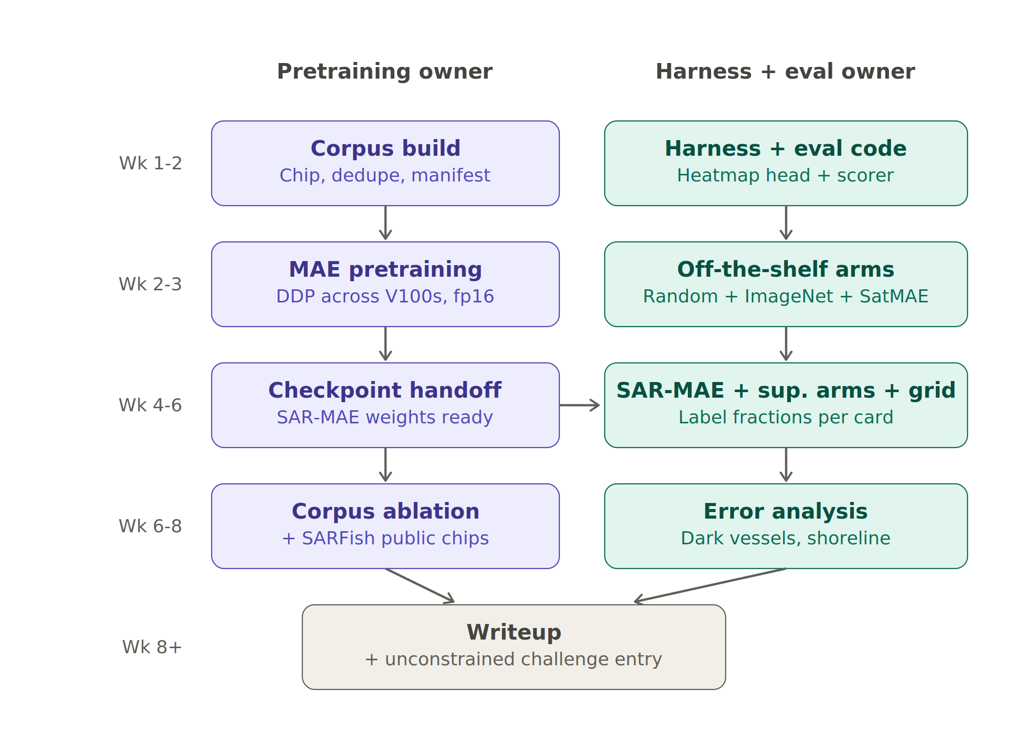
9. Schedule
Two independent lanes with no hard dependency: both foundation models are downloaded, so there is no pretraining handoff to block on.
Dates | Data / scorer owner | Detector + eval owner
Jul 1-14 | Download + chip xView3; build splits | Heatmap detector + frozen scorer; YOLO26 ref
Jul 15-28 | Centroid conversion; data QA | SatDINO + SARMAE + random arms (FMs first)
Jul 29-Aug 11 | Support supervised-transfer training | Supervised arm; full label-fraction grid + seeds
Aug 12-25 | Assist error analysis | Final eval; error analysis: dark vessels, shoreline
Aug 26-Sep 1 | Support writeup | Writeup + optional ImageNet-ConvNeXt reference

Slide 17
10. Alternatives & Fallbacks
Compositing bridge (answers the synthetic-data question). Paste real vessel chips onto real vessel-free backgrounds; ~1 week, no diffusion anywhere. Adds a synthetic-augmentation row so the final table reads SSL vs. augmentation vs. both.
Self-training / pseudo-labeling. Train on human-verified scenes, pseudo-label the noisy train scenes with high-confidence predictions (AI2 4th-place precedent; Zoph et al. 2020). Same detector; stands alone if pretraining underwhelms.
SAR-aware preprocessing study. dB scaling, speckle filtering, and polarimetric channel handling vs. RGB-style normalization; cheap, fast, and orthogonal to every other track.
Detection-head comparison. Heatmap head vs. ViTDet-style box head on the best initialization; timeboxed, one-slide result after the init grid lands.
Complex-valued SLC (stretch). SARFish SLC products (2.3 m azimuth spacing) enable Doppler/sublook features for moving vessels and complex-valued nets; storage and non-square pixels are the tax.
Ancillary-layer fusion. Add bathymetry, wind, or land/ice channels to disambiguate vessels from fixed infrastructure, especially close to shore.

Slide 18
11. References
Task & benchmark
xView3-SAR challenge (official site)
Paolo et al. 2022, xView3-SAR dataset paper (arXiv 2206.00897)
SARFish - xView3 GRD+SLC extension (Hugging Face)
AI2 sar_vessel_detect - xView3 4th-place pipeline (GitHub)
Models & methods
Ultralytics YOLO26 (baseline detector)
NVIDIA LocateAnything - grounding VLM (project page)
He et al. 2022, Masked Autoencoders (MAE) - arXiv 2111.06377
Straka & Gruber 2025, SatDINO - satellite DINO, ViT-B (arXiv 2508.21402)
Liu et al. 2026, SARMAE - SAR foundation model on SAR-1M, ViT-B (arXiv 2512.16635)
Li et al. 2024, SAR-JEPA gradient-feature SSL (ISPRS)
Zoph et al. 2020, Rethinking Pre-training & Self-training (arXiv 2006.06882)
SAR ship / vessel datasets
SAR-Ship-Dataset - Sentinel-1 + Gaofen-3 chips (GitHub)
BigEarthNet reBEN - ConvNeXt-V2-B RS weights (HuggingFace)
SSDD - SAR Ship Detection Dataset, official release (GitHub)
LS-SSDD-v1.0 - large-scene Sentinel-1 small-ship (GitHub)
OpenSARShip / OpenSARUrban - Sentinel-1 chips (SJTU)
SAR-JEPA datasets hub: MSAR, FUSAR-Ship, etc. (GitHub)

