Slide 1
Multi-Capital Decision Making Under Energy Constraints
CME 241
Jordan Rothkowitz
Winter 2026
Notes:
Last quarter at Stanford, moving to Philadelphia to start first full-time job
More agency over how I choose to allocate my resources for multiple types of capital: time, money, and energy
Decided for this project to try to model this simplified version of a life optimization problem for an early career professional
In particular, I wanted to look at the interplay between these multiple types of capital, since something very important to me is athletics.
I spend most of my time and energy outside of work doing olympic weightlifting, crossfit, (competitively) and cycling (just for fun).

Slide 2












MDP: State Space
Financial State
Liquid cash : discretized level (0–$50k in $2.5k bins)
Invested assets ​ : discretized level (0–$150k in $5k bins)
Work & Energy
Work intensity : low / medium / high (stochastic)
Energy : physical energy level (low / medium / high)
Time
Month : planning horizon index (0–35)
State Space Size = 10 dimensions, |S| = 202,487,040
Fitness State
Three independent fitness dimensions:
Strength (0–3)
Work capacity (0–3)
Endurance ​ (0–3)
Training Stress & Health
Training load : accumulated fatigue (0–4)
Injury state : (healthy / minor injury / major injury)
Additional variables
Injury risk score : deterministic function of current physiological state and training decisions
Training cycle phase : accumulation / intensification / peak month
Notes:
All variables are discrete, in bins, modeled as one-hot encodings
Finite-horizon (T=3 years) to model early stage in my career

Slide 3
MDP: Action Space
Investment level (0%, 10%, 20% of monthly take-home after base expenses)
Training mode (recovery / strength-focused / mixed-modal / endurance-focused)
Training volume (low / medium / high)
Discretionary spending (frugal / moderate / generous)
Action space size = 4 dimensions, |A| = 108

Slide 4
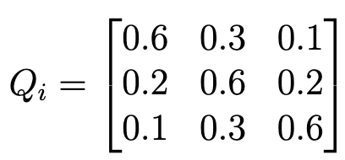
MDP: Transition Dynamics
Stochastic Transitions
Work intensity: Markov chain with
Energy: depends on
Current energy
Training volume
Work intensity
Accumulated fatigue
Injury status
Training load: accumulated fatigue
Increases with training mode, intensity, and injury state
Decreases with high energy and low work intensity
Fitness dimensions evolve separately, depending on
Mode, volume, recovery, fatigue, injury state
Injury depends on an injury risk score calculated via
Accumulated load, energy, work intensity, training volume
Deterministic Transitions
Time: Monthly
Financial state: Cash and assets updated by a financial function depending on
Income
Required expenses
Discretionary consumption
Investment allocation
Asset returns
Forced liquidation if cash becomes negative
Notes:
One time step = 1 month.
Financial state moves deterministically: income - monthly expenses - investment allocation - discretionary consumption + asset returns
Everything else depends about linearly on the mentioned variables + some added stochastic noise
Energy: deterministic drift term + stochastic noise

Slide 5
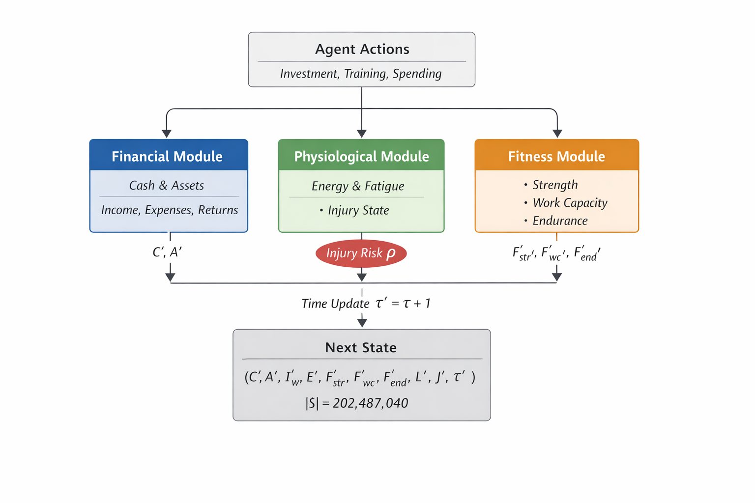

Slide 6
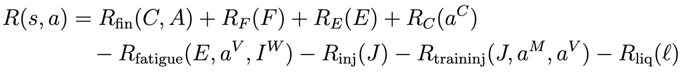
MDP: Reward Function
Linear
Additive across financial, fitness, and energy states with penalties for fatigue, injury, training while injured, and forced asset liquidation
Terminal reward for reaching the planning horizon (36 months / 3 years) with high fitness, wealth, and energy

Slide 7
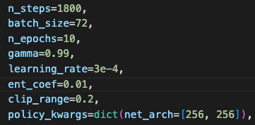
Implementation
MDP: Finite-horizon (T=36 months) value iteration via backward induction
One-hot encodings for discrete state variables
Precomputed transition tables
Vectorized
RL: PPO with Stable-Baselines3
Policy gradient method for higher-dimensional, stochastic environments
MDP wrapped in Gymnasium environment
MultiDiscrete action space
Hyperparameters:

Slide 8
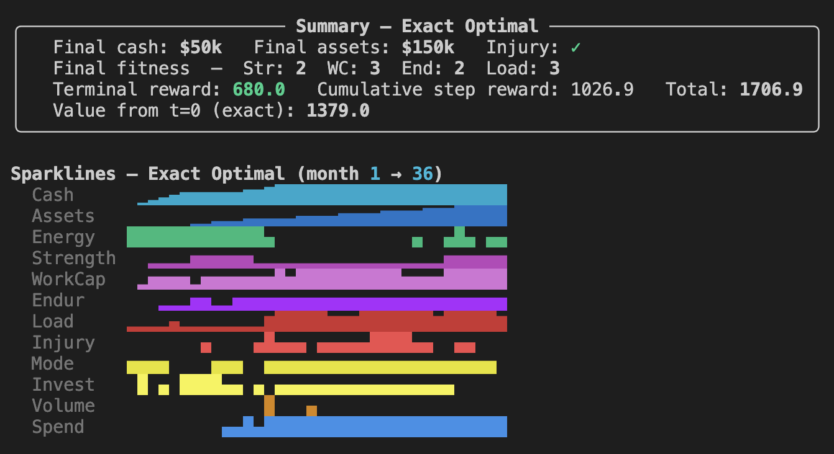
Results: DP

Slide 9
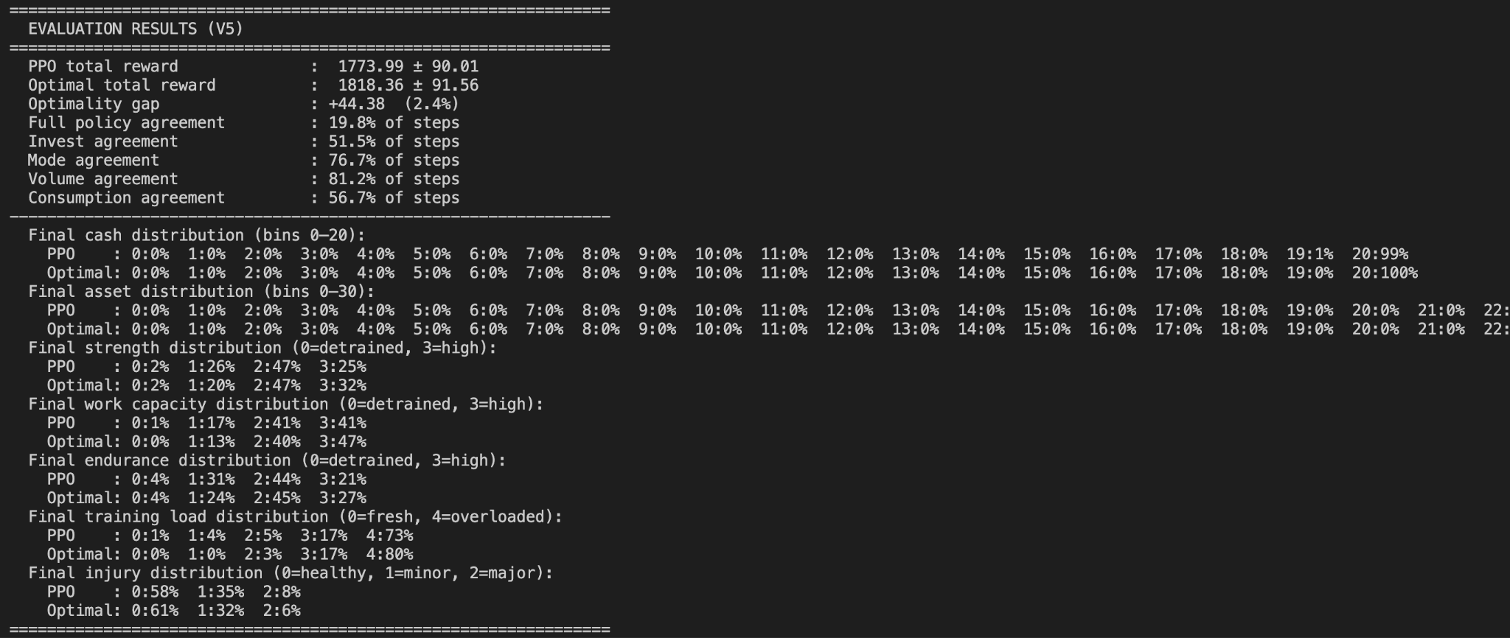
Results: PPO

Slide 10
Extensions
Richer representation of finances, add stochasticity to asset returns
Richer representation of work intensity (phase by quarter or stochastic shocks)
Transition dynamics to capture more interplay between different types of capital
Increase time horizon

