Slide 1
Research Data Challenges and Opportunities
Sia Najafi
Executive Director Academic Research Computing
Worcester Polytechnic Institute

Slide 2
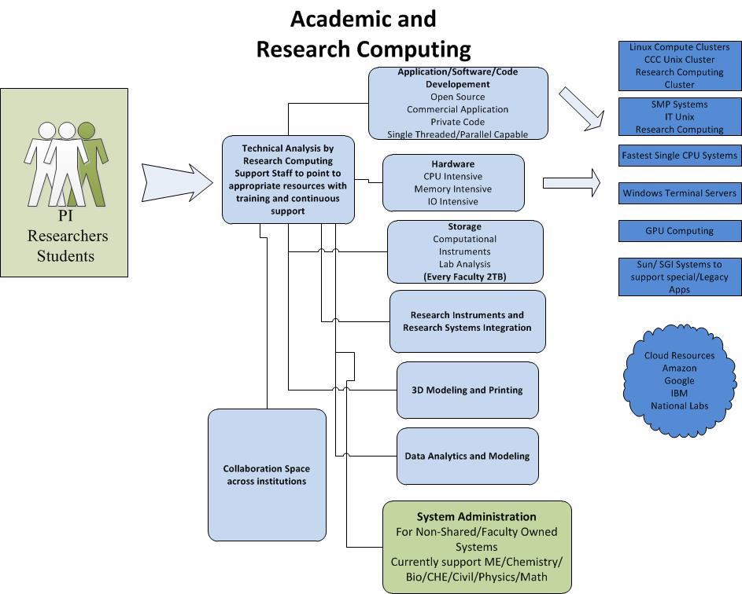

Slide 3
Research Data Management
Where we were 10 years ago….life was much simpler
Well understood sources and types of research data
Long practiced and established methods for backup and archiving
Lax federal guidelines on research data
Sharing research data done manually or at very rudimentary level online (External/Internal Hard Drives, FTP Sites)

Slide 4
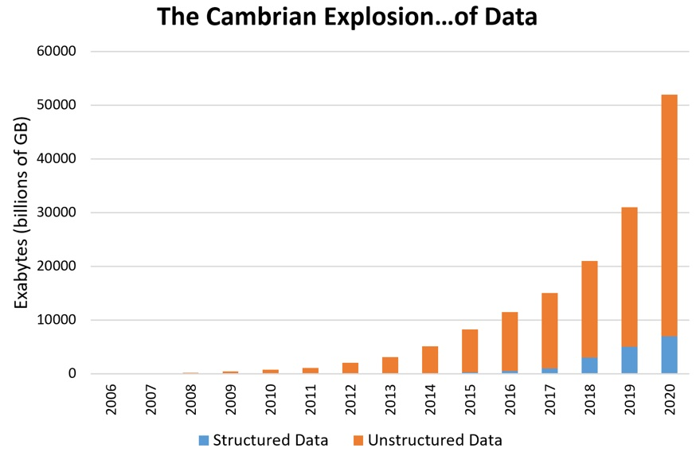
Research Data Management
Source: Patrick Cheesman

Slide 5
Research Data Management
Where we were 5 years ago
NSF Data Management Guidelines (DMP) was a catalyst for change
Centralizing Research data storage and convincing faculty to adopt it
Minimum 2 TB of free enterprise level storage for every faculty
Hourly snapshot going back weeks
All data synched to a Disaster recovery site
Still Tape backup and Archiving
Collaboration tools for sharing large datasets (Owncloud) with external collaborators

Slide 6
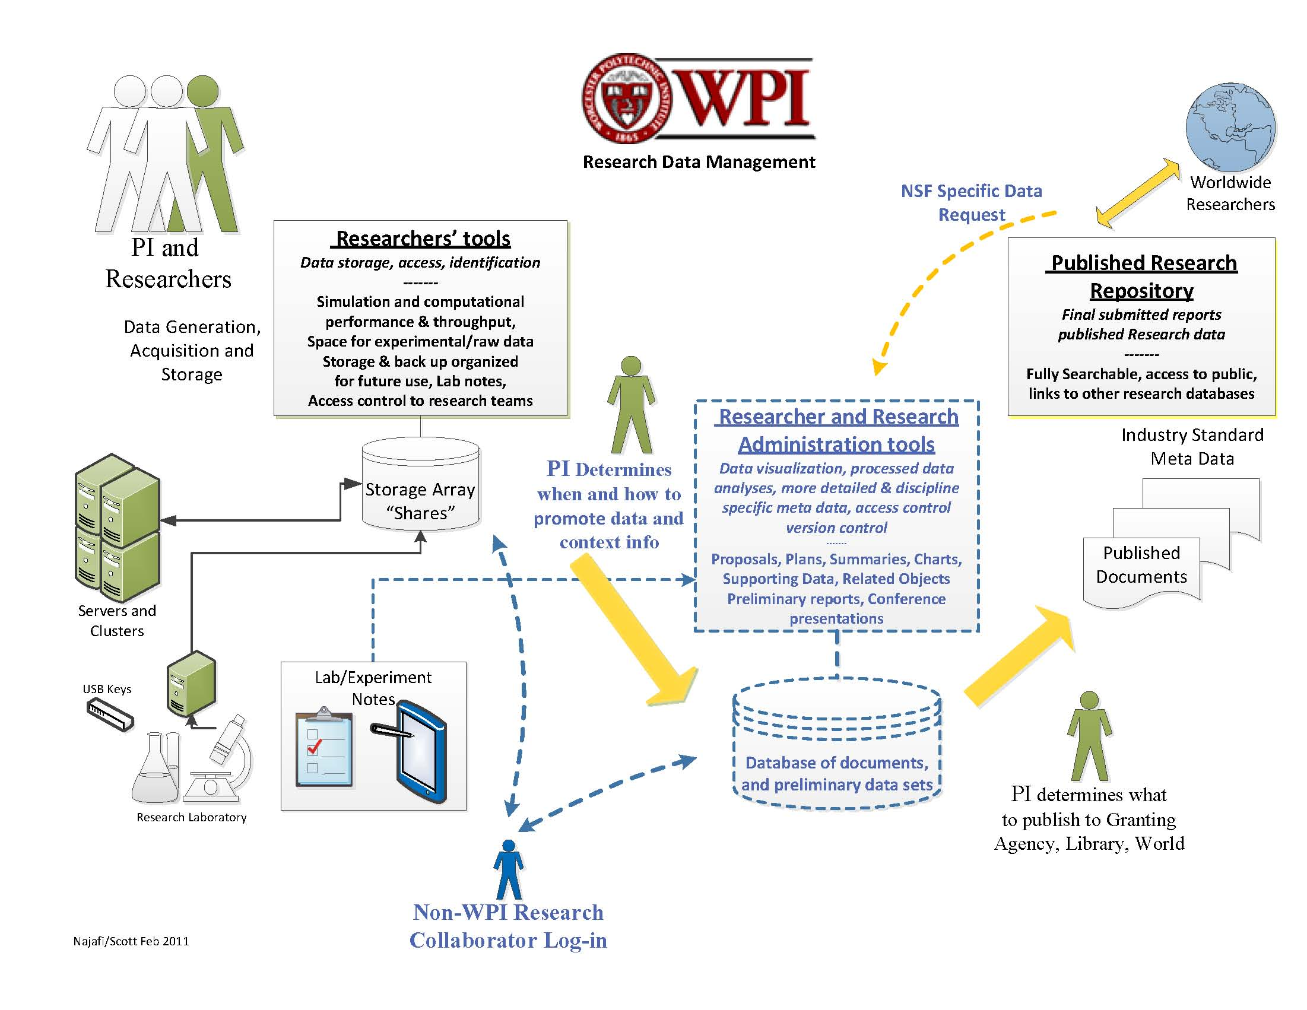

Slide 7
Research Data Management
Current state
Explosion of data totally changed Research architecture
Multi-tired storage
DELL/EMC Isilon now only for gold standard of data protection
Qumulo for tier 2 and 3, High Performance Computing and storage for raw data sets mostly from instruments
Gradually moving away from tape to object storage and cloud options for backup and archiving
Data analytics tools absolutely crucial for File movement and reporting (starfish)

Slide 8
Research Data Management
Current challenges in sharing and access for Data Sciences, Health Delivery Institute and Controlled data
Sensitive Data from (VA, Dana Farber, Commercial Institutions, etc.).
Access Control
Retention and destruction
Encryption
Delivery
Collaboration with external entities
Compliance

Slide 9
Research Data Management
Current work in Progress
Next generation collaboration tools
Code Management
File sharing
Shared Apps
Science DMZ
Automated tiering of Research data (e.g. starfish)

