Slide 1
Academic and Research Computing
2006 - 2016
Ten Years of SESA Training
Sia Najafi
Exec Director Research Academic Computing
snajafi@wpi.edu

Slide 2
SESA Support
Scientific and Engineering Software Applications (SESA) @ WPI
Technical Computing | Data Acquisition, Instrument Control | Computer-aided engineering (CAE): FEA, CFD, MBD | Computer-aided design (CAD) , Material selection
MATLAB Mathcad Phyton Fortran Parallel Computing R Data Management ----------------------Linux | Labview | ANSYS Fluent Comsol Abaqus | PTC Creo/ProE Solidworks Autocad Rapid Prototyping CES EduPack
Black: Supported
Blue: To be supported in the near future

Slide 3
SESA Support
Training sessions :
crash courses
advanced courses
Invited lectures
general topics
more specific topics such as using software to solve a problem/project or homework
Help sessions for courses
Training sessions and office hours for small groups. The material covered is customized after a discussion about the project/problem with the students or/and their advisor.
Office hours (posted regularly on web), one-to-one consultations
Consultations for TAs and faculty
Instructors:
Adriana Hera, PhD– Mechanical Engineering
Erica Stults, PhD– Mechanical Engineering
Spencer Pruitt, PhD – Chemistry
Ermal Toto, PhD Candidate – Data Science
TAs:
Siamak Ghorbani Faal, PhD candidate - Robotics
Shadi Tasdighikalat, PhD student - Robotics

Slide 4
Ten Years of SESA Training: 2006 - 2016
 | Number of Training/Help Sessions, Invited Lectures, Office Hours |  |  | Number of Students (unique count) |  |  |  | Number of attendees | Number of sessions /student
 | Total | Customized | General | Total | Under-grad. | Grad. | Others
Spring 2006 | 52 | 3 | 49 | 255 | 100 | 99 | 56 | 534 | 2.1
2006-2007 | 93 | 36 | 57 | 468 | 343 | 81 | 44 | 864 | 1.8
2007-2008 | 105 | 63 | 42 | 561 | 430 | 86 | 45 | 950 | 1.7
2008-2009 | 147 | 90 | 57 | 736 | 574 | 110 | 52 | 1597 | 2.2
2009-2010 | 147 | 95 | 52 | 935 | 790 | 105 | 40 | 2043 | 2.2
2010-2011 | 145 | 107 | 38 | 1045 | 872 | 135 | 38 | 2105 | 2.0
2011-2012 | 172 | 122 | 50 | 1250 | 1064 | 152 | 34 | 2947 | 2.4
2012-2013 | 319 | 256 | 63 | 1480 | 1155 | 249 | 76 | 2105 | 1.4
2013-2014 | 323 | 270 | 53 | 1357 | 1096 | 161 | 104 | 2947 | 2.2
2014-2015 | 320 | 268 | 52 | 1130 | 900 | 182 | 50 | 2336 | 2.1
2015-2016 | 357 | 284 | 73 | 1313 | 994 | 252 | 67 | 3187 | 2.4
More than :
7,000 students
22,000 attendees
2,000 sessions
SESA sessions =
Training sessions + Help Sessions + Invited Lectures + some of the Office Hours
Not included in the statistics: assistance by email and phone, many office hours, ad-hoc consultations and help . Attendance was not recorded for many of the help sessions and office hours

Slide 5
Ten Years of SESA Training: 2006 - 2016
More than :
7,000 students
22,000 attendees
2,000 sessions
Number of sessions
No sessions per student
Number of students
SESA sessions =
Training sessions + Help Sessions + Invited Lectures + some of the Office Hours

Slide 6
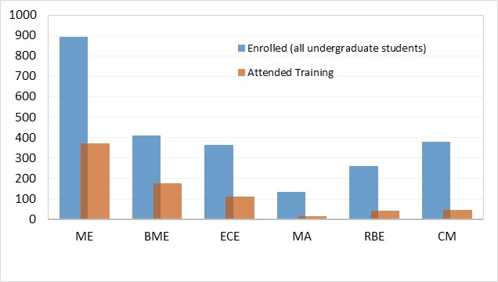
SESA Training: 2015 -2016
Data refers to the currently enrolled undergraduate students who attended SESA training in 2015-2016.
Number of undergrad
students
2015 – 2016
Department/Major | ME | BME | ECE | MA | RBE | CM | … | Total
Currently enrolled students (freshmen, sophomore, juniors, seniors). | 948 | 397 | 344 | 129 | 281 | 356 |  | 4041
# students who attended SESA training | 457 | 214 | 73 | 25 | 20 | 47 |  | 994
% attendance | 48% | 54% | 21% | 19% | 7% | 13% |  | 24%
Instruction sessions/ student* | 1.9 | 5.0 | 1.3 | 2.0 | 1.7 | 1.4 |  | 2.4
Not included in the statistics: assistance by email and phone, many office hours, ad-hoc consultations and help . Attendance was not recorded for many of the help sessions and office hours

Slide 7

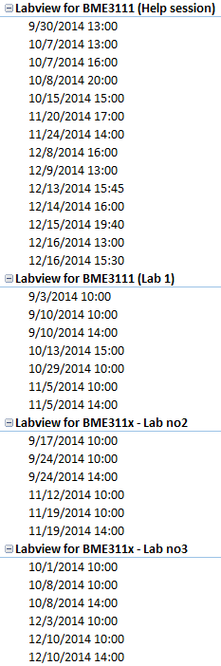
Customized support for BME 3111 - PHYSIOLOGY AND ENGINEERING
Term A: 2 sections, 35 students
Term B: 2 sections, 44 students
Developed:
Lecture notes for the Labview labs
Labview homework assignments
Lecture on Mathematics of Signal Processing
Conducted Labview labs, help sessions on Labview and Signal Processing , invited lecture on Mathematics of Signal Processing
Troubleshooting of data acquisition systems used in the animal labs
Office hours, assistance by email, ad-hoc consultations for students and TAs.
2014-2015
2014-2015

