Slide 1
4.3 Fields
Electric Fields
Breithaupt pages 72 to 89
October 9th, 2012

Slide 2
AQA A2 Specification
Lessons | Topics
1 | Coulomb’s law Force between point charges in a vacuum F = (1 / 4πε_{o} ) (Q₁Q₂ / r ²) where ε_{o} is the permittivity of free space.
2 & 3 | Electric field strength E as force per unit charge defined by E = F / Q Representation by electric field lines. Magnitude of E in a radial field given by: E = (1 / 4πε_{o} ) (Q / r ²) Magnitude of E in a uniform field given by: E = V / d
4 & 5 | Electric potential Understanding of definition of absolute electric potential, including zero value at infinity, and of electric potential difference. Work done in moving charge Q given by Δ W = Q Δ V Magnitude of V in a radial field given by V = (1 / 4πε_{o} ) (Q / r) Graphical representations of variations of E and V with r.
6 | Comparison of electric and gravitational fields Similarities; inverse square law fields having many characteristics in common. Differences; masses always attract but charges may attract or repel.

Slide 3
Electric force
This is the ATTRACTIVE or REPULSIVE force exerted between objects due to their CHARGE
LIKE charges REPEL;
UNLIKE charges ATTRACT
(‘UNLIKE’ includes the case where one object is uncharged)
CHARGE is measured in COULOMBS (C)

Slide 4
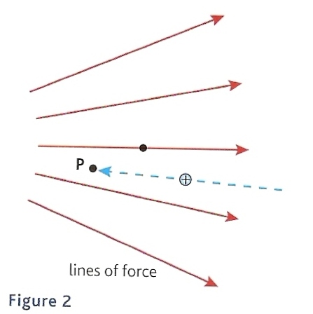
Electric fields
These are regions within which an object experiences electric force.
They can be represented by lines of force.
  Arrows show the direction of the force on a POSITIVE charge.
  Line density increases with the strength of the field.
test positive charge

Slide 5
Radial electrical fields
These exist around point charges.
The field around a uniform sphere is also radial.

Slide 6
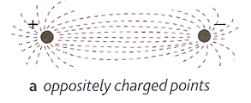
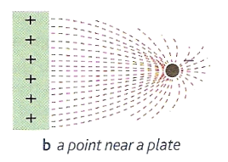
Some other field patterns
Draw the pattern expected for two like positive charges – add some arrows to show the field direction.
neutral point
X

Slide 7
Field between parallel plates
+ + + + + + +
Electric field is uniform in the central region
- - - - - - -

Slide 8
Electric field strength (E )
This is equal to the force per very small positive unit test charge.
Definition: E = force E = F charge q
unit of E: N C ⁻¹
VECTOR:
Direction the same as the force on a POSITIVE charge.

Slide 9
Answers:
Complete:
Force / N | Charge | E / NC⁻¹
12 | 3 C | 4
25 | 50 C | 0.5
48 | 6 C | 8
0.01 | 500 μC | 20
9 m | 300 μC | 30
20 μ | 500 nC | 40
0.5 n | 500 pC | 1

Slide 10
Coulomb’s law
The force between two point charges is:
1. directly proportional to the product of
the charges
2. inversely proportional to the square of
their distance apart
3. maximum when the charges are separated
by a vacuum
Coulomb’s law is the electric field equivalent of Newton’s law of gravitation.

Slide 11
Mathematically: F α Q₁ Q₂
r²
Q₁ and Q₂ are the charges, r is the distance apart
Inserting a constant of proportionality:
F = 1 Q₁ Q₂
4πε_{o} r ²
ε_{o} is called the ‘permittivity of free space’.
ε_{o} = 8.85 x 10 ⁻¹² C ² N ⁻¹ m ⁻².
The permittivity of air is usually taken to be the same as a vacuum ‘free space’.
The permittivity of other media, especially insulators, is higher.
The unit of permittivity is more usually F m ⁻¹ (farad per metre) where the farad is the unit of capacitance (to be covered later).

Slide 12
Question
Calculate the electrostatic force of attraction between the proton and electron inside an atom of hydrogen.
Charge of a proton = + 1.6 x 10 ^{– 19} C
Charge of an electron = - 1.6 x 10 ^{– 19} C
Distance apart = 5.0 x 10 ^{– 11} m
ε_{o} = 8.85 x 10 ⁻¹² C ² N ⁻¹ m ⁻²

Slide 13
F = 1 Q₁ Q₂
4πε_{o} r²
F = 1 (+ 1.6 x 10 ^{– 19} C) x (- 1.6 x 10 ^{– 19} C)
(4π x 8.85 x 10 ⁻¹²) (5.0 x 10 ^{– 11} ) ²
F = 9.00 x 10 ⁹ x - 2.56 x 10 ⁻³⁸
2.5 x 10 ^{– 21}
electrical force = - 9.21 x 10 ⁻ ⁸ N
Notes:
The NEGATIVE answer indicates ATTRACTIVE force.
The constant of proportionality ( 1 / 4πε_{o} ) is sometimes shown in
text books as ‘k’ where k = 9.0 x 10 ⁹ N m ² C ^{– 2}
and the equation as: F = k Q₁ Q₂
r²

Slide 14
Gravity Comparison Question
Calculate the gravitational force of attraction between the proton and electron inside an atom of hydrogen and compare your answer with the previous question.
Mass of a proton = 1.67 x 10 ^{– 27} kg
Mass of an electron = 9.11 x 10 ^{– 31} kg
Distance apart = 5.0 x 10 ^{– 11} m
G = 6.672 x 10 ⁻¹¹ N m ² kg ⁻ ².

Slide 15
F = G m₁ m₂
r²
= (6.672 x 10 ⁻¹¹) x (1.67 x 10 ^{– 27}) x (9.11 x 10 ^{– 31})
(5.0 x 10 ^{– 11}) ²
= 1.015 x 10 ⁻ ⁶⁷
2.5 x 10 ^{– 21}
gravitational force = 4.06 x 10 ⁻ ⁴⁷ N
Comment:
Ratio of electric to gravitation force
= 9.21 x 10 ⁻ ⁸ N / 4.06 x 10 ⁻ ⁴⁷ N
= 2.27 x 10³⁹.
Gravitational attraction is INSIGNIFICANT at the atomic level.

Slide 16
Radial field relationship between E and ε_{o}
E = F / q
where q is a very small positive test charge feeling the electric force of a much greater charge Q
Coulomb’s law in this situation can now be written:
F = 1 Q q
4πε_{o} r²
Substituting F from the 2nd equation into the 1st:
E = 1 Q q
4πε_{o} r² q
E = Q i
4πε_{o} r ²

Slide 17
Question
Calculate the electrical field strength:
2 cm away from a point charge of + 5 μC
4 cm away from a point charge of - 10 μC
ε_{o} = 8.85 x 10 ⁻¹² C ² N ⁻¹ m ⁻²
(a) E = Q i
4πε_{o} r ²
= + 5 x 10 ^{– 6} C
4π x 8.85 x 10 ⁻¹² x (0.02 m) ²
= + 5 x 10 ^{– 6}
4.45 x 10 ⁻¹³
E due to + 5 μC
= + 1.12 x 10 ⁸ NC⁻¹
POSITIVE sign indicates that the field would REPEL a positive test charge placed at this point.
(b) E = Q i
4πε_{o} r ²
= - 10 x 10 ^{– 6} C
4π x 8.85 x 10 ⁻¹² x (0.04 m) ²
= - 10 x 10 ^{– 6}
17.8 x 10 ⁻¹³
E due to – 10 μC
= - 0.56 x 10 ⁸ NC⁻¹
NEGATIVE sign indicates that the field would ATTRACT a positive test charge placed at this point.

Slide 18
Electrical potential (V )
The electrical potential of a point within an electric
field is equal to the work that must be done per
coulomb of POSITIVE charge in bringing the charge
from infinity to the point.
Notes:
The electrical potential at infinity is ZERO.
Points around positive charges usually (but not always) have positive potentials and vice-versa.
Electrical potential is measured in joules per coulomb (J C⁻¹) or more commonly volts (V) where 1V equals 1 JC⁻¹.
Electrical potential is a SCALAR quantity

Slide 19
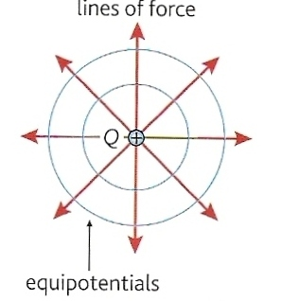
Electrical equipotentials
These are surfaces that join up points of equal potential.
  No work is done by electrical force when a charge is moved along an equipotential surface.
  Equipotentials are always perpendicular to field lines.

Slide 20
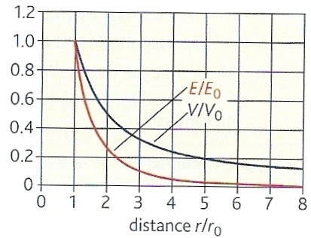
Variation of E and V about a positive charged sphere of charge Q and radius r_{o}
E = Q i
4πε_{o} r ²
V = Q i
4πε_{o} r

Slide 21
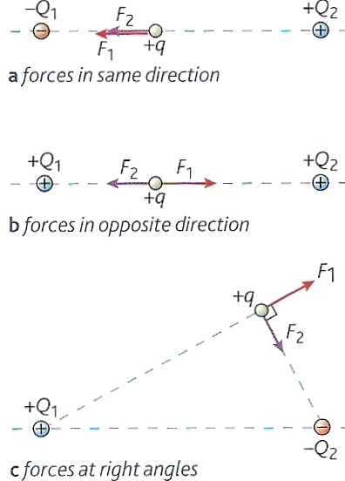
Combining fields question
Calculate the resultant force, electric field strength and electrical potential experienced by test charge + q of magnitude 2pC in the situations shown opposite.
Both Q₁ & Q₂ have a charge of magnitude of 4μC
In situations (a) and (b) q is 3cm from Q₁ and 4cm from Q₂
In situation (c) q is 4cm from Q₁ and 3cm from Q₂
Remember that both force and electric field strength are vectors but that electrical potential is a scalar.

Slide 22
Combining fields answers
(a) F₁ = 8.0 x 10 ⁻⁵ N LEFT
F₂ = 4.5 x 10 ⁻⁵ N LEFT
ΣF = 12.5 x 10 ⁻⁵ N LEFT
E₁ = 4.0 x 10 ⁷ NC⁻¹ LEFT
E₂ = 2.25 x 10 ⁷ NC⁻¹ LEFT
ΣE = 6.25 x 10 ⁷ NC⁻¹ LEFT
V₁ = - 1.2 x 10 ⁶ V
V₂ = + 0.9 x 10 ⁶ V
ΣV = - 0.3 x 10 ⁶ V
(b) F₁ = 8.0 x 10 ⁻⁵ N RIGHT
F₂ = 4.5 x 10 ⁻⁵ N LEFT
ΣF = 3.5 x 10 ⁻⁵ N RIGHT
E₁ = 4.0 x 10 ⁷ NC⁻¹ RIGHT
E₂ = 2.25 x 10 ⁷ NC⁻¹ LEFT
ΣE = 1.75 x 10 ⁷ NC⁻¹ RIGHT
V₁ = + 1.2 x 10 ⁶ V
V₂ = + 0.9 x 10 ⁶ V
ΣV = + 2.1 x 10 ⁶ V
(c) F₁ = 4.5 x 10 ⁻⁵ N
UPWARDS TO THE RIGHT
F₂ = 8.0 x 10 ⁻⁵ N
DOWNWARDS TO THE RIGHT
ΣF = 9.17 x 10 ⁻⁵ N
RIGHTWARDS
E₁ = 2.25 x 10⁷ NC⁻¹
UPWARDS TO THE RIGHT
E₂ = 4.0 x 10⁷ NC⁻¹
DOWNWARDS TO THE RIGHT ΣE = 4.59 x 10 ⁷ NC⁻¹
RIGHTWARDS
V₁ = + 0.9 x 10 ⁶ V
V₂ = - 1.2 x 10 ⁶ V
ΣV = - 0.3 x 10 ⁶ V

Slide 23
Electrical potential difference (ΔV )
When a charge, Q is moved through an electrical potential difference of ΔV the work done ΔW is given by:
ΔW = Q x ΔV

Slide 24
Question 1
Calculate the work required to move a charge 40 mC between two electrodes of potential difference 5 kV.
ΔW = Q x ΔV
= (40 x 10 ⁻³ C) x (5 x 10 ³ V)
Work = 200 J

Slide 25
Question 2
Calculate the work required to move an electron of charge 1.6 x 10 ⁻¹⁹ C between two electrodes of potential difference 1V.
ΔW = Q x ΔV
= (1.6 x 10 ⁻¹⁹ C ) x (1 V)
Work = 1.6 x 10 ⁻¹⁹ J
= 1 electron-volt !!

Slide 26
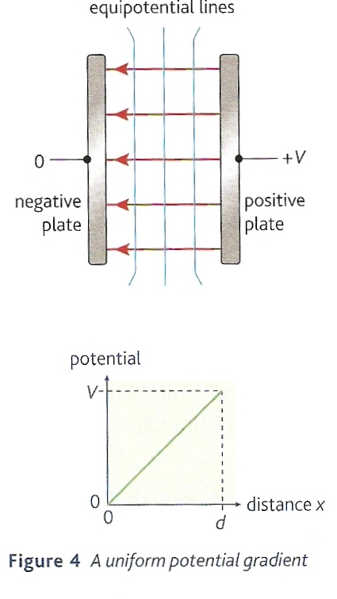
Potential gradient in a uniform electric field (ΔV / Δd)
This is the change in potential per metre at a point within an electrical field.
potential gradient = ΔV
Δd
unit: J C⁻¹ m⁻¹
or more usually: V m⁻¹
E = ΔV
Δd
Electric field strength is also more commonly measured in V m ⁻¹

Slide 27
Question 1
Calculate the electric field strength between two parallel electrodes separated by 2.0 mm and a potential difference of 60V.
E = ΔV
Δd
= 60V / 0.002 m
E = 30 000 Vm⁻¹

Slide 28
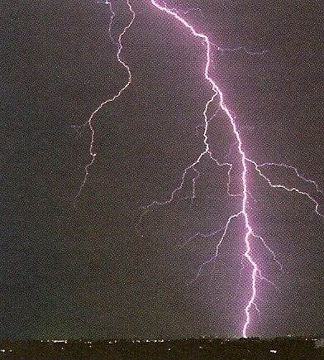
Question 2
Estimate the potential difference between the base of a thundercloud and the ground if they are separated by 500m and if an electric field of 12 kV m ⁻¹ is required for a lightning stroke.
E = ΔV
Δd
rearranged:
ΔV = E x Δd
ΔV = 12 000 Vm⁻¹ x 500 m
PD = 6.0 x 10⁶ V = 6 MV

Slide 29
Comparison of electric and gravitational fields
Similarities:
Both consist of inverse square law fields.
Both are long range compared with the nuclear strong and weak forces.
In both cases the force exerted is parallel to the field direction (unlike magnetic fields)
Similar definitions and equations:
g = F / m : E = F / q
F = Gm₁m₂ / r² : F = q₁q₂ / 4πε_{o}r²
g = GM / r² : E = Q / 4πε_{o}r²
V = - GM / r : V = Q / 4πε_{o}r
ΔW = m ΔV : ΔW = q ΔV
g = - ΔV / Δr : E = ΔV / Δd
Differences:
Gravitation fields affect masses electric fields affect charges
Masses always attract but charges may attract or repel.
Electric force is maximum when the charges are separated by a vacuum.
The constant of proportionality for gravity G is about 10²⁰ times smaller than that for electric fields (1/ 4πε_{o})
Other comparisons can be found on page 89 of the Breithaupt A2 Text Book

Slide 30
Internet Links
Fuel Ignition While Refuelling A Car - Word document with embedded video clip
Charged Rod & Pith Ball - Iona
Electric Force Tutorial - Science Trek
2D Electric field diagrams in 2D - falstad
2D Electric field in 3D - falstad
3D Electric fields in 3D - falstad
Milikan Oil Drop Experiment - NTNU

Slide 31
Core Notes from Breithaupt pages 72 to 89
Sketch the electric field patterns between: (a) two oppositely charged points; (b) a point near a plate; (c) oppositely charged plates.
Explain what is meant by a uniform electric field.
Define ‘electric field strength’. State an equation and unit.
Describe the electric field between two parallel but oppositely charged plates. State an equation for this situation.
Define what is meant by ‘electric potential’ and state a unit.
Draw Figure 4 on page 82 and state how the potential difference between the plates is related to electric field strength and plate separation.
State Coulomb’s law and give a mathematical expression for this law.
Answer summary question 1 on page 85 showing your working as fully as possible.
Copy the graph part of figure 3 on page 87 and use it to describe how the electric field strength and potential very with distance from a charged sphere.
Answer summary question 2 on page 88 showing your working as fully as possible.
Copy table 1 on page 89.

Slide 32
Notes from Breithaupt pages 72 to 75
Electric field patterns
Sketch the electric field patterns between: (a) two oppositely charged points; (b) a point near a plate; (c) oppositely charged plates.
Explain what is meant by a uniform electric field.
State the law of charges and how you might go about confirming it in the laboratory.
Explain in terms of electrons the difference between a conductor and an insulator.
Redo the worked example on page 73 this time for a frequency of 6.0 Hz with a current of 45 nA.
Explain how an electric field pattern can be reproduced in the laboratory.
Try the summary questions on page 75

Slide 33
Notes from Breithaupt pages 76 to 79
Electric field strength
Define ‘electric field strength’. State an equation and unit.
Describe the electric field between two parallel but oppositely charged plates. State an equation for this situation.
Redo the worked example on page 76 this time for an alpha particle of charge + 3.2 x 10⁻¹⁹ C
Explain the action of a lightning conductor.
Redo the worked example on page 77 this time for a plate separation of 25mm and a pd of 1500V.
Describe how field strength can be affected by the shape of a charged object
Try the summary questions on page 79

Slide 34
Notes from Breithaupt pages 80 to 82
Electric potential
Define what is meant by ‘electric potential’ and state a unit.
Draw Figure 4 on page 82 and state how the potential difference between the plates is related to electric field strength and plate separation.
With the aid of a diagram, describe how a Van de Graff generator produces a high voltage.
Explain the analogy between equipotentials and contour lines.
Try the summary questions on page 82

Slide 35
Notes from Breithaupt pages 83 to 85
Coulomb’s law
State Coulomb’s law and give a mathematical expression for this law.
Answer summary question 1 on page 85 showing your working as fully as possible.
Describe how Coulomb’s law can be verified experimentally.
Try the other summary questions on page 85

Slide 36
Notes from Breithaupt pages 86 to 88
Point charges
Copy the graph part of figure 3 on page 87 and use it to describe how the electric field strength and potential very with distance from a charged sphere.
Answer summary question 2 on page 88 showing your working as fully as possible.
Calculate the resultant force, electric field strength and electrical potential experienced by test charge + q of magnitude 2pC in the situations shown in figure 2 on page 86. Both Q₁ & Q₂ have a charge of magnitude of 4μC. In situations (a) and (b) q is 3cm from Q₁ and 4cm from Q₂. In situation (c) q is 4cm from Q₁ and 3cm from Q₂
Try the other summary questions on page 88

Slide 37
Notes from Breithaupt page 89
Comparison between electric and gravitational fields
Copy table 1 on page 89.
Compare electric and magnetic fields in similar ways.

