Slide 1
Capacitance

Slide 2

Capacitors
A capacitor is a device for storing electrical charge.
Most capacitors consist of two parallel conductors (plates) separated by a thin insulator (air in the simplest case)
Uses of capacitors include: voltage regulation in power supplies, timing circuits, tuning circuits and in back-up power supplies.
capacitor symbol

Slide 3
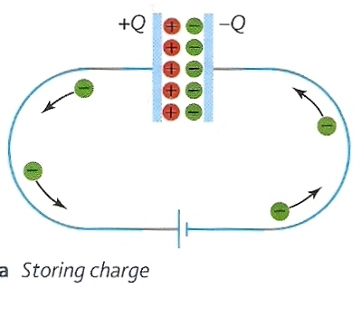
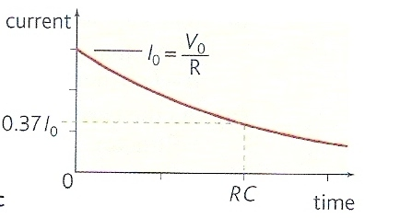
Capacitor charging
When a voltage is connected to the capacitor electrons flow off one of the plates (which becomes positive) and onto the other (which becomes negative)
The rate of flow of charge (electric current) falls exponentially in time from an initial value, I_{o} as the capacitor becomes fully charged. This is because it becomes more and more difficult to remove electrons from the positive plate.
The charging of a capacitor is analogous to the inflating of a tyre with a pump:
tyre size = capacitance
pump pressure = applied voltage
air flow rate = charge flow rate, current

Slide 4
Capacitance (C)
The capacitance of a capacitor is defined as the charge stored per unit potential difference change
C = Q
V
unit of capacitance: farad (F)
also: Q = CV and V = Q / C

Slide 5
Question
A capacitor of 500μF is charged by a power supply 4V through a 200Ω resistor. Calculate (a) the initial charging current and (b) the final charge stored on the capacitor.
(a) Initially the capacitor voltage is zero and all 4V of the power supply will be across the resistor.
I_{o} = V / R
= 4V / 200Ω
Initial current = 0.02 A = 20 mA
(b) At the end of the charging process, all 4V will be across the capacitor.
Q = CV
= 500μF x 4V
final charge = 2000 μC

Slide 6
Answers
Complete:
charge | potential difference | capacitance
300 μC | 6 V | 50 μF
200 μC | 5 V | 40 μF
720 μC | 12 V | 60 μF
500 nC | 25 V | 20 nF
2 μC | 40 mV | 50 μF
900 pC | 9 V | 100 pF

Slide 7
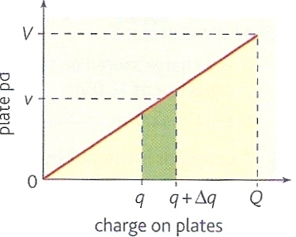
Energy stored by a capacitor
Consider a capacitor of capacitance C with charge q.
To add a further small amount of charge Δq requires work ΔW where:
ΔW = v Δq
v = average potential difference during the process.

Slide 8
The work ΔW is represented by the green area on the graph.
The total work W done in charging the capacitor by charge Q to potential difference V is equal to the area under the curve.
= ½ x base x height
W = ½ QV
This is also the energy stored by the capacitor

Slide 9
Energy equations
W = ½ QV
substituting Q = C V gives:
W = ½ CV ²
substituting V = Q / C gives:
W = ½ Q ² / C

Slide 10
Question
Calculate the energy stored when:
(a) a 10μF capacitor is charged by 12V
(b) 200μC is placed on a capacitor using 6V
(c) a 0.05μF capacitor receives 40 nC of charge.
(a) W = ½ CV ²
= ½ x (10 x 10 ^{– 6} ) x (12)²
= 7.2 x 10 ⁻ ⁴ J (720 μJ)
(b) W = ½ QV
= ½ x (200 x 10 ^{– 6} ) x (6)
= 6.0 x 10 ⁻ ⁴ J (600 μJ)
(c) W = ½ Q ² / C
= ½ x (40 x 10 ^{– 9}) ² / (5 x 10 ^{– 8})
= 1.6 x 10 ⁻ ⁸ J (16 nJ)

Slide 11
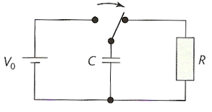
Capacitor discharge
A capacitor C is discharged through a resistor R.
The charge Q left on a capacitor, initially charged to Q_{o} after time t is given by:
Q = Q_{o} e ^{– t / RC}
also: V = V_{o} e ^{– t / RC}
and: I = I_{o} e ^{– t / RC}

Slide 12
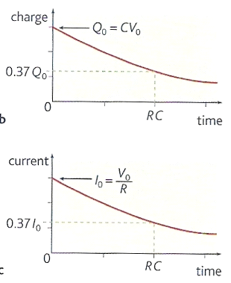
Time constant (RC)
This is the time taken for the capacitor to discharge to 0.37 of its initial charge.
It is also the time taken for the discharge current and potential difference to fall to 0.37 of their initial values.

Slide 13
Why RC is called the time constant
time constant = RC
Substituting R = V / I and C = Q / V gives:
time constant = (V x Q) / (I x V)
= Q / I
but Q = I x t
time constant = I x t / I
= t

Slide 14
Why 0.37 ?
Q = Q_{o} e ^{– t / RC}
When the time t = RC
Q = Q_{o} e ^{– 1}
Q / Q_{o} = e ^{– 1}
Q / Q_{o} = 0.3679
Which is approximately 0.37

Slide 15
Question 1
Calculate the time taken for a capacitor of 1500 μF to discharge to 0.37 of its initial charge through a resistance of 2 kΩ.
Time constant
= time to discharge to 0.37 of initial state
= RC
= 2000 Ω x 0.0015 F
= 3 seconds

Slide 16
Question 2
A capacitor of 5000 μF is charged by a 12 V supply and then discharged through a 150 Ω resistor. Calculate
(a) its initial charge,
(b) the time constant
(c) the charge remaining after 1.5 seconds.
(a) Q = CV
= 5000 μF x 12 V
= 60000 μC
(b) time constant = RC
= 150 Ω x 5000 μF
= 0.75 second
(c) Q = Q_{o} e ^{– t / RC}
= 60000 μC x e ^{( - 1.5 s / 0.75 s)}
= 60000 x e ⁽ ⁻ ²⁾
= 60000 x 0.135
= 8120 μC

Slide 17
Internet Links
Circuit Construction AC + DC - PhET - This new version of the CCK adds capacitors, inductors and AC voltage sources to your toolbox! Now you can graph the current and voltage as a function of time.
RC circuit - charging and discharging - netfirms
RC circuit - charging & discharging - NTNU
Charging and discharging a capacitor CapacitorChargeDemo - Crocodile Clip Presentation

Slide 18
Core Notes from Breithaupt pages 94 to 101
What is a capacitor? Give four uses of capacitors.
Draw figure 1 on page 94 (both parts) and describe what happens as a capacitor charges.
Define capacitance, state an equation and unit.
Draw figure 2 on page 96 and use it to derive the equation W = ½ QV.
State two other equations for the energy stored by a capacitor.
State, and explain the terms of an equation that shows how the charge of a discharging capacitor varies in time.
Draw figure 1 part b on page 98 and use it to explain what is meant by the ‘time constant RC’.

Slide 19
Notes from Breithaupt pages 94 & 95
Capacitance
What is a capacitor? Give four uses of capacitors.
Draw figure 1 on page 94 (both parts) and describe what happens as a capacitor charges.
Define capacitance, state an equation and unit.
Describe an experiment to show that the charge of a capacitor is proportional to its potential difference.
Try the summary questions on page 95

Slide 20
Notes from Breithaupt pages 96 to 97
Energy stored in a charged capacitor
Draw figure 2 on page 96 and use it to derive the equation W = ½ QV.
State two other equations for the energy stored by a capacitor.
Explain how energy becomes stored in a thundercloud.
Try the summary questions on page 97

Slide 21
Notes from Breithaupt pages 98 to 101
Charging and discharging a capacitor through a fixed resistor
State, and explain the terms of an equation that shows how the charge of a discharging capacitor varies in time.
Draw figure 1 part b on page 98 and use it to explain what is meant by the ‘time constant RC’.
Redo the worked example on page 99 this time for a 1500μF capacitor initially charged to 6V.
Explain two applications of capacitor discharge.
Compare the charging of a capacitor with its discharge.
Try the summary questions on page 101

