Slide 1
5.3a Thermal Physics
Thermal Energy
Breithaupt pages 198 to 207
November 14th, 2011

Slide 2
AQA A2 Specification
Lessons | Topics
1 & 2 | Thermal energy Calculations involving change of energy. For a change of temperature; Q = m c Δθ where c is specific heat capacity. For a change of state; Q = m l where l is specific latent heat.

Slide 3
Thermal energy
Thermal energy is the energy of an object due to its temperature.
It is also known as internal energy.
It is equal to the sum of the random distribution of the kinetic and potential energies of the object’s molecules. Molecular kinetic energy increases with temperature. Potential energy increases if an object changes state from solid to liquid or liquid to gas.

Slide 4
Temperature
Temperature is a measure of the degree of hotness of a substance.
Heat energy normally moves from regions of higher to lower temperature.
Two objects are said to be in thermal equilibrium with each other if there is not net transfer of heat energy between them. This will only occur if both objects are at the same temperature.

Slide 5
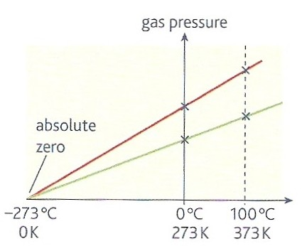
Absolute zero
Absolute zero is the lowest possible temperature.
An object at absolute zero has minimum internal energy.
The graph opposite shows that the pressure of all gases will fall to zero at absolute zero which is approximately - 273°C.

Slide 6
Temperature Scales
A temperature scale is defined by two fixed points which are standard degrees of hotness that can be accurately reproduced.

Slide 7
Celsius scale
symbol: θ
unit: ºC
Fixed points:
  ice point:
  0ºC: the temperature of pure melting ice
  steam point:
  100ºC: the temperature at which pure water boils at standard atmospheric pressure

Slide 8
Absolute scale
symbol: T
unit: kelvin (K)
Fixed points:
  absolute zero:
  0K: the lowest possible temperature.
  This is equal to – 273.15ºC
  triple point of water:
  273.16K: the temperature at which pure water exists in thermal equilibrium with ice and water vapour.
  This is equal to 0.01ºC.

Slide 9
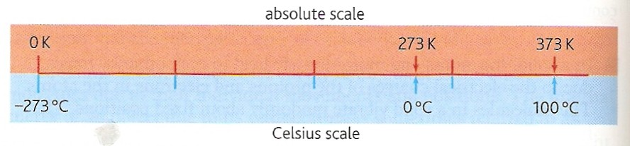
Converting between the scales
A change of one degree celsius is the same as a change of one kelvin.
Therefore:
ºC = K - 273.15
OR K = ºC + 273.15
Note: usually the converting number, ‘273.15’ is approximated to ‘273’.

Slide 10
Complete (use ‘273’):
Situation | Celsius (ºC) | Absolute (K)
Boiling water | 100 | 373
Vostok Antarctica 1983 | - 89 | 184
Average Earth surface | 15 | 288
Gas flame | 1500 | 1773
Sun surface | 5727 | 6000

Slide 11
Specific heat capacity, c
The specific heat capacity, c of a substance is the energy required to raise the temperature of a unit mass of the substance by one kelvin without change of state.
ΔQ = m c ΔT
where:
ΔQ = heat energy required in joules
m = mass of substance in kilograms
c = specific heat capacity (shc) in J kg ⁻¹ K ⁻¹
ΔT = temperature change in K

Slide 12
If the temperature is measured in celsius:
ΔQ = m c Δθ
where:
c = specific heat capacity (shc) in J kg ⁻¹ °C ⁻¹
Δθ = temperature change in °C
Note:
As a change one degree celsius is the same as a change of one kelvin the numerical value of shc is the same in either case.

Slide 13
Examples of SHC
Substance | SHC (Jkg⁻¹K⁻¹) | Substance | SHC (Jkg⁻¹K⁻¹)
water | 4 200 | helium | 5240
ice or steam | 2 100 | glass | 700
air | 1 000 | brick | 840
hydrogen | 14 300 | wood | 420
gold | 129 | concrete | 880
copper | 385 | rubber | 1600
aluminium | 900 | brass | 370
mercury | 140 | paraffin | 2130

Slide 14
Answers
Complete:
Substance | Mass | SHC (Jkg⁻¹K⁻¹) | Temperature change | Energy (J)
water | 4 kg | 4 200 | 50 ºC | 840 000
gold | 4 kg | 129 | 50 ºC | 25 800
air | 4 kg | 1 000 | 50 K | 200 000
glass | 3 kg | 700 | 40 ºC | 84 000
hydrogen | 5 mg | 14 300 | 400 K | 28.6
brass | 400 g | 370 | 50ºC to 423 K | 14 800

Slide 15
Question
Calculate the heat energy required to raise the temperature of a copper can (mass 50g) containing 200cm³ of water from 20 to 100ºC.
ΔQ = m c Δθ
For the copper can:
ΔQ = 0.050 kg x 385 J kg ⁻¹ ºC ⁻¹ x (100 – 20) ºC
= 0.050 x 385 x 80 = 1 540 J
For the water:
Density of water = 1 g cm⁻³.
Therefore mass of water = 200g.
ΔQ = 0.200 kg x 4200 J kg ⁻¹ ºC ⁻¹ x 80 ºC = 67 200 J
TOTAL HEAT ENERGY = 68 740 J

Slide 16
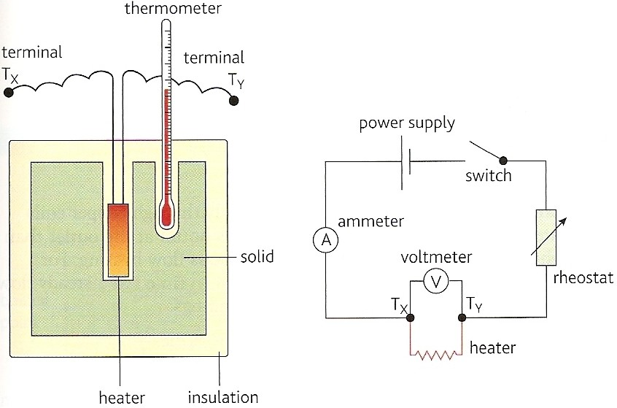
Measuring SHC (metal solid)

Slide 17
Metal has known mass, m.
Initial temperature θ₁ measured.
Heater switched on for a known time, t
During heating which the average p.d., V and electric current I are noted.
Final maximum temperature θ₂ measured.
Energy supplied = VIt = mc(θ₂ - θ₁ )
Hence: c = VIt / m(θ₂ - θ₁ )

Slide 18
Example calculation
Metal mass, m. = 500g = 0.5kg
Initial temperature θ₁ = 20ºC
Heater switched on for time, t = 5 minutes = 300s.
p.d., V = 12V; electric current I = 2.0A
Final maximum temperature θ₂ = 50ºC
Energy supplied = VIt = 12 x 2 x 300 = 7 200J
= mc(θ₂ - θ₁ ) = 0.5 x c x (50 – 20) = 15c
Hence: c = 7 200 / 15
= 480 J kg ⁻¹ ºC ⁻¹

Slide 19
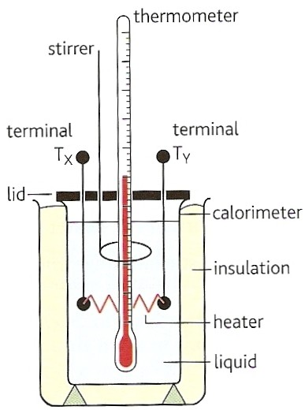
Measuring SHC (liquid)
Similar method to metallic solid.
However, the heat absorbed by the liquid’s container (called a calorimeter) must also be allowed for in the calculation.

Slide 20

Electrical heater question
What are the advantages and disadvantages of using paraffin rather than water in some forms of portable electric heaters?
Advantages:
Electrical insulator – safer
Does not corrode metal container
Lower SHC – heats up quicker
Disadvantages:
Lower SHC – cools down quicker

Slide 21
Climate question
Why are coastal regions cooler in summer but milder in winter compared with inland regions?
Water has about 4 to 5 x higher SHC than land.
Water has a ‘polished’ reflective surface.
Therefore in summer the sea takes much longer to warm up than land and in winter the sea cools far more slowly than the land. (polished surfaces radiate heat less quickly)

Slide 22
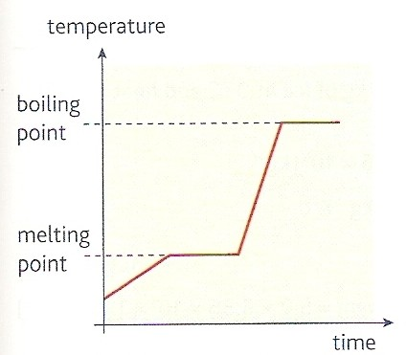
Latent heat
This is the energy required to change the state of a substance. e.g. melting or boiling.
With a pure substance the temperature does not change. The average potential energy of the substance’s molecules is changed during the change of state.
‘latent’ means ‘hidden’ because the heat energy supplied during a change of state process does not cause any temperature change.

Slide 23
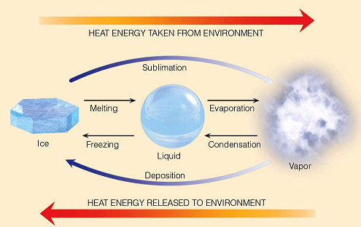

Slide 24
Specific latent heat, l
The specific latent heat, l of a substance is the energy required to change the state of unit mass of the substance without change of temperature.
ΔQ = m l
where:
ΔQ = heat energy required in joules
m = mass of substance in kilograms
l = specific latent heat in J kg ⁻¹

Slide 25
Examples of SLH
Substance | State change | SLH (Jkg⁻¹)
ice → water | solid → liquid specific latent heat of fusion | 336 000
water → steam | liquid → gas / vapour specific latent heat of vaporisation | 2 250 000
carbon dioxide | solid → gas / vapour specific latent heat of sublimation | 570 000
lead | solid → liquid | 26 000
solder | solid → liquid | 1 900 000
petrol | liquid → gas / vapour | 400 000
mercury | liquid → gas / vapour | 290 000

Slide 26
Complete:
Answers
Substance | Change | SLH (Jkg⁻¹) | Mass | Energy (J)
water | melting | 336 000 | 4 kg | 1.344 M
water | freezing | 336 000 | 200 g | 67.2 k
water | boiling | 2.25 M | 4 kg | 9 M
water | condensing | 2.25 M | 600 mg | 1 350
CO₂ | subliming | 570 k | 8 g | 4 560
CO₂ | depositing | 570 k | 40 000 μg | 22.8

Slide 27
Question 1
Calculate (a) the heat energy required to change 100g of ice at – 5ºC to steam at 100ºC.
(b) the time taken to do this if heat is supplied by a 500W immersion heater.
Sketch a temperature-time graph of the whole process.
Stage 1: ice at – 5ºC to ice at 0ºC
ΔQ = m c Δθ
= 0.100 kg x 2100J kg ⁻¹ ºC ⁻¹ x (0 – (- 5)) ºC
= 0.100 x 2100 x 5
= 1 050 J

Slide 28
Stage 2: ice at 0ºC to water at 0ºC
ΔQ = m l
= 0.100 x 336 000
= 33 600 J
Stage 3: water at 0ºC to water at 100ºC
ΔQ = m c Δθ
= 0.100 x 4200 x 100
= 42 000 J
Stage 4: water at 100ºC to steam at 100ºC
ΔQ = m l
= 0.100 x 2 250 000
= 225 000 J
Stages 1 to 4: ice at – 5ºC to steam at 100ºC
= 1 050J + 33 600J + 42 000J + 225 000J
= 301 650J

Slide 29
(b) 500W heater
This supplies 500J per second to water.
Assuming no heat loss to the surroundings:
Stage 1:
1 050J / 500W = 2.1 seconds
Stage 2:
33 600J / 500W = 67.2s
Stage 3:
42 000J / 500W = 84s
Stage 4:
225 000J / 500W = 450s
Stages 1 to 4:
301 650J / 500W = 603.3s

Slide 30
(c) Sketch graph
temperature / ºC
100
0
stage 4
stage 2
stage 3
-5
100 200 300 400 500 600
time / s
stage 1

Slide 31
Question 2
A glass contains 300g of water at 30ºC. Calculate the water’s final temperature when cooled by adding (a) 50g of water at 0ºC; (b) 50g of ice at 0ºC. Assume no heat energy is transferred to the glass or the surroundings.
Let the final temperature be: θ_{F}
Heat energy lost by 30ºC water
= Heat energy gained by 0ºC water

Slide 32
m₃₀ c Δθ₃₀ = m₀ c Δθ₀
SHC cancels on both sides
0.300 x (30 - θ_{F}) = 0.050 x (θ_{F} - 0)
9 – 0.3θ_{F} = 0.05θ_{F}
9 = 0.35θ_{F}
Final temperature = 26ºC

Slide 33
(b) In this case heat energy from the water is also used to melt the ice at 0ºC before raising the ice’s temperature.
Let the final temperature again be: θ_{F}
Heat energy lost by 30ºC water
= Heat energy gained by 0ºC water
+ Heat required to melt the ice

Slide 34
m₃₀ c Δθ₃₀ = m₀ c Δθ₀ + m₀ l
0.300 x 4200 x (30 - θ_{F})
= [0.050 x 4200 x (θ_{F} - 0)]
+ [0.050 x 336 000]
37800 – 1260θ_{F} = 210θ_{F} + 16800
21000 = 1470θ_{F}
Final temperature = 14ºC
The ice cools the water far more than the cold water.

Slide 35
Internet Links

Slide 36
Core Notes from Breithaupt pages 198 to 207
Define what is meant by temperature.
Explain the structure of the celsius and absolute temperature scales and how they are related to each other.
What is meant by ‘absolute zero’?
Define ‘specific heat capacity’. Give an equation and unit.
Explain what is meant by ‘latent heat’.
Define ‘specific latent heat’. Give an equation and unit.
Explain what is meant by ‘latent heat of fusion’ and ‘latent heat of vaporisation’.

Slide 37
Notes from Breithaupt pages 198 to 201
Internal energy and temperature
Define what is meant by temperature.
Explain the structure of the celsius and absolute temperature scales and how they are related to each other.
What is meant by ‘absolute zero’?
Explain the following terms: (a) internal energy; (b) thermal energy; (c) thermal equilibrium.
In terms of molecular motion and energy explain what happens as a substance is turned from a solid to a gas via the liquid phase.
Try the summary questions on page 201

Slide 38
Notes from Breithaupt pages 202 to 204
Specific heat capacity
Define ‘specific heat capacity’. Give an equation and unit.
Explain how specific heat capacity can be measured experimentally for (a) a solid & (b) a liquid.
Try the summary questions on page 204

Slide 39
Notes from Breithaupt pages 205 to 207
Change of state
Explain what is meant by ‘latent heat’.
Define ‘specific latent heat’. Give an equation and unit.
Explain what is meant by ‘latent heat of fusion’ and ‘latent heat of vaporisation’.
Explain the form of the graph shown on page 206.
Redo the worked example on page 206 but this time with 3.0kg of ice finishing at 70ºC.
Try the summary questions on page 207

