Slide 1
5A-1 Astrophysics
Telescopes
Astrophysics booklet pages 1 to 27
April 11th, 2010

Slide 2
AQA A2 Specification
Lessons | Topics
1 to 9 | 1.1 Lenses & Optical Telescopes Lenses Principal focus, focal length of converging lens. Formation of images by a converging lens. Ray diagrams. 1/u + 1/v = 1/f Astronomical telescope consisting of two converging lenses Ray diagram to show the image formation in normal adjustment. Angular magnification in normal adjustment. M = angle subtended by object at unaided eye / angle subtended by image at eye Focal lengths of the lenses. M = fo / fe Reflecting telescopes Focal point of concave mirror. Cassegrain arrangement using a parabolic concave primary mirror and convex secondary mirror, ray diagram to show path of rays through the telescope as far as the eyepiece. Relative merits of reflectors and refractors including a qualitative treatment of spherical and chromatic aberration. Resolving power Appreciation of diffraction pattern produced by circular aperture. Resolving power of telescope, Rayleigh criterion, θ ≈ λ / D Charge coupled devices Use of CCD to capture images. Structure and operation of the charge coupled device: A CCD is silicon chip divided into picture elements (pixels). Incident photons cause electrons to be released. The number of electrons liberated is proportional to the intensity of the light. These electrons are trapped in potential wells in the CCD. An electron pattern is built up which is identical to the image formed on the CCD. When exposure is complete, the charge is processed to give an image. Quantum efficiency of pixel > 70%.
10 & 11 | 1.2 Non Optical Telescopes Single dish radio telescopes, I-R, U-V and X-ray telescopes Similarities and differences compared to optical telescopes including structure, positioning and use, including comparisons of resolving and collecting powers.

Slide 3
Lenses
Lenses use the process of refraction to change the direction of light at their two surfaces.
There are two types of lenses:
1. CONVERGING - These make a parallel beam of light converge to a focus.
2. DIVERGING - These make a parallel beam of light spread out so that it appears to come from a focus.

Slide 4
Converging lens
With glass a converging lens has a convex shape.
Converging lens with a parallel beam of light
principal focus
centre
of the lens
principal axis
O
F
converging lens
focal length, f

Slide 5
Some definitions
The principal axis is a construction line that is perpendicular to and passes through the centre of the lens.
The principal focus, F is the point through which all rays travelling parallel to the principal axis before refraction pass through after refraction.
The focal length, f is the distance from the centre of the lens, O to the principal focus, F.

Slide 6
Standard rays – converging lens
(a) Rays incident parallel to the principal axis pass through the principal focus after refraction.
principal focus
principal axis
F

Slide 7
Standard rays – converging lens
(b) Rays passing through the centre of the lens are not deviated.
centre
of the lens
centre
of the lens
O
O

Slide 8
Standard rays – converging lens
(c) Rays passing through the principal focus before refraction are refracted parallel to the principal axis.
principal axis
F
F

Slide 9
Converging lens images
1. Object more than twice the focal length distant from a converging lens
object
2F
O
F
2F
F
image
Uses:
Camera and Eye
The image formed is:
Smaller than the object (diminished)
Between the F and 2F
Inverted (upside down)
Real (light rays travel to the image)

Slide 10
Converging lens images
2. Object between F and 2F
object
F
2F
2F
F
image
Use:
Projector
The image formed is:
Larger than the object (magnified)
Beyond 2F
Inverted
Real (light rays travel to the image)

Slide 11
Converging lens images
3. Object nearer than the principal focus
image
F
object
F
Uses:
Magnifying glass
The image formed is:
Larger than the object
On the same side of the lens as the object
Upright
Virtual (light rays only appear to come from the image)
observer

Slide 12
Real and virtual images
REAL images are formed where light rays cross after refraction by a lens.
Real images can be cast onto a screen.
Example: A projector image
VIRTUAL images are formed from where light rays only appear to come from.
A virtual image cannot be cast onto a screen.
Example: The image formed by a plane mirror or a magnifying glass

Slide 13
Scale diagram questions
Draw scale ray diagrams to determine the position size, orientation and nature of the images formed by a converging lens:
(a) of focal length 20 cm of an object size 12 cm placed 60 cm from this lens.
position = 30 cm;
size = 6 cm;
orientation = inverted;
nature = real
(b) of focal length 12 cm of an object size 4 cm placed 8 cm from this lens.
position = 24 cm;
size = 12 cm;
orientation = upright;
nature = virtual

Slide 14
The lens formula
1
1
1
+
=
u
v
f
where:
u = distance of an object along the principal axis from the centre of the lens
v = distance of the image along the principal axis from the centre of the lens
f = the focal length of a thin lens

Slide 15
Real is positive sign convention
When using the lens formula:
Converging lens focal lengths and real image distances are POSITIVE numbers.
Diverging lens focal lengths and virtual image distances are NEGATIVE numbers.

Slide 16
Question 1
Calculate the image distance when an object is placed 30 cm away from a converging lens of focal length 10 cm.
(1 / 30 ) + (1 / v ) = (1 / 10)
0.03333 + (1 / v ) = 0.1000
(1 / v ) = 0.1000 - 0.03333
(1 / v ) = 0.06667
v = 15.00
Image distance = 15 cm
The image is also real as the value of v is positive.
1
1
1
+
=
u
v
f
REAL IS POSITIVE

Slide 17
Question 2
Calculate the image distance when an object is placed 20 cm away from a converging lens of focal length 40 cm.
(1 / 20 ) + (1 / v ) = (1 / 40)
0.05000 + (1 / v ) = 0.02500
(1 / v ) = 0.02500 - 0.05000
(1 / v ) = - 0.02500
v = - 40.00
Image distance = - 40 cm
The image is also virtual as the value of v is negative.
1
1
1
+
=
u
v
f
REAL IS POSITIVE

Slide 18
Question 3
Calculate the object distance required for a diverging lens of focal length 25 cm to produce a virtual image at a distance of 10 cm.
A diverging lens has a negative focal length.
(1 / u ) + (1 / - 10 ) = (1 / - 25)
(1 / u ) - 0.1000 = - 0.04000
(1 / u ) = - 0.04000 + 0.1000
(1 / u ) = 0.06000
u = 16.67
Object distance = 17 cm
The object is REAL hence u is POSITIVE
1
1
1
+
=
u
v
f
REAL IS POSITIVE

Slide 19
Answers:
Complete:
lens type | f / cm | u / cm | v / cm | image type
converging | 20 | 30 | 60 | real
converging | 25 | 50 | 50 | real
diverging | 20 | 20 | 10 | virtual
converging | 20 | 15 | 60 | virtual
diverging | 20 | 20 * | 10 | real
60
real
25
diverging
20
converging
20
6.7 *
* Note: It is possible in some circumstances to have a ‘virtual’ object

Slide 20
Magnification
magnification (m) = image size
object size
It can also be shown that:
magnification (m) = image distance
object distance
v
m =
u

Slide 21
Magnification question
Calculate the magnification produced and the image size when an object of size 35 mm is placed 6 cm away from a lens of focal length 5 cm.
Applying the lens formula:
(1 / u ) + (1 / v ) = (1 / f )
(1 / 6 ) + (1 / v ) = (1 / 5 )
(1 / v ) = (1 / 5 ) – ( 1 / 6)
(1 / v ) = 0.2000 – 0.1667
(1 / v ) = 0.0333
v = 30 cm
m = v / u
= 30 / 6
magnification = 5 x
Therefore the image size
= 5 x 35 mm
= 175 mm

Slide 22
The power of a lens
The power of a lens is a measure of how quickly it causes an initial parallel beam of light to converge to a focus.
lens power = 1 / focal length
If the focal length is measured in metres then lens power is measured in dioptres (D)
Converging lenses have positive powers,
diverging lenses have negative powers.

Slide 23
Lens power questions
Calculate:
(a) the power of a converging lens of focal length 20 cm.
(b) the power of a diverging lens of focal length 50 cm.
(c) the focal length of a lens of power + 4.0 D
lens power = 1 / focal length
(a) power = 1 / 0.20m
= + 5.0 dioptres
(b) power = 1 / - 0.50m
= - 2.0 dioptres
(c) + 4.0 = 1 / f
f = 1 / 4.0
focal length = 0.25 m (25 cm)

Slide 24
The refracting telescope
f_{o}
f_{e}
short focal length EYEPIECE lens
long focal length OBJECTIVE lens
The refracting telescope consists of two converging lenses.
Light is collected by a wide, long focal length objective lens.
The image formed by this lens is viewed through, and further magnified by, a short focal length eyepiece lens.
When in normal adjustment the distance between the two lenses is equal to the sum of their focal lengths (f_{o} + f_{e} ).

Slide 25
Ray diagram for a refracting telescope in normal adjustment
Parallel light from the top of a very distant object
Intermediate INVERTED REAL image formed by the objective lens
EYEPIECE LENS
F_{o}
&
F_{e}
F_{e}
construction line
Parallel light viewed by the observer
OBJECTIVE LENS
Final INVERTED VIRTUAL image formed at INFINITY

Slide 26
The objective lens forms an inverted real image between the lenses at their common focal planes.
The eyepiece lens acts like a magnifying glass with this image. The final image, viewed by the observer, is virtual, inverted and formed at infinity.
light from the top of the object
light from the bottom of the object
eyering
Once through the eyepiece lens, all the light originally from the distant object passes through a circular area called the eyering.
This is the best position for the pupil of the observer’s eye.

Slide 27
Angular magnification (M )
A telescope makes a distant object appear to be bigger by making the image subtend a greater angle (β) to the eye than the angle (α) subtended by the object to the unaided eye.
distant object
telescope
α
viewer
β
virtual image
The ratio of these angles (β / α) is called the angular magnification (M) OR magnifying power (M).
Do not confuse this with ‘magnification (m)’

Slide 28
Magnifying power of a telescope in normal adjustment
M =
angle subtended by the final image at infinity to the observer
angle subtended by the distant object to the unaided eye
β
M =
α
It can also be shown that if both angles are less than about 10°:
M =
focal length of the objective
focal length of the eyepiece
f_{o}
M =
f_{e}

Slide 29
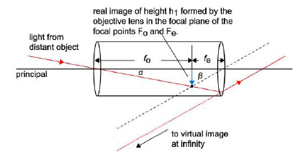
Proof of
f_{o}
M =
f_{e}
From the diagram above it can be seen that:
tan α = h₁ / f₀ and tan β = h₁ / f_{e}
combining these two:
tan α / tan β = f_{e} / f_{o}
If both angles are less than about 10° then the small angle approximation can be applied in that tan α and tan β both equal α and β in radians.
Hence: α / β = f_{e} / f_{o} = 1 / M
And so: β / α = f_{o} / f_{e} = M

Slide 30
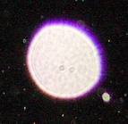
Chromatic aberration
Blue light is refracted more than red light.
For a given lens the focal length is therefore longer for red light than blue.
red image
light from a white object
blue image
This defect can cause a white object to produce an image with coloured tinges.
This defect is called chromatic aberration and is particularly noticeable with light that has passed through the edges of a lens.

Slide 31
Question 1
A refracting telescope in normal adjustment of objective focal length 70 cm, eyepiece focal length 2 cm, is used to observe the Moon which subtends an angle of 0.53° to the naked eye. Calculate:
(a) the distance between the lenses
(b) the magnifying power of the telescope
(c) the angular size of the Moon when viewed through the telescope.
(d) why might the previous answer be inaccurate?
(a) lens distance = f_{o} + f_{e}
= 70 cm + 2 cm
lens separation = 72 cm
(b) M = f_{o} / f_{e}
= 70 cm / 2 cm
magnifying power = 35 x
(c) M = β / α
35 = β / 0.53°
β = 35 x 0.53°
Moon angle = 18.6°
(d) 18.6° is greater than 10°
Therefore the relationship that:
M = f_{o} / f_{e} = β / α
is no longer accurate as it depends
on the angles being small.

Slide 32
Question 2
A refracting telescope in normal adjustment of objective focal length 120 cm is used to observe Mars. Through the telescope Mars subtends an angle of 0.40°. If the magnifying power of the telescope is 160 X calculate:
the angular size of Mars to the naked eye.
(b) the focal length of the eyepiece lens.
(a) M = β / α
160 = 0.40° / α
α = 0.40° / 160
Mars angle = 0.0025°
(b) M = f_{o} / f_{e}
160 = 120 cm / f_{e}
f_{e} = 120 cm / 160
eyepiece f = 0.75 cm

Slide 33
Concave mirrors
A concave mirror is like the inside of a spoon.
concave mirror
principal focus
F
principal axis
O
centre
of the mirror
focal length, f
The principal focus, F is the point through which all rays travelling parallel to the principal axis before reflection pass through after reflection.
The focal length, f is the distance from the centre of the mirror, O to the principal focus, F.

Slide 34
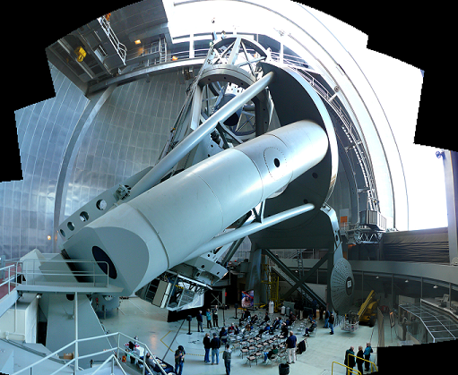
Reflecting telescopes
Reflecting telescopes use a concave mirror of long focal length as an objective to collect light from distant objects.
The eyepiece is a short focal length converging lens, as in the refracting telescope.
The equations used for refracting telescopes for magnifying power also apply for reflecting telescopes.
The Mount Palomar telescope in California, with an objective mirror of 5m (200 inches), was for many years the world’s largest telescope

Slide 35
Newtonian reflecting telescope
This was the first type of reflecting telescope.
small plane mirror
eyepiece lens
concave mirror objective

Slide 36
Cassegrain reflecting telescope
concave mirror objective with a central small hole
small convex mirror
eyepiece lens
The effective focal length of the objective is increased by making the secondary mirror convex. This allows a Cassegrain telescope to be shorter than a similarly powered Newtonian.
Focussing is achieved by adjusting the position of the convex mirror.

Slide 37
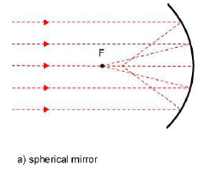
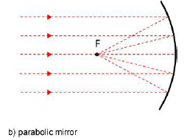
Spherical aberration
The primary mirror should be parabolic in shape and not spherical. Otherwise the outermost rays do not focus at the same place as the innermost ones.
This defect, when it occurs, is called spherical aberration.

Slide 38
Comparison of refracting and reflecting telescopes
Refracting telescopes:
Do not have a secondary mirror and its supports. Both of these block out some of the light from the object.
Have a wider field of view than reflectors of the same length because their angular magnification is less. Astronomical objects are consequently easier to locate.
Do not suffer from spherical aberration.
Reflecting telescopes:
Can have much wider objectives because their mirror can be supported from below. This allows the telescope to detect much fainter objects and also allows greater magnifying powers without loss of resolution (see later)
Are shorter and are therefore easier to handle than refractors of the same magnification.
Suffer less from chromatic aberration
The largest telescopes in the world are reflectors.

Slide 39
The resolving power of a telescope
This is the ability of a telescope to show detail.
For example two stars that are close to each other may appear as shown below:
stars resolved
stars just resolved
stars unresolved - they appear to be a single star
The higher the resolving power of a telescope the better able it can show separately two adjacent stars.

Slide 40
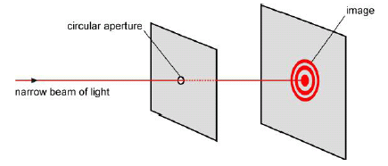
Diffraction at a circular aperture
The limit of a telescope’s resolving power is due to the diffraction of light that occurs at the objective lens or mirror.
The objective acts as a circular aperture to light.
Light from a distant star produces a circular diffraction pattern as shown in the diagram below.
The diffraction pattern consists of a central bright maximum surrounded by a circular minimum which is further surrounded by further circular maxima and minima.

Slide 41
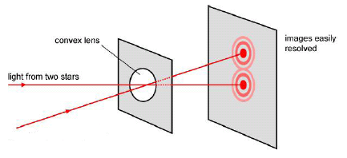
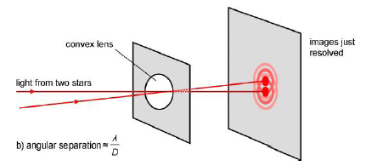
Light from two stars will form a pair of circular diffraction patterns.
images easily resolved
If the stars are close together the diffraction patterns overlap.
images just resolved

Slide 42
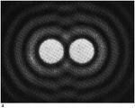
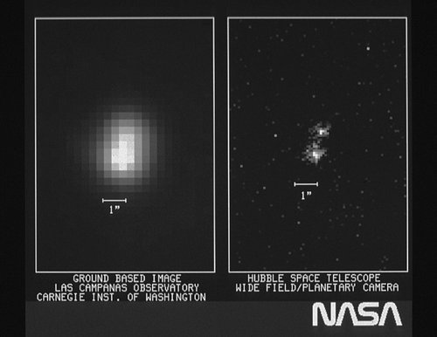
The Rayleigh Criterion
The Rayleigh criterion states that the resolution of two point objects is NOT possible if any part of the central maximum of either image lies inside the first minimum ring of the other image.
With light of wavelength λ and an aperture of diameter, D the minimum angular separation, θ that can be just resolved is given approximately by:
θ ≈ λ
D
Note: θ is measured in radians

Slide 43
Comparing optical devices question
Calculate the Rayleigh criterion angle for the following devices with light of wavelength 500 nm.
(a) human eye – pupil aperture diameter 8 mm
(b) cheap telescope – objective aperture 5 cm
(c) expensive telescope –
objective aperture 20 cm
(d) Hubble Space Telescope –
objective aperture 2.4 m
Rayleigh criterion: θ ≈ λ
D
(a) θ ≈ λ / D
≈ 500 nm / 8 mm
≈ 5 x 10 ⁻⁷ m / 0.008 m
human eye ≈ 6.3 x 10⁻⁵ rad (0.003°)
(b) ≈ 5 x 10 ⁻⁷ m / 0.05 m
cheap telescope ≈ 1 x 10⁻⁵ rad
(c) ≈ 5 x 10 ⁻⁷ m / 0.20 m
expensive telescope ≈ 2.5 x 10⁻⁶ rad
(d) ≈ 5 x 10 ⁻⁷ m / 2.4 m
HST ≈ 2.1 x 10⁻⁷ rad
NOTE: The BETTER the resolving power of a telescope the LOWER the Rayleigh criterion angle

Slide 44
Moon crater question
A terrestrial telescope of objective diameter 15 cm has its resolving power ‘reduced’ by atmospheric smearing by a factor of 5.
Calculate the smallest diameter of crater it can resolve on the Moon with light of wavelength 500 nm.
Take the distance to the Moon to be 380 000 km
Rayleigh criterion: θ ≈ λ / D
≈ 500 nm / 15 cm
≈ 5 x 10 ⁻⁷ m / 0.15 m
≈ 3.33 x 10⁻⁶ rad
Resolution reduced by x 5
means that the minimum angle is INCREASED by x 5
Therefore new θ ≈ 5 x (3.33 x 10⁻⁶ rad)
≈ 1.67 x 10⁻⁵ rad
but: s = r θ (remember circular motion)
where:
s = arc length = crater diameter
r = radius = Moon distance
crater diameter:
= (380 000 km) x (1.67 x 10⁻⁵ rad)
= (3.8 x 10⁸ m) x (1.67 x 10⁻⁵ rad)
= 6333 m
Minimum crater diameter = 6.3 km
NOTE: If the wavelength of light was reduced (made bluer) the resolving power would be improved and so smaller craters could be defined.

Slide 45
Collecting power
The collecting power of a telescope is a measure of how much energy per second it collects.
This depends on the area of its objective as well as the power per unit area (intensity) of the incident radiation.
For the same power of incident radiation:
collecting power is PROPORTIONAL to the area of the objective
Hence an objective of diameter 20 cm will have FOUR times the collecting power of one of 10 cm diameter.
It will also have TWICE the resolving power.

Slide 46
Cheap & Expensive Telescope Question
A customer is given the choice of buying one of two telescopes. Telescope A has an objective of focal length 100 cm and diameter 4 cm and costs £50. Telescope B has an objective of focal length 80 cm, diameter 8 cm and costs £200. Both are supplied with an eyepieces of focal length 5 mm & 20 mm. Compare and contrast the two telescopes.
Magnifying powers:
M = f₀ / f_{e}
Maximum power is with the 5 mm eyepiece
telescope A:
M = 100cm / 5mm
= 200X
telescope B:
M = 80cm / 5mm
= 160X

Slide 47
Resolving powers:
Rayleigh criterion ≈ λ / D
For the same wavelength (e.g. 500nm)
telescope A:
RC ≈ 500 nm / 4 cm
≈ 1.25 x 10⁻⁵ rad
telescope B:
RC ≈ 500 nm / 8 cm
≈ 0.625 x 10⁻⁵ rad
Collecting powers:
Collecting power = k D²
Where k is a constant for both telescopes
telescope A:
CP = k x (4)²
= 16k
telescope B:
CP = k x (8)²
= 64k
Summary:
Telescope B is FOUR times more expensive than telescope A
BUT it will produce TWICE as detailed
and FOUR times brighter images than telescope A.
This more than offsets its slightly lower maximum magnifying power.

Slide 48
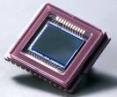
Charge-coupled devices (CCDs)
The human eye is not very sensitive to light compared with photographic film.
In recent years CCDs have greatly improved on the sensitivity of photographic film.
Virtually all modern telescopic images are obtained using CCDs.

Slide 49
The structure and operation of a CCD
A CCD is a silicon chip divided into picture elements (pixels).
Incident photons cause electrons to be released.
The number of electrons liberated is proportional to the intensity of the light.
These electrons are trapped in potential wells in the CCD.
An electron pattern is built up which is identical to the image formed on the CCD.
When exposure is complete, the charge is processed to give an image.

Slide 50
Quantum efficiency
The quantum efficiency of a pixel is the percentage of incident photons that liberate an electron.
With a CCD this is usually at least 70% and can be as high as 90% at certain light wavelengths.
Photographic film is typically 4%
Hence a CCD is about 20x more sensitive to light than photographic film.

Slide 51
Advantages of using CCDs
They have a much higher quantum efficiency than photographic film and are therefore far more sensitive to light.
They can be used to record changes of an image.
They are sensitive to a wider range of wavelengths than the human eye. Typically this is 100 nm (UV) to 1100 nm (IR) compared with the human eye’s 350 nm to 650 nm.
They have a fairly constant quantum efficiency across the visible light range of wavelengths unlike the eye and photographic film.

Slide 52
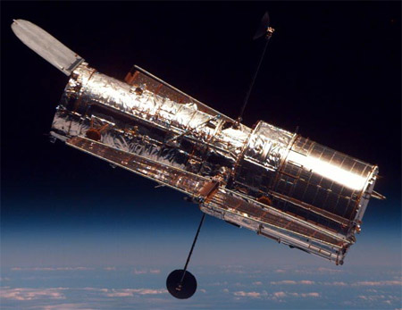
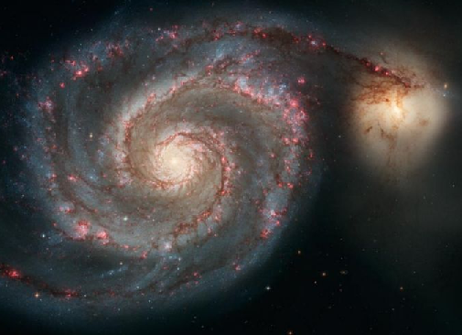
Non Optical Telescopes
Many of the most spectacular modern images are in fact composites images taken of a number of regions of the electromagnetic spectrum.
The picture below of the Whirlpool Galaxy is such an example taken by the Hubble Space Telescope. It is of the galaxy taken with ultra-violet and infra-red as well as with visible light.
The Hubble Space Telescope

Slide 53
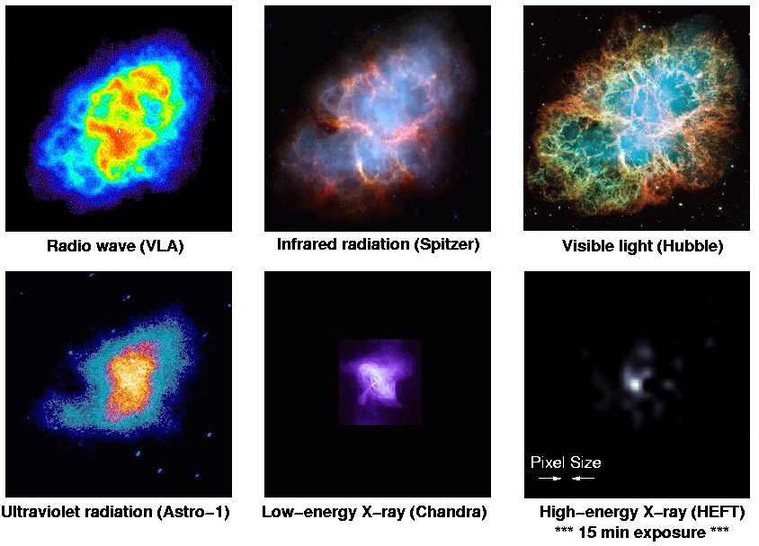
The Crab Nebula (M1) at different wavelengths

Slide 54
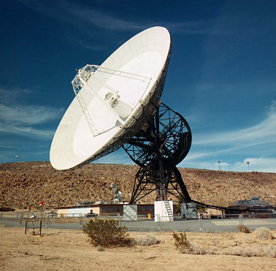
1. Single dish radio telescopes
These consist of a large parabolic dish with an aerial at the focal point of the dish.
The atmosphere transmits radio waves in the wavelength range from about 1mm to about 10m.
They are used to study strong radio sources such as the Sun, Jupiter, the Milky Way and many other galaxies.
The structure of the Milky Way can be studied using radio waves as these waves are able to travel through gas clouds where visible light cannot. Our knowledge of what is at the centre of our galaxy has been obtained primarily by using radio telescopes.

Slide 55
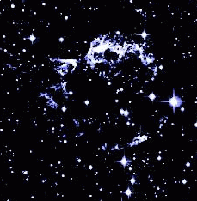
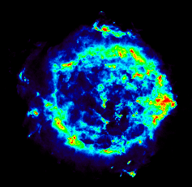
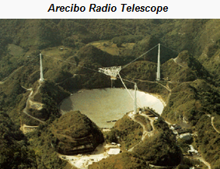
Comparison of radio and optical telescopes
Both radio and optical telescopes can be ground based.
The resolving power of a radio telescope is much lower than that of a comparably sized optical telescope. In order to achieve a reasonable resolution radio telescopes have to use large collecting dishes.
The largest radio telescope in the world is the non-steerable Arecibo telescope in Puerto Rico which has a diameter of 305 m.
Supernova remnant picture taken with light by the Hubble Space Telescope
Same supernova remnant taken with a radio telescope

Slide 56
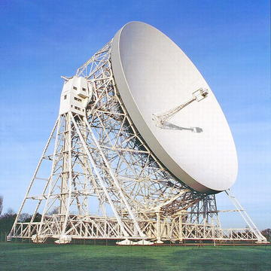
Radio telescope resolution question
Calculate the resolving power of the Jodrell Bank telescope when it is used to receive the 21cm wavelength radio waves given off by interstellar hydrogen gas. The steerable dish has a diameter of 76m.
Rayleigh criterion: θ ≈ λ / D
≈ 21cm / 76m
≈ 0.21m / 76m
≈ 0.0028 rad (≈ 0.2°)
This is about 100x worse than the human eye.

Slide 57
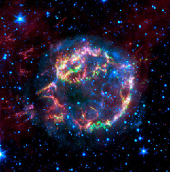
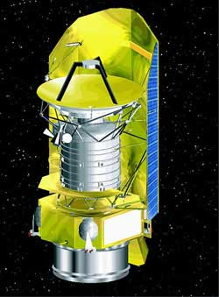
2. Infra-red telescopes
Infrared telescopes consist of a large concave reflector which focuses infrared radiation onto a detector at the focal point of the reflector.
Planets and dust clouds in space, while not hot enough to emit light, do emit infrared radiation.
The recently launched (2009) Herschel Space Telescope will amongst other tasks be trying to detect the formation of young stars within gas nebulae.
Same supernova remnant taken with the Spitzer IR telescope
Supernova remnant picture taken with light by the Hubble Space Telescope
Herschel Space Telescope

Slide 58
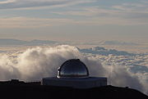
Like optical telescopes IR telescopes can be ground based. The principal limitation on infrared sensitivity is the water vapour in the Earth's atmosphere, which absorbs a significant amount of infrared radiation. For this reason most infrared telescopes are built in very dry places at high altitude (above most of the water vapour in the atmosphere). Suitable locations on Earth include Mauna Kea Observatory at 4205 meters above sea level and regions of high altitude ice-desert such as in Antarctica.
IR telescope on Mauna Kea
Infrared telescopes need to have their detectors shielded from heat and chilled with liquid nitrogen in order to actually form images. This limits the lifetime of space based IR telescopes, for example the Spitzer Space Telescope, launched on 2003 ran out of helium coolant in 2009.
The resolving power of a IR telescope is lower than that of a comparably sized optical telescope due to the longer wavelength of IR.

Slide 59
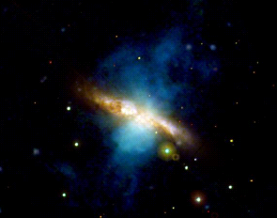
3. Ultra-violet telescopes
Ultraviolet telescopes must be carried by satellites because UV radiation is absorbed by the Earth’s atmosphere.
As glass absorbs UV, mirrors are used to focus UV radiation onto a UV detector.
UV radiation is emitted by very hot objects such as stars, supernovae, quasars and some gas clouds.
The resolving power of a UV telescope is higher than that of a comparably sized optical telescope due to the shorter wavelength of UV.
Combined optical and UV image of the galaxy M82 (UV in blue)

Slide 60
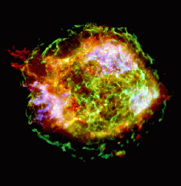
4. X-ray telescopes
X-ray telescopes must be carried by satellites because X-rays are absorbed by the Earth’s atmosphere.
X-ray telescopes work by reflecting X-rays of highly-polished metal plates at ‘grazing’ incidence onto a suitable detector.
X-rays are emitted by pulsars and the gas around suspected black holes.
With X-rays diffraction is insignificant. Image resolution is determined by the pixel separation in the detector.
Same supernova remnant taken with the Chandra X-Ray telescope
Supernova remnant picture taken with light by the Hubble Space Telescope

Slide 61
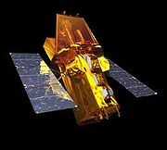
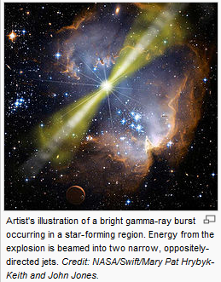
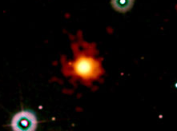
5. Gamma-ray telescopes
Gamma-ray telescopes must be carried by satellites because gamma-rays are absorbed by the Earth’s atmosphere.
Gamma-ray telescopes work by detecting gamma photons as they pass through a detector containing layers of ‘pixels’, triggering a signal in each pixel it passes through. The direction of each incident gamma photon can be determined from the signals.
Some of the most distant objects observed give off bursts of gamma rays, known as GRBs.
With Gamma-rays diffraction is insignificant. Image resolution is determined by the pixel separation in the detector.
NASA's Swift Spacecraft launched in 2004
Most distant object observed as of April 23rd 2009. The source of a GRB.

Slide 62
Internet Links
Tiger image formation by a plane or curved mirror - NTNU
Mirage of pig formed by a concave mirror - includes UTube clip - NTNU
Geometric Optics with Lenses - PhET - How does a lens form an image? See how light rays are refracted by a lens. Watch how the image changes when you adjust the focal length of the lens, move the object, move the lens, or move the screen.
Prism/Lens - no dispersive refraction and reflections - NTNU
Lens images / ray diagrams - NTNU
How an image is formed by a convex lens / effect of stopping down lens - NTNU
Lens / mirror effect on a beam of light - NTNU
Curved mirror images / ray diagrams - NTNU
Resolution from two circular apertures - NTNU

Slide 63
Core Notes from the Student Guide pages 1 to 27
Draw a diagram and explain what is meant by for a converging lens (a) principal focus & (b) focal length.
Draw diagrams and show how a converging lens forms images for object distances: (a) more than 2F; (b) between F and 2F & (c) less than F. Also in each case describe the image formed.
State the lens formula on page 5 and explain the significance of the signs of each term.
Draw a diagram showing the construction of a refracting telescope. Explain what is meant by ‘normal adjustment’.
Copy the ray diagram on page 8.
Define the angular magnification of a telescope in normal adjustment in terms of angles and focal lengths.
Explain why a telescope with an objective of diameter 200 mm collects more than twice the light of one with a diameter of 100 mm.
Draw a diagram and explain what is meant by for a concave mirror (a) principal focus & (b) focal length.
Draw a ray diagram of a Cassegrain reflecting telescope.
Explain what is meant by ‘spherical aberration’ and how this can be reduced in a reflecting telescope.
Compare reflecting and refracting telescopes.
Draw a diagram showing the diffraction pattern caused by a circular aperture. How is the size of this pattern affected by the size of the aperture and the wavelength of the light used?
What is meant by the resolving power of a telecope?
What is the ‘Rayleigh criterion’ and how is this related to the resolving power of a telecope?
Why are the best telescopes big?
What is a CCD? How is it used to obtain an image?
What are the advantages of using a CCD with a telescope?
What is meant by ‘quantum efficiency’?
Compare radio and optical telescopes in terms of structure, use and resolving power.
State the uses of infra-red, ultra-violet and X-ray telescopes. In each case also compare them with optical telescopes in terms of their positioning and resolving powers.
Complete the table on page 27.

Slide 64
Notes from the Student Guide pages 1 to 6
1.1 Lenses
Draw a diagram and explain what is meant by for a converging lens (a) principal focus & (b) focal length.
Draw diagrams and show how a converging lens forms images for object distances: (a) more than 2F; (b) between F and 2F & (c) less than F. Also in each case describe the image formed.
State the lens formula on page 5 and explain the significance of the signs of each term.
Repeat the worked example on page 5 but this time with object distances of (a) 400 mm & (b) 100 mm.
Try the summary questions on pages 5 & 6

Slide 65
Notes from the Student Guide pages 7 to 13
1.2 The Refracting Telescope
Draw a diagram showing the construction of a refracting telescope. Explain what is meant by ‘normal adjustment’.
Copy the ray diagram on page 8.
Define the angular magnification of a telescope in normal adjustment in terms of angles and focal lengths.
Explain why a telescope with an objective of diameter 200 mm collects more than twice the light of one with a diameter of 100 mm.
Repeat the worked examples on page 11 but this time with a telescope with an objective of 1.200m and eyepiece of 0.060m focal lengths.
Try the summary questions on page 13

Slide 66
Notes from the Student Guide pages 14 to 17
1.3 Reflecting Telescopes
Draw a diagram and explain what is meant by for a concave mirror (a) principal focus & (b) focal length.
Draw a ray diagram of a Cassegrain reflecting telescope.
Explain what is meant by ‘spherical aberration’ and how this can be reduced in a reflecting telescope.
Compare reflecting and refracting telescopes.
Try the summary questions on pages 16 & 17

Slide 67
Notes from the Student Guide pages 18 to 21
1.4 Resolving Power
Draw a diagram showing the diffraction pattern caused by a circular aperture. How is the size of this pattern affected by the size of the aperture and the wavelength of the light used?
What is meant by the resolving power of a telecope?
What is the ‘Rayleigh criterion’ and how is this related to the resolving power of a telecope?
Why are the best telescopes big?
Try the summary questions on page 21

Slide 68
Notes from the Student Guide pages 22 to 27
1.5 Telescopes & Technology
What is a CCD? How is it used to obtain an image?
What are the advantages of using a CCD with a telescope?
What is meant by ‘quantum efficiency’?
Compare radio and optical telescopes in terms of structure, use and resolving power.
State the uses of infra-red, ultra-violet and X-ray telescopes. In each case also compare them with optical telescopes in terms of their positioning and resolving powers.
Complete the table on page 27.
Try the other summary questions on page 27

