Slide 1
0 General
General Items
Breithaupt pages 219 to 239
September 1st, 2010

Slide 2
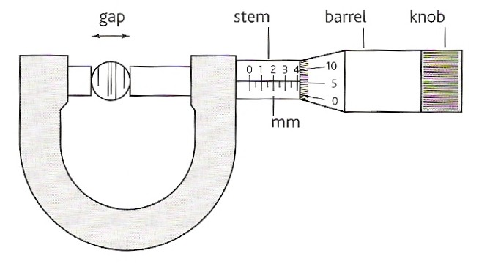
Analogue Micrometer
The micrometer is reading 4.06 ± 0.01 mm

Slide 3
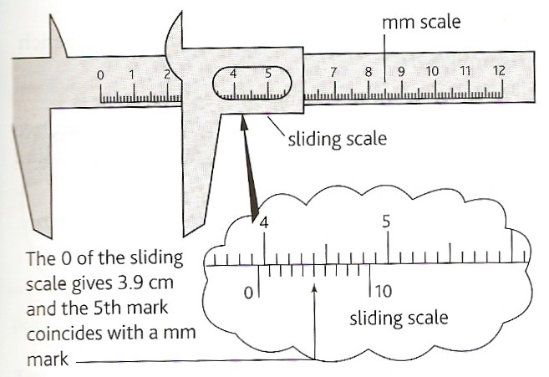
Analogue Vernier Callipers
The callipers reading is 3.95 ± 0.01 cm
NTNU Vernier Applet

Slide 4
SI Base Units
Physical Quantity |  | Unit
Name | Symbol | Name | Symbol
mass | m | kilogram | kg
length | x | metre | m
time | t | second | s
electric current | I | ampere | A
temperature interval | ΔT | kelvin | K
amount of substance | n | mole | mol
luminous intensity | I | candela | cd
‘SI’ comes from the French ‘Le Système International d'Unités’
Symbol cases are significant (e.g. t = time; T = temperature)

Slide 5
Derived units (examples)
Consist of one or more base units multiplied or divided together
quantity | symbol (s) | unit
area | A | m²
volume | V | m³
density | D or ρ | kg m⁻³
velocity | u or v | m s⁻¹
momentum | p | kg m s⁻¹
acceleration | a | m s⁻²
force | F | kg m s⁻²
work | W | kg m² s⁻²

Slide 6
Special derived units (examples)
All named after scientists and/or philosophers to simplify notation
physical quantity |  | unit
name | symbol (s) | name | symbol | base SI form
force | F | newton | N | kg m s⁻²
work & energy | W & E | joule | J | kg m² s⁻²
power | P | watt | W | kg m² s⁻³
pressure | p | pascal | Pa | kg m⁻¹ s⁻²
electric charge | q or Q | coulomb | C | A s
p.d. (voltage) | V | volt | V | kg m² A⁻¹ s⁻³
resistance | R | ohm | Ω | kg m² A⁻² s⁻³
frequency | f | hertz | Hz | s⁻¹
Note – Special derived unit symbols all begin with an upper case letter

Slide 7
Some Greek characters used in physics
character | name | use | character | name | use
α | alpha | radioactivity | μ | mu | micro & muons
β | beta | radioactivity | ν | nu | neutrinos
γ | gamma | radioactivity | π | pi | 3.142… & pi mesons
δ Δ | delta | very small & finite changes | ρ | rho | density & resistivity
ε | epsilon | emf of cells | σ Σ | sigma | summation
Κ | kappa | K mesons | τ | tau | tau lepton
θ | theta | angles | φ | phi | work function
λ Λ | lambda | wavelength & lambda particle | ω Ω | omega | angular speed & resistance

Slide 8
Multiples and prefixes
multiple | prefix | symbol | example
x 1000
x 1000 000
x 10⁹
x 10¹²
x 10¹⁵
x 10¹⁸
kilo
k
km
mega
M
MΩ
giga
G
GW
tera
T
THz
peta
P
Ps
exa
E
Em
also, but rarely used: deca = x 10, hecto = x 100

Slide 9
Smaller multiples
multiple | prefix | symbol | example
÷ 10
÷ 100
÷ 1000
÷ 1000 000
x 10⁻⁹
x 10⁻¹²
x 10⁻¹⁵
x 10⁻¹⁸
deci
d
dB
centi
c
cm
milli
m
mA
micro
μ
μV
nano
n
nC
pico
p
pF
femto
f
fm
atto
a
as
Powers of 10 presentation

Slide 10
Complete:
There are 5000 mA in 5A
There are 8000 pV in 8 nanovolts
There are 500 μm in 0.05 cm
There are 6 000 000 g in 6 000 kg
There are 4 fm in 4 000 am
There are 5.0 x 10⁷ kHz in 50 GHz
There are 3.6 x 10⁶ ms in 1 hour
There are 0.030 MΩ in 30 k Ω
There are 4.0 x 10²⁸ pC in 40 PC
There are 60 pA in 0.060 nA

Slide 11
Mathematical signs
sign | meaning | sign | meaning
> | greater than | √ | square root
< | less than | < x > | mean value
» | much greater than | < x² > | mean square value
« | much less than | √<x²> | root mean square value
≥ | greater than or equal to | α | proportional to
≤ | less than or equal to | ∆ | finite change
≈ | approximately equal to | ∂ | extremely small change
≠ | not equal to | ∑ | sum of
≡ | equivalent to | ∞ | infinity

Slide 12
Internet Links
Unit Conversion - meant for KS3 - Fendt
Hidden Pairs Game on Units - by KT - Microsoft WORD
Fifty-Fifty Game on Converting Milli, Kilo & Mega - by KT - Microsoft WORD
Hidden Pairs Game on Milli, Kilo & Mega - by KT - Microsoft WORD
Hidden Pairs Game on Prefixes - by KT - Microsoft WORD
Sequential Puzzle on Energy Size - by KT - Microsoft WORD
Sequential Puzzle on Milli, Kilo & Mega order - by KT - Microsoft WORD
Powers of 10 - Goes from 10E-16 to 10E+23 - Science Optics & You
A Sense of Scale - falstad
Use of vernier callipers - NTNU

Slide 13
Notes from Breithaupt pages 232 & 236
Copy table 1 on page 232
What is the difference between a base unit and a derived unit? Give five examples of derived units.
Convert (a) 52 kg into g; (b) 4 m² into cm²; (c) 6 m³ into mm³ ; (d) 3 kg m⁻³ into g cm⁻³
How many (a) mg in 1 Mg; (b) Gm in 1 TM; (c) μs in 1 ks; (d) fV in 1 nV; am in 1 pm?
Copy and learn table 2 on page 236
Try the summary questions on pages 233 & 237

