Slide 1
1.1a Particles & Radiation
Matter & Radiation
Breithaupt pages 4 to 15
December 14th, 2011

Slide 2
AQA AS Specification
Lessons | Topics
1 | Constituents of the atom Proton, neutron, electron. Their charge and mass in SI units and relative units. Specific charge of nuclei and of ions. Atomic mass unit is not required. Proton number Z, nucleon number A, nuclide notation, isotopes.
2 to 4 | Stable and unstable nuclei The strong nuclear force; its role in keeping the nucleus stable; short-range attraction to about 3 fm, very-short range repulsion below about 0.5 fm; Equations for alpha decay and β - decay including the neutrino.
5 to 8 | Particles, antiparticles and photons Candidates should know that for every type of particle, there is a corresponding antiparticle. They should know that the positron, the antiproton, the antineutron and the antineutrino are the antiparticles of the electron, the proton, the neutron and the neutrino respectively. Comparison of particle and antiparticle masses, charge and rest energy in MeV. Photon model of electromagnetic radiation, the Planck constant, E = hf = hc / λ Knowledge of annihilation and pair production processes and the respective energies involved. The use of E = mc² is not required in calculations.
9 to 11 | Particle interactions Concept of exchange particles to explain forces between elementary particles. The electromagnetic force; virtual photons as the exchange particle. The weak interaction limited β - , β + decay, electron capture and electron-proton collisions; W+ and W- as the exchange particles. Simple Feynman diagrams to represent the above reactions or interactions in terms of particles going in and out and exchange particles.

Slide 3
Structure of an atom
An atom consists of a central positively charged nucleus containing protons and neutrons (nucleons)
Diameter approx. 10⁻¹⁵ m (1 femtometre)
Electrons surround the nucleus
Atomic diameter approx. 10⁻¹⁰ m roughly 100 000 x nucleus diameter
atomic diameter ~ 10 ^{– 10} m
nucleus diameter ~ 10 ^{– 15} m

Slide 4
Properties of sub-atomic particles
 | charge |  | mass
 | in coulombs | relative to a proton | in kilograms | relative to a proton
proton
neutron
electron
+ 1.6 x 10 ⁻¹⁹
+ 1
1.67 x 10 ⁻²⁷
1
0
0
1.67 x 10 ⁻²⁷
1
- 1.6 x 10 ⁻¹⁹
- 1
9.11 x 10 ⁻³¹
0.0005
Note: u = unified mass unit = 1.67 x 10 ⁻ ²⁷ kg
and e = charge of an electron = - 1.6 x 10 ⁻ ¹⁹ C

Slide 5
Proton number (Z)
This is equal to the number of protons in the nucleus of an atom
Also known as atomic number
Atoms of the same atomic number are of the same element

Slide 6
Nucleon number (A)
This is equal to the number of nucleons (protons plus neutrons) in the nucleus of an atom
Also known as mass number

Slide 7
Isotopes
These are atoms that the same number of protons but different numbers of neutrons
Isotopes have the same proton number and so are all of the same element
Atomic structure quiz

Slide 8
Isotope notation
nucleon or mass number
14
C
carbon 14
C-14
6
proton or atomic number
chemical symbol

Slide 9
Answers:
Complete:
symbol | A | Z | number of protons | number of neutrons
 | 14 | 7 | 7 | 7
 | 20 | 9 | 9 | 11
 | 238 | 92 | 92 | 146
 | 11 | 6 | 6 | 5
 | 235 | 92 | 92 | 143
14
N
7
7
7
20
9
20
9
9
11
F
238
92
238
U
238
92
92
11
6
11
6
6
C
6
235
92
92
U
92

Slide 10
Specific charge
specific charge = charge of particle
mass of particle
unit: coulombs per kilogram (C kg⁻¹)

Slide 11
Question
Calculate the specific charge of a nucleus
of helium 4
helium 4 contains 2 protons and 2 neutrons
charge = 2 x (+ 1.6 x 10⁻¹⁹ C)
= + 3.2 x 10⁻¹⁹ C
mass = 4 x 1.67 x 10⁻²⁷ kg
= 6.68 x 10⁻²⁷ kg
specific charge = 4.79 x 10⁷ Ckg⁻¹

Slide 12
The strong nuclear force
This is one of the four fundamental forces of nature (along with gravitational, electromagnetic and the weak nuclear force)
Provides attractive force between nucleons with a range of about 3 femtometres (3 x 10⁻¹⁵ m)
Overcomes the repulsive electrostatic force exerted by positively charged protons on each other
At distances less than about 0.5 fm the strong nuclear force is repulsive and prevents the nucleus collapsing into a point.

Slide 13
Variation with distance
force
electrostatic force
attract repel
distance from centre / femtometres
1
3
strong force

Slide 14
Alpha radiation (α)
Usually occurs with very large nuclei e.g. uranium 238
An alpha particle consists of 2 protons plus 2 neutrons
After decay:
  Proton number (Z) decreases by 2
  Nucleon number (A) decreases by 4
General equation for decay:
Example:
A
X
→
A - 4
Y
4
+
α
Z
Z - 2
2
238
234
4
U
→
Th
+
α
92
90
2

Slide 15
Beta radiation (β -)
Occurs with nuclei that have too many neutrons e.g. carbon 14
Beta particle consists of a fast moving electron
In the nucleus a neutron decays into a proton and an electron.
The electron is emitted as the beta particle
An antineutrino is also emitted
After decay:
  Proton number (Z) increases by 1
  Nucleon number (A) does not change
General equation for decay:
Example:
A
X
→
A
Y
0
+
β ⁻
Z
Z + 1
- 1
14
14
0
C
→
N
+
β ⁻
6
7
- 1

Slide 16
Gamma radiation (γ)
This is electromagnetic radiation emitted from an unstable nucleus.
Gamma radiation often occurs straight after alpha or beta decay. The child nuclide formed often has excess energy which is released by gamma emission.
No change occurs to either the proton or nucleon numbers as a result of gamma decay.
Internet link demonstrating radiation absorption and decay equations

Slide 17
Neutrinos (ν)
These are emitted with beta decay.
Beta decay from a particular nuclide produces a constant amount of energy.
However, the emitted beta particles emerge with a range of kinetic energies. Therefore some other particle, a neutrino, must be emitted with the remaining kinetic energy.
Beta-minus decay (β -) results in the emission of an antineutrino. Beta-plus decay (β +) produces a neutrino.
Neutrinos are very difficult to detect as the have nearly zero mass and no charge. They barely interact with matter. Billions of these particles, that have been emitted from the Sun, sweep through our bodies every second night and day (the Earth has hardly any effect on them).

Slide 18
Answers:
Complete:
20
9
20
10
0
- 1
0
0
1.
F →
Ne +
β +
ν
2.
236
92
232
90
4
2
U →
Th +
α
242
92
242
93
0
- 1
0
0
+
ν
3.
U
→
Np +
β
13
7
9
4
2
4.
N →
5
B +
α

Slide 19
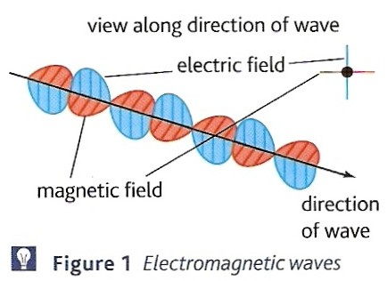
Electromagnetic radiation
This is radiation emitted by charged particles losing energy. Examples include:
  electrons decreasing in energy inside an atom (Light)
  electrons losing kinetic energy when stopped by a solid material (X-rays)
  accelerating electrons in an aerial
The radiation consists of two linked electric and magnetic field waves which are:
  at right-angles to each other
  are in phase (peak together)
Electromagnetic wave by Fendt

Slide 20
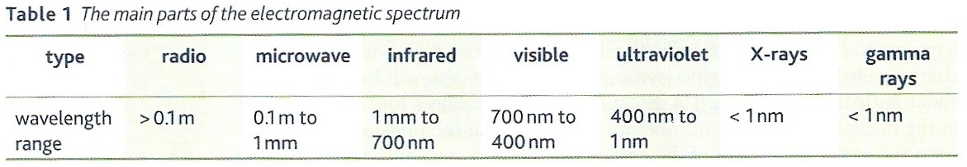
The electromagnetic spectrum
All forms of this radiation travel at the same speed through a vacuum, known as ‘c’ and equal to 3.0 x 10⁸ ms⁻¹ (186 000 miles per second).
Note: 1nm (nanometre) = 1.0 x 10⁻⁹ m
Question: What is the wavelength of red light in cm?
= 7.0 x 10⁻⁵ cm

Slide 21
The wave equation
wave speed = frequency x wavelength
c = f x λ
also: λ = c / f and f = c / λ
Units:
speed (c ) in metres per second (ms⁻¹)
frequency (f ) in hertz (Hz)
wavelength (λ ) in metres (m)

Slide 22
Question
Calculate the frequency of violet light if the wavelength of violet light is 400 nm.
f = c / λ
= 3.0 x 10⁸ ms⁻¹ / 400 nm
= 3.0 x 10⁸ ms⁻¹ / 4.0 x 10⁻⁷ m
= 7.5 x 10¹⁴ Hz

Slide 23
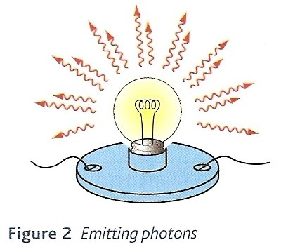
Photons
Electromagnetic radiation is emitted as short ‘burst’ of waves, each burst leaving the source in a different direction.
Each packet of waves is called a photon.
Each photon contains a set amount of energy is proportional to the frequency of the electromagnetic radiation.

Slide 24
Photon energy
photon energy, E = h x f
where h = the Planck constant
= 6.63 x 10⁻³⁴ Js
also as f = c / λ;
E = hc / λ

Slide 25
Question
Calculate the energy of a photon of violet light (wavelength, λ = 4.0 x 10⁻⁷ m)
E = hc / λ
= (6.63 x 10⁻³⁴ Js) x (3.0 x 10⁸ ms⁻¹) / (4.0 x 10⁻⁷ m)
photon energy = 4.97 x 10⁻¹⁹ J

Slide 26
Answers:
Complete:
Medium | Speed / x 10⁸ ms⁻¹ | Frequency / x 10¹⁴ Hz | Wavelength / nm | Energy / x 10⁻¹⁹ J
vacuum | 3.0 |  | 600
vacuum |  | 4.0
vacuum |  |  |  | 200
glass | 2.0 | 8.0
water |  | 4.6 | 500
5.0
3.32
3.0
750
2.65
3.0
302
10
250
5.3
2.3
3.05

Slide 27
Antimatter
All particles of normal matter, such as protons, neutrons and electrons have a corresponding particle that:
  has the same mass as the normal particle
  has opposite charge (if the normal particle is charged)
  will undergo annihilation with the normal particle if they meet
LHC Rap

Slide 28
Examples of antimatter
  ANTIPROTON
  An antiproton is negatively charged proton.
  POSITRON
  This is a positively charged electron. The expression ‘anti-electron’ is not used.
  ANTINEUTRINO
  The antineutrino produced in beta-minus decay.
LHC Rap

Slide 29
Further notes on antimatter
Other particle properties are also reversed in antimatter allowing the existence of uncharged antiparticles such as the antineutron.
Two particles that have the same mass and opposite charges are not necessarily a particle and an antiparticle pair.
Most examples of antimatter have a symbol that adds a bar above the normal matter symbol e.g.
Certain man-made isotopes are made in order to provide a source of antimatter. e.g. positrons are needed for PET scans (see page 10 of the text book).
p and p; n and n; v and v

Slide 30
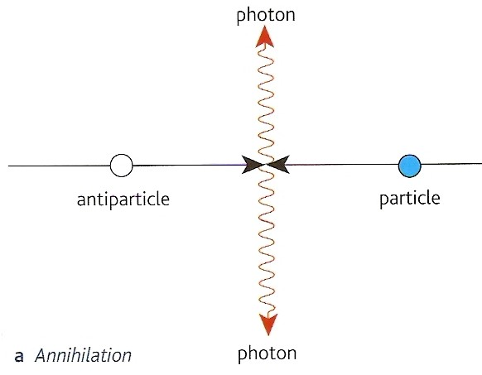
Annihilation
When a particle and its corresponding antiparticle meet together annihilation occurs.
All of their mass and kinetic energy is converted into two photons of equal frequency that move off in opposite directions.

Slide 31
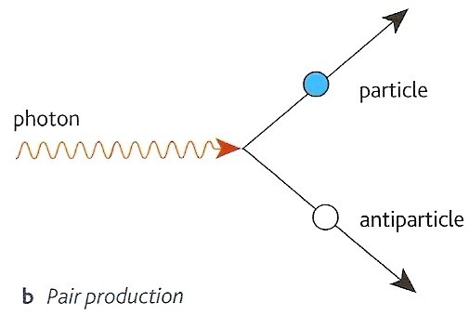
Pair production
The opposite of annihilation.
The energy of one photon can be used to create a particle and its corresponding antiparticle.
The photon ceases to exist afterwards

Slide 32
The electron-volt (eV) and MeV
The electon-volt (eV) is a very small unit of energy equal to 1.6 x 10⁻¹⁹ J
The electron-volt is equal to the kinetic energy gained by an electron when it is accelerated by a potential difference of one volt.
Also: 1 MeV (mega-electron-volt) = 1.6 x 10⁻¹³ J

Slide 33
Question
Calculate the energy in electron-volts of a photon of orange light of frequency 4.5 x 10¹⁴ Hz.
E = h x f
= (6.63 x 10⁻³⁴ Js) x (4.5 x 10¹⁴ Hz)
= 2.98 x 10⁻¹⁹ J
energy in eV = energy in joules / 1.6 x 10⁻¹⁹
= 1.86 eV

Slide 34
Particle rest energy
Using Einstein’s relation E = mc² the energy equivalent of mass can be calculated. The masses of sub-atomic particles are commonly quoted in energy terms using the unit MeV.
Example: the mass of a proton is 1.67 x 10⁻²⁷ kg
E = mc² = (1.67 x 10⁻²⁷ kg) x (3.0 x 10⁸ ms⁻¹)²
= 1.50 x 10⁻¹⁰ J
This is normally expressed in terms of MeV
where 1 MeV = 1.6 x 10⁻¹³ J
And so the mass-energy of a proton in MeV
= (1.50 x 10⁻¹⁰ J) / (1.6 x 10⁻¹³ J)
= 938 MeV

Slide 35
938 MeV will be the energy of a stationary proton having no kinetic energy and as such is referred to as the rest energy of a proton
Other (and more precise) rest energies in MeV
(from page 245):
  proton = 938.257; neutron = 939.551;
  electron = 0.510999; photon = 0
Mass is sometimes quoted using the unit GeV/c²
(1000 MeV/c² = 1 GeV/c² )
  for example: proton rest mass = 0.938 GeV/c²

Slide 36
Annihilation calculation
Calculate the minimum energies of the photons produced by the annihilation of a proton and antiproton.
The minimum energies occur when the pair of particles have initially insignificant kinetic energy.
rest energy of a proton in MeV = 938MeV
rest energy of an antiproton also = 938MeV
total mass converted into electromagnetic radiation in the form of two photons = 1876 MeV
therefore each photon has an energy of 938 MeV

Slide 37
Further question
What would be the wavelength of these photons?
938MeV = 1.50 x 10⁻¹⁰ J;
E = hc / λ becomes λ = hc / E;
and so λ = ((6.63 x 10⁻³⁴ Js) x (3.0 x 10⁸ ms⁻¹)) / (1.50 x 10⁻¹⁰ J)
= 1.33 x 10⁻¹⁵ m
(gamma radiation)

Slide 38
Pair production calculation
Calculate the minimum photon energy required to produce an electron-positron pair.
The minimum energy will produce two stationary particles (which would then annihilate each other again!)
rest energy of an electron in MeV = 0.511 MeV
rest energy of a positron also = 0.511MeV
therefore minimum energy required = 2 x 0.511
= 1.022 MeV

Slide 39
Further question
What would be the frequency of this photon?
1.022 MeV = 1.64 x 10⁻¹³ J
E = hf
becomes: f = E / h
and so f = (1.64 x 10⁻¹³ J) / (6.63 x 10⁻³⁴ Js)
= 2.47 x 10²⁰ Hz
(gamma radiation)

Slide 40
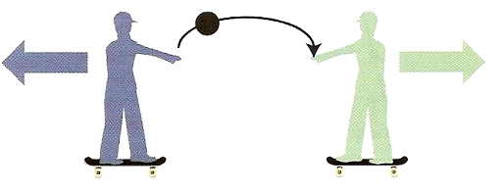
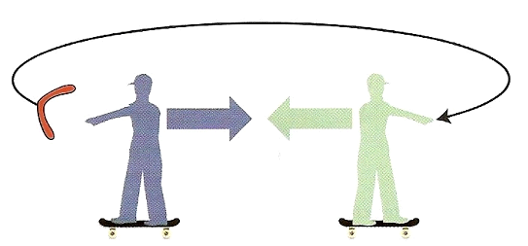
Exchange particles
REPULSION
ATTRACTION

Slide 41
Electromagnetic force
The repulsive force felt by two like charges such as two protons is due to electrostatic force.
The two protons exchange a virtual photon.
This photon is called ‘virtual’ because it cannot be detected – if it was – it would be intercepted and repulsion would no longer occur.
Attraction of unlike charges also involves the exchange of a virtual photon.
This explanation of how electromagnetic force operates was first worked out in detail by the American physicist Richard Feynman.

Slide 42
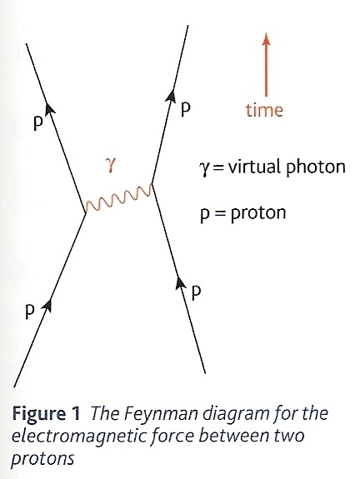
Feynman diagrams
These are used to illustrate the interactions between sub-atomic particles.
Opposite is the diagram showing the repulsion between protons.
Note:
  The lines do not represent the paths of the particles.
  The virtual photon exchanged is represented by a wave
The strong nuclear force between nucleons can be represented in a similar way. In this case the exchange particle is called a gluon.

Slide 43
The weak nuclear force
The weak nuclear force is responsible for beta-minus decay where a neutron inside a nucleus decays into a proton.
It is called ‘weak’ because it is only significant in unstable nuclei. Stable nuclei are kept from decaying by the ‘stronger’ strong nuclear force.
The exchange particles involved with beta decay are called W bosons.
Why would electrostatic force tend to prevent beta decay?

Slide 44
Comparing W bosons and photons
 | W bosons | photons
mass | non-zero (rest energy = 80 MeV) | zero
range | maximum of 0.001 femtometre (much smaller than a nucleus) | infinite
charge | W+ (positive) W- (negative) | zero
There also exists another weak force boson called Z, which is uncharged.

Slide 45
The four fundamental interactions
(the electromagnetic and weak are sometimes combined as the electroweak interaction)
 | range | relative strength | exchange particle | time for exchange
electromagnetic | infinite | 1 | photon | 10 ⁻¹⁸ s
gravity | infinite | 10 ⁻³⁶ | graviton (undiscovered) | ?
strong | 1 am (1 x 10⁻¹⁸ m) | 100 | gluon | 10 ⁻²³ s
weak | 10 fm (1 x 10⁻¹⁴ m) | 10 ⁻³ | W+, W- & Z bosons | 10 ⁻¹⁰ s or longer

Slide 46
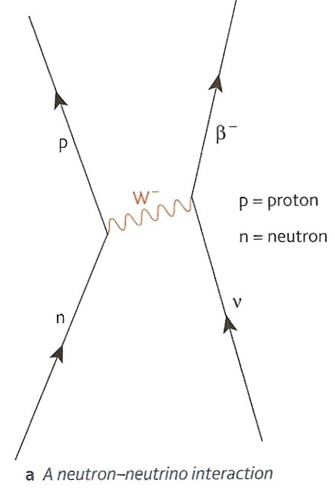
The interaction of a neutron and a neutrino
Neutrinos are affected by the nuclear weak force (they do not feel the strong or electrostatic forces)
The Feynman diagram opposite shows what happens when a neutron interacts with a neutrino.
A W minus boson (W⁻) is exchanged resulting in the production of a proton and a beta-minus particle
Notice that charge is conserved during the interaction (W⁻ is negative)

Slide 47
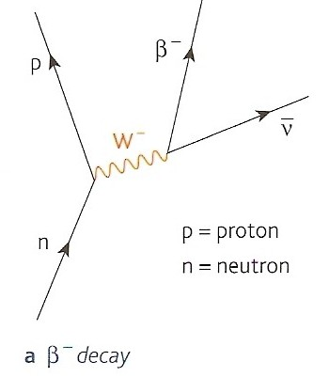
Beta-minus decay
In this case a neutron decays into a proton and a W- boson.
While still within the nucleus (due to its very short range) the W- boson decays to a beta-minus particle and an antineutrino.
The outgoing antineutrino is equivalent to an incoming neutrino shown in the neutron-neutrino interaction.

Slide 48
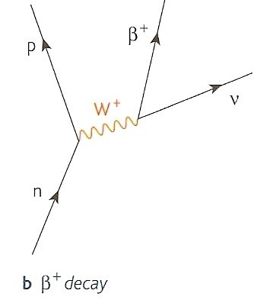
Beta-plus (positron) decay
In this case a proton decays into a neutron and a W+ boson.
While still within the nucleus (due to its very short range) the W+ boson decays to a beta-plus (positron) particle and a neutrino.
Note: The antineutrino is distinguished from a neutrino symbolically by placing a bar above the normal particle symbol.
n
p
Corrected from some versions of the text book

Slide 49
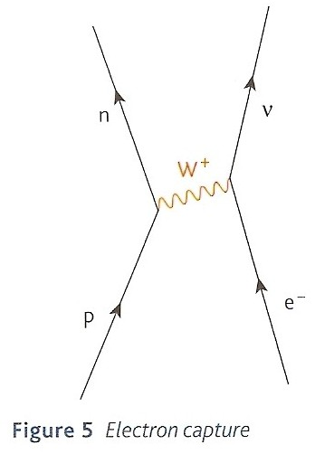
Electron capture
This can occur with a proton rich nucleus
One of the excess protons interacts with one of the inner shell electrons to form a neutron and producing a neutrino

Slide 50
Internet Links
Atoms, ions & isotopes (GCSE) - Powerpoint presentation by KT
Build an atom - eChalk
Atomic Structure Quiz - by KT - Microsoft WORD
Hidden Pairs Game on Atomic Structure - by KT - Microsoft WORD
Decay series - Fendt
BBC Bitesize Revision:
Atoms & Isotopes
Alpha, beta & gamma radiation - what they are .

Slide 51
Core Notes from Breithaupt pages 4 to 15
Describe the structure of an atom of carbon 14, (proton number = 6), include a diagram and give approximate dimensions
Copy out table 1 on page 4
Define what is meant by proton number, nucleon number, isotopes and specific charge
Explain the various ways of notating atomic nuclei
What is the ‘strong nuclear force’? What part does it play in nuclear stability and what is its range?
Describe the processes of alpha, beta and gamma decay. State the effect they have on the parent nuclide.
What are neutrinos? Why are they required in beta decay?
What are photons?
State the equations relating photon energy to frequency and wavelength.
What is antimatter? How does antimatter compare in mass and charge with normal matter?
State what is meant by ‘annihilation’ and ‘pair-production’ in the context of antimatter.
What is: (a) an electron-volt; (b) MeV?; (c) Rest energy?
Explain how the rest energy of a proton can be stated as 938MeV
Explain why a photon must have a minimum energy of 1.022MeV in order to produce an electron-positron pair.
Explain how the concept of exchange particles can account for the forces between particles.
Show how a Feynman diagram can illustrate the repulsion between two protons.
Why is the force called ‘nuclear weak’ required to explain beta decay? What is the exchange particle?
Compare W bosons with photons.
Draw Feynman diagrams and explain what happens in (a) beta-minus decay; (b) positron decay & (c) electron capture.

Slide 52
1.1 Inside the atom
Notes from Breithaupt pages 4 & 5
Describe the structure of an atom of carbon 14, (proton number = 6), include a diagram and give approximate dimensions
Copy out table 1 on page 4
Define what is meant by proton number, nucleon number, isotopes and specific charge
Explain the various ways of notating atomic nuclei
Calculate the specific charge of a nucleus of carbon 14 (proton number = 6)
Try the summary questions on page 5

Slide 53
1.2 Stable and unstable nuclei
Notes from Breithaupt pages 6 & 7
What is the ‘strong nuclear force’? What part does it play in nuclear stability and what is its range?
Describe the processes of alpha, beta and gamma decay. State the effect they have on the parent nuclide.
What are neutrinos? Why are they required in beta decay?
Try the summary questions on page 7

Slide 54
1.3 Photons
Notes from Breithaupt pages 8 & 9
What are photons?
State the equations relating photon energy to frequency and wavelength.
What is electromagnetic radiation? How is it produced? Copy figure 1 on page 9
Copy out table 1
Calculate the energy of a photon of infra-red radiation of wavelength 1200 nm.
Try the summary questions on page 9

Slide 55
1.4 Particles and antiparticles
Notes from Breithaupt pages 10 to 12
What is antimatter? How does antimatter compare in mass and charge with normal matter?
State what is meant by ‘annihilation’ and ‘pair-production’ in the context of antimatter.
What is: (a) an electron-volt; (b) MeV?; (c) Rest energy?
Explain how the rest energy of a proton can be stated as 938MeV
Explain why a photon must have a minimum energy of 1.022MeV in order to produce an electron-positron pair.
How was the positron first discovered? How are positrons used in PET scans?
Try the summary questions on page 12

Slide 56
1.5 How particles interact
Notes from Breithaupt pages 13 to 15
Explain how the concept of exchange particles can account for the forces between particles.
Show how a Feynman diagram can illustrate the repulsion between two protons.
Why is the force called ‘nuclear weak’ required to explain beta decay? What is the exchange particle?
Compare W bosons with photons.
Draw Feynman diagrams and explain what happens in (a) beta-minus decay; (b) positron decay & (c) electron capture.
Try the summary questions on page 15

