Slide 1
1.2 Electromagnetic Radiation and Quantum Phenomena
Quantum Phenomena
Breithaupt pages 30 to 43
December 5th, 2011

Slide 2
AQA AS Specification
Lessons | Topics
1 & 2 | The photoelectric effect Work function φ, photoelectric equation hf = φ + E_{k}; the stopping potential experiment is not required.
3 & 4 | Collisions of electrons with atoms The electron volt. Ionisation and excitation; understanding of ionization and excitation in the fluorescent tube.
5 & 6 | Energy levels and photon emission Line spectra (e.g. of atomic hydrogen) as evidence of transitions between discrete energy levels in atoms. hf = E₁ - E₂
7 & 8 | Wave-particle duality Candidates should know that electron diffraction suggests the wave nature of particles and the photoelectric effect suggests the particle nature of electromagnetic waves; details of particular methods of particle diffraction are not expected. de Broglie wavelength λ = h / mv, where mv is the momentum.

Slide 3
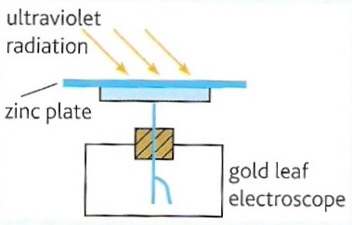
The photoelectric effect
The photoelectric effect is the emission of electrons from the surface of a material due to the exposure of the material to electromagnetic radiation.
For example zinc emits electrons when exposed to ultraviolet radiation.
If the zinc was initially negatively charged and placed on a gold leaf electroscope, the electroscope’s gold leaf would be initially deflected.
However, when exposed to the uv radiation the zinc loses electrons and therefore negative charge.
This causes the gold-leaf to fall.
Phet – Photoelectric effect
NTNU – Photoelectric effect

Slide 4
Experimental observations
Threshold frequency
The photoelectric effect only occurs if the frequency of the electromagnetic radiation is above a certain threshold value, f₀
Variation of threshold frequency
The threshold frequency varied with different materials.
Affect of radiation intensity
The greater the intensity the greater the number of electrons emitted, but only if the radiation was above the threshold frequency.
Time of emission
Electrons were emitted as soon as the material was exposed.
Maximum kinetic energy of photoelectrons
This depends only on the frequency of the electromagnetic radiation and the material exposed, not on its intensity.

Slide 5
Problems with the wave theory
Up to the time the photoelectric effect was first investigated it was believed that electromagnetic radiation behaved like normal waves.
The wave theory could not be used to explain the observations of the photoelectric effect – in particular wave theory predicted:
  that there would not be any threshold frequency – all frequencies of radiation should eventually cause electron emission
  that increasing intensity would increase the rate of emission at all frequencies – not just those above a certain minimum frequency
  that emission would not take place immediately upon exposure – the weaker radiations would take longer to produce electrons.

Slide 6
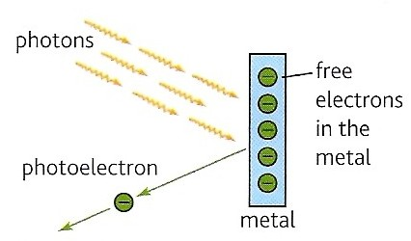
Einstein’s explanation
Electromagnetic radiation consisted of packets or quanta of energy called photons
The energy of these photons:
  depended on the frequency of the radiation only
  was proportional to this frequency
Photons interact one-to-one with electrons in the material
If the photon energy was above a certain minimum amount (depending on the material)
  the electron was emitted
  any excess energy was available for electron kinetic energy
Einstein won his only Nobel Prize in 1921 for this explanation. This explanation also began the field of Physics called Quantum Theory, an attempt to explain the behaviour of very small (sub-atomic) particles.

Slide 7
Photon energy (revision)
photon energy (E) = h x f
where h = the Planck constant = 6.63 x 10⁻³⁴ Js
also as f = c / λ;
E = hc / λ
Calculate the energy of a photon of ultraviolet light (f = 9.0 x 10¹⁴ Hz) (h = 6.63 x 10⁻³⁴ Js)
E = h f
= (6.63 x 10⁻³⁴ Js) x (9.0 x 10¹⁴ Hz) = 5.37 x 10⁻¹⁹ J

Slide 8
The photoelectric equation
hf = φ + E_{Kmax}
where:
  hf = energy of the photons of electromagnetic radiation
  φ = work function of the exposed material
  E_{Kmax} = maximum kinetic energy of the photoelectrons
Work function, φ
This is the minimum energy required for an electron to escape from the surface of a material

Slide 9
Threshold frequency f₀
As: hf = φ + E_{Kmax}
If the incoming photons are of the threshold frequency f₀, the electrons will have the minimum energy required for emission
and E_{Kmax} will be zero
therefore: hf₀ = φ
and so: f₀ = φ / h

Slide 10
Question 1
Calculate the threshold frequency of a metal if the metal’s work function is 1.2 x 10 ⁻¹⁹ J.
(h = 6.63 x 10⁻³⁴ Js)
f₀ = φ / h
= (1.2 x 10⁻¹⁹ J) / (6.63 x 10⁻³⁴ Js)
threshold frequency = 1.81 x 10¹⁴ Hz

Slide 11
Question 2
Calculate the maximum kinetic energy of the photoelectrons emitted from a metal of work function 1.5 x 10 ⁻¹⁹ J when exposed with photons of frequency 3.0 x 10¹⁴ Hz.
(h = 6.63 x 10⁻³⁴ Js)
hf = φ + E_{Kmax}
(6.63 x 10⁻³⁴ Js) x (3.0 x 10¹⁴ Hz) = (1.5 x 10⁻¹⁹ J) + E_{Kmax}
E_{Kmax} = 1.989 x 10⁻¹⁹ - 1.5 x 10⁻¹⁹
= 0.489 x 10⁻¹⁹ J
maximum kinetic energy = 4.89 x 10 ⁻ ²⁰ J

Slide 12
hf = φ + E_{Kmax}
becomes: φ = hf - E_{Kmax}
but: f = c / λ
= (3.0 x 10⁸ ms⁻¹) / (2.0 x 10⁻⁷ m)
= 1.5 x 10¹⁵ Hz
φ = hf - E_{Kmax}
= (6.63 x 10⁻³⁴ x 1.5 x 10¹⁵ ) – (1.0 x 10⁻¹⁹)
= (9.945 x 10⁻¹⁹) – (1.0 x 10⁻¹⁹)
work function = 8.95 x 10⁻¹⁹ J
f₀ = φ / h
= 8.95 x 10⁻¹⁹ J / 6.63 x 10⁻³⁴ Js
threshold frequency = 1.35 x 10¹⁵ Hz

Slide 13
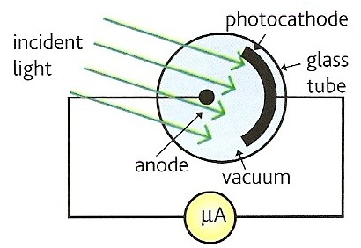
The vacuum photocell
The photocell is an application of the photoelectric effect
Light is incident on a metal plate called the photocathode.
If the light’s frequency is above the metal’s threshold frequency electrons are emitted.
These electrons passing across the vacuum to the anode constitute and electric current which can be measured by the microammeter.
Phet – Photoelectric effect
NTNU – Photoelectric effect

Slide 14
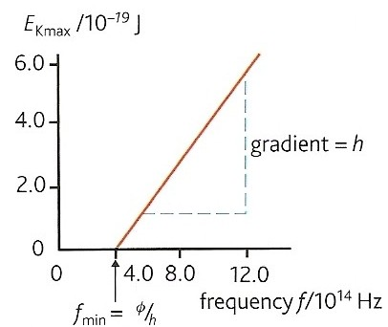
Obtaining Planck’s constant
By attaching a variable voltage power supply it is possible to measure the maximum kinetic energy of the photoelectrons produced in the photocell.
The graph opposite shows how this energy varies with photon frequency.
hf = φ + E_{Kmax}
becomes:
E_{Kmax} = hf – φ
which has the form y = mx +c
with gradient, m = h
Hence Planck’s constant can be found.

Slide 15
The electron-volt (revision)
The electron-volt (eV) is equal to the kinetic energy gained by an electron when it is accelerated by a potential difference of one volt.
1 eV = 1.6 x 10⁻¹⁹ J
Question: Calculate the energy in electron-volts of a photon of ultraviolet light of frequency 8 x 10¹⁴ Hz. (h = 6.63 x 10⁻³⁴ Js)
E = h f
= (6.63 x 10⁻³⁴ Js) x (8 x 10¹⁴ Hz)
= 5.30 x 10⁻¹⁹ J
energy in eV = energy in joules / 1.6 x 10⁻¹⁹
= 3.32 eV

Slide 16
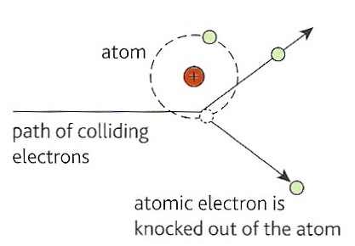
Ionisation
An ion is a charged atom
Ions are created by adding or removing electrons from atoms
The diagram shows the creation of a positive ion from the collision of an incoming electron.
Ionisation can also be caused by:
  nuclear radiation – alpha, beta, gamma
  heating
  passing an electric current through a gas (as in a fluorescent tube)
incoming electron

Slide 17
Ionisation energy
Ionisation energy is the energy required to remove one electron from an atom.
Ionisation energy is often expressed in eV.
The above defines the FIRST ionisation energy – there are also 2nd, 3rd etc ionisation energies.

Slide 18
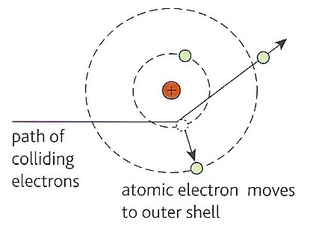
Excitation
Excitation is the promotion of electrons from lower to higher energy levels within an atom.
In the diagram some of the incoming electron’s kinetic energy has been used to move the electron to a higher energy level.
The electron is now said to be in an excited state.
Atoms have multiple excitation states and energies.
incoming electron

Slide 19
Question
An electron with 6 x 10⁻¹⁹J of kinetic energy can cause
(a) ionisation or (b) excitation in an atom.
If after each event the electron is left with
(a) 4 x 10⁻¹⁹J and (b) 5 x 10⁻¹⁹J kinetic energy
calculate in eV the ionisation and excitation energy of the atom.

Slide 20
Question
(a) Ionisation has required
6 x 10⁻¹⁹J - 4 x 10⁻¹⁹J of electron ke
= 2 x 10⁻¹⁹J
= 2 x 10⁻¹⁹ /1.6 x 10⁻¹⁹J
ionisation energy = 1.25 eV
(b) Excitation has required
6 x 10⁻¹⁹J - 5 x 10⁻¹⁹J of electron ke
= 1 x 10⁻¹⁹J
= 1 x 10⁻¹⁹ /1.6 x 10⁻¹⁹J
excitation energy = 0.625 eV

Slide 21
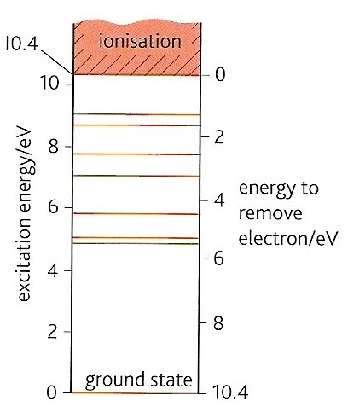
Electron energy levels in atoms
Electrons are bound to the nucleus of an atom by electromagnetic attraction.
A particular electron will occupy the nearest possible position to the nucleus.
This energy level or shell is called the ground state.
It is also the lowest possible energy level for that electron.
Only two electrons can exist in the lowest possible energy level at the same time. Further electrons have to occupy higher energy levels.

Slide 22
Electron energy levels in atoms
Energy levels are measured with respect to the ionisation energy level, which is assigned 0 eV.
All other energy levels are therefore negative. The ground state in the diagram opposite is - 10.4 eV.
Energy levels above the ground state but below the ionisation level are called excited states.
Different types of atom have different energy levels.

Slide 23
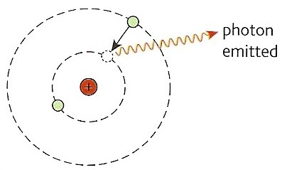
De-excitation
Excited states are usually very unstable.
Within about 10 ⁻ ⁶ s the electron will fall back to a lower energy level.
With each fall in energy level (level E₁ down to level E₂) a photon of electromagnetic radiation is emitted.
emitted photon energy = hf = E₁ – E₂

Slide 24
Energy level question
Calculate the frequencies of the photons emitted when an electron falls to the ground state (at 10.4 eV) from excited states (a) 5.4 eV and (b) 1.8 eV.
(h = 6.63 x 10⁻³⁴ Js)
hf = E₁ – E₂
(a) hf = 5.4 eV – 10.4 eV
= - 5.0 eV
= 5.0 x 1.6 x 10⁻¹⁹J (dropping –ve sign)
= 8.0 x 10⁻¹⁹J
therefore f = 8.0 x 10⁻¹⁹J / 6.63 x 10⁻³⁴ Js
for -5.4 to -10.4 transition, f = 1.20 x 10¹⁵ Hz
(b) hf = 1.8 eV – 10.4 eV)
= - 8.6 eV
= 13.8 x 10⁻¹⁹J
therefore f = 13.8 x 10⁻¹⁹J / 6.63 x 10⁻³⁴ Js
for -1.8 to -10.4 transition, f = 2.08 x 10¹⁵ Hz

Slide 25
Complete:
transition |  | photon
E₁ / eV | E₂ / eV | f / PHz | λ / nm
5.4 | 10.4 | 1.20 | 250
1.8 | 10.4 | 2.08 | 144
1.8 | 5.4 | 0.871 | 344
1.8 | 4.5 | 0.653 | 459
250
1.8
144
0.871
344
4.5
0.653

Slide 26
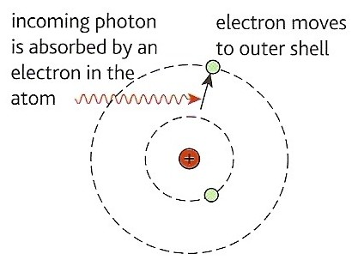
Excitation using photons
An incoming photon may not have enough energy to cause photoelectric emission but it may have enough to cause excitation.
However, excitation will only occur if the photon’s energy is exactly equal to the difference in energy of the initial and final energy level.
If this is the case the photon will cease to exist once its energy is absorbed.

Slide 27
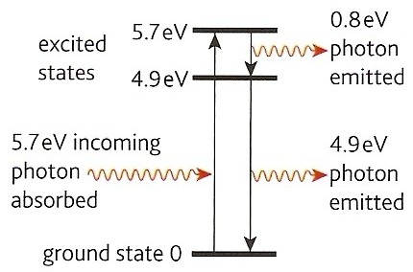
Fluorescence
The diagram shows an incoming photon of ultraviolet light of energy 5.7eV causing excitation.
This excited electron then de-excites in two steps producing two photons.
The first has energy 0.8eV and will be of visible light. The second of energy 4.9eV is of invisible ultraviolet of slightly lower energy and frequency than the original excitating photon.
This overall process explains why certain substances fluoresce with visible light when they absorb ultraviolet radiation. Applications include the fluorescent chemicals are added as ‘whiteners’ to toothpaste and washing powder.
Electrons can fall back to their ground states in steps.

Slide 28
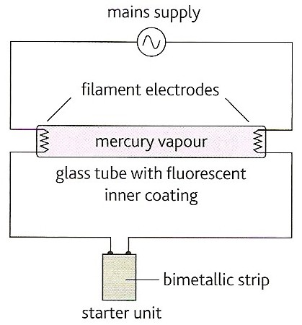
Fluorescent tubes
A fluorescent tube consists of a glass tube filled with low pressure mercury vapour and an inner coating of a fluorescent chemical.
Ionisation and excitation of the mercury atoms occurs as the collide with each other and with electrons in the tube.
The mercury atoms emit ultraviolet photons.
The ultraviolet photons are absorbed by the atoms of the fluorescent coating, causing excitation of the atoms.
The coating atoms de-excite and emit visible photons.
See pages 37 and 38 for further details of the operation of a fluorescent tube

Slide 29
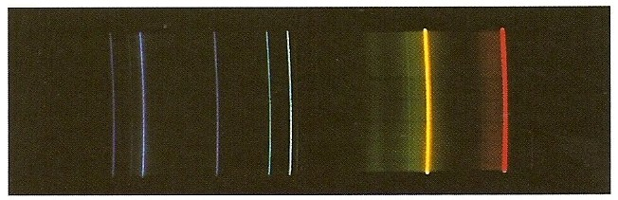
Line spectra
A line spectrum is produced from the excitation of a low pressure gas.
The frequencies of the lines of the spectrum are characteristic of the element in gaseous form.
Such spectra can be used to identify elements.
Each spectral line corresponds to a particular energy level transition.

Slide 30
Question
Calculate the energy level transitions (in eV) responsible for (a) a yellow line of frequency 5.0 x 10¹⁴ Hz and (b) a blue line of wavelength 480 nm.
(a) energy of a yellow photon = hf
= 6.63 x 10⁻³⁴ Js x 5.0 x 10¹⁴ Hz
= 3.315 x 10⁻¹⁹ J
= (3.315 x 10⁻¹⁹ / 1.6 x 10⁻¹⁹ ) eV
transition = 2.07 eV
(b) energy of a blue photon = hc / λ
= (6.63 x 10⁻³⁴ Js) x (3.0 x 10⁸ ms⁻¹) / (4.8 x 10⁻⁷ m)
= 4.144 x 10⁻¹⁹ J
= (4.144 x 10⁻¹⁹ / 1.6 x 10⁻¹⁹ ) eV
transition = 2.59 eV

Slide 31
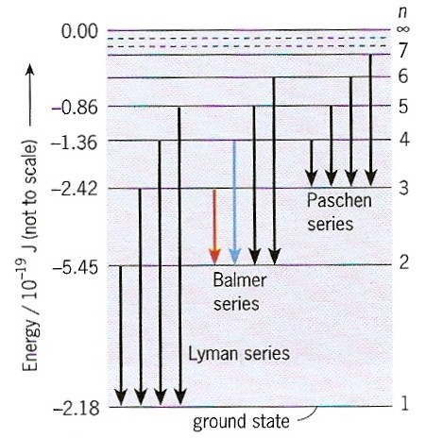
The hydrogen atom
- 21.8
Phet – Models of the hydrogen atom

Slide 32
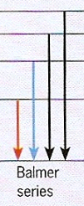
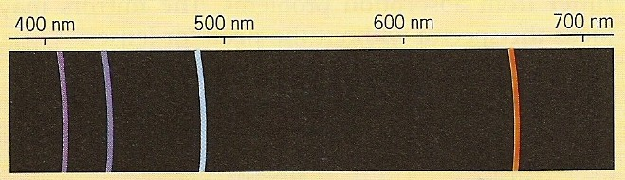
Phet – Models of the hydrogen atom

Slide 33
With only one electron, hydrogen has the simplest set of energy levels and corresponding line spectrum.
Transitions down to the lowest state, n=1 in the diagram, give rise to a series of ultraviolet lines called the Lyman Series.
Transitions down to the n=2 state give rise to a series of visible light lines called the Balmer Series.
Transitions down to the n=3, n=4 etc states give rise to sets of infra-red spectral lines.
- 21.8
Phet – Models of the hydrogen atom

Slide 34
The discovery of helium
Helium was discovered in the Sun before it was discovered on Earth. Its name comes from the Greek word for the Sun ‘helios’.
A pattern of lines was observed in the Sun’s spectrum that did not correspond to any known element of the time.
In the Sun helium has been produced as the result of the nuclear fusion of hydrogen.
Subsequently helium was discovered on Earth where it has been produced as the result of alpha particle emission from radioactive elements such as uranium.

Slide 35
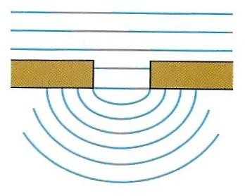
The wave like nature of light
Light undergoes diffraction (shown opposite) and displays other wave properties such as polarisation and interference.
By the late 19th century most scientists considered light and other electromagnetic radiations to be like water waves

Slide 36
The particle like nature of light
Light also produces photoelectric emission which can only be explained by treating light as a stream of particles.
These ‘particles’ with wave properties are called photons.

Slide 37
The dual nature of electromagnetic radiation
Light and other forms of electromagnetic radiation behave like waves and particles.
On most occasions one set of properties is the most significant
The longer the wavelength of the electromagnetic wave the more significant are the wave properties.
Radio waves, the longest wavelength, is the most wavelike.
Gamma radiation is the most particle like
Light, of intermediate wavelength, is best considered to be equally significant in both

Slide 38
Matter waves
In 1923 de Broglie proposed that particles such as electrons, protons and atoms also displayed wave like properties.
The de Broglie wavelength of such a particle depended on its momentum, p according to the de Broglie relation:
λ = h / p
As momentum = mass x velocity = mv
λ = h / mv
This shows that the wavelength of a particle can be altered by changing its velocity.

Slide 39
Question 1
Calculate the de Broglie wavelength of an electron moving at 10% of the speed of light. [m_{e} = 9.1 x 10⁻³¹ kg]
(h = 6.63 x 10⁻³⁴ Js; c = 3.0 x 10⁸ ms⁻¹)
v = 10% of c
= 3.0 x 10⁷ ms⁻¹
λ = h / mv
= (6.63 x 10⁻³⁴ Js) / [(9.1 x 10⁻³¹ kg) x (3.0 x 10⁷ ms⁻¹)]
de Broglie wavelength = 2.43 x 10 ⁻ ¹¹ m
This is similar to the wavelength of X-rays.
Particle properties dominate.

Slide 40
Question 2
Calculate the de Broglie wavelength of a person of mass 70 kg moving at 2 ms⁻¹.
(h = 6.63 x 10⁻³⁴ Js)
λ = h / mv
= (6.63 x 10⁻³⁴ Js) / [(70 kg) x (2 ms⁻¹)]
de Broglie wavelength = 4.74 x 10 ⁻ ³⁶ m
This is approximately 10²⁰ x smaller than the nucleus of an atom.
Wave like properties can be ignored!

Slide 41
Question 3
Calculate the effective mass of a photon of red light of wavelength 700 nm.
(h = 6.63 x 10⁻³⁴ Js)
λ = h / mv
becomes: m = h / λ v
= (6.63 x 10⁻³⁴ Js) / [(7.0 x 10⁻⁷m) x 3.0 x 10⁸ ms⁻¹)]
mass = 3.16 x 10 ⁻ ³⁶ kg
This is approximately 30 000 x smaller than the mass of an electron.
The mass of photons can normally be considered to be zero.

Slide 42
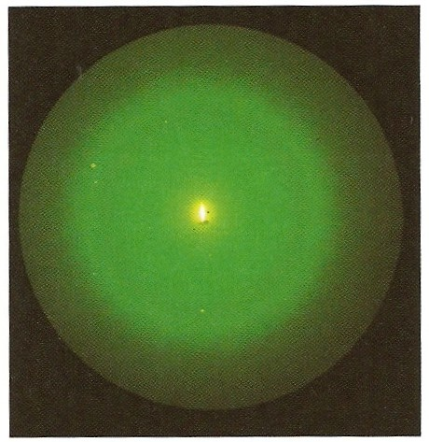
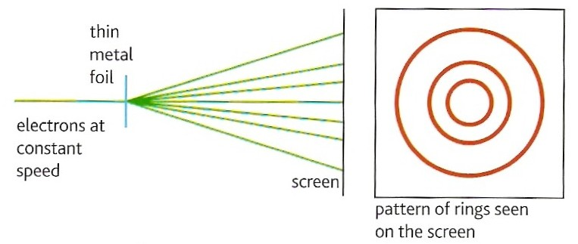
Evidence for de Broglie’s hypothesis
A narrow beam of electrons in a vacuum tube is directed at a thin metal foil. On the far side of the foil a circular diffraction pattern is formed on a fluorescent screen. A pattern that is similar to that formed by X-rays with the same metal foil.
Electrons forming a diffraction pattern like that formed by X-rays shows that electrons have wave properties.
The radii of the circles can be decreased by increasing the speed of the electrons. This is achieved by increasing the potential difference of the tube.

Slide 43
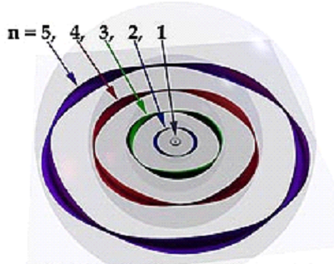
Energy levels and electron waves
An electron in an atom has a fixed amount of energy that depends on the shell it occupies.
Its de Broglie wavelength has to fit the shape and size of the shell.
Fendt – Bohr Hydrogen Atom
Phet – Models of the hydrogen atom

Slide 44
Internet Links
Photoelectric Effect - PhET - See how light knocks electrons off a metal target, and recreate the experiment that spawned the field of quantum mechanics.
Photoelectric Effect - NTNU
Photoelectric Effect - Fendt
Neon Lights - PhET - Produce light by bombarding atoms with electrons. See how the characteristic spectra of different elements are produced, and configure your own element's energy states to produce light of different colours.
Lasers - PhET - Create a laser by pumping the chamber with a photon beam. Manage the energy states of the laser's atoms to control its output.
Bohr Atom- Fendt
Bohr Atom - 7stones
Quantum Mechanics - A Summary - Powerpoint presentation by Mrs Andrew - July 2004
Models of the Hydrogen Atom - PhET - How did scientists figure out the structure of atoms without looking at them? Try out different models by shooting photons and alpha particles at the atom. Check how the prediction of the model matches the experimental results.
Davisson-Germer Electron Diffraction - PhET - Simulate the original experiment that proved that electrons can behave as waves. Watch electrons diffract off a crystal of atoms, interfering with themselves to create peaks and troughs of probability.

Slide 45
Core Notes from Breithaupt pages 30 to 43
What is the photoelectric effect?
Explain how the observations made from photoelectric experiments contradict the wave theory of electromagnetic radiation.
Show how the photoelectric equation, hf = E_{kmax} + φ, follows from Einstein’s explanation of the photoelectric effect.
Define: (a) threshold frequency (b) work function. Give the relationship between these two quantities.
Define what is meant by ionisation and list the various ways in which ionisation may occur.
Define the electron-volt.
What is excitation? Why are all the excitation energies of a particular atom less than its ionisation energy?
Copy figure 1 on page 36 and define what is meant by (a) ground state and (b) excited state
Explain the process of de-excitation showing how the energy and frequency of emitted photons is related to energy level changes.
What condition must be satisfied for a photon to cause excitation?
What is fluorescence? Explain how this occurs in terms of energy level transitions.
Explain how the processes of ionization and excitation occur in a fluorescent tube.
What is a line spectrum? Draw a diagram.
Explain how line spectra are produced.
What observations indicate that light behaves as (a) a wave? (b) a particle?
What are matter waves? State the de Broglie relation.
What evidence is there of the wave nature of particles?

Slide 46
3.1 Photoelectricity
Notes from Breithaupt pages 30 & 31
What is the photoelectric effect?
Explain how the observations made from photoelectric experiments contradict the wave theory of electromagnetic radiation.
Show how the photoelectric equation, hf = E_{kmax} + φ, follows from Einstein’s explanation of the photoelectric effect.
Define: (a) threshold frequency (b) work function. Give the relationship between these two quantities.
A metal emits photoelectrons with a maximum kinetic energy of 2.0 x 10⁻¹⁹ J when exposed with photons of wavelength 300 nm. Calculate the work function and threshold frequency of the metal.
Try the summary questions on page 31

Slide 47
3.2 More about photoelectricity
Notes from Breithaupt pages 32 & 33
Explain why Einstein’s photon model was revolutionary.
What is a quantum?
Draw a diagram and explain the operation of a vacuum photocell.
Describe how the value of Planck’s constant can be found from measurements made with a photocell.
Try the summary questions on page 33

Slide 48
3.3 Collisions of electrons with atoms
Notes from Breithaupt pages 34 & 35
Define what is meant by ionisation and list the various ways in which ionisation may occur.
Define the electron-volt.
What is excitation? Why are all the excitation energies of a particular atom less than its ionisation energy?
Describe how ionisation energy can be measured.
Try the summary questions on page 35

Slide 49
3.4 Energy levels in atoms
Notes from Breithaupt pages 36 to 38
Copy figure 1 on page 36 and define what is meant by (a) ground state and (b) excited state
Explain the process of de-excitation showing how the energy and frequency of emitted photons is related to energy level changes.
What condition must be satisfied for a photon to cause excitation?
What is fluorescence? Explain how this occurs in terms of energy level transitions.
Explain how the processes of ionization and excitation occur in a fluorescent tube.
Explain the operation of a fluorescent tube.
Try the summary questions on page 38

Slide 50
3.5 Energy levels and spectra
Notes from Breithaupt pages 39 & 40
What is a line spectrum? Draw a diagram.
Explain how line spectra are produced.
Calculate the wavelength of the spectral line produced by the energy level transition from – 6.4eV to –15.2eV.
Use the equation on page 40 to work out (in eV) the first four energy levels of a hydrogen atom.
Explain how Helium was first discovered.
Try the summary questions on page 40

Slide 51
3.6 Wave particle duality
Notes from Breithaupt pages 41 to 43
What observations indicate that light behaves as (a) a wave? (b) a particle?
What are matter waves? State the de Broglie relation.
What evidence is there of the wave nature of particles?
Show that electrons moving at 50% of the speed of light have a de Broglie wavelength similar to that of X-rays.
How do the energy levels in atoms tie up with the wave like properties of electrons?
Try the summary questions on page 43

