Slide 1
Current electricity

Slide 2
Specification
Lessons | Topics
1 to 3 | Charge, current and potential difference Electric current as the rate of flow of charge; potential difference as work done per unit charge. I = ΔQ / Δt and V = W / Q Resistance is defined by R = V / I
4 to 6 | Current / voltage characteristics For an ohmic conductor, a semiconductor diode and a filament lamp; candidates should have experience of the use of a current sensor and a voltage sensor with a data logger to capture data from which to determine V-I curves. Ohm’s law as a special case where I α V.
7 & 8 | Resistivity ρ = RA / L Description of the qualitative effect of temperature on the resistance of metal conductors and thermistors. Applications (e.g. temperature sensors). Superconductivity as a property of certain materials which have zero resistivity at and below a critical temperature which depends on the material. Applications (e.g. very strong electromagnets, power cables).

Slide 3
Charge carriers
Electric current is the flow of electric charge. This charge is carried by particles such as electrons and ions.
In metals the charge carriers are negatively charged conduction electrons. They move about inside the metal, repeatedly colliding with each other and the fixed positive ions of the metal.
In other conducting substances such as acids, low pressure gases and molten salt the charge carriers consist of both positive and negative ions.

Slide 4
Good conductors have many free to move charge carriers. Insulators have few.
When the temperature of a semiconductor (e.g. silicon) is increased more charge carriers are produced and the semiconductor turns from an insulator into a conductor.

Slide 5
Conventional current flow
+ -
In electric circuits electric current is considered to flow out of the positive terminal of a power supply around a circuit and back to the negative terminal.
This convention holds even when there are no charge carriers flowing in this direction (e.g. conduction electrons in metals flow in the opposite direction).
In many conductors (e.g. cells) charge carriers, both +ve and –ve, are flowing in both directions at once.
electron flow
conventional current flow
NTNU simulation showing charge flow and current

Slide 6
Current, charge and time
I = ΔQ / Δt
  where:
  I = electric current in amperes
  ΔQ = quantity of charge moving in coulombs
  Δt = time in seconds for charge ΔQ to flow
also: ΔQ = I x Δt
and: Δt = ΔQ / I

Slide 7
Questions
1. Calculate the current flowing when a charge of 60C flows past a point over a period of 2 minutes
I = ΔQ / Δt
= 60C / 120s
= 0.5 A (500mA)
2. In metals charge is carried by electrons each having -1.6 x 10⁻¹⁹ coulomb of charge. Calculate how many electrons pass a point in an electric circuit when a current of 3A flows for 10 seconds
ΔQ = I x Δt
= 3A x 10s = 30 C
number of electrons = 30C / 1.6 x 10⁻¹⁹ C
= 1.88 x 10²⁰

Slide 8
Answers:
Complete:
electric current | charge | time
5.0 A | 250 C | 50 s
600 mA | 12 C | 20 s
3A | 9 MC | 3 x 10⁶ s
8 μA | 9.6 x 10⁻³ C | 20 minutes
4.0 A | 16 kC | 4000 s
5.0 A
12 C
3 x 10⁶ s
9.6 x 10⁻³ C
4.0 A

Slide 9
Energy transfer in an electric circuit
The battery gives each electron a fixed amount of energy.
Chemical energy is transformed into electrical potential energy.
Work has to be done to passes electrons through devices like the bulb.
This causes the electrons to lose their electrical potential energy.
This energy is converted into thermal and light energy by the bulb.

Slide 10
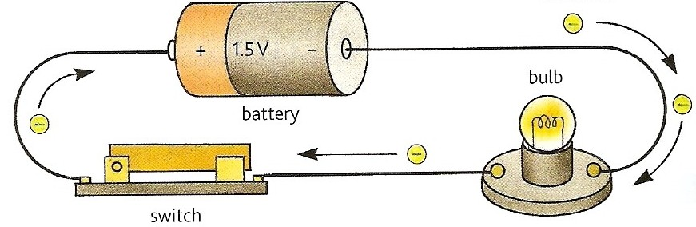
Either side of the bulb there exists a difference in the electron’s electric potential energy.
This difference when divided by the electron’s charge is called potential difference or voltage.
The electrons return to the battery to receive further electrical potential energy.

Slide 11
Potential difference
The potential difference across a device is equal to the work done (or energy transferred) per unit charge passing through the device.
V = W / Q
where:
V = potential difference in volts
W = the work done (or energy transferred) in joules
Q = the charge moved in coulombs
also: W = V x Q
and: Q = W / V
1 volt is equivalent to 1 joule per coulomb

Slide 12
Electromotive force (emf)
The electromotive force (emf) of a power supply is equal to the energy supplied per unit charge by the power supply
ε = W / Q
where:
ε = emf in volts
W = the energy supplied in joules
Q = the charge supplied in coulombs
also: W = ε x Q
and: Q = W / ε

Slide 13
Questions
1. Calculate the potential difference across the bulb if 2kJ of work is required to push a charge of 250C through the bulb.
V = W / Q
= 2000 J / 250 C
= 8.0 V
2. Calculate the energy supplied by a power supply of emf 12V when it produces a charge of 300 mC
W = ε x Q
= 12 V x 0.300 C
= 3.6 J

Slide 14
Answers:
Complete:
voltage | work /energy | charge
 | 250 J | 50 C
10 kV |  | 50 C
3V | 600 mJ
 | 2 GJ | 40 kC
50 mV |  | 600 μC
5.0 V
500 kJ
0.200 C
50 kV
3.0 x 10⁻⁵ J (30 μJ)

Slide 15
Electrical power
V = W / Q rearranged becomes:
W = VQ
I = ΔQ / Δt rearranged becomes:
ΔQ = I Δt or Q = I Δt
Therefore when a charge Q passes through a device the work done is given by:
W = V x I x Δt
= I x V x Δt

Slide 16
But: power = work done / time
Therefore electrical power, P = W / Δt
= I x V x Δt / Δt
Electrical power, P = I x V
also: I = P / V
and V = P / I
with power in watts; current in A; p.d. in V

Slide 17
Questions on P = I V
1. Calculate the power produced by a bulb connected to a 230V power supply if a current of 50mA flows
P = I x V
= 0.050 A x 230V
= 11.5 W
2. Calculate the current drawn from a 12V battery by a 60W device
I = P / V
= 60 W / 12 V
= 5.0 A

Slide 18
Answers:
Complete:
charge | time | current | voltage | work | power
60 C |  | 5A | 12V
 | 5s | 3A |  |  | 27W
 | 200s |  | 6V | 12kJ
6kC | 50 mins |  | 230V
12s
720 J
60 W
15 C
9 V
135 J
2 kC
10 A
60 W
2 A
1.38 MJ
460 W

Slide 19
Resistance
resistance = p.d. across a component current through the component
R = V / I
resistance in measured in ohms (Ω)
potential difference in volts (V)
electric current in amperes (A)
also: V = I R
and I = V / R

Slide 20
Resistance is a measure of the difficulty of making a current pass through a substance.
It is caused by the repeated collisions between the charge carriers and the positive ions of the substance.
Resistance simulation at Phet Resistance equation demo at Phet

Slide 21
Questions
1. Calculate the resistance of a device if a current of 250mA flows when a potential difference of 6V is applied
R = V / I
= 6V / 0.250A
= 24 Ω
2. Calculate the current that flows through a resistance of 4MΩ when 60V is applied across it
I = V / R
= 60 V / 4 000 000 Ω
= 0.000 015 A = 15 μA

Slide 22
Answers:
Complete:
resistance | voltage | current
 | 12 V | 2 A
10 kΩ |  | 4 mA
460 Ω | 230 V
 | 6 V | 300 μA
2 GΩ |  | 4 nA
6 Ω
40 V
0.5 A
20 kΩ
8 V

Slide 23
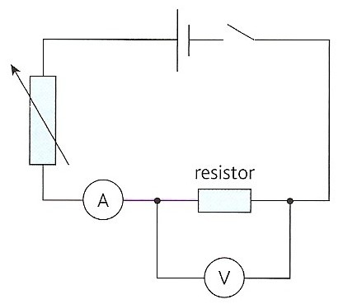
Measuring resistance

Slide 24
Measure the current through the resistor with the ammeter.
Measure the potential difference across the resistor with the voltmeter.
Calculate resistance using R = V / I .
Further sets of values of I and V can be obtained by changing the setting of the variable resistor. From these an average value for resistance can be obtained.
Note: The resistance of the voltmeter should be as high as possible so that the ammeter only measures the current through the resistor.
Fendt Ohm’s law simulation

Slide 25
Ohm’s law
Ohm’s law states that the potential difference across an ohmic conductor is proportional to the current through it, provided the physical conditions do not change.

Slide 26
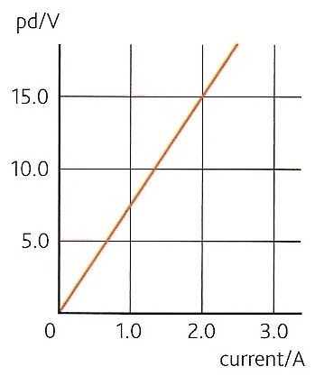
A graph of p.d. against current for a conductor obeying ohm’s law will be a straight line through the origin.
The gradient of such a graph is equal to the resistance of the conductor.
Physical conditions remaining constant include temperature and the dimensions of the conductor.

Slide 27
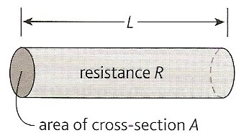
Resistivity (ρ)
Experiments show that the resistance of a conductor is:
1. proportional to its length, L
2. inversely proportional to its cross-section area, A
and so: R α L / A

Slide 28

The constant of proportionality is the
resistivity, ρ of the conductor
Therefore: R = ρ L
A
Resistivity is measured in ohm-metre, Ωm.
Resistivity equation demo at Phet
KT resistivity simulation

Slide 29
Variation in resistivity
Metals and other good conductors have very low resistivities.
(e.g. copper = 1.7 x 10 ^{– 8} Ωm)
Good insulators have very high resistivities.
(e.g. PVC = 1.0 x 10 ⁺ ¹⁴ Ωm)
Semiconductors have intermediate resistivities.
(e.g. silicon = 2.3 x 10 ⁺ ³ Ωm)
Resistivity table on Wikipedia

Slide 30
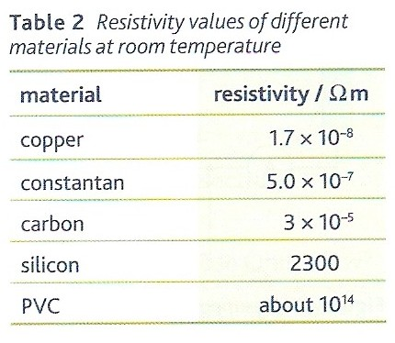
Resistivity table on Wikipedia

Slide 31
Superconductivity
Superconductivity is a state where certain materials have zero resistivity.
This occurs at and below a critical temperature (T_{c}) which depends on the material.
T_{c} is usually below – 200ºC.
Applications include:
  very strong electromagnets (e.g. in MRI scanners)
  power cables to prevent wastage of electrical energy (e.g. to supply the LHC)

Slide 32
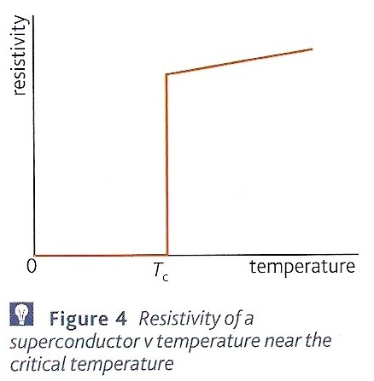

Slide 33
Questions on resistivity
1. Calculate the resistance of a 0.30m length of copper wire of cross-section area 5 x 10⁻⁶ m² [resistivity of copper = 1.7 x 10⁻⁸ Ωm]
R = ρ L A
= (1.7 x 10⁻⁸ Ωm) x (0.30m) / (5 x 10⁻⁶ m²)
= 0.00102 Ω = 1.02 mΩ
2. Repeat the above question, this time with silicon [resistivity of silicon = 2300 Ωm]
= (2300 Ωm) x (0.30m) / (5 x 10⁻⁶ mm²)
= 1.38 x 10⁸ Ω = 138 MΩ

Slide 34
3. Calculate the resistivity of a metal wire of cross-section diameter 0.4mm if a 25cm length of this wire has a resistance of 6Ω.
A = πd²
4
= π x (4 x 10 ⁻ ⁴ m)² / 4
= π x (1.6 x 10 ⁻ ⁷ m²) / 4
cross-section area = 1.2566 x 10 ⁻ ⁷ m²
ρ = RA
L
= (6 Ω) x (1.2566 x 10 ⁻ ⁷ m² ) / (0.25 m)
resistivity = 3.02 x 10 ⁻ ⁶ Ωm

Slide 35
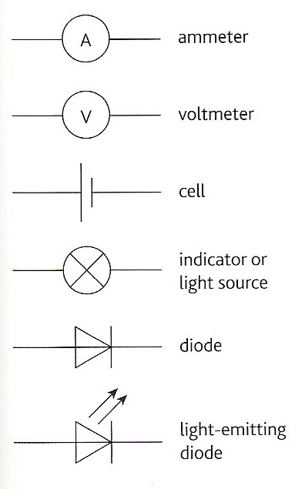
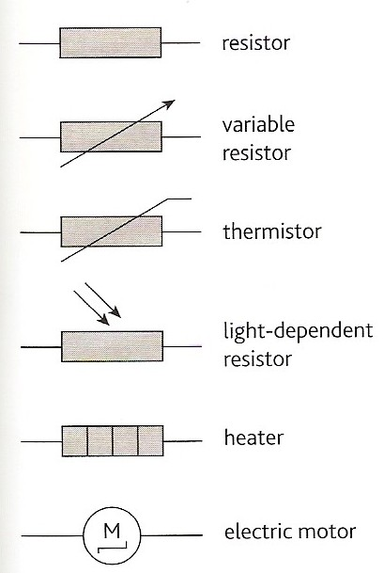
Answers:
Circuit component quiz
Identify the symbols below:
Circuit symbols quiz

Slide 36
Component notes
cell - a source of chemical energy
battery - a combination of cells
indicator - to show the state of a circuit (on or off) also used for a filament bulb but not an LED
resistor - a component designed to have resistance
thermistor - resistance decreases with increasing temperature
Crocodile Physics Simulations: Thermistor LDR Diode FB Diode RB

Slide 37
light-dependent resistor (LDR) - resistance decreases with increasing illumination
diode - allows current to flow in one direction only. The allowed, ‘forward’, direction is indicated by the arrow on the symbol
light-emitting diode (LED) - emits light when diode conducts
Crocodile Physics Simulations: Thermistor LDR Diode FB Diode RB

Slide 38
Characteristic curves
These are graphs of current against potential difference that are used to show how a component behaves in an electric circuit.
Negative and positive values are plotted to show any differences in device behaviour that depend on the current direction (e.g. diode)

Slide 39
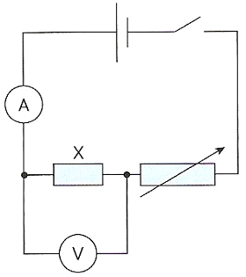
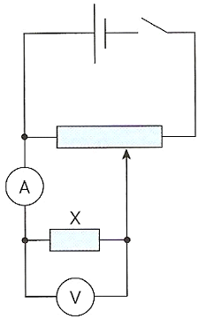
Either of the circuits shown below can be used.
  Variable resistor control
  Potential divider control
  This is less complicated but lower range of values obtained than with potential divider control
  This is the best option but more complicated

Slide 40
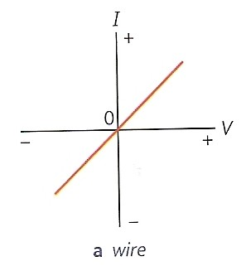
Wire (and fixed resistors)
Straight line through the origin.
Obeys Ohm’s law.
Note: With I-V graphs, a greater gradient means a lower resistance

Slide 41
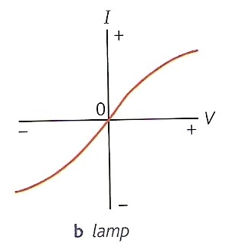
Filament Lamp
Resistance increases at higher currents (due to increasing temperature).
Does not obey Ohm’s law.

Slide 42
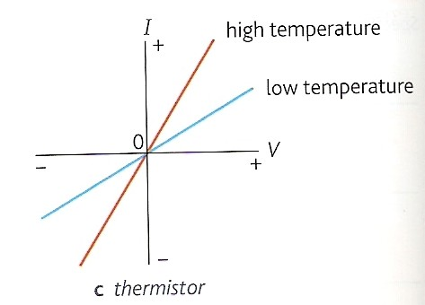
Thermistor
Resistance decreases with increasing temperature.
Obeys Ohm’s law if the temperature remains constant.

Slide 43
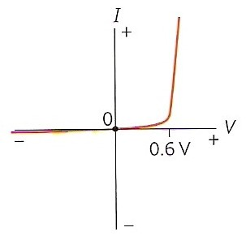
Silicon diode
Reverse direction (reverse-biased)
Very high resistance, the current is typically below 1μA
Forward direction (forward-biased)
With p.d.s below about 0.6V resistance is high. With p.d.s above 0.6V the resistance falls rapidly to a few ohms and the current increases rapidly.
Turn-on voltage
0.6V is known as the turn-on voltage. Different types of diode have different turn-on voltages, LEDs are typically about 1.5V.
Crocodile Physics Simulations: Diode FB Diode RB

Slide 44
Diode – resistor IV combinations
Sketch the IV characteristics of the diode-resistor combinations shown below.
5Ω
5Ω
I
I
combination
diode
+ 0.6
V
diode
+ 0.6
V
combination
resistor
resistor

Slide 45
Resistance and temperature
1. Metallic conductors
Resistance increases relatively slowly with temperature
They are said to have a ‘positive temperature coefficient’
Positive ions within the conductor vibrate more with increasing temperature
Charge carriers (conduction electrons) cannot pass through the conductor as easily when a p.d. is applied

Slide 46
2. Semiconductors
Resistance decreases relatively quickly with temperature
Said to have a ‘negative temperature coefficient’
The number of charge carriers increase far more rapidly with temperature than the impedance caused by the more quickly vibrating positive ions
Application - the thermistor - used to sense temperature changes

Slide 47
Internet Links
Signal Circuit - PhET - Why do the lights turn on in a room as soon as you flip a switch? Flip the switch and electrons slowly creep along a wire. The light turns on when the signal reaches it.
Circuit Construction AC + DC - PhET - This new version of the CCK adds capacitors, inductors and AC voltage sources to your toolbox! Now you can graph the current and voltage as a function of time.
Hidden Pairs Game Circuit Pairs Quiz basic circuit symbols with this pairs game - by eChalk
Hidden Pairs Game on Circuit Symbols - by KT - Microsoft WORD
Effect of voltage on current and lamp brightness - Macleans School NZ
Effect of resistance on current flow- Macleans School NZ
Variable resistor with an ammeter & a voltmeter Resist.ckt - Crocodile Clip Presentation
Resistance measurement demo - Molecular Expressions
Ohm's Law - PhET - See how the equation form of Ohm's law relates to a simple circuit. Adjust the voltage and resistance, and see the current change according to Ohm's law. The sizes of the symbols in the equation change to match the circuit diagram.
Ohm's Law - Fendt
Thermistor Therm.ckt - Crocodile Clip Presentation
Light Dependent Resistor (LDR) LDR.ckt - Crocodile Clip Presentation
Resistance in a Wire - PhET - Learn about the physics of resistance in a wire. Change its resistivity, length, and area to see how they affect the wire's resistance. The sizes of the symbols in the equation change along with the diagram of a wire.
Resistance Wire Simulation- by KT - Designed for the GCSE Investigation but can also be used to show the affect of source resistance and to show power supply maximum power.
Conductivity- PhET - Experiment with conductivity in metals, plastics and photoconductors. See why metals conduct and plastics don't, and why some materials conduct only when you shine a flashlight on them.
Semiconductors - PhET - Dope the semiconductor to create a diode or transistor. Watch the electrons change position and energy.
Forward Biased Silicon Diode Diodef.ckt - Crocodile Clip Presentation
Reversed Biased Silicon Diode Dioder.ckt- Crocodile Clip Presentation

Slide 48
Core Notes from Breithaupt pages 46 to 55
What is an electric current?
State the relationship between charge and current and give a sample calculation.
Define potential difference and give the equation for potential difference in terms of charge and work done.
What is electromotive force?
Show how the equation P = IV can be derived from the equations defining current and voltage.
What is resistance? Give the equation defining resistance and a sample resistance calculation.
What is Ohm’s law? How can Ohm’s law be verified graphically?
Give the equation for resistivity.
What is superconductivity? When does it occur? Give two applications.
Sketch and explain the shapes of the characteristic curves of (a) a metal wire; (b) a lamp; (c) a thermistor & (d) a diode
Describe and explain the resistance variation with temperature of (a) metallic conductors & (b) semiconductors

Slide 49
4.1 Current and charge
Notes from Breithaupt pages 46 & 47
What is an electric current?
State the relationship between charge and current and give a sample calculation.
Explain the different ways in which a substance can conduct electricity.
Draw figure 2 on page 46 and hence explain the direction of current flow through a metal.
Try the summary questions on page 47

Slide 50
4.2 Potential difference and power
Notes from Breithaupt pages 48 & 49
Define potential difference and give the equation for potential difference in terms of charge and work done.
What is electromotive force?
Show how the equation P = IV can be derived from the equations defining current and voltage.
Explain how the concept of potential difference arises from the energy transfers in an electrical circuit.
Calculate the p.d. if a charge of 50C requires 300J of work.
Calculate the current drawn by a 15W device from a 12V power supply.
Try the summary questions on page 49

Slide 51
4.3 Resistance
Notes from Breithaupt pages 50 to 52
What is resistance? Give the equation defining resistance and a sample resistance calculation.
What is Ohm’s law? How can Ohm’s law be verified graphically?
Give the equation for resistivity.
What is superconductivity? When does it occur? Give two applications.
Draw a circuit diagram and explain how resistance can be measured.
Calculate the resistance of a copper wire of diameter 1mm and length 3m.
Compare the resistivities of copper, silicon and PVC.
Try the summary questions on page 52

Slide 52
4.4 Components and their characteristics
Notes from Breithaupt pages 53 to 55
Sketch and explain the shapes of the characteristic curves of (a) a metal wire; (b) a lamp; (c) a thermistor & (d) a diode
Describe and explain the resistance variation with temperature of (a) metallic conductors & (b) semiconductors
Copy and learn the component symbols on page 53
What is (a) a battery; (b) resistor; (c) thermistor; (d) LDR; (e) diode & (f) LED?
What is the purpose of a characteristic curve? Explain, with the aid of a circuit diagram, how one can be produced
Try the summary questions on page 55

