Slide 1
1.3b Current Electricity
Direct Current Circuits
Breithaupt pages 58 to 71
October 5th, 2010

Slide 2
AQA AS Specification
Lessons | Topics
1 to 3 | Circuits Resistors in series; R_{T} = R₁ + R₂ + R₃ + … Resistors in parallel; 1/R_{T} = 1/R₁ + 1/R₂ + 1/R₃ +… energy E = I V t, P = IV, P = I ² R; application, e.g. Understanding of high current requirement for a starter motor in a motor car. Conservation of charge and energy in simple d.c. circuits. The relationships between currents, voltages and resistances in series and parallel circuits, including cells in series and identical cells in parallel. Questions will not be set which require the use of simultaneous equations to calculate currents or potential differences.
4 & 5 | Potential divider The potential divider used to supply variable pd e.g. application as an audio ‘volume’ control. Examples should include the use of variable resistors, thermistors and L.D.R.s. The use of the potentiometer as a measuring instrument is not required.
6 & 7 | Electromotive force and internal resistance ε = E / Q; ε = I (R + r) Applications; e.g. low internal resistance for a car battery.

Slide 3
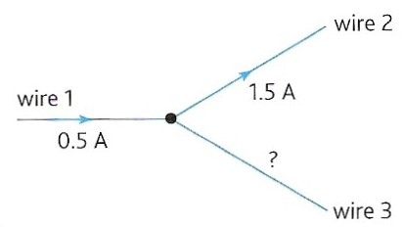
Current rules
At any junction in a circuit, the total current leaving the junction is equal to the total current entering the junction.
This rule follows from that fact that electric charge is always conserved.
This rule is also known as Kirchhoff’s 1st law.
Total current into the junction = 0.5 A
Total current out of the junction = 1.5 A
Therefore wire 3 must have 1.0 A INTO the junction
NTNU Current flow in series and parallel circuits

Slide 4
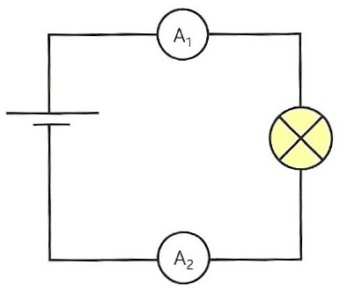
Components in series
Series connection of components means:
The current entering a component is the same as the current leaving the component
  Components do not use up current
The current passing through two or more components in series is the same through each component
  The rate of flow of charge through components in series is always the same
Ammeters A₁ and A₂ are in series with the bulb and cell. They will always show the same current measurement.
NTNU Current flow in series and parallel circuits

Slide 5
Potential difference rules
1. Components in series
For two or more components in series, the total p.d. across all the components is equal to the sum of the potential differences across each component.

Slide 6
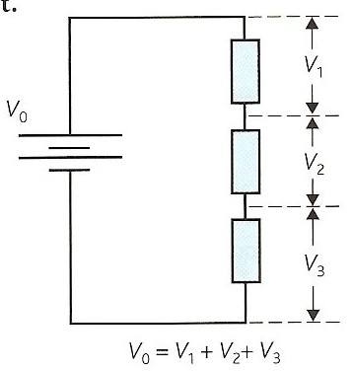
The battery opposite gives each coulomb of charge energy, V_{o} per coulomb
This energy is lost in three stages V₁, V₂ and V₃ per coulomb.
Therefore: V_{o} = V₁ + V₂ + V₃
Phet Circuit construction kit

Slide 7
Potential difference rules
2. Components in parallel
The potential difference across components in parallel is the same.

Slide 8
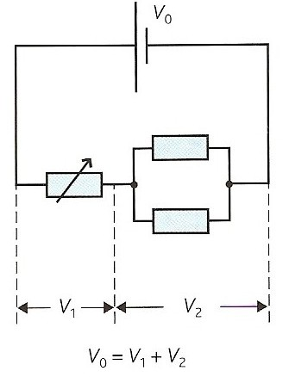
In the circuit opposite after passing through the variable resistor the charge carriers have energy per coulomb, (V_{o} - V₁), available.
The charge carriers then pass through both of the resistors in parallel.
The same amount of energy per coulomb, V₂ is delivered to both resistors.
Hence the p.d. across both parallel resistors is the same and equals V₂ .

Slide 9
Potential difference rules
3. For a complete circuit loop
For any complete loop in a circuit, the sum of the emfs round the loop is equal to the sum of the potential drops round the loop.

Slide 10
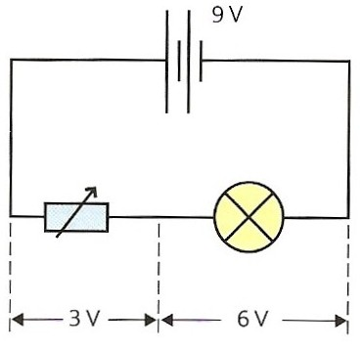
In the circuit opposite the battery gives 9 joules of energy to every coulomb of charge and so the battery emf = 9V.
In the circuit loop the variable resistor uses up 3J per coulomb (pd = 3V) and the bulb 6J per coulomb (pd = 6V)
Therefore: Σ (emfs) = 9V
and Σ (p.d.s) = 3V + 6V = 9V
and so: Σ (emfs) = Σ (pds)
This law is a statement of conservation of energy for a complete circuit.
This law is also known as Kirchhoff’s 2nd law.

Slide 11
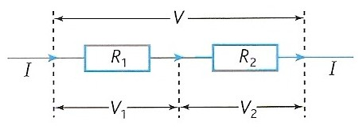
Resistors in series
Resistors in series pass the same current, I.
The total potential difference across the two resistors, V is equal to the sum of the individual pds:
V = V₁ + V₂
Netfirms resistor combination demo
Multimedia combination calculator

Slide 12
The pd across R₁, V₁ is given by: V₁ = I R₁
and across R₂, V₂ = I R₂
The total pd,V across the total resistance R_{T} is equal to I R_{T}
but: V = V₁ + V₂
= I R₁ + I R₂
therefore: I R_{T} = I R₁ + I R₂
as all the currents (I) cancel
so: R_{T} = R₁ + R₂
R_{T} = R₁ + R₂ + R₃ + …
The total resistance is always greater than any of the individual resistances
Netfirms resistor combination demo Multimedia combination calculator

Slide 13
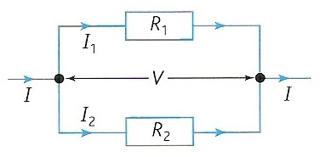
Resistors in parallel
Resistors in parallel all have the same pd, V.
The total current through the two resistors, I is equal to the sum of the individual currents:
I = I₁ + I₂
Netfirms resistor combination demo Multimedia combination calculator

Slide 14
The current through R₁, I₁ is given by: I₁ = V / R₁
and through R₂, I₂ = V / R₂
The total current, I through the total resistance, R_{T} is equal to V / R_{T}
but: I = I₁ + I₂
= V / R₁ + V / R₂
therefore: V / R_{T} = V / R₁ + V / R₂
as all the p.d.s (V) cancel
so: 1 / R_{T} = 1 / R₁ + 1 / R₂
1 = 1 + 1 + 1 …
R_{T} R₁ R₂ R₃
The total resistance is always smaller than any of the individual resistances
Netfirms resistor combination demo Multimedia combination calculator

Slide 15
Question
Calculate the total resistance of a 4 and 6 ohm resistor connected (a) in series, (b) in parallel.
(a) series
R_{T} = R₁ + R₂
= 4 Ω + 6 Ω
= 10 Ω
(b) parallel
1 / R_{T} = 1 / R₁ + 1 / R₂
= 1 / (4 Ω) + 1 / (6 Ω)
= 0.2500 + 0.1666
= 0.4166
= 1 / R_{T} !!!!
and so R_{T} = 1 / 0.4166
= 2.4 Ω

Slide 16
Answers:
Complete to the table below:
Give all of your answers to 3 significant figures
R₁ / Ω | R₂ / Ω | R₃ / Ω | R_{T} / Ω
 |  |  | series | parallel
6.00 | 3.00 | two resistors only
8.00 | 8.00 | two resistors only
200 | 0.00500 | two resistors only
10.0 | 6.00 | 14.0
9.00 | 9.00 | 9.00
9.00
2.00
16.0 (2 x 8)
4.00 (8 / 2)
200
0.00500
30.0
2.97
27.0 (3 x 9)
3.00 (9 / 3)

Slide 17
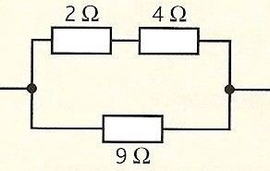
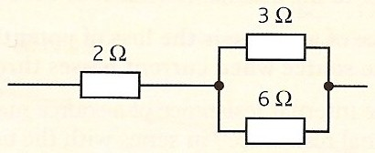
Calculate the total resistance of the two circuits shown below:
5 Ω
8 Ω
1.
2 Ω
2.
4 Ω
5 Ω
12 Ω
Calculate the parallel section first
1 / R₁₊₂ = 1 / R₁ + 1 / R₂
= 1 / (2 Ω) + 1 / (5 Ω)
= 0.5000 + 0.2000
= 0.7000
R₁₊₂ = 1.429 Ω
Add in series resistance
R_{T} = 5.429 Ω
= 5.43 Ω (to 3sf)
Calculate the series section first
5 Ω + 8 Ω = 13 Ω
Calculate 13 Ω in parallel with 12 Ω
1 / R_{T} = 1 / R₁ + 1 / R₂
= 1 / (13 Ω) + 1 / (12 Ω)
= 0.07692 + 0.08333
= 0.16025
R_{T} = 6.2402 Ω
= 6.24 Ω (to 3sf)

Slide 18
Undergraduate level question
3. Calculate the total resistance of the circuit below:
60 Ω
60 Ω
60 Ω
Hint: Are the resistors in series or parallel with each other?
The three resistors are in parallel to each other.
ANSWER: R_{T} = 20 Ω

Slide 19
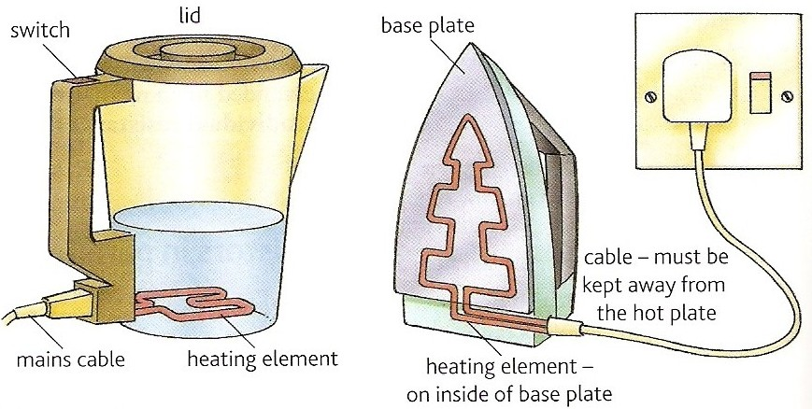
The heating effect of an electric current
When an electric current flows through an electrical conductor the resistance of the conductor causes the conductor to be heated.
This effect is used in the heating elements of various devices like those shown below:
Heating effect of resistance Phet

Slide 20
Power and resistance
Revision of previous work
When a potential difference of V causes an electric current I to flow through a device the electrical energy converted to other forms in time t is given by:
E = I V t
but: power = energy / time
Therefore electrical power, P is given by:
P = I V

Slide 21
The definition of resistance: R = V / I
rearranged gives: V = I R
substituting this into P = I V gives:
P = I ² R
Also from: R = V / I
I = V / R
substituting this into P = I V gives:
P = V ² / R

Slide 22
Question 1
Calculate the power of a kettle’s heating element of resistance 18Ω when draws a current of 13A from the mains supply.
P = I ² R
= (13A)² x 18Ω
= 169 x 18
= 3042W
or = 3.04 kW

Slide 23
Question 2
Calculate the current drawn by the heating element of an electric iron of resistance 36Ω and power 1.5kW.
P = I ² R gives:
I ² = P / R
= 1500W / 36 Ω
= 41.67
= I ² !!!!
therefore I = √ ( 41.67)
= 6.45 A

Slide 24
Starting a car problem
A car engine is made to turn initially by using a starter motor connected to the 12V car battery.
If a current of 80A is drawn by the motor in order to produce an output power of at least 900W what must be the maximum resistance of the coils of the starter motor?
Comment on your answer.

Slide 25
Power supplied by the battery:
P = I V
= 80 A x 12 V
= 960 W
Therefore the maximum power allowed to be lost due to resistance
= 960 W – 900 W
= 60 W
P = I ² R gives:
R = P / I ²
= 60 W / (80 A)²
= 60 / 6400
= 0.009375 Ω
maximum resistance = 9.38 mΩ

Slide 26
Comment:
This is a very low resistance.
It is obtained by using thick copper wires for both the coils of the motor and for its connections to the battery.
‘Jump-leads’ used to start cars also have to be made of thick copper wire for the same reason.

Slide 27
Power distribution question
A power station produces 10MW of electrical power.
The power station has a choice of transmitting this power at either (i) 100kV or (ii) 10kV.
(a) Calculate the current supplied in each case.
P = I V
gives: I = P / V
case (i) = 10MW / 100kV = 100 A
case (ii) = 10MW / 10kV = 1000 A

Slide 28
(b) The power is transmitted along power cables of total resistance 5Ω. Calculate the power loss in the cables for the two cases. Comment on your answers.
P = I ² R
case (i) = (100A)² x 5 Ω
= 50 000W = 50 kW
case (ii) = (1000A)² x 5 Ω
= 5 000 000W = 5 MW
Comment:
In case (i) only 50kW (0.5%) of the supplied 10MW is lost in the power cables.
In case (ii) the loss is 5MW (50%!).
The power station should therefore transmit at the higher voltage and lower current.

Slide 29
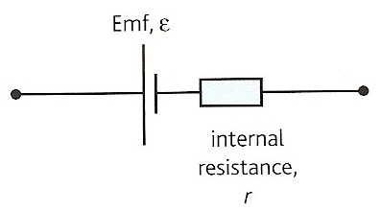
Emf and internal resistance
Emf, electromotive force (ε):
The electrical energy given per unit charge by the power supply.
Internal resistance (r):
The resistance of a power supply, also known as source resistance.
It is defined as the loss of potential difference per unit current in the source when current passes through the source.
ε = E
Q

Slide 30
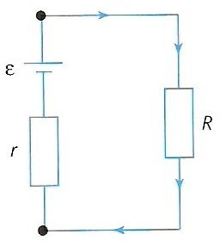
Equation of a complete circuit
The total emf in a complete circuit is equal to the total pds.
Σ (emfs) = Σ (pds)
For the case opposite:
ε = I R + I r
or
ε = I ( R + r )

Slide 31
Terminal pd (V )
The pd across the external load resistance, R is equal to the pd across the terminals of the power supply. This called the terminal pd V.
therefore,
ε = I R + I r
becomes:
ε = V + I r (as V = I R )
or
V = ε - I r

Slide 32
Lost volts (v)
I r , the lost volts, is the difference between the emf and the terminal pd
ε = V + I r
becomes: ε = V + v
that is:
emf = terminal pd + lost volts
This equation is an example of the conservation of energy.
The energy supplied (per coulomb) by the power supply equals the energy supplied to the external circuit plus the energy wasted inside the power supply.
Resistance wire simulation – has internal resistance and lost volts

Slide 33
Question 1
Calculate the internal resistance of a battery of emf 12V if its terminal pd falls to 10V when it supplies a current of 6A.
ε = I R + I r
where I R = terminal pd = 10V
so: 12 V = 10 V + (6A x r )
(6 x r ) = 2
r = 2 / 6
internal resistance = 0.333 Ω

Slide 34
Question 2
Calculate the current drawn from a battery of emf 1.5V whose terminal pd falls by 0.2V when connected to a load resistance of 8Ω.
ε = I R + I r
where I r = lost volts = 0.2V
1.5 V = (I x 8 Ω) + 0.2V
1.5 – 0.2 = (I x 8)
1.3 = (I x 8)
I = 1.3 / 8
current drawn = 0.163 A

Slide 35
Question 3
Calculate the terminal pd across a power supply of emf 2V, internal resistance 0.5Ω when it is connected to a load resistance of 4Ω.
ε = I R + I r
where I R = terminal pd
2 V = (I x 4 Ω) + (I x 0.5 Ω )
2 = (I x 4.5)
I = 2 / 4.5
= 0.444 A
The terminal pd = I R
= 0.444 x 4
terminal pd = 1.78 V

Slide 36
Answers:
Complete:
ε / V | I / A | R / Ω | r / Ω | terminal pd / V | lost volts / V
6 | 2 | 2
12 |  | 1 | 0.5
1.5 | 0.050 |  | 2
 | 10 |  | 1 | 220 | 10
 | 100 | 0.015 |  |  | 0.5
1
4
2
8
8
4
28
1.4
0.1
230
22
2
0.005
1.5

Slide 37
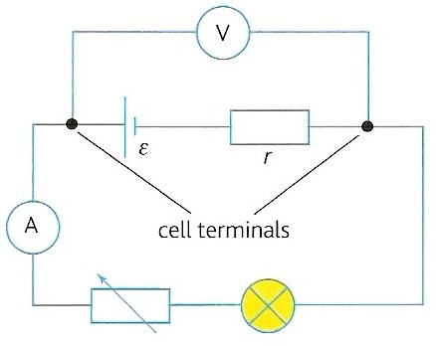
Measurement of internal resistance
Connect up circuit shown opposite.
Measure the terminal pd (V) with the voltmeter
Measure the current drawn (I) with the ammeter
Obtain further sets of readings by adjusting the variable resistor
The bulb, a resistor, limits the maximum current drawn from the cell

Slide 38
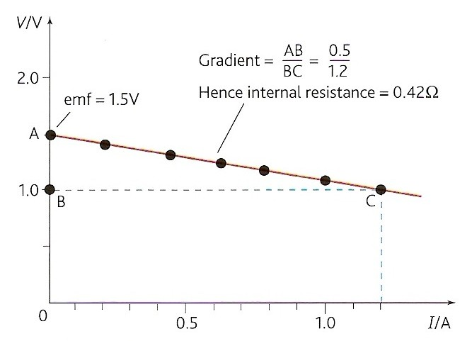
6. Plot a graph of V against I (see opposite)
7. Measure the gradient which equals – r (the negative of the internal resistance)
terminal pd, V = I R
and so: ε = I R + I r
becomes: ε = V + I r
and then V = - r I + ε
this has form y = mx + c,
and so a graph of V against I has:
y-intercept (c) = ε
gradient (m) = - r

Slide 39
Car battery internal resistance
A car battery has an emf of about 12V.
Its prime purpose is to supply a current of about 100A for a few seconds in order to turn the starter motor of a car.
In order for its terminal pd not to fall significantly from 12V it must have a very low internal resistance (e.g. 0.01Ω)
In this case the lost volts would only be 1V and the terminal pd 11V

Slide 40
High voltage power supply safety
A high voltage power supply sometimes has a large protective internal resistance.
This resistance limits the current that can be supplied to be well below the fatal level of about 50 mA.
For example a PSU of 3 kV typically has an internal resistance of 10 MΩ.
The maximum current with a near zero load resistance (a wet person)
= I_{max} = 3 kV / 10 M Ω
= 3 000 / 10 000 000
= 0.000 3 A = 0.3 mA (safe)

Slide 41
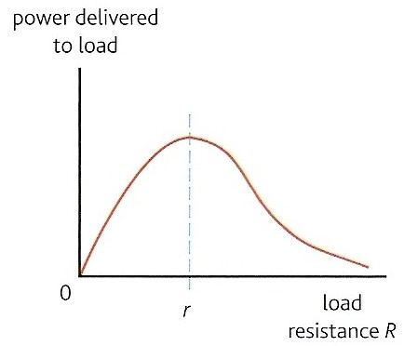
Maximum power transfer
The power delivered to the external load resistance, R varies as shown on the graph opposite.
The maximum power transfer occurs when the load resistance is equal to the internal resistance, r of the power supply.
Therefore for maximum power transfer a device should use a power supply whose internal resistance is as close as possible to the device’s own resistance.
e.g. The loudest sound is produced from a loudspeaker when the speaker’s resistance matches the internal resistance of the amplifier.

Slide 42
Single cell circuit rules
1. Current drawn from the cell:
= cell emf total circuit resistance
2. PD across resistors in SERIES with the cell:
= cell current x resistance of each resistor
3. Current through parallel resistors:
= pd across the parallel resistors resistance of each resistor

Slide 43
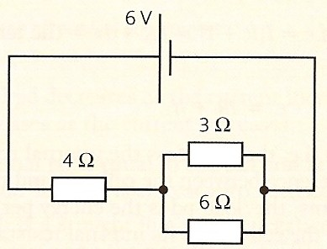
Single cell question
Calculate the potential difference across and the current through the 6 ohm resistor in the circuit below.
Total resistance of the circuit
= 8 Ω in series with 12 Ω in parallel with 6 Ω
= 8 + 5.333
= 13.333 Ω
Total current drawn from the battery
= V / R_{T}
= 9V / 13.333 Ω
= 0.675 A
pd across 8 Ω resistor = V₈ = I R₈
= 0.675 A x 8 Ω
= 5.40 V
therefore pd across 6 Ω (and 12 Ω) resistor, V₆
= 9 – 5.4
pd across 6 Ω resistor = 3.6 V
Current through 6 Ω resistor = I₆ = V₆ / R₆
= 3.6 V / 6 Ω
current through 6 Ω resistor = 0.600 A
9 V
12 Ω
8 Ω

Slide 44
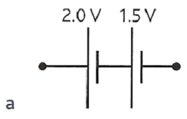
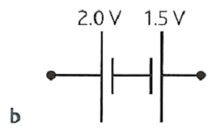
Cells in series
TOTAL EMF
Case ‘a’ - Cells connected in the same direction
Add emfs together
In case ‘a’ total emf = 3.5V
Case ‘b’ - Cells connected in different directions
Total emf equals sum of emfs in one direction minus the sum of the emfs in the other direction
In case ‘b’ total emf = 0.5V in the direction of the 2V cell
TOTAL INTERNAL RESISTANCE
In both cases this equals the sum of the internal resistances
Phet DC Circuit Construction Simulation

Slide 45
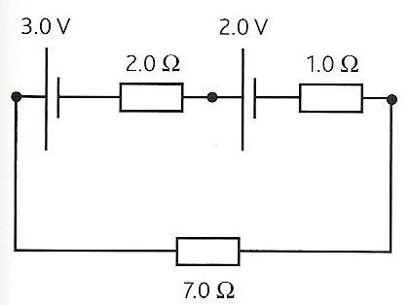
Question on cells in series
In the circuit shown below calculate the current flowing and the pd across the 8 ohm resistor
Both cells are connected in the same direction.
Therefore total emf = 1.5 + 6.0
= 7.5V
All three resistors are in series.
Therefore total resistance
= 4.0 + 3.0 + 8.0
= 15 Ω
Current = I = ε_{T} / R_{T}
= 7.5 / 15
current = 0.5 A
PD across the 8 ohm resistor
= V₈ = I x R₈
= 0.5 x 8
pd = 4 V
1.5 V
6.0 V
4.0 Ω
3.0 Ω
8.0 Ω

Slide 46
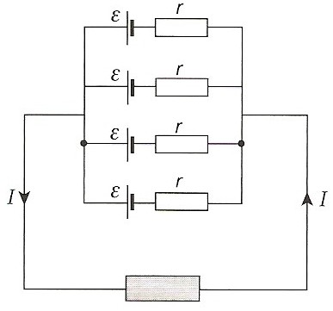
Identical cells in parallel
For N identical cells each of emf ε and internal resistance , r
Total emf = ε
Total internal resistance = r / N
The lost volts = I r / N and so cells placed in parallel can deliver more current for the same lost volts due to the reduction in internal resistance.

Slide 47
Car battery question
A car battery is made up of six groups of cells all connected the same way in series.
Each group of cells consist of four identical cells connected in parallel.
If each of the 24 cells making up the battery have an emf of 2V and internal resistance 0.01Ω calculate the total emf and internal resistance of the battery.
Each cell group consists of 4 cells in parallel.
Therefore emf of each group = 2V
Internal resistance of each group
= 0.01Ω / 4 = 0.0025Ω
There are 6 of these cell groups in series. Therefore total emf of the battery
= 6 x 2V
total emf = 12V
Internal resistance of the battery
= 6 x 0.0025Ω
total internal resistance = 0.015 Ω

Slide 48
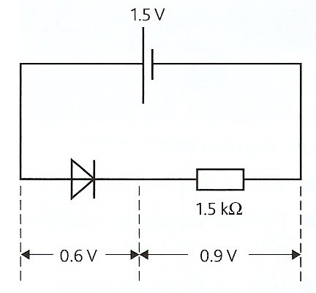
Diodes in circuits
In most electrical circuits a silicon diode can be assumed to have the following simplified behaviour:
Applied pd > 0.6V in the forward direction
diode resistance = 0
diode pd = 0.6V
Applied pd < 0.6V or in the reverse direction
diode resistance = infinite
diode pd = emf of power supply

Slide 49
Diode question
Calculate the current through the 5.0 kΩ resistor in the circuit below.
Applied pd across the diode is greater than 0.6V in the forward direction and so the diode resistance = 0 Ω
and diode pd, V_{D} = 0.6V
therefore the pd across the resistor, V_{R} = 2.0 – 0.6
= 1.4 V
current = I = V_{R} / R
= 1.4 / 5000
= 0.000 28 A
current = 0.28 mA
2.0 V
5.0 kΩ
V_{D}
V_{R}

Slide 50
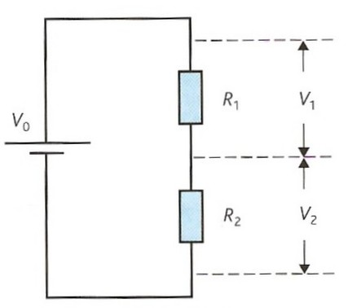
The potential divider
A potential divider consists of two or more resistors connected in series across a source of fixed potential difference
It is used in many circuits to control the level of an output.
For example:
  volume control
  automatic light control
Fendt – potential divider

Slide 51
Potential divider theory
In the circuit opposite the current, I flowing in this circuit = V_{o} / (R₁ + R₂ )
But the pd across, V₁ = I R₁
and so; V₁ = V_{o} R₁ / (R₁ + R₂ )
Likewise, V₂ = I R₂
and so; V₂ = V_{o} R₂ / (R₁ + R₂ )
Dividing the two equations yields:
V₁ / V₂ = R₁ / R₂
The potential differences are in the same ratio as the resistances.
Fendt – potential divider

Slide 52
Potential divider question
Calculate the pd across R₂ in the circuit opposite if the fixed supply pd, V_{o} is 6V and R₁ = 4kΩ and R₂ = 8kΩ
The pd across, V₂
= V_{o} R₂ / (R₁ + R₂ )
= 6V x 8kΩ / (4kΩ + 8kΩ)
= 6 x 8 / 12
pd = 4 V

Slide 53
Answers:
Complete:
V₀ / V | R₁ / Ω | R₂ / Ω | V₁ / V | V₂ / V
12 | 5000 | 5000
12 | 9000 | 1000
 | 1000 |  | 1.2 | 10.8
230 |  | 500 |  | 46
9 | 400 |  |  | 6
6
6
10.8
1.2
12
9000
2000
184
800
3

Slide 54
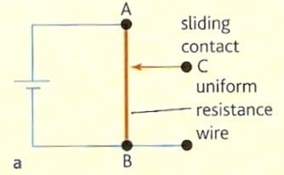
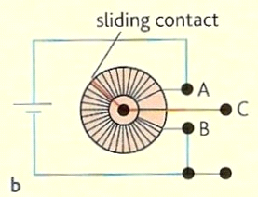
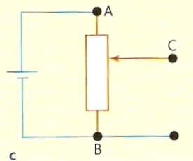
Supplying a variable pd
In practice many potential dividers consist of a single resistor (e.g. a length of resistance wire) split into two parts by a sliding contact as shown in diagram ‘a’ opposite.
In order to save space this wire is usually made into a coil as shown in diagram ‘b’.
Diagram ‘c’ shows the circuit symbol of a potential divider.
Fendt – potential divider

Slide 55
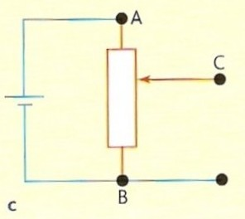
Output variation of pd
The output pd is obtained from connections C and B.
This output is:
- maximum when the slider is next to position A
- minimum (usually zero) when the slider is next to position B

Slide 56
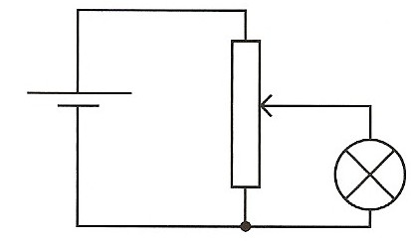
Controlling bulb brightness
As the slider of the potential divider is moved upwards the pd across the bulb increases from zero to the maximum supplied by the cell.
This allows the brightness of the bulb to be continuously variable from completely off to maximum brightness.
This method of control is better than using a variable resistor in series with the bulb. In this case the bulb may still be glowing even at the maximum resistance setting.
The volume level of a loudspeaker can be controlled in a similar way.

Slide 57
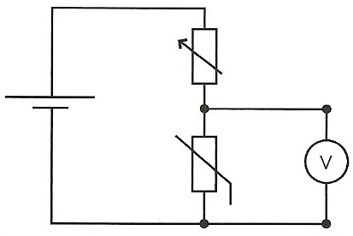
Temperature sensor
At a constant temperature the source pd is split between the variable resistor and the thermistor.
The output of the circuit is the pd across the thermistor.
This pd is measured by the voltmeter and could be used to control a heater.
If the temperature falls, the resistance of the thermistor increases.
This causes the output pd to increase bringing on the heater.
The setting of the variable resistor will determine how quickly the output pd increases as the temperature falls.

Slide 58
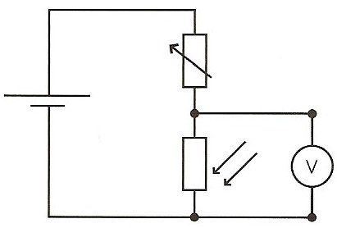
Light sensor
At a constant level of illumination the source pd is split between the variable resistor and the LDR.
The output of the circuit is the pd across the LDR.
This pd is measured by the voltmeter and could be used to control a lamp.
If the light level falls, the resistance of the LDR increases.
This causes the output pd to increase bringing on the lamp.
The setting of the variable resistor will determine how quickly the output pd increases as the light level falls.

Slide 59
Internet Links
Charge flow with resistors in series and parallel - NTNU
Circuit Construction AC + DC - PhET - This new version of the CCK adds capacitors, inductors and AC voltage sources to your toolbox! Now you can graph the current and voltage as a function of time.
Electric Current Quizes - by KT - Microsoft WORD
Battery Voltage - Colorado - Look inside a battery to see how it works. Select the battery voltage and little stick figures move charges from one end of the battery to the other. A voltmeter tells you the resulting battery voltage.
Charge flow with resistors in series and parallel - NTNU
Electric circuits with resistors - series & parallel with meters - netfirms
Variable resistor with an ammeter & a voltmeter Resist.ckt - Crocodile Clip Presentation
Resistors in parallel & series - Multimedia
Shunts & multipliers with meters - netfirms
Comparing the action of a variable resistor and a potential divider VarRPotD - Crocodile Clip Presentation

Slide 60
Core Notes from Breithaupt pages 58 to 71
State the current rules for currents (a) at junctions and (b) through series components. Give a numerical example or the first rule.
State the potential difference rules for (a) series components, (b) parallel components and (c) a complete circuit loop. Draw diagrams showing each rule and give a numerical example of the final rule.
Copy out the proofs for the total resistance of resistors connected (a) in series and (b) in parallel.
State the equation for the rate of heat transfer (power) shown on page 62.
Define what is meant by (a) emf; (b) terminal pd and (c) internal resistance.
Explain the meaning of the terms in the equation, ε = I R + I r . Explain how this equation illustrates the conservation of energy in a complete circuit.
Explain why it is important that a 12V car battery should have a very low internal resistance in order to deliver a current of about 100A to a car’s starter motor.
State the rules for dealing with circuits containing a single cell.
State the rules for combining cells (a) in series and (b) identical cells in parallel.
Draw figure 1 on page 70 and explain the operation of a potential divider.
Draw figure 2c on page 70 (circuit symbol) and explain how a potential divider can be used to control the brightness of a lamp of the volume level of an amplifier.
Draw circuit diagrams and explain how a potential divider is used in (a) a temperature sensor and (b) a light sensor.

Slide 61
5.1 Circuit rules
Notes from Breithaupt pages 58 to 60
State the current rules for currents (a) at junctions and (b) through series components. Give a numerical example or the first rule.
State the potential difference rules for (a) series components, (b) parallel components and (c) a complete circuit loop. Draw diagrams showing each rule and give a numerical example of the final rule.
Try the summary questions on page 60

Slide 62
5.2 More about resistance
Notes from Breithaupt pages 61 to 63
Copy out the proofs for the total resistance of resistors connected (a) in series and (b) in parallel.
State the equation for the rate of heat transfer (power) shown on page 62.
Calculate the total resistance of a 3Ω and a 7Ω resistor connected (a) in series and (b) in parallel.
Calculate the power of a resistor of resistance 20Ω when drawing a current of 4A.
A car engine is made to turn initially by using a starter motor connected to the 12V car battery. If a current of 100A is drawn by the motor in order to produce an output power of at least 1100W what must the maximum resistance of the coils of the starter motor? Comment on your answer.
Try the summary questions on page 63

Slide 63
5.3 Emf and internal resistance
Notes from Breithaupt pages 64 to 66
Define what is meant by (a) emf; (b) terminal pd and (c) internal resistance.
Explain the meaning of the terms in the equation, ε = I R + I r . Explain how this equation illustrates the conservation of energy in a complete circuit.
Explain why it is important that a 12V car battery should have a very low internal resistance in order to deliver a current of about 100A to a car’s starter motor.
Calculate the internal resistance of a battery of emf 6V if its terminal pd falls to 5V when it supplies a current of 3A.
Describe an experiment to measure the internal resistance of a cell. Include a circuit diagram and explain how the value of r is found from a graph.
Try the summary questions on page 66.

Slide 64
5.4 More circuit calculations
Notes from Breithaupt pages 67 to 69
State the rules for dealing with circuits containing a single cell.
State the rules for combining cells (a) in series and (b) identical cells in parallel.
Explain how solar cells, each of emf 0.45V and internal resistance 20Ω, could be combined to make a battery of emf 18V and internal resistance 40 Ω
Describe the simplified way in which a silicon diode behaves in a circuit.
Copy a modified version of figure 5 on page 69. In your version the cell should have emf 3V and the resistor have a value of 800Ω. Calculate in this case the pd across the resistor and the current through the diode.
Try the summary questions on page 69

Slide 65
5.5 The potential divider
Notes from Breithaupt pages 70 & 71
Draw figure 1 on page 70 and explain the operation of a potential divider.
Draw figure 2c on page 70 (circuit symbol) and explain how a potential divider can be used to control the brightness of a lamp of the volume level of an amplifier.
Draw circuit diagrams and explain how a potential divider is used in (a) a temperature sensor and (b) a light sensor.
In figure 1 calculate the pd across R₂ in the circuit if the fixed supply pd, V_{o} is 2V and R₁ = 3kΩ and R₂ = 9kΩ
Try the summary questions on page 71.

