Slide 1
1.3c Current Electricity
Alternating Currents
Breithaupt pages 74 to 79
November 14th, 2010

Slide 2
AQA AS Specification
Lessons | Topics
1 to 3 | Alternating currents Sinusoidal voltages and currents only; root mean square, peak and peak-to-peak values for sinusoidal waveforms only. I_{rms} = I_{o} / √2; V_{rms} = V_{o} / √2 Application to calculation of mains electricity peak and peak-to-peak voltage values.
4 & 5 | Oscilloscope Use of an oscilloscope as a d.c. and a.c. voltmeter, to measure time intervals and frequencies and to display a.c. waveforms. No details of the structure of the instrument is required but familiarity with the operation of the controls is expected.

Slide 3
Direct and alternating current
Direct current (d.c.)
This is electric current that does not change direction in a circuit.
Note: Direct current may change in size.
Alternating current (a.c.)
This is electric current that repeatedly reverses its direction.
Phet AC & DC Circuit Construction Kit

Slide 4
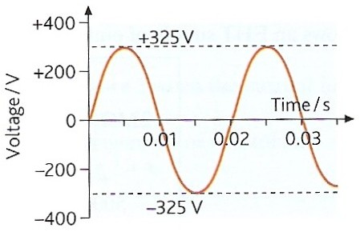
Sinusoidal voltage variation
Sinusoidal voltage variation causes the most common type of alternating current.
The frequency of the voltage is equal to the number of complete cycles produced in one second.
The UK’s a.c. supply has frequency of 50Hz. (USA is 60Hz)
The peak value (V₀ or I₀ ) is the maximum current or pd in either direction.
The UK’s a.c. voltage supply has a peak value of 325V. (USA is 155V)
The sinusoidal variation of the voltage of the UK’s domestic mains supply.

Slide 5
The peak-to-peak value (2V₀ or 2I₀ ) is equal to the maximum variation in current or pd.
With a pure a.c. this is equal to twice the peak value.
The UK’s a.c. supply has a peak-to-peak voltage of 650V (2 x 325V)
The period of the a.c. is the time taken to complete one cycle of variation.
The UK’s a.c. supply has a period of 0.02s or 20ms.
The sinusoidal variation of the voltage of the UK’s domestic mains supply.

Slide 6
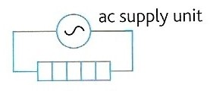
The heating effect of a.c.
The heating effect of current is independent of the direction of current flow.
Power is the rate of heat transfer.
With a resistor, R :
P = I² R
With a varying current:
P = < I² > R
Phet AC & DC Circuit Construction Kit

Slide 7
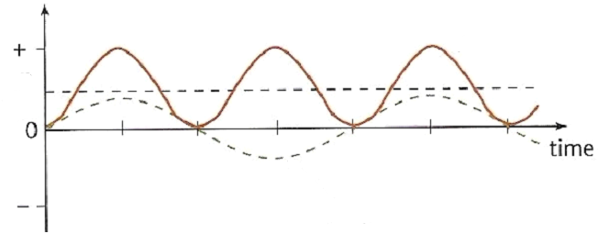
mean power
power
current
With sinusoidal variation: < I² > = ½ I₀²
And so: P = ½ I₀² R

Slide 8
Root mean square values
The root mean square (rms) value of an alternating current is equal to the value of direct current that would give the same heating effect as the alternating current in the same resistor.
if: I_{rms}² R = ½ I₀² R
then: I_{rms}² = ½ I₀²
and so:
I_{rms} = I₀ / √2
also with pds:
V_{rms} = V₀ / √2
and: P = I_{rms} V_{rms}

Slide 9
Question
Calculate the rms values of the UK and USA mains voltage supplies if the peak values, V₀ are 325V and 155V respectively.
V_{rms} = V₀ / √2
UK: = 325V / √2
V_{rms} = 230V
USA: = 155V / √2
V_{rms} = 110V

Slide 10
Answers:
Complete:
V₀ / V | I₀ / A | R / Ω | V_{rms} / V | I_{rms} / A | P / W
12 | 4
 |  | 50 | 230 | 4.6
155 |  |  |  | 5.5
 |  |  | 1.41 |  | 0.50
 | 0.30 | 20
3
8.49
2.83
24
325
6.5
1058
7.75
20
110
605
2
0.50
4
0.353
6
4.24
0.212
0.90

Slide 11
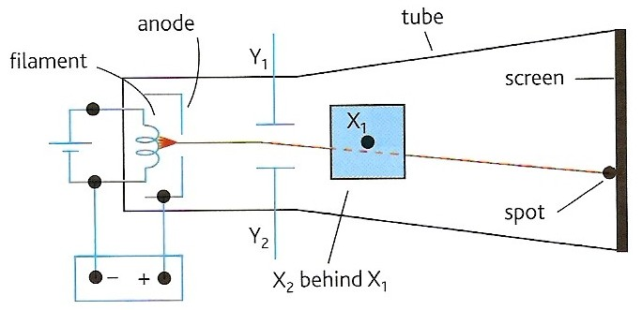
The Oscilloscope

Slide 12
An oscilloscope (of traditional design) consists of a specially made electron tube and associated control circuits.
An electron gun at one end of the glass tube emits electrons in a beam towards a fluorescent screen at the other end of the tube. Light is emitted from the spot on the screen where the beam hits the screen.
The position of the spot on the screen is affected by the pd across either pair of deflecting plates (Y₁Y₂) and (X₁X₂).
The X-plates deflect the beam horizontally, the Y-plates vertically. In both cases the deflection of the beam is proportional to the applied pd.

Slide 13
The oscilloscope ‘graph’ scales
Y-AXIS
Potential difference
Scale determined by the ‘Y-GAIN’ control
Typical setting: 1V / cm
+ V
0V
- V
cm squares
X-AXIS
Time
Scale determined by the ‘X-GAIN’ or ‘TIME-BASE’ control
Typical setting: 0.1s / cm

Slide 14
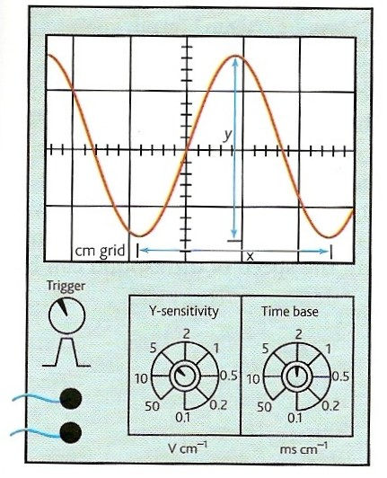
Displaying a waveform
1. The time base
The X-plates are connected to the oscilloscope’s time base circuit.
This makes the spot move across the screen, from left to right, at a constant speed.
Once the spot reaches the right hand side of the screen it is returned to the left hand side almost instantaneously.
The X-scale opposite is set so that the spot takes two milliseconds to move one centimetre to the right.
(2 ms cm⁻¹).
NTNU Oscilloscope Simulation
KT Oscilloscope Simulation

Slide 15
Displaying a waveform
2. Y-sensitivity or Y-gain
The Y-plates are connected to the oscilloscope’s Y-input.
This input is usually amplified and when connected to the Y-plates it makes the spot move vertically up and down the screen.
The Y-sensitivity opposite is set so that the spot moves vertically by one centimetre for a pd of five volts (5 V cm⁻¹).
The trace shown appears when an alternating pd of 16V peak-to-peak and period 7.2 ms is connected to the Y-input with the settings as shown.
NTNU Oscilloscope Simulation
KT Oscilloscope Simulation

Slide 16
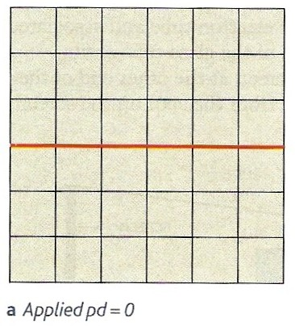
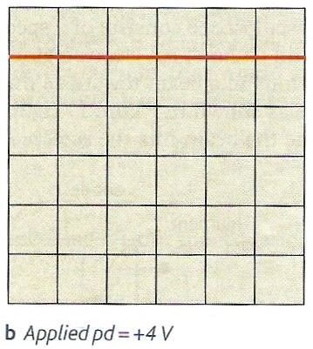
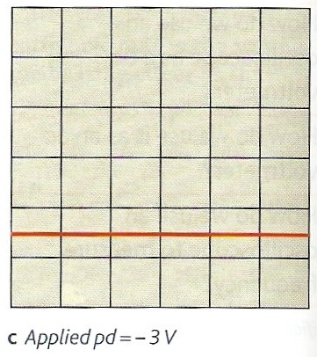
Measuring d.c. potential difference
All three diagrams below show the trace with the time base on and the Y-gain set at 2V cm⁻¹.
Diagram a shows the trace for pd = 0V.
Diagram b shows the trace for pd = +4V
Diagram c shows the trace for pd = -3V.
NTNU Oscilloscope Simulation
KT Oscilloscope Simulation

Slide 17
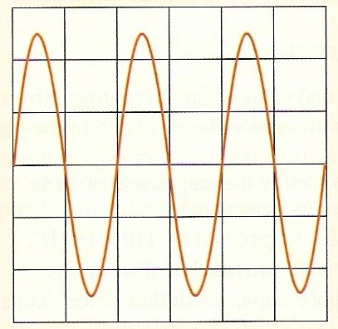
Measuring a.c. potential difference
Let the time base setting be 10ms cm⁻¹ and the Y-gain setting 2V cm⁻¹.
In this case the waveform performs one complete oscillation over a horizontal distance of 2 cm.
Therefore the period of the waveform is 2 x 10ms
period = 20 ms
as frequency = 1 / period
frequency = 1 / 0.020s
= 50 Hz.
The peak-to-peak displacement of the waveform is about 5cm.
Therefore the peak-to-peak pd is 5 x 2V
Peak-to-peak pd = 10V
NTNU Oscilloscope Simulation
KT Oscilloscope Simulation

Slide 18
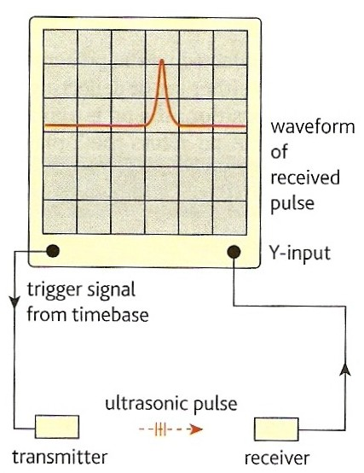
Measuring a time interval
The diagram opposite shows how an oscilloscope could be used to measure the speed of a pulse of ultrasound.
A trigger pulse is sent from the oscilloscope to the transmitter. At the same time the spot is moved across the screen by the time base.
When the receiver, which is connected to the Y-input, detects the pulse a deflection appears on the screen.
If the time base had been set to 2 ms cm⁻¹ then this pulse is shown to have taken about 7 ms to traverse the gap between the transmitter and receiver.
Note: The time taken for the pulse to travel as an electric current in the wires is usually so small (< 1 microsecond) that it can be ignored.

Slide 19
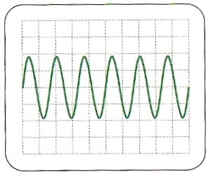
Question 1
Measure the approximate period, frequency and peak-to-peak pd of the trace opposite if:
Time base = 5ms cm⁻¹
Y-gain = 5V cm⁻¹
period = 50ms / 6 ≈ 8.7ms
frequency ≈ 115 Hz
peak-to-peak pd ≈ 20V

Slide 20
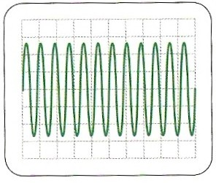
Question 2
Measure the approximate period, frequency and peak pd of the trace opposite if:
Time base = 2ms cm⁻¹
Y-gain = 0.5V cm⁻¹
period = 20ms / 12 ≈ 1.7ms
frequency ≈ 600 Hz
peak pd ≈ 1.3V

Slide 21
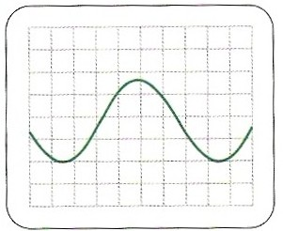
Question 3
The trace shows how a waveform of frequency 286 Hz and peak-to-peak pd 6.4V is displayed.
Suggest the settings of the time base and Y-gain amplifier.
The period of a wave of frequency 286Hz = 1/285 = 0.0035s = 3.5ms
One complete oscillation of the trace occupies 7cm.
Therefore time base setting is 3.5ms / 7cm
≈ 0.5 ms cm⁻¹
The peak-to-peak displacement of the trace is about 3.7 cm.
Therefore the Y-gain setting is 6.4V / 3.7cm
≈ 2V cm⁻¹

Slide 22
Internet Links
Oscilloscope - basic display function - NTNU
Oscilloscope Simulation - by KT
Lissajous figures - Explore Science
Lissajous figures - by KT

Slide 23
Core Notes from Breithaupt pages 74 to 79
Explain what is meant by alternating current
Draw figure 1 on page 74 and define what is meant in the context of a.c. (a) peak value and (b) peak-to-peak value.
Explain what is meant by the r.m.s value of a sinusoidal current and voltage. State the equations relating r.m.s. values to peak values.
Calculate the rms values of the UK and USA mains voltage supplies if the peak values, V₀ are 325V and 155V respectively.
Explain how an oscilloscope is able to display an alternating waveform. Your description should include an account of the role of the time base and the Y-sensitivity controls.
Explain how an oscilloscope can be used to measure: (a) d.c. voltage; (b) a.c. voltage; (c) a time interval & (d) frequency.

Slide 24
6.1 Alternating current and power
Notes from Breithaupt pages 74 to 76
Explain what is meant by alternating current
Draw figure 1 on page 74 and define what is meant in the context of a.c. (a) peak value and (b) peak-to-peak value.
Explain what is meant by the r.m.s value of a sinusoidal current and voltage. State the equations relating r.m.s. values to peak values.
Calculate the rms values of the UK and USA mains voltage supplies if the peak values, V₀ are 325V and 155V respectively.
Try the summary questions on page 76

Slide 25
6.2 Using an oscilloscope
Notes from Breithaupt pages 77 to 79
Explain how an oscilloscope is able to display an alternating waveform. Your description should include an account of the role of the time base and the Y-sensitivity controls.
Explain how an oscilloscope can be used to measure: (a) d.c. voltage; (b) a.c. voltage; (c) a time interval & (d) frequency.
An oscilloscope is set with its time base on 10 ms cm⁻¹ and Y-gain on 2V cm⁻¹. Draw diagrams of the traces that would be displayed with inputs of: (a) 0V d.c.; (b) +5V d.c.; (c) – 3V d.c.; (d) sinusoidal a.c. of frequency 50Hz and peak value 4V.
Describe how an oscilloscope could be used to measure the speed of an ultrasound pulse.
Try the summary questions on page 79

