Slide 1
2.1a Mechanics
Forces in equilibrium
Breithaupt pages 90 to 109
January 10th 2013

Slide 2
AQA AS Specification
Lessons | Topics
1 to 3 | Scalars and vectors The addition of vectors by calculation or scale drawing. Calculations will be limited to two perpendicular vectors. The resolution of vectors into two components at right angles to each other; examples should include the components of forces along and perpendicular to an inclined plane. Conditions for equilibrium for two or three coplanar forces acting at a point; problems may be solved either by using resolved forces or by using a closed triangle.
4 & 5 | Moments Moment of a force about a point defined as force x perpendicular distance from the point to the line of action of the force; torque. Couple of a pair of equal and opposite forces defined as force x perpendicular distance between the lines of action of the forces. The principle of moments and its applications in simple balanced situations. Centre of mass; calculations of the position of the centre of mass of a regular lamina are not expected.

Slide 3
Vectors and Scalars
All physical quantities (e.g. speed and force) are described by a magnitude and a unit.
VECTORS – also need to have their direction specified
examples: displacement, velocity, acceleration, force.
SCALARS – do not have a direction
examples: distance, speed, mass, work, energy.

Slide 4
Representing Vectors
An arrowed straight line is used.
The arrow indicates the direction and the length of the line is proportional to the magnitude.
Displacement 50m EAST
Displacement 25m at 45º North of East

Slide 5
Addition of vectors 1
4N
4N
6N
6N
object
object
resultant = 10N
object
The original vectors are called COMPONENT vectors.
The final overall vector is called the RESULTANT vector.
4N
6N
6N
4N
object
object
resultant = 2N
object

Slide 6
Addition of vectors 2
With two vectors acting at an angle to each other:
Draw the first vector.
Draw the second vector with its tail end on the arrow of the first vector.
The resultant vector is the line drawn from the tail of the first vector to the arrow end of the second vector.
This method also works with three or more vectors.
4N
3N
4N
3N
Resultant vector
= 5N

Slide 7
Question
Scale drawing:
Calculation:
Pythagoras:
ΣF² = 6² + 4² = 36 + 16 = 52
ΣF² = 52
ΣF = 7.21 N
tan θ = 4 / 6 = 0.6667
θ = 33.7º
The resultant force is 7.21 N to the left 33.7 degrees below the horizontal (bearing 236.3º)
By scale drawing and calculation find the resultant force acting on an object in the situation below. You should also determine the direction of this force.
6N
θ
4N
ΣF
6N
4N

Slide 8
The parallelogram of vectors
This is another way of adding up two vectors.
To add TWO vectors draw both of them with their tail ends connected. Complete the parallelogram made using the two vectors as two of the sides. The resultant vector is represented by the diagonal drawn from the two tail ends of the component vectors.
Example: Calculate the total force on an object if it experiences a force of 4N upwards and a 3N force to the right.
Resultant force = 5 N
Angle θ = 53.1º
4N up
θ
3N right

Slide 9
Resolution of vectors
It is often convenient to split a single vector into two perpendicular components.
Consider force F being split into vertical and horizontal components, F_{V} and F_{H}.
In rectangle ABCD opposite:
sin θ = BC / DB = DA / DB = F_{V} / F
Therefore: F_{V} = F sin θ
cos θ = DC / DB = F_{H} / F
Therefore: F_{H} = F cos θ
A
B
F_{V}
F
θ
F_{H}
D
C
F_{V} = F sin θ
F_{H} = F cos θ
The ‘cos’ component is always the one next to the angle.

Slide 10
Question
Calculate the vertical and horizontal components if F = 4N and θ = 35º.
F_{V} = F sin θ
= 4 x sin 35º
= 4 x 0.5736
F_{V} = 2.29 N
F_{H} = F cos θ
= 4 x cos 35º
= 4 x 0.8192
F_{H} = 3.28 N
F_{V}
F
θ
F_{H}

Slide 11
Inclined planes
Components need not be vertical and horizontal.
In the example opposite the weight of the block W has components parallel, F₁ and perpendicular F₂ to the inclined plane .
Calculate these components if the block’s weight is 250N and the angle of the plane 20º.
F₂ is the component next to the angle and is therefore the cosine component.
F₂ = W cos θ
= 250 x cos 20º = 250 x 0.9397
F₂ = component perpendicular to the plane
= 235 N
F₁ = W sin θ
= 250 x sin 20º = 250 x 0.3420
F₁ = component parallel to the plane
= 85.5 N
F₁
θ = 20º
θ
F₂
W = 250N

Slide 12
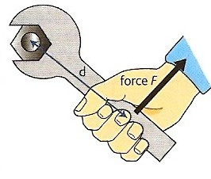
The moment of a force
Also known as the turning effect of a force.
The moment of a force about any point is defined as:
force x perpendicular distance from the turning point to the line of action of the force
moment = F x d
Unit: newton-metre (Nm)
Moments can be either CLOCKWISE or ANTICLOCKWISE
Force F exerting an ANTICLOCKWISE moment through the spanner on the nut

Slide 13
Question
Calculate the moments of the 25N and 40N forces on the door in the diagram opposite.
moment = F x d
For the 25N force:
moment = 25N x 1.2m
= 30 Nm CLOCKWISE
For the 40N force:
moment = 40N x 0.70m
= 28 Nm ANTICLOCKWISE
25N
40N
door
1.2 m
0.70 m
hinge

Slide 14
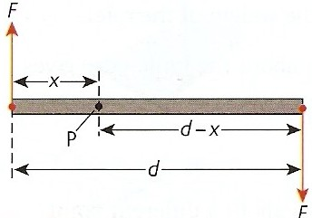
Couples and Torque
A couple is a pair of equal and opposite forces acting on a body, but not along the same line.
In the diagram above:
total moment of couple = F x + F(d - x) = F d
= One of the forces x the distance between the forces
Torque is another name for the total moment of a couple.

Slide 15
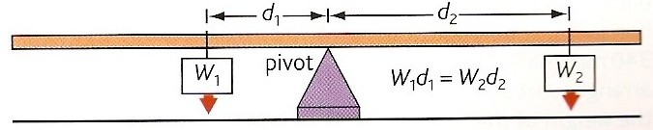
The principle of moments
When an object is in equilibrium (e.g. balanced):
the sum of the = the sum of the
anticlockwise moments clockwise moments
If the ruler above is in equilibrium:
W₁ d₁ = W₂ d₂

Slide 16
Complete for a ruler in equilibrium:
W₁ | d₁ | W₂ | d₂
5 N | 20 cm | 10 N | 10 cm
4 N | 15 cm | 6 N | 10 cm
6 N | 12 cm | 2 N | 36 cm
8 N | 25 cm | 2 N | 100 cm
10 cm
6 N
12 cm
8 N

Slide 17
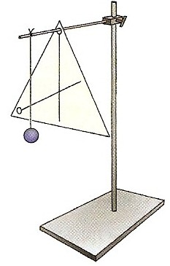
Centre of mass
The centre of mass of a body is the point through which a single force on the body has no turning effect.
The centre of mass is also the place through which all the weight of a body can be considered to act.
The ‘single force’ in the definition could be a supporting contact force. e.g. from a finger below a metre ruler.
The diagram opposite shows the method for finding the centre of mass of a piece of card.

Slide 18
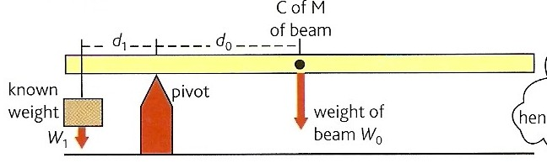
Question
Calculate the weight of the beam, W₀ if it is in equilibrium when:
W₁ = 6N;
d₁ = 12 cm;
d₀ = 36 cm.
Applying the principle of moments:
W₁ d₁ = W₀ d₀
6N x 12 cm = W₀ x 36 cm
W₀ = 72 / 36
W₀ the weight of the beam = 2N

Slide 19
Equilibrium
When a body is in equilibrium it will
EITHER be at rest
OR move with a constant linear and rotational velocity.
Conditions required for equilibrium:
The resultant force acting on the body must be zero.
The principle of moments must apply about any point on the body.

Slide 20
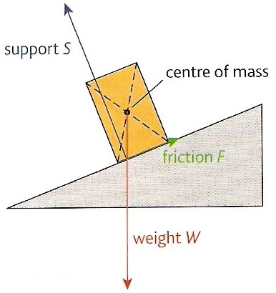
Equilibrium with three forces
Three forces acting on a body in equilibrium will form a closed triangle.
S
W
F
Triangle of forces

Slide 21
Question 1
The rod shown opposite is held horizontal by two wires. If the weight of the rod is 60N calculate the values of the tension forces in the wires
60 cm
120 cm
T₁
T₂
If the rod is in equilibrium:
1. Resultant force = zero
Therefore:
W = T₁ + T₂ = 60N
W = 60N
2. Principle of moments applies about any point.
Let the point of contact of T₁ be the pivot.
total clockwise moments = total anticlockwise moments
60N x 60 cm = T₂ x 180 cm
T₂ = 3600 / 180
T₂ = 20 N
and so T₁ = 40 N

Slide 22
Question 2
T = 100N
The hinged rod shown opposite is held horizontal by a single wire. Find the force exerted by the hinge.
H
30º
If the rod is in equilibrium then the three forces acting, W, T & H will form a closed triangle.
30 cm
50 cm
W = 60N
T = 100N
A
30º
By calculation !!!:
Angle A = 60º (angles in a triangle)
Applying the cosine rule: H ² = T ² + W ² – 2TW cosA
= 100² + 60² – 2(100x60) x cos 60º
= 10000 + 3600 – (12000 x 0.5) = 7600
H = 87.2 N
Applying the sine rule: H / sin A = W / sin (θ + 30)
87.2 / sin 60 = 60 / sin (θ + 30)
87.2 / 0.866 = 60 / sin (θ + 30)
100.7 = 60 / sin (θ + 30)
sin (θ + 30) = 60 / 100.7 = 0.596
θ + 30 = 36.6º
θ = 6.6º
θ
W = 60N
H
θ
By scale drawing:
H = 87 N
θ = 7º

Slide 23
Internet Links
Vector Addition - PhET - Learn how to add vectors. Drag vectors onto a graph, change their length and angle, and sum them together. The magnitude, angle, and components of each vector can be displayed in several formats.
Representing vectors - eChalk
Vectors & Scalars- eChalk
Vector addition - eChalk
Vector Chains - eChalk
Fifty-Fifty Game on Vectors & Scalars - by KT - Microsoft WORD
Vector addition - NTNU
Vector addition - Explore Science
Equilibrium of three forces - Fendt
Components of a vector - Fendt
See-Saw - Explore Science
See-saw forces - uses g - NTNU
Lever - Fendt
Torque - includes affect of angle - netfirms
Leaning Ladder - NTNU
BBC KS3 Bitesize Revision: Moments - includes formula triangle applet
Centre of mass - Explore Science
Stability of a block - NTNU
Blocks and centre of gravity - NTNU
Why it is easier to hold a rod at its centre of gravity- NTNU .

Slide 24
Core Notes from Breithaupt pages 90 to 107
What are vector and scalar quantities? Give five examples of each.
Explain how vectors are represented on diagrams.
Explain how two vectors are added together when they are: (a) along the same straight line; (b) at right-angles to each other.
Explain how a vector can be resolved into two perpendicular components.
What must be true about the forces acting on a body for the body to be in equilibrium?
Define what is meant by the moment of a force. Give a unit for moment.
What is the principle of moments? Under what condition does it apply?
Define and explain what is meant by ‘centre of mass’.
What is a couple. What is torque?
Describe the possible modes of movement for a body in equilibrium.
What conditions are required for a body to be in equilibrium?

Slide 25
Notes from Breithaupt pages 90 to 93
Vectors and scalars
What are vector and scalar quantities? Give five examples of each.
Explain how vectors are represented on diagrams.
Explain how two vectors are added together when they are: (a) along the same straight line; (b) at right-angles to each other.
Explain how a vector can be resolved into two perpendicular components.
Redo the worked example on page 93 if the force is now 400N at an angle of 40 degrees.
Try the summary questions on page 93

Slide 26
Notes from Breithaupt pages 94 to 96
Balanced forces
Describe the motion of a body in equilibrium.
What must be true about the forces acting on a body for the body to be in equilibrium?
Describe an experiment to test out the parallelogram rule.
Try the summary questions on page 96

Slide 27
Notes from Breithaupt pages 97 & 98
The principle of moments
Define what is meant by the moment of a force. Give a unit for moment.
What is the principle of moments? Under what condition does it apply?
Define and explain what is meant by ‘centre of mass’.
How can the centre of mass of an irregularly shaped piece of card be found?
Try the summary questions on page 98

Slide 28
Notes from Breithaupt pages 99 & 100
More on moments
What is a couple. What is torque?
Try the summary questions on page 100

Slide 29
Notes from Breithaupt pages 101 to 103
Stability
Explain what is meant by (a) stable and (b) unstable equilibrium.
Explain with the aid of diagrams how the position of the centre of mass affects the stability of an object.
Try the summary questions on page 103

Slide 30
Notes from Breithaupt pages 104 to 107
Equilibrium rules
Describe the possible modes of movement for a body in equilibrium.
What conditions are required for a body to be in equilibrium?
Try the summary questions on page 107

